Slide 1
Preliminary Assessment of CAGI7 Annotate All In-Frame Indels Challenge
Haneen Abderrazzaq and Mugdha Singh
Northeastern University
Broad Institute of MIT and Harvard, Boston Children’s Hospital
December 6, 2025
Created for CAGI7
genomeinterpretation.org
Haneen Abderrazzaq

Slide 2
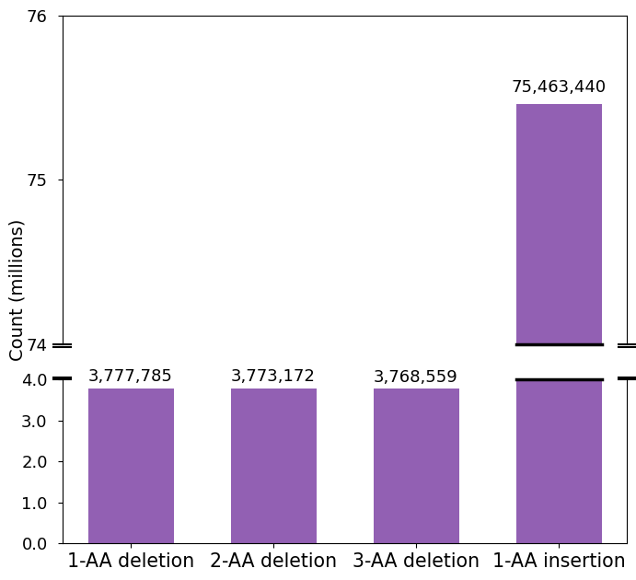
Annotate All In-Frame Indels Challenge
Challenge description:
Predict functional effect of in-frame indels (deletions of up to 3 amino acids, insertions of 1 amino acid) from a score of 0 (benign) to 1 (deleterious)
Variant data for annotation:
All possible single, double, and triple amino acid deletions and single amino acid insertions in disease-associated genes from ClinVar
Total genes: 4,613
Created for CAGI7
Haneen Abderrazzaq

Slide 3
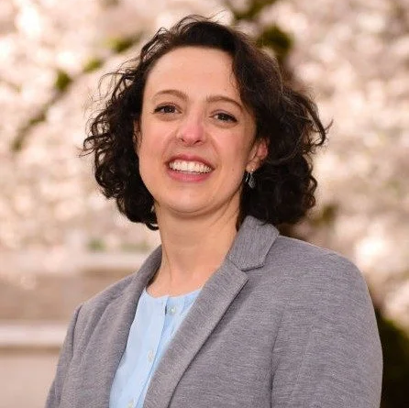
Preliminary Assessment Approach
We used functional saturation genome editing (SGE) data provided by Lea Starita’s group for our preliminary assessment
Single amino acid deletions from 6 genes: BARD1, CTCF, PALB2, RAD51D, SFPQ, and XRCC2
Survival score is reported for each variant, which is then determined to be functionally normal/abnormal
  Scores <0 indicate decreased survival, suggesting LOF caused by variant
Created for CAGI7
genomeinterpretation.org
Haneen Abderrazzaq

Slide 4
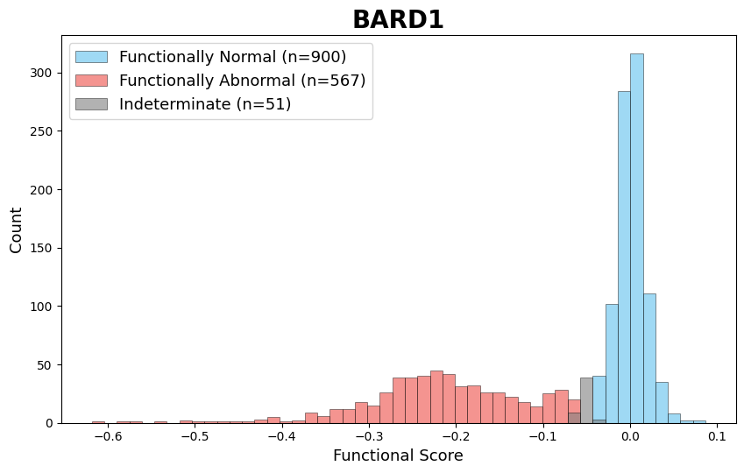
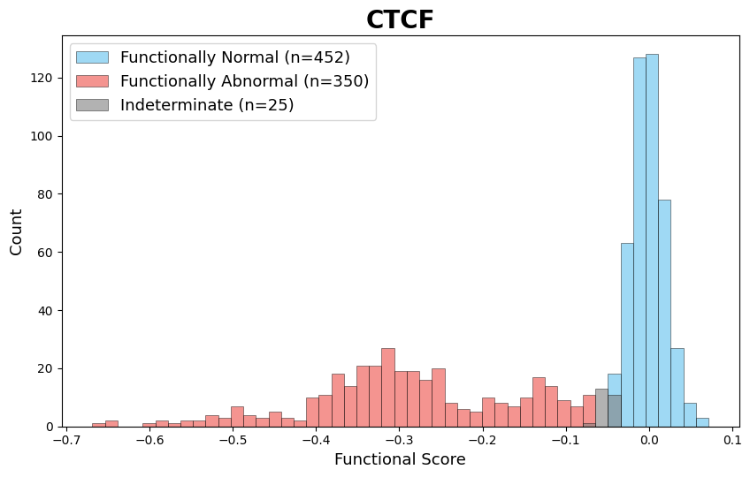
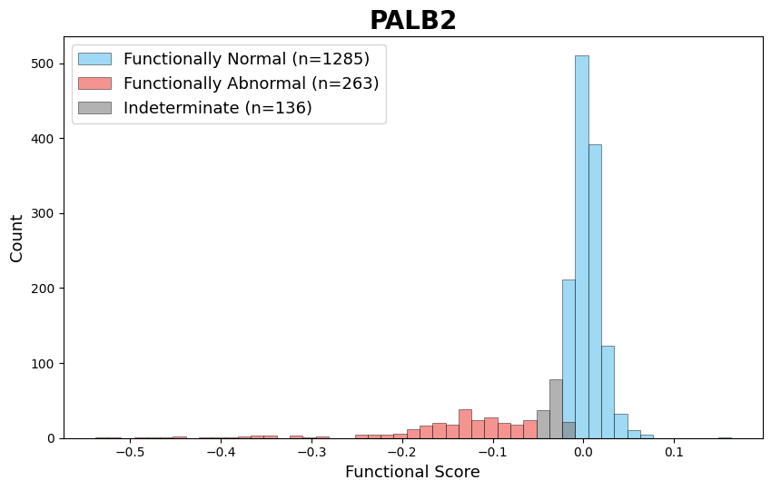
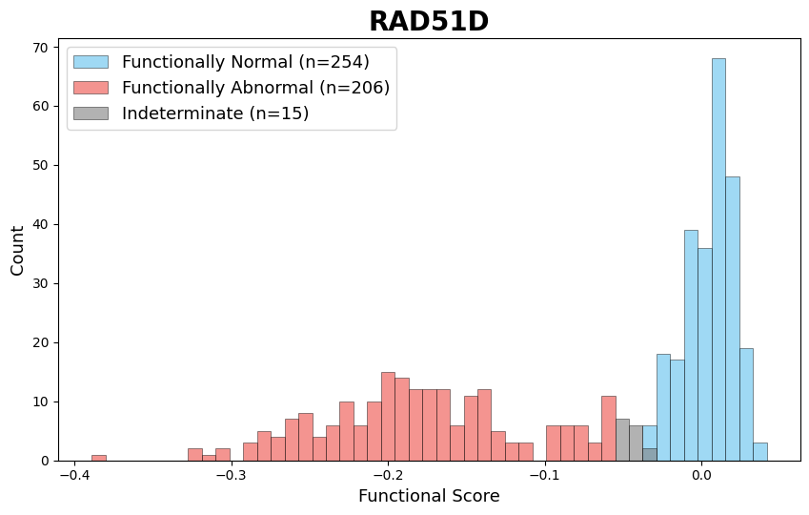
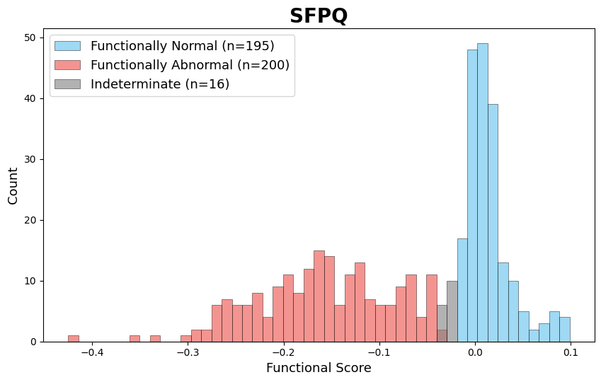
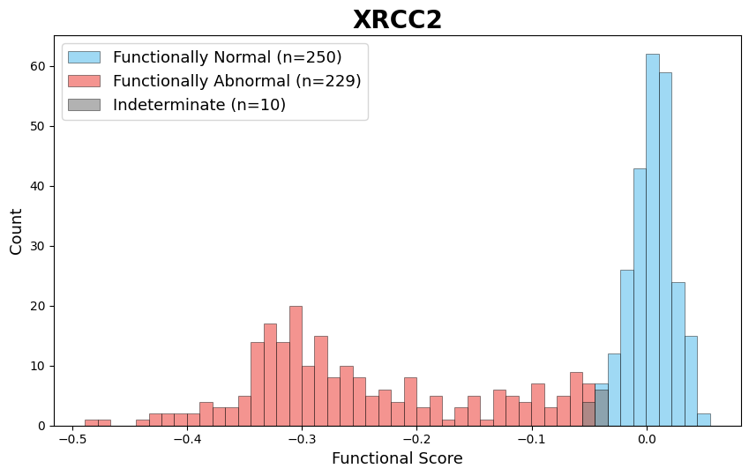
SGE Data Distribution by Gene
*SFPQ not included in this challenge
Created for CAGI7
genomeinterpretation.org
Haneen Abderrazzaq

Slide 5
Models Evaluated
CAGI7 challenge submissions:
DMIIP
3billion (5 models)
LUPSB (6 models)
Existing in-frame indel tools:
PROVEAN (Choi et al., 2012)
CADD v1.7 (Schubach et al., 2024)
VEST-Indel (Douville et al., 2015)
FATHMM-indel (Ferlaino et al., 2017)
ESM1b (Rives et al., 2020)
ProGen2 (Nijkamp et al., 2023)
Created for CAGI7
genomeinterpretation.org
Haneen Abderrazzaq

Slide 6
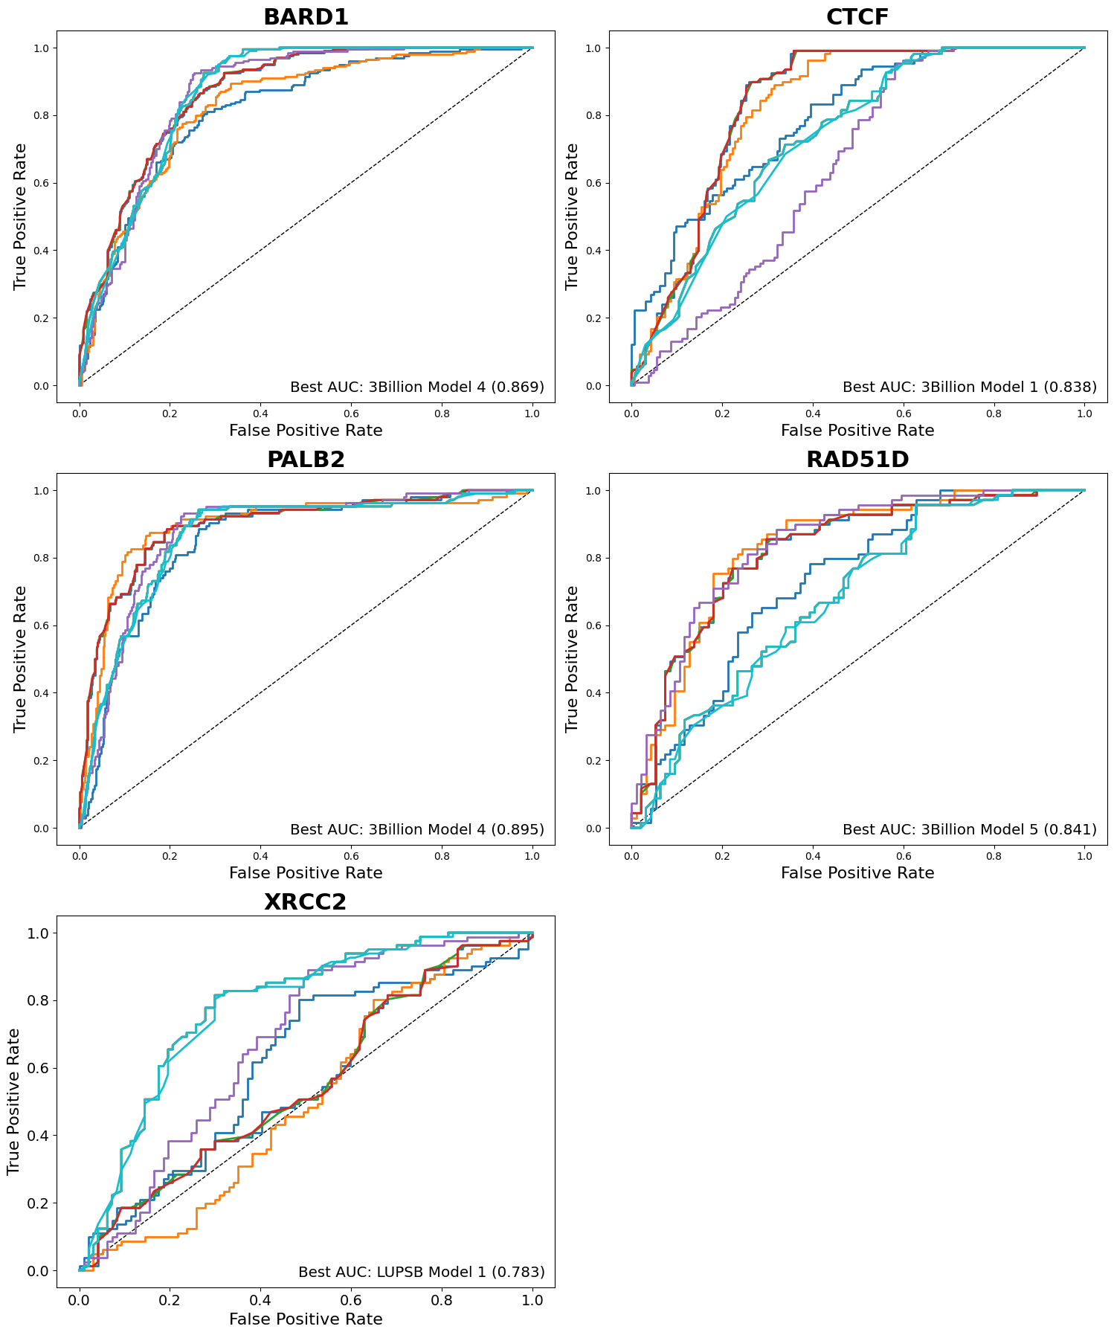
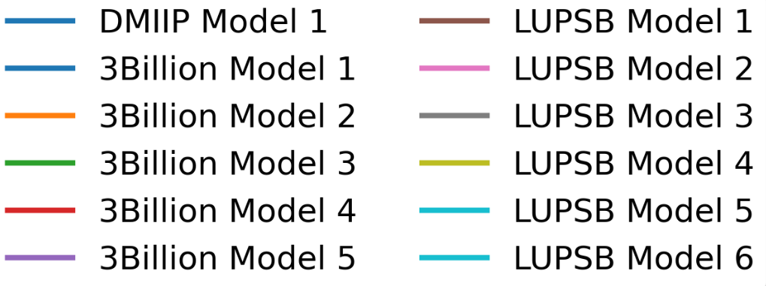
Challenge Submission Results

Slide 7
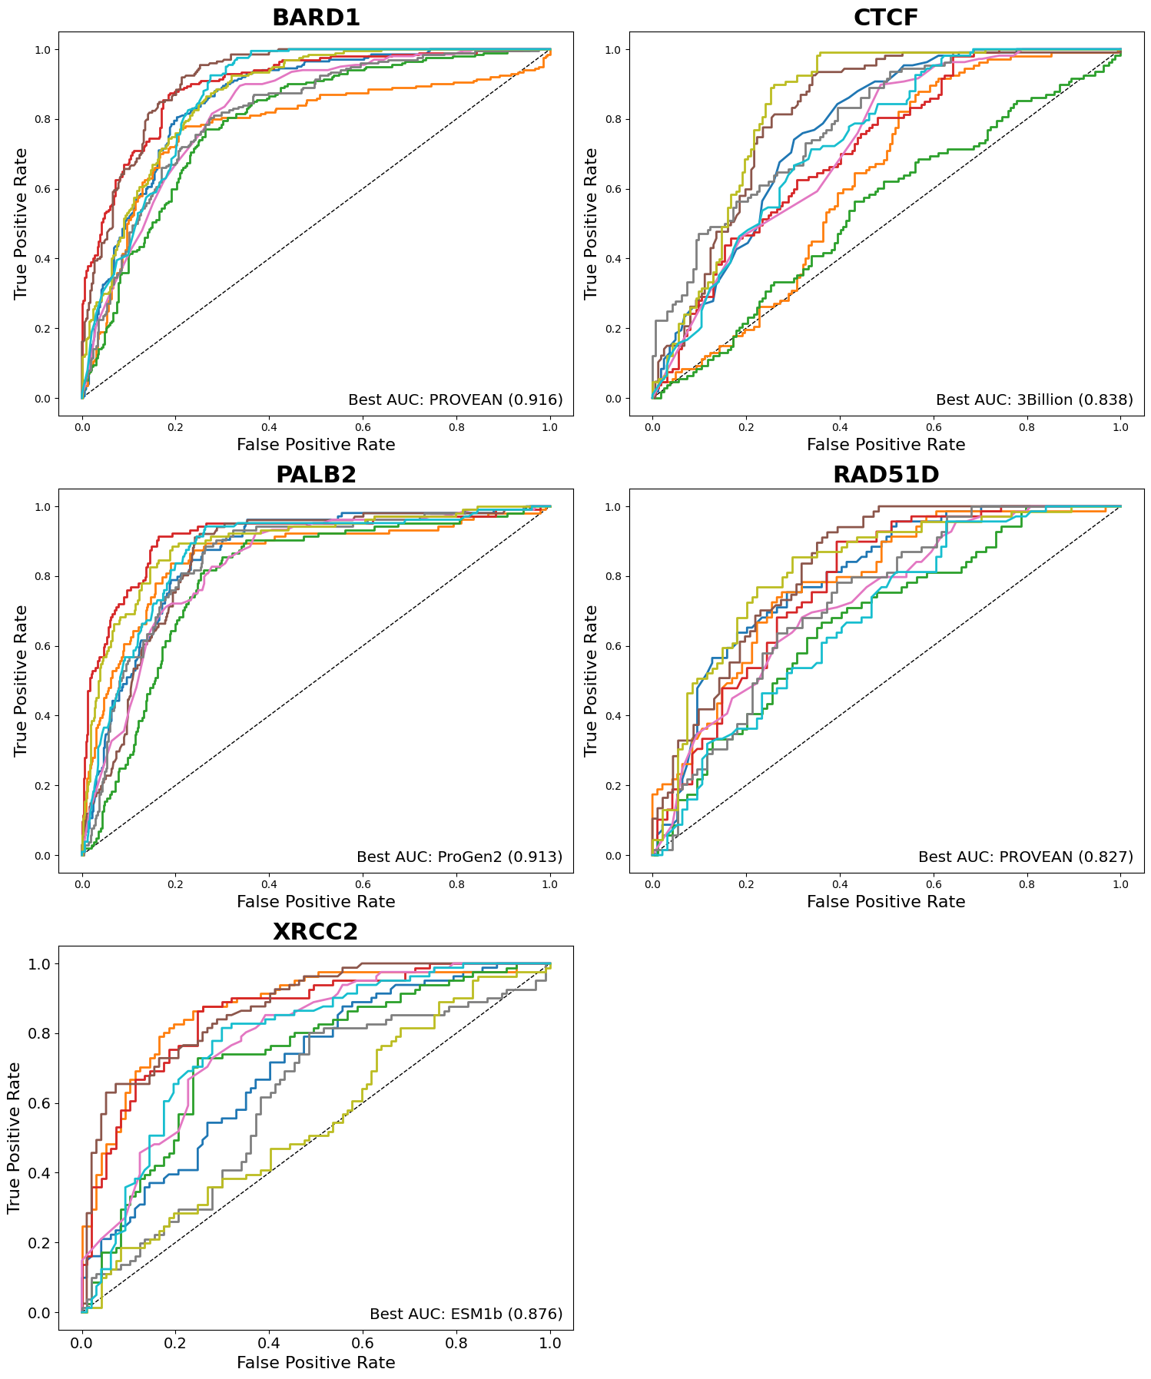
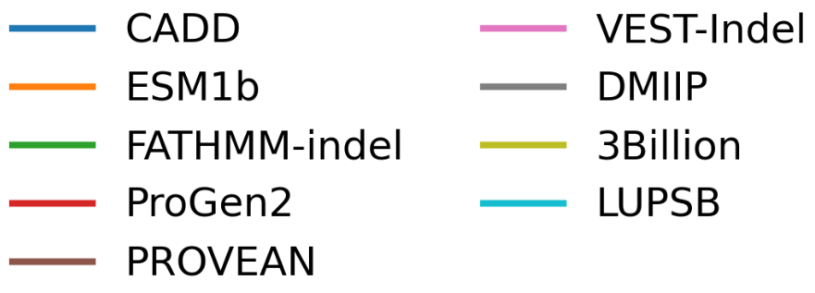
Challenge Submissions vs. Existing Predictors

Slide 8
Performance Statistics
Average AUC
Average Spearman Correlation
PROVEAN | 0.857
ProGen2 | 0.834
CADD | 0.799
3billion | 0.795
LUPSB | 0.788
ESM1b | 0.784
VEST-Indel | 0.781
DMIIP | 0.761
FATHMM-indel | 0.709
PROVEAN | 0.555
ProGen2 | 0.506
CADD | 0.459
VEST-Indel | 0.446
LUPSB | 0.435
ESM1b | 0.429
3billion | 0.421
DMIIP | 0.380
FATHMM-indel | 0.275
Created for CAGI7
genomeinterpretation.org
Haneen Abderrazzaq

Slide 9
Conclusions
Preliminary analysis indicates CAGI-submitted models perform well on SGE data, approaching but not exceeding performance of existing tools
  Full assessment will be done with the accumulation of more variants in ClinVar, will also include evaluation of other types of in-frame indels
Overall, indel predictor performance lags behind that of missense predictors
  Need for increased community focus on improving interpretation of indel variants
Created for CAGI7
genomeinterpretation.org
Haneen Abderrazzaq

Slide 10


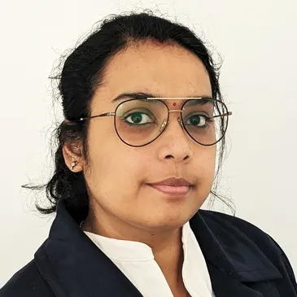


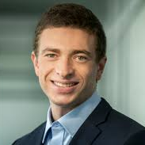

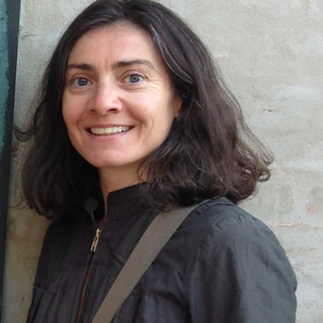


Acknowledgements
Mugdha Singh
Daniel Zeiberg
Anne O’Donnell-Luria
SGE team including Silvia Casadei, Matthew Snyder, Nahum Smith, and Lea Starita
CAGI organizers: Predrag Radivojac, Steven Brenner, Nilah Ioannidis
CAGI challenge participants
Created for CAGI7
genomeinterpretation.org
Haneen Abderrazzaq

