Slide 1
Missense
Annotation Accumulation Accuracy Assessments
(Annotate-All)
Predrag Radivojac
Northeastern University
December 6, 2025
Created for CAGI7
genomeinterpretation.org
Predrag Radivojac

Slide 2
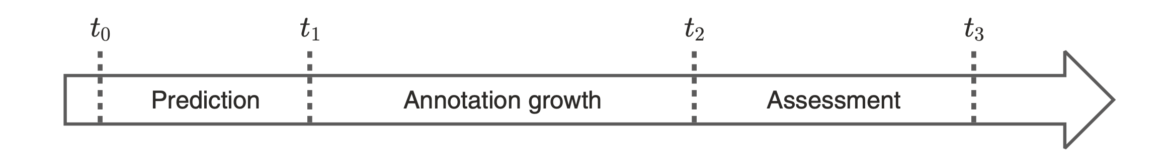


Annotate All Challenges
CAGI 6: 81,782,923 missense variants
CAGI 6: 10,456 variants
Created for CAGI7
genomeinterpretation.org
Predrag Radivojac

Slide 3
Annotate All Challenges
Missense
CAGI 7
June 2025
September 2025
CAGI 6
May 2021
October 2021
April 2023
June 2024
Rastogi et al. Human Genet (2025)
CAGI 5
November 2017
May 2018
December 2020
May 2022
CAGI Consortium. Genome Biol (2024)
CAGI 6: 81,782,923 missense variants
CAGI 6: 10,456 variants
Created for CAGI7
genomeinterpretation.org
Predrag Radivojac

Slide 4
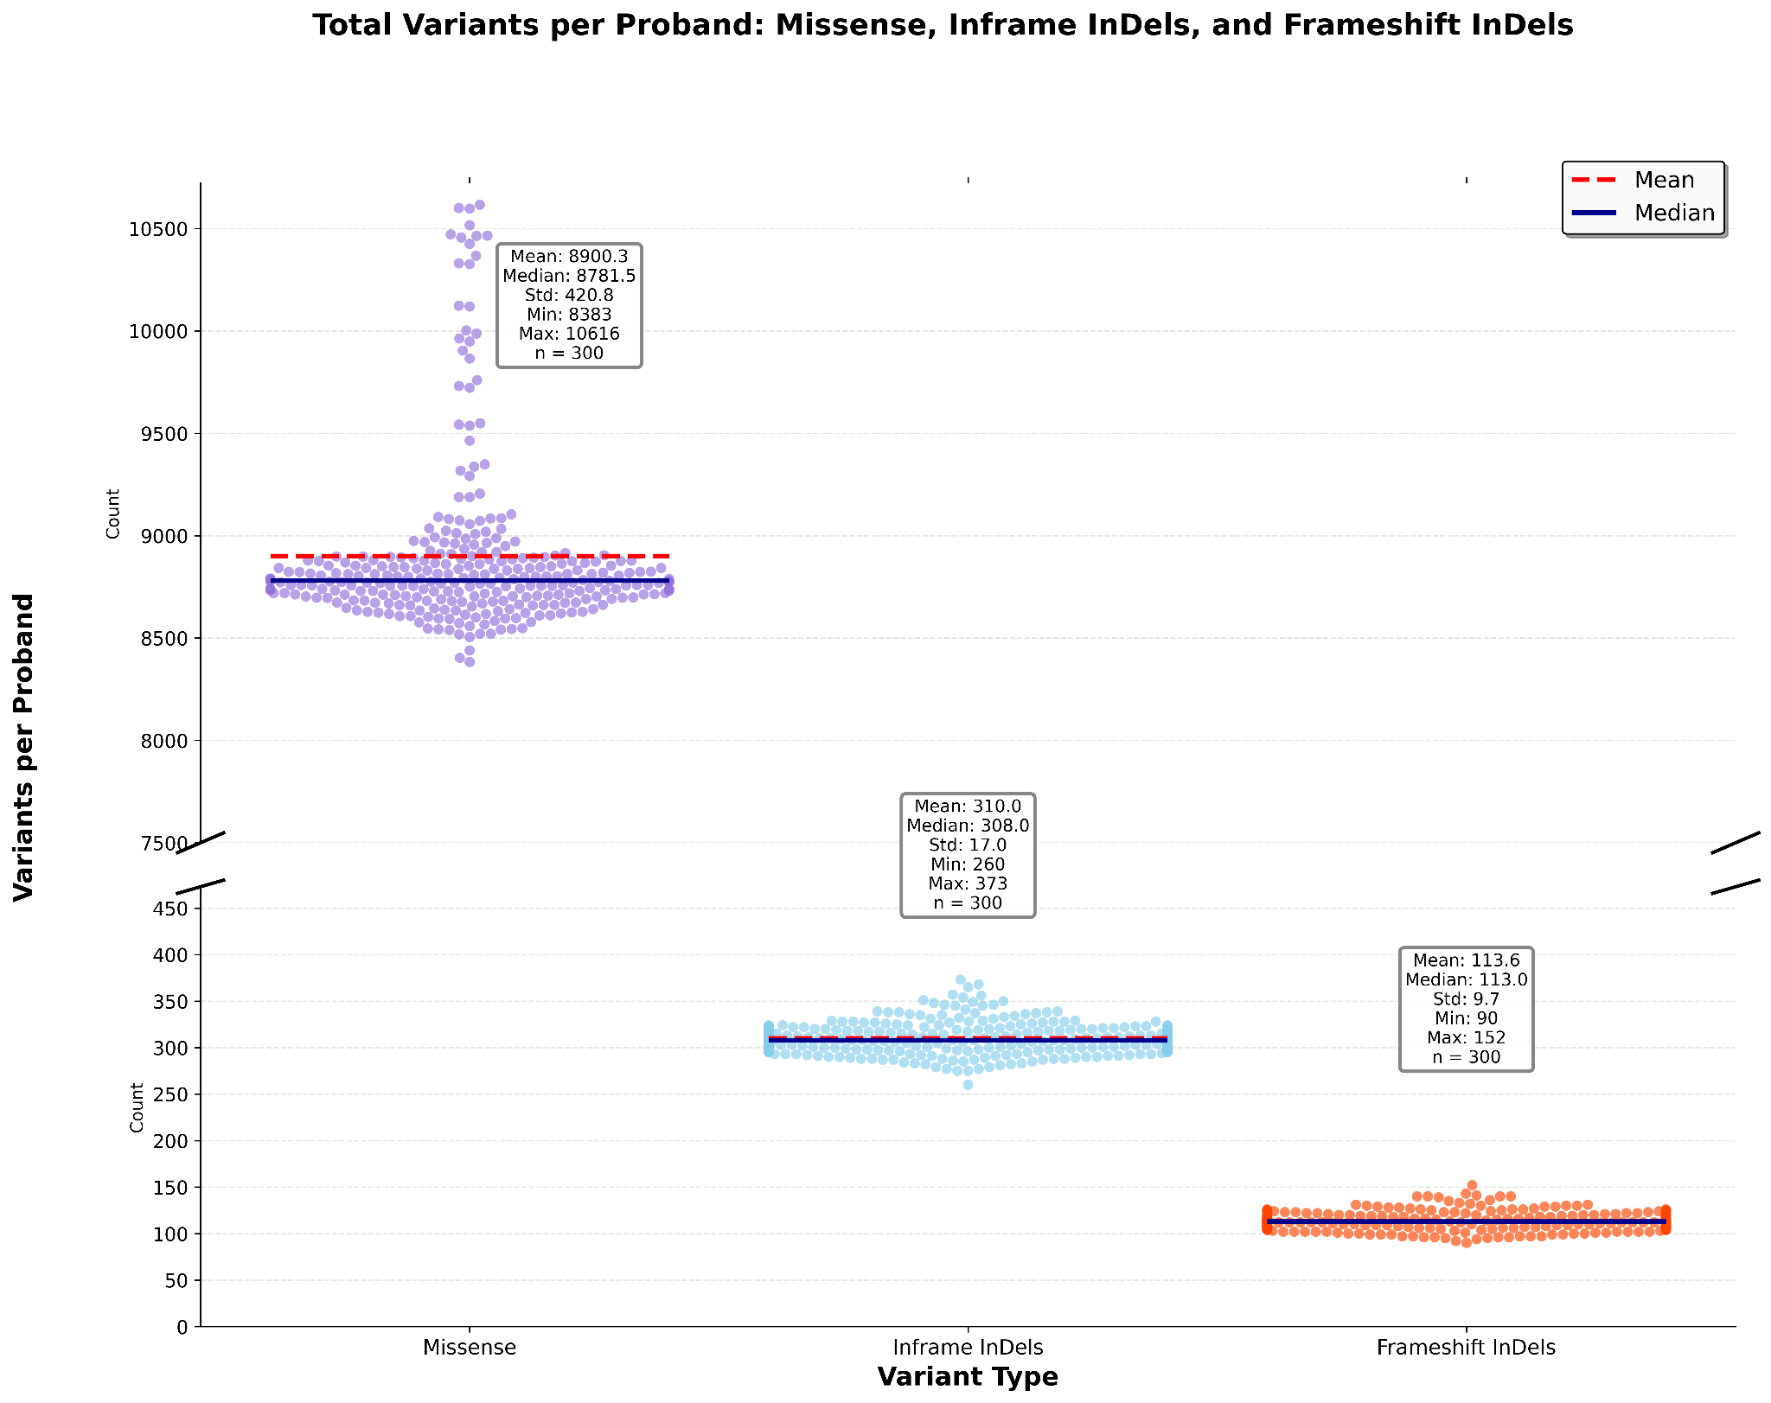

Annotate All Challenges
Credit: Mugdha Singh
Created for CAGI7
genomeinterpretation.org
Predrag Radivojac

Slide 5
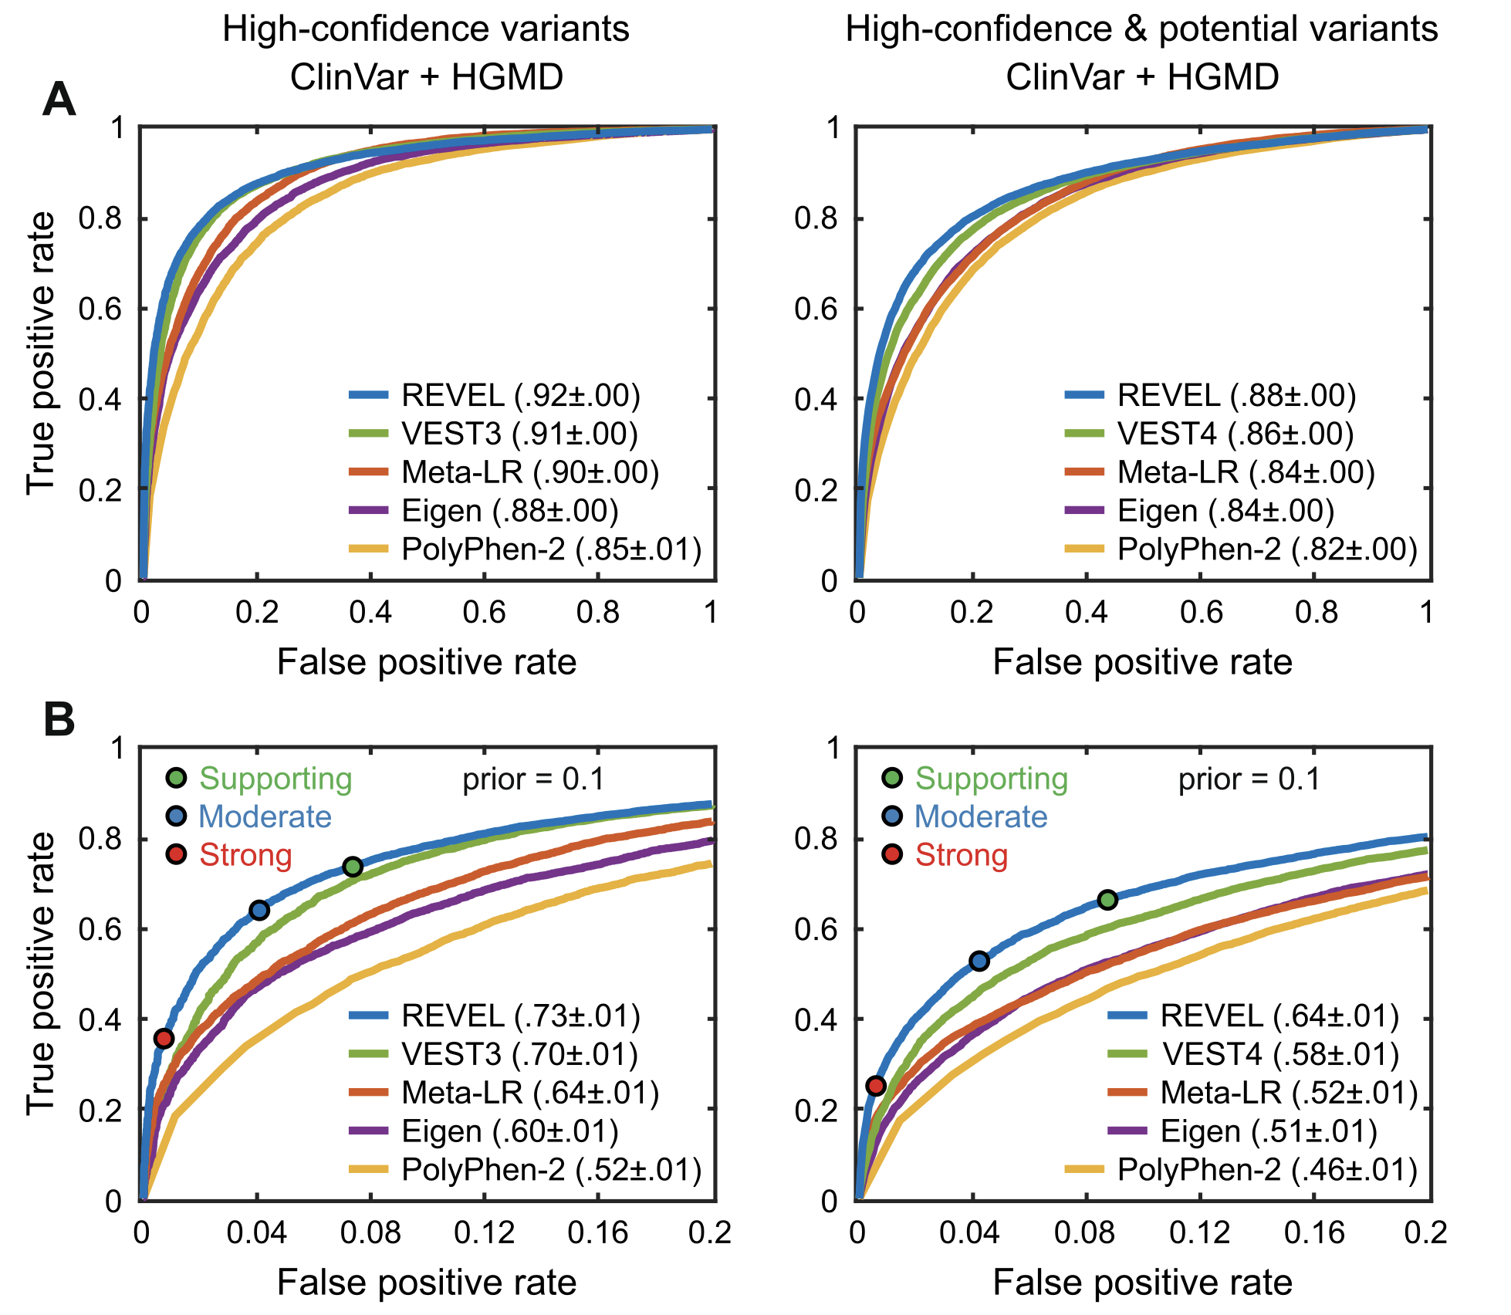
CAGI5 Results
CAGI Consortium. Genome Biol (2024)
Created for CAGI7
genomeinterpretation.org
Predrag Radivojac

Slide 6
CAGI5 Results
CAGI Consortium. Genome Biol (2024)
Created for CAGI7
genomeinterpretation.org
Predrag Radivojac

Slide 7
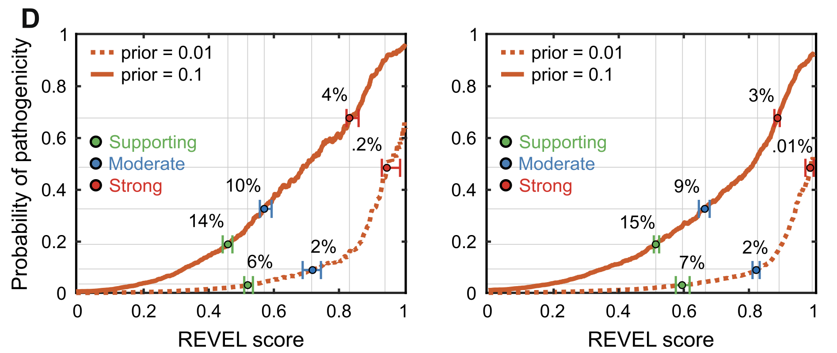
CAGI5 Results
CAGI Consortium. Genome Biol (2024)
Created for CAGI7
genomeinterpretation.org
Predrag Radivojac

Slide 8
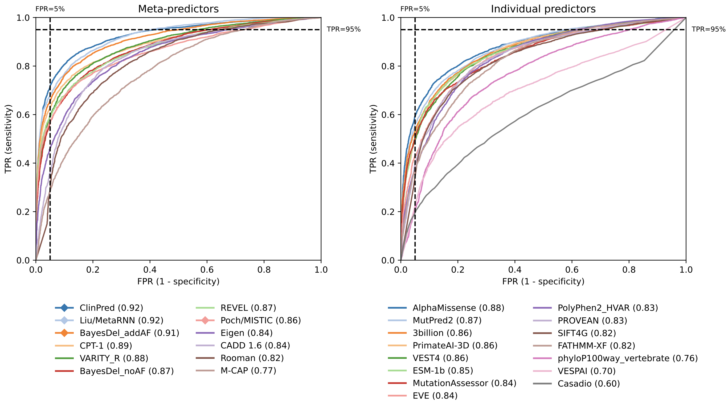
CAGI6 Results
Rastogi et al. Human Genet (2025)
Created for CAGI↓↓
genomeinterpretation.org
Nilah Ioannidis

Slide 9
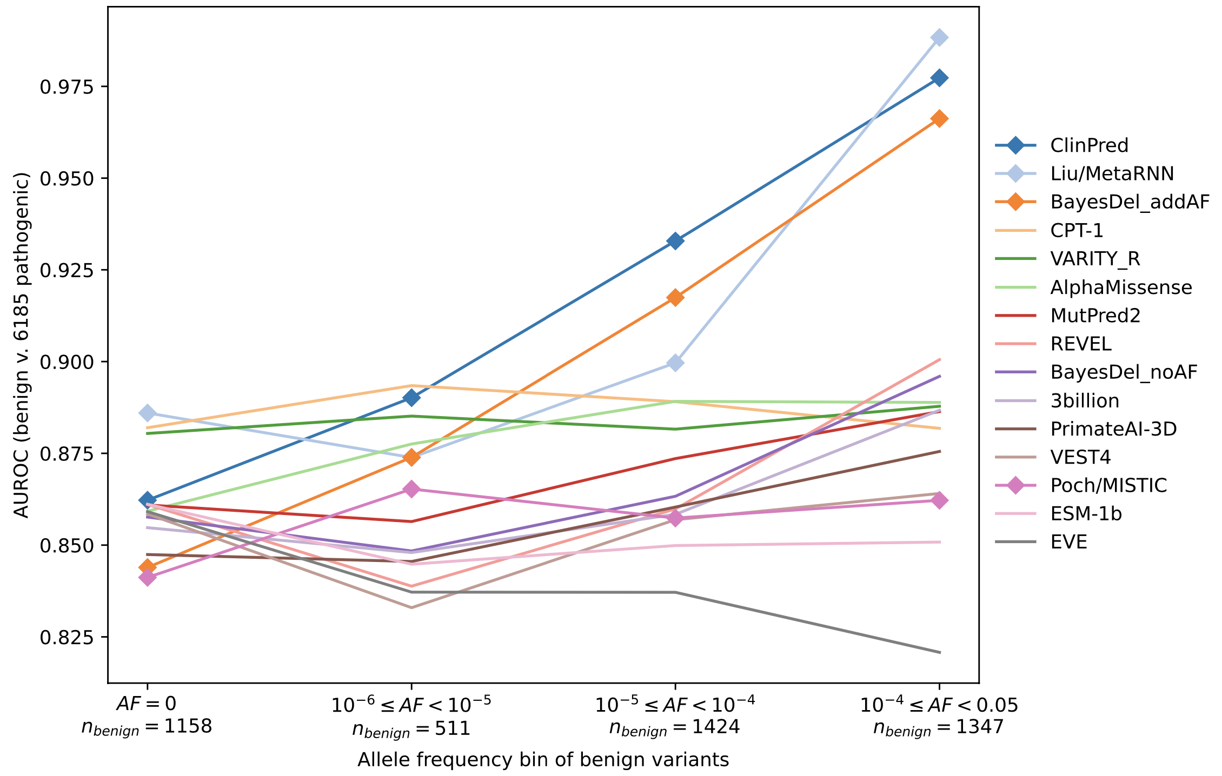
Benign Allele Frequency Breakdown
Rastogi et al. Human Genet (2025)
Created for CAGI↓↓
genomeinterpretation.org
Nilah Ioannidis

Slide 10
Conclusions
Model rankings depend on the particular use case of interest.
In general, meta-predictors tend to outperform individual predictors.
Recently-developed methods show moderate improvement on many metrics and may be good candidates to incorporate into meta-predictors.
Acknowledgements
All of CAGI
Created for CAGI7
genomeinterpretation.org
Predrag Radivojac

