Slide 1

CAGI 7 slide pack guidelines
I agree to my slides being used according to the following terms:
_______Kerr Ding_______
Authors: please include THIS slide at the beginning of your presentation to indicate that you agree with reuse of your slides in CAGI presentations, according to the terms below, and digitally sign by writing your name above.
At CAGI 7, use of this slide pack is only required for CAGI dataset providers, assessors, and predictors, but all are encouraged to use the annotations for materials they do not want shared publicly.
To disseminate the CAGI results, I encourage all CAGI participants to remix these CAGI slides for inclusion in their oral and poster presentations
CAGI participants may use or publish any content of these slides only in compliance with the CAGI Data Use Agreement
CAGI participants may not cite or publish any content of these slides except with the written permission of the originating author or in the primary CAGI publications
CAGI participants must acknowledge the original authors of these slides and CAGI 7. Include the acknowledgement banner across the bottom
CAGI participants must include the CAGI credits slide in their presentations
Slides with a red slash (no remix) may not be included in a presentation unless all attendees are registered CAGI participants who signed the data use agreement
Slides with a red X over the entire slide may not be used in any circumstances
Slides with a blue slash (embargoed) may not be used unless the embargo is explicitly lifted
Slides without slash or X may be tweeted, tooted, posted, X’d unless flagged with “No tweet” icon
CAGI participants using these slides must explain the “No tweet” icon, which means that the slide content should not be disseminated outside the presenting conference hall. If the presentation venue permits pervasive tweeting, you may not include these slides in your talk
Note for slide authors: we expect all CAGI participants to abide by these restrictions, and will make best effort to ensure they are followed. However, but bear in mind that we have limited means of enforcing them, and therefore the restrictions cannot be guaranteed.

Slide 2
Leveraging evolutionary and stability information for accurate prediction of protein mutational effects
Tony Tu, Ziang Li, Kerr Ding, Yunan Luo
Team Evocoders
Presenter: Kerr Ding
Georgia Institute of Technology
Created for CAGI 7
genomeinterpretation.org
Kerr Ding

Slide 3
Outline
SPURS
  Generalizable and scalable protein stability prediction
  Supervised mutational effect prediction
SPURSx
  Unsupervised mutational effect prediction
Created for CAGI 7
genomeinterpretation.org
Kerr Ding

Slide 4
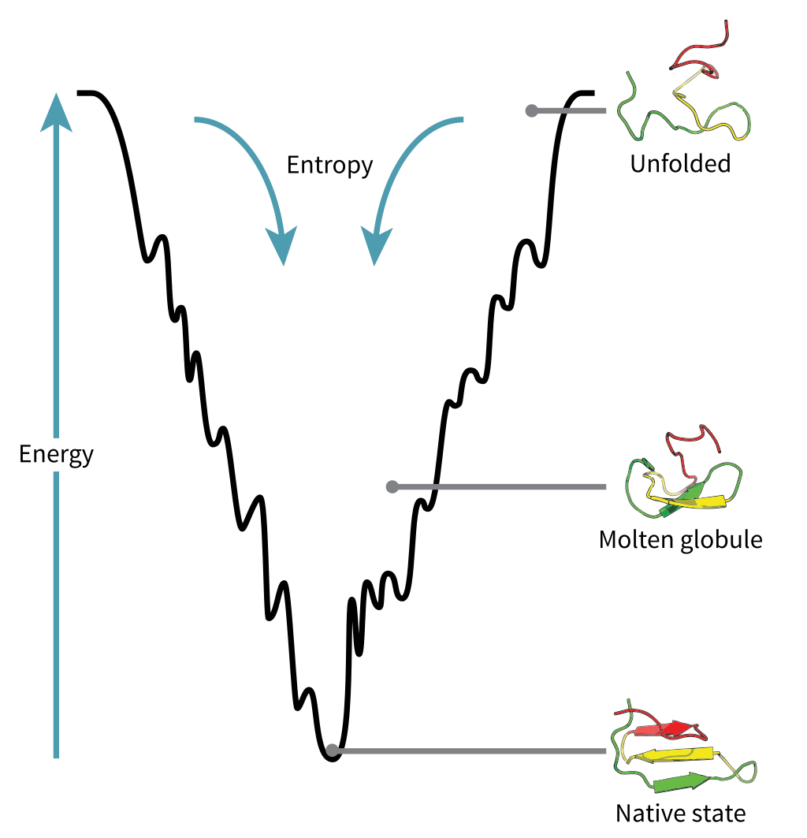
Protein stability change prediction
Protein thermostability: ΔG (Gibbs free energy)​
Created for CAGI 7
genomeinterpretation.org
Kerr Ding

Slide 5
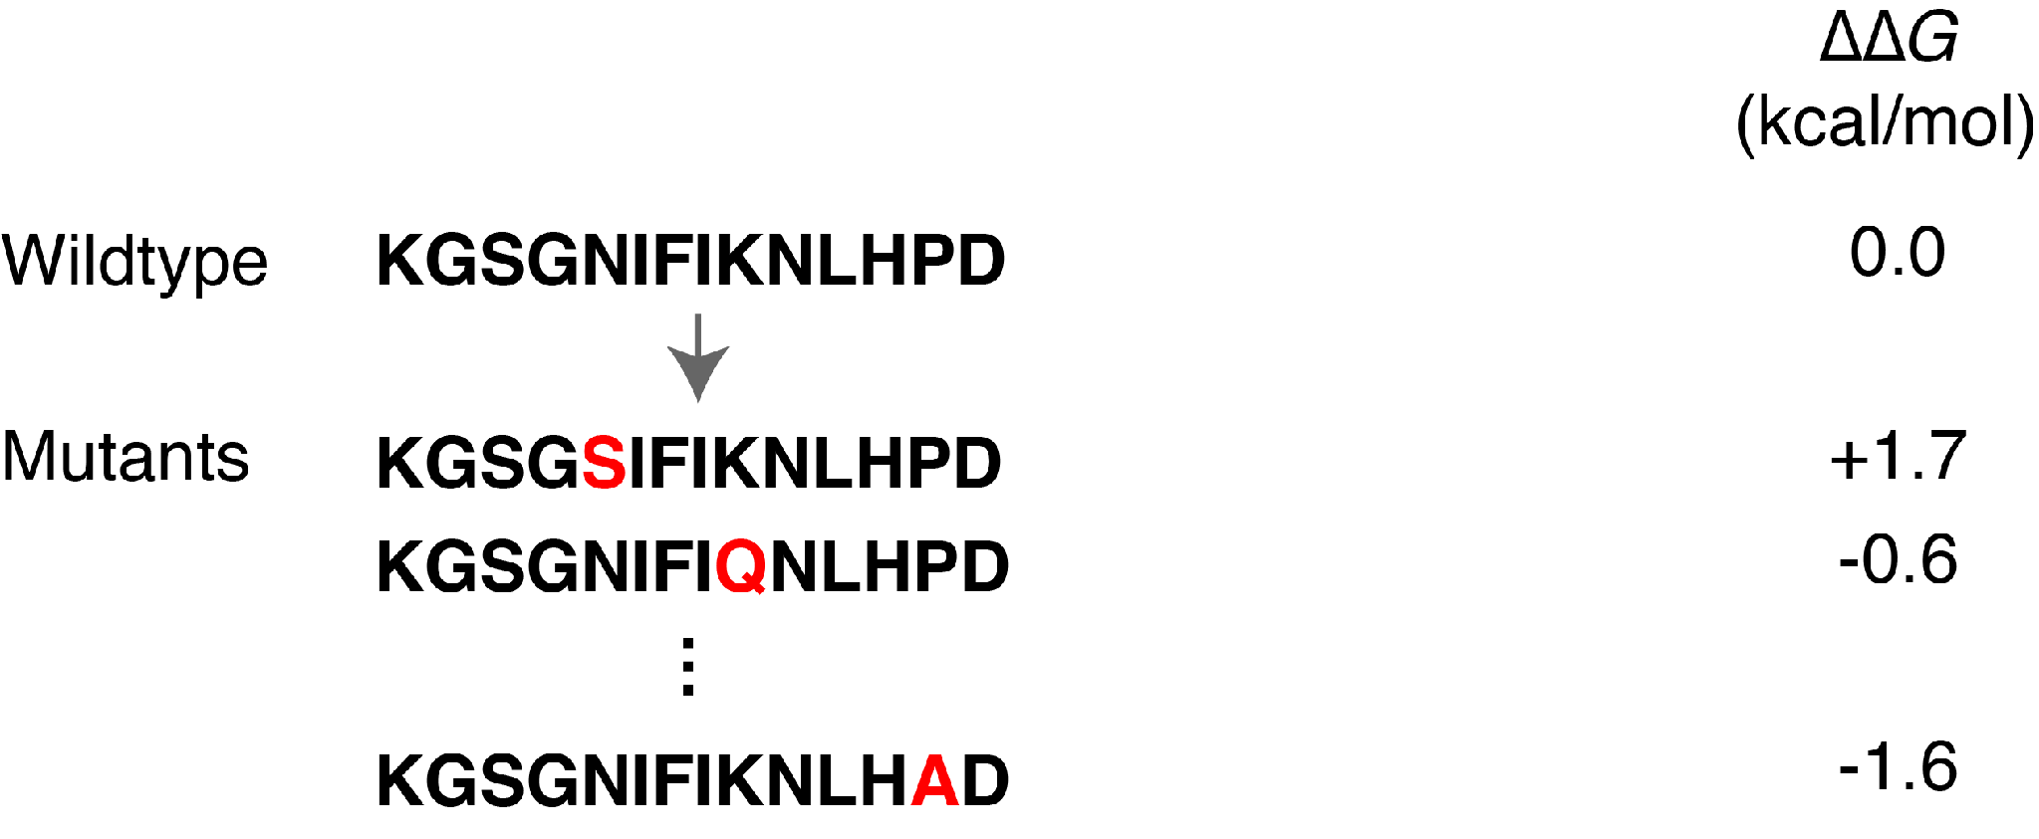
Protein stability change prediction
Protein stability change: ΔΔG (kcal/mol)​
ΔΔG = ΔG(Mutant) – ΔG(Wildtype)
Created for CAGI 7
genomeinterpretation.org
Kerr Ding

Slide 6
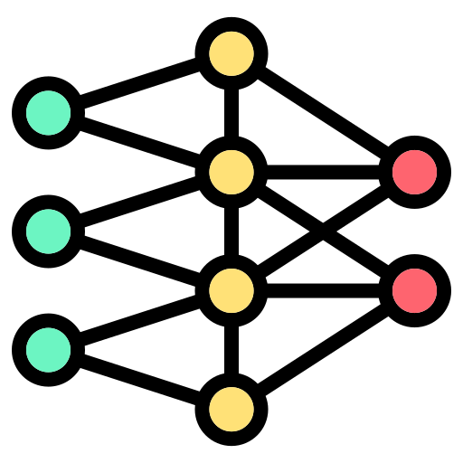
Protein stability change prediction
Protein stability change: ΔΔG (kcal/mol)​
ΔΔG = ΔG(Mutant) – ΔG(Wildtype)
Created for CAGI 7
genomeinterpretation.org
Kerr Ding

Slide 7
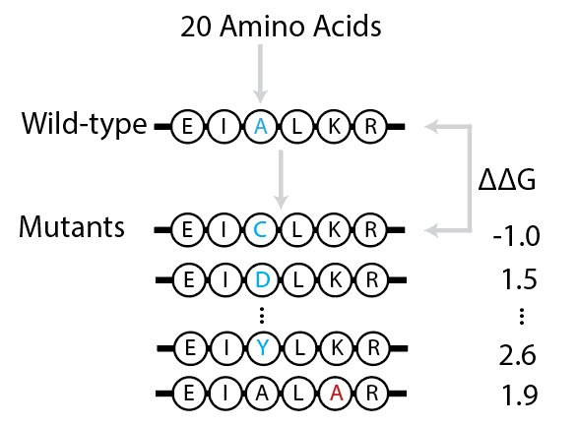
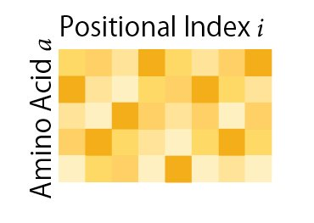
Protein stability change prediction
Protein stability change: ΔΔG (kcal/mol)​
ΔΔG = ΔG(Mutant) – ΔG(Wildtype)
Created for CAGI 7
genomeinterpretation.org
Kerr Ding

Slide 8


Measurement of protein stability
Wet-lab
methods
Biophysical
methods
Machine learning
methods
Costly
Time-consuming
Computationally slow
Small training set
Limited generalizability
Created for CAGI 7
genomeinterpretation.org
Kerr Ding

Slide 9
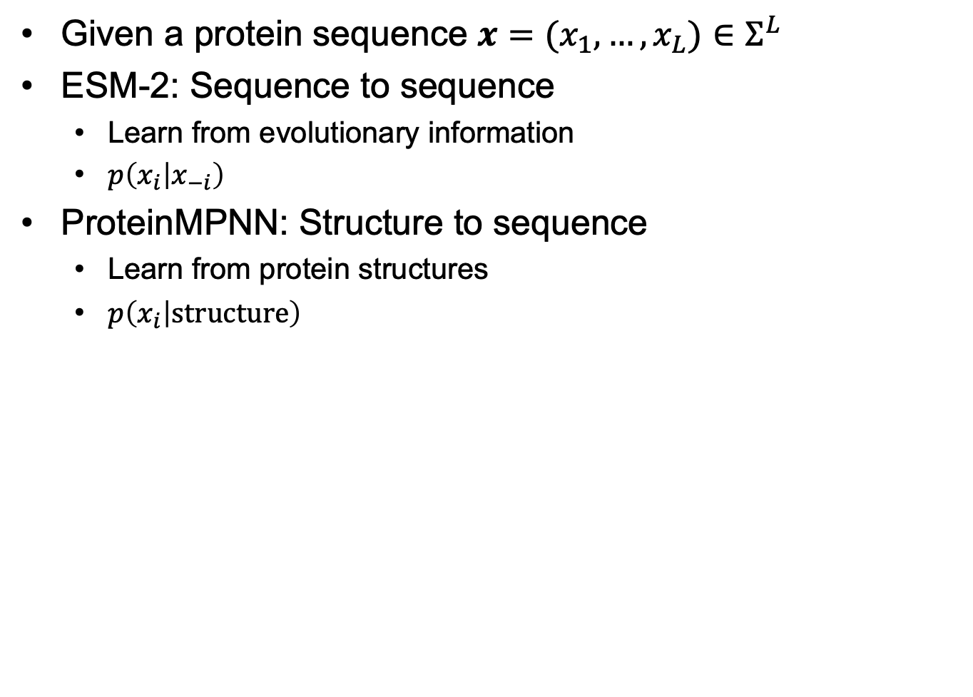
Pre-trained protein language models
Created for CAGI 7
genomeinterpretation.org
Kerr Ding

Slide 10
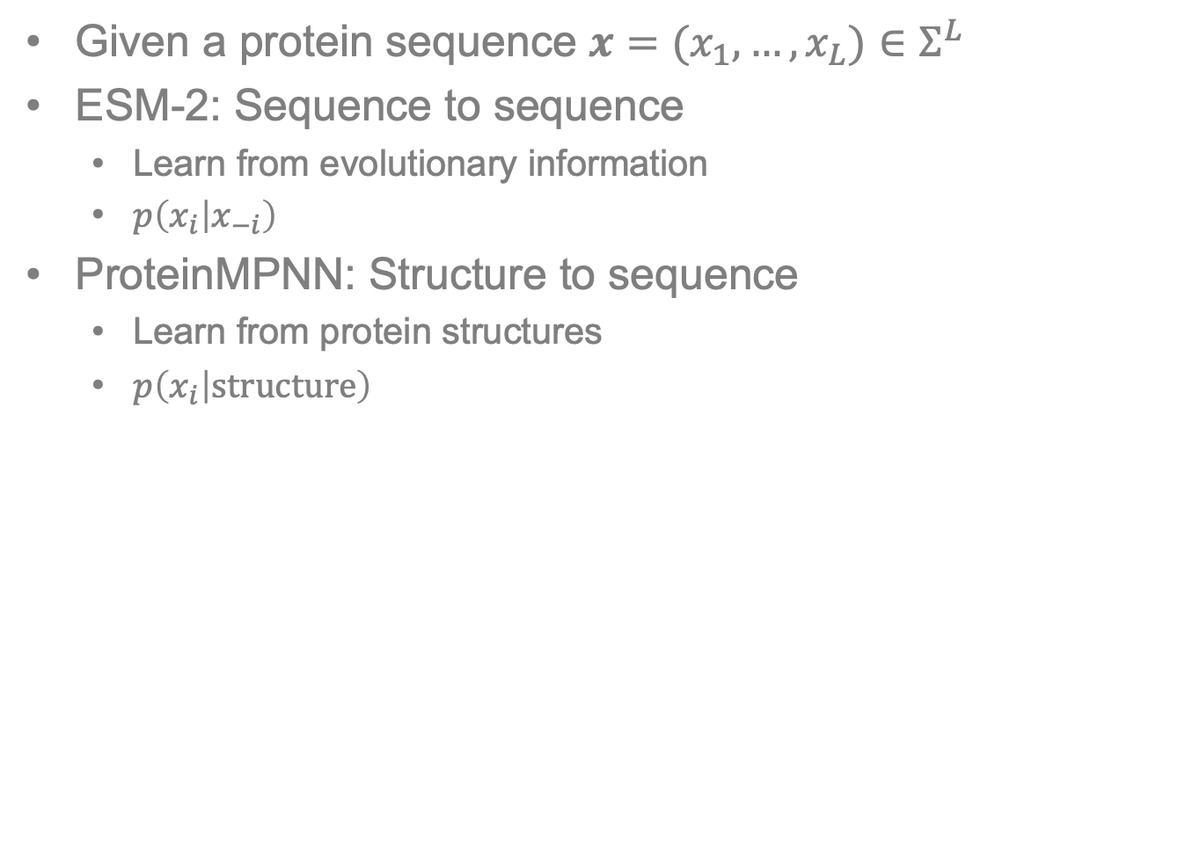
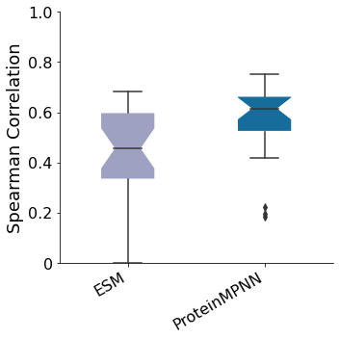
Pre-trained protein language models
Pre-trained models correlate well with protein stability
Created for CAGI 7
genomeinterpretation.org
Kerr Ding

Slide 11
Pre-trained protein language models
Pre-trained models correlate well with protein stability
Can we add supervision signal?
Created for CAGI 7
genomeinterpretation.org
Kerr Ding

Slide 12
Megascale Dataset is larger than previous training sets
Megascale dataset (Tsuboyama et al., Nature, 2023)
  200,000 mutants
  300 proteins
Previous datasets (Fireprot, Stourac et al., Nucleic Acids Research, 2021)
  3,000 mutants
  90 proteins
Created for CAGI 7
genomeinterpretation.org
Kerr Ding

Slide 13
Megascale Dataset is larger than previous training sets
Megascale dataset (Tsuboyama et al., Nature, 2023)
  200,000 mutants
  300 proteins
Previous datasets (Fireprot, Stourac et al., Nucleic Acids Research, 2021)
  3,000 mutants
  90 proteins
Larger datasets provide possibility for improved generalizability
Created for CAGI 7
genomeinterpretation.org
Kerr Ding

Slide 14
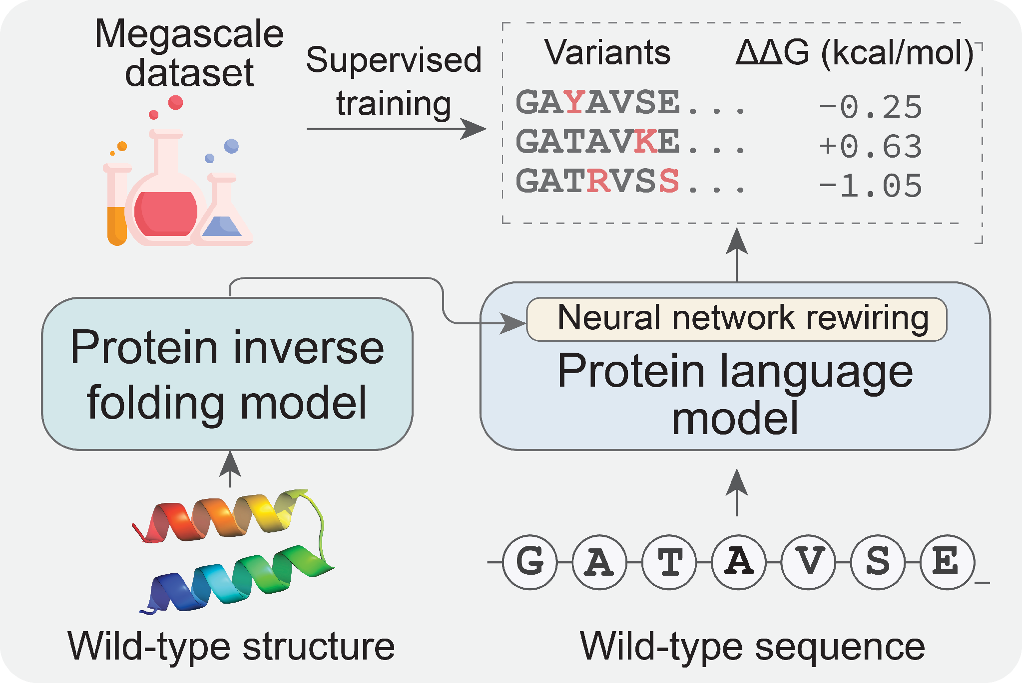
SPURS architecture
Created for CAGI 7
genomeinterpretation.org
Kerr Ding

Slide 15
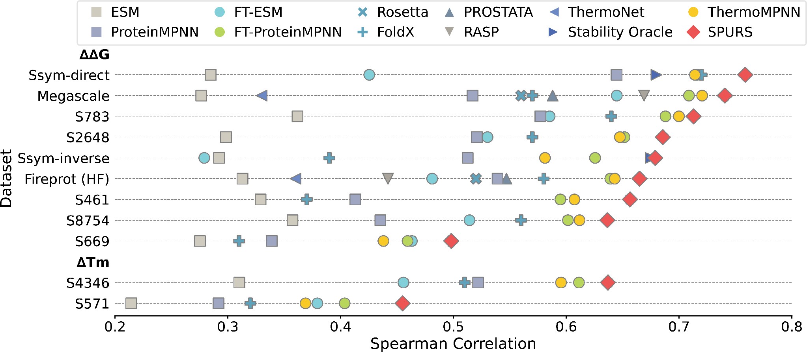
SPURS achieves accurate prediction
for protein stability
Created for CAGI 7
genomeinterpretation.org
Kerr Ding

Slide 16
SPURS achieves accurate prediction
for protein stability
SPURS is an efficient stability predictor
SPURS benefits multiple downstream applications
Created for CAGI 7
genomeinterpretation.org
Kerr Ding

Slide 17
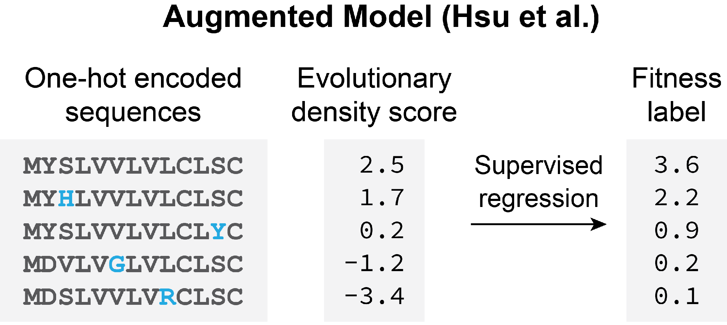
SPURS improves low-N protein mutational effect prediction
Created for CAGI 7
genomeinterpretation.org
Kerr Ding

Slide 18
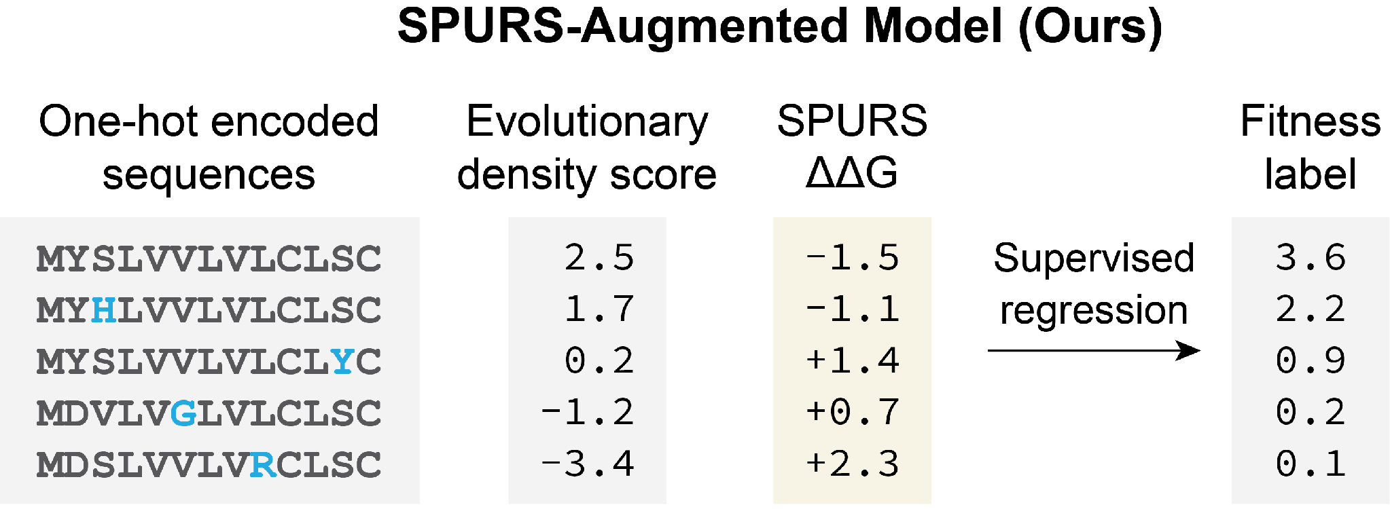
SPURS improves low-N protein mutational effect prediction
Created for CAGI 7
genomeinterpretation.org
Kerr Ding

Slide 19
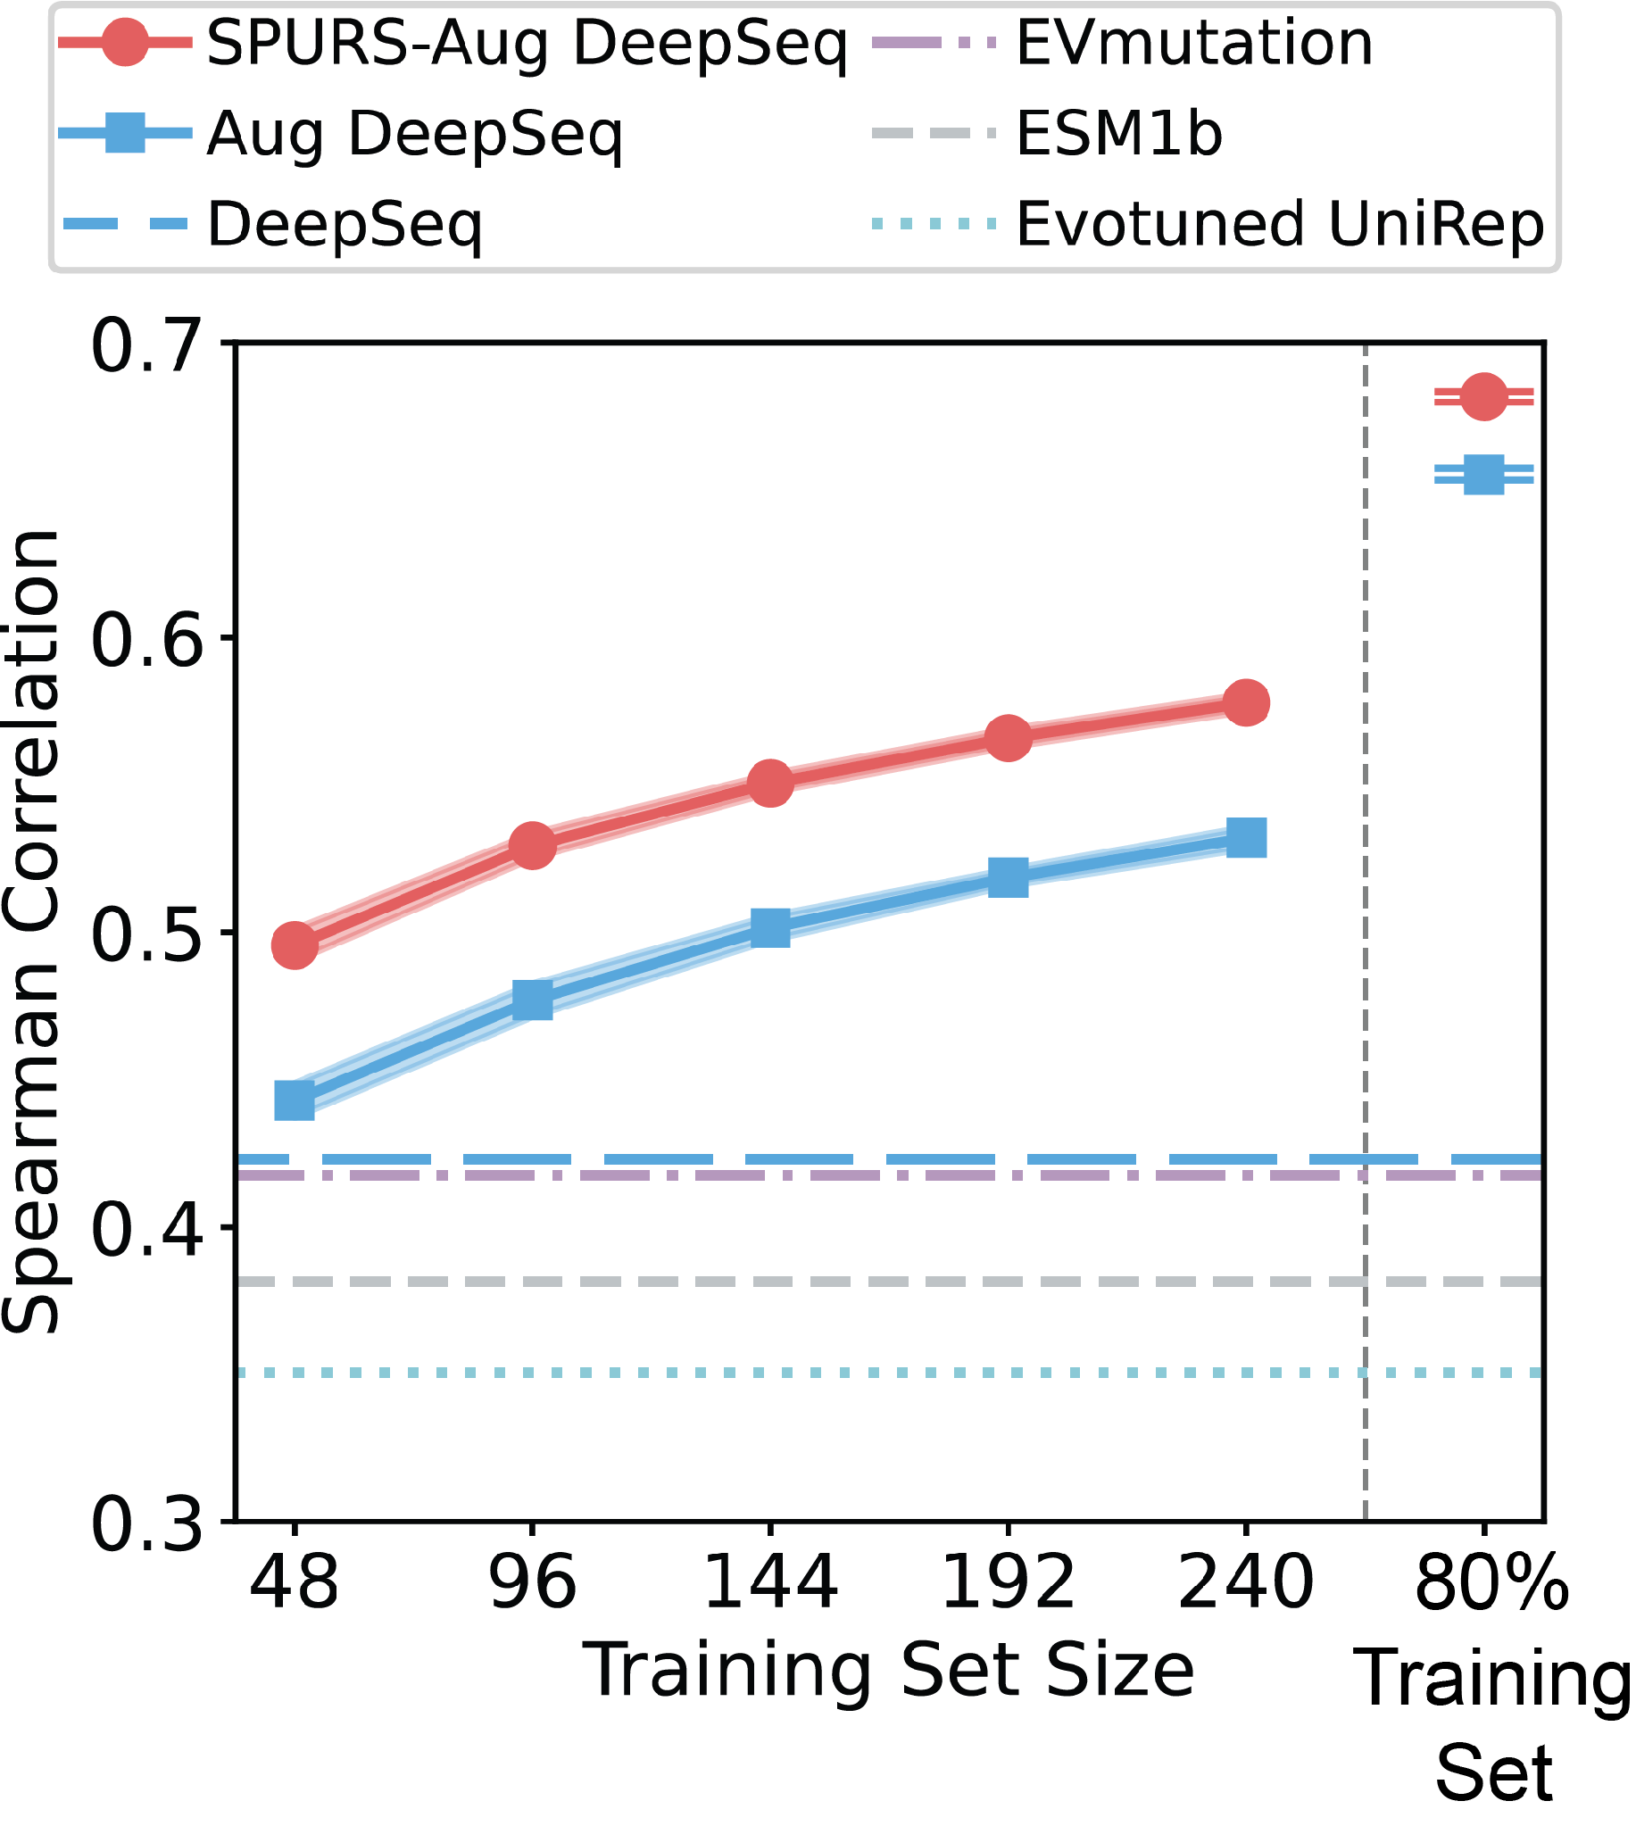
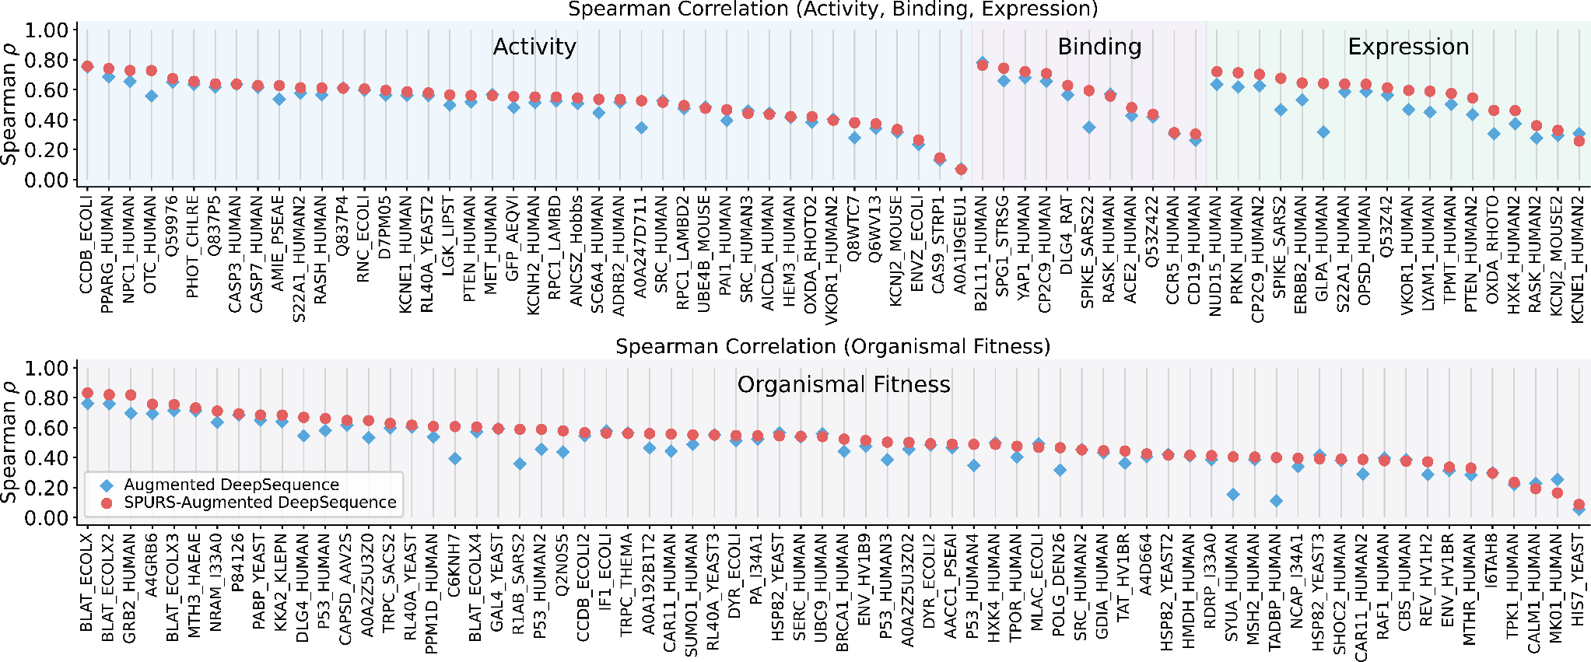
SPURS improves low-N protein mutational effect prediction
Created for CAGI 7
genomeinterpretation.org
Kerr Ding

Slide 20
SPURS improves low-N protein mutational effect prediction
Incorporating stability prior improves supervised mutational effect prediction
Created for CAGI 7
genomeinterpretation.org
Kerr Ding

Slide 21
CAGI7 Deep mutational scanning challenges
6 challenges:
  TSC2, BARD1, LPL, ATP7B, ARSA, FGFR
Created for CAGI 7
genomeinterpretation.org
Kerr Ding

Slide 22
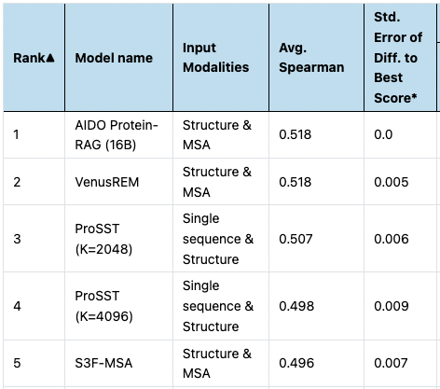
CAGI7 Deep mutational scanning challenges
6 challenges:
  TSC2, BARD1, LPL, ATP7B, ARSA, FGFR
Unsupervised mutational effect prediction is challenging!
ProteinGym
benchmark
Created for CAGI 7
genomeinterpretation.org
Kerr Ding

Slide 23
CAGI7 Deep mutational scanning challenges
6 challenges:
  TSC2, BARD1, LPL, ATP7B, ARSA, FGFR
Can we do better than evolution-based zero-shot predictors on ProteinGym?
ProteinGym
benchmark
Created for CAGI 7
genomeinterpretation.org
Kerr Ding

Slide 24
Conclusion
SPURS achieves accurate and generalizable stability prediction
Incorporating stability priors improves both supervised and unsupervised mutational effect prediction
SPURSx achieves competitive performances across FGFR, ARSA, and TSC2 challenges
SPURS code: https://github.com/luo-group/SPURS
SPURS preprint:
Correspondence: ziang@gatech.edu, kerrding@gatech.edu, yunan@gatech.edu
Created for CAGI 7
genomeinterpretation.org
Kerr Ding

