Slide 1

CAGI7 Slide pack guidelines
I agree to my slides being used according to the following terms:
Doyeon Ha
Authors: please include THIS slide at the beginning of your presentation to indicate that you agree with reuse of your slides in CAGI presentations, according to the terms below, and digitally sign by writing your name above.
To disseminate the CAGI results, I encourage all CAGI participants to remix these CAGI slides for inclusion in their oral and poster presentations.
CAGI participants may use or publish any content of these slides only in compliance with the CAGI Data Use Agreement.
CAGI participants may not cite or publish any content of these slides except with the written permission of the originating author or in the primary CAGI publications.
CAGI participants must acknowledge the original authors of these slides and CAGI7. Include the acknowledgement banner across the bottom.
CAGI participants must include the CAGI credits slide in their presentations.
Slides with a red slash (no remix) may not be included in a presentation unless all attendees are registered CAGI participants who signed the data use agreement.
Slides with a red X over the entire slide may not be used in any circumstances.
Slides with a blue slash (embargoed) may not be used unless the embargo is explicitly lifted.
Slides without slash or X may be tweeted unless flagged with the “No tweet” icon.
CAGI participants using these slides must explain the “No tweet” icon, which means that the slide content should not be disseminated outside the presenting conference hall. If the presentation venue permits pervasive tweeting, you may not include these slides in your talk.
Note for slide authors: we expect all CAGI participants to abide by these restrictions and will make best effort to ensure they are followed. However, bear in mind that we have limited means of enforcing them, and therefore the restrictions cannot be guaranteed.

Slide 2
ClearVariantPro (CVP)
Target-Specific Embedding Space Optimization with Multi-Task Learning
Doyeon Ha, Ph.D. | AI Lead Manager
2025.12

Slide 3

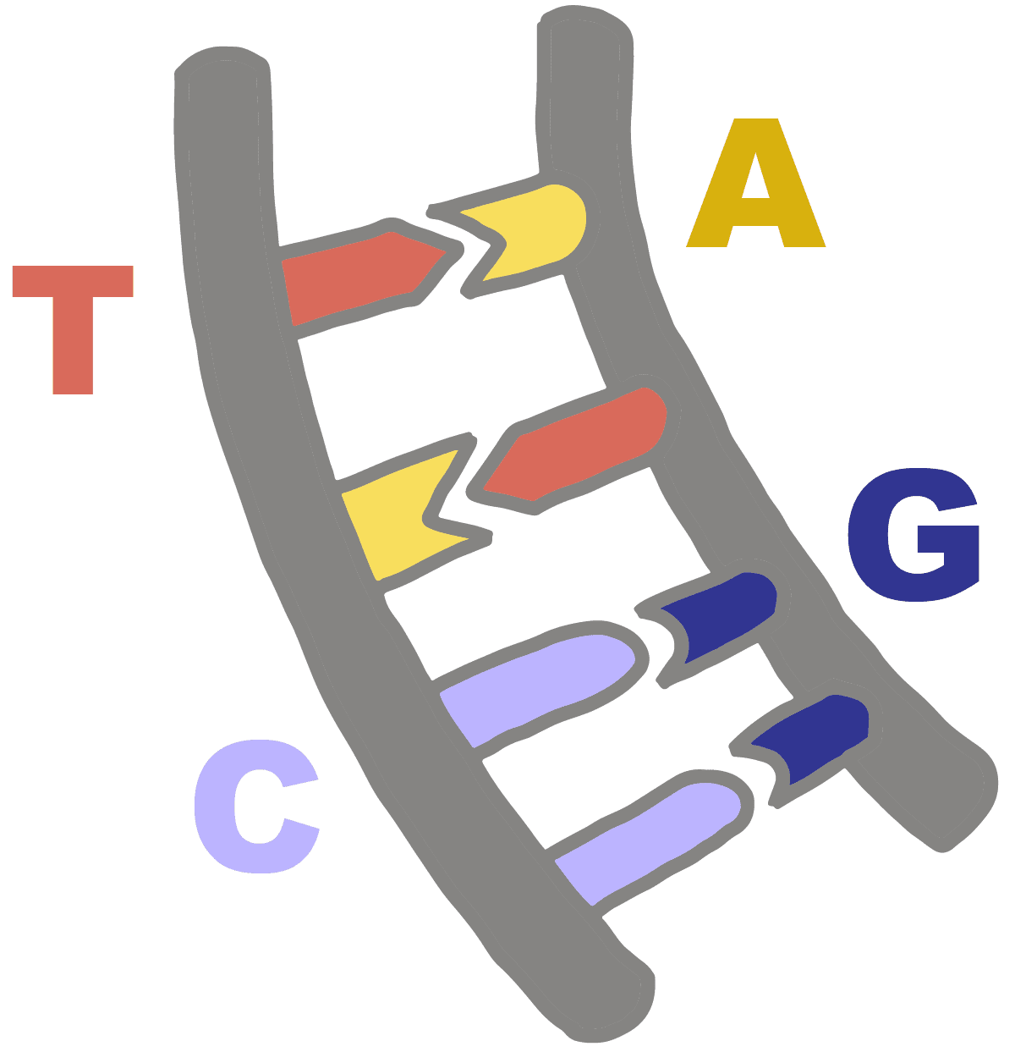
3billion
https://3billion.io/
The number of DNA pairs
Mission: Save 10%
→ Rare disease patients

Slide 4
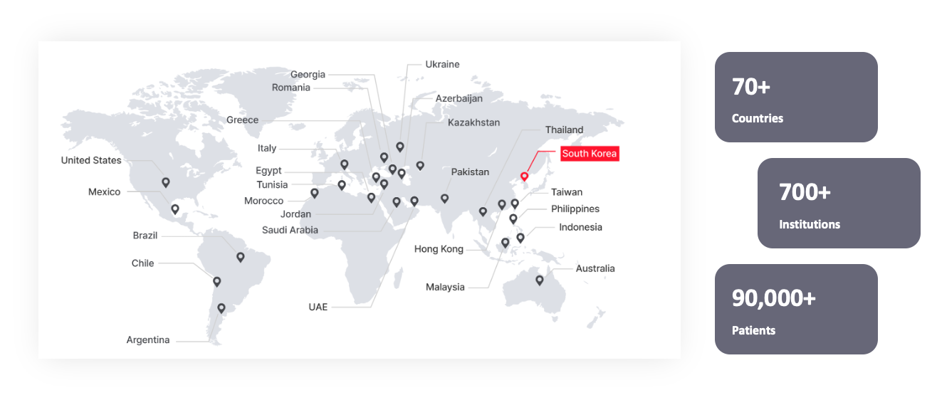
3billion

Slide 5
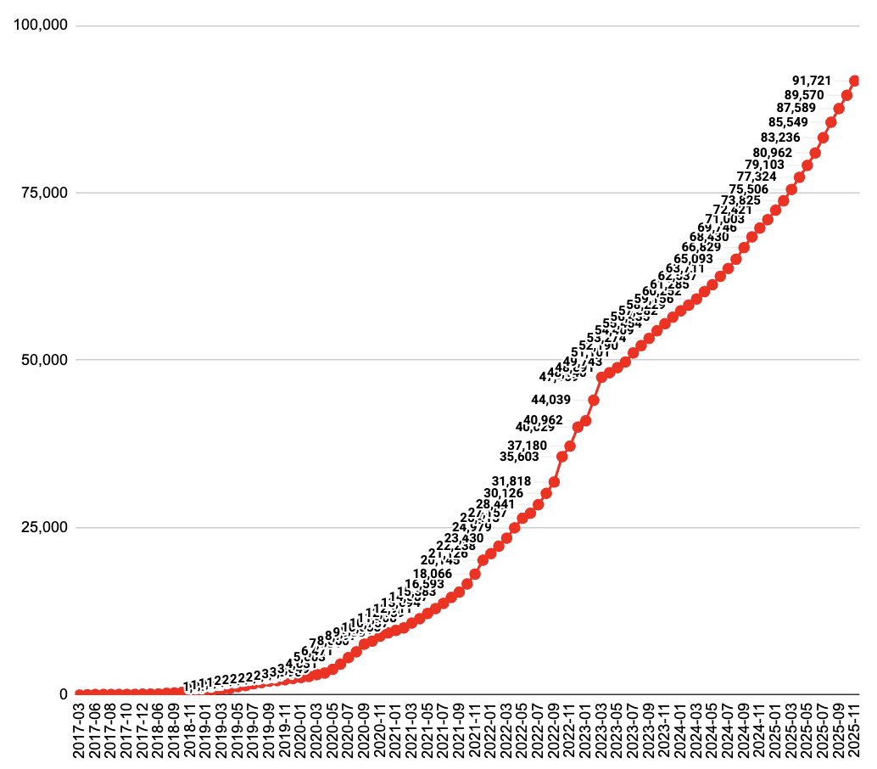
3billion
total = 100,000 WGS/WES
5,000 a month,
TAT = 4 weeks
https://3billion.io/
Mission: Save 10%
The number of samples
→ Rare disease patients

Slide 6
Contents
Purpose
Results
  Prediction performance
3 core methods
  Model architecture
  Data curation
  Knowledge transfer
Summary
FGFR
FGFR
TSC2
TSC2

Slide 7
Purpose

Slide 8
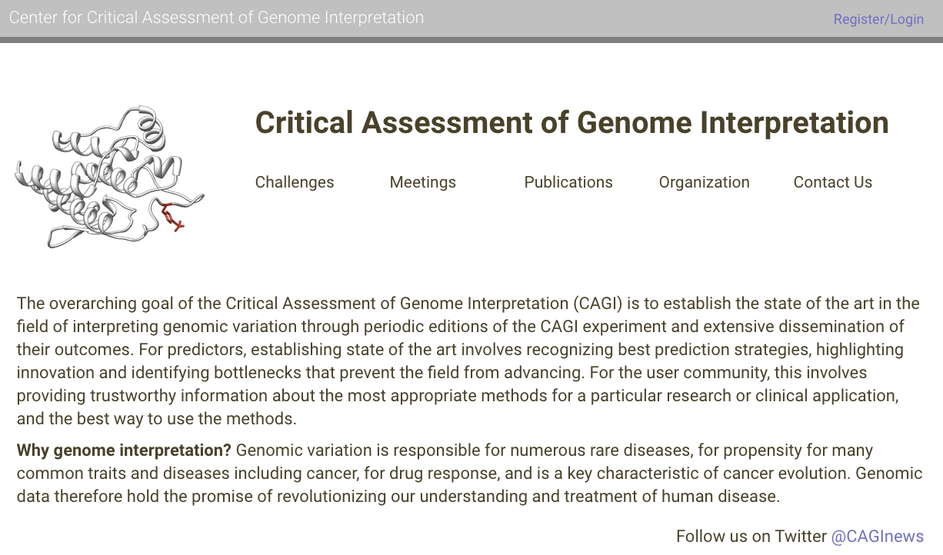
Purpose
FGFR
TSC2

Slide 9
Results

Slide 10
3 core methods

Slide 11
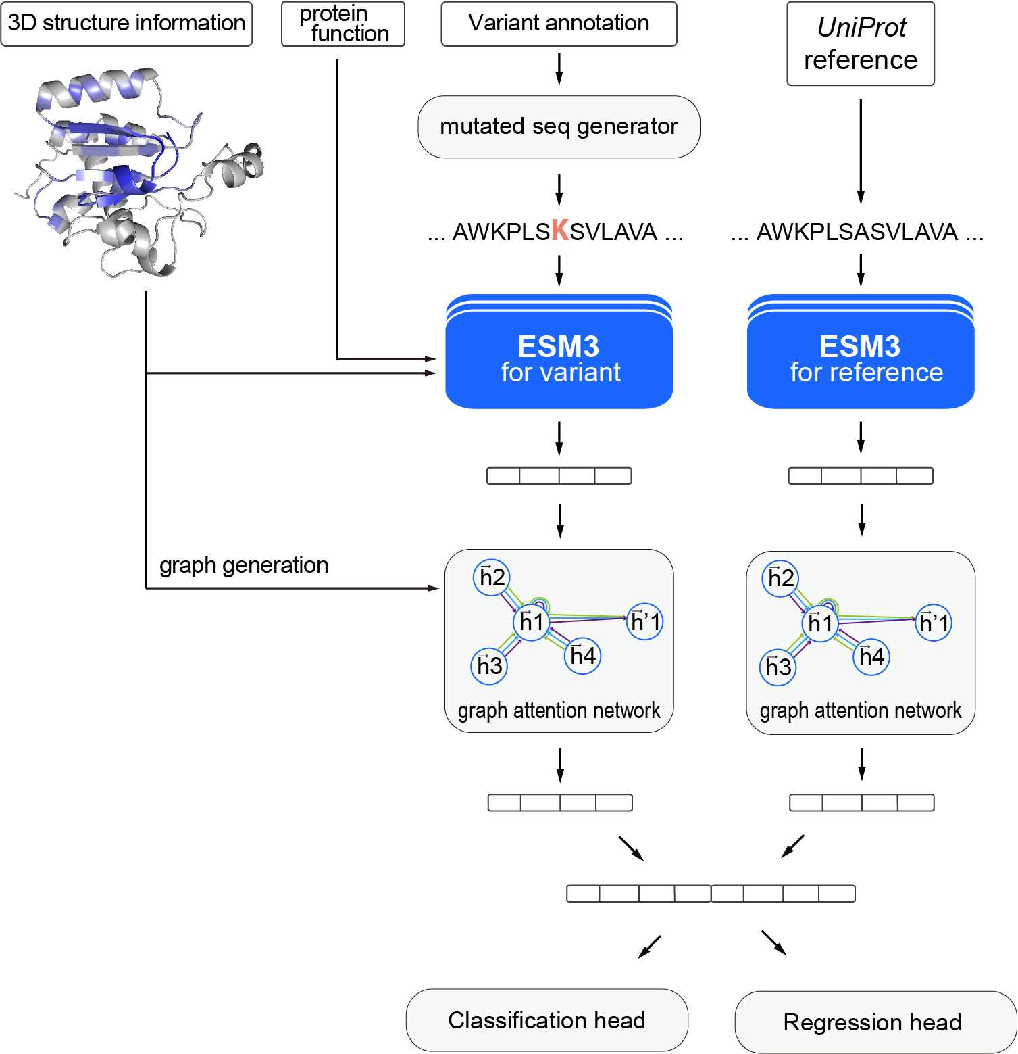
1. Model Architecture
FGFR
1) Comparison between embedding vectors of
variant and reference sequences
2) GAT layers based on protein structures
3) Multi-task learning: classification and regression

Slide 12
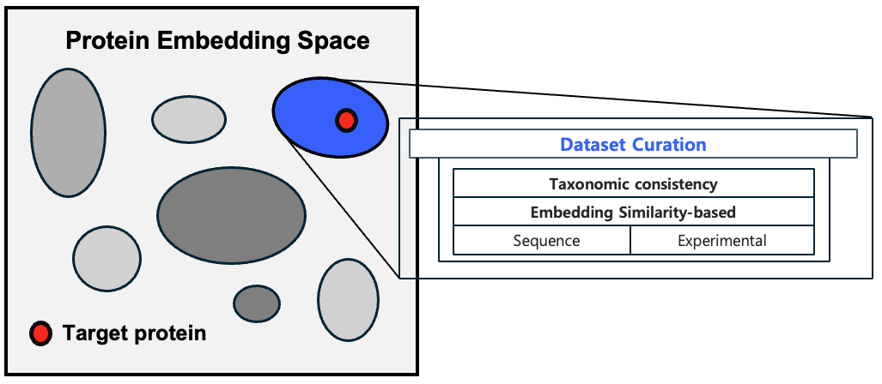
2. Data Curation (1): train protein selection
FGFR
TSC2
For FGFR prediction, which protein could be included in our train data?
1) Only human proteins selected

Slide 13
2. Data Curation (1): train protein selection
FGFR
TSC2
For FGFR prediction, which protein could be included in train data?
1) Only human proteins selected
2) Cosine similarity of
PLM embedding vectors with FGFRs

Slide 14


2. Data Curation (1): train protein selection
FGFR
TSC2
For FGFR prediction, which protein could be included in train data?
FGFR sequence
1) Only human proteins selected
Cosine similarity
Train candidate protein sequence
2) Cosine similarity of
PLM embedding vectors with FGFRs

Slide 15
2. Data Curation (1): train protein selection
FGFR
TSC2
For FGFR prediction, which protein could be included in train data?
1) Only human proteins selected
3) Text similarity of experiment descriptions with FGFRs
2) Cosine similarity of
PLM embedding vectors with FGFRs

Slide 16
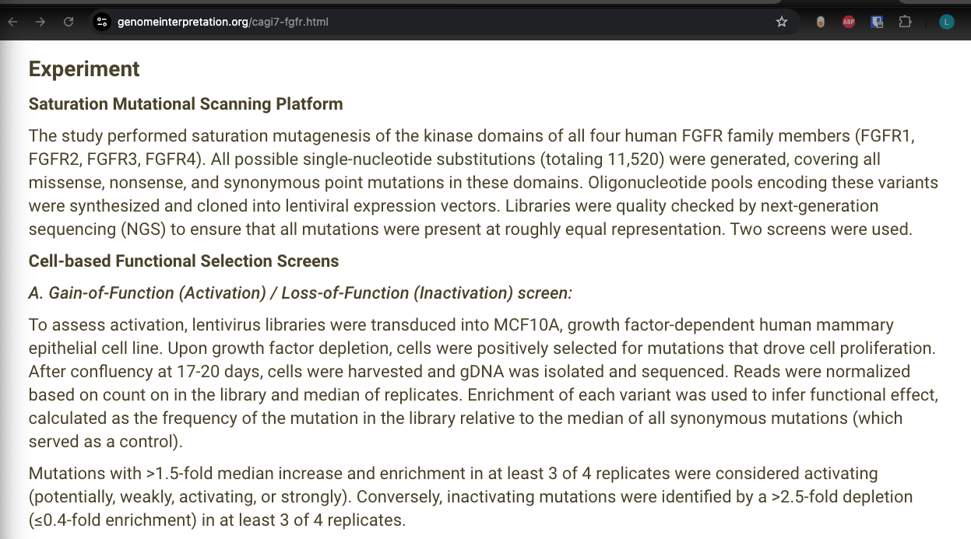

2. Data Curation (1): train protein selection
FGFR
TSC2
For FGFR prediction, which protein could be included in train data?
1) Only human proteins selected
3) Text similarity of experiment descriptions with FGFRs
2) Cosine similarity of
PLM embedding vectors with FGFRs

Slide 17
2. Data Curation (1): train protein selection
FGFR
TSC2
For FGFR prediction, which protein could be included in train data?
1) Only human proteins selected
3) Text similarity of experiment descriptions with FGFRs
2) Cosine similarity of
PLM embedding vectors with FGFRs

Slide 18
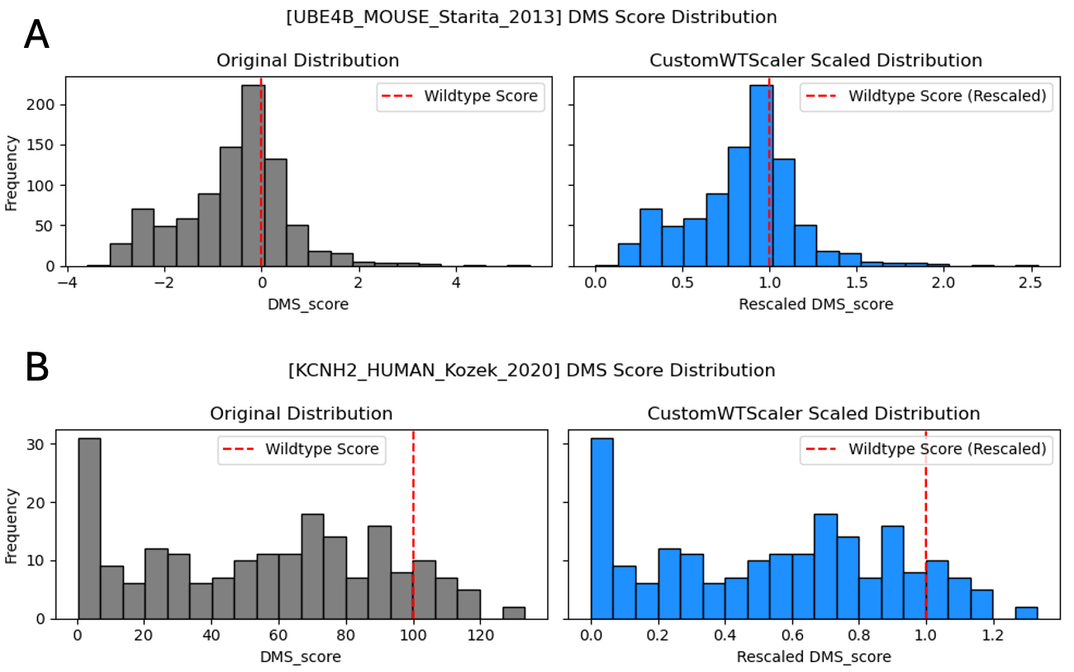
2. Data Curation (2): CustomWTScaler
FGFR
TSC2

Slide 19
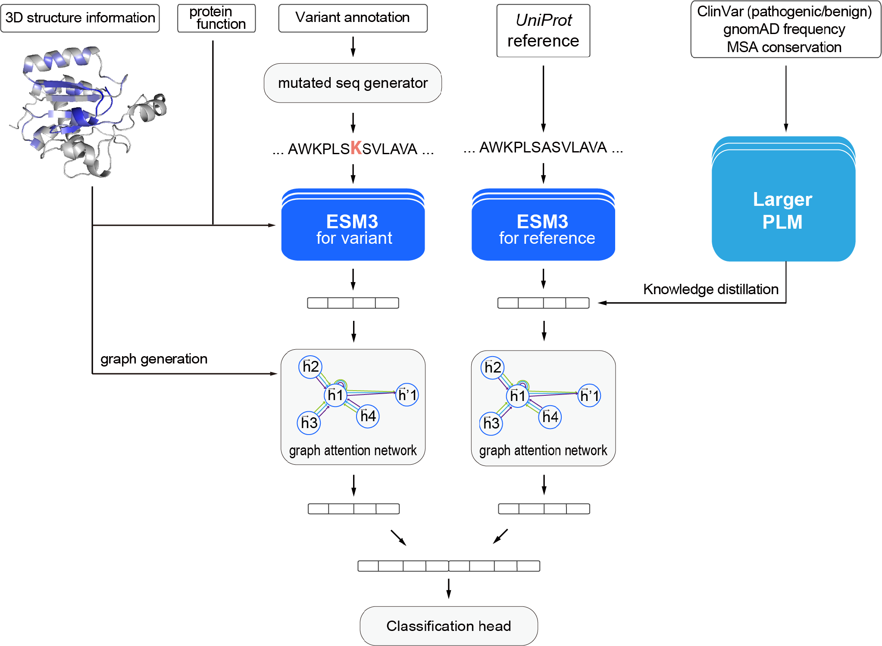
3. Knowledge Transfer
TSC2
1) Knowledge distillation: Concatenating embedding vectors from the pre-trained
larger PLM
→ Detailed explanation in the poster section
2) Transfer learning: leveraging our previous model by using pseudo-labels

Slide 20
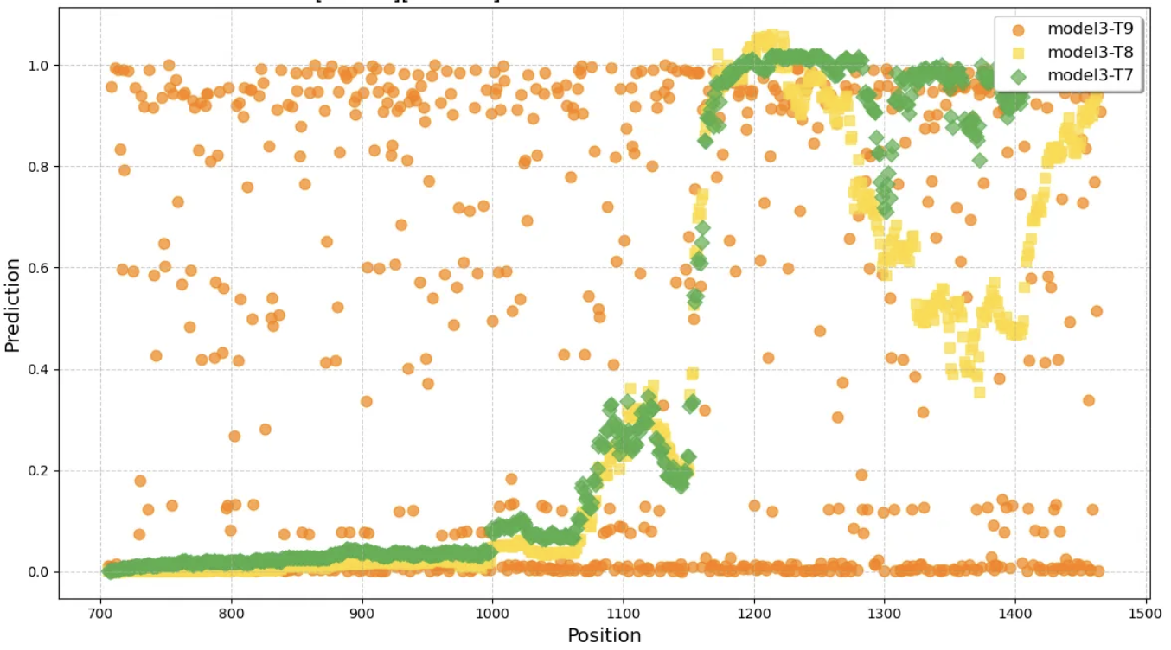
Additionally, stop-gain validation
FGFR
TSC2

Slide 21
Summary

Slide 22
Summary
We, 3billion, developed ClearVariantPro(CVP) to accurately predict mutational effects
  Well fine-tuned performance higher than foundation models
3 core methods are
  i) Model architecture: comparison of ref and mut sequence on GAT of protein structures
  ii) Data curation: similar proteins and experiments
  iii) Knowledge transfer: AI skills to leverage other models
Open to discussions after this presentation or at our poster
  for the underserved!
  of course, we made advances after CAGI7 challenge submissions
  my email: dy.ha@3billion.io

Slide 23
References
FGFR
TSC2
Ha, D., Kim, D., Kim, I., Oh, Y., Kong, J., Han, S. K., & Kim, S. (2022). Evolutionary rewiring of regulatory networks contributes to phenotypic differences between human and mouse orthologous genes. Nucleic Acids Research, 50(4), 1849-1863.
Hayes, T., Rao, R., Akin, H., Sofroniew, N. J., Oktay, D., Lin, Z., ... & Rives, A. (2025). Simulating 500 million years of evolution with a language model. Science, 387(6736), 850-858.
Hinton, G., Vinyals, O., & Dean, J. (2015). Distilling the knowledge in a neural network. arXiv preprint arXiv:1503.02531.
Landrum, M. J., Chitipiralla, S., Kaur, K., Brown, G., Chen, C., Hart, J., ... & Kattman, B. L. (2025). ClinVar: updates to support classifications of both germline and somatic variants. Nucleic Acids Research, 53(D1), D1313-D1321.
Lee, J., Chen, F., Dua, S., Cer, D., Shanbhogue, M., Naim, I., ... & Duerig, T. (2025). Gemini embedding: Generalizable embeddings from gemini. arXiv preprint arXiv:2503.07891.
Jumper, J., Evans, R., Pritzel, A., Green, T., Figurnov, M., Ronneberger, O., ... & Hassabis, D. (2021). Highly accurate protein structure prediction with AlphaFold. nature, 596(7873), 583-589.
Notin, P., Kollasch, A., Ritter, D., Van Niekerk, L., Paul, S., Spinner, H., ... & Marks, D. (2023). Proteingym: Large-scale benchmarks for protein fitness prediction and design. Advances in Neural Information Processing Systems, 36, 64331-64379.
Paysan-Lafosse, T., Blum, M., Chuguransky, S., Grego, T., Pinto, B. L., Salazar, G. A., ... & Bateman, A. (2023). InterPro in 2022. Nucleic acids research, 51(D1), D418-D427.
Stenson, P. D., Mort, M., Ball, E. V., Chapman, M., Evans, K., Azevedo, L., ... & Cooper, D. N. (2020). The Human Gene Mutation Database (HGMD®): optimizing its use in a clinical diagnostic or research setting. Human genetics, 139(10), 1197-1207.
UniProt: the universal protein knowledgebase in 2025. Nucleic acids research, 2025, 53.D1: D609-D617.
Vaswani, A., Shazeer, N., Parmar, N., Uszkoreit, J., Jones, L., Gomez, A. N., ... & Polosukhin, I. (2017). Attention is all you need. Advances in neural information processing systems, 30.
Veličković, P., Cucurull, G., Casanova, A., Romero, A., Lio, P., & Bengio, Y. (2017). Graph attention networks. arXiv preprint arXiv:1710.10903.
Won, D. G., Kim, D. W., Woo, J., & Lee, K. (2021). 3Cnet: pathogenicity prediction of human variants using multitask learning with evolutionary constraints. Bioinformatics, 37(24), 4626-4634.

Slide 24
Thank you

