Slide 1

CAGI 7 slide pack guidelines
I agree to my slides being used according to the following terms:
Gowri Nayar, Peter Eckman, Betty Xiong, Russ B. Altman
Authors: please include THIS slide at the beginning of your presentation to indicate that you agree with reuse of your slides in CAGI presentations, according to the terms below, and digitally sign by writing your name above.
At CAGI 7, use of this slide pack is only required for CAGI dataset providers, assessors, and predictors, but all are encouraged to use the annotations for materials they do not want shared publicly.
To disseminate the CAGI results, I encourage all CAGI participants to remix these CAGI slides for inclusion in their oral and poster presentations
CAGI participants may use or publish any content of these slides only in compliance with the CAGI Data Use Agreement
CAGI participants may not cite or publish any content of these slides except with the written permission of the originating author or in the primary CAGI publications
CAGI participants must acknowledge the original authors of these slides and CAGI 7. Include the acknowledgement banner across the bottom
CAGI participants must include the CAGI credits slide in their presentations
Slides with a red slash (no remix) may not be included in a presentation unless all attendees are registered CAGI participants who signed the data use agreement
Slides with a red X over the entire slide may not be used in any circumstances
Slides with a blue slash (embargoed) may not be used unless the embargo is explicitly lifted
Slides without slash or X may be tweeted, tooted, posted, X’d unless flagged with “No tweet” icon
CAGI participants using these slides must explain the “No tweet” icon, which means that the slide content should not be disseminated outside the presenting conference hall. If the presentation venue permits pervasive tweeting, you may not include these slides in your talk
Note for slide authors: we expect all CAGI participants to abide by these restrictions, and will make best effort to ensure they are followed. However, but bear in mind that we have limited means of enforcing them, and therefore the restrictions cannot be guaranteed.
Created for CAGI 7
genomeinterpretation.org
Altman

Slide 2
Predict Gain-of-Function variants in Fibroblast Growth Factor Receptors
Assessment of submissions
Gowri Nayar, Peter Eckmann, Betty Xiong, Russ B. Altman
CAGI7 12/6/2025

Slide 3
"Gain of function" mutations requires more precision in assessing performance of predictors.
Nature works hard to optimize many functions, so most mutations tend to reduce those functions.
Gain of function can result from increased expression, miraculous mutations that increase enzymatic rates (or similar), increased protein stability, or reducing molecular "brakes" on function--as well as other mechanisms.
Methods that predict "deleterious or not" are not sufficiently precise because deleterious may result from reduction or increase of function.
Proteins are pleiotropic and so mutations may affect different functions in different directions.
In our evaluation ESM-1V and AlphaMissense are almost exactly anticorrelated but are arguably predicting the same thing. The polarity of "deleterious" needs to be explicitly specified.
So in the future methods should:
  Decide whether a variant materially changes any of a protein's functions
  For each function change, decide whether the variant "reduces" some (ideally) quantitative measure of function or "increases" that measure.
Created for CAGI 7
genomeinterpretation.org
Altman

Slide 4
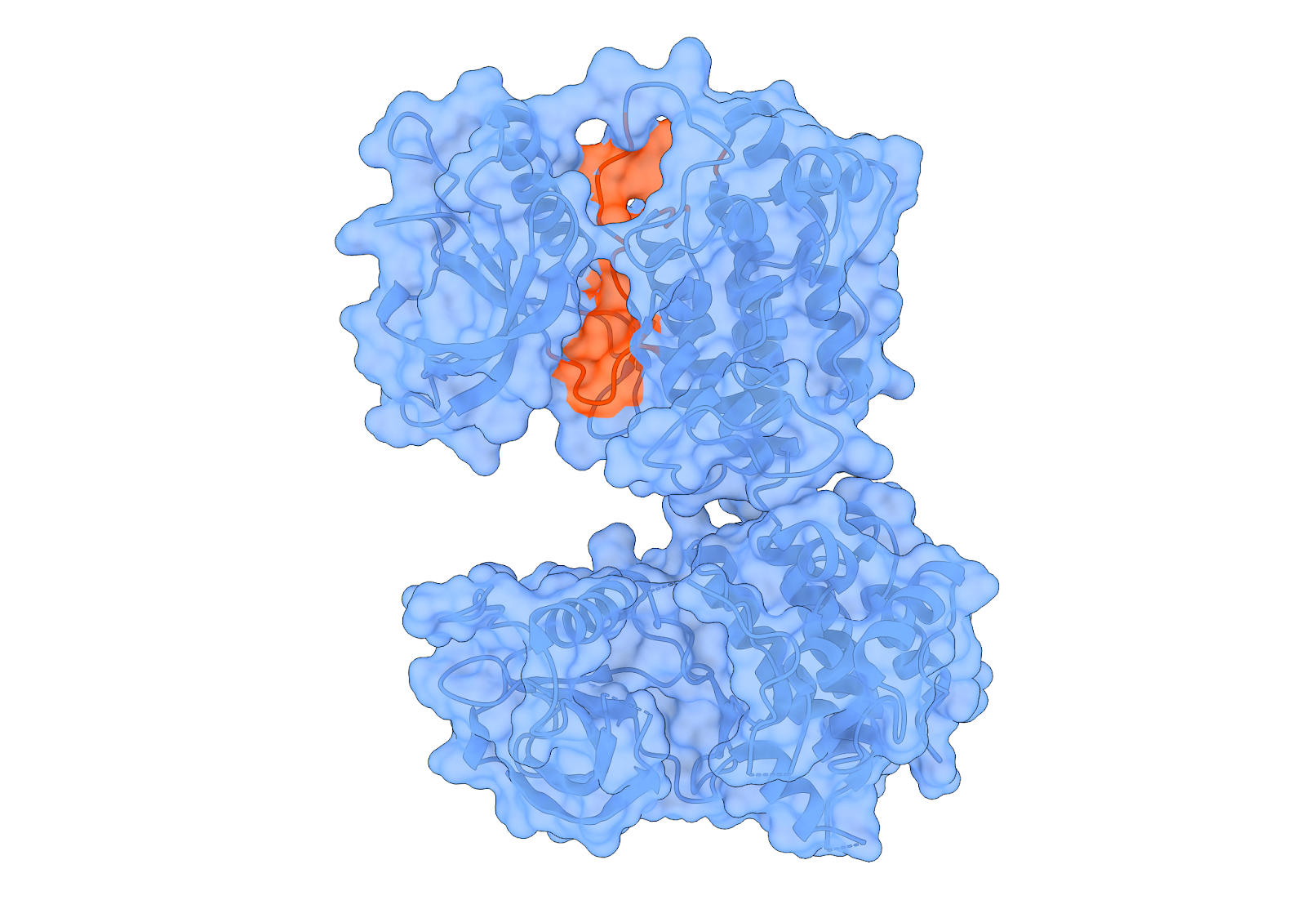
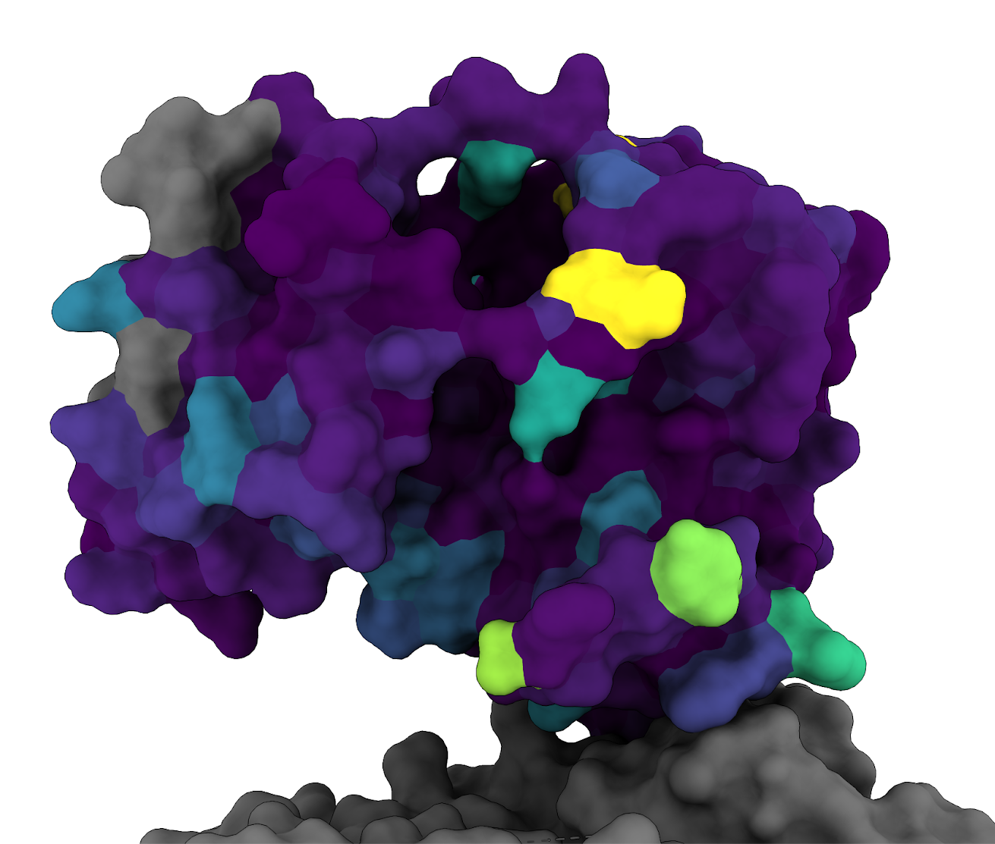
Predicting activating mutations is challenging
Activation depends on dynamic kinase regulation
Homologous positions behave differently across FGFR family members
Many activating mutations occur outside the ATP-binding site
Sparse ground-truth for model training
  <2% of possible FGFR kinase-domain variants have experimental activation data
ATP binding site
Activating mutation examples
Created for CAGI 7
genomeinterpretation.org
Altman

Slide 5
The challenge benchmarks three variant effects
Activation enrichment:
whether the variant leads to functional kinase activation and cell growth
Inactivation probability:
whether the variant is likely to result in loss of kinase function
Resistance and Druggability:
whether the variant mediates resistance or is targetable by Pemigatinib and Futibatinib
Created for CAGI 7
genomeinterpretation.org
Altman

Slide 6
Overview of submissions
9 teams and 32 submissions
Models incorporate kinase biology (ATP-binding pocket, activation loop, cancer hotspots)
Different strategies for representing biology
  Energetics-based models simulate structural state preference
  Representation-learning approaches rely on PLM embeddings to infer constraint
  Multimodal methods combine PLMs + structural 3D encodings
Input data
  Enrichment from experimental assays (not FGFR specific)
  Clinical pathogenicity annotation
  Physics-based rules (unsupervised)
Created for CAGI 7
genomeinterpretation.org
Altman

Slide 7
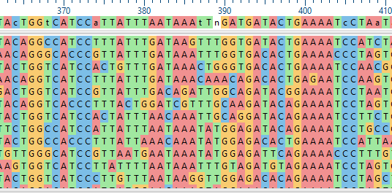
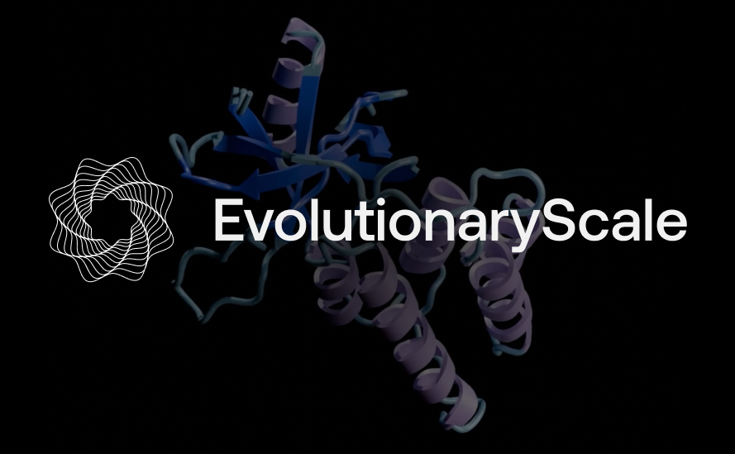


Baseline variant scoring methods
Sequence-based
MSA log-likelihood
ESM 1-v
Structure-based
Distance to Active site
AlphaMissense
Cancer-specific
CHASM/CHASMplus

Slide 8
Task 1: Activation Enrichment Prediction

Slide 9
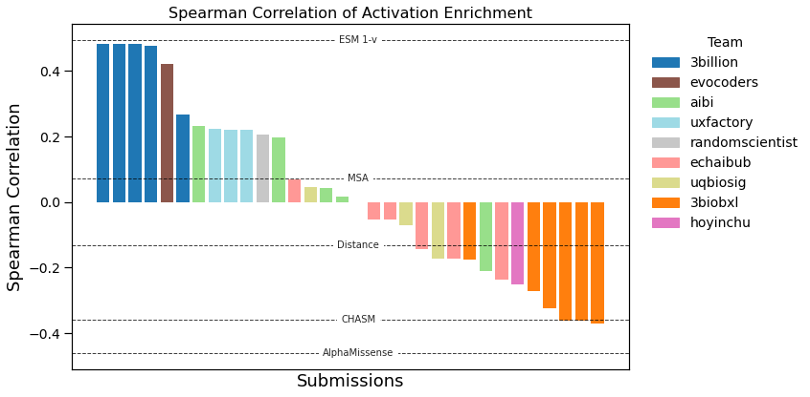
Activation results - Correlation
Correlation performance ceiling : 0.796
Created for CAGI 7
genomeinterpretation.org
Altman

Slide 10
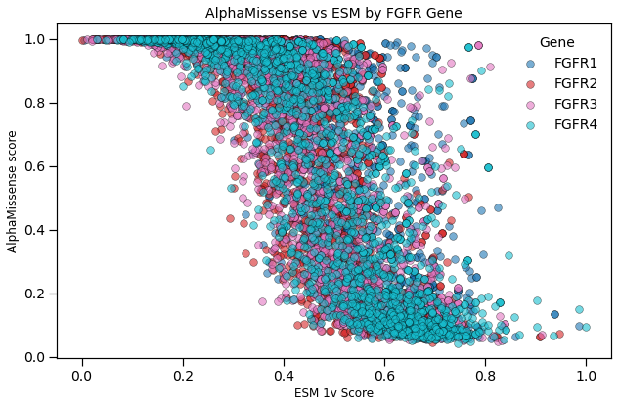
AlphaMissense and ESM-1v are inversely related
Pearson correlation = -0.861
Created for CAGI 7
genomeinterpretation.org
Altman

Slide 11
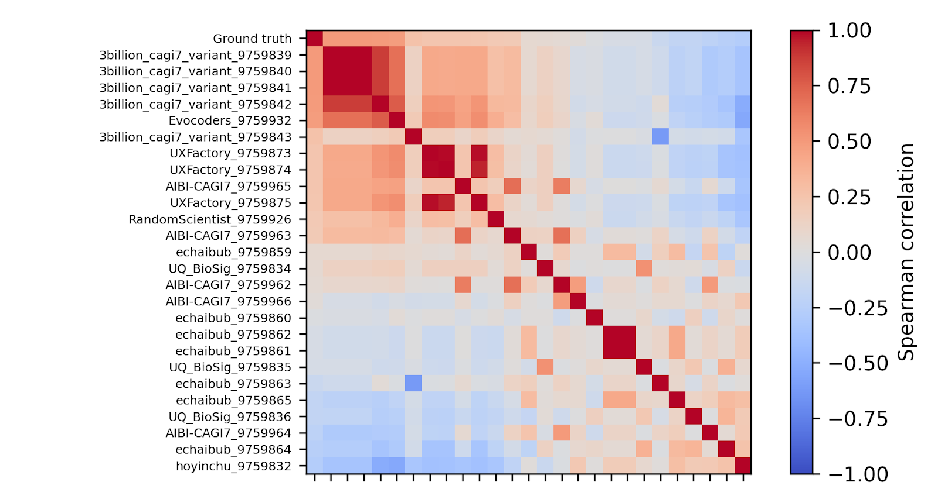
Correlation between predictors
Designed structure features
Generalizability
Supervised learning
PLM + 3D encoders
Latent protein grammar
Learned representations
Created for CAGI 7
genomeinterpretation.org
Altman
Notes:
3billion – focus on out-of-distribution generalizability by
1. Uses structural features (rather than only sequence similarity)
2. Removes highly protein-specific features during training
3. Splits training vs validation at the protein level

Slide 12
Deep learning enabled strong activation predictions
Commonalities among high performers for Activation task*
  Deep learning methods that utilize both structure and sequence information
  Training on MaveDB, ProteinGym, and ClinVar
  Model is explicitly conditioned on both the wild type and mutant forms of the protein
  Attention-based architecture utilizing modern deep learning models (GATs, Mamba)
Commonalities among low performers
  Rule-based methods that take advantage of known structural features in kinase biology
  Energy-based methods for predicting protein stabilization
  Deep learning methods that did not explicitly model the wild type and mutant forms, or did not utilize MaveDB or ProteinGym
*no information from Evocoders, 2nd-highest performer
Created for CAGI 7
genomeinterpretation.org
Altman

Slide 13
Task 2: Inactivation probability prediction

Slide 14
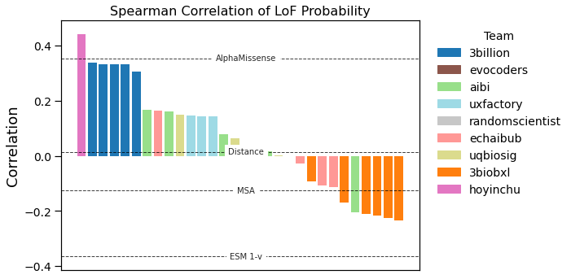
Inactivation probability prediction results
Correlation between binned experimental and predicted probability
Created for CAGI 7
genomeinterpretation.org
Altman

Slide 15
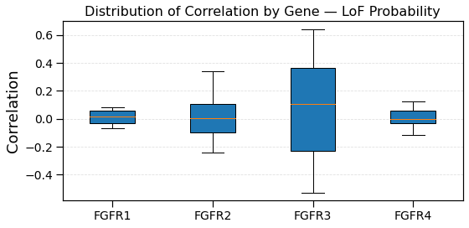
Inactivation correlation varies across gene
Higher variance in correlation to ground truth (across all predictors) for FGFR3
Compared to the other FGFRs, FGFR3 binds a very select group of FGFs, and has many key mutation hotspots
Prediction performance may be highly dependent on correctly predicting inactivation for a few ligands/mutation hotspots
Created for CAGI 7
genomeinterpretation.org
Altman

Slide 16
Task 3: Drug Resistance prediction

Slide 17
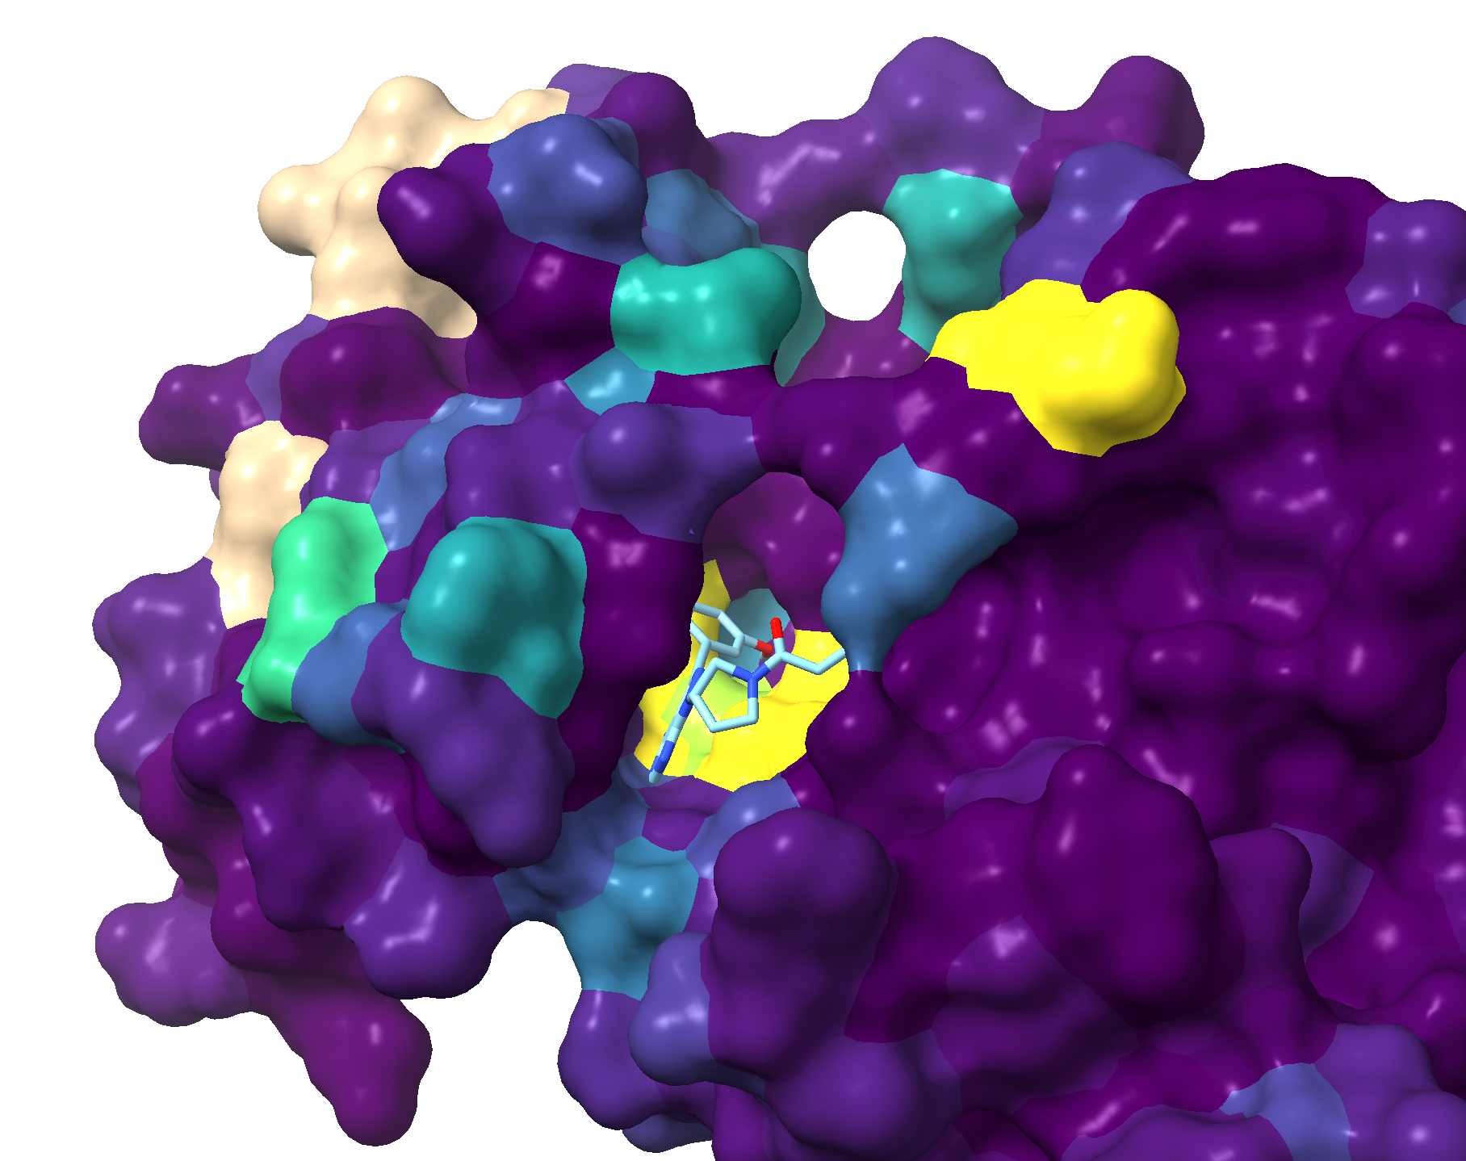
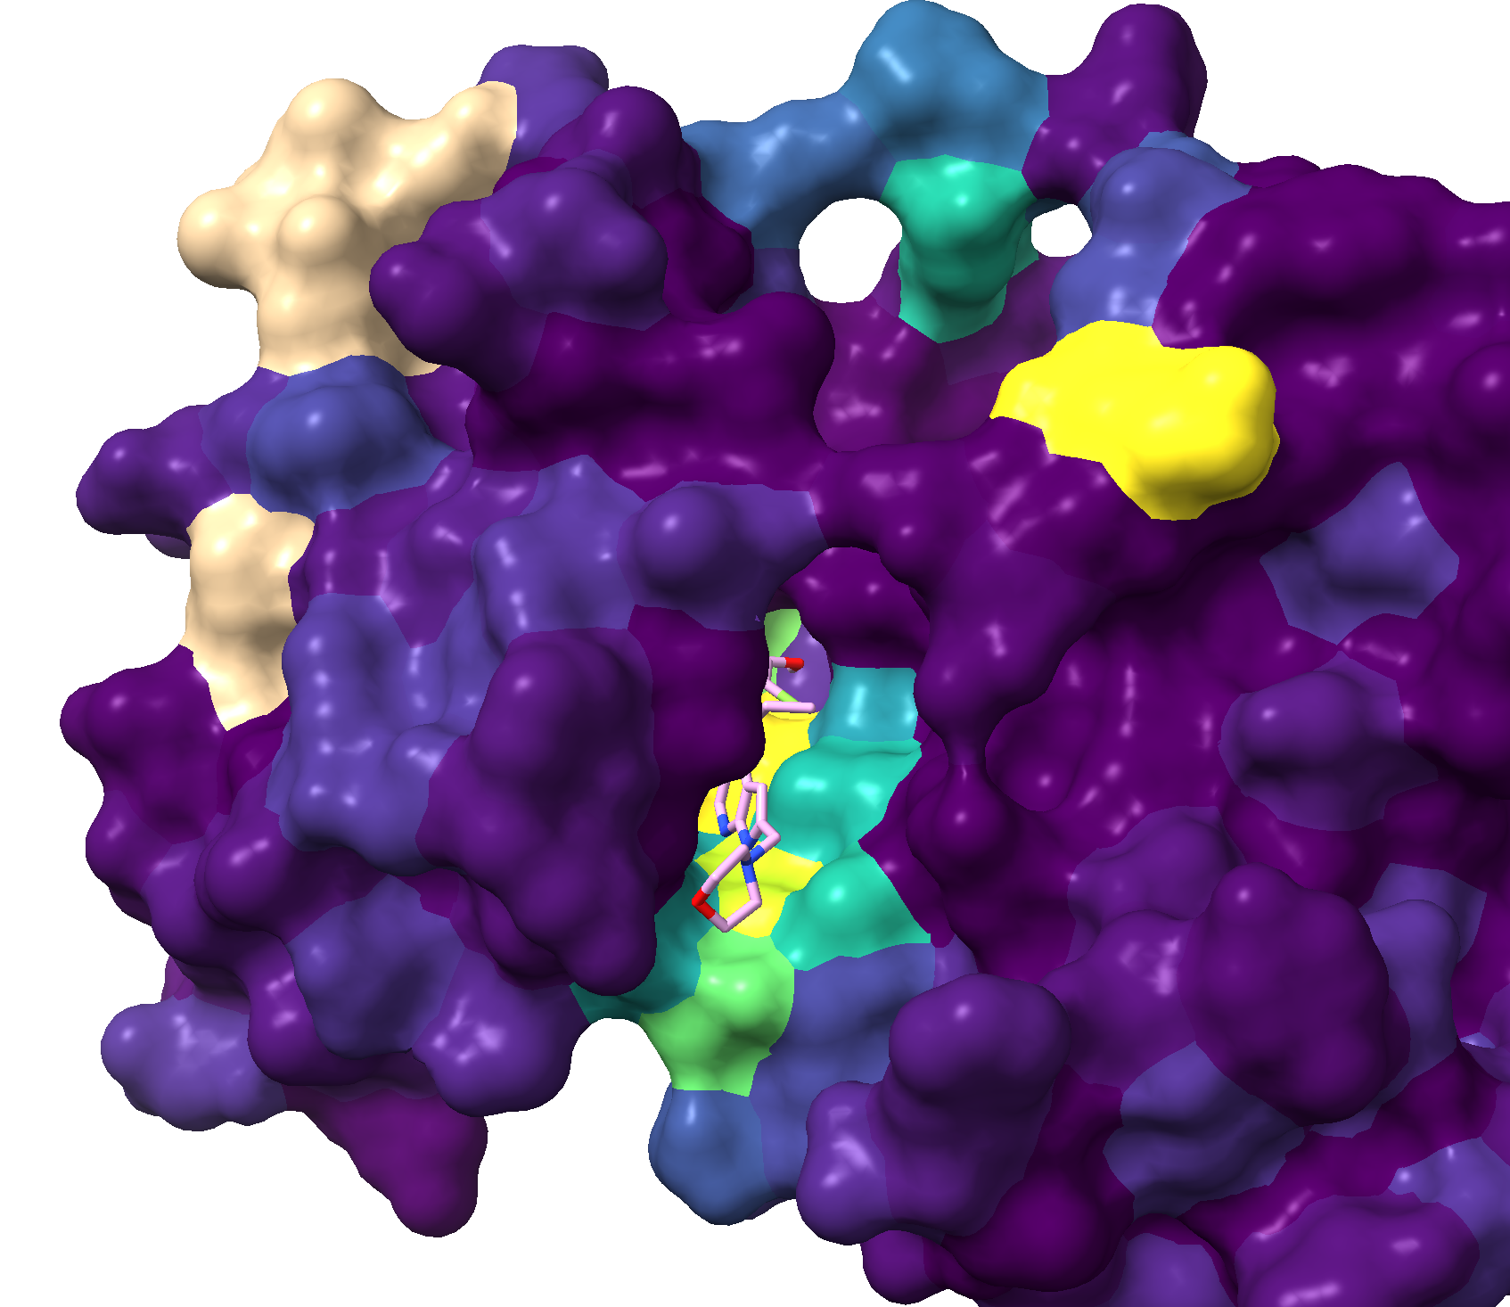
Drug resistance depends on proximity to binding site
Two drugs used in this challenge: futibatinib (Fut) and pemigatinib (Pem)
Many mutations that confer resistance found within the drug binding pocket, but not all
Figures highlight the resistance-conferring mutations (yellow) with the drug overlaid
Fut
Pem
Created for CAGI 7
genomeinterpretation.org
Altman

Slide 18
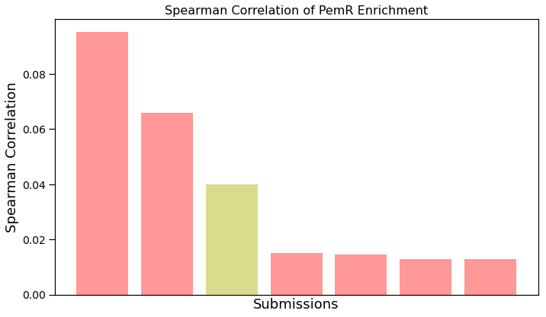
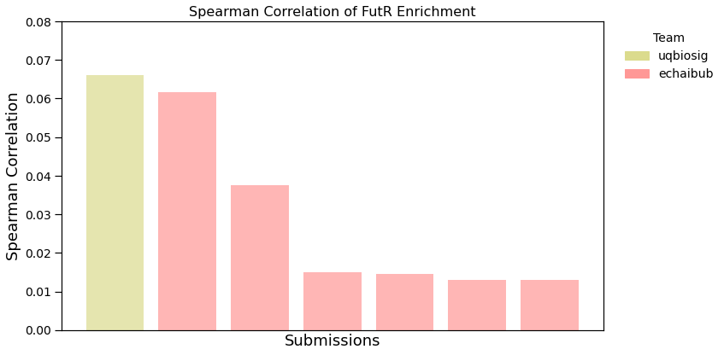
Enrichment for resistance results
Correlation to experimental enrichment values
Pem correlation performance ceiling : 0.939
Fut correlation performance ceiling : 0.890
Created for CAGI 7
genomeinterpretation.org
Altman

Slide 19
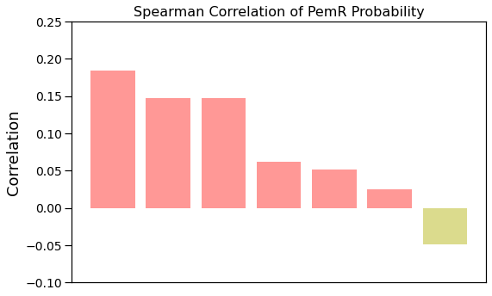
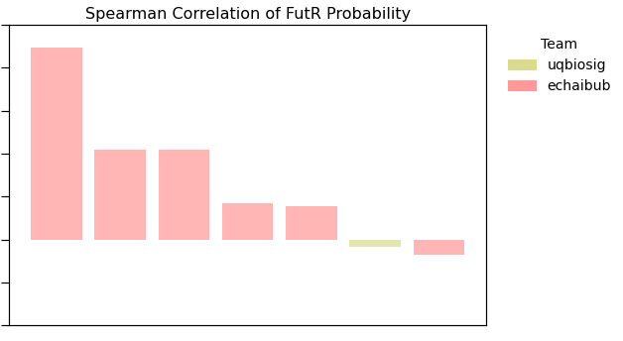
Probability resistance predictions
Correlation to binned categorical values
Created for CAGI 7
genomeinterpretation.org
Altman

Slide 20
Predicting drug resistance remains an open question
Pemigatinib - mutations in molecular brake mechanism confer resistance
  Easier for rule-based method (echaibub) to model
Futibatinib - mutations disrupting covalent binding confer resistance
  Easier for structure-based drug-protein binding method (UQBioSig) to model
Suggestions for future drug resistance predictors
  Combine energetics (binding affinities) and learned features (structure and sequence)
  Use structural context around key motifs
  Use known similar drug interactions to augment training
  Include structure-based pocket modeling (e.g. with docking)
Created for CAGI 7
genomeinterpretation.org
Altman

Slide 21
Suggestions for Future Directions
Integrate Conformational Dynamics Static structures are insufficient. Future models must simulate the energy landscape to identify mutations that lower the activation barrier and destabilize the inactive state ("molecular brake" release).
Leverage Paralogous Training Data Given the sparsity of ground-truth data (<2%), models should utilize evolutionary data across the entire kinase family to learn conserved activation mechanisms while accounting for family-specific divergence.
Hybrid "Physics + AI" Architectures Pure sequence models correlate with function but lack mechanistic insight. Combining evolutionary embeddings (PLMs) with physics-based stability scores can better distinguish benign variants from true pathogenic drivers.
Created for CAGI 7
genomeinterpretation.org
Altman

Slide 22
Thank You
Created for CAGI 7
genomeinterpretation.org

