Slide 1

CAGI 7 slide pack guidelines
I agree to my slides being used according to the following terms:
_______Sven Diederichs_______
To disseminate the CAGI results, I encourage all CAGI participants to remix these CAGI slides for inclusion in their oral and poster presentations
CAGI participants may use or publish any content of these slides only in compliance with the CAGI Data Use Agreement
CAGI participants may not cite or publish any content of these slides except with the written permission of the originating author or in the primary CAGI publications
CAGI participants must acknowledge the original authors of these slides and CAGI 7. Include the acknowledgement banner across the bottom
CAGI participants must include the CAGI credits slide in their presentations
Slides without slash or X may be tweeted, tooted, posted, X’d unless flagged with “No tweet” icon
Slide content of slides with the “No tweet” icon must not be disseminated outside the presenting conference hall in any form or used in any other form = CAGI7 MEETING ONLY

Slide 2
Saturation mutagenesis identifies activating and resistance-inducing FGFR kinase domain mutations
Prof. Dr. Sven Diederichs
University Hospital Freiburg - Head of the Division „Cancer Research“
German Cancer Consortium (DKTK) - Speaker of the Program „Oncogenic Mechanisms“

Slide 3
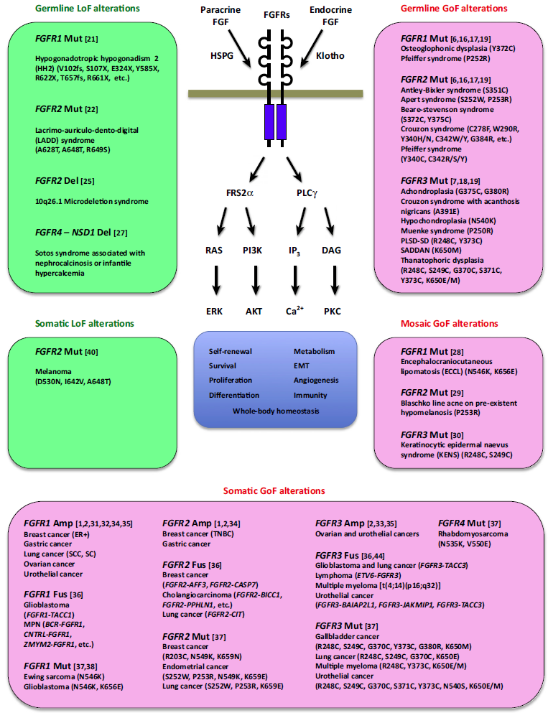
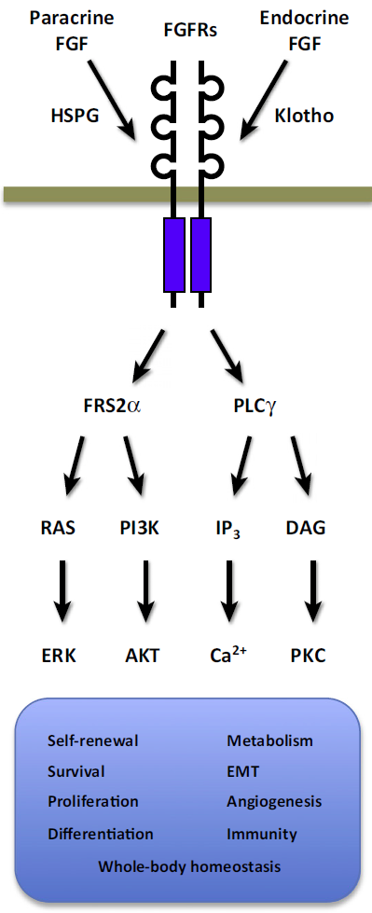
FGFR Pathway
& Diseases
Fibroblast
Growth
Factor
Receptors
Human FGFR1-4
Receptor Tyrosine Kinases
22 FGF Ligands
Governing multiple
downstream pathways
Katoh, Trends Pharmacol Sci 2016

Slide 4
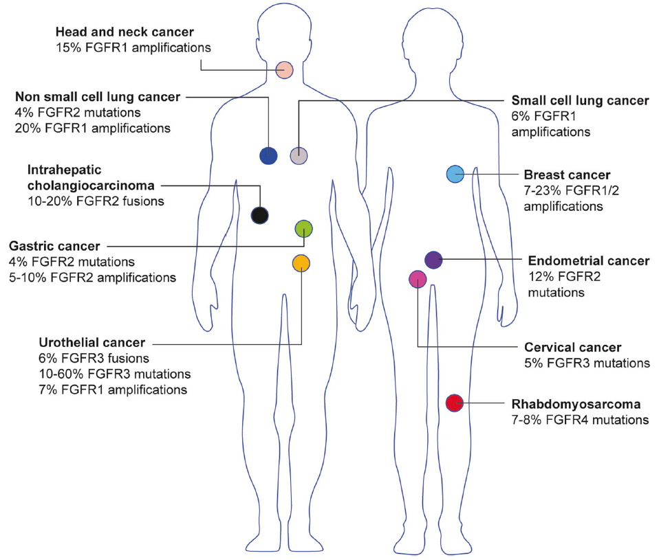
Different FGFR aberrations frequently drive cancer
Fibroblast Growth Factor Receptors
aberrant activation:
  single nucleotide variants (SNVs)
  gene fusions (translocations)
  amplifications
  indels
in ca. 8% of all human cancers
Krook et al., Br J Cancer 124, 880–892 (2021)

Slide 5
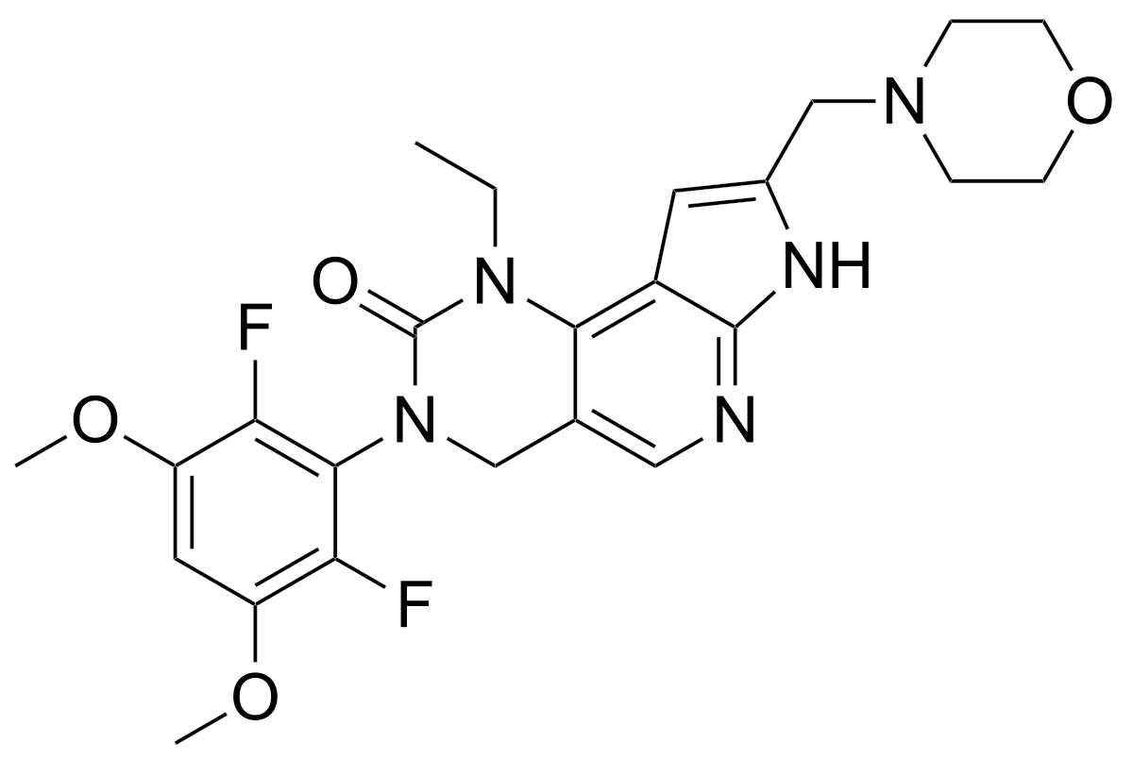
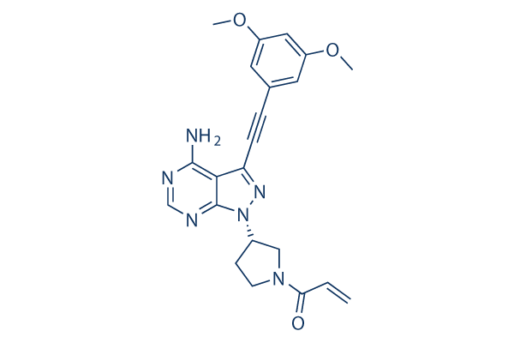
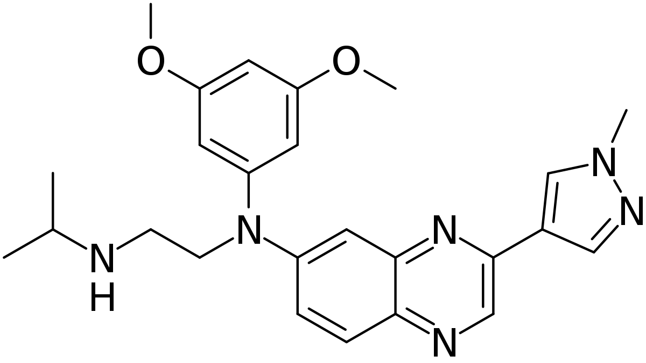
FDA-/EMA-approved FGFR inhibitors
Erdafitinib
(JNJ-42756493)
Pemigatinib
(INCB054828)
Futibatinib
(TAS-120)
Approved for:
Advanced or metastatic urothelial carcinoma with FGFR2 / FGFR3 genetic alterations
Approved for:
Locally advanced or metastatic cholangiocarcinoma with FGFR2 gene fusion or rearrangement
Approved for:
Advanced solid tumors with FGFR1-4 genetic aberrations, including cholangiocarcinoma

Slide 6
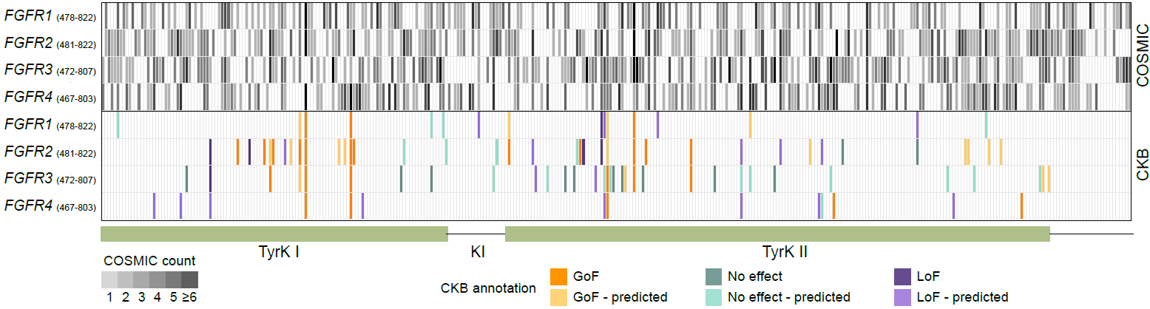
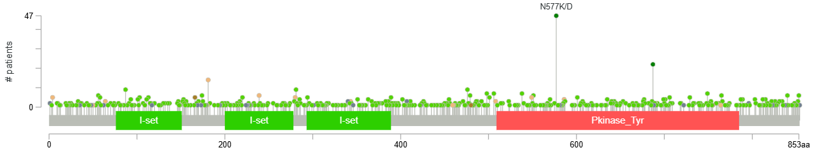
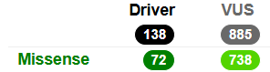
FGFR mutations frequently occur across the gene, but only very few mutations are annotated
FGFR1
cBioPortal
95474 tumor samples
Tangermann C et al., Nat Genet (2025) in press

Slide 7
Saturation Mutagenesis to functionally annotate
all FGFR mutations frequently occurring across the gene
Variants of Uncertain Significance (VUS)
  Functional relevance unknown (driver / passenger)
  Major challenge for targeted therapy decisions
  Mutations cannot be exploited for clinical decisions
  Saturation Mutational Scanning Approach
    Generation of every possible point mutation (SNVs): 29259 mutations in FGFR1-4
    Comprehensive catalog for activation & drug resistance
    Characterization of mutations before they are found in a patient
    Expand spectrum of mutations interpretable for therapy decision

Slide 8
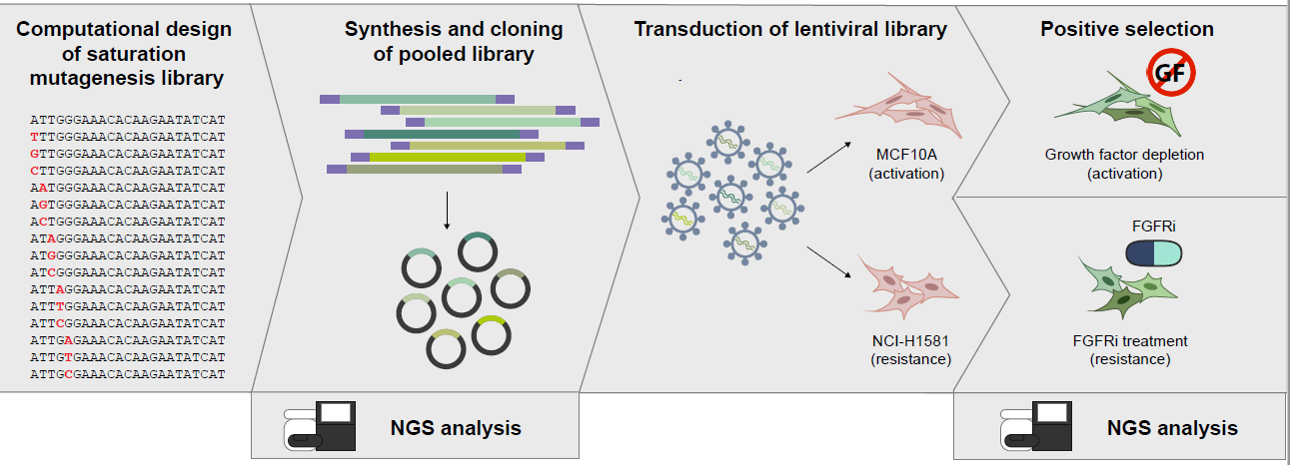
Saturation Mutational Scanning:
Approach
Covering all 29259 possible point mutations (SNVs) of FGFR1 - FGFR4

Slide 9
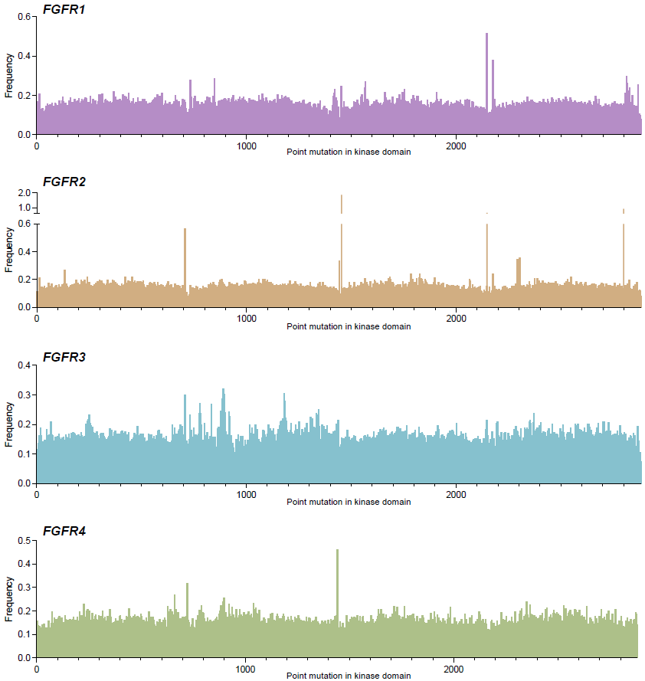
Homogeneity of the pooled libraries
FGFR1-4 kinase domains
11520 mutations
Tangermann C et al., Nat Genet (2025) in press

Slide 10
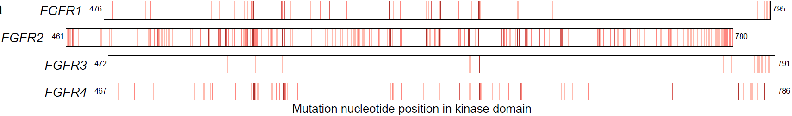
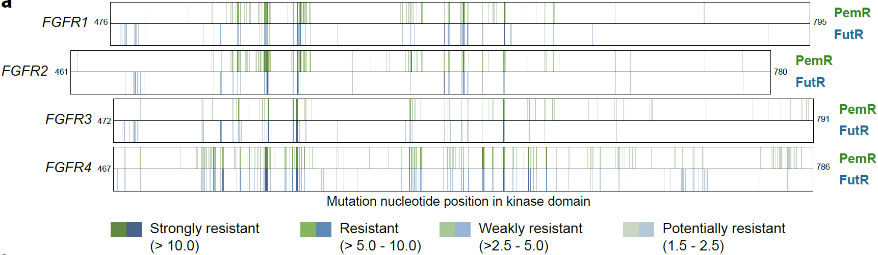
Homogeneity of the pooled libraries
Activation / Pemigatinib (PemR) & Futibatinib Resistance (FutR)
median enrichment
median enrichment
FGFR1-4 kinase domains (11520 mutations)
Tangermann C et al., Nat Genet (2025) in press

Slide 11
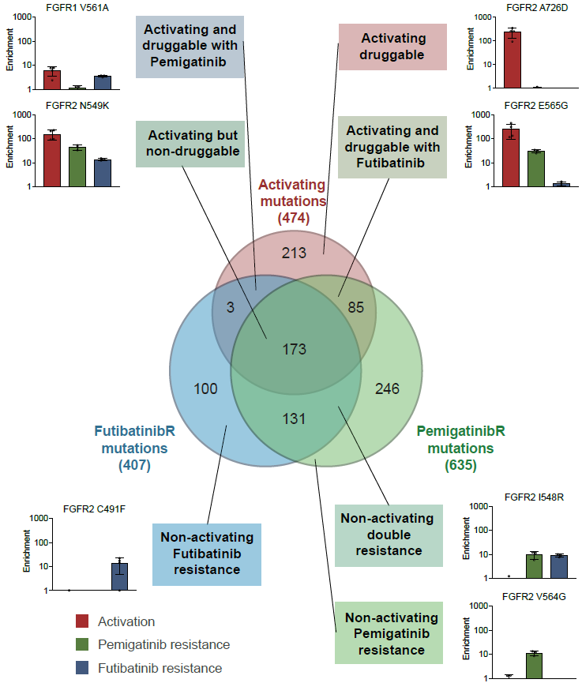
Saturation Mutational Scanning:
Hundreds of new activating & resistance mutations
Screening results
for 11520 mutations covering the kinase domains of
FGFR1 - FGFR4
Tangermann C et al., Nat Genet (2025) in press

Slide 12
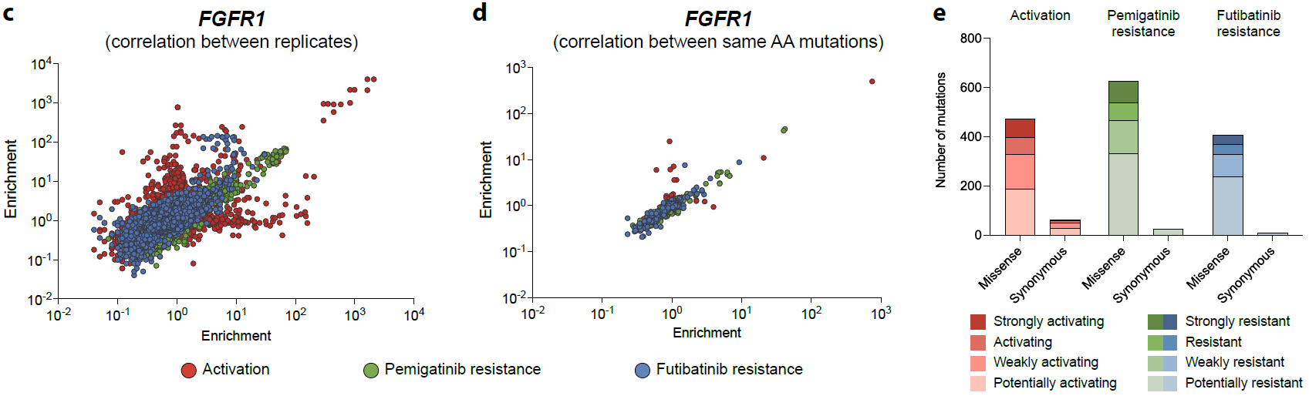
Saturation Mutational Scanning:
Controls
Correlation
Replicates
Correlation
same AA Changes
Enrichment of
Missense over
Synonymous Mutations
Tangermann C et al., Nat Genet (2025) in press

Slide 13
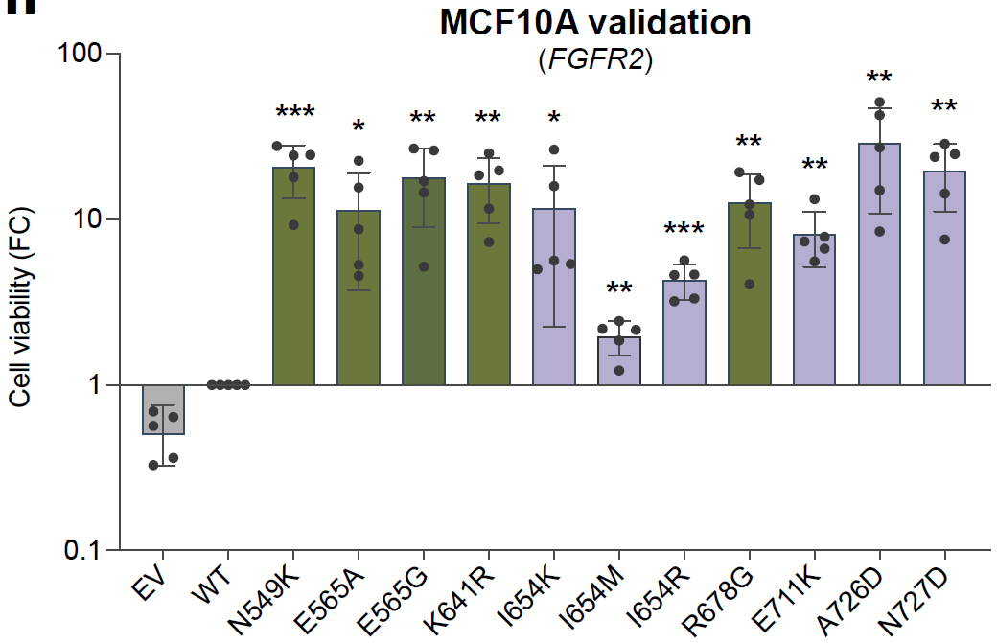
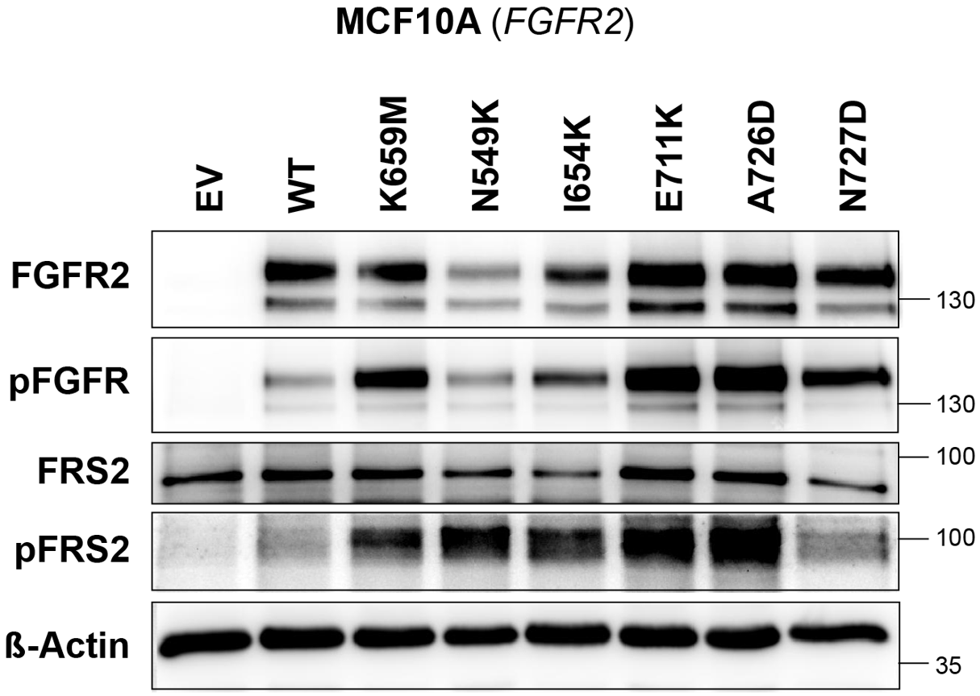
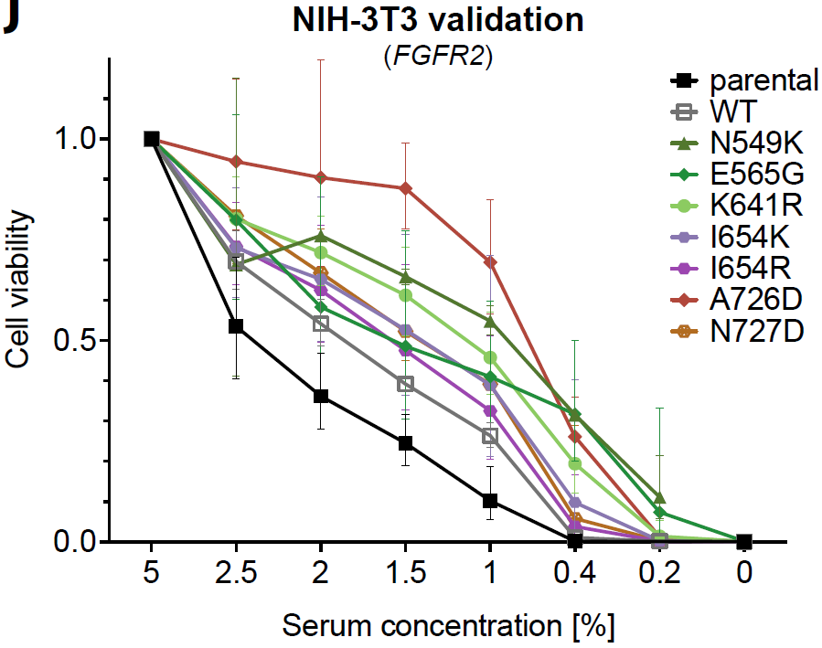
Saturation Mutational Scanning:
Validation
kDa
Validation of activating mutations in MCF10A and NIH-3T3 cells
NIH-3T3:
Martin Ziegler, Sonja Loges
Tangermann C et al., Nat Genet (2025) in press

Slide 14
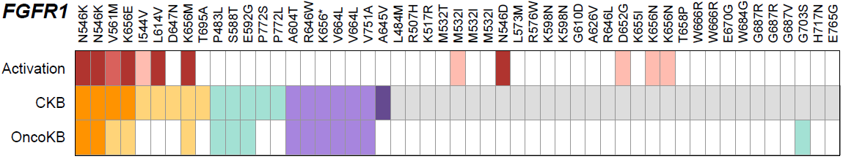
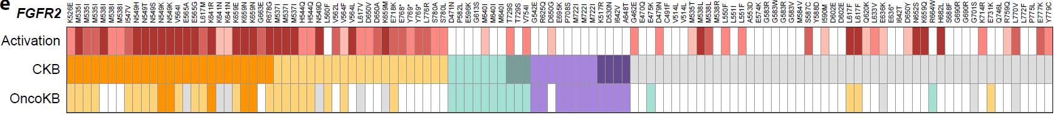
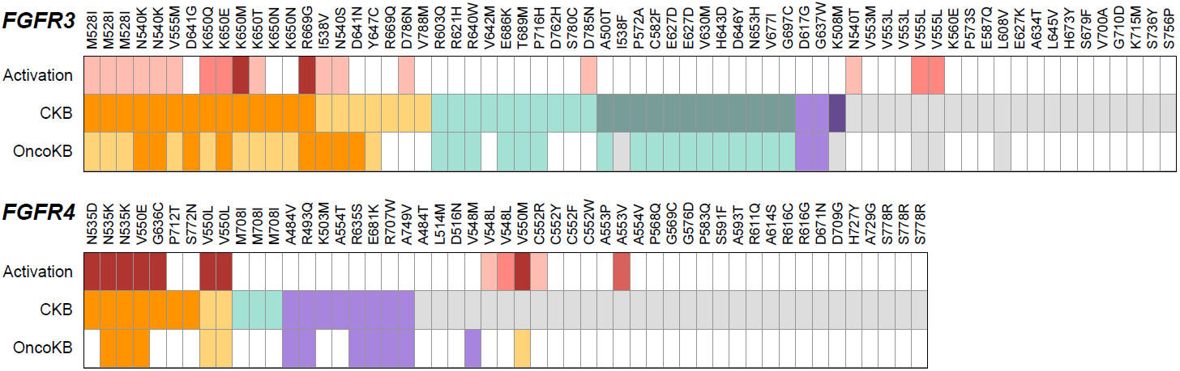
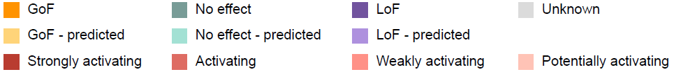
Comparison to Clinical Knowledgebase (CKB) with almost all GoF mutations identified in screens
CKB:
Screen:
Tangermann C et al., Nat Genet (2025) in press

Slide 15
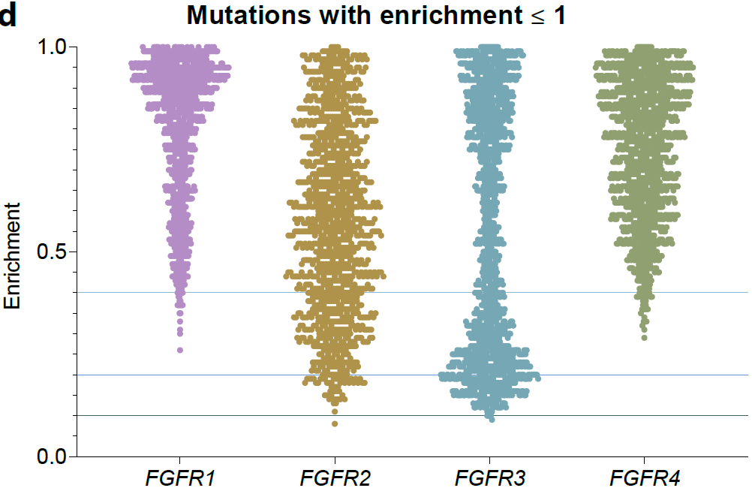
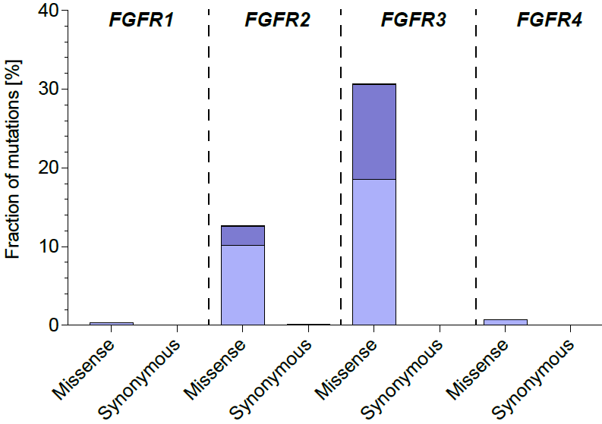
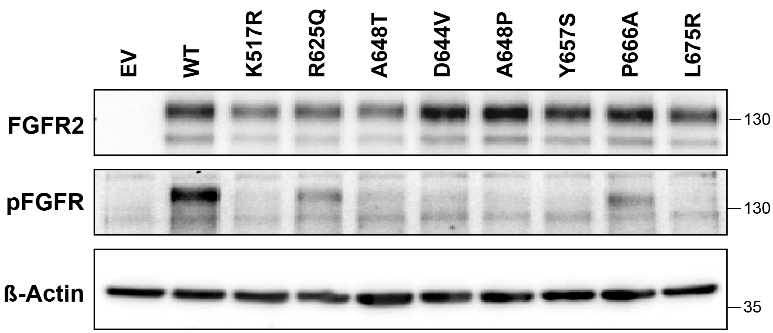
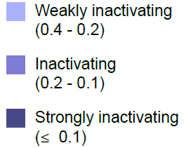
Saturation Mutational Scanning:
Loss-of-Function (LoF) Mutations
kDa
Tangermann C et al., Nat Genet (2025) in press

Slide 16
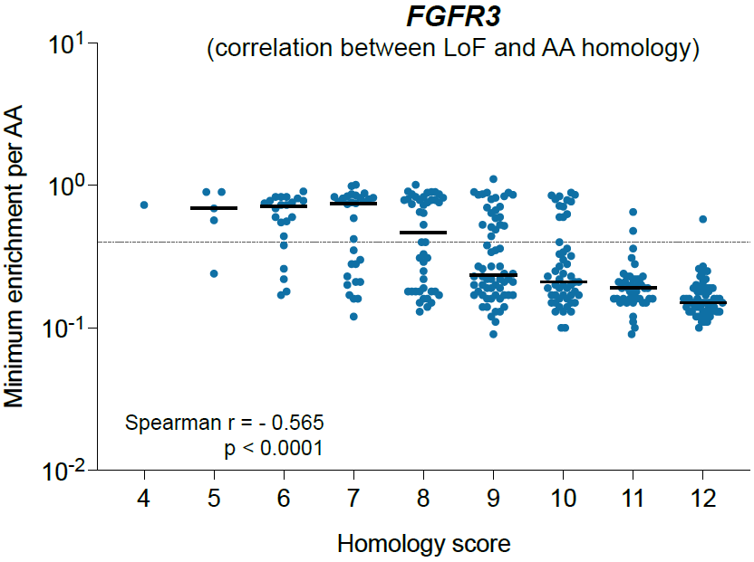
Amino acids conserved among 12 RTKs are enriched in stronger LoF mutations
Tangermann C et al., Nat Genet (2025) in press

Slide 17
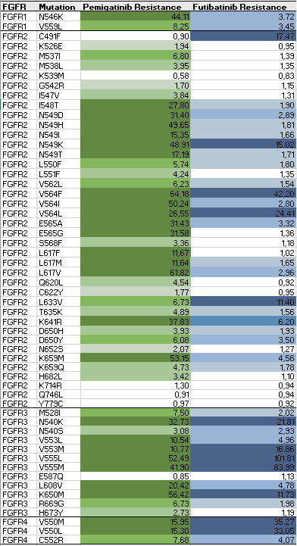
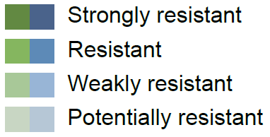
Comparison to all 21 published Clinical Studies
56 mutations found in
138 patients
upon acquired FGFRi resistance
in all 21 published clinical studies:
Patients: resistance mutations identified in 137 of 138 patients (99.3%)
Mutations: 51 of 52 mutations resistant to Pemigatinib / Futibatinib (98%)
minus 4 mutations only found once in patients with multiple resistance mutations
Study Data:
Francesco Facchinetti, Luc Friboulet & Yohann Loriot - Gustave Roussy
Tangermann C et al.,
Nat Genet (2025) in press

Slide 18
Summary: Saturation Mutagenesis of FGFR
  Saturation Mutational Scanning Approach
    Generation of every possible point mutation
    Comprehensive catalog for drug sensitivity & resistance
    Characterization of mutations before they are found in a patient
    Expand spectrum of mutations considered for therapy decision
  Saturation Mutagenesis of FGFR Family
      Screening 29259 mutations covering FGFR1-4
      Hundreds of novel activation and resistance mutations identified in FGFR1-4 kinase domains - with strong PS3/BS3 evidence level according to ACMG
      Validation of 70+ individual mutations in two different cell models
      Mapping of mutations to structural elements
      Specific loss-of-function (LoF) mutations also identified
      Hydrophobicity of the change correlates with GoF or LoF impact
      Correlation of FGFR3 GoF & LoF mutations to body height (skeletal dysplasias)
Tangermann C et al., Nat Genet (2025) in press

Slide 19







Acknowledgements
Cancer Research
Luka Bacic
Anton Barth
Johanna Blietz
Öykü Carus Sahin
Luisa Köttgen
Annika Metzner
Julie Pfeil
Marisa Riester
Paul Scholz
Idil Su Canitez
Carla Tangermann
Alumni
Sonam Dhamija
Avantika Ghosh
Jagriti Pal
Jannis Stappenbeck
Luise Viardot
Chul Min Yang
Collaborators
BioMarin:
Naomi Ziv
Daniel Gaffney
Chris Bauer
University of Freiburg:
Heiko Becker
Melanie Börries
Athina Ganner
Ian Frew
Tilman Brummer
Oliver Schilling
Lighthouse Core
Rolf Backofen
University of Göttingen:
Lena Illert
TU Munich:
Bernhard Küster
Institut Gustave Roussy:
Yohann Loriot
Francesco Facchinetti
Luc Friboulet
DKFZ Heidelberg:
Sonja Loges
Disclosure: Coowner of
sven.diederichs@uniklinik-freiburg.de
s.diederichs@dkfz.de

Slide 20
Summary: Saturation Mutagenesis of FGFR
  Saturation Mutational Scanning Approach
    Generation of every possible point mutation
    Comprehensive catalog for drug sensitivity & resistance
    Characterization of mutations before they are found in a patient
    Expand spectrum of mutations considered for therapy decision
  Saturation Mutagenesis of FGFR Family
      Screening 29259 mutations covering FGFR1-4
      Hundreds of novel activation and resistance mutations identified in FGFR1-4 kinase domains - with strong PS3/BS3 evidence level according to ACMG
      Validation of 70+ individual mutations in two different cell models
      Mapping of mutations to structural elements
      Specific loss-of-function (LoF) mutations also identified
      Hydrophobicity of the change correlates with GoF or LoF impact
      Correlation of FGFR3 GoF & LoF mutations to body height (skeletal dysplasias)
Tangermann C et al., Nat Genet (2025) in press

Slide 22
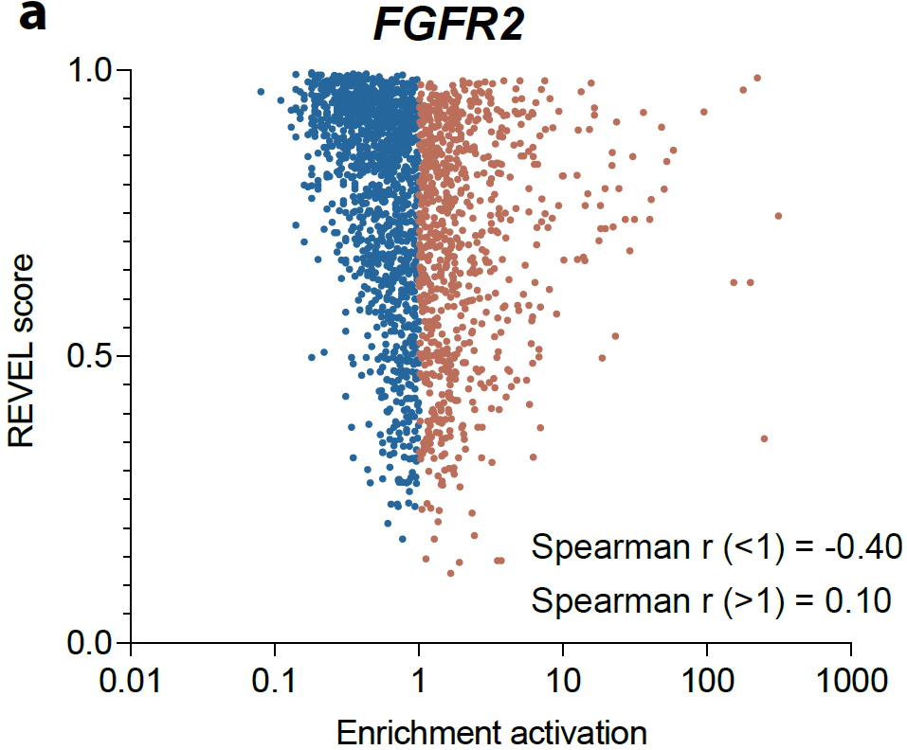
Saturation Mutational Scanning:
Poor Correlation to Prediction Tools for GoF Mutations
= LoF
= GoF
Tangermann C et al., Nat Genet (2025) in press

Slide 23
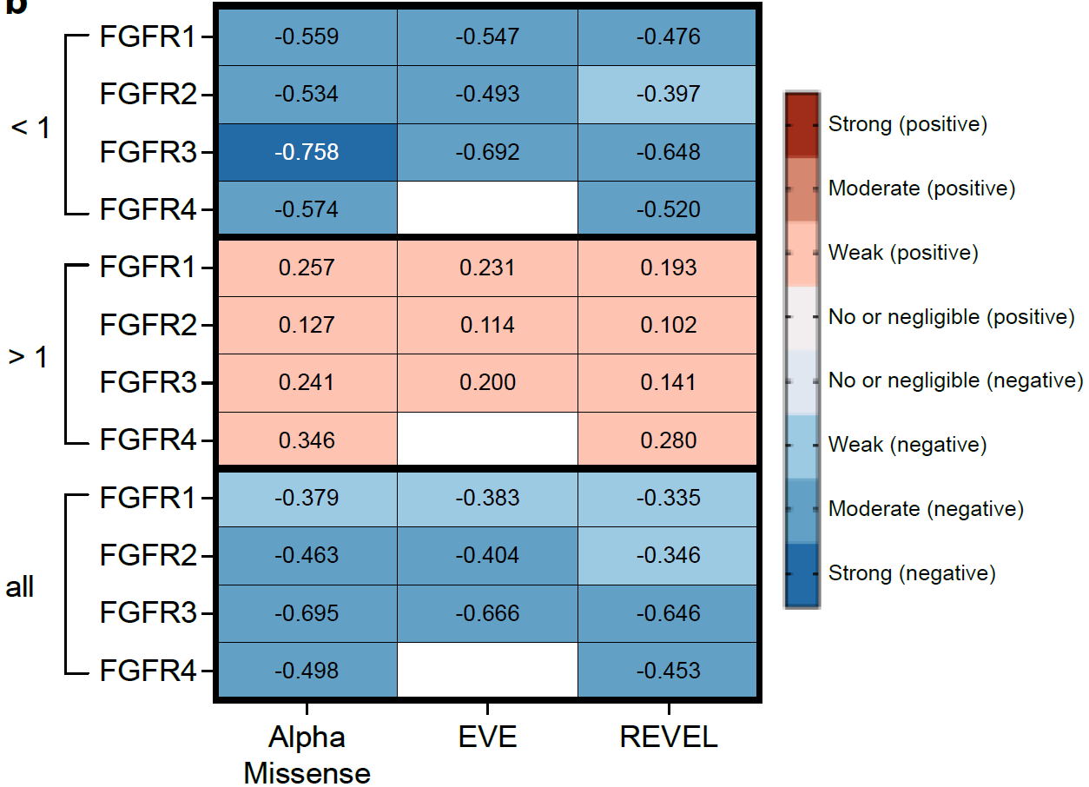
Saturation Mutational Scanning:
Poor Correlation to Prediction Tools for GoF Mutations
= LoF
Screen: Median Enrichments
= GoF
Tangermann C et al., Nat Genet (2025) in press

