Slide 1

CAGI 7 slide pack guidelines
I agree to my slides being used according to the following terms:
_______Mustafa TEKPINAR_______
Authors: please include THIS slide at the beginning of your presentation to indicate that you agree with reuse of your slides in CAGI presentations, according to the terms below, and digitally sign by writing your name above.
At CAGI 7, use of this slide pack is only required for CAGI dataset providers, assessors, and predictors, but all are encouraged to use the annotations for materials they do not want shared publicly.
To disseminate the CAGI results, I encourage all CAGI participants to remix these CAGI slides for inclusion in their oral and poster presentations
CAGI participants may use or publish any content of these slides only in compliance with the CAGI Data Use Agreement
CAGI participants may not cite or publish any content of these slides except with the written permission of the originating author or in the primary CAGI publications
CAGI participants must acknowledge the original authors of these slides and CAGI 7. Include the acknowledgement banner across the bottom
CAGI participants must include the CAGI credits slide in their presentations
Slides with a red slash (no remix) may not be included in a presentation unless all attendees are registered CAGI participants who signed the data use agreement
Slides with a red X over the entire slide may not be used in any circumstances
Slides with a blue slash (embargoed) may not be used unless the embargo is explicitly lifted
Slides without slash or X may be tweeted, tooted, posted, X’d unless flagged with “No tweet” icon
CAGI participants using these slides must explain the “No tweet” icon, which means that the slide content should not be disseminated outside the presenting conference hall. If the presentation venue permits pervasive tweeting, you may not include these slides in your talk
Note for slide authors: we expect all CAGI participants to abide by these restrictions, and will make best effort to ensure they are followed. However, but bear in mind that we have limited means of enforcing them, and therefore the restrictions cannot be guaranteed.

Slide 2
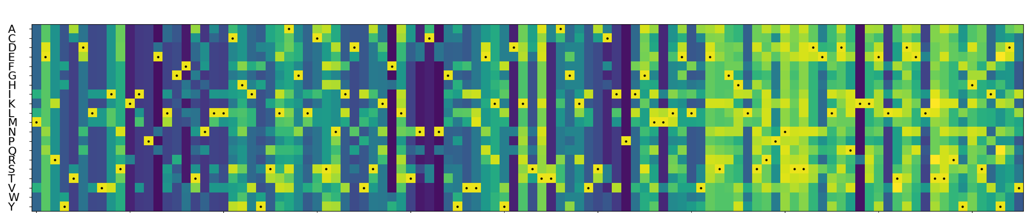
APE: A Straightforward Ensemble Approach for Improving Missense Mutational Effect Predictions
Mustafa TEKPINAR
Van Yuzuncu Yil University
Department of Physics
Van, Türkiye
CAGI7 Challenge
December 6, 2025
Notes:
Introduce the motivation, highlight importance of missense variant interpretation.

Slide 3
Motivation
Introduction
Missense variants heavily influence risk and progression of many diseases, including cancer.
Predictors show variable accuracy across protein contexts
Clinical interpretation still limited by high VUS rates
Cancer genes were widely used in training supervised methods
Created for CAGI 7
genomeinterpretation.org
MT
Notes:
Emphasize clinical burden of uncertain variants.

Slide 4
Three State‑of‑the‑Art Unsupervised Predictors
Methods
AlphaMissense — deep learning + AlphaFold structural context
PRESCOTT — population-aware, epistatic, structural modeling
ESM1b — protein language model with evolutionary signals
AlphaMissense: Cheng, J., Novati, G., Pan, J., Bycroft, C., Zemgulyte, A., Applebaum, T., . . . Avsec, Z. (2023). Accurate proteome-wide missense variant effect prediction with AlphaMissense. Science, 381(6664), eadg7492. doi:10.1126/science.adg7492
PRESCOTT: Tekpinar, M., David, L., Henry, T. et al. PRESCOTT: a population aware, epistatic, and structural model accurately predicts missense effects. Genome Biol 26, 113 (2025). https://doi.org/10.1186/s13059-025-03581-y
ESM1b: Brandes, N., Goldman, G., Wang, C. H., Ye, C. J., & Ntranos, V. (2023). Genome-wide prediction of disease variant effects with a deep protein language model. Nat Genet. doi:10.1038/s41588-023-01465-0
Created for CAGI 7
genomeinterpretation.org
MT
Notes:
Explain why unsupervised models avoid cancer‑dataset training bias.

Slide 5

PRESCOTT
Methods
PRESCOTT: population-aware, epistatic, structural model
  ESCOTT: epistatic, structural modeling
  PRESCOTT: (Allele Frequency) + ESCOTT
Major advantages:
  Better prediction of pathogenic gain-of-function mutations
  Better separation of benign variants from the pathogenic ones.
PRESCOTT: Tekpinar, M., David, L., Henry, T. Carbone, A. PRESCOTT: a population aware, epistatic, and structural model accurately predicts missense effects. Genome Biol 26, 113 (2025). https://doi.org/10.1186/s13059-025-03581-y
Created for CAGI 7
genomeinterpretation.org
MT
Notes:
Explain why unsupervised models avoid cancer‑dataset training bias.

Slide 6
Introducing the APE Score
Methods
Linear ensemble of AlphaMissense + PRESCOTT + ESM1b
All components have equal weights (w₁ = w₂ = w₁ =0.33)
Scores normalized to 0 (low)–1(high) pathogenicity scale
Goal: improve prediction quality with a straightforward ensemble approach
$$APE Score=w1∗AlphaMissense+w2∗PRESCOTT+{w3∗ESM1b}_{\left(1−minmax\right)}$$
Created for CAGI 7
genomeinterpretation.org
MT
Notes:
This is the central concept—emphasize simplicity and power.

Slide 7
Datasets
Materials
24 oncoproteins: 1068 labeled clinical variants
5 oncoproteins with 9 deep mutational scanning (DMS) experiments
Additional 20 DMS experiments from non-oncogenic human proteins for an extended comparisons
Created for CAGI 7
genomeinterpretation.org
MT
Notes:
Briefly describe why DMS is ideal for ground‑truth benchmarking.

Slide 8
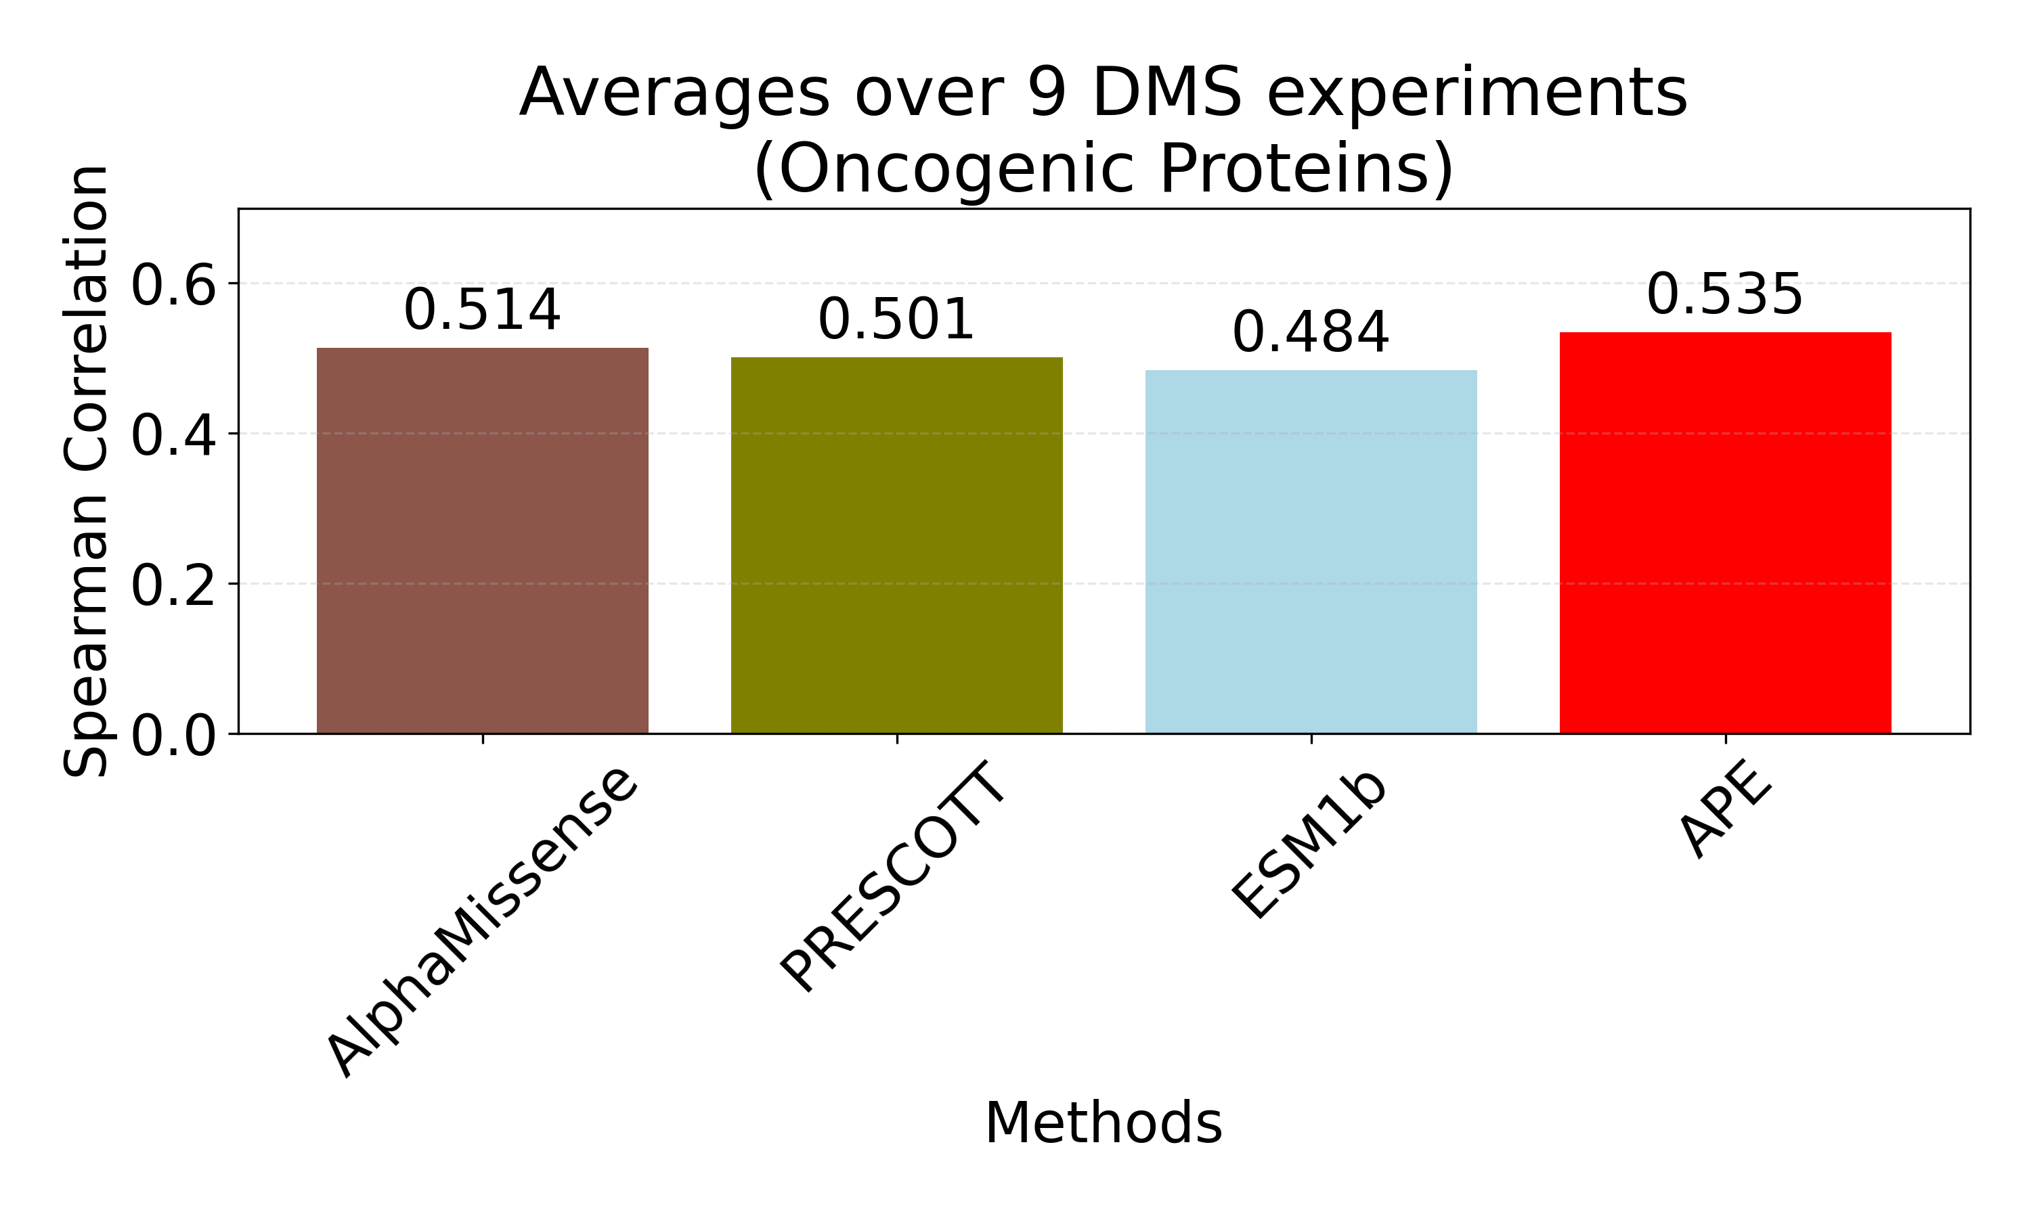
Performance on Deep Mutational Scanning
Results
Created for CAGI 7
genomeinterpretation.org
MT
Notes:
Highlight that robustness is often more important than peak accuracy.

Slide 9
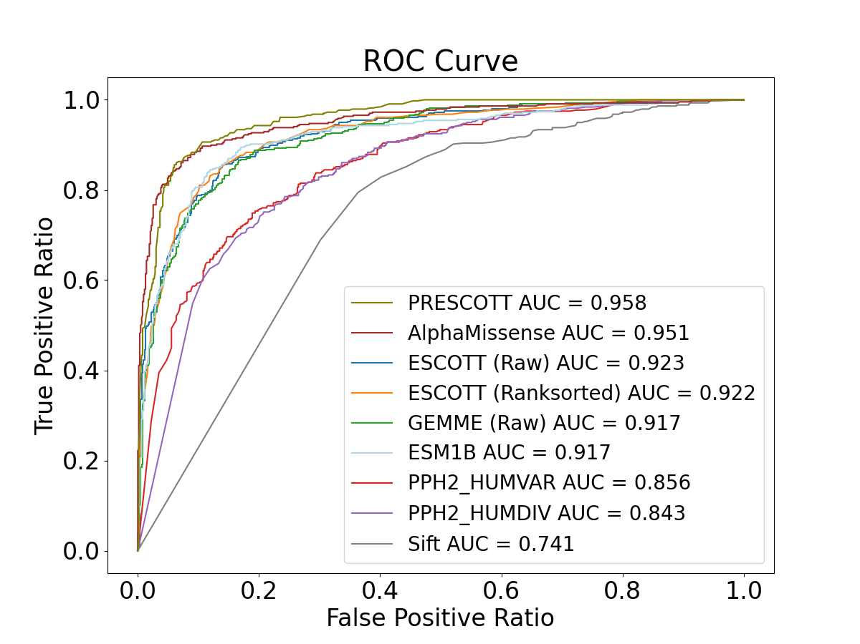
Binary Classification (Clinical Labels)
Results
APE achieves
  AUC=0.968
  AUC‑PR=0.962
Surpasses each component and all pairwise combinations
Most consistent performer across datasets
Created for CAGI 7
genomeinterpretation.org
MT
Notes:
Stress the importance of AUC‑PR in imbalanced datasets.

Slide 10
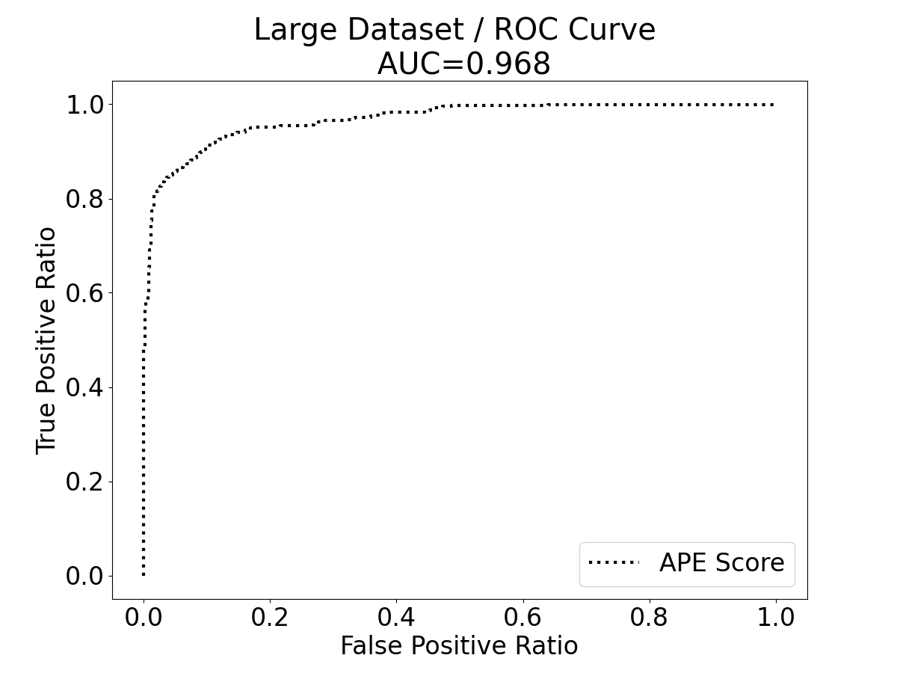
Binary Classification (Clinical Labels)
Results
APE achieves
  AUC=0.968
  AUC‑PR=0.962
Surpasses each component and all pairwise combinations
Most consistent performer across datasets
Created for CAGI 7
genomeinterpretation.org
MT
Notes:
Stress the importance of AUC‑PR in imbalanced datasets.

Slide 11
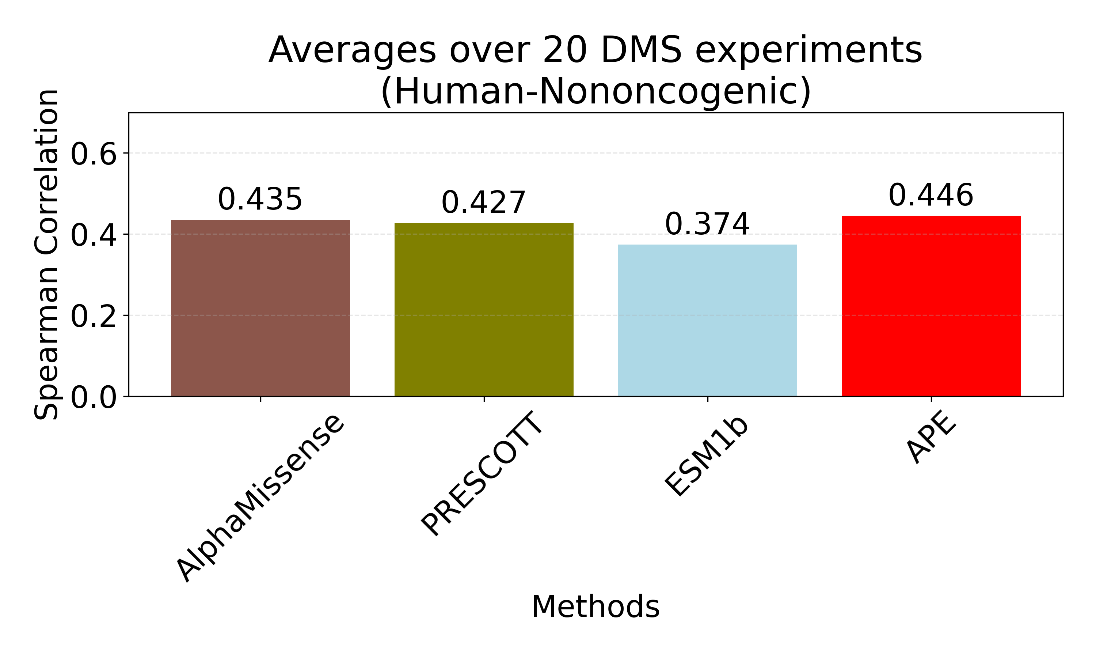
ProteinGym – 20 DMS Experiments
Results
ProteinGym: Notin, P., Kollasch, A. W., Ritter, D., van Niekerk, L., Paul, S., Spinner, H., . . . Marks, D. S. (2023). ProteinGym: Large-Scale Benchmarks for Protein Design and Fitness Prediction. bioRxiv, 2023.2012.2007.570727. doi:10.1101/2023.12.07.570727
Created for CAGI 7
genomeinterpretation.org
MT
Notes:
Thresholds determined via precision‑recall intersection.

Slide 12

Conclusions
Conclusions
APE improves accuracy both in DMS experiments and binary classifications
  PRESCOTT contributes significantly to the improvements in the ensemble.
Unsupervised ensemble avoids training bias
APE has the to potential to be used for large‑scale human variant investigations
APE: Tekpinar, A. D., & Tekpinar, M. (2025). A Collaborative Approach to Improving Missense Mutational Effect Predictions in Oncoproteins. medRxiv, 2025.2005.2015.25327738. doi:10.1101/2025.05.15.25327738
Created for CAGI 7
genomeinterpretation.org
MT
Notes:
Close with potential future applications.

Slide 13



Acknowledgement
Acknowledgement
Alessandra Carbone
Sorbonne Université
Paris, France.
Ayten Dizkirici Tekpinar
Van YYU
Van, Türkiye.
Created for CAGI 7
genomeinterpretation.org
MT

Slide 14
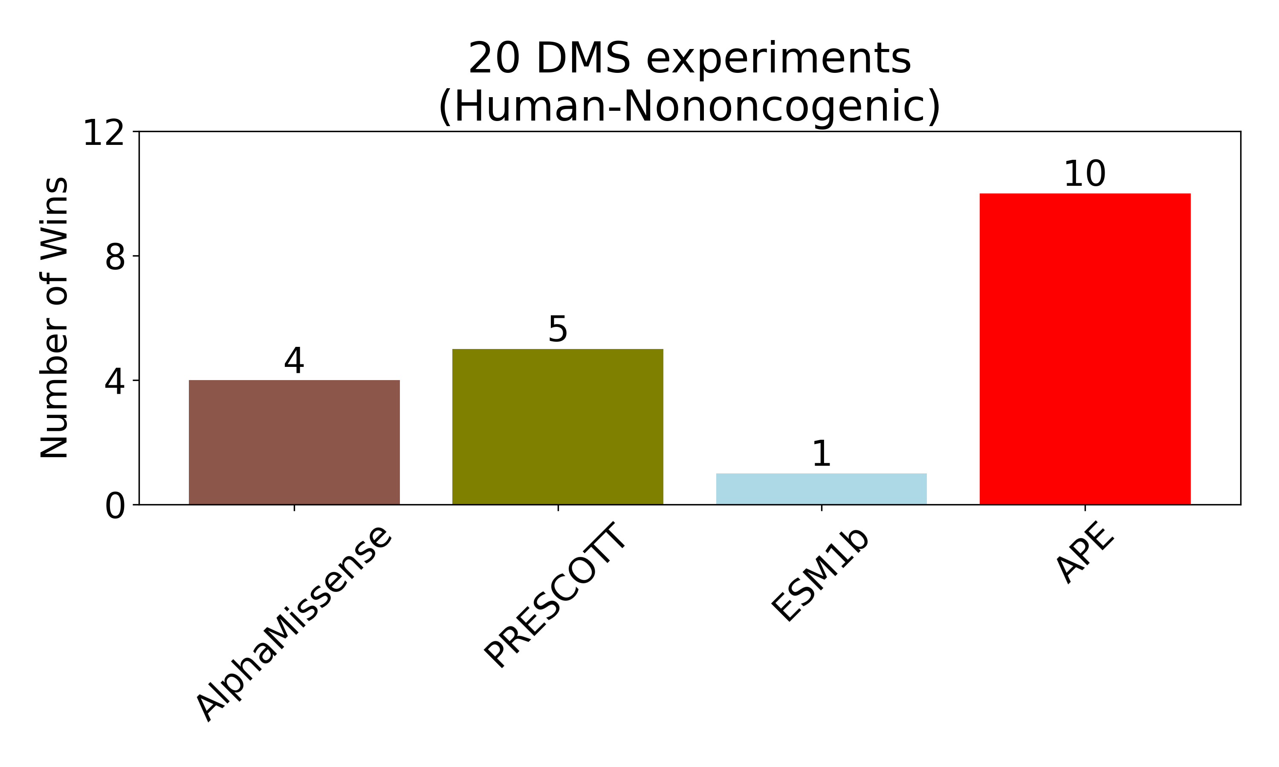
ProteinGym – 20 DMS Experiments
Created for CAGI 7
genomeinterpretation.org
MT
Notes:
Thresholds determined via precision‑recall intersection.

