Slide 1

CAGI7 slide pack guidelines
I agree to my slides being used according to the following terms:
Vikas Pejaver
Authors: please include THIS slide at the beginning of your presentation to indicate that you agree with reuse of your slides in CAGI presentations, according to the terms below, and digitally sign by writing your name above.
To disseminate the CAGI results, I encourage all CAGI participants to remix these CAGI slides for inclusion in their oral and poster presentations.
CAGI participants may use or publish any content of these slides only in compliance with the CAGI Data Use Agreement.
CAGI participants may not cite or publish any content of these slides except with the written permission of the originating author or in the primary CAGI publications.
CAGI participants must acknowledge the original authors of these slides and CAGI7. Include the acknowledgement banner across the bottom.
CAGI participants must include the CAGI credits slide in their presentations.
Slides with a red slash (no remix) may not be included in a presentation unless all attendees are registered CAGI participants who signed the data use agreement.
Slides with a red X over the entire slide may not be used in any circumstances.
Slides with a blue slash (embargoed) may not be used unless the embargo is explicitly lifted.
Slides without slash or X may be tweeted unless flagged with the “No tweet” icon.
CAGI participants using these slides must explain the “No tweet” icon, which means that the slide content should not be disseminated outside the presenting conference hall. If the presentation venue permits pervasive tweeting, you may not include these slides in your talk.
Note for slide authors: we expect all CAGI participants to abide by these restrictions and will make best effort to ensure they are followed. However, bear in mind that we have limited means of enforcing them, and therefore the restrictions cannot be guaranteed.
Notes:
At CAGI7, use of this slide pack is only required for CAGI dataset providers, assessors, and predictors, but all are encouraged to use the annotations for materials they do not want shared publicly.

Slide 2

TSC2 CHALLENGE ASSESSMENT
Vikas Pejaver
CAGI 7 Meeting, Boston, MA
December 6, 2025
Created for CAGI7
genomeinterpretation.org
Vikas Pejaver

Slide 3
Overview of TSC2 challenge
TSC2 or Tuberin
  Tumor suppressor protein
  Forms a complex with TSC1 to negatively regulate mTOR signaling
  Variants associated with Tuberous sclerosis and Lymphangioleiomyomatosis
VAMP-Seq or Variant Stability Profiling (VSP) assay
  Measures abundance (stability) of proteins
  Similar to PTEN and TPMT from CAGI5
Created for CAGI7
genomeinterpretation.org
Vikas Pejaver

Slide 4
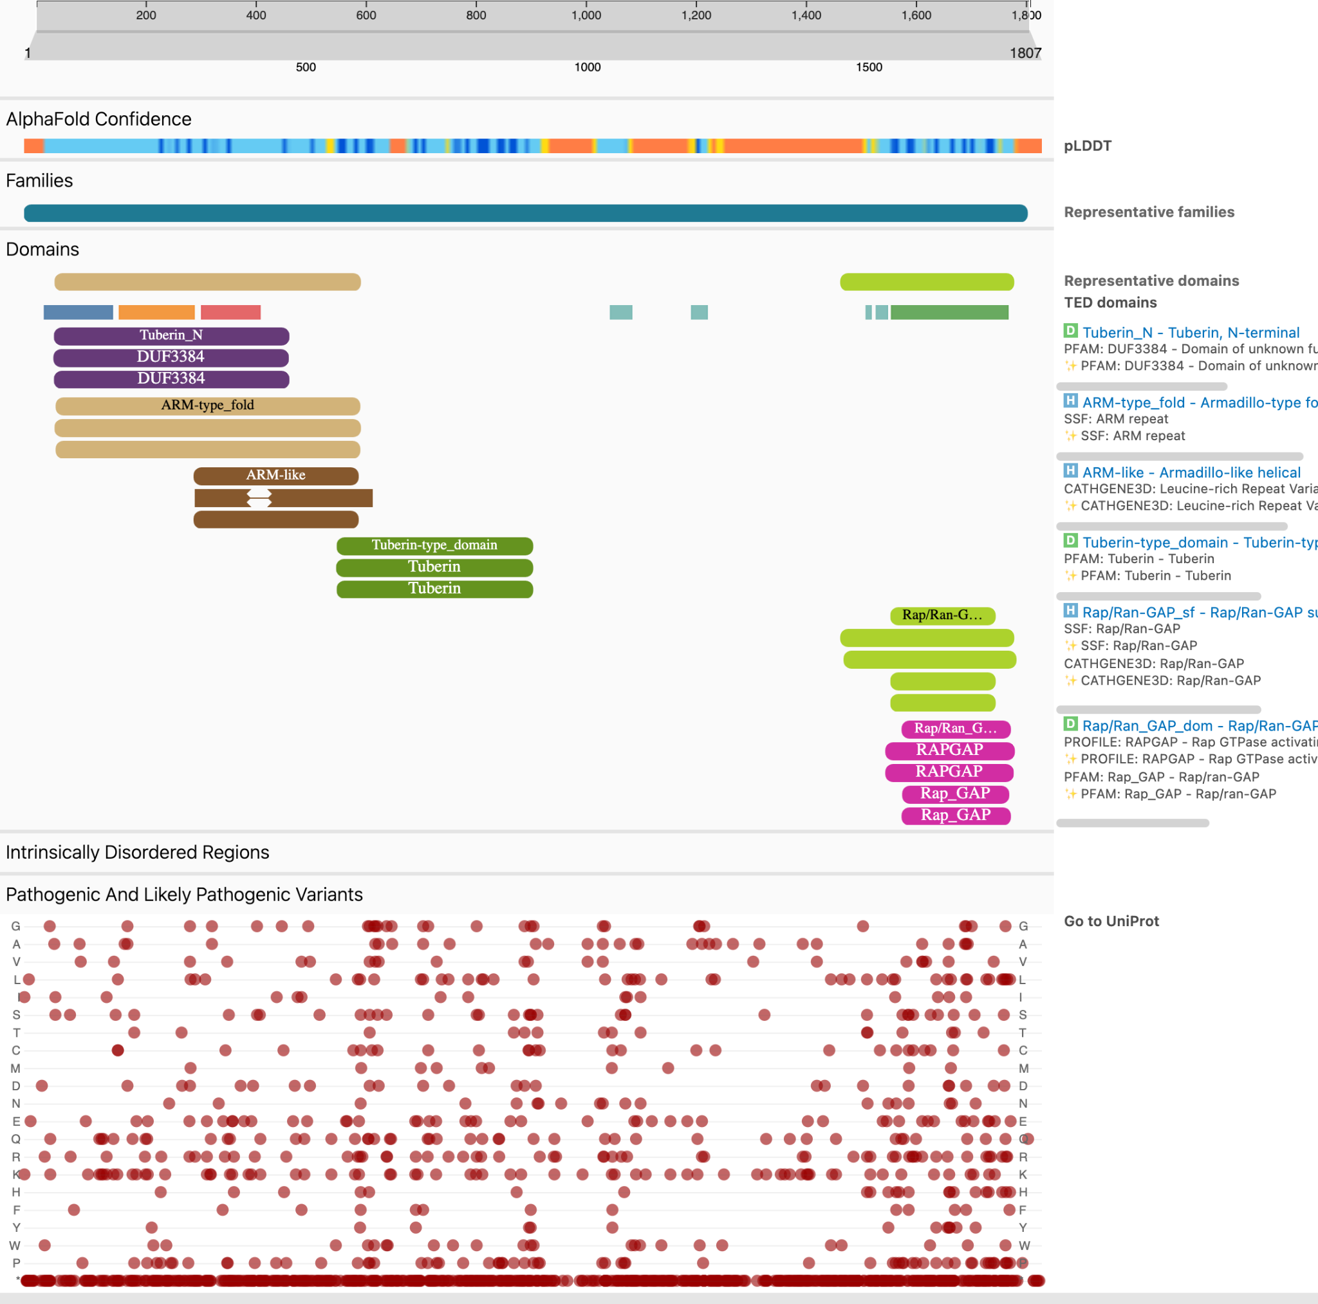
Overview of TSC2 challenge
TSC2 or Tuberin
  Tumor suppressor protein
  Forms a complex with TSC1 to negatively regulate mTOR signaling
  Variants associated with Tuberous sclerosis and Lymphangioleiomyomatosis
VAMP-Seq or Variant Stability Profiling (VSP) assay
  Measures abundance (stability) of proteins
  Similar to PTEN and TPMT from CAGI5
Prediction task
  Given 8891 variants from two distinct regions
    Tuberin: 3482 variants in positions 554-757
    RapGAP: 5409 variants in positions 1512-1805
  Predict relative TSC2 protein stability as a real value:
    Unstable = 0
    Wildtype = 1
    Greater stability than wildtype > 1
Created for CAGI7
genomeinterpretation.org
Vikas Pejaver

Slide 5
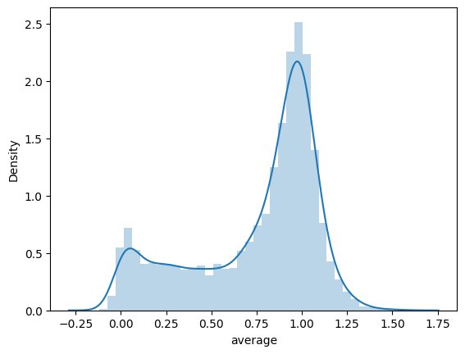
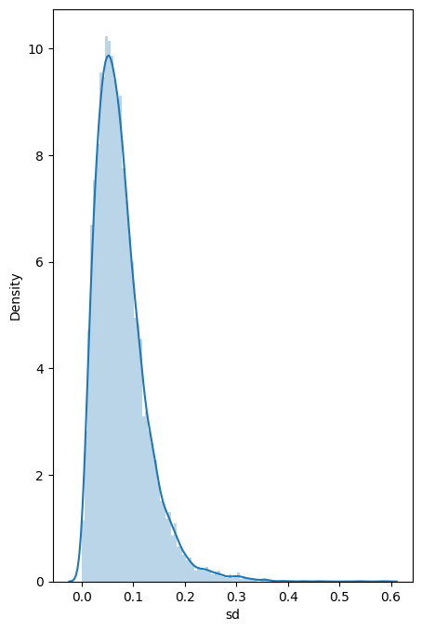
Overview of the data - Quality
All variants considered for assessment with equal weighting
Created for CAGI7
genomeinterpretation.org
Vikas Pejaver

Slide 6
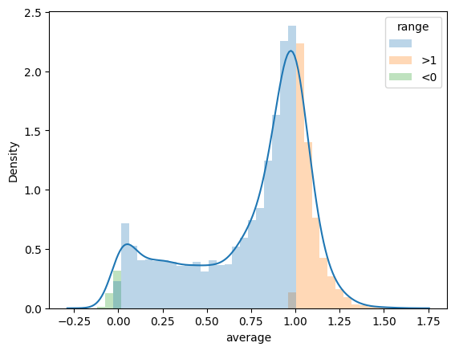
Overview of the data - Points of interest
Tails of the distribution
  183 variants across 57 positions have values less than zero
  2222 variants across 351 positions have values greater than one
  Considered two modes of assessment:
    Capped assay scores between 0 and 1
    Uncapped assay scores
Created for CAGI7
genomeinterpretation.org
Vikas Pejaver

Slide 7
Overview of the data - Points of interest
Tails of the distribution
  183 variants across 57 positions have values less than zero
  2222 variants across 351 positions have values greater than one
  Considered two modes of assessment:
    Capped assay scores between 0 and 1
    Uncapped assay scores
Coverage
  9 positions have only a single variant
    Tuberin positions: 614, 616, 624, 672, 673, 675
    RapGAP positions: 1747, 1798, 1802
  87 of the 486 positions have less than 19 variants
  No positions excluded in assessment
Created for CAGI7
genomeinterpretation.org
Vikas Pejaver

Slide 8
Overview of Submissions
19 teams submitted 77 models
Most teams provided predictions and descriptions as stipulated
But two types of discrepancies observed
  Scores scaled differently from the expected range
  Z-score normalization
  “Inverted” directionality
  Negated scores
Team | Models | Team | Models
3billion | 6 | BolognaBiocompute | 4
3BIOBXL | 6 | DMIIP | 4
AIBI | 6 | LFolkman | 3
bat | 6 | compbiomed | 2
CLINTRABI | 6 | Tumor AI | 2
UQ BioSig | 6 | VespaG | 2
UXFactory | 6 | biofold | 1
Evolutionary Action | 5 | Evocoders | 1
INLAB BBI 2025 | 5 | YF | 1
PRESCOTT | 5
Created for CAGI7
genomeinterpretation.org
Vikas Pejaver

Slide 9
Approach to assessment
Baseline methods
  CADD (SNV only)
  PolyPhen-2
  SIFT (SNV only)
Other recruited methods
  AlphaMissense
  EVE
  ESM models - 1b, 3 (SNV only) and 1v
  PopEVE
  MutPred2
  REVEL (SNV only)
  ThermoMPNN (stability predictor)
  VARITY models - ER and R (SNV only)
  VEST4 (SNV only)
Created for CAGI7
genomeinterpretation.org
Vikas Pejaver

Slide 10
Approach to assessment
Baseline methods
  CADD (SNV only)
  PolyPhen-2
  SIFT (SNV only)
Other recruited methods
  AlphaMissense
  EVE
  ESM models - 1b, 3 (SNV only) and 1v
  PopEVE
  MutPred2
  REVEL (SNV only)
  ThermoMPNN (stability predictor)
  VARITY models - ER and R (SNV only)
  VEST4 (SNV only)
Evaluated all models but showing only top models from each team
Regression
  Spearman correlation coefficient
  Pearson correlation coefficient
  Coefficient of determination (R²)
Classification
  Calibrated assay according to the ACMG/AMP guidelines (Zeiberg et al. bioRxiv. 2025. PMID: 40654914; PMCID: PMC12248162.)
  Used the threshold corresponding to supporting evidence for pathogenicity for each domain
    1072 low abundance, 7819 high abundance
  AUROC
All variants vs. only SNVs
Created for CAGI7
genomeinterpretation.org
Vikas Pejaver

Slide 11
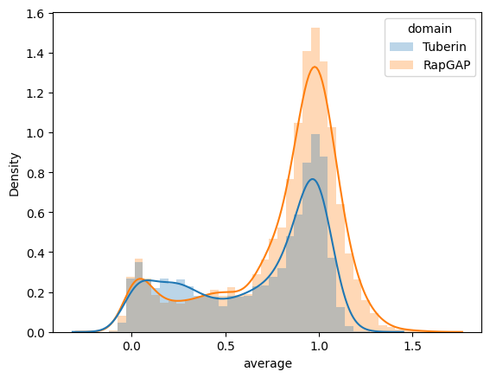
Domain-specific differences in performance
Created for CAGI7
genomeinterpretation.org
Vikas Pejaver

Slide 12
Summary and Discussion
Advances appear to be real
  ~10% increase in performance over state-of-the-art methods across different metrics
  Multiple methods succeed over existing generic effect and stability predictors
  More methods surface when dichotomizing on extremely low abundance variants
Created for CAGI7
genomeinterpretation.org
Vikas Pejaver

Slide 13
Summary and Discussion
Advances appear to be real
  ~10% increase in performance over state-of-the-art methods across different metrics
  Multiple methods succeed over existing generic effect and stability predictors
  More methods surface when dichotomizing on extremely low abundance variants
Emerging methodological themes and questions
  Structure-based methods (either explicit or implicit) were enriched in the top-performers
  Generic methods vs. TSC2-specific information - how generalizable are these approaches?
  Performance varies across the two regions - why?
  The use of PTEN and TPMT VAMP-Seq data proved advantageous - what does this mean?
Created for CAGI7
genomeinterpretation.org
Vikas Pejaver

Slide 14
Summary and Discussion
Advances appear to be real
  ~10% increase in performance over state-of-the-art methods across different metrics
  Multiple methods succeed over existing generic effect and stability predictors
  More methods surface when dichotomizing on extremely low abundance variants
Emerging methodological themes and questions
  Structure-based methods (either explicit or implicit) were enriched in the top-performers
  Generic methods vs. TSC2-specific information - how generalizable are these approaches?
  Performance varies across the two regions - why?
  The use of PTEN and TPMT VAMP-Seq data was advantageous - what does this mean?
Other analyses (proposed)
  Assessing “difficult-to-predict” variants
  Per-position assessment and correlations with biology
  Impact on clinical variant classification
  Addressing standard deviations in experimental data as well as predictions
Created for CAGI7
genomeinterpretation.org
Vikas Pejaver

Slide 15
Acknowledgements
Icahn School of Medicine at Mount Sinai
Timothy Bergquist
Matthew Neky
Himanshu Sharma
Northeastern University
Ross Stewart
Data generators
Dan Holmes
Doug Fowler
Lea Starita
CAGI team and assessors
Gaia Andreoletti
Steven Brenner
Predrag Radivojac
Nilah Ioannidis
Joe Marsh
Created for CAGI7
genomeinterpretation.org
Vikas Pejaver

Slide 16
THANK YOU
Created for CAGI7
genomeinterpretation.org
Vikas Pejaver

