Slide 1
CAGI 7 slide pack guidelines
I agree to my slides being used according to the following terms:
Fabrizio Pucci
Authors: please include THIS slide at the beginning of your presentation to indicate that you agree with reuse of your slides in CAGI presentations, according to the terms below, and digitally sign by writing your name above.
At CAGI 7, use of this slide pack is only required for CAGI dataset providers, assessors, and predictors, but all are encouraged to use the annotations for materials they do not want shared publicly.
To disseminate the CAGI results, I encourage all CAGI participants to remix these CAGI slides for inclusion in their oral and poster presentations
CAGI participants may use or publish any content of these slides only in compliance with the CAGI Data Use Agreement
CAGI participants may not cite or publish any content of these slides except with the written permission of the originating author or in the primary CAGI publications
CAGI participants must acknowledge the original authors of these slides and CAGI 7. Include the acknowledgement banner across the bottom
CAGI participants must include the CAGI credits slide in their presentations
Slides with a red slash (no remix) may not be included in a presentation unless all attendees are registered CAGI participants who signed the data use agreement
Slides with a red X over the entire slide may not be used in any circumstances
Slides with a blue slash (embargoed) may not be used unless the embargo is explicitly lifted
Slides without slash or X may be tweeted, tooted, posted, X’d unless flagged with “No tweet” icon
CAGI participants using these slides must explain the “No tweet” icon, which means that the slide content should not be disseminated outside the presenting conference hall. If the presentation venue permits pervasive tweeting, you may not include these slides in your talk
Note for slide authors: we expect all CAGI participants to abide by these restrictions, and will make best effort to ensure they are followed. However, but bear in mind that we have limited means of enforcing them, and therefore the restrictions cannot be guaranteed.

Slide 2



Integrating Structural, Coevolutionary, and protein Language Models for
CAGI7 Challenge Predictions
Fabrizio Pucci
Computational Biology and Bioinformatics,
École polytechnique de Bruxelles, ULB
Interuniversity Institute of Bioinformatics in Brussels (IB²)
Critical Assessment of Genome Interpretation 7
Boston, 6-8 December 2025

Slide 3
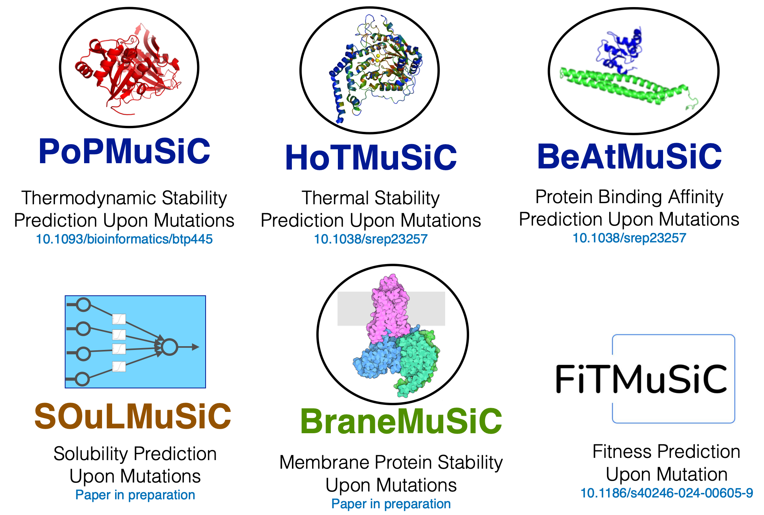
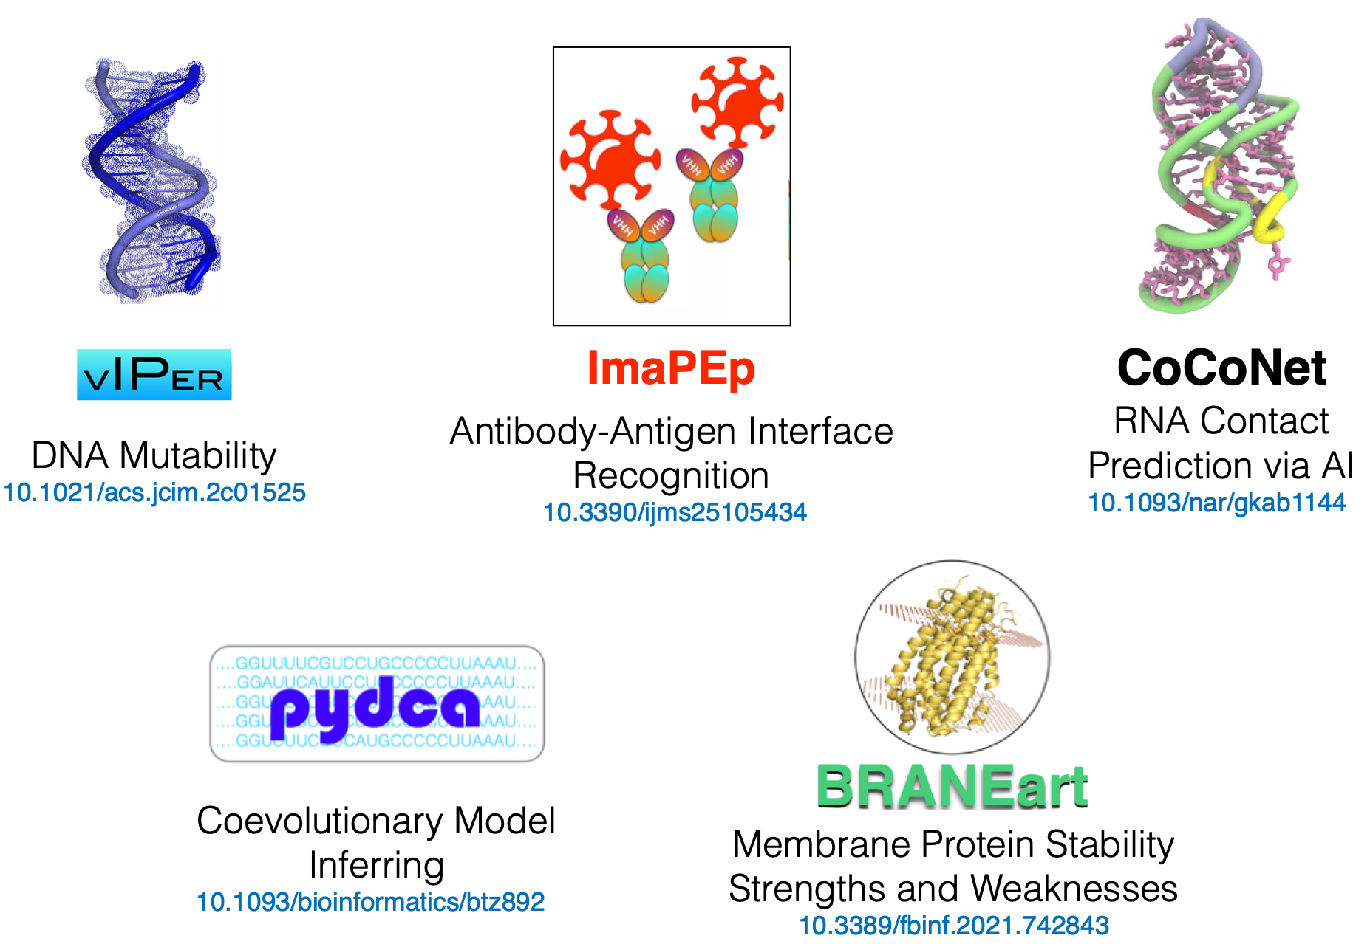
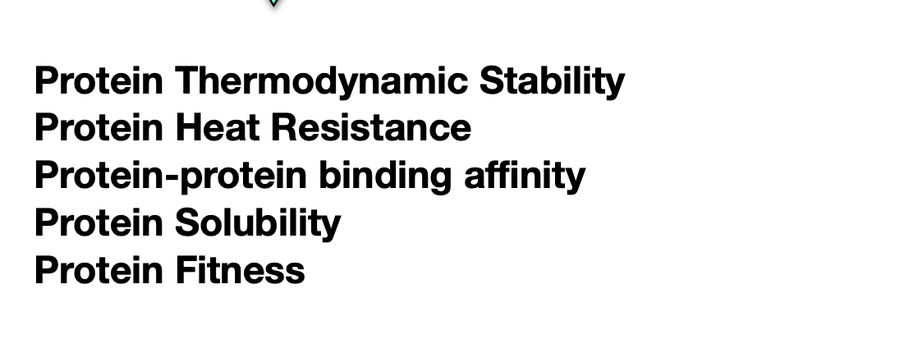


Develop and apply computational methods to predict the impact of mutations on :
3BIOBXL: Matsvei Tsishyn, Pauline Hermans, Hugo Talibart, Gabriel Cia, Marianne Rooman, Fabrizio Pucci

Slide 4
We partecipated to different CAGI7 challenges:
TSC2, BARD1, LPL, ATP7B, ARSA, FGFR, Annotate-all-missense
(Co)-Evolutionary
Models
Protein 3D structural
approaches
Artificial Intelligence
methods
Our Toolbox

Slide 5
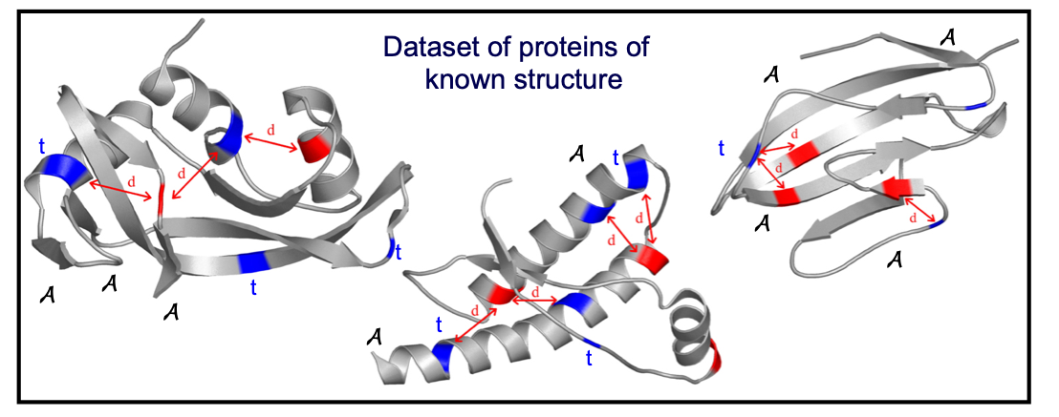
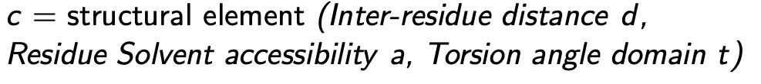
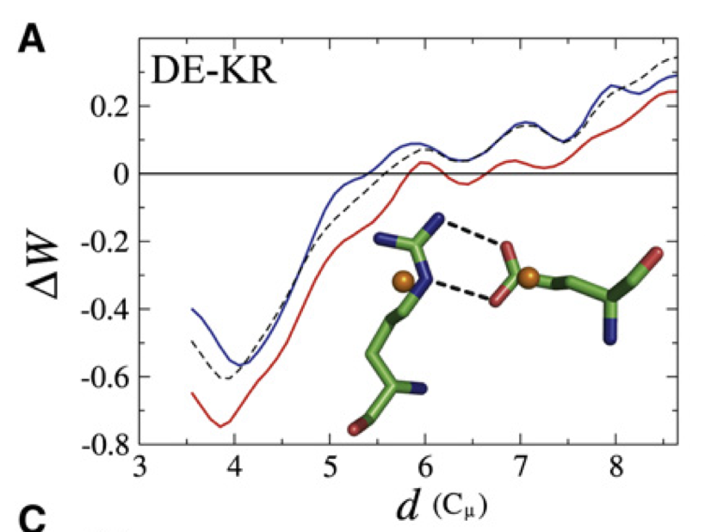
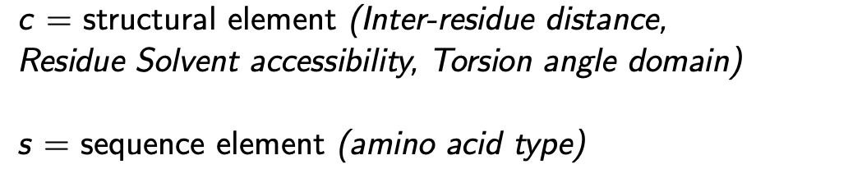
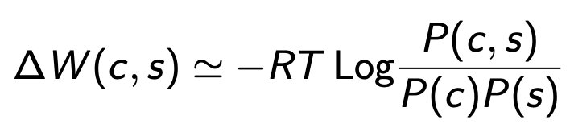
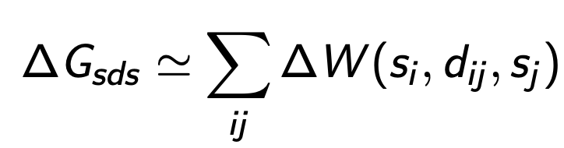
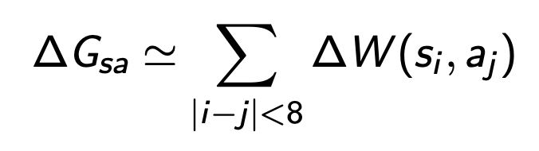
✽ We used a simplified representation of protein structure (only main chain atoms + average side chain center)
✽ We computed mean-force potentials (statistical potentials derived from a non-redundant dataset of resolved protein structures)
C
✽ We evaluated protein free energy using the derived mean-force potentials. (different values of “energies” according to (c,s) elements considered, for example:
Tertiary interactions
Local interactions
✽ Effect of mutations as change in protein free energy between wild type and mutants
Y. Dehouck, D. Gilis, M. Rooman, "A new generation of statistical potentials for proteins." Biophysical journal 90.11 (2006)

Slide 6
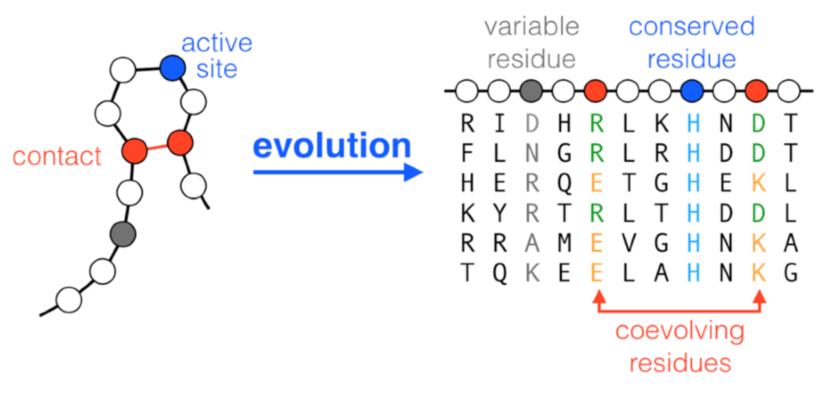
Multiple sequence alignment

Slide 7

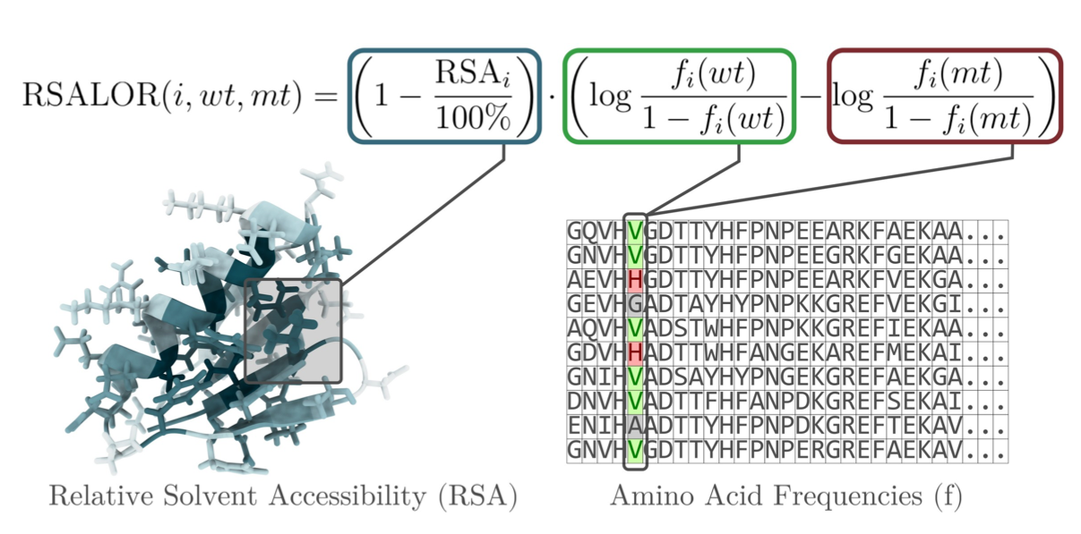
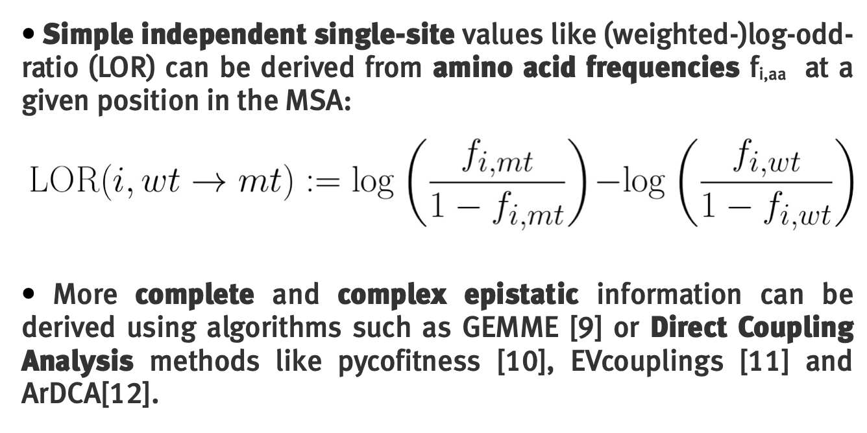
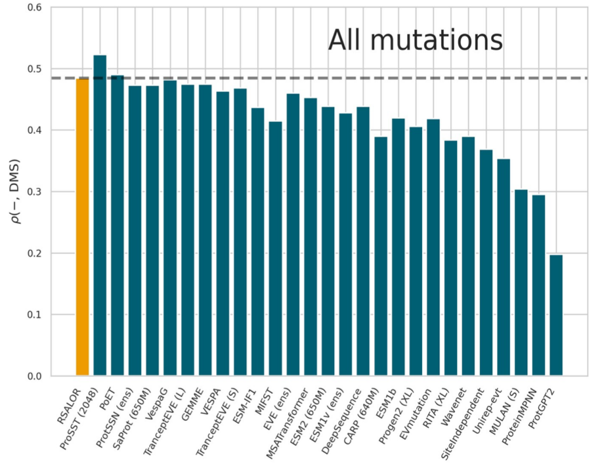
✽ and are amino acid frequencies of mutant (mt) and wild type (wt) aa at position i in the MSA
✽ Important role of Residue Solvent Accessibility (RSA) to predict the impact of mutations
Despite its simplicity, the model achieves performance competitive with larger and more complex approaches.
Here the performances on ProteinGym (Jan 25).
P. Hermans, M. Tsishyn, M. Schwersensky, M. Rooman, and F. Pucci. Molecular Biology and Evolution 42.1 (2025), msae267.
M. Tsishyn, P. Hermans, M. Rooman. F. Pucci. Bioinformatics 41.6 (2025), btaf322

Slide 8

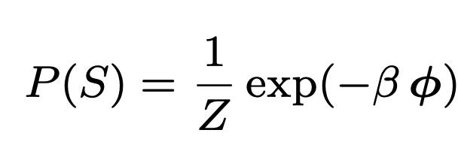
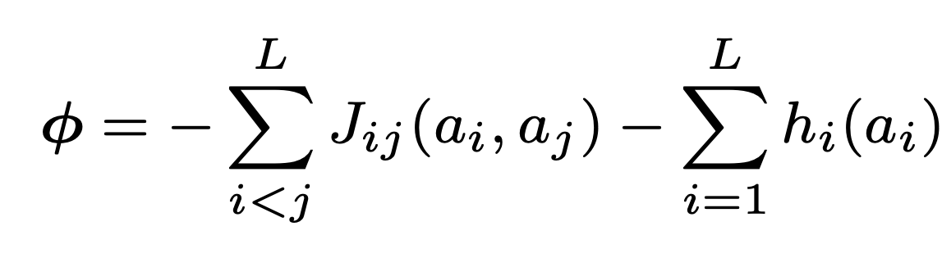
A protein sequence S = (a1….aL) of length L is sampled by evolution trough:
hi and Jij parameters are inferred by fitting the empirical single-site and pairwise frequencies in the MSA of homologous proteins of S
,
Couplings between all residues pairs
Single site fields
M. Tsishyn, H. Talibart, M.Rooman, F. Pucci. work in progress

Slide 9

A protein sequence S = (a1….aL) of length L is sampled by evolution trough:
hi and Jij parameters are inferred by fitting the empirical single-site and pairwise frequencies in the MSA of homologous proteins of S
,
Couplings between all residues pairs
Single site fields
M. Tsishyn, H. Talibart, M.Rooman, F. Pucci. work in progress

Slide 10
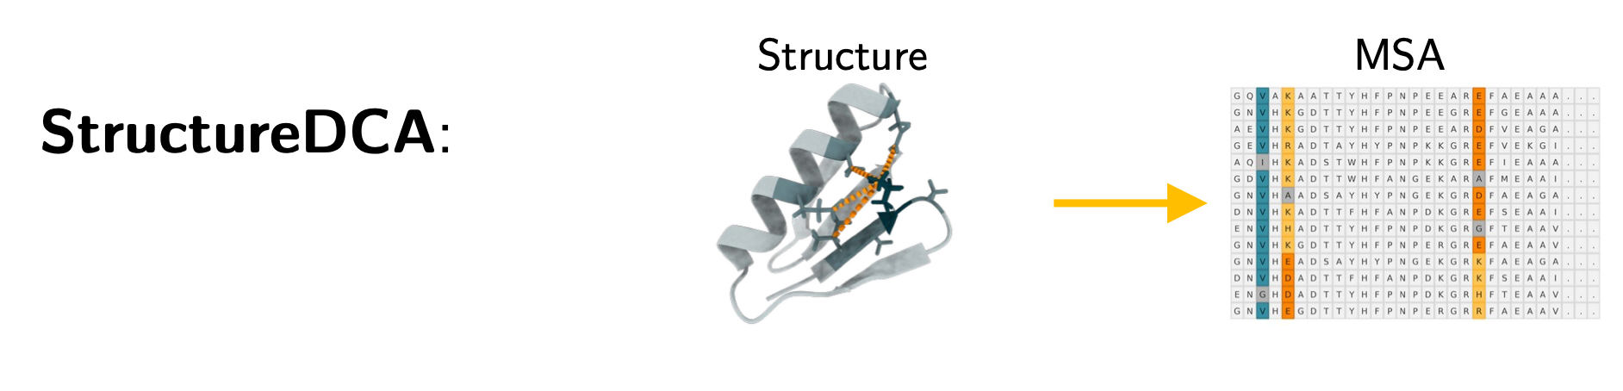
We develop StructureDCA by considering a sparse DCA model where only the couplings corresponding to residue pairs that are in physical contact are considered
M. Tsishyn, H. Talibart, M.Rooman, F. Pucci. work in progress

Slide 11
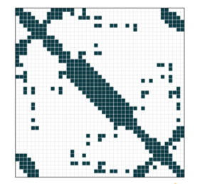

We develop StructureDCA by considering a sparse DCA model where only the couplings corresponding to residue pairs that are in physical contact are considered
Contact Map
M. Tsishyn, H. Talibart, M.Rooman, F. Pucci. work in progress

Slide 12
Here the performances on ProteinGym (Dec 25).
M. Tsishyn, H. Talibart, M.Rooman, F. Pucci. work in progress

Slide 13
Standard pLM
????
Predicting the likelihood of each amino acid at masked position(s) in the sequence leveraging transformer architecture.
J. Su, C. Han, Y. Zhou, J. Shan, X. Zhou, F. Yuan, "Saprot: Protein language modeling with structure-aware vocabulary." BioRxiv (2023)

Slide 14
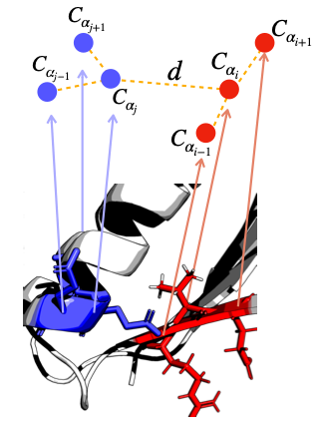

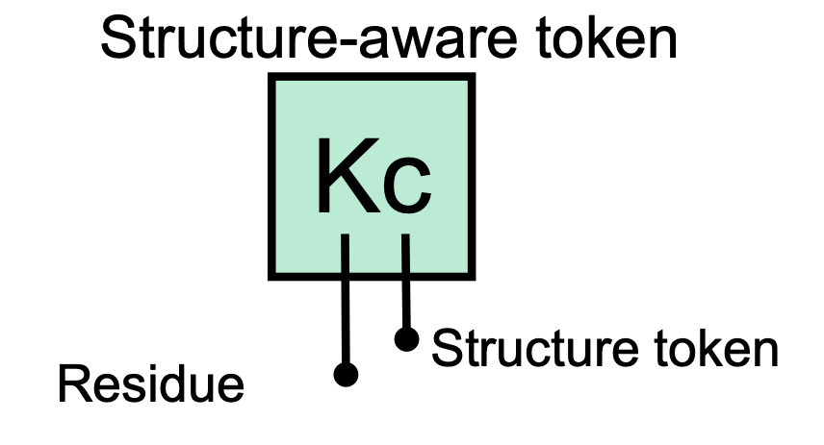
Standard pLM
????
Predicting the likelihood of each amino acid at masked position(s) in the sequence leveraging transformer architecture.
SaProt
incorporates structural information to define a structure-informed vocabulary, and then uses a masking approach to train a standard ESM-like architecture.
FoldSeek
J. Su, C. Han, Y. Zhou, J. Shan, X. Zhou, F. Yuan, "Saprot: Protein language modeling with structure-aware vocabulary." BioRxiv (2023)

Slide 15
✽ Different properties measured = Different prediction models
TSC2 and LPL challenges: protein stability/abundance prediction
Structural information is likely to play an important role, so we use additional structural features (statistical potentials)
ARSA, BARD1, FRFG: protein activity/function prediction
We use less or no structural information and based our models on evolutions

Slide 16
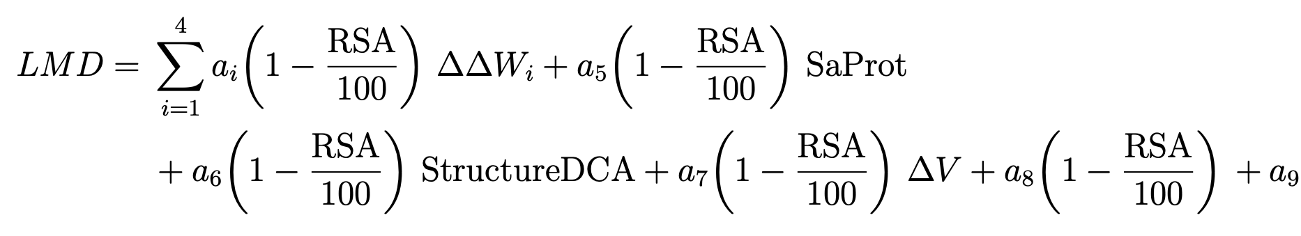
✽ Type of models of different complexity:
For each challenge we submit 6 models:
Two simple linear models, two ANNs, RSALOR and StructureDCA
Me
vs
PhD student M. Tshisyn
vs
Unsupervised
✽ Simple linear regression with RMSE as the loss function. Example TSC2
✽ Artificial neural network fully connected that includes in additional to
above mentioned features additional data, secondary structures, pLDDT and RSA of the wild type aa and the mutation type.

Slide 17
Choice of training set is important.
We select DMS training datasets based on the following criteria:
they come from the same or similar assays of the target dataset.
They measure the same biophysical or function properties
Involve the same class of proteins

Slide 18
Choice of training set is important.
We select DMS training datasets based on the following criteria:
they come from the same or similar assays of the target dataset.
They measure the same biophysical or function properties
Involve the same class of proteins
✽ ATP7B Challenge
Training dataset 1
DMS yeast-based assay from Fritz Roth Lab.
We take 4 DMS datasets (HMBS, UBE2I, GCK and SUMO1)
Training dataset 2
ATP7B is a membra protein: Collection of 3 DMS datasets in membrane proteins (S22A1, SC6A4 and VKOR1) even if from different assays.

Slide 19
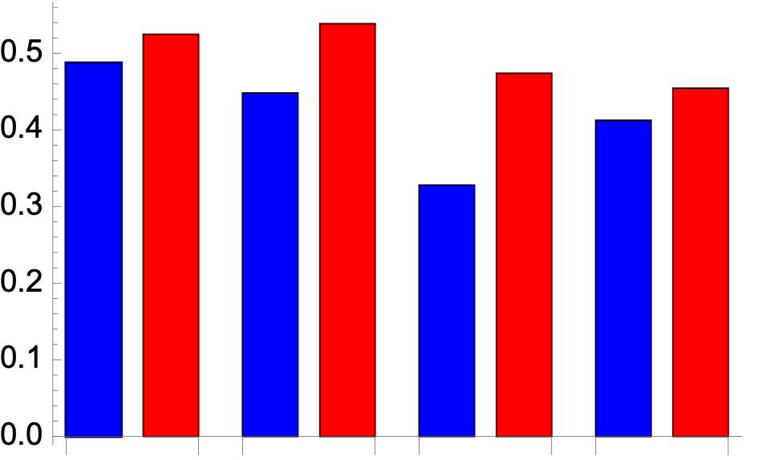
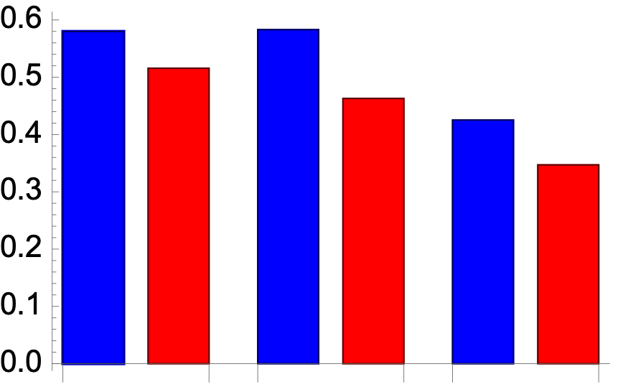
✽ ATP7B Challenge
DMS from Roth’s Lab
Membrane protein DMS
Spearman
Spearman
GCK
SUMO1
UBE2I
HMBS
SC6A4
VKOR1
S22A1
Linear Model train on Membrane protein DMS
Linear Model train on DMS from Fritz’s Lab

Slide 20
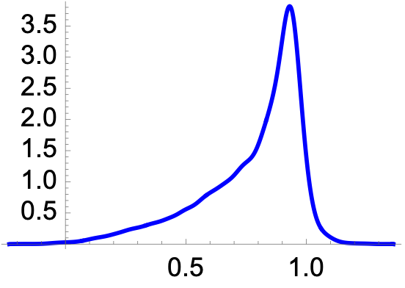
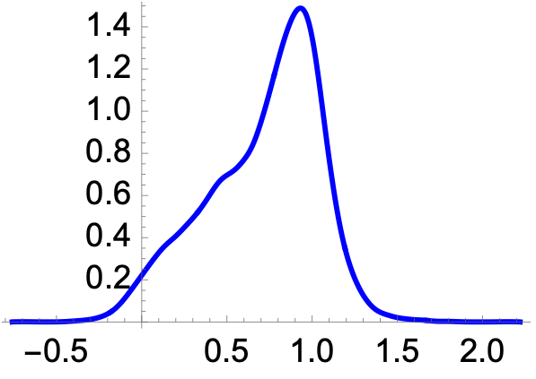
✽ Not only the Spearman correlation but also RMSE is usually important in ranking the predictions
✽ Normalize the score using the experimental DMS distribution obtained from the same assay (if available) or from similar ones.
Rescaled
Prediction
Rank-based
quantile
transformation
Prediction

Slide 21
✽ Not only the Spearman correlation but also RMSE is usually important in ranking the predictions
✽ Normalize the score using the experimental DMS distribution obtained from the same assay (if available) or from similar ones.
Rescaled
Prediction
Rank-based
quantile
transformation
Prediction
✽ We also apply the same normalization to training DMS sets when their score distributions differ, for example when they come from different assays. This usually slightly improve the performances.
It is still an open problem how to train models on different assays with completely different score distributions

Slide 22
✽ Integrating structure, evolution, and pLM features improves mutational landscape prediction.
✽ We learned about some strengths and weaknesses of our models.

Slide 23
✽ Integrating structure, evolution, and pLM features improves mutational landscape prediction.
✽ We learned about some strengths and weaknesses of our models.
✽ Simple models vs complex models (?)
✽ Different methods needed to predict the impact of a mutation on different protein properties (?)
✽ Does assay-specific model training improve predictions, or does it only introduce bias toward the assay?

Slide 24
Matsvei Tsishyn
Pauline Hermans
Hugo Talibart
Gabriel Cia
Marianne Rooman

Slide 25
Matsvei Tsishyn
Pauline Hermans
Hugo Talibart
Gabriel Cia
Marianne Rooman
..experimentalists, assessors and organizers!

Slide 26
Matsvei Tsishyn
Pauline Hermans
Hugo Talibart
Gabriel Cia
Marianne Rooman
..experimentalists, assessors and organizers!
…and thank you for your attention!

