Slide 1

CAGI 7 slide pack guidelines
I agree to my slides being used according to the following terms:
Gianluca Lombardi
Authors: please include THIS slide at the beginning of your presentation to indicate that you agree with reuse of your slides in CAGI presentations, according to the terms below, and digitally sign by writing your name above.
At CAGI 7, use of this slide pack is only required for CAGI dataset providers, assessors, and predictors, but all are encouraged to use the annotations for materials they do not want shared publicly.
To disseminate the CAGI results, I encourage all CAGI participants to remix these CAGI slides for inclusion in their oral and poster presentations
CAGI participants may use or publish any content of these slides only in compliance with the CAGI Data Use Agreement
CAGI participants may not cite or publish any content of these slides except with the written permission of the originating author or in the primary CAGI publications
CAGI participants must acknowledge the original authors of these slides and CAGI 7. Include the acknowledgement banner across the bottom
CAGI participants must include the CAGI credits slide in their presentations
Slides with a red slash (no remix) may not be included in a presentation unless all attendees are registered CAGI participants who signed the data use agreement
Slides with a red X over the entire slide may not be used in any circumstances
Slides with a blue slash (embargoed) may not be used unless the embargo is explicitly lifted
Slides without slash or X may be tweeted, tooted, posted, X’d unless flagged with “No tweet” icon
CAGI participants using these slides must explain the “No tweet” icon, which means that the slide content should not be disseminated outside the presenting conference hall. If the presentation venue permits pervasive tweeting, you may not include these slides in your talk
Note for slide authors: we expect all CAGI participants to abide by these restrictions, and will make best effort to ensure they are followed. However, but bear in mind that we have limited means of enforcing them, and therefore the restrictions cannot be guaranteed.

Slide 2




Combining PRESCOTT and deep learning models for improved zero-shot predictions of missense mutations
Gianluca Lombardi ^{1, 2}, Mustafa Tekpinar³ and Alessandra Carbone ^{1, 2}
¹CQSB, Sorbonne Université and CNRS, Paris, France; ²SCAI, Sorbonne Université, Paris, France,
³Department of Physics, Van Yüzüncü Yıl University, Van, Turkiye

Slide 3
Mutations and SNVs
71 million possible missense variants in the human proteome, with more than 4 million observed missense variants in human populations
2% have been clinically classified as pathogenic or benign, while the vast majority are VUS

Slide 4
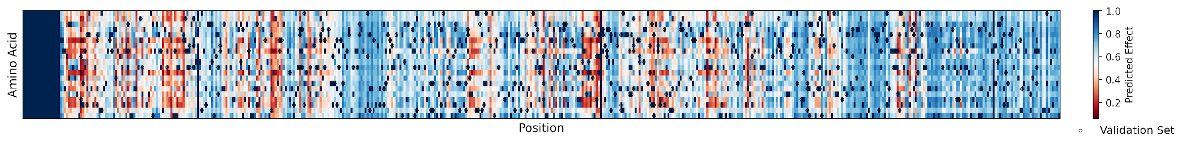
Mutations and SNVs
71 million possible missense variants in the human proteome, with more than 4 million observed missense variants in human populations
2% have been clinically classified as pathogenic or benign, while the vast majority are VUS
DMS reconstruction
Development of computational methods, based on bioinformatics algorithms and machine learning models, to predict mutational effects at large scale and with increasing accuracy
Amino acids
Sequence position

Slide 5
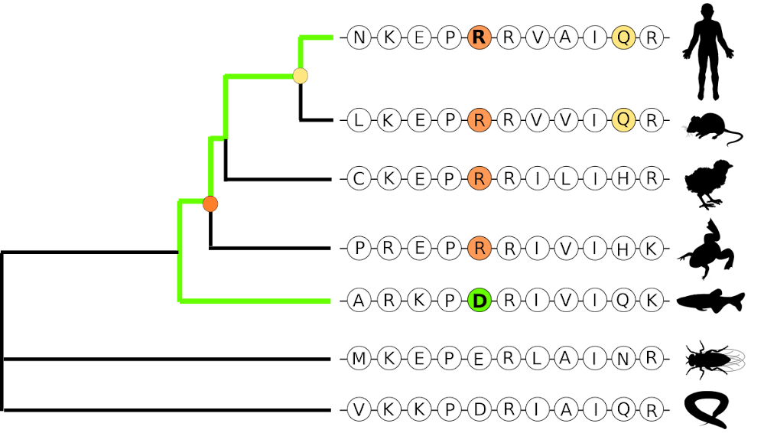
Modelling priors in missense mutations prediction
Evolutionary conservation: mutations appearing very rarely in nature are likely deleterious
Epistasis: Effect of a mutations depends on surrounding sequence context
Evolution

Slide 6
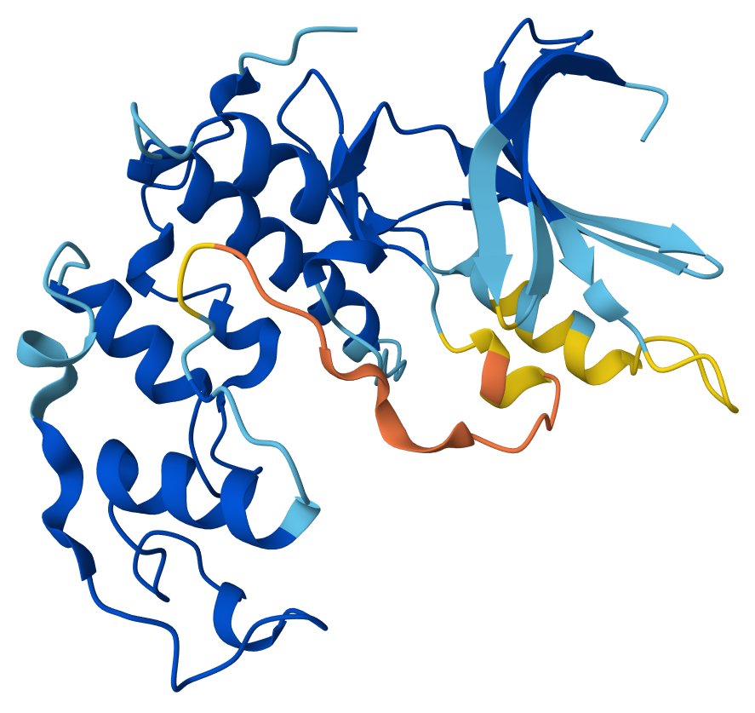
Modelling priors in missense mutations prediction
Evolutionary conservation: mutations appearing very rarely in nature are likely deleterious
Epistasis: Effect of a mutations depends on surrounding sequence context
Structure: mutations in the core of a protein and in interaction surfaces have higher impact
Evolution
Structure

Slide 7


Modelling priors in missense mutations prediction
Evolutionary conservation: mutations appearing very rarely in nature are likely deleterious
Epistasis: Effect of a mutations depends on surrounding sequence context
Structure: mutations in the core of a protein and in interaction surfaces have higher impact
Spread of a mutation in human populations is informative on its pathogenicity
Evolution
Structure
Allele Frequency

Slide 8
Modelling priors in missense mutations prediction
Evolutionary conservation: mutations appearing very rarely in nature are likely deleterious
Epistasis: Effect of a mutations depends on surrounding sequence context
Structure: mutations in the core of a protein and in interaction surfaces have higher impact
Spread of a mutation in human populations is informative on its pathogenicity
Generalisation even when alignment is shallow or structure has low confidence
Evolution
Structure
Allele Frequency

Slide 9
GEMME: Evolution
Evolutionary conservation
Site-independent conservation
Epistatic term
Query sequence
AGFHICVQVYENK
AGFHPCVQVYENK
[Laine, Karami and Carbone, 2019]

Slide 10
GEMME: Evolution
Evolutionary conservation
Site-independent conservation
Epistatic term
AGFHICVQVYENK
ASFHICVQVYENK
Query sequence
MGFHICVQVYQNK
MMseqs2
LGFHICVQVY-NK
AGFHICVQVYENK
GSFHPLVEVYQDK
MGFHPLVEVYQDK
KGFHP-VEIY-DK
AGFHPCVQVYENK
[Laine, Karami and Carbone, 2019]

Slide 11
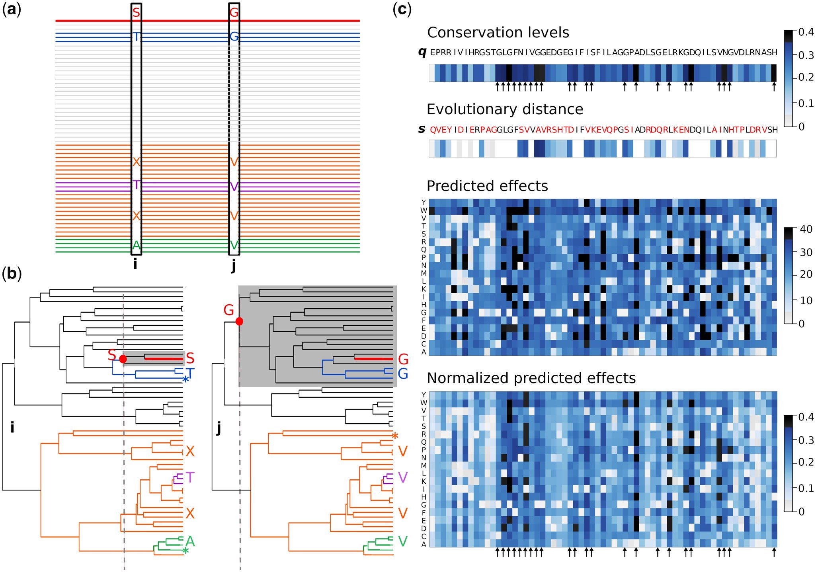
GEMME: Evolution
Conservation

Slide 12
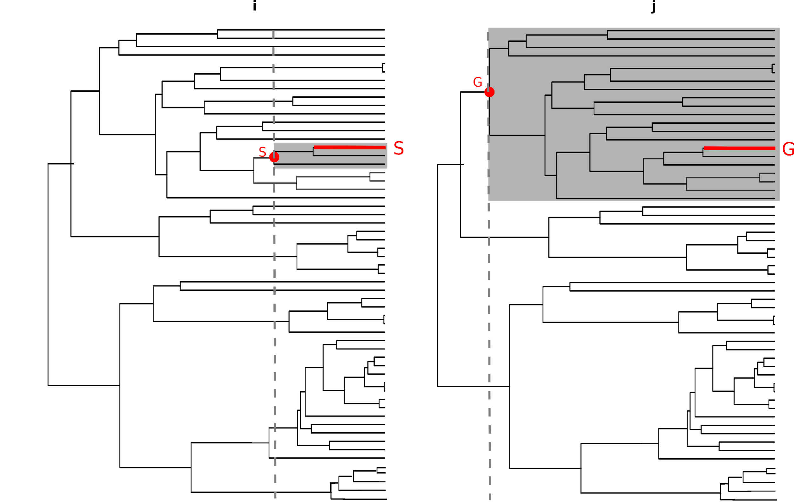
GEMME: Evolution
S
Evolutionary conservation
K
S
E
P
V
V
0
[Engelen et al, 2009]

Slide 13
GEMME: Evolution
S
Evolutionary conservation
K
S
Construction of phylogenetic trees with effective sequences from input alignment, to compute residues trace levels
E
P
V
V
0
[Engelen et al, 2009]

Slide 14
Evolution (GEMME)
Epistatic effects

Slide 15
Evolution (GEMME)
Epistatic effects

Slide 16
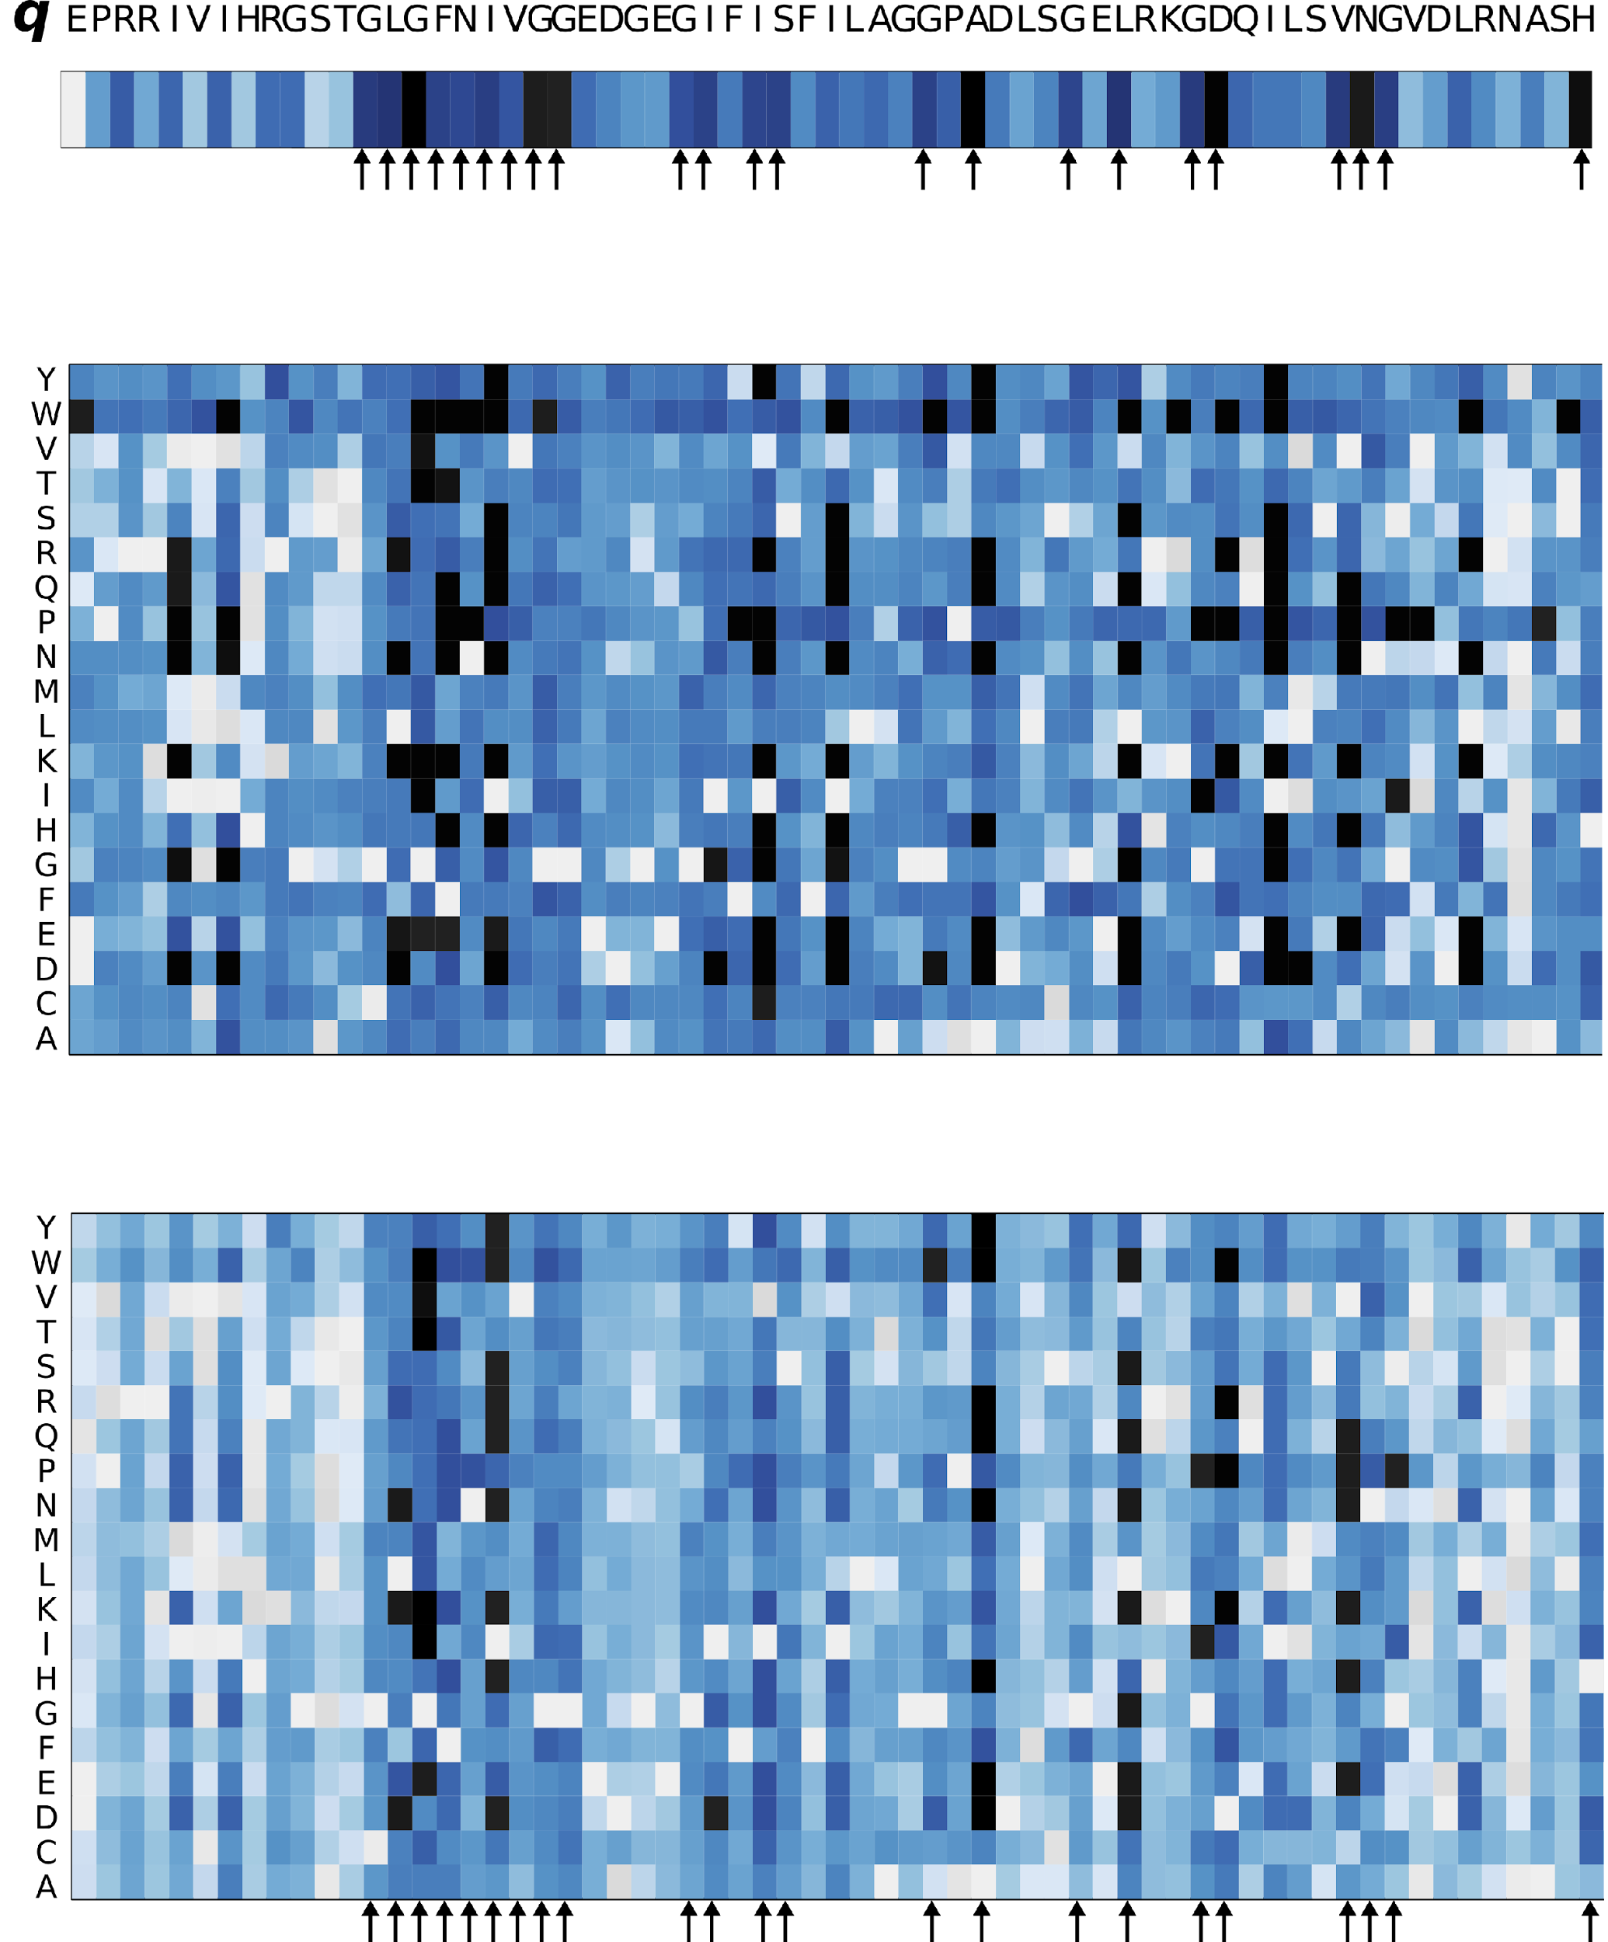
Evolution (GEMME)
The more conserved a position, the more sensitive to mutations.
Scores are used as a filter applied on the matrix of predicted effects.
High T_{JET} score positions become highly intolerant to mutations while any substitution at a poorly T_{JET} score position will have a small effect.

Slide 17
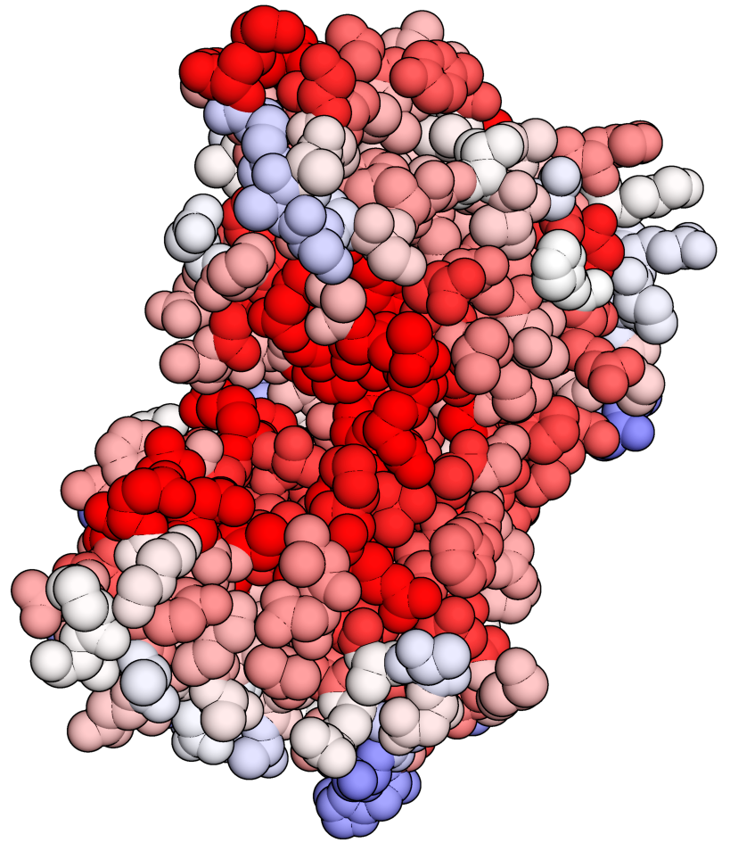
ESCOTT: Evolution + Structure
Mutations appearing in the interfaces and in the core of a protein structure are likely deleterious
[Engelen et al, 2009]

Slide 18
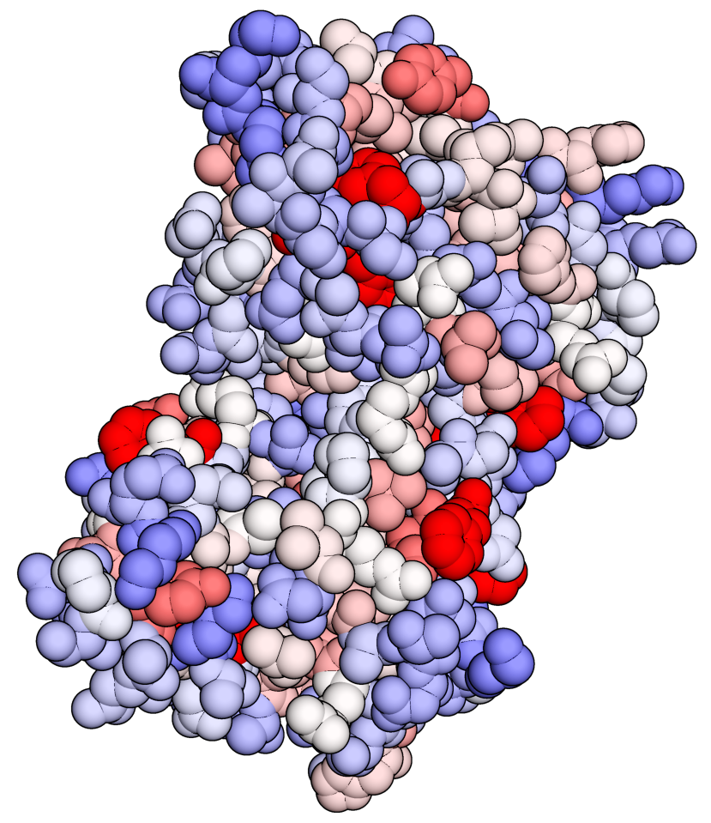
ESCOTT: Evolution + Structure
Mutations appearing in the interfaces and in the core of a protein structure are likely deleterious
stronger the physico-chemical propensity stronger the deleterious effect
Physico- chemical propensities
[Engelen et al, 2009]

Slide 19
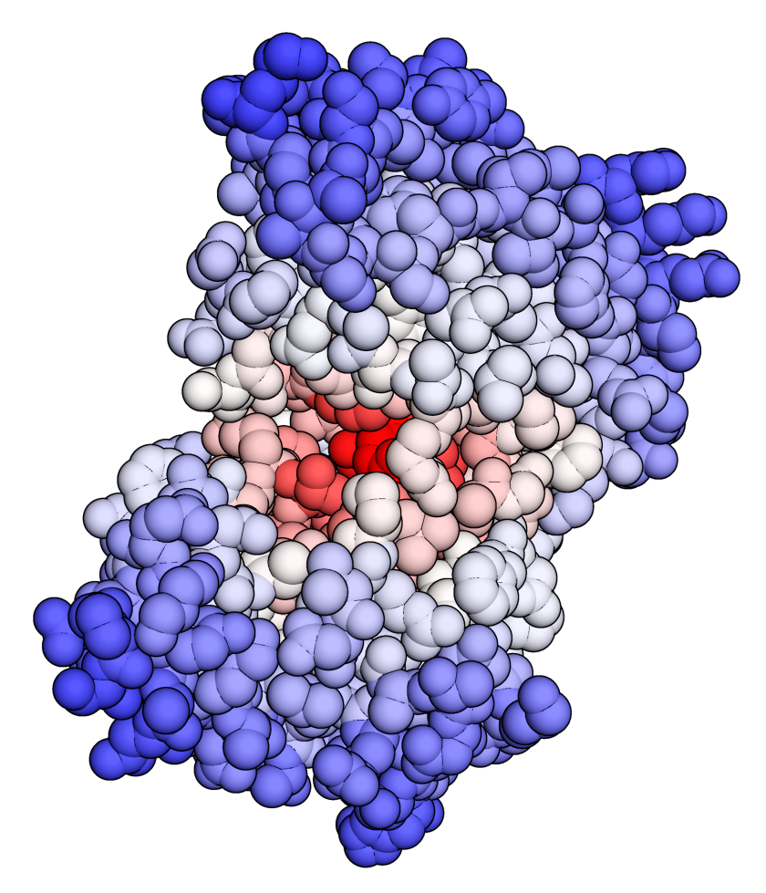
ESCOTT: Evolution + Structure
Mutations appearing in the interfaces and in the core of a protein structure are likely deleterious
stronger the physico-chemical propensity stronger the deleterious effect
higher the packing density stronger the deleterious effect
Physico- chemical propensities
Circular Variance
[Ceres et al, 2012]
[Laine and Carbone, 2016]

Slide 20
ESCOTT: Evolution + Structure
(T_{JET} + PC)/2
(T_{JET} + CV)/2
Mutations appearing in the interfaces and in the core of a protein structure are likely deleterious
stronger the physico-chemical propensity stronger the deleterious effect
higher the packing density stronger the deleterious effect
Surface
(for non-coiled regions)
[Tekpinar et al, 2025]

Slide 21
ESCOTT: Evolution + Structure
(T_{JET} + PC)/2
(T_{JET} + CV)/2
Mutations appearing in the interfaces and in the core of a protein structure are likely deleterious
stronger the physico-chemical propensity stronger the deleterious effect
higher the packing density stronger the deleterious effect
Surface
(for non-coiled regions)
[Tekpinar et al, 2025]

Slide 22
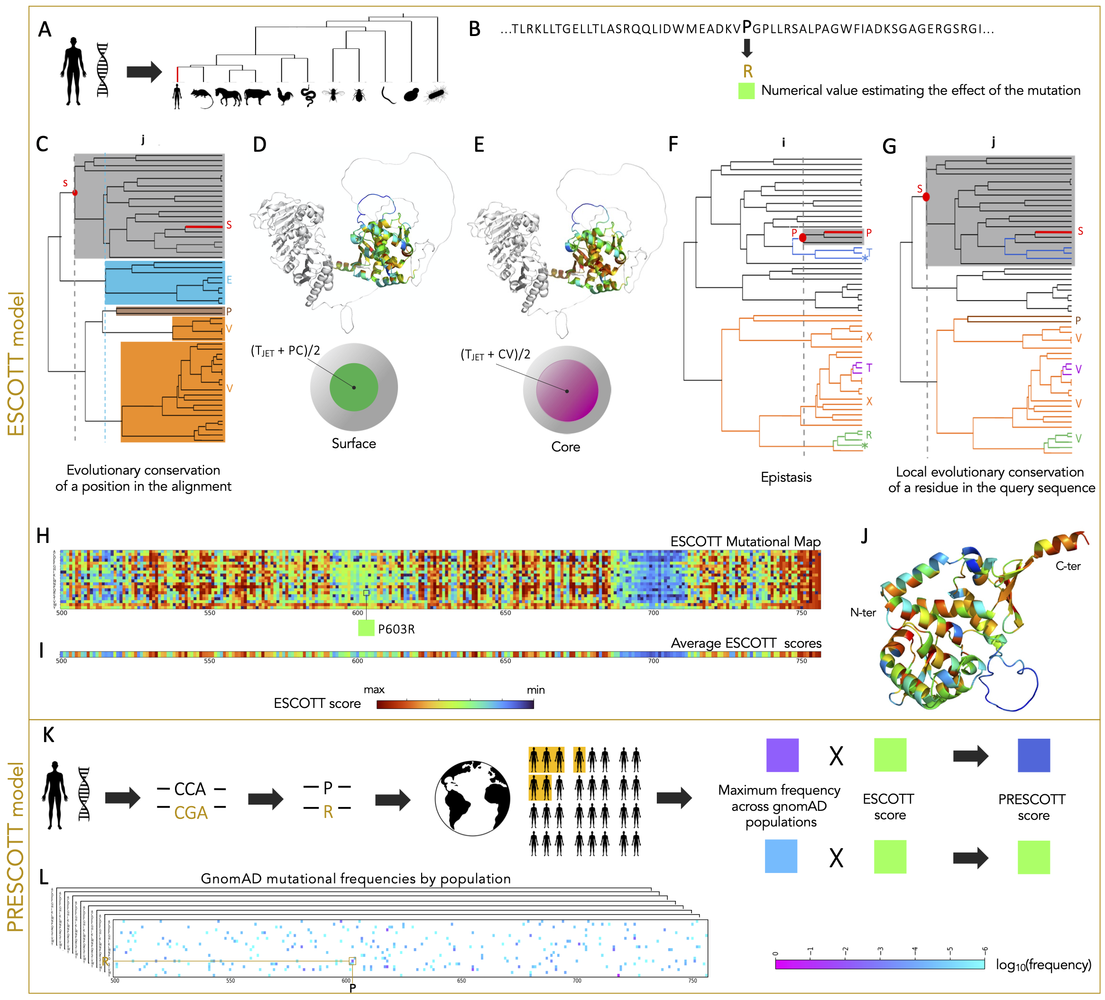
PRESCOTT: Allele frequency from human population data
gnomAD v4.0.0
730,947 individuals from 8 populations (>20,000 ind):
African/African American
Admixed American
Ashkenazi Jewish (14804 ind)
East Asian
European (Finnish)
European (non Finnish)
South Asian
Middle Eastern (3031 ind)
[Tekpinar et al, 2025]

Slide 23
PRESCOTT: Allele frequency from human population data
gnomAD v4.0.0
730,947 individuals from 8 populations (>20,000 ind):
African/African American
Admixed American
Ashkenazi Jewish (14804 ind)
East Asian
European (Finnish)
European (non Finnish)
South Asian
Middle Eastern (3031 ind)
Effect: decrease pathogenicity scores for common missense mutations
[Tekpinar et al, 2025]

Slide 24
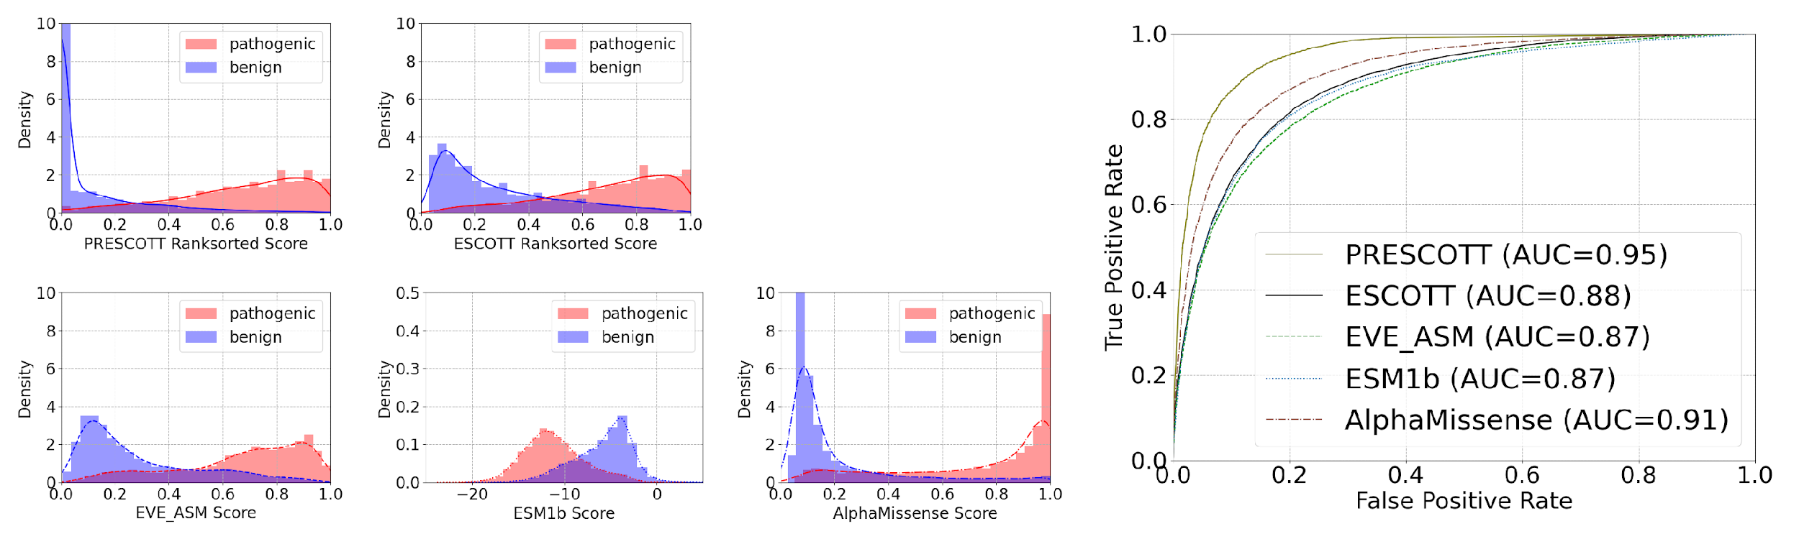
ESCOTT and PRESCOTT performances
[Tekpinar et al, 2025]

Slide 25
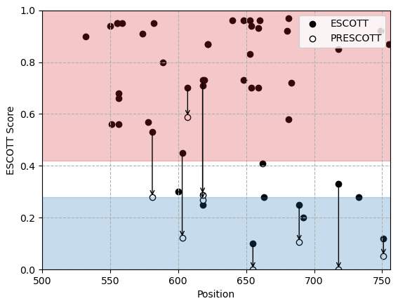
ESCOTT and PRESCOTT performances
MLH1
[Tekpinar et al, 2025]

Slide 26
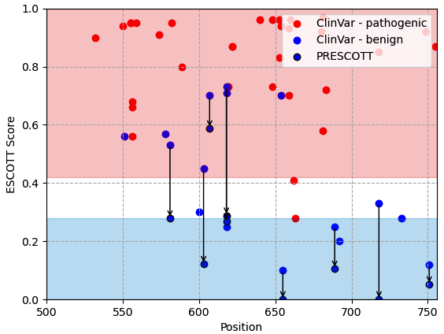
ESCOTT and PRESCOTT performances
MLH1
[Tekpinar et al, 2025]

Slide 27
ESCOTT and PRESCOTT performances
Results on 1883 human proteins from ClinVar, present in gnomAD
MLH1
[Tekpinar et al, 2025]

Slide 28
Can we further improve generalisation?
AGFHICVQVYENK
ASFHICVQVYENK
Query sequence
MGFHICVQVYQNK
MMseqs2
LGFHICVQVY-NK
AlphaFold
AGFHICVQVYENK
GSFHPLVEVYQDK
MGFHPLVEVYQDK
KGFHP-VEIY-DK

Slide 29
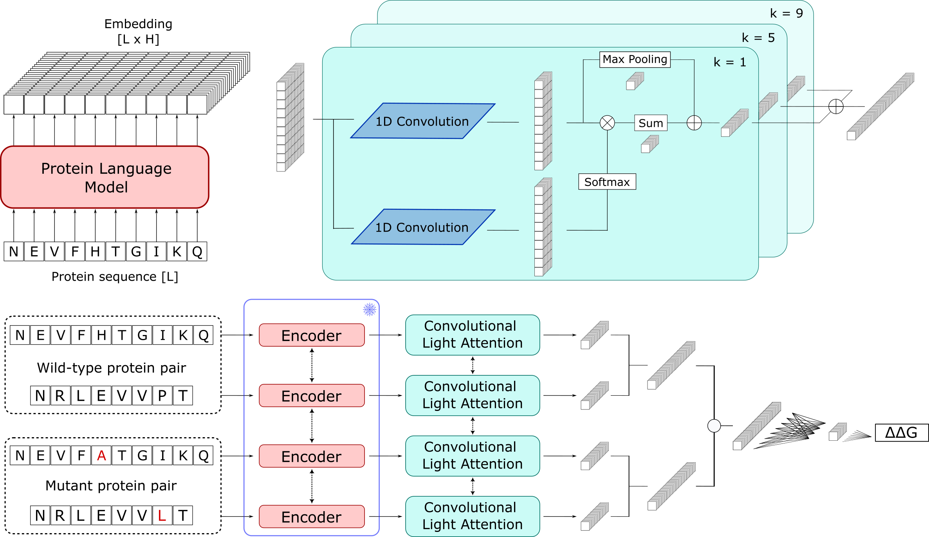
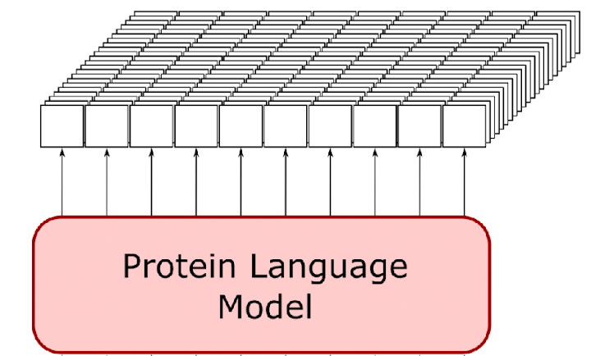
Can we further improve generalisation?
PLMs: large transformer architectures trained on protein sequences/structures
Masked LM objective:
Mask a small fraction of tokens
Predict masked tokens based on context
Context-aware embeddings
#
#

Slide 30
Can we further improve generalisation? Ensemble multiple modalities!
x N models
Different modalities:
sequence, structure, alignments
AIDO RAG 16B
ProSST-2048
ESM2-650M
ESM-IF1
AlphaMissense
…
#
#

Slide 31
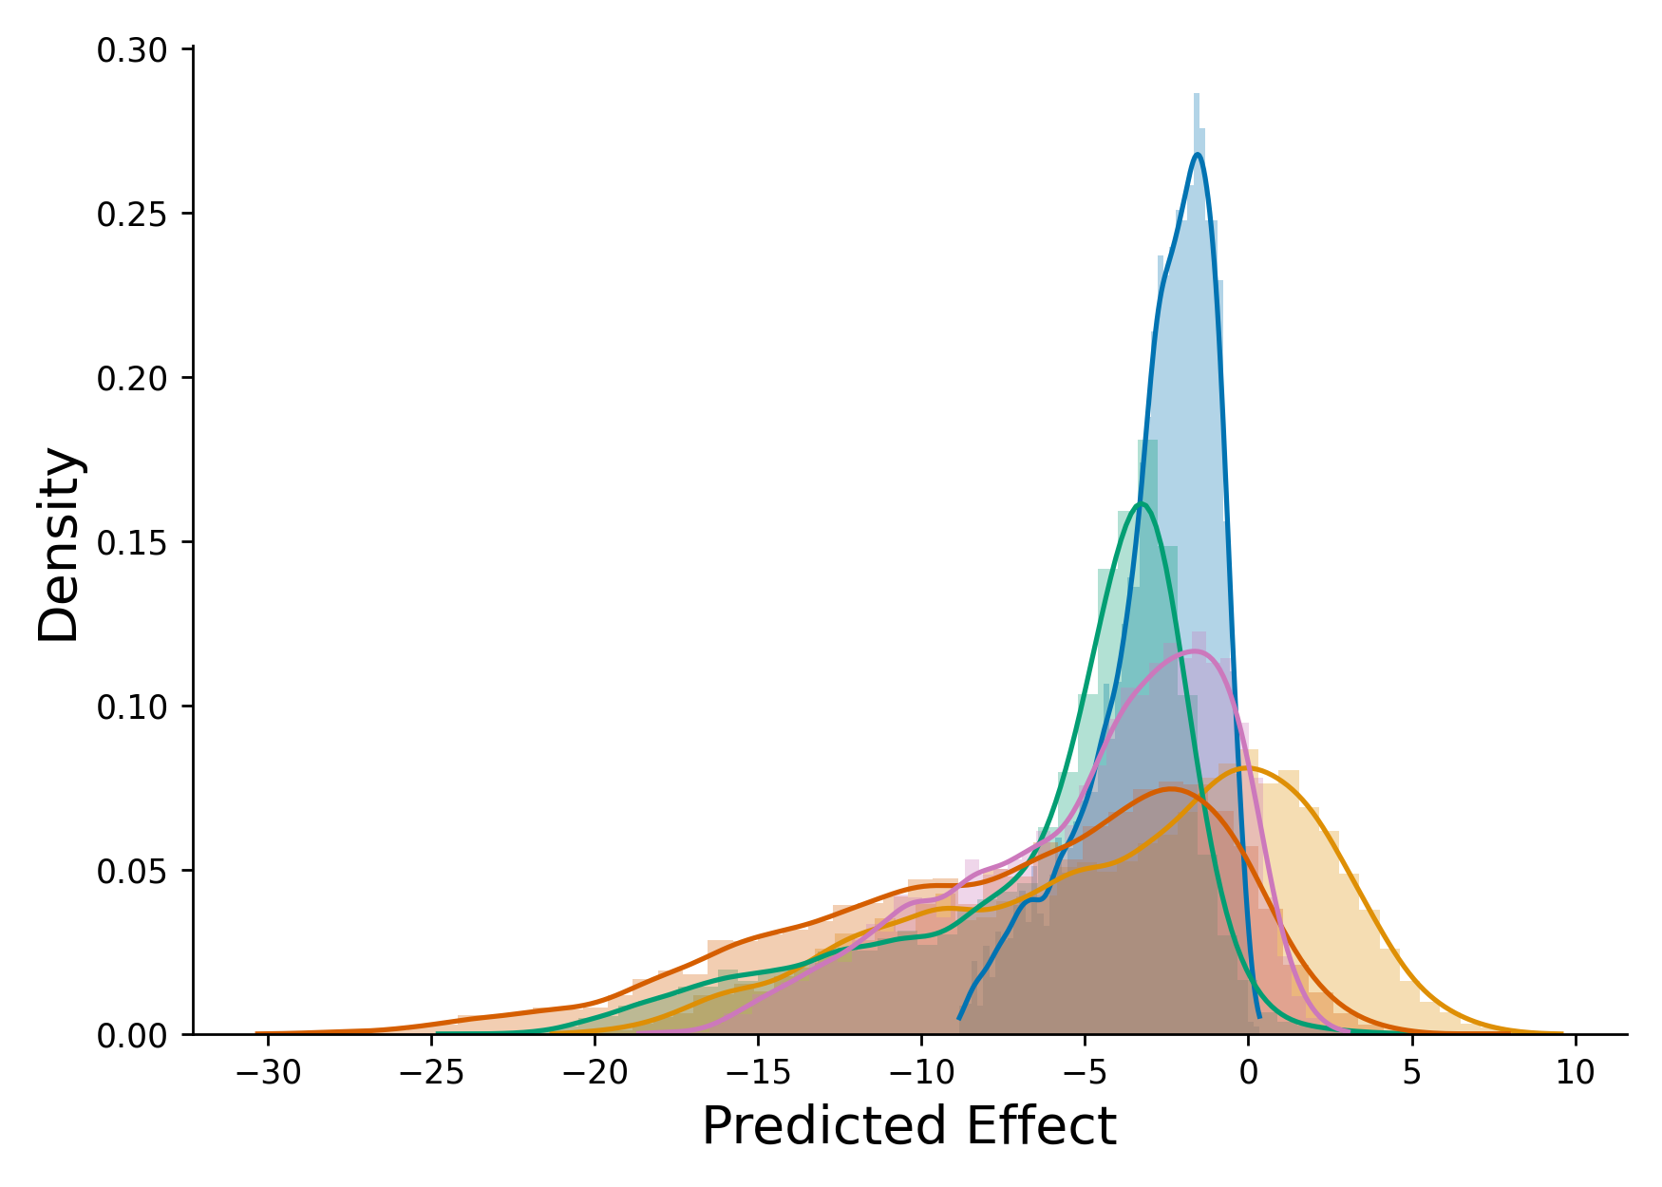
Can we further improve generalisation? Ensemble multiple modalities!
x N models
Similar distributions,
different ranges
#
#
Rescale to ESCOTT range

Slide 32
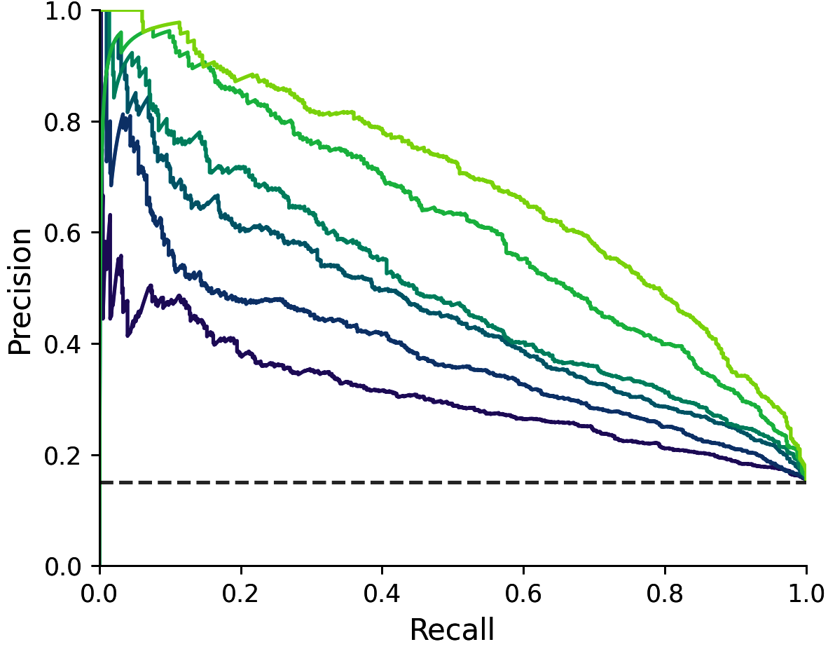
Can we further improve generalisation? Ensemble multiple modalities!
  Bagging over different combinations of models and selection
x N models
  ClinVar
  ProteinGym
  Available validation data
#
#

Slide 33
Example: ARSA challenge
Goal: prediction of stability scores at 48h post expression for (almost) all missense variants
Available data: Subset of experimental scores for 4% mutations

Slide 34
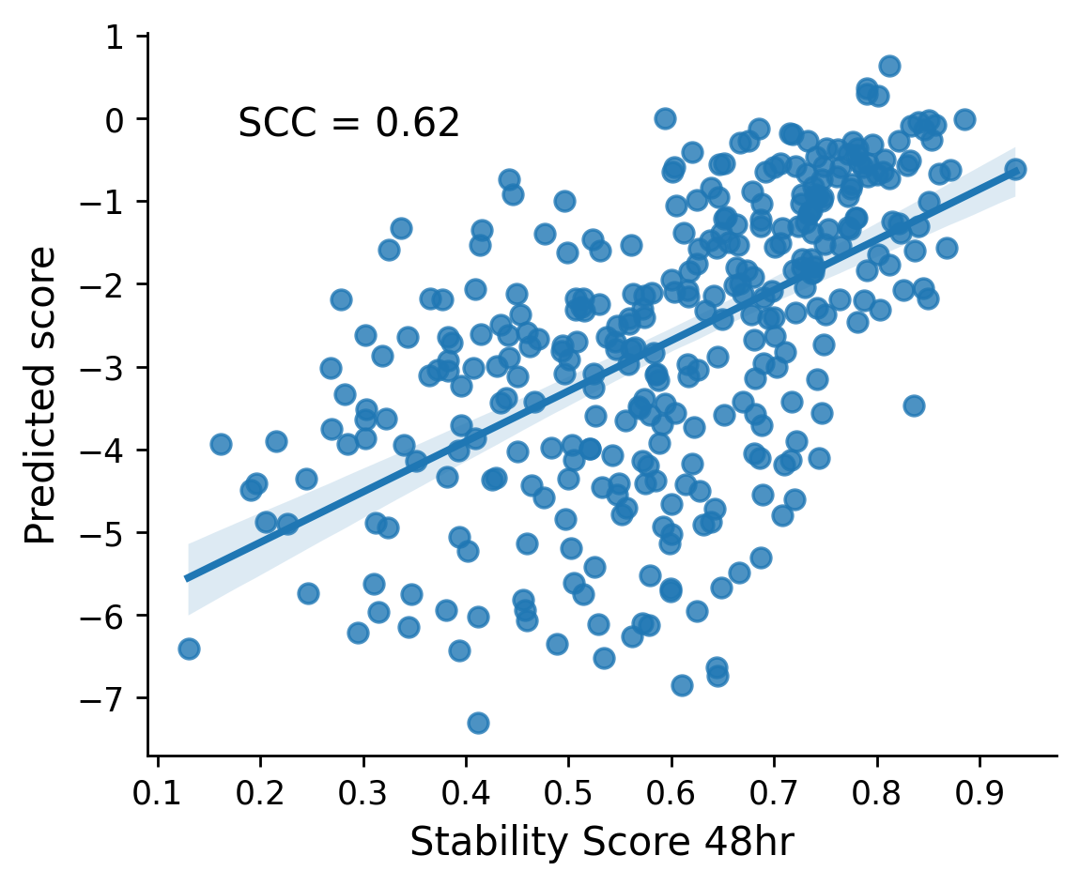
Example: ARSA challenge
Goal: prediction of stability scores at 48h post expression for (almost) all missense variants
Available data: Subset of experimental scores for 4% mutations
Validation set
Selection
Correlations on validation data
ESCOTT + AIDO RAG 16B
[Sun et al, 2024]

Slide 35
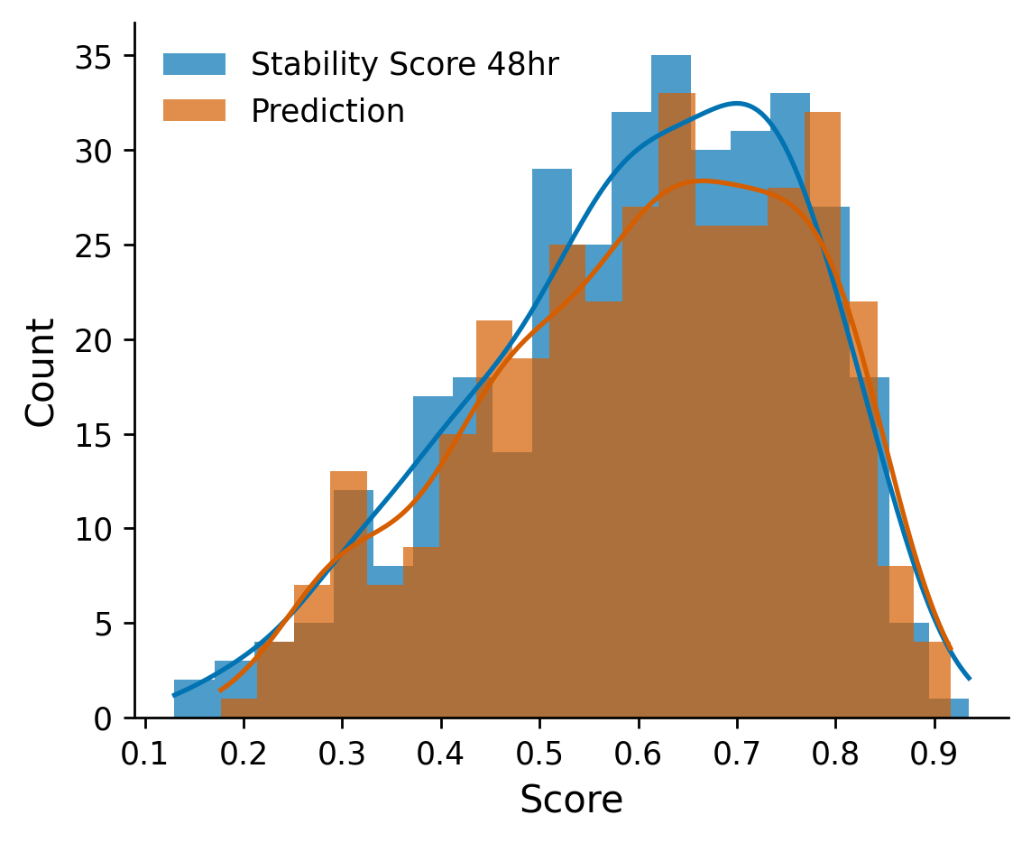
Example: ARSA challenge
Goal: prediction of stability scores at 48h post expression for (almost) all missense variants
Available data: Subset of experimental scores for 4.4% mutations
Validation set
Selection
Affine
Rescaling
Fit params on experimental data
+
Ensure low KL divergence
Correlations on validation data
ESCOTT + AIDO RAG 16B
[Sun et al, 2024]

Slide 36
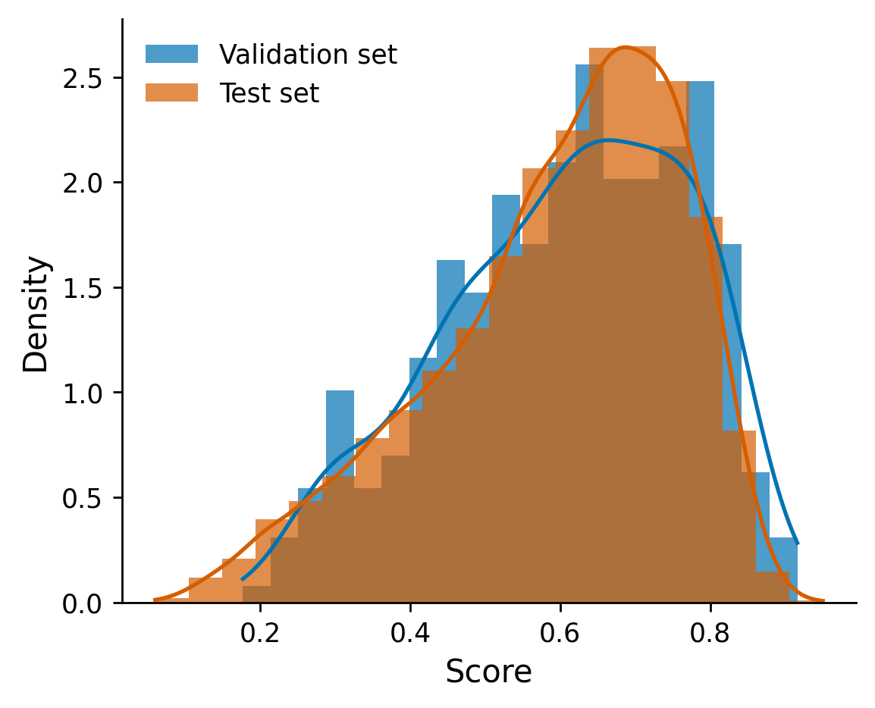
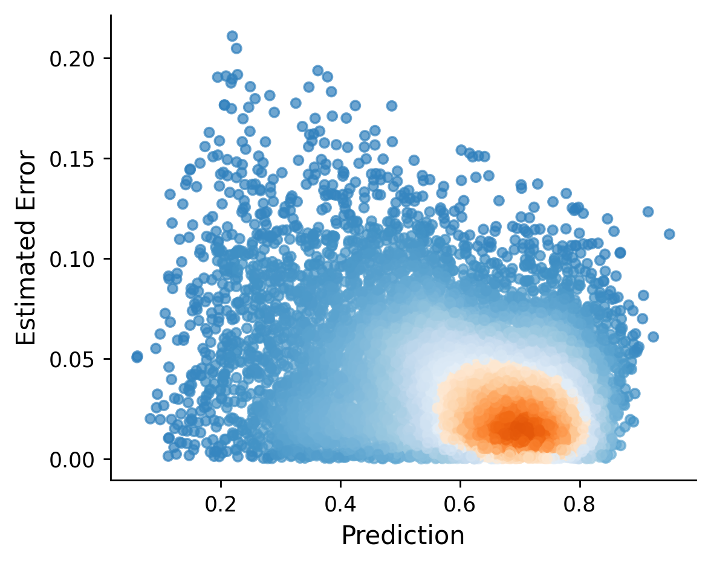
Example: ARSA challenge
Goal: prediction of stability scores at 48h post expression for (almost) all missense variants
Available data: Subset of experimental scores for 4.4% mutations
Apply transformation to test data and errors estimates

Slide 37

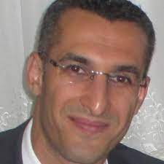
Acknowledgments
Alessandra Carbone
Mustafa Tekpinar

Slide 38


Acknowledgments
PRESCOTT article
Alessandra Carbone
Mustafa Tekpinar
PRESCOTT webserver

Slide 40
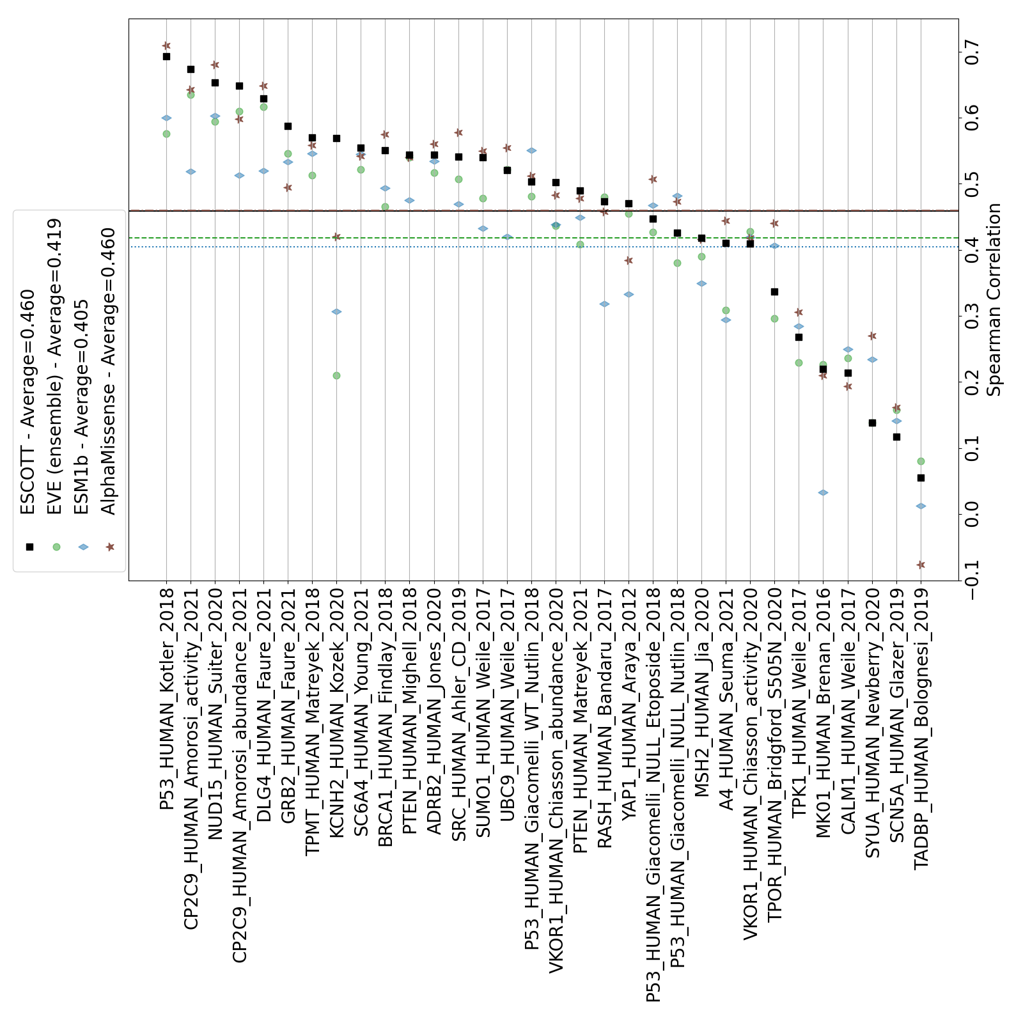
ESCOTT and PRESCOTT performances
Deep mutational scanning experiments on human proteins
[Tekpinar et al, 2025]

