Slide 1

CAGI 7 slide pack guidelines
I agree to my slides being used according to the following terms:
_______Kyungkeon Chung_______
Authors: please include THIS slide at the beginning of your presentation to indicate that you agree with reuse of your slides in CAGI presentations, according to the terms below, and digitally sign by writing your name above.
At CAGI 7, use of this slide pack is only required for CAGI dataset providers, assessors, and predictors, but all are encouraged to use the annotations for materials they do not want shared publicly.
To disseminate the CAGI results, I encourage all CAGI participants to remix these CAGI slides for inclusion in their oral and poster presentations
CAGI participants may use or publish any content of these slides only in compliance with the CAGI Data Use Agreement
CAGI participants may not cite or publish any content of these slides except with the written permission of the originating author or in the primary CAGI publications
CAGI participants must acknowledge the original authors of these slides and CAGI 7. Include the acknowledgement banner across the bottom
CAGI participants must include the CAGI credits slide in their presentations
Slides with a red slash (no remix) may not be included in a presentation unless all attendees are registered CAGI participants who signed the data use agreement
Slides with a red X over the entire slide may not be used in any circumstances
Slides with a blue slash (embargoed) may not be used unless the embargo is explicitly lifted
Slides without slash or X may be tweeted, tooted, posted, X’d unless flagged with “No tweet” icon
CAGI participants using these slides must explain the “No tweet” icon, which means that the slide content should not be disseminated outside the presenting conference hall. If the presentation venue permits pervasive tweeting, you may not include these slides in your talk
Note for slide authors: we expect all CAGI participants to abide by these restrictions, and will make best effort to ensure they are followed. However, but bear in mind that we have limited means of enforcing them, and therefore the restrictions cannot be guaranteed.

Slide 2
Multimodal Prediction of TSC2
Protein Stability
Kyungkeon Chung
UX Factory Inc.
South Korea
Created for CAGI 7
genomeinterpretation.org
Kyungkeon Chung
Notes:
Hello, my name is Kyungkeon Chung from UX Factory in South Korea.
I’m very pleased to be here today and to share our work with you.
Today, I’d like to introduce our approach for predicting the stability of TSC2 missense variants using a multimodal framework.

Slide 3

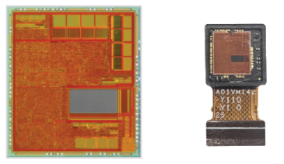
UX Factory Inc.
  AI Platform • Edge AI • FPGA/ASIC Acceleration
Bio-AI Research Team
  Efficient Bio-medical Data Analysis
  Members
    Kyungkeon Chung, Jaekyung Lee, Chungheorn Lee,
    Yutae Kim, Hyejin Lee, Junyoung Park
Created for CAGI 7
genomeinterpretation.org
Kyungkeon Chung
Notes:
Before I begin, let me briefly introduce who we are.
We are UX Factory — a South Korea–based company that designs edge-AI semiconductors and develops the full stack from AI algorithms all the way down to custom hardware.
Within UX Factory, our Bio-AI research team focuses on building efficient and scalable methods for analyzing complex biomedical data.

Slide 4
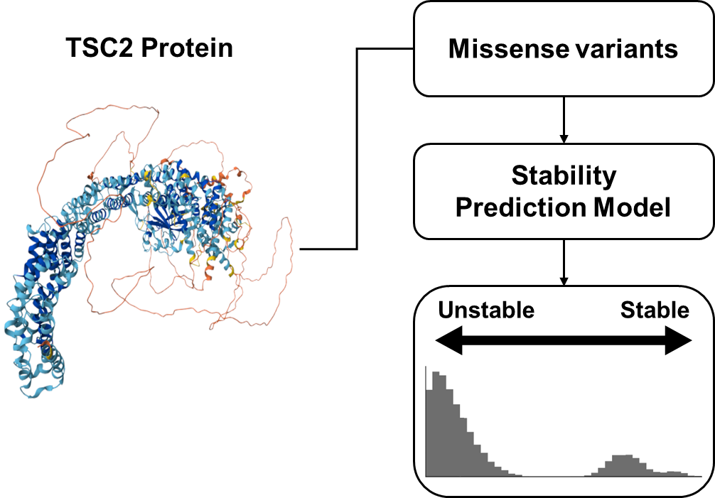
What is the TSC2 challenge?
Created for CAGI 7
genomeinterpretation.org
Kyungkeon Chung
Notes:
First let me explain what the TSC2 challenge is.
We are given a large number of missense variants in the TSC2 protein, and the goal is to predict how each mutation affects its stability.
This is meaningful because TSC2 works together with TSC1 as a large regulatory complex, and its stability is critical for the complex to function properly.
If one side of the complex becomes unstable due to a mutation, the entire assembly can be affected.
This has downstream impact on important biological processes, especially in tissues like the brain and lungs.
So predicting how mutations change its stability gives us valuable insight into its functional impact.
But predicting the stability of TSC2 is not a easy task.
Protein stability can be affected by many different factors, such as evolutionary pressure across species and the local structural environment around the mutation.
This complexity makes accurate prediction quite challenging.
So based on these challenges, here is the idea behind our approach.

Slide 5
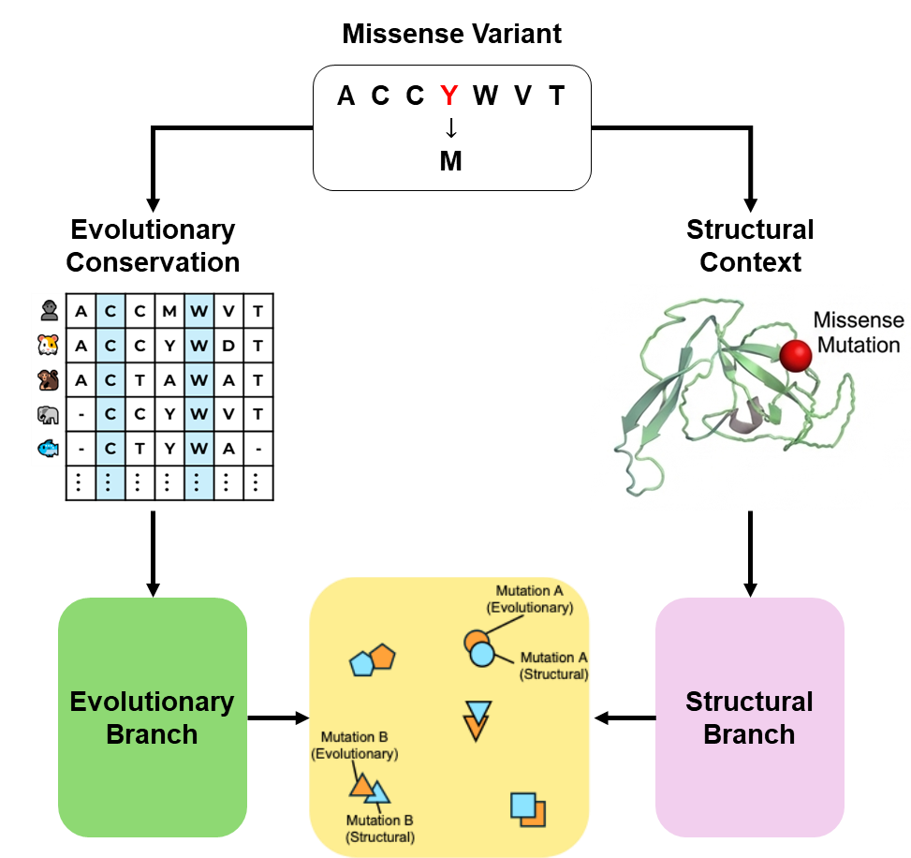
Our idea
Created for CAGI 7
genomeinterpretation.org
Kyungkeon Chung
Notes:
To model stability changes effectively, we focus on the two most fundamental sources of information:
evolutionary conservation and local structural context.
Evolutionary conservation tells us which residues are important across species.
These patterns reveal which residues are conserved or tend to change together with nearby residues, helping us understand how sensitive each site is to mutation.
On the other hand, structural context tells us how the surrounding environment is organized around the residue.
Understanding this local structure is crucial, because the physical layout determines how a mutation will actually affect stability.
But yet most models use only one of these information and often give inconsistent results.
In our approach, we build a multimodal framework that uses both sources of information together, allowing the model to integrate complementary evolutionary conservation and structural context.
To train this representation, each missense variant from the ClinVar database is preprocessed into two inputs:
one prepared for the evolutionary branch, and another prepared for the structural branch.
Each branch then processes its corresponding input and produces an embedding.
During training, the model learns to pull the two embeddings of the same mutation closer together, and to push embeddings of different mutations farther apart.
In simple terms, similar mutations naturally cluster, while mutations with different effects separate clearly in the embedding space.
Now I’ll move on to how this representation is implemented in our model architecture.

Slide 6
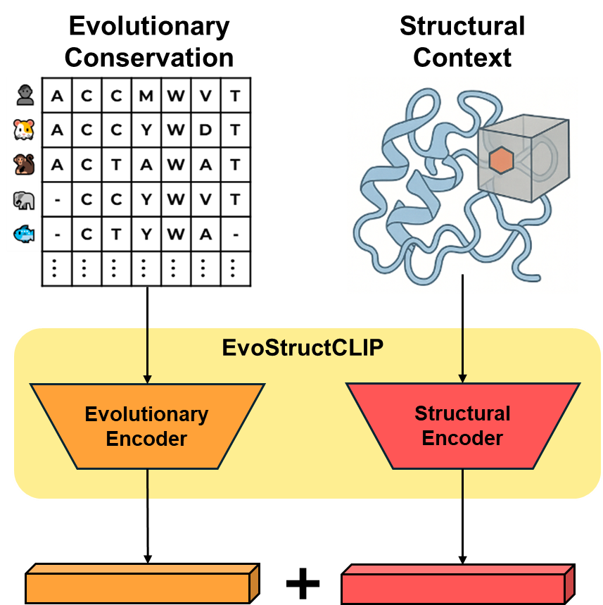
EvoStructCLIP overview
Created for CAGI 7
genomeinterpretation.org
Kyungkeon Chung
Notes:
Here, we illustrate how this idea is realized in our EvoStructCLIP architecture.
Our model encodes evolutionary conservation and structural context.
These are not two separate models — they are two coordinated branches within a single EvoStructCLIP framework,
trained together to learn a unified mutation representation.
Evolutionary encoder encode evolutionary conservation from the MSA.
Structural encoder extract the local Structural environment around the mutation.
These two embeddings together form the core of our stability representation for each variant.
Now, let’s look at how each branch is implemented inside the model.

Slide 7
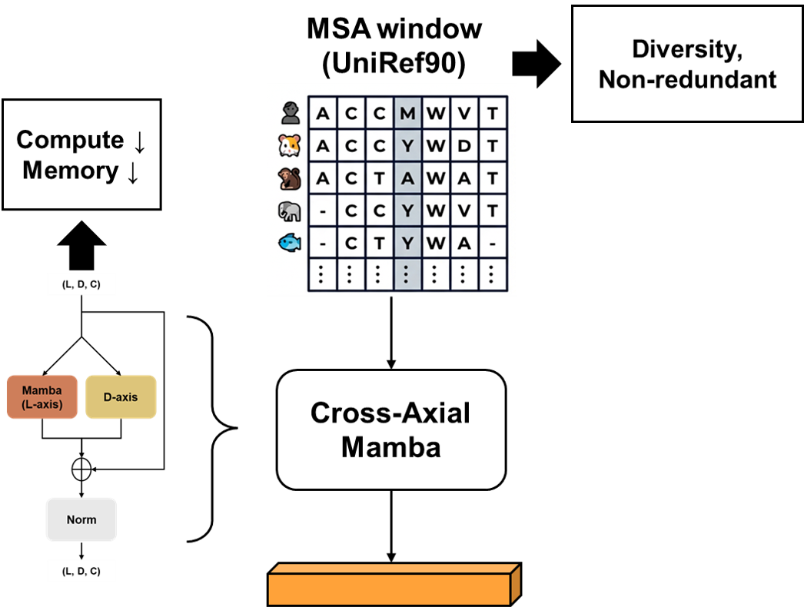
Evolutionary Branch
Created for CAGI 7
genomeinterpretation.org
Kyungkeon Chung
Notes:
First, the evolutionary branch.
For each variant, we construct a local MSA window using UniRef90, which provides a diverse and low-redundancy set of homologs.
This MSA window is then processed by our Cross-Axial Mamba encoder, which models both the sequence axis and the depth axis.
We processed this sequential data using the mamba module instead of standard transformer.
Because Mamba gives us the benefits of sequence modeling while keeping compute low, memory low, and overall inference efficient.
The output is an evolutionary embedding summarizing conservation around the mutation.

Slide 8
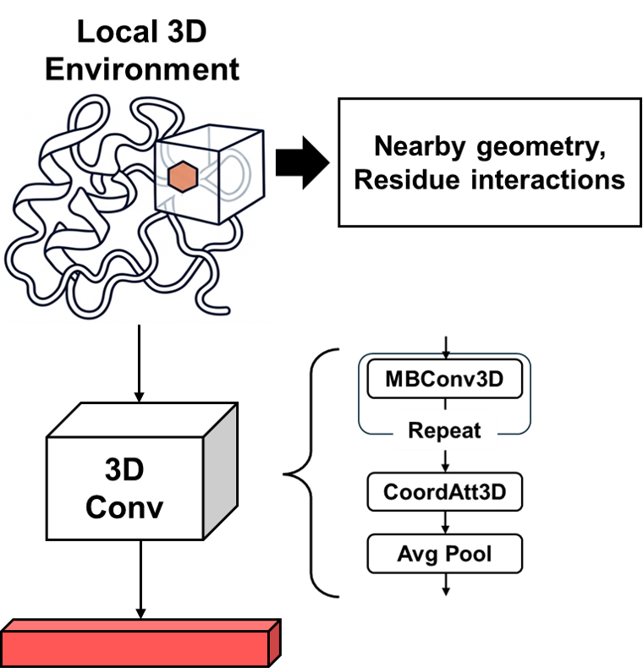
Structural Branch
Created for CAGI 7
genomeinterpretation.org
Kyungkeon Chung
Notes:
Next, the structural branch.
Here, we focus on the local topology environment around the mutated residue.
We extract a local topology around the mutation from the AlphaFold prediction of protein structurals, capturing the nearby geometry and residue interactions that can influence stability.
This is then processed by 3D convolutional neural network module.
The output is a structural embedding that summarizes the local physical environment around the mutation.
Together with the evolutionary embedding from the previous slide,
these two embeddings are concatenated to form a single unified representation for each variant.
This concatenated representation serves as the input to our downstream stability regression model.
And on the following slides, I’ll explain how the predictors are trained using this representation.

Slide 9
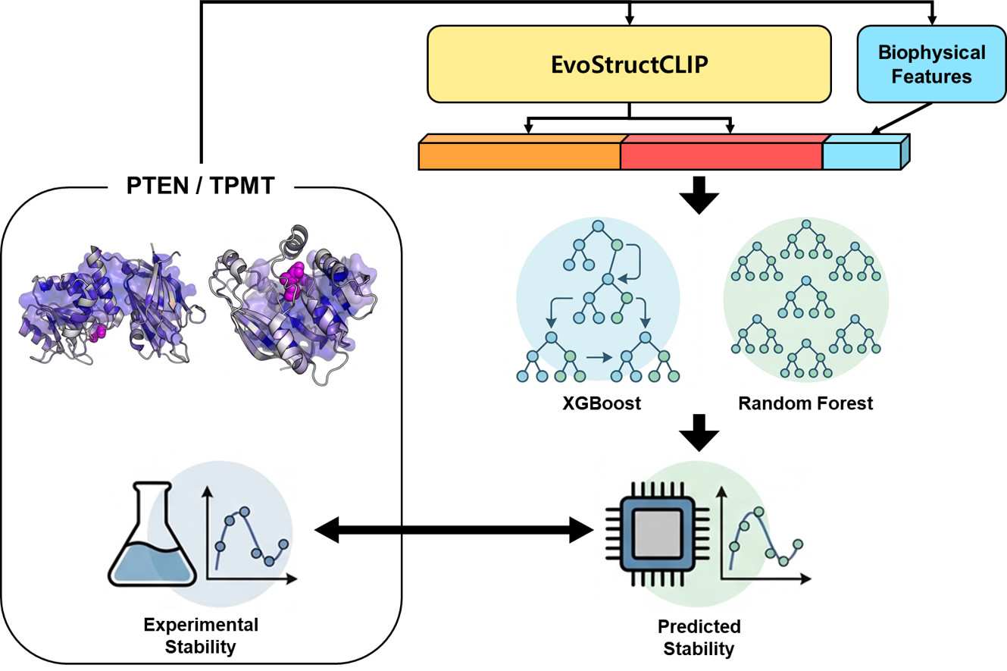
Training the Stability Predictors
Confidence
Energetics
Flexibility
Physicochemical
Topology
Geometry
Created for CAGI 7
genomeinterpretation.org
Kyungkeon Chung
Notes:
We concatenate the two EvoStructCLIP embeddings with the biophysical descriptors to form a single representation for each variant.
The biophysical descriptors are shown in the box on the right.
This unified vector is then used to train two regressors, XGBoost and Random Forest.
Since TSC2 has no experimental measurements, we train these regressors on PTEN and TPMT VAMP-seq data, which are generated using the same assay.
PTEN and TPMT variants are provided as input to our model, and the regressors are trained to match their experimental stability values.
Each regressor — XGBoost and Random Forest — is trained through cross-validated training, producing multiple models, and we combine all of their outputs into a single ensemble prediction to increase robustness.
After learning this mapping, our trained model is applied directly to TSC2 to generate its stability scores.

Slide 10
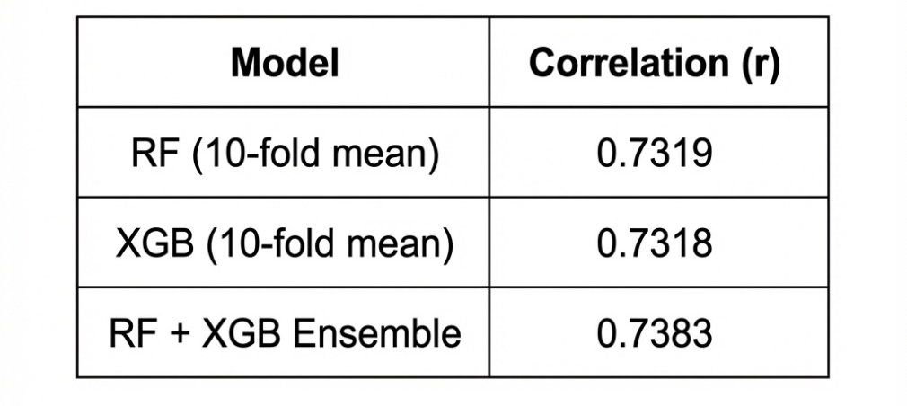
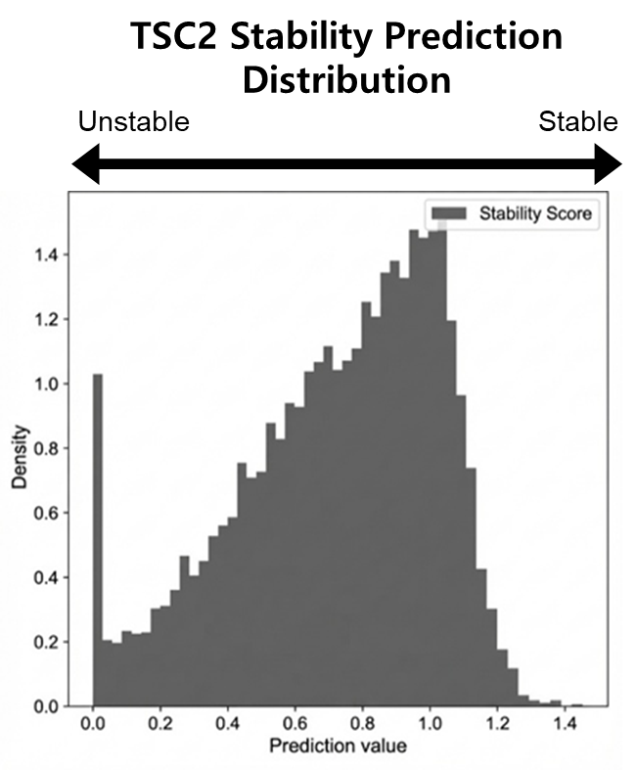
Results
PTEN/TPMT test result
Strong Correlation with Experimental Stability
Created for CAGI 7
genomeinterpretation.org
Kyungkeon Chung
Notes:
And here are the results from this training setup.
We first evaluate the predictors on PTEN and TPMT.
Both Random Forest and XGBoost were trained using 10-fold cross-validation, so each number represents the mean Pearson correlation across the same held-out test set.
We then average the predictions from all 20 models to obtain the ensemble score shown at the bottom.
The ensemble achieves the highest agreement with the experimental stability measurements.
Using this ensemble model, we generated stability scores for all TSC2 missense variants.
Below is the predicted stability distribution, where values toward the left indicate more unstable variants, and values toward the right correspond to more stable ones.

Slide 11
Discussion
Our representation demonstrated strong performance on PTEN and TPMT, showing that combining evolutionary signals and local structural context is highly effective for stability prediction.
Given this behavior, we expect our TSC2 predictions to also align well with experimental outcomes once they become available.
As future work, we plan to expand this approach to additional proteins to evaluate its generality across different structural and evolutionary contexts.
Created for CAGI 7
genomeinterpretation.org
Kyungkeon Chung
Notes:
Now that we’ve seen how the model behaves, let’s discuss what this means.
Our representation demonstrated strong performance on PTEN and TPMT, showing that combining evolutionary signals and local structural context is highly effective for stability prediction.
Given this behavior, we expect our TSC2 predictions to also align well with experimental outcomes once they become available.
As future work, we plan to expand this approach to additional proteins to evaluate its generality across different structural and evolutionary contexts..

Slide 12
Thank you
Created for CAGI 7
genomeinterpretation.org
Kyungkeon Chung
Notes:
Thank you.
My name is Kyungkeon Chung, and that concludes my presentation.

Slide 13
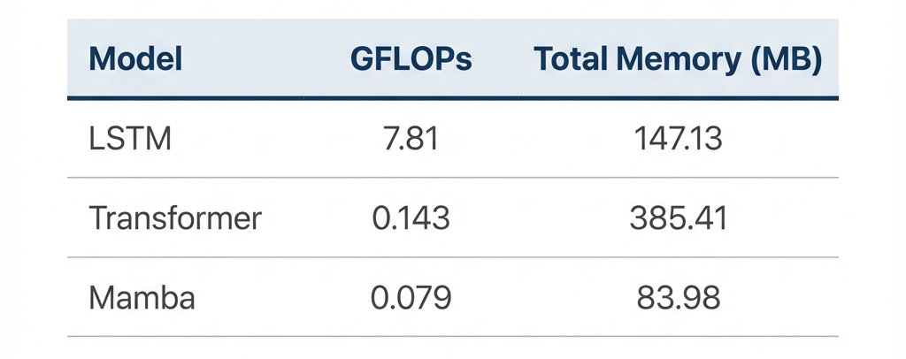
Appendix - Why Mamba for MSA Encoding?
Compute ↓ Memory ↓ Efficient ↑
Created for CAGI 7
genomeinterpretation.org
Kyungkeon Chung

Slide 14
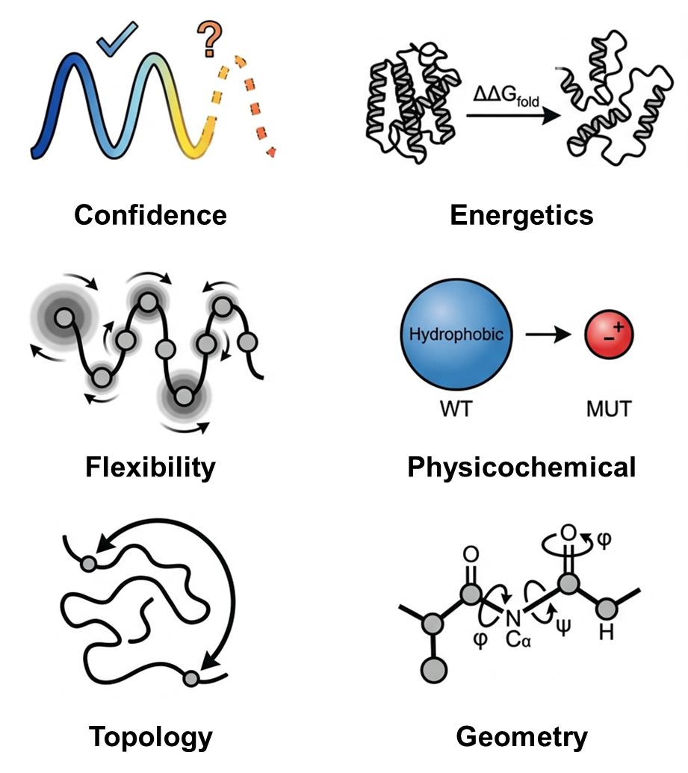
Appendix - Biophysical Features
Created for CAGI 7
genomeinterpretation.org
Kyungkeon Chung

