Slide 1
Measuring the steady-state abundance of ~9,000 TSC2 variants VAMP-seq
CAGI, 2025
Douglas M. Fowler, Ph. D.
Professor, Genome Sciences
University of Washington

Slide 2
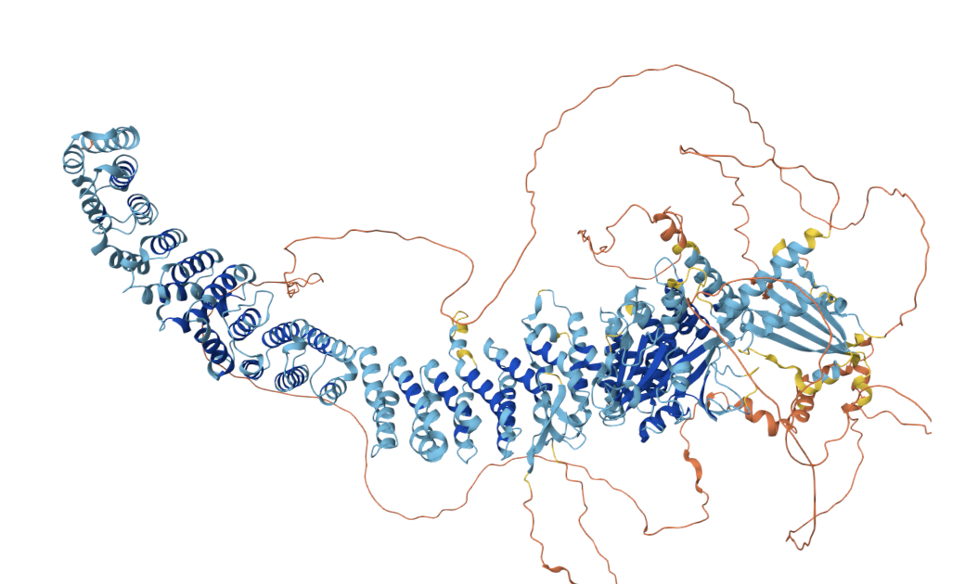
TSC2 is a tumor suppressor in the mTOR pathway
Tuberous sclerosis complex (TSC) is an autosomal dominant disorder characterized by the development of hamartomas
Affects approximately 1 in 10,000 individuals and is caused by inactivating mutations in TSC2
Forms a complex with TSC1
Dufner Almeida et al., Human Mutation 2019
Notes:
The resulting distribution of scores clearly separates expected abundance phenotypes.
Synonymous variants cluster around WT, which is set at 1.
Nonsense variants are at the lowest end, around 0.
And the missense variant scores span this range.

Slide 3
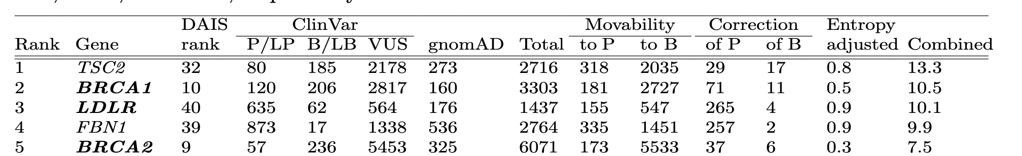

We targeted TSC2 because variant effect data would be particularly impactful
Criteria
Movability scores to prioritize genes with the most VUS moving to non-VUS categories
Correction scores to prioritize genes with the most pathogenic and/or benign variants that could be reclassified
Uncertainty scores to prioritize genes with VUS for which predictors used in clinical classification exhibit the greatest uncertainty
Chen, …, Radivojac, Pejaver, Pac Symp Biocomput. 2023
Notes:
The resulting distribution of scores clearly separates expected abundance phenotypes.
Synonymous variants cluster around WT, which is set at 1.
Nonsense variants are at the lowest end, around 0.
And the missense variant scores span this range.

Slide 4
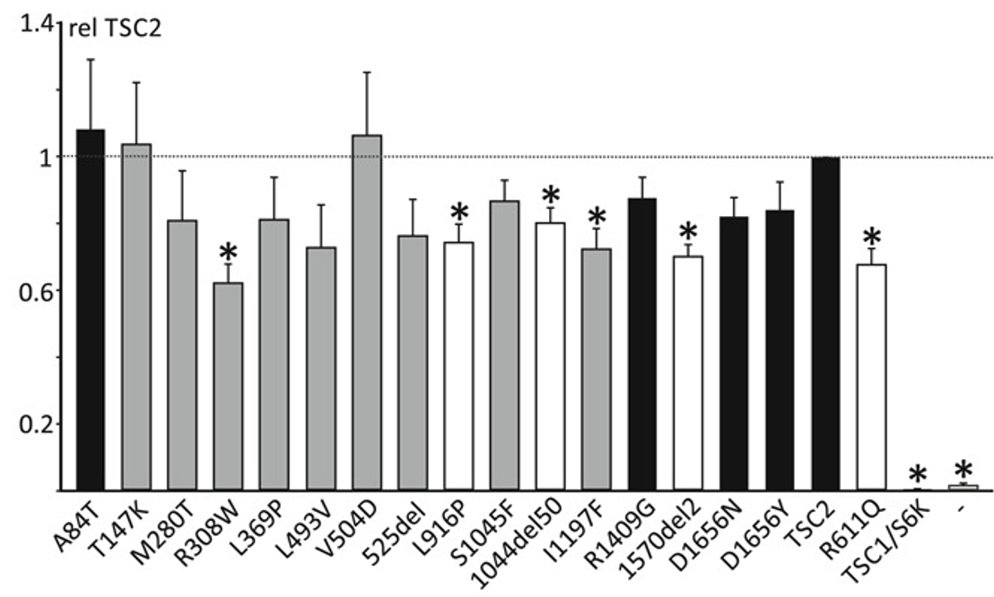
~50% of TSC2 pathogenic variants exhibit loss of abundance
Dufner Almeida et al., Human Mutation 2019
Notes:
The resulting distribution of scores clearly separates expected abundance phenotypes.
Synonymous variants cluster around WT, which is set at 1.
Nonsense variants are at the lowest end, around 0.
And the missense variant scores span this range.

Slide 5
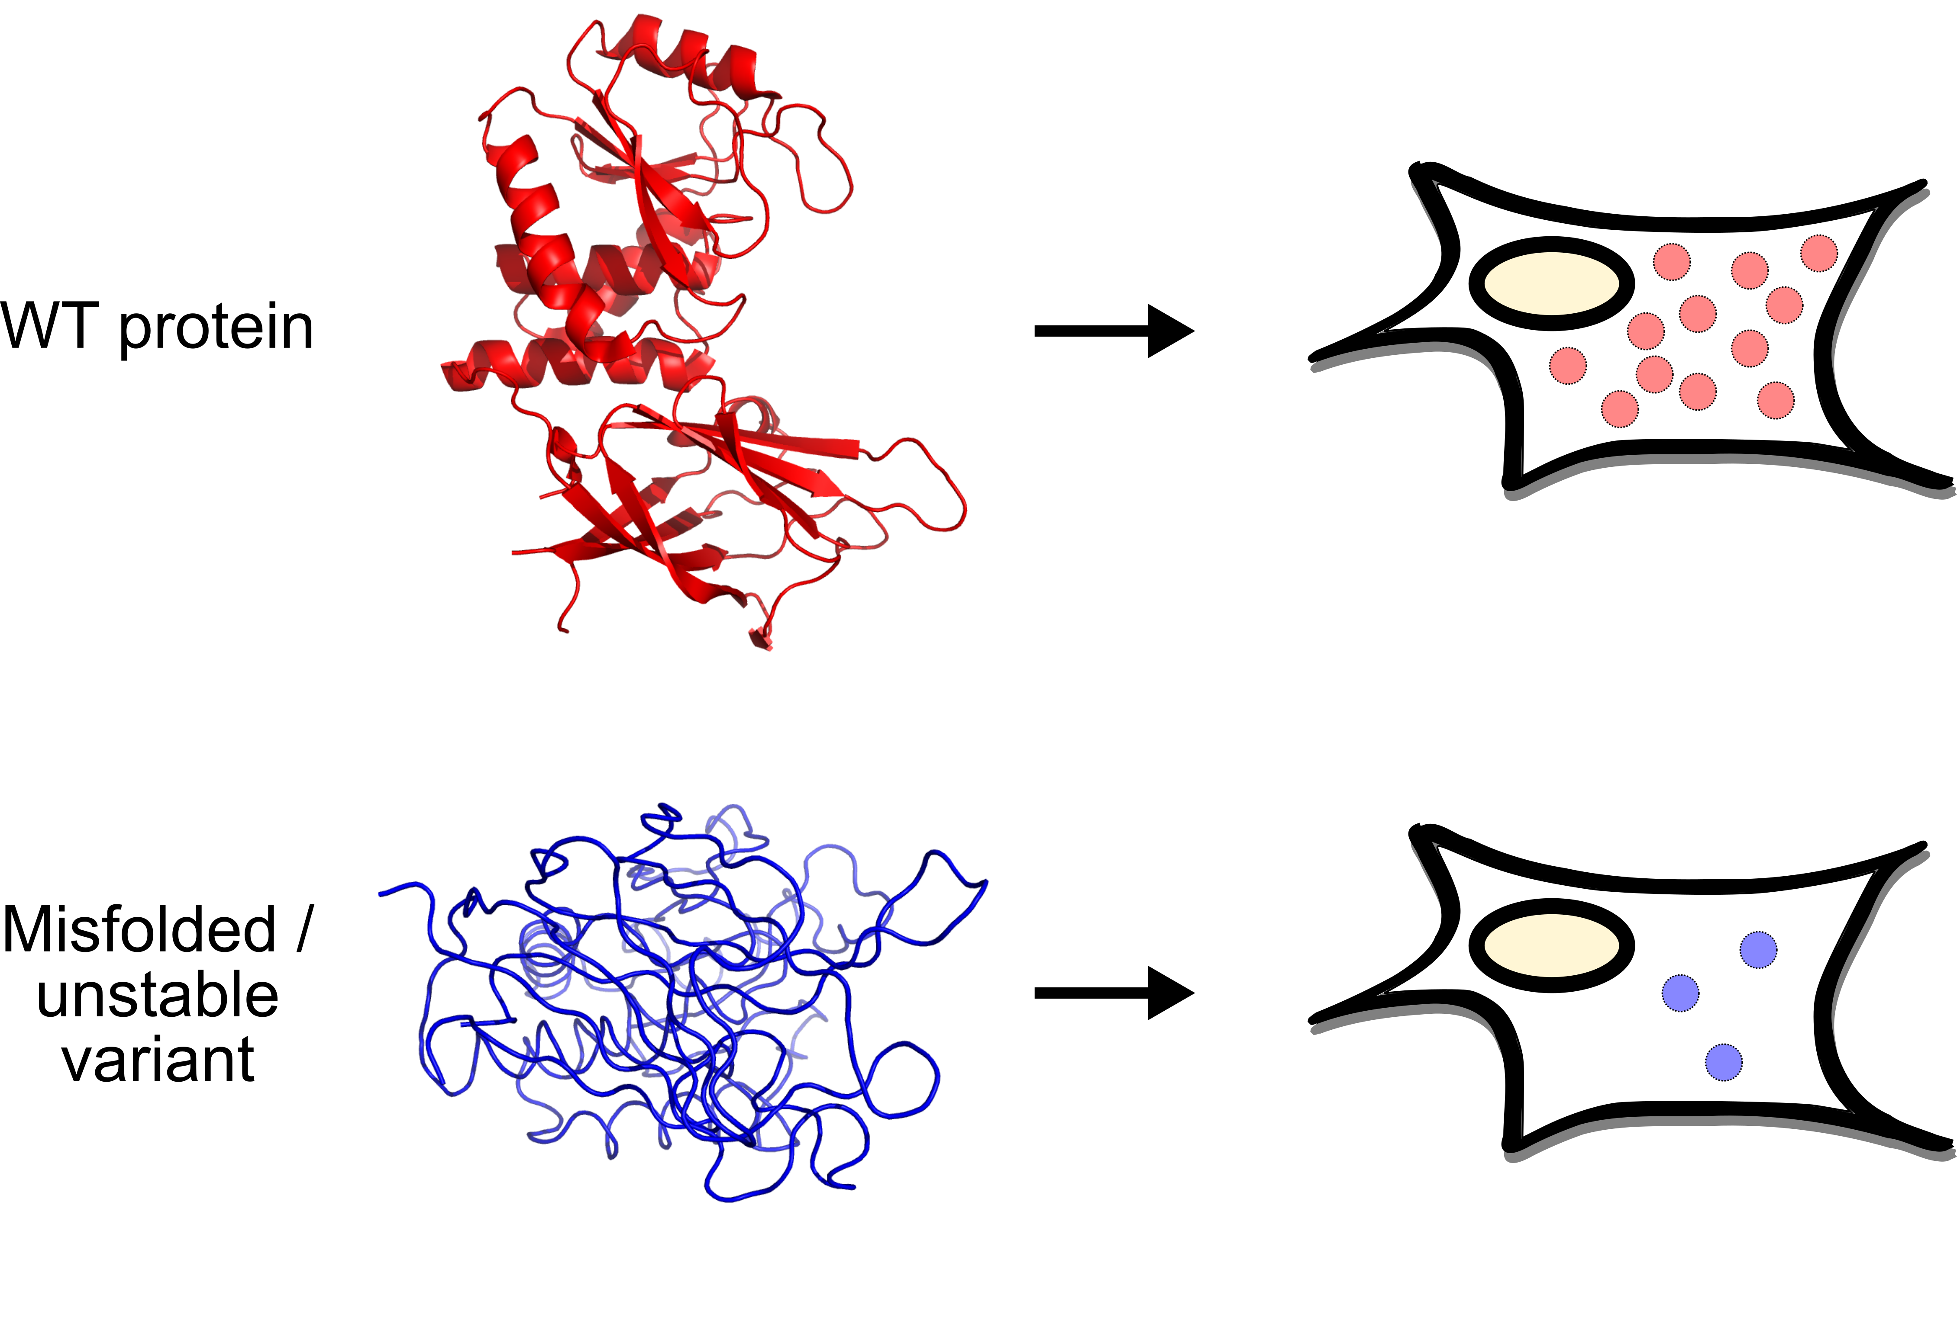
Proteins need to be correctly folded and stable to function
Notes:
To find a generalizable assay, we looked to a fundamental feature of protein function, which is that almost all proteins have to be correctly folded and stable to do their jobs.

Slide 6
Loss of stability and, consequently, abundance is major mechanism of pathogenicity
Notes:
Oftentimes when a protein sequence becomes altered, the variation causes the protein to mis-fold and become less stable.
This results in lower total amounts of protein at steady-state, which we refer to as lowered protein abundance in cells.
Importantly, this phenotype is a major contributor to disease, such as with the CFTR deltaF508 variation, which causes cystic fibrosis in homozygous individuals.
Notably, there are estimates that as low as 1/3 and as high as 3/4 of all monogenic disease-causing variants reduce protein stability.

Slide 7
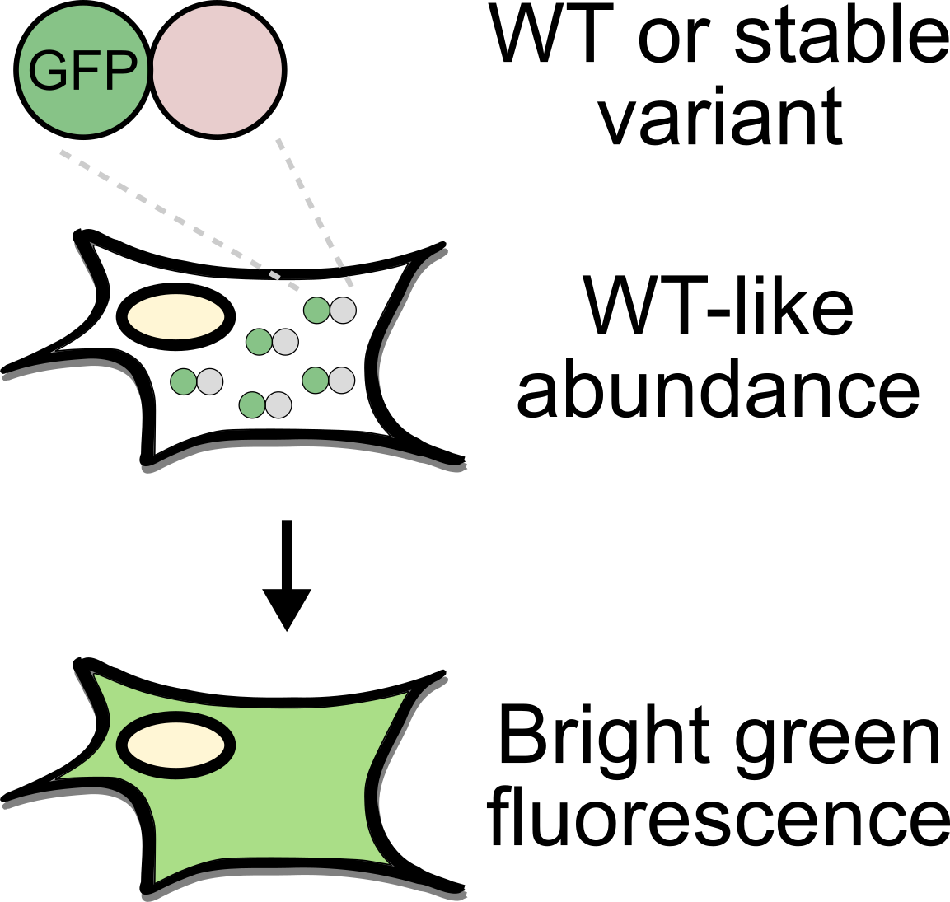
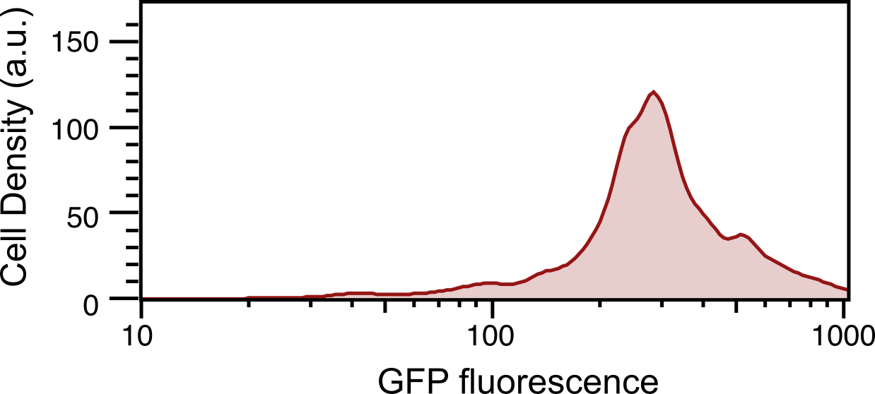
GFP fusions provide clear fluorescence-based readouts of variant stability
WT
Notes:
To assess protein variant abundance at high throughput, VAMP-seq uses recombinant DNA expression where GFP is directly fused to your protein of interest.
If it is fused to the WT protein or a stable variant, then the entire GFP-fusion folds fine, there’s plenty of it in the cell, and the cell ends up glowing green.

Slide 8
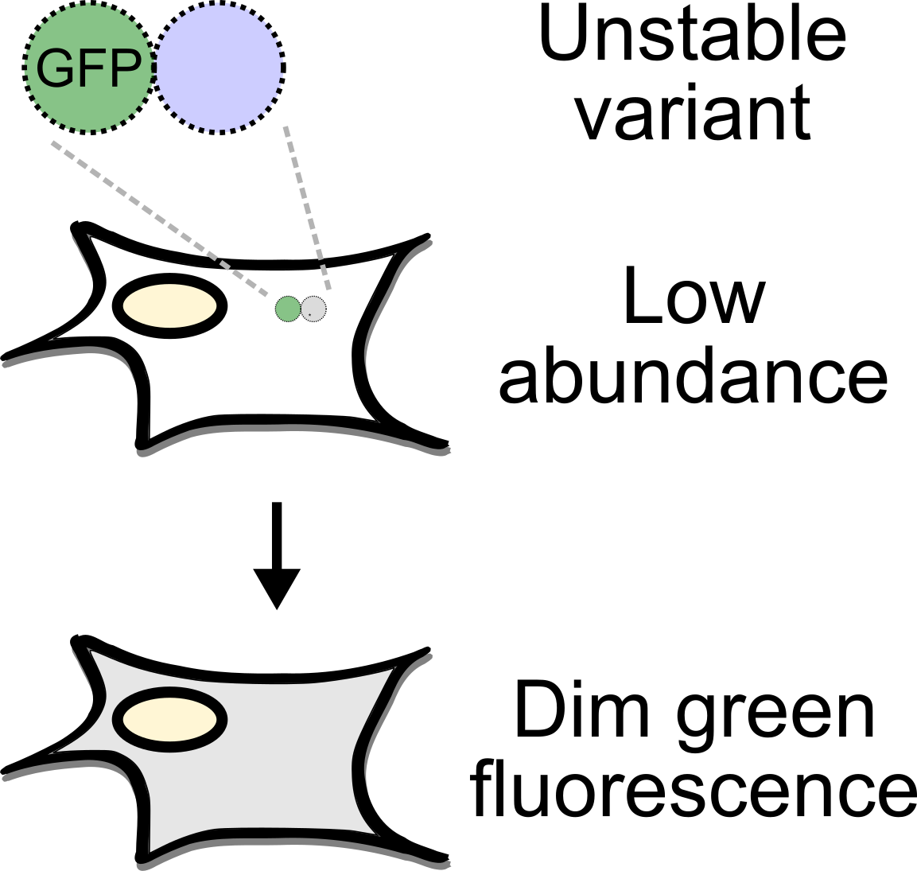
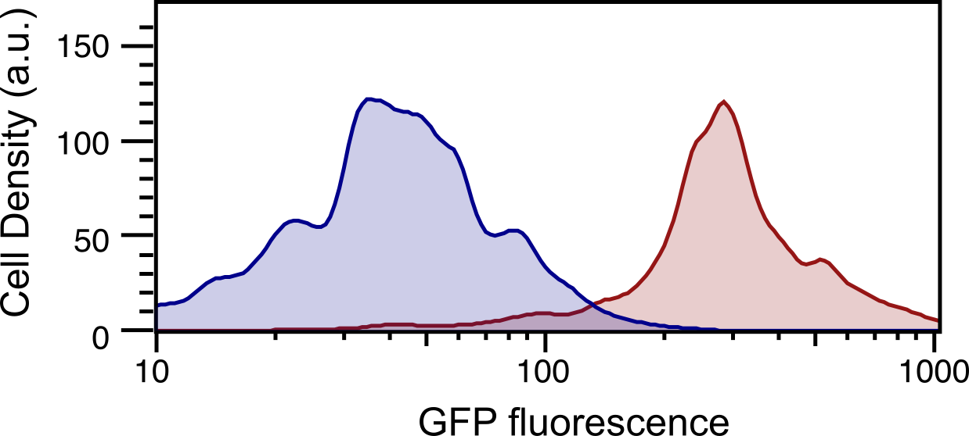
GFP fusions provide clear fluorescence-based readouts of variant stability
Unstable
WT
Notes:
If I instead fuse GFP to a known destabilized variant, then the entire GFP fusion product is destabilized and degraded, there’s fewer overall molecules of GFP in the cell, and the cell remains dark.

Slide 9
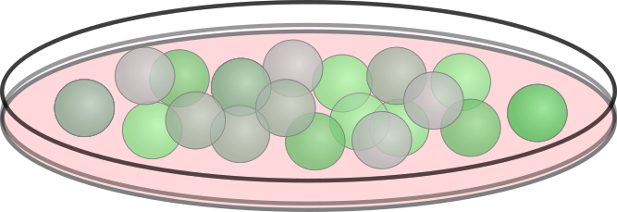
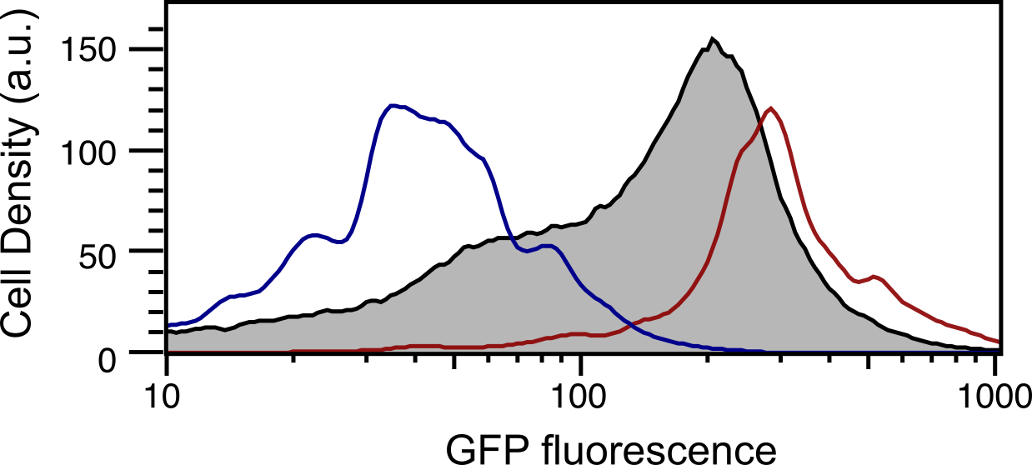
GFP fusions of a missense variant library span the assay fluorescence range
Saturating library of missense variants
Unstable
Library
WT
GFP fluorescence
Notes:
We can exploit the range of this assay by fusing GFP to a library of thousands of possible missense variants for a protein, which typically spans the range of fluorescence values.

Slide 10
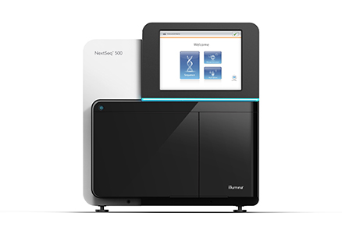
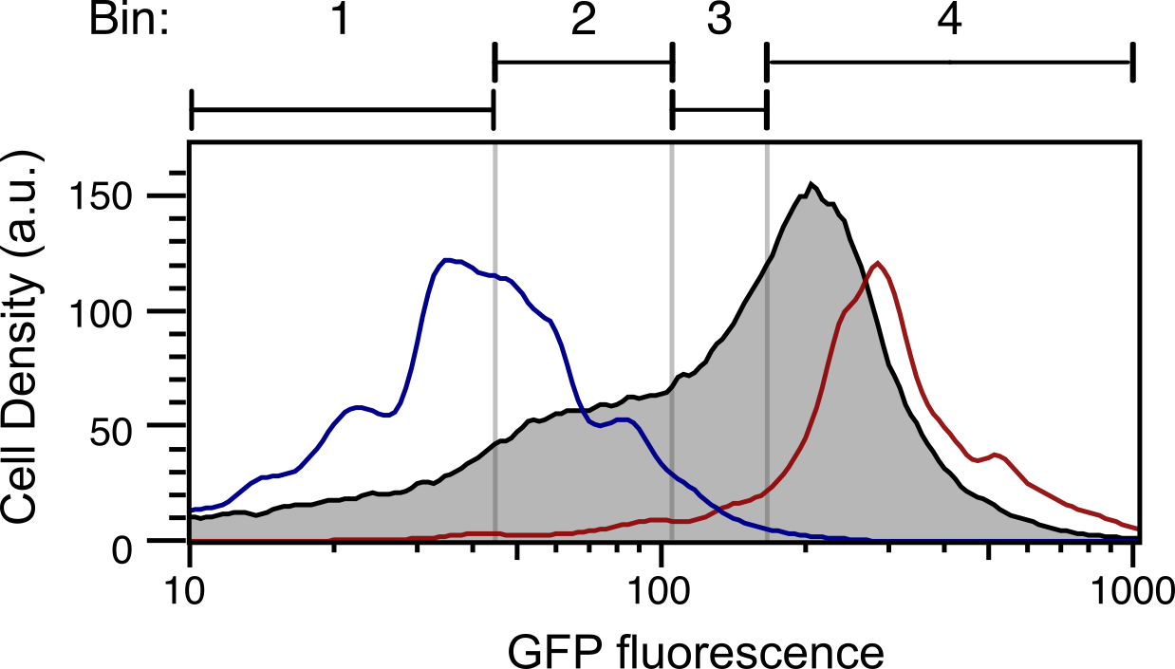
Variant Abundance by Massively Parallel sequencing (VAMP-seq) quantifies protein abundance in cells
High throughput
sequencing
GFP fluorescence
Notes:
We can then separate out the variants using FACS, or fluorescence activated cells sorting. Low abundance variants largely go into bin 1, stable variants largely go into bin 4, and the intermediate variants go into bins 2 and 3.
High throughput sequencing is then used to count and score each variant.

Slide 11
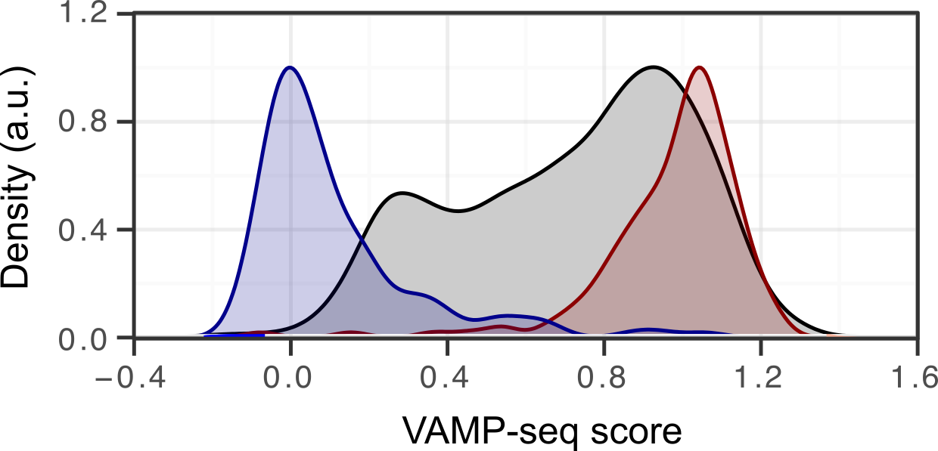
Characterizing protein Variant Abundance by Massively Parallel sequencing (VAMP-seq)
Nonsense
Missense
Synonymous
Notes:
The resulting distribution of scores clearly separates expected abundance phenotypes.
Synonymous variants cluster around WT, which is set at 1.
Nonsense variants are at the lowest end, around 0.
And the missense variant scores span this range.

Slide 12
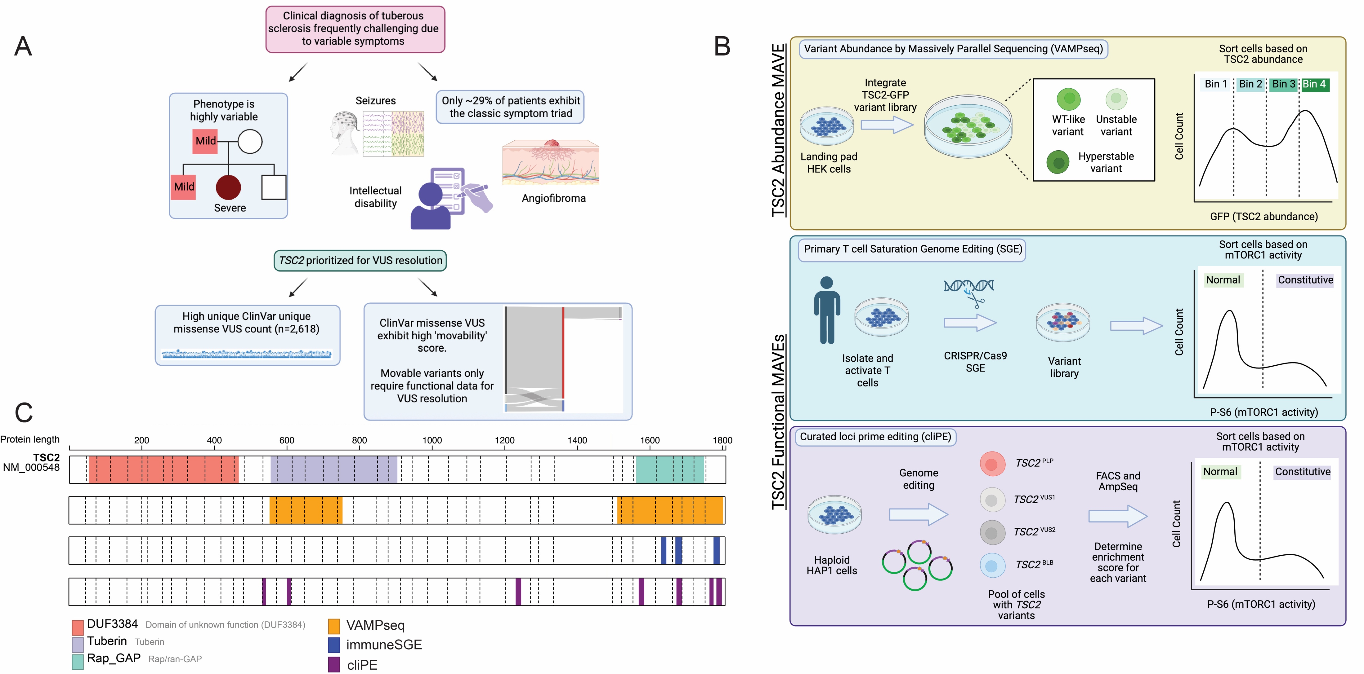
~9,000 missense, nonsense, synonymous and 3 bp deletions in two domains
Library 1
  205 amino acids in the Tuberin domain (534-737)
  4,510 variants were ordered, 3,841 were scored (~85%)
Library 2
  295 amino acids including the Rap Gap domain (1,512-1,805)
  6,468 variants were ordered, 6,004 were scored (~93%)
All missense, 1 synonymous, 1 stop, 1 3bp deletion at each position
Both libraries used a barcoded design, with ~24 barcodes per variant for the Tuberin domain and 14 barcodes per variant for the Rap Gap domain
Image: Jeff Calhoun
Notes:
Missingness comes from Twist

Slide 13
Data processing details
Individual barcode counts across samples were summed and then divided by the sum of all the sums to generate a frequency
  A cut-off of 5x10⁻⁷ was used to eliminate low frequency barcodes
A pseudo-count of 1 was added to all remaining barcode counts
Bin barcode frequencies are calculated and then barcodes are collapsed to variants according to the map
  Only variants that are present at a frequency greater than 8x10⁻⁴ receive a score

Slide 14
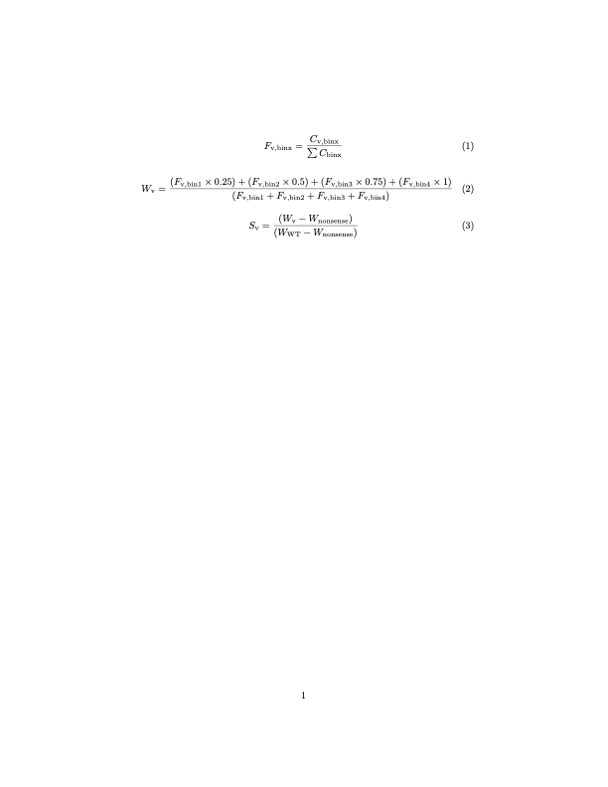
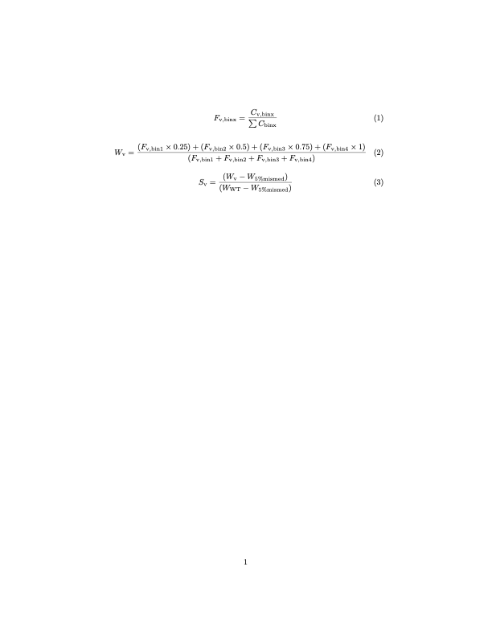
Data Processing Details (Continued)
Weighted average calculations as in Matreyek et al, 2018
Weighted frequencies for each variant (W_{V}) are min-maxed normalized using the wild type (W_{WT}) and the median of the bottom 5th percentile of missense values (W_{5%mismed})
Variants whose abundance is like wild type will score around 1, and lower abundance variants will be less than 1.
Standard deviation and standard error were provided
Scores from the two libraries were combined

Slide 15
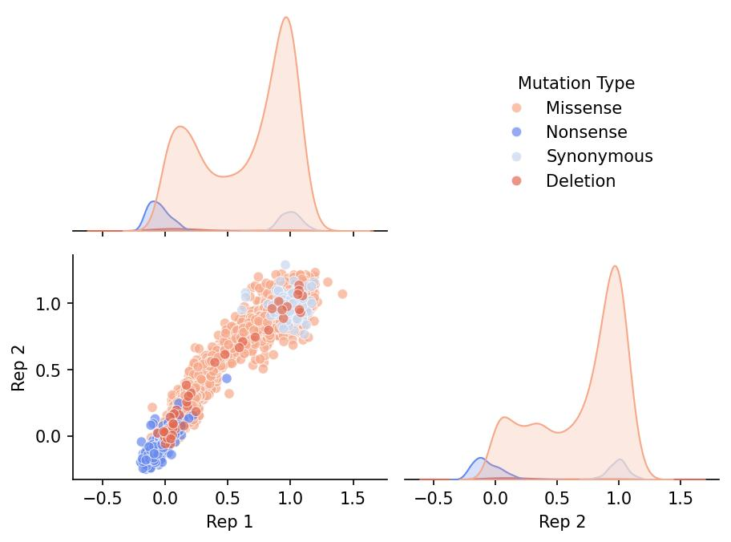
Replicate abundance scores were well correlated, Pearson R ~ 0.95

Slide 16
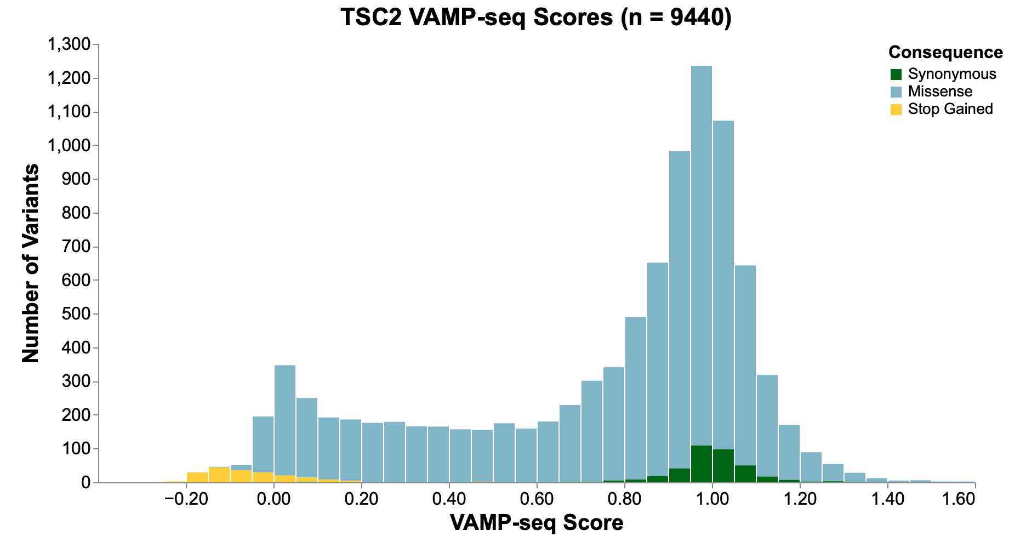
Synonymous and nonsense variants were well separated, missense variants were ~bimodal
Plot: Ivan Woo

Slide 17
Tuberin domain library shows expected patterns of variant effect, with some missing positions

Slide 18
RAP GAP domain
RAP GAP Domain
RAP GAP Domain

Slide 19
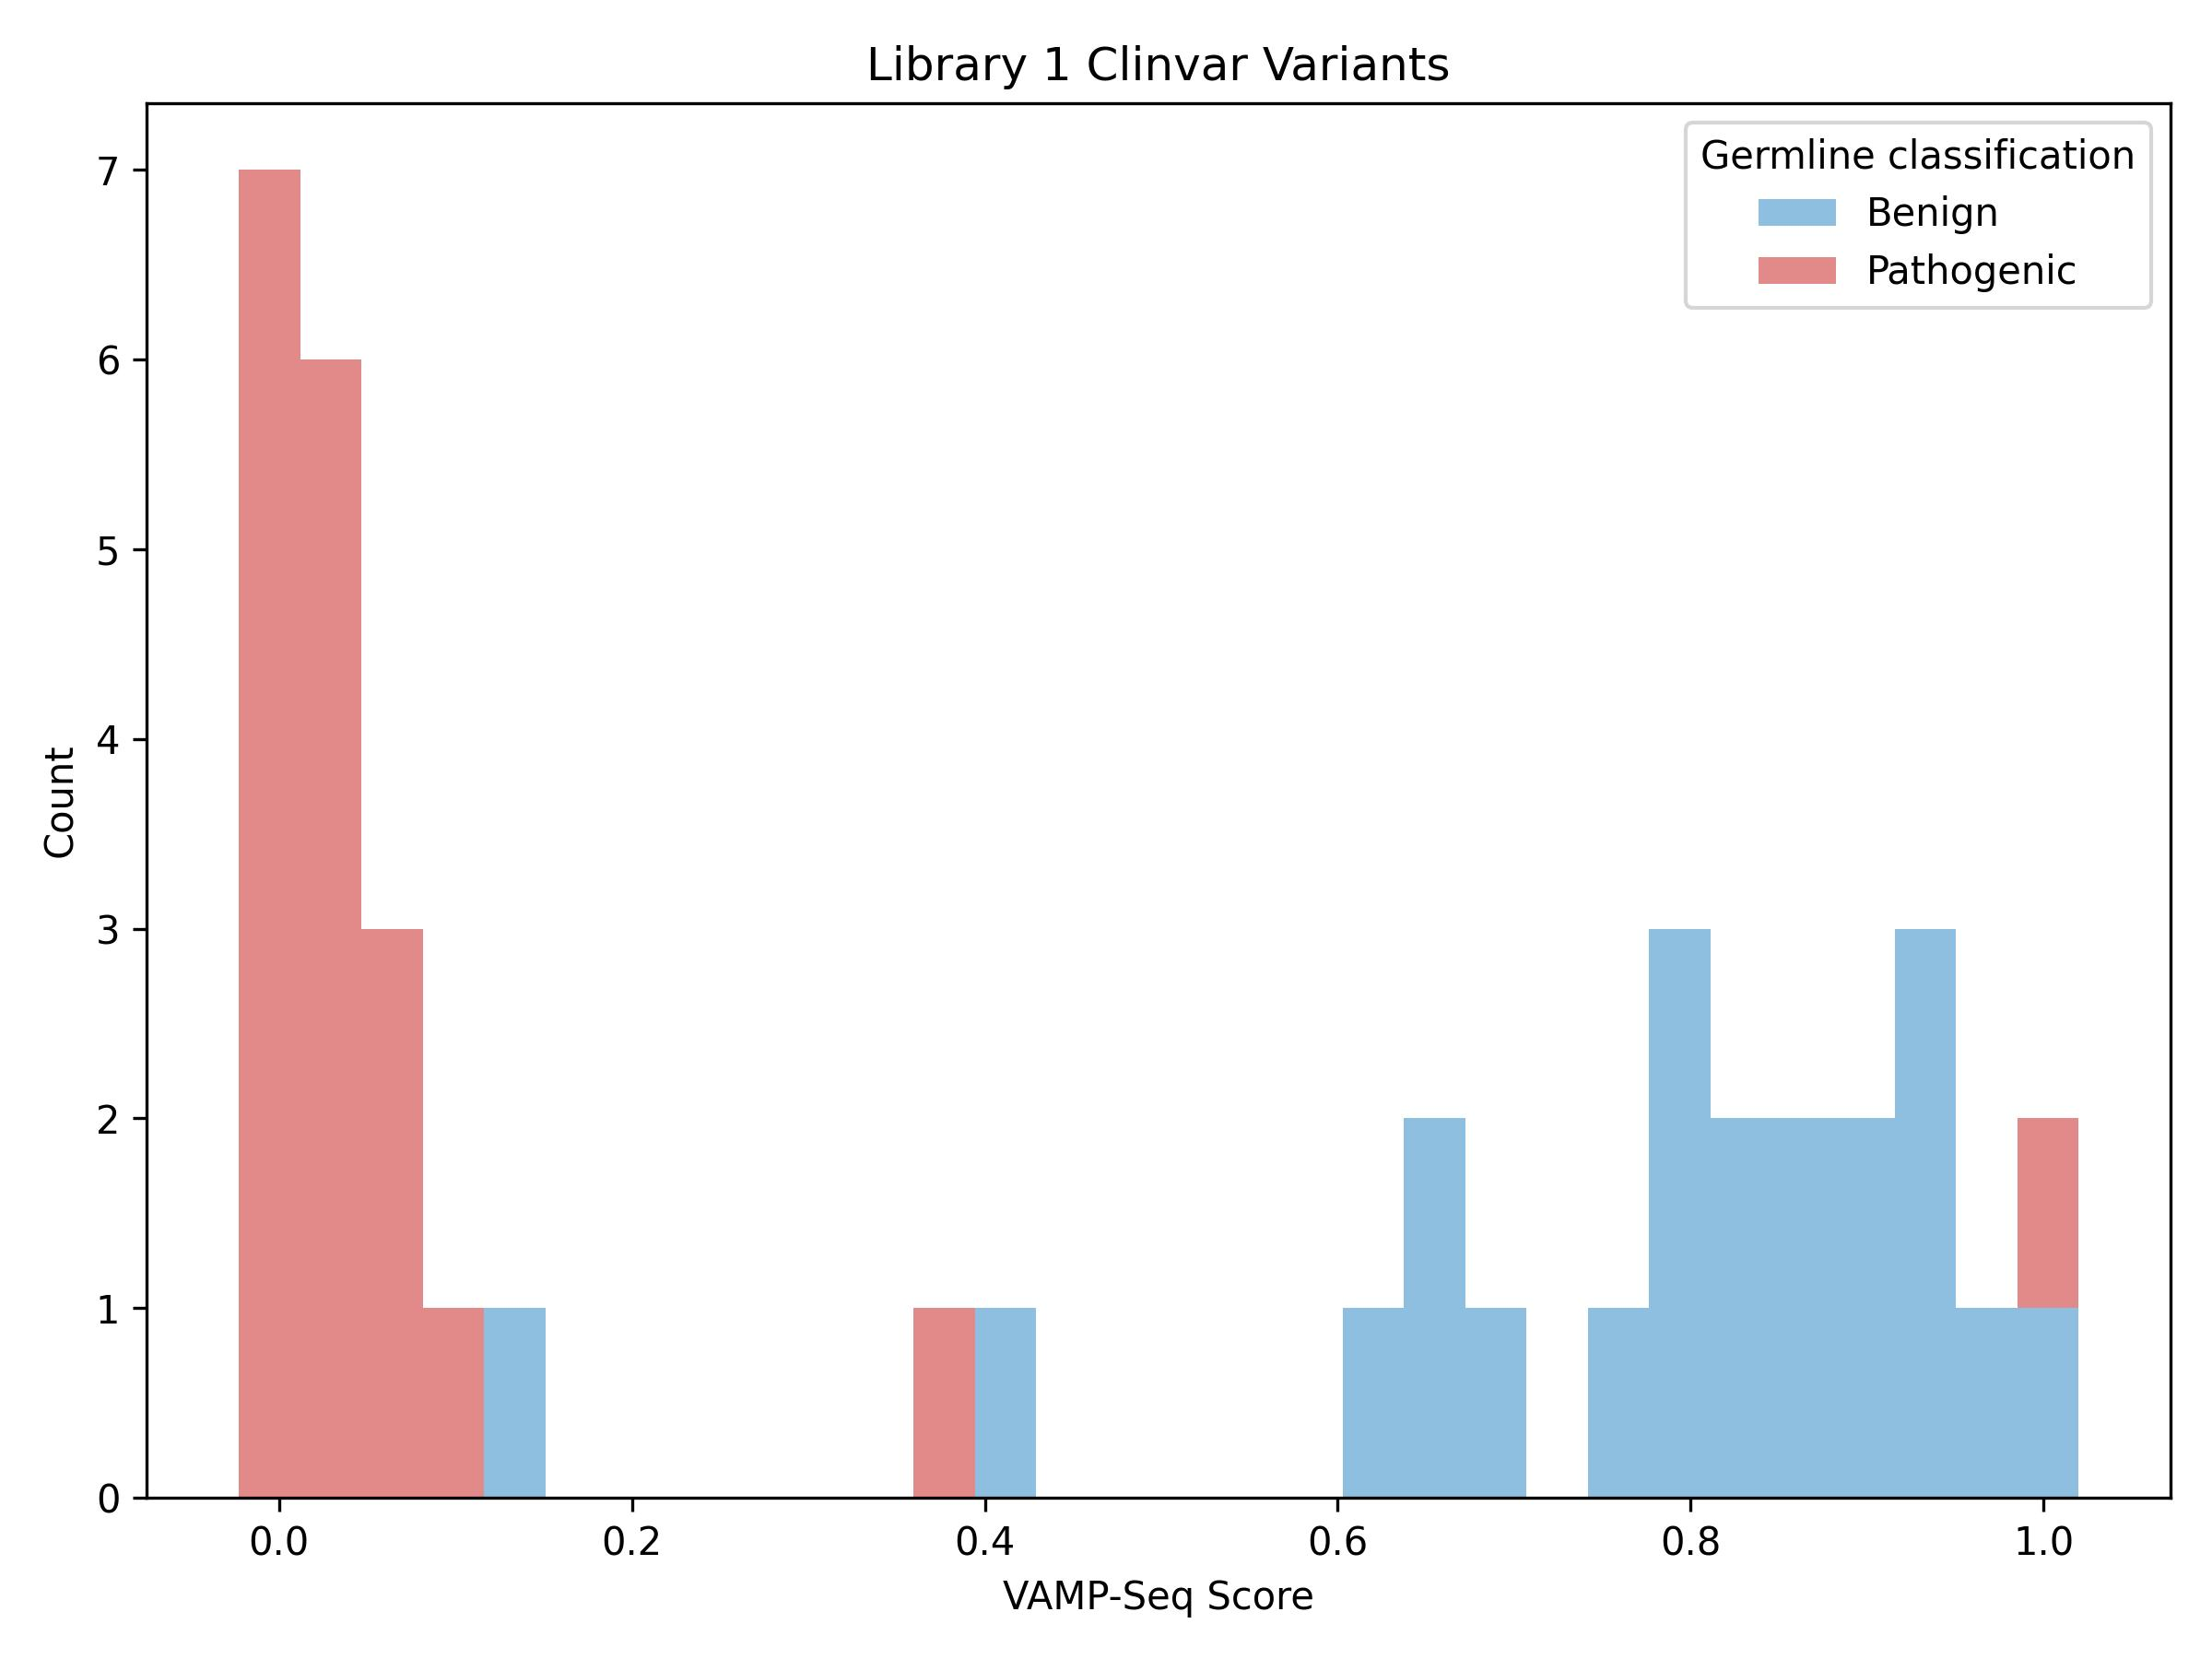
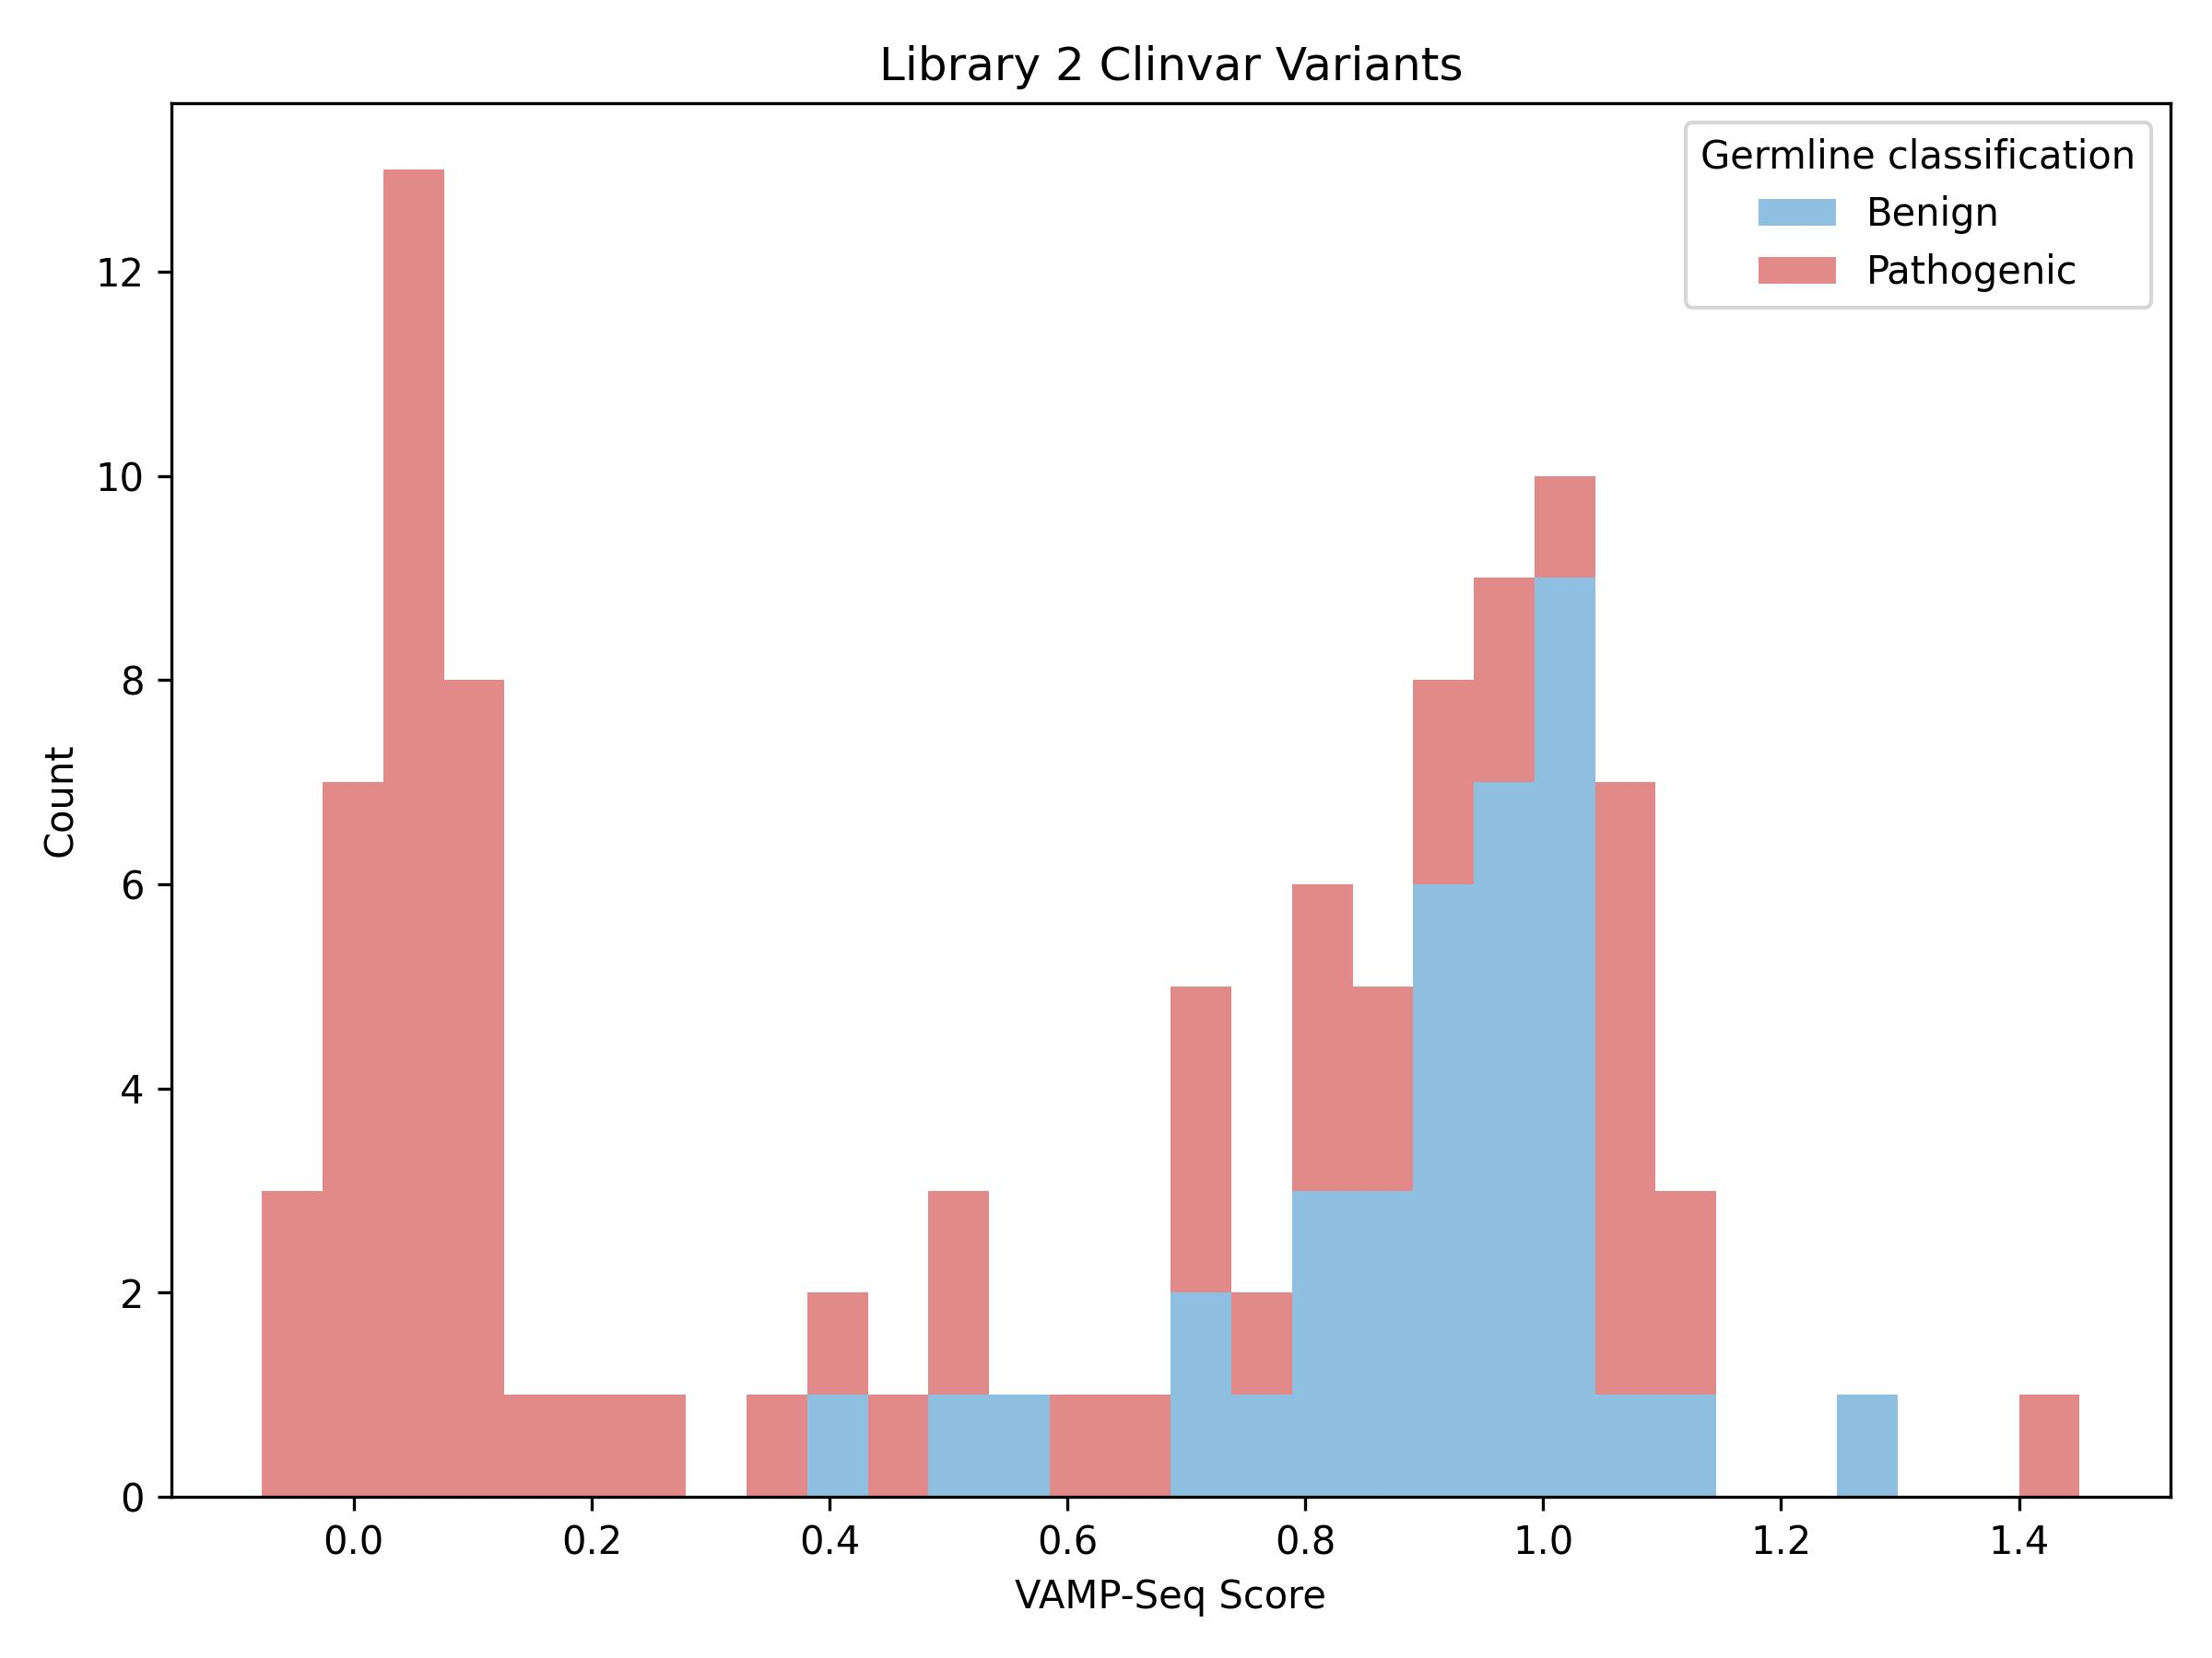
Positive predictive value for pathogenic variants is high, negative predictive value modest
1 star or greater P/LP, LB/B variants retrieved June 2025

Slide 20
Limitations and challenges of VAMP-seq
Cell sorting
        FACS instruments can sort into at most 4 bins
        Binning causes score compression and loss of dynamic range at the top and bottom end of the range
        Protein abundance
        Abundance is a single phenotype which, while important, does not capture all pathogenic variants

Slide 21
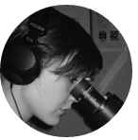





















Fowler lab
Katie Partington
Jordan Opsahl
IGVF Coding Variant
Focus Group
UWVEP production
and data teams
Collaborators
Jeff Calhoun
Lea Starita
Pedja Radivojac
Vikas Pejaver
Dan Zieberg
Yile Chen
Lara Muffley
Arielle Hancko
Shawn Fayer
Melissa Hopkins
Abbye McEwen
Dan Holmes
Nicholas Bradley
Raining Wang
Manali Sawant
Allyssa Vandi
Alex Hopkins
Melinda Wheelock
Malvika Tejura
http://gs.fowlerlab.washington.edu
https://github.com/FowlerLab
Notes:
THANK NHGRI

