Slide 1
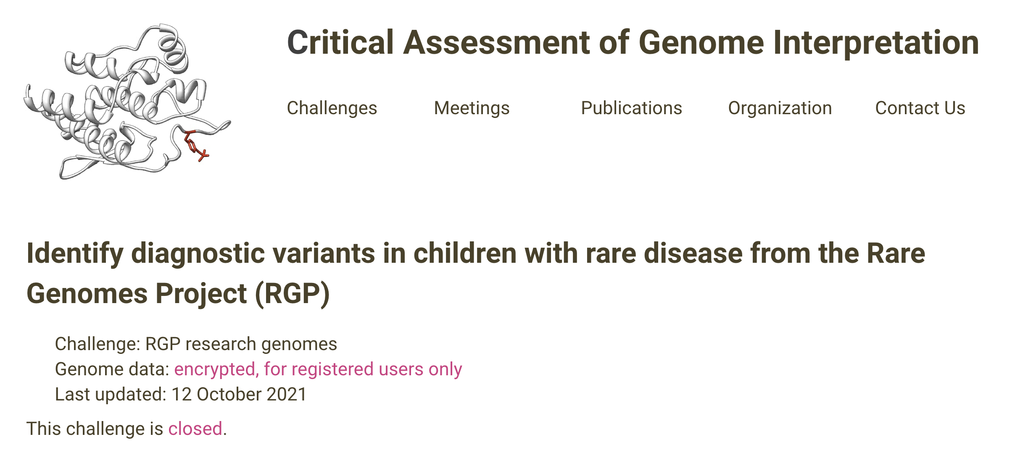




Rare Genomes Project:
CAGI 6 and CAGI 7 challenges
Anne O’Donnell-Luria, MD, PhD
Institute Member, Broad Institute of MIT and Harvard
Clinical Genetics Physician, Boston Children’s Hospital
Associate Professor, Harvard Medical School
12/6/2025
Created for CAGI 7
genomeinterpretation.org
O’Donnell-Luria

Slide 2

CAGI 7 slide pack guidelines
I agree to my slides being used according to the following terms:
_______Anne O’Donnell-Luria_______
Authors: please include THIS slide at the beginning of your presentation to indicate that you agree with reuse of your slides in CAGI presentations, according to the terms below, and digitally sign by writing your name above.
To disseminate the CAGI results, I encourage all CAGI participants to remix these CAGI slides for inclusion in their oral and poster presentations
CAGI participants may use or publish any content of these slides only in compliance with the CAGI Data Use Agreement
CAGI participants may not cite or publish any content of these slides except with the written permission of the originating author or in the primary CAGI publications
CAGI participants must acknowledge the original authors of these slides and CAGI 7. Include the acknowledgement banner across the bottom
CAGI participants must include the CAGI credits slide in their presentations
Slides with a red slash (no remix) may not be included in a presentation unless all attendees are registered CAGI participants who signed the data use agreement
Slides with a red X over the entire slide may not be used in any circumstances
Slides with a blue slash (embargoed) may not be used unless the embargo is explicitly lifted
Slides without slash or X may be tweeted, tooted, posted, X’d unless flagged with “No tweet” icon
CAGI participants using these slides must explain the “No tweet” icon, which means that the slide content should not be disseminated outside the presenting conference hall. If the presentation venue permits pervasive tweeting, you may not include these slides in your talk
Note for slide authors: we expect all CAGI participants to abide by these restrictions, and will make best effort to ensure they are followed. However, but bear in mind that we have limited means of enforcing them, and therefore the restrictions cannot be guaranteed.

Slide 3
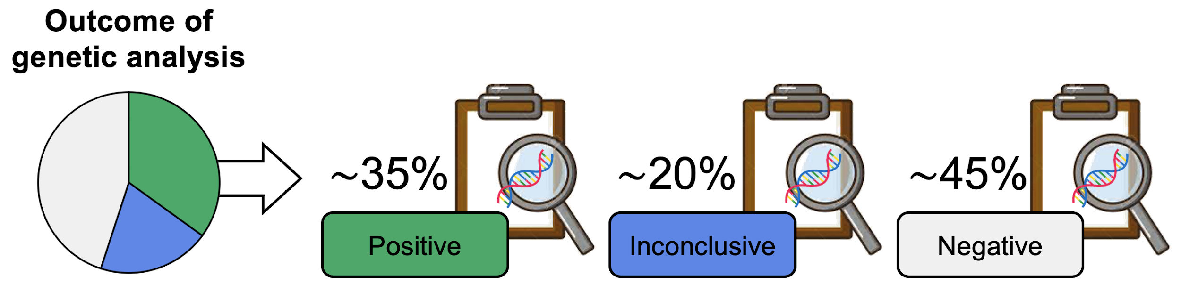
Diagnostic landscape
One major obstacle facing rare disease patients is simply obtaining a genetic diagnosis
The average “diagnostic odyssey” lasts more than five years, and over 60% of patients still lack a genetic diagnosis
Clinical genomic sequencing
Pathogenic/Likely Pathogenic Variant in Gene Consistent with Phenotype and Inheritance Mode
No variants reported
Candidate variant of uncertain significance (VUS)
Created for CAGI 7
genomeinterpretation.org
O’Donnell-Luria

Slide 4
The challenges of rare disease diagnosis
One major obstacle facing rare disease patients is simply obtaining a genetic diagnosis
The average “diagnostic odyssey” lasts more than five years, and over 60% of patients still lack a genetic diagnosis
Genome sequencing provides coverage of coding and noncoding regions resulting in thousands of rare variants per individual
The impact on gene function of the vast majority of variation is unknown
Analytical obstacle to diagnosis to recognize pathogenic variation within a sea of benign variation
Created for CAGI 7
genomeinterpretation.org
O’Donnell-Luria

Slide 5

Rare Genomes Project (RGP)
Direct-to-participant research study on the utility of genome sequencing for rare disease diagnosis and gene discovery
Led by genomics experts and clinicians at the Broad Institute of MIT and Harvard
Research subjects are consented for genomic sequencing and the sharing of their sequence and phenotype information with researchers working to understand the molecular causes of rare disease
Most have had prior clinical testing including exome sequencing (45%), array and/or gene panel (45%), though some are unable to access genetic testing (10%)
Created for CAGI 7
genomeinterpretation.org
O’Donnell-Luria

Slide 6
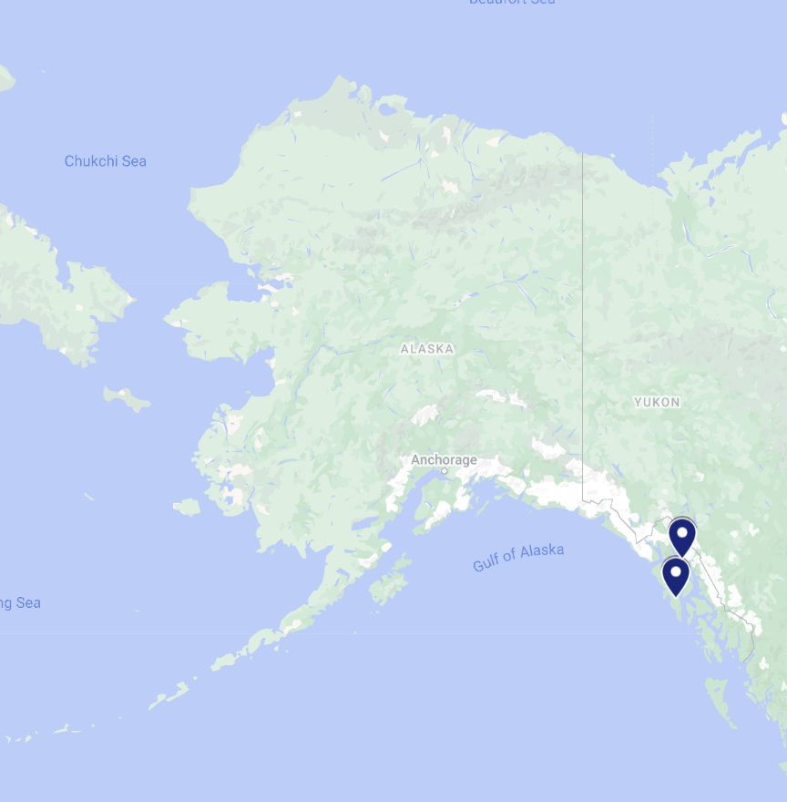
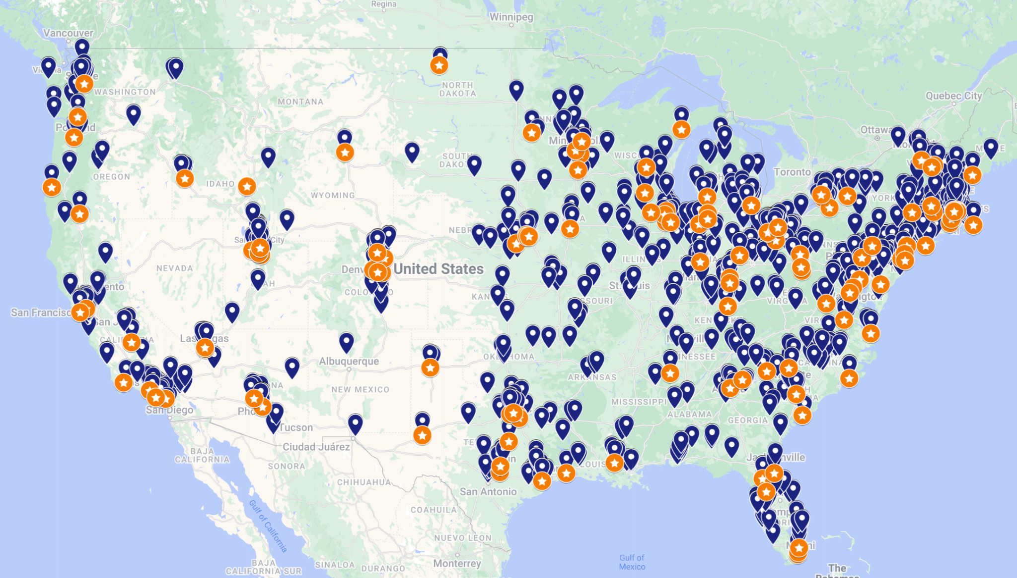
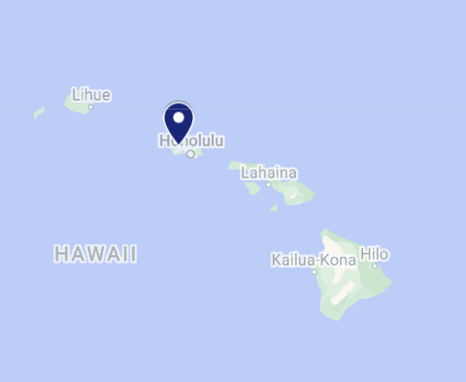
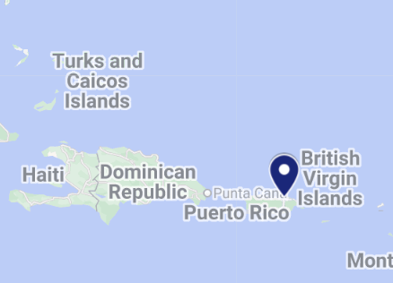



Who is enrolled in RGP?
3394 individuals from 1300 families
50 states + DC + Puerto Rico
85% urban; 15% rural
Proband age range 1m-89y

Slide 7
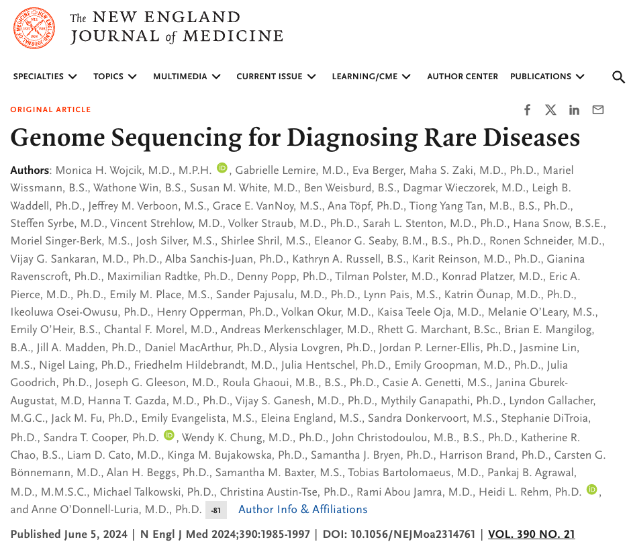
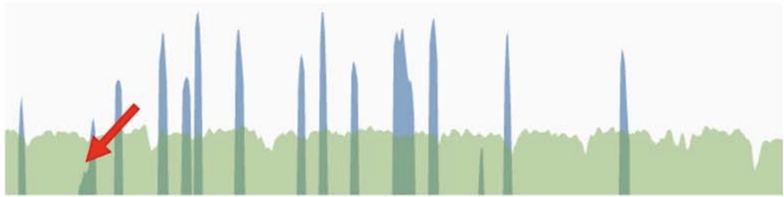
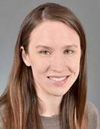

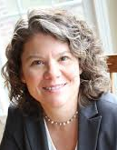
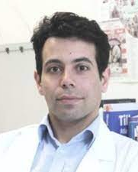
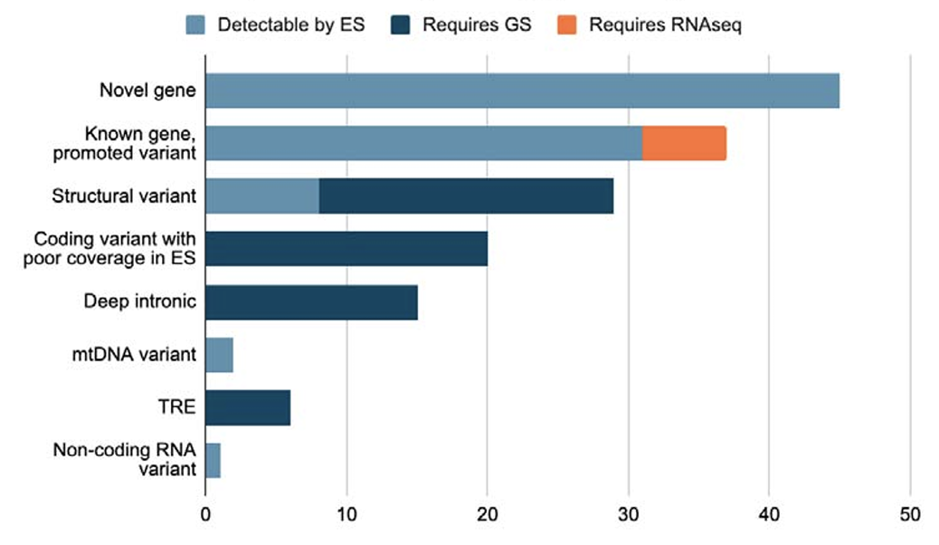
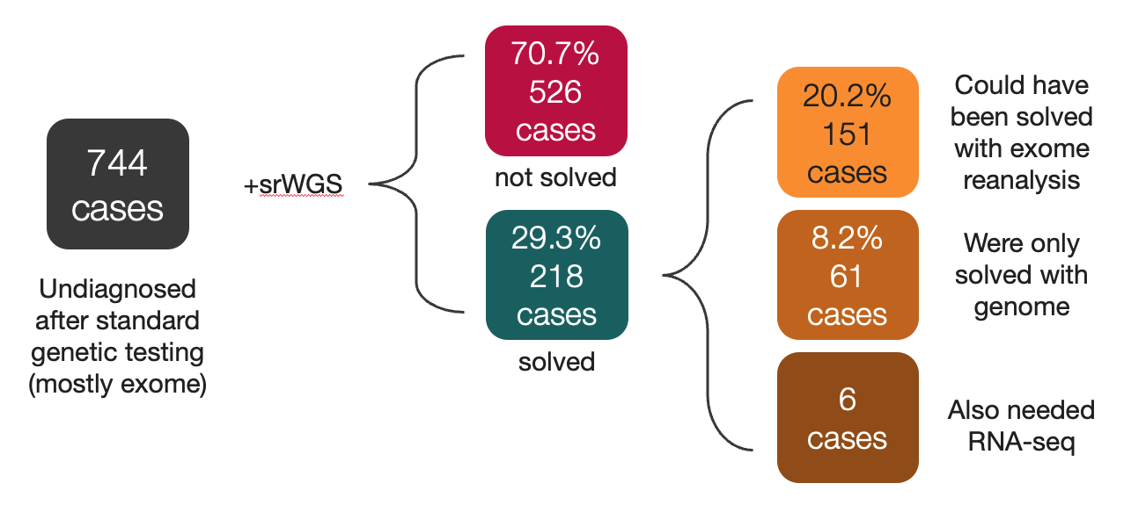
Genome sequencing after exome
Exome
vs
Genome
sequencing
Center for Mendelian Genomics cohort
Replication cohort
Monica
Wojcik
Anne
O’Donnell-Luria
Heidi
Rehm
Rami
Abou Jamra
Wojcik et al., NEJM, 2024, PMC11350637
Created for CAGI 7
(small proportion had RNAseq data)
O’Donnell-Luria

Slide 8
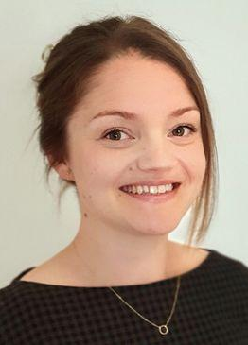

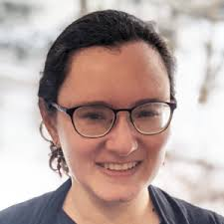
Long read sequencing after short read genome
Long read genome sequencing (lrGS) after short read genome (srGS)
Exome
vs
Genome
sequencing
Center for Mendelian Genomics cohort
Replication cohort
Long-read genome sequencing (ONT/PacBio) after short-read genome sequencing detected 1 new diagnosis in 96 families (1%) not detectable by srGS
De novo possibly mosaic SNV in a region with decent coverage on srGS
Additional diagnoses from reanalysis (14/96 diagnosed, 15%)
Monica
Wojcik
Anne
O’Donnell-Luria
Heidi
Rehm
Rami
Abou Jamra
Sarah
Stenton
Alba
Sanchis-Juan
Yulia
Mostovoy
Created for CAGI 7
O’Donnell-Luria

Slide 9
Overview of the RGP CAGI 6 challenge
Opened June 8, 2021
Closed October 11, 2021
…with the idea to put variant pathogenicity prediction models and diagnostic algorithms head-to-head in a “real-life” diagnostic setting
Created for CAGI 7
genomeinterpretation.org
O’Donnell-Luria

Slide 10




Design of the RGP CAGI 6 challenge
35 families provided as example data and shared diagnoses
30 families as test data - proband only (2), duos (3), trios (23), quads (2)
14/30 solved - included to evaluate the performance of each participant's predictive model
16/30 unsolved - included with the goal of identifying new potentially causal variants
Probands with suspected Mendelian disease
Phenotype provided as Human Phenotype Ontology (HPO) nomenclature
Range 1-9 per proband (median 5)
Diversity represents the range of phenotypes routinely seen in patients referred for genetic testing
HPO extraction from medical records
Sequencing performed at the Broad Institute on an Illumina sequencer at 30x depth
Raw sequence reads reassembled against GRCh38 with variant calling by GATK
Variant calls in the form of SNVs and indels (no structural variants) provided within a joint vcf
DNA purified from blood for genetic analysis
Aim: participants asked to provide a molecular diagnosis for as many probands as possible i.e., to identify one or more causal variants per proband
Created for CAGI 7
genomeinterpretation.org
O’Donnell-Luria

Slide 11
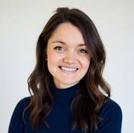
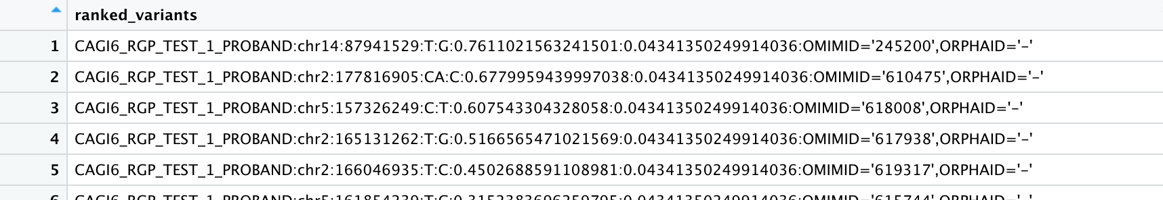
RGP CAGI 6 challenge entry format
Participants submitted a ranked list of maximum 100 variants per proband
Proposed monoallelic or biallelic variants
proband identifier
variant
estimated probability of causal relationship (real number, 0 to 1, indicating the degree of certainty)
Variants ranked by the estimated probability of causal relationship value
Accessor RGP CAGI 6
Sarah Stenton
Created for CAGI 7
genomeinterpretation.org
O’Donnell-Luria

Slide 12
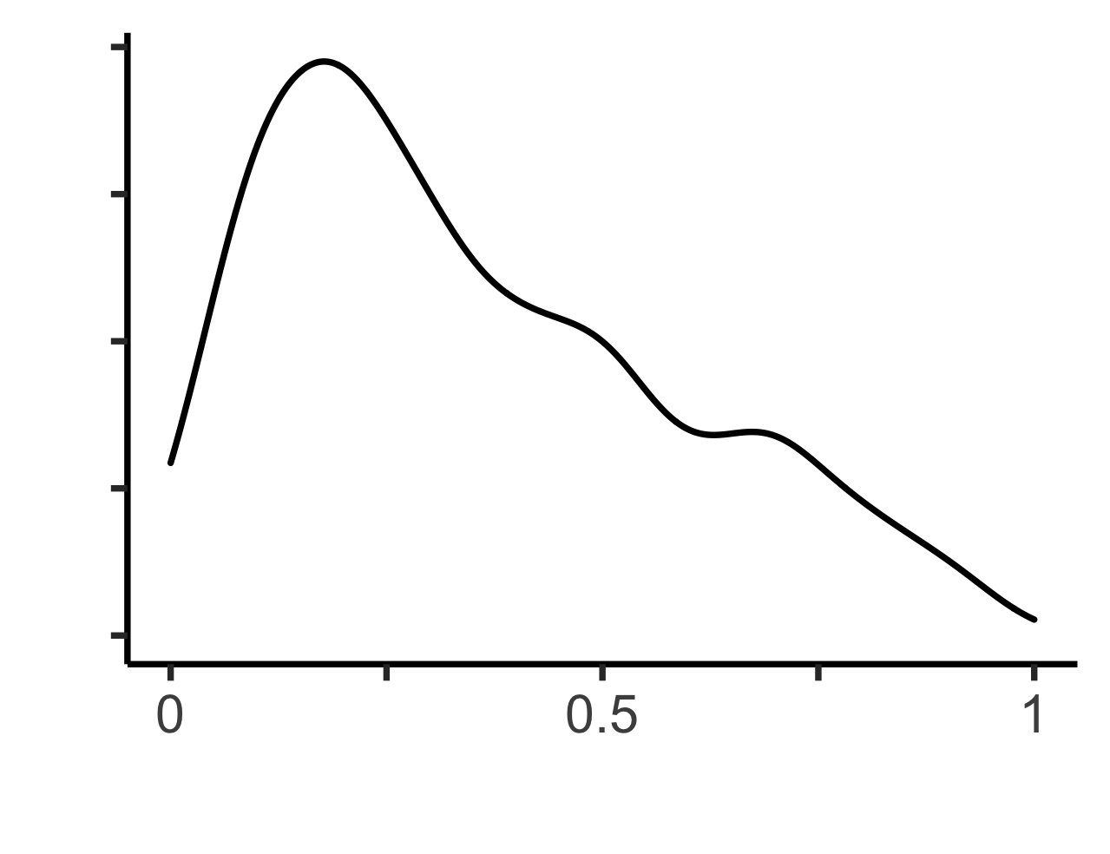
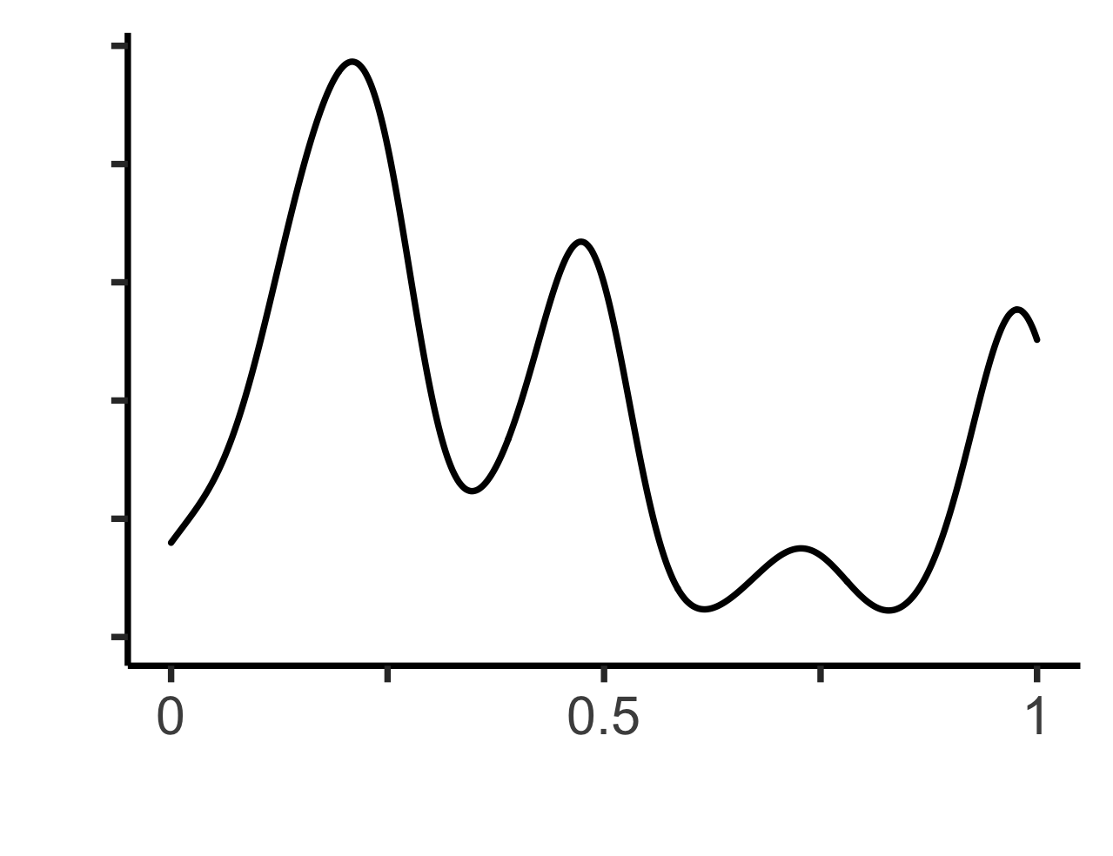
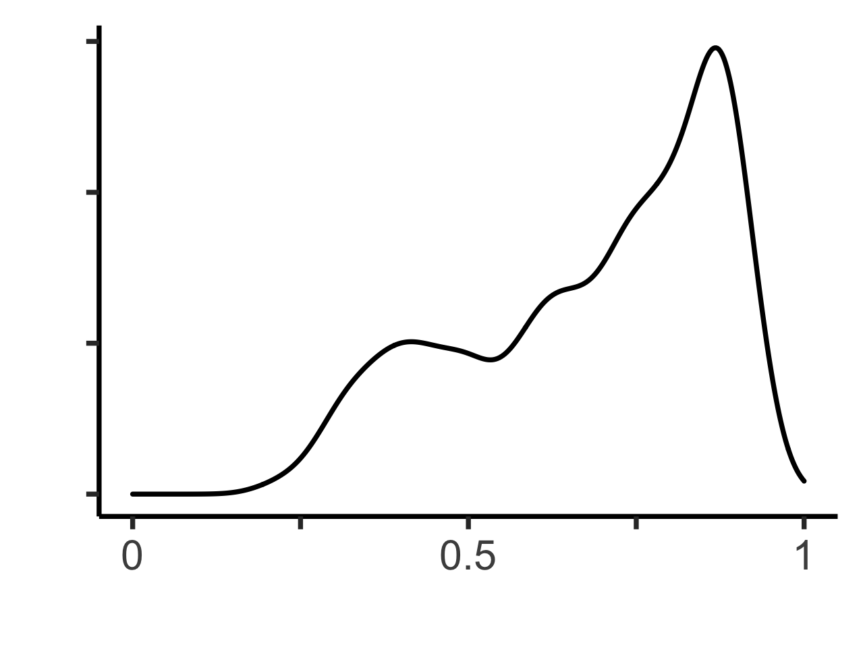
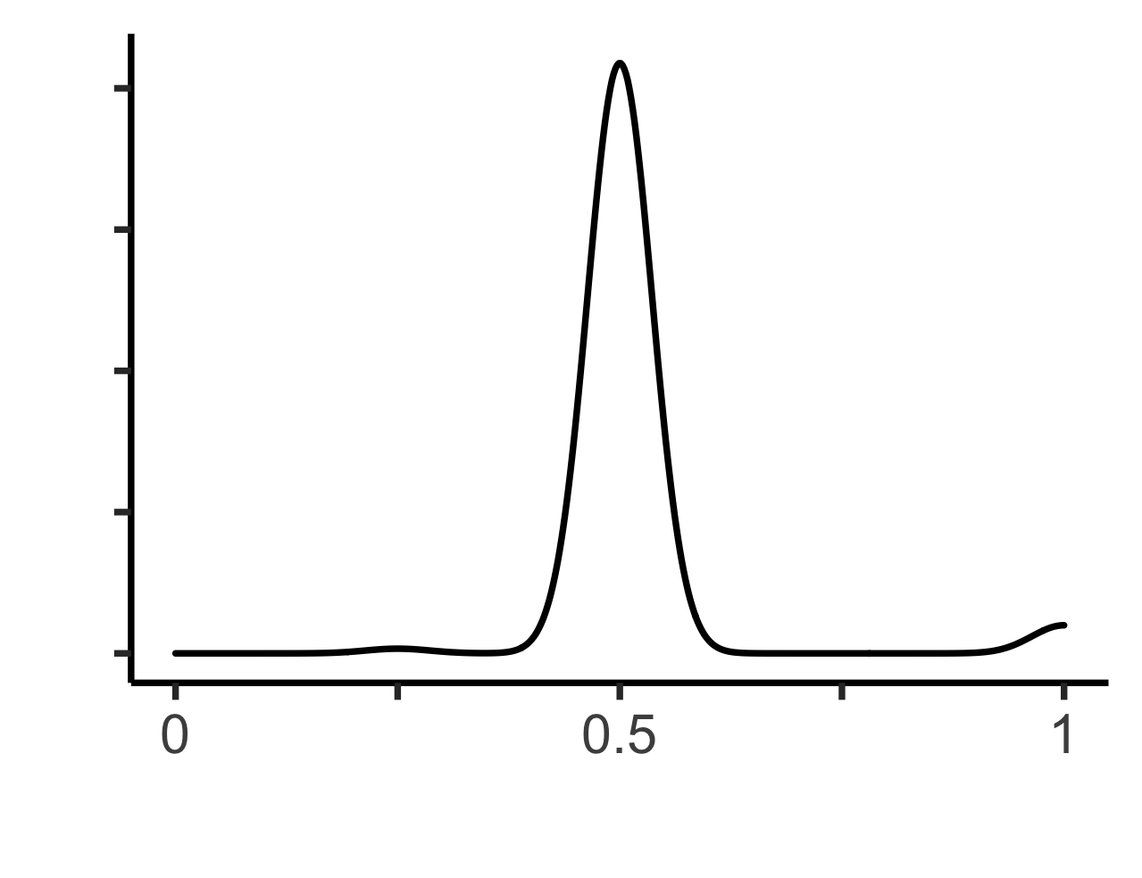
RGP CAGI 6 challenge participant summary
16 teams entered the challenge across academia and industry
52 models submitted in total, 1-6 models per team (one primary model nominated). Model performance was scored twice:
Score 1
Weighted scoring system for occurrence of the correct diagnosis in the top 5, 10, 20, 50, or 100 ranked variants
Maximum 1,400 points to be gained from the 14 solved cases
Score 2
All teams submitted an estimated probability of causal relationship value with each variant prediction
Real number, 0 to 1, indicating the degree of certainty of causal relationship in the proband
Determine how confident the teams were in their predictions based on how well they discriminated between P and B
To account for stark differences in distribution, maximum F-measure (F-max) was used to reward models with high precision and recall of causative variants
Causative variant rank | Rank score
Top 5 | 100
Top 10 | 50
Top 20 | 25
Top 50 | 10
Top 100 | 5
Variant not listed | 0
Created for CAGI 7
genomeinterpretation.org
O’Donnell-Luria

Slide 13
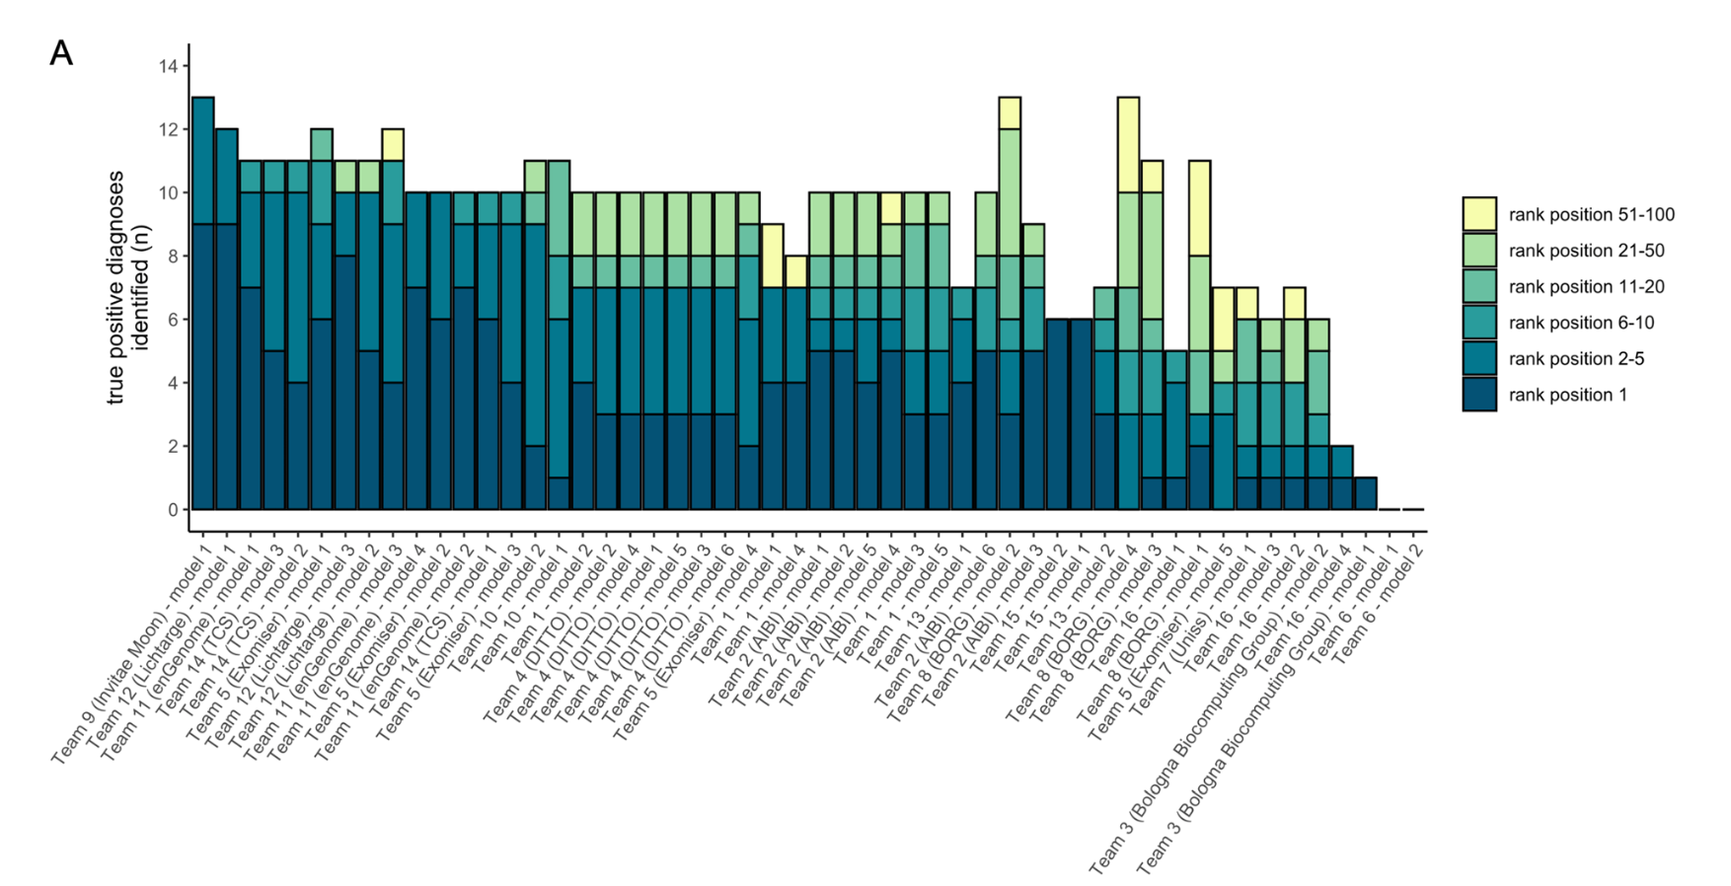
Model accuracy in solved cases
The most successful team identified the correct diagnosis for 13 of the 14 probands within the top 5.
Created for CAGI 7
genomeinterpretation.org
O’Donnell-Luria

Slide 14
Overview of the solved cases for RGP CAGI 6 challenge
Family | HPO n | HPO IC | Gene | Variant(s) | Inheritance | Variant class | Sequencing type | ACMG
F28 | 4 | 27.1 | FGFR2 | chr10:g.121517378C>T | de novo | missense | trio, unaffected parents | P
F11 | 4 | 33.4 | TPM2 | chr9:g.35685677T>A | AD | missense | proband only | VUS
F04 | 5 | 32.6 | NALCN | chr13:g.101229500C>A | de novo | missense | trio, unaffected parents | LP
F07 | 5 | 42.7 | EHMT1 | chr9:g.137743969AG>A | de novo | frameshift | trio, unaffected parents | LP
F02 | 5 | 38.6 | FAM111B | chr11:g.59125977G>C | AD | missense | proband only | LP
F24 | 7 | 59.8 | KMT2D | chr12:g.49054901T>C | de novo | missense | trio, unaffected parents | LP
F21 | 3 | 21.8 | BICC1 | chr10:g.58813842T>C | de novo | missense | trio, unaffected parents | LP
F22 | 6 | 47.6 | GRIN2A | chr16:g.9764502C>T | unknown | nonsense | duo, unaffected mother | P
F23 | 6 | 43.1 | GNAI1 | chr7:g.80212805G>C | de novo | missense | trio, unaffected parents | LP
F16 | 9 | 68.9 | DLG4 | chr17:g.7190808AC>A | de novo | frameshift | trio, unaffected parents | LP
F27 | 1 | 9.4 | TUBB8 | chr10:g.47353T>C | AD | missense | quad with affected sibling | VUS
F19 | 8 | 65.4 | CLTC | chr17:g.59664785AG>A | de novo | frameshift | trio, unaffected parents | LP
F05 | 7 | 55.5 | PI4KA | chr22:g.20726493C>T; 20799245G>A | AR | nonsense; missense | duo, unaffected father | P; LP
F06 | 8 | 63.3 | KCND2 | chr7:g.120732994C>G | unknown | missense | duo, unaffected father | LP
Detection rate
Created for CAGI 7
genomeinterpretation.org
O’Donnell-Luria

Slide 15
Patterns in performance –
what did top performing teams have in common?
 | T9 | T12 | T11 | T5 | T14 | T4 | T1 | T10 | T2 | T8 | T13 | T15 | T16 | T7 | T3 | T6
variant QC
variant frequency
pathogenicity prediction
familial segregation, inheritance
phenotype relevance, similarity
use of proprietary data
all models
some models
not specified
Highest performing teams identified high quality rare damaging variants segregating correctly in-keeping with the phenotype
Created for CAGI 7
genomeinterpretation.org
O’Donnell-Luria

Slide 16
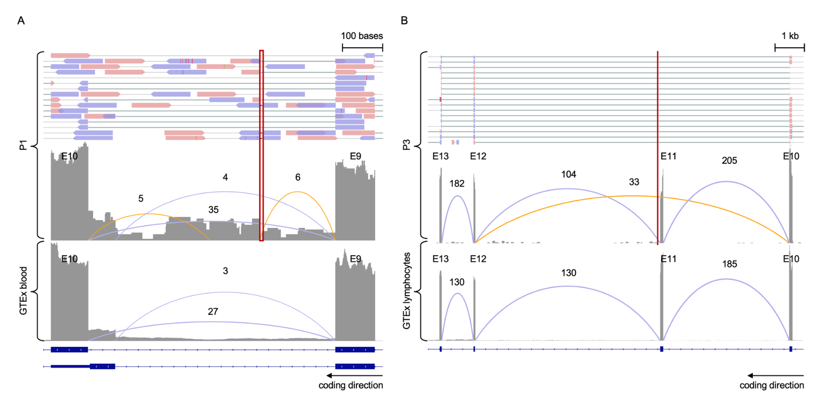
Exploration of unsolved cases – two cases solved in RGP CAGI 6
16 unsolved cases included in the challenge in the hope of discovering novel diagnoses
The majority of candidates were deemed non-disease-causing due to issues with variant quality metrics, segregation (assuming complete penetrance) and/or phenotype relevance. RNA-seq confirmed candidates in 2/16 patients
Intron retention caused by deep intronic variant in ASNS
Skipped exon caused by near-splice site variant in TCF4
Created for CAGI 7
Results returned to participants through their local providers.
O’Donnell-Luria

Slide 17

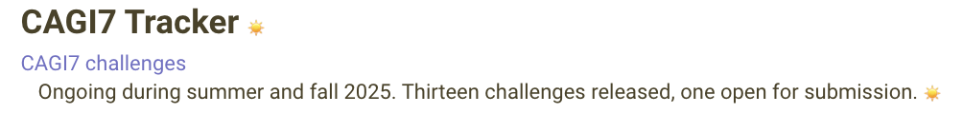
Overview of the RGP CAGI challenge 2025
and one to open soon
In 2021, CAGI/Northeastern took responsibility for data security, but this is not practical when users accessing data from many institutions/countries to participate in CAGI.
Data sharing agreement required several months of renegotiation.
An institutional signature is required for participation in the challenge, with a separate form for each individual who will “touch” the data.
Created for CAGI 7
genomeinterpretation.org
O’Donnell-Luria

Slide 18
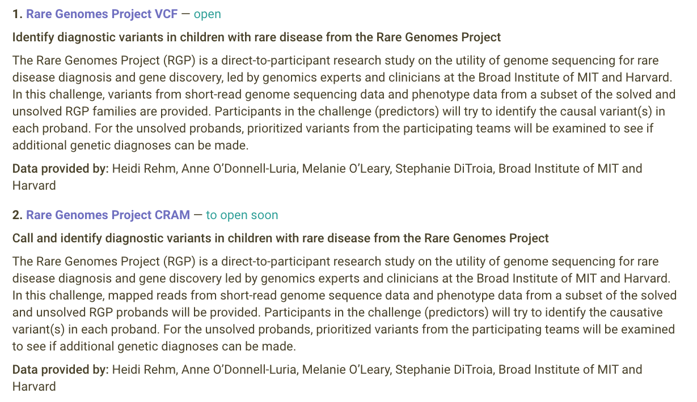

Overview of the RGP CAGI challenge 2025
Opened October 31, 2025
Closes February 28, 2026
Created for CAGI 7
genomeinterpretation.org
O’Donnell-Luria

Slide 19
Design of the RGP VCF CAGI 7 challenge
Example set: 14 solved families from RGP CAGI 6
Test set: 30 solved and unsolved families – proband, duos, trios, quads
Discovery set: 20 unsolved families
Probands with suspected Mendelian disease
Phenotype provided as Human Phenotype Ontology (HPO) nomenclature – in csv and phenopackets
Diversity represents the range of phenotypes routinely seen in patients referred for genetic testing
HPO extraction from medical records
Sequencing performed at the Broad Institute on an Illumina sequencer at least 30x depth
Raw sequence reads reassembled against GRCh38 with variant calling by DRAGEN v3.7.8
Variant calls in the form of SNVs and indels (no structural variants) provided within a joint-called vcf
DNA purified from blood for genetic analysis
Aim: participants asked to provide a molecular diagnosis for as many probands as possible i.e., to identify one or more causal variants per proband
Solved families will be used in assessment
Top hits from high-performing models will be evaluated for new solves in unsolved families
Created for CAGI 7
genomeinterpretation.org
O’Donnell-Luria

Slide 20
Results submission for RGP VCF CAGI 7
Submission
List of single or pairs of variants and a probability score indicating the degree of certainty of causal relationship in the proband
Each EPCR must be a real number, (0,1]
Scoring
Will use rank and probability score to assess model performance
Both sensitivity and specificity will be evaluated
Partial credit will be given for identifying one causal variant for a compound heterozygous recessive diagnosis
Additional data requested:
If the submission file is the automated output of the computational model (preferred) or whether the file has undergone downstream manual review and curation
If training of the model only used publicly-available data (preferred) or if proprietary data were also used
If the model is able to output proposed pairs of compound heterozygous CV candidates or only single CV candidates (this will be taken into consideration in the assessment of performance in detecting true positive recessive diagnoses)
An estimate of run time and cost for the model where possible
A survey will be conducted, collecting information on methods/platforms from participating teams upon submission
Please do not mark any case or variant in the ongoing CAGI challenge as solved in data-sharing analysis platforms.
Created for CAGI 7
genomeinterpretation.org
O’Donnell-Luria

Slide 21
Increasing participation
Goal to see more diagnostic laboratories participating
Heidi Rehm invited us to present RGP CAGI 6 and plans for CAGI 7 on two calls:
Medical Genome Initiative – small group of lab directors offering genome https://medgenomeinitiative.org/ (organized by Illumina)
Clinical Genomics Laboratory Community (CGLC) in GA4GH
https://www.ga4gh.org/community/clinical-genomics-laboratory-community/
Feedback: High interest in an analysis bakeoff but more focused on platforms/software:
Wanted to start from CRAMs as this is their normal workflow
Interested in broader array of diagnostic variants beyond SNV/indels
Created for CAGI 7
genomeinterpretation.org
O’Donnell-Luria

Slide 22
RGP CRAM CAGI 7 challenge was born – opening soon
Example set: 4 solved probands
Test set: 20 solved and unsolved probands
Diagnostic variants include SNV, indel, structural variants, mitochondrial variants, and tandem repeat expansions (TREs)
Probands with suspected Mendelian disease
Phenotype provided as Human Phenotype Ontology (HPO) nomenclature – in csv and phenopackets
Diversity represents the range of phenotypes routinely seen in patients referred for genetic testing
HPO extraction from medical records
Sequencing performed at the Broad Institute on an Illumina sequencer at least 30x depth
Raw sequence reads reassembled against GRCh38 by DRAGEN v3.7.8
Data delivered as CRAM files
DNA purified from blood for genetic analysis
Aim: participants asked to provide a molecular diagnosis for as many probands as possible i.e., to identify one or more causal variants per proband, from extensive read data including more complicated solves
Created for CAGI 7
genomeinterpretation.org
O’Donnell-Luria

Slide 23
Ethical considerations
Data in this challenge are derived from individuals with rare, potentially undiagnosed, diseases and their close biological relatives, and includes families who are medically underserved.
Families have consented that data will be analyzed for findings related to the stated phenotype and that no active searching is conducted for variants unrelated to the rare condition in the family.
Data should be stored securely with access only to CAGI challenge participants only.
No efforts should be made to re-identify RGP research participants.
Original and derived data must be destroyed after the challenge is completed (after time for assessment period and publication).
We have embargoed data sharing such as depositing these diagnostic variants in ClinVar for the duration of the CAGI challenge.
Created for CAGI 7
genomeinterpretation.org
O’Donnell-Luria

Slide 24
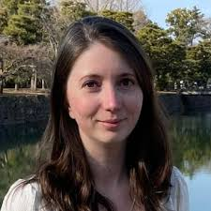
Acknowledgements
Heidi Rehm
Anne O’Donnell-Luria
Melanie O'Leary
Stephanie DiTroia
Alicia Pham
CAGI Organizers
Steven E. Brenner
Predrag Radivojac
Nilah Ioannidis
RGP Team during CAGI 6 and 7
Christina Austin-Tse
Vijay Ganesh
Emily Groopman
Gabrielle Lemire
Emily O’Heir
Ikeoluwa Osei-Owusu
Lynn Pais
Monica Wojcik
Grace VanNoy
Michael Wilson
William Phu
Stacey Hall
Katie Larsson
Brian Mangilog
Jillian Serrano
Sarah Stenton
Mutaz Amin
Jialan Ma
Daniel Marten
Lindsay Romo
Mugdha Singh
Ben Weisburd
Accessor RGP CAGI 6
Sarah Stenton
Accessor RGP CAGI 7
Laura Covill
https://raregenomes.org/
Created for CAGI 7
genomeinterpretation.org
O’Donnell-Luria

Slide 25
Summary slide: RGP CAGI
Participate in the RGP CAGI challenges
Opened October 31, 2025
Closes February 28, 2026
Created for CAGI 7
genomeinterpretation.org
O’Donnell-Luria

Slide 26
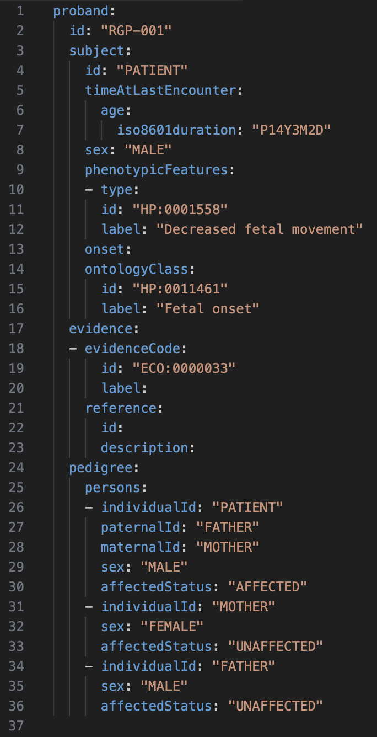
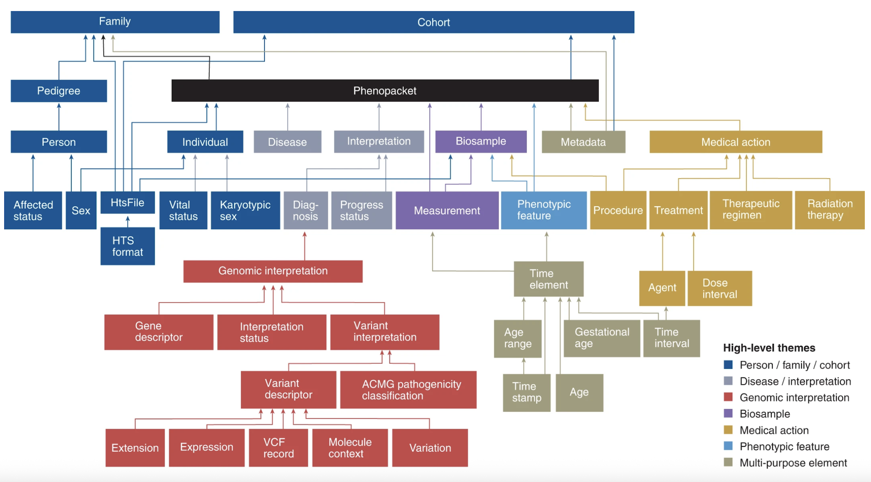
GA4GH Phenopackets
Structured format for clinical and phenotypic data in JSON or YAML
Machine readable
Easily incorporates HPO terms
Created for CAGI 7
genomeinterpretation.org
O’Donnell-Luria

Slide 27
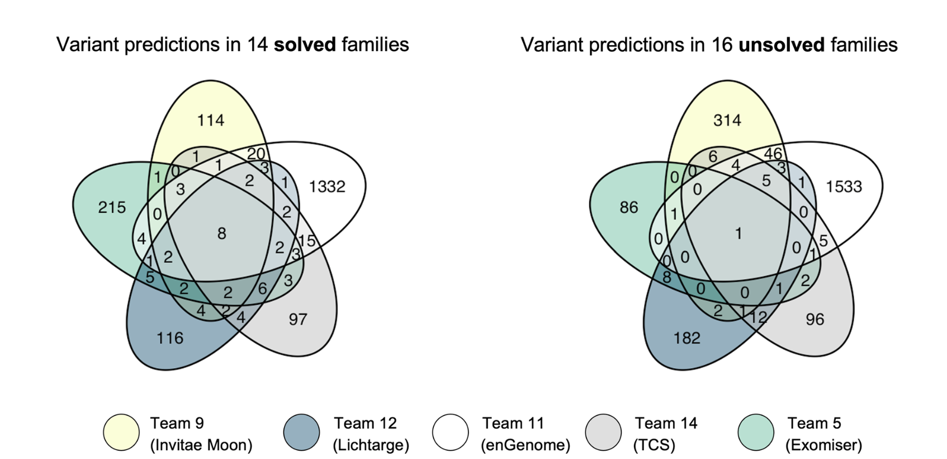
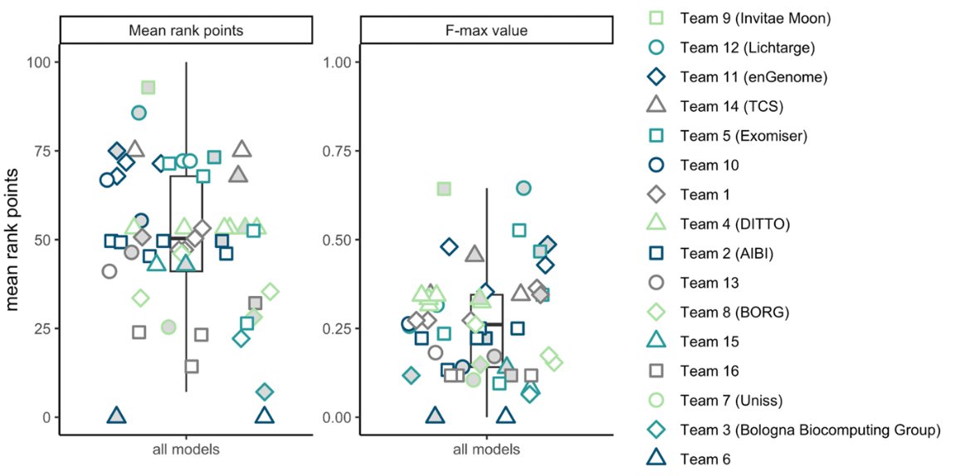
Result 2. Agreement of the top-performing models in solved vs unsolved
14 solved cases
16 unsolved cases
Created for CAGI 7
genomeinterpretation.org
O’Donnell-Luria

