Slide 1

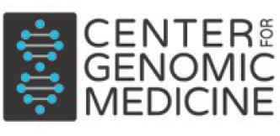




Tackling the VUS Problem
Heidi L. Rehm, PhD, FACMG
Center for Genomic Medicine, Massachusetts General Hospital
Chief Genomics Officer, Massachusetts General Hospital
Co-Director, Program in Medical and Population Genetics, Broad Institute
Chief Medical Officer and Clinical Lab Director, Broad Clinical Labs
Professor of Pathology, Harvard Medical School
Slides can be accessed here:
http://broad.io/RehmCAGI2025
Lab Website: the-tgg.org
@heidirehm.bsky.social

Slide 2
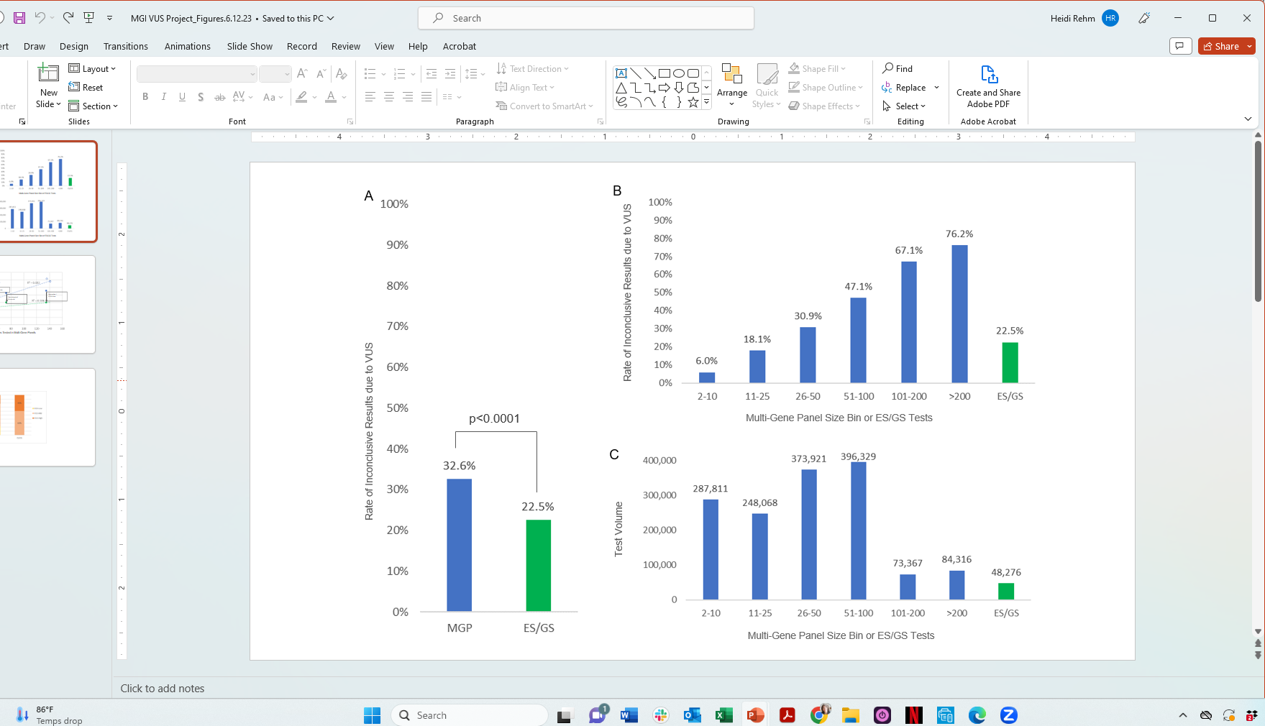
Rate of inconclusive reports due to VUS:
Average = 32.6%
1.5 million tests
19 laboratories
(symptomatic germline testing)
Rehm et al. Genet Med. 2023;25(12):100947. PMID: 37534744

Slide 3
What are the benefits of returning VUS to patients?
Opportunity to build evidence immediately
          Parental testing and/or segregation testing in family members
          Deeper phenotyping and clinical follow-up to inform diagnosis
Enable functional studies or research investigation of variants
Track variant over time as new evidence emerges
Inform clinical decision-making – clinicians make decisions everyday in the face of uncertainty

Slide 4
What are the harms of returning VUS to patients?
May create patient anxiety
Increased health care resources to investigate VUS
Mismanagement of clinical care if diagnosis is falsely assumed
Patient harm if irreversible medical care performed
  Surgical procedures
  Pregnancy termination
Diminish physician use of genetic testing due to negative experiences and uncertainty of how to handle these results

Slide 5
What can we do to better understand and resolve VUS?
Benign
VUS
Pathogenic

Slide 6

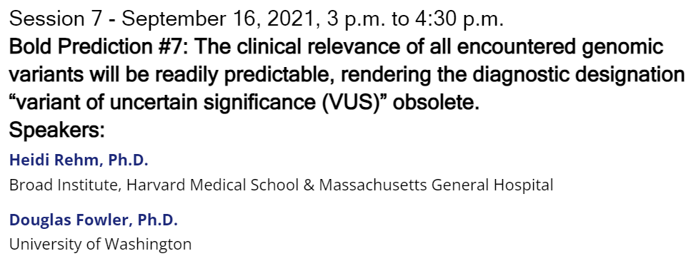
https://www.genome.gov/event-calendar/Bold-Predictions-for-Human-Genomics-by-2030

Slide 7

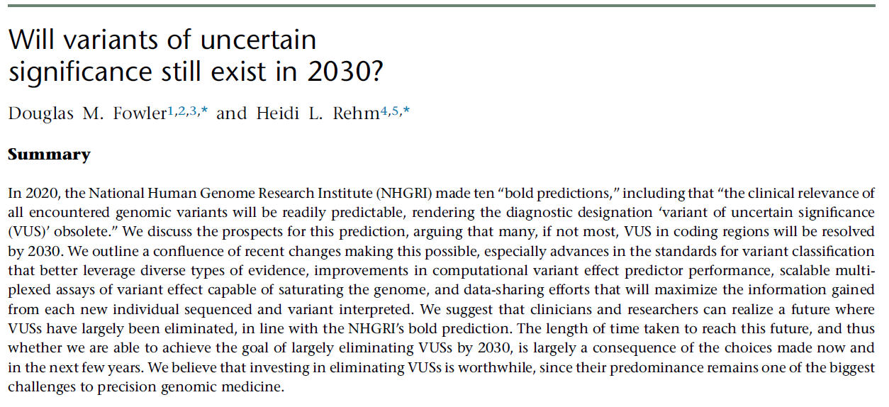
What can we do to resolve VUS?
Improve standards for variant classification
Share data - Share case observations: submit to ClinVar, publish data, build and share case repositories
Improve predictors of variant impact - Better training datasets; machine learning; gene and mechanism-specific models
Scale the functional assessment of human variation
Volume 111
Issue 1, p.5-10
Jan 2024

Slide 8
Standards for Sequence Variant Classification
SVC v1
Kazazian et al 2002
Major overhaul of evidence application, reduce double counting and ambiguity of code application
Points-based system build on Bayesian framework
Introduction of VUS subclasses
SVC v2
Richards et al. 2008
SVC v3
Richards et al. 2015
SVC versioning is being applied retrospectively
SVC v4.0
2026
(in pilot phase 2)
SVCv4 Standards User Network (526 members) svcv4user@broadinstitute.org
SVCv4 Software Platform Development Network (173 members) svcv4softwaredev@broadinstitute.org

Slide 9
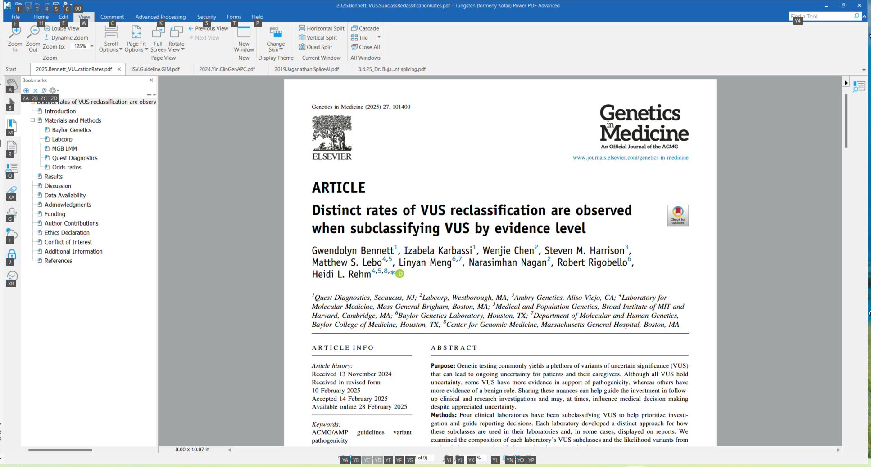
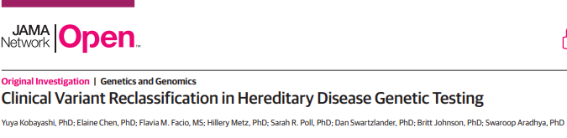
Rates and direction of VUS reclassification across 2.2 million variants
Invitae
2,051,736 variants observed over 8 years
94,453 (4.6%) variants were reclassified
79% of VUS reclassifications went to B/LB
Baylor, Labcorp, MGB, Quest
151,368 variants examined over 2-6 years
4,958 (3.3%) variants were reclassified
80% of VUS reclassifications went to B/LB
Bennett et al. Genet Med (2025) PMID:40035215
Kobayashi et al. JAMA Netw Open (2024) PMID:39504018

Slide 10
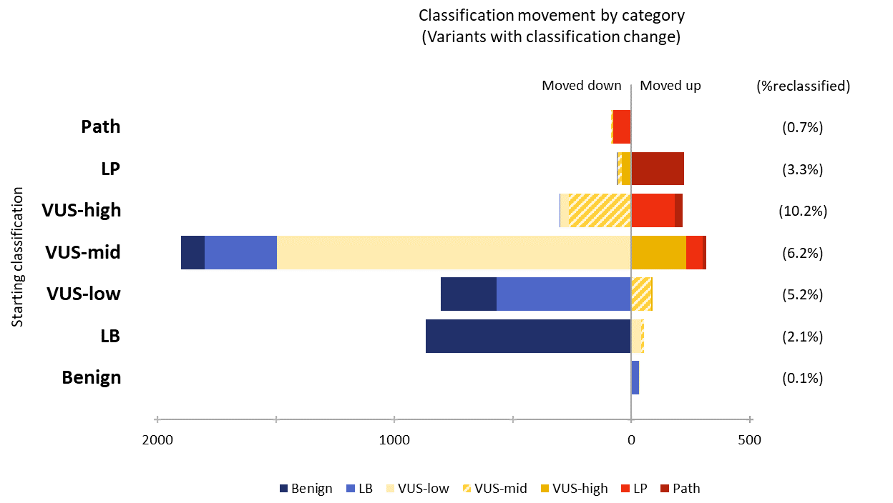
VUS tiering correlates with reclassification
Baylor, Labcorp, MGB, Quest
Variants classified as VUS-low never moved to LP/P
VUS-high variants had the highest rate of reclassification (10%)
Bennett et al. Genet. Med. 2025;27(6):101400. PMID: 40035215

Slide 11
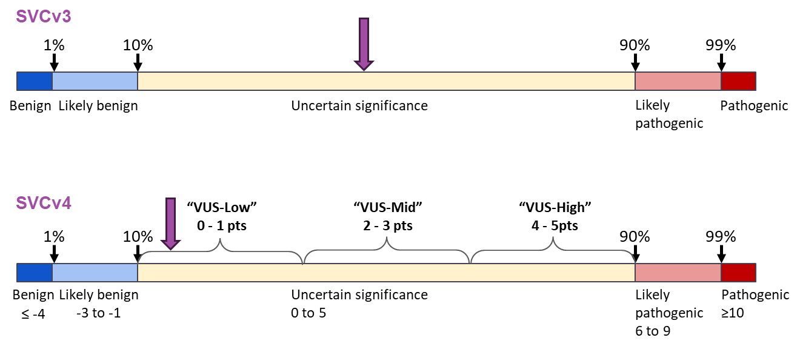
In the absence of evidence, what is the prior probability of pathogenicity?
SVCv3
SVCv4

Slide 12
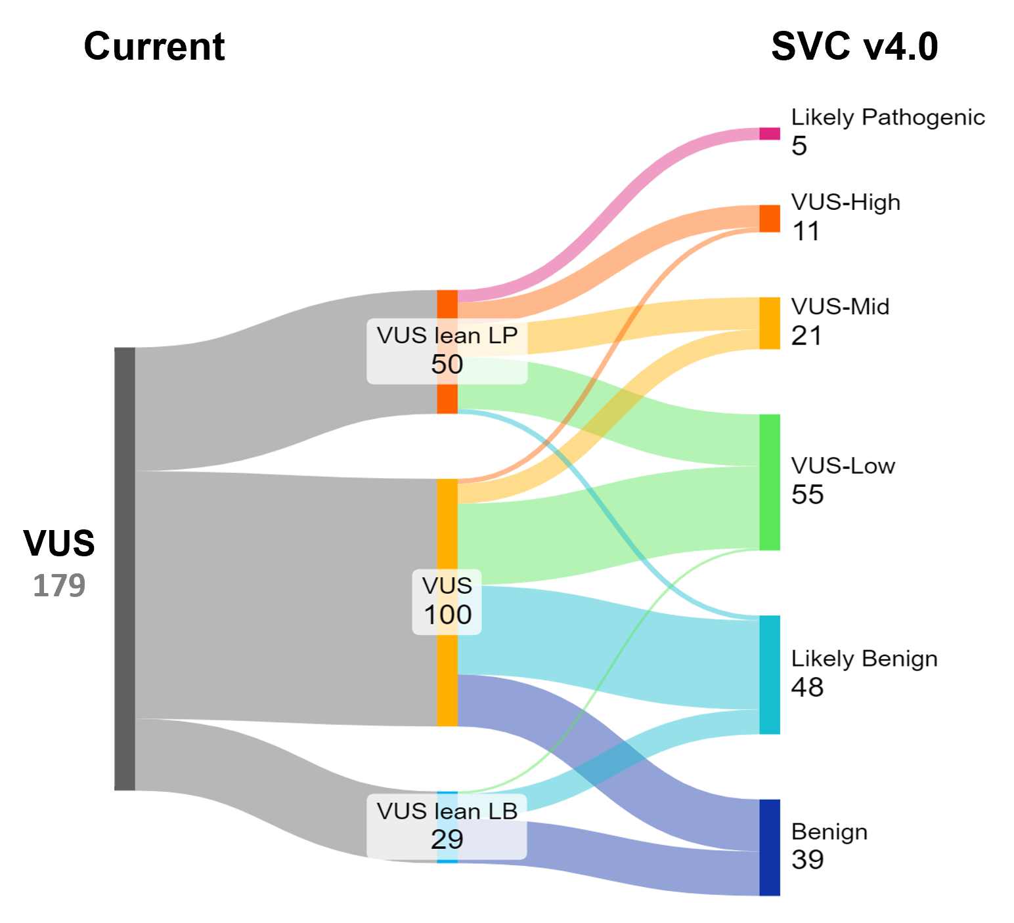
Courtesy of Hela Azaiez
University of Iowa
ClinGen Hearing Loss VCEP
Applied new draft rules to 179 Missense VUS
31% VUS-Low
80%
49% LB/B

Slide 13
Rate of inconclusive reports due to VUS:
Average = 32.6%
1.5 million tests
19 laboratories
(symptomatic testing)
Rehm et al. Genet Med. 2023;25(12):100947. PMID: 37534744

Slide 14
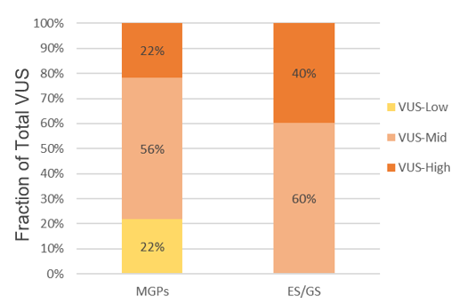
Rate of inconclusive reports due to VUS higher in MGPs vs ES/GS
Multi-Gene Panels
Exome/Genome Sequencing
Rehm et al. Genet Med. 2023;25(12):100947. PMID: 37534744

Slide 15
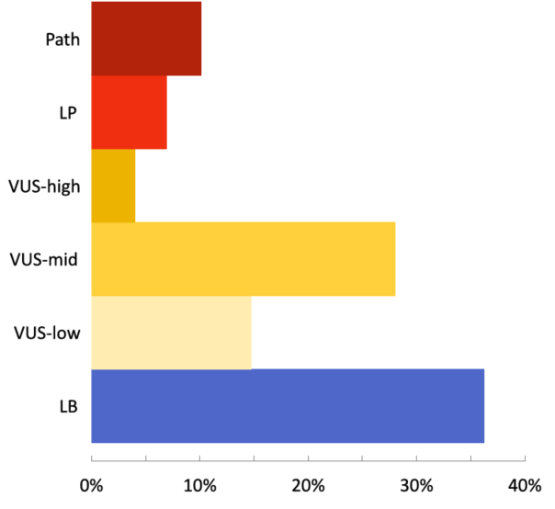
Distribution of VUS subclasses across 4 laboratories that have used subclasses for many years
Labs: Baylor, Labcorp, Mass General Brigham, Quest
Out of 151,368 variants
only 4% of variants were classified as VUS-high
These are the variants that should be the focus of clinicians follow-up resources
4%
Bennett et al. Genet. Med. 2025;27(6):101400. PMID:40035215

Slide 16
Draft ACMG guidance posted for member comment
Points to Consider for the Reporting of Variants of Uncertain Significance in Germline Genetic and Genomic Testing: A Standard of the American College of Medical Genetics and Genomics
Chloe Mighton^{1,2}, Aya Abu-El-Haija^{3,4}, Vimla Aggarwal⁵, Yassmine MN Akkari⁶, Caroline Astbury⁷, D. Hunter Best^{8,9}, Laura K. Conlin¹⁰, Steven M. Harrison¹¹, Nan Jiang¹², Paul Kruszka¹³, Dianalee McKnight¹⁴, Tiffany T. Nguyen Dolphyn¹⁶, Farid Barquet Ramos¹⁷, Christie P. Thomas¹⁸, Lora J. H. Bean¹⁹, Heidi L. Rehm^{1,2,3}
Labs should use subclasses of VUS and display subclasses on genetic test reports allowing clinicians and patients to focus on the most important VUS
Explore ways to deemphasize or not report VUS-low (e.g. move to a separate section or supplement)

Slide 17
What can we do to resolve VUS?
Improve standards for variant classification
Share data - Share case observations: submit to ClinVar, publish data, build and share case repositories
Improve predictors of variant impact - Better training datasets; machine learning; gene and mechanism-specific models
Scale the functional assessment of human variation
Volume 111
Issue 1, p.5-10
Jan 2024

Slide 18


Advances in Computational Predictors
Pedja
Radivojac
Anne
O’Donnell-Luria
Missense – lots of predictors!
Splice – SpliceAI and Pangolin
Indel – guidance underway by the ClinGen Computational WG
Regulatory – emerging area
  Whiffin Lab
  PromoterAI
  AlphaGenome
  Others
Co-Chairs
ClinGen Computational WG

Slide 19

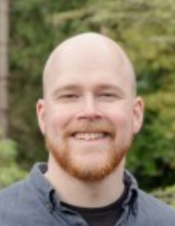
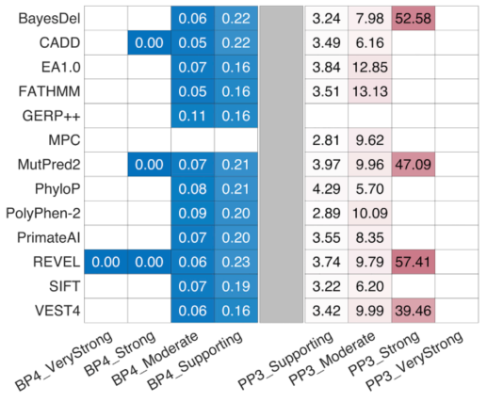
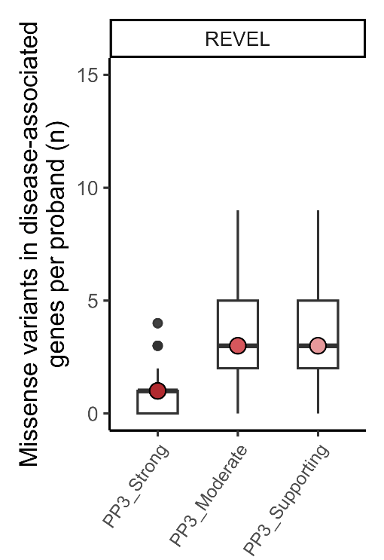

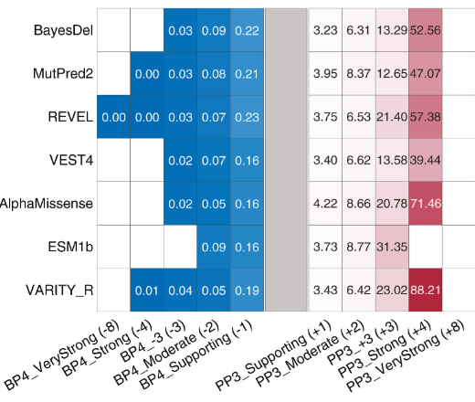
Calibration of Missense Predictors
by ClinGen Computational WG
Pejaver et al. Am J Hum Genet (2022)
Bergquist et al. Genet Med (2025)
Stenton et al. Genet Med (2024)
Vikas Pejaver
Timothy
Bergquist
Sarah
Stenton
Out of 76 rare missense in disease-associated genes per proband

Slide 20
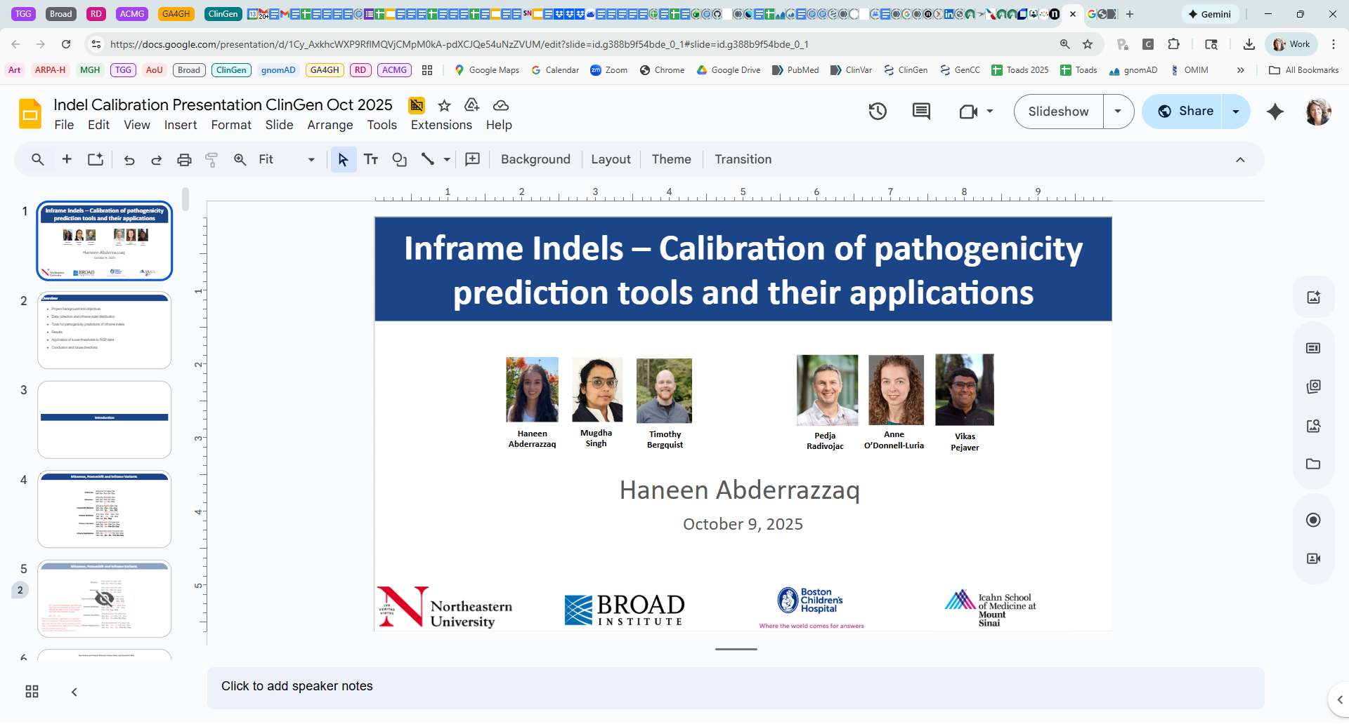
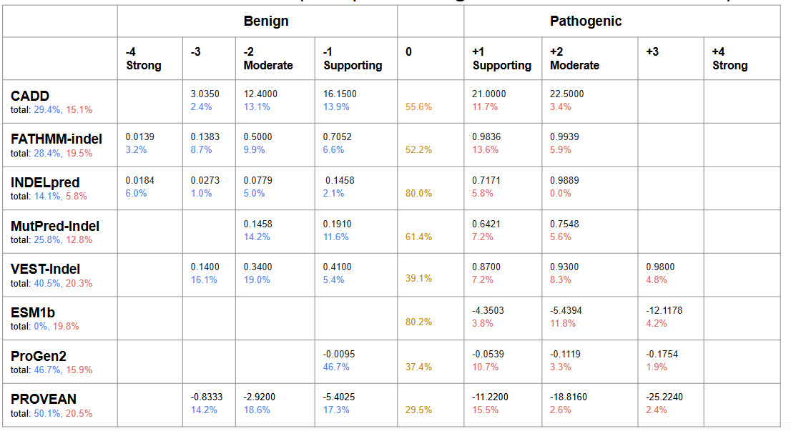
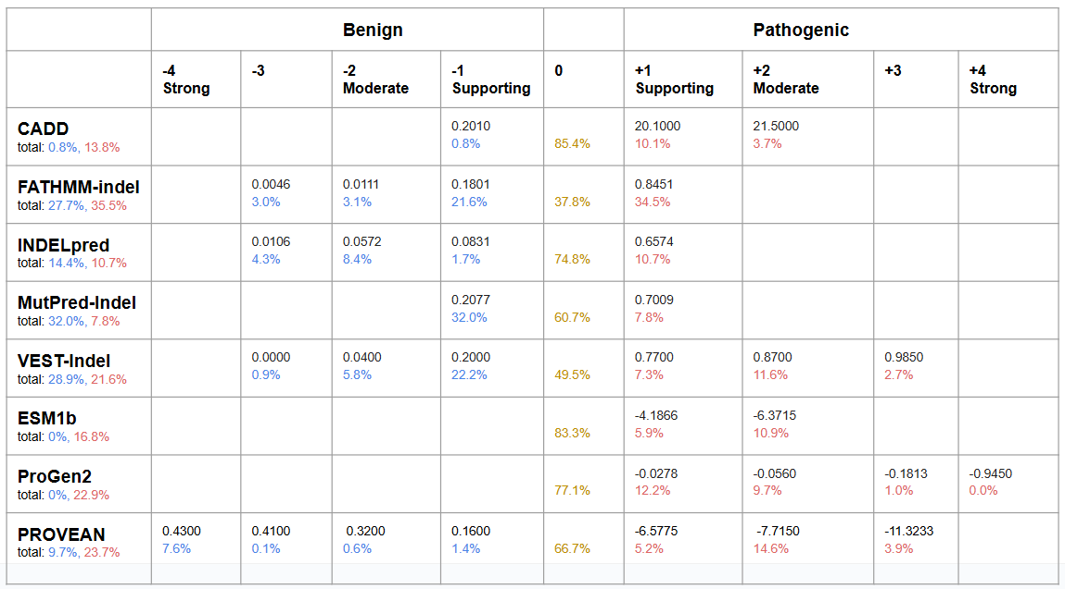
InDel Predictor Calibration by ClinGen Computational WG
Deletions
Predictions for majority of the indel tools reach moderate strength
Insertions

Slide 21
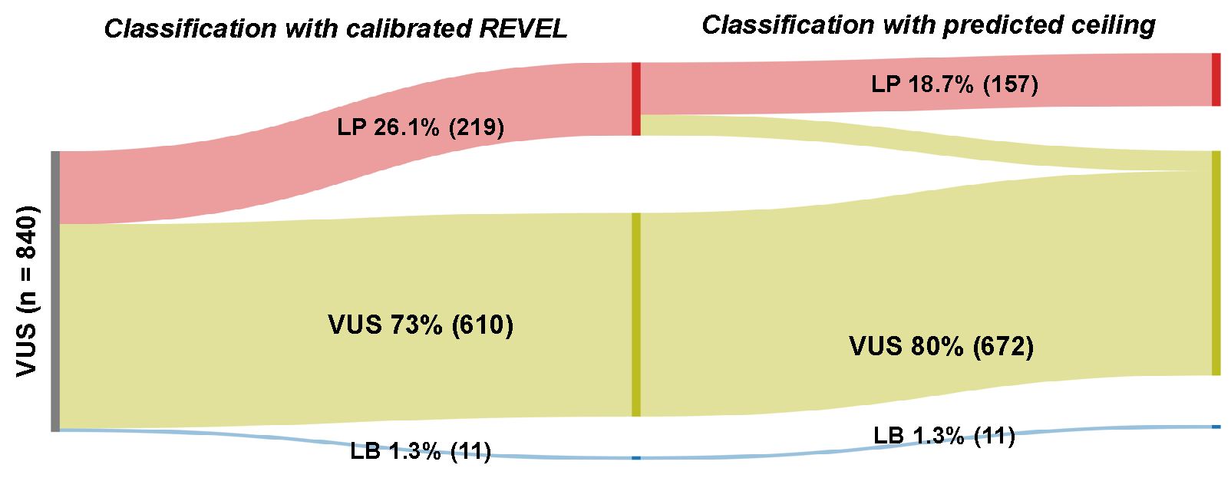
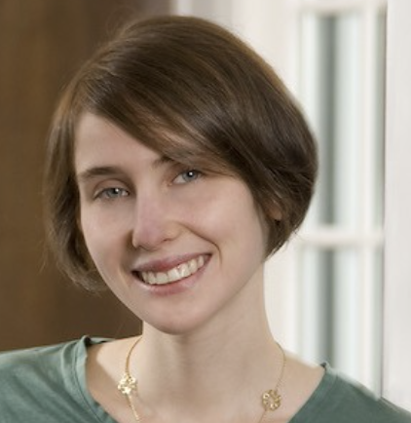

19% of ClinGen VCEP VUS would move to LP (1% to LB) with new evidence strength
PP3/BP4 code overlap: PM1(hot spot/fx domain), PP1 (low rate benign missense), PS1 (dif nt, same aa), PM5 (dif aa, same site), PM4 (protein length changing)
Emily Groopman
Steven Harrison

Slide 22
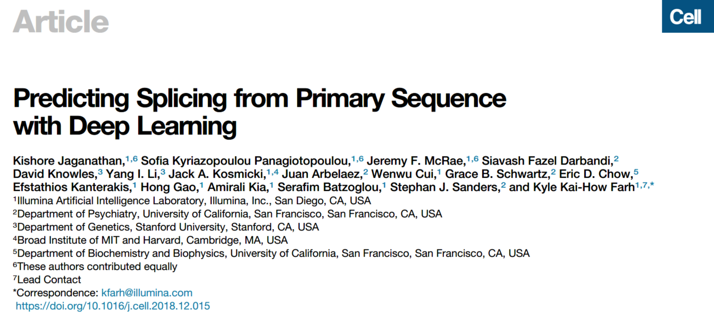
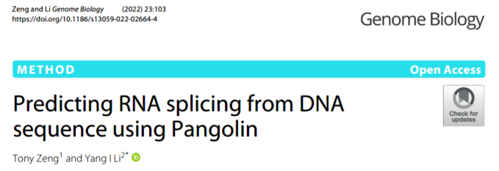
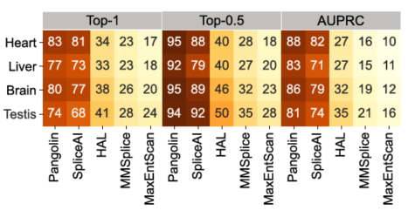
Splice prediction using machine learning developed tools
SpliceAI
Pangolin
SpliceAI is free for academic labs and
also for commercial labs on ClinGen’s LabList: https://clinicalgenome.org/tools/clinical-lab-data-sharing-list/
Pangolin is freely available under a GPL-3.0 License on GitHub
Free lookup tool for SpliceAI, Pangolin, and other tools https://spliceailookup.broadinstitute.org/

Slide 23

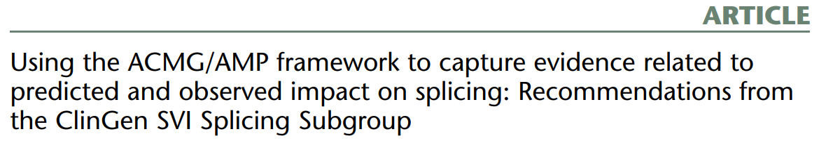
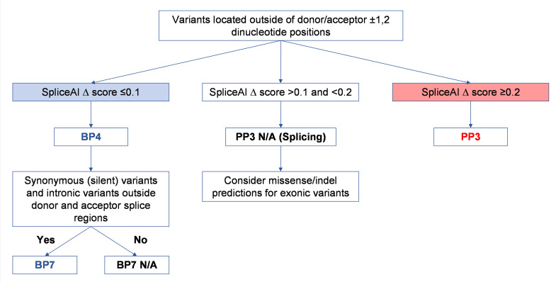
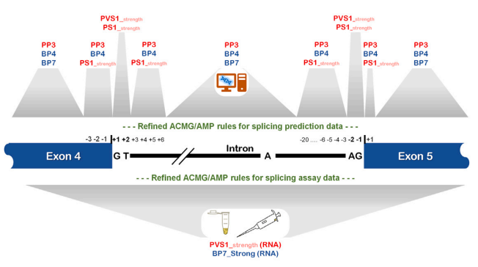
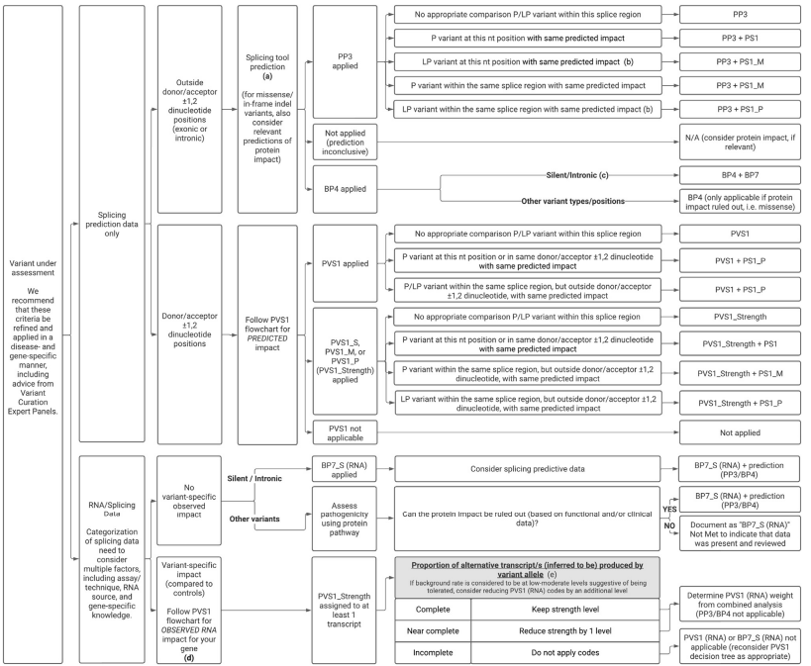
ClinGen Splicing WG released calibration guidance for SpliceAI and experimental splicing assays
Walker et al. Am J Hum Genet. 2023 PMID: 37352859

Slide 24
What can we do to resolve VUS?
Improve standards for variant classification
Share data - Share case observations: submit to ClinVar, publish data, build and share case repositories
Improve predictors of variant impact - Better training datasets; machine learning; gene and mechanism-specific models
Scale the functional assessment of human variation
Volume 111
Issue 1, p.5-10
Jan 2024

Slide 25

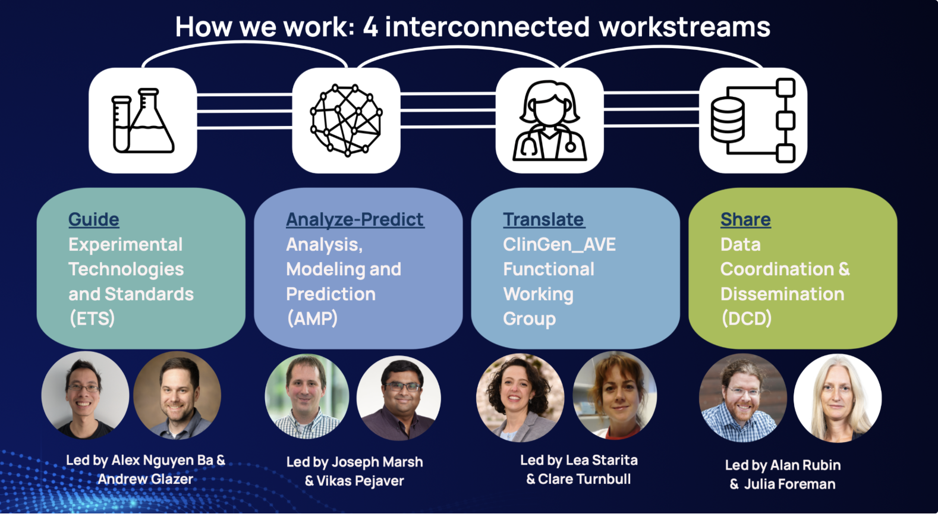

Slide 26


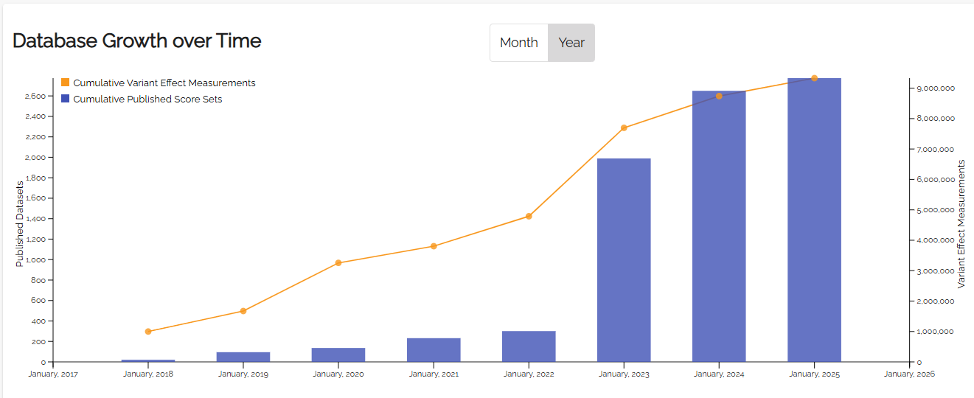
MaveDB is a public repository for datasets from Multiplexed Assays of Variant Effect (MAVEs)
Doug
Fowler
9,330,570 variant effect measurements as of November 11th, 2025
MaveDB is open-source, released under the AGPLv3 license and available at https://www.mavedb.org.

Slide 27

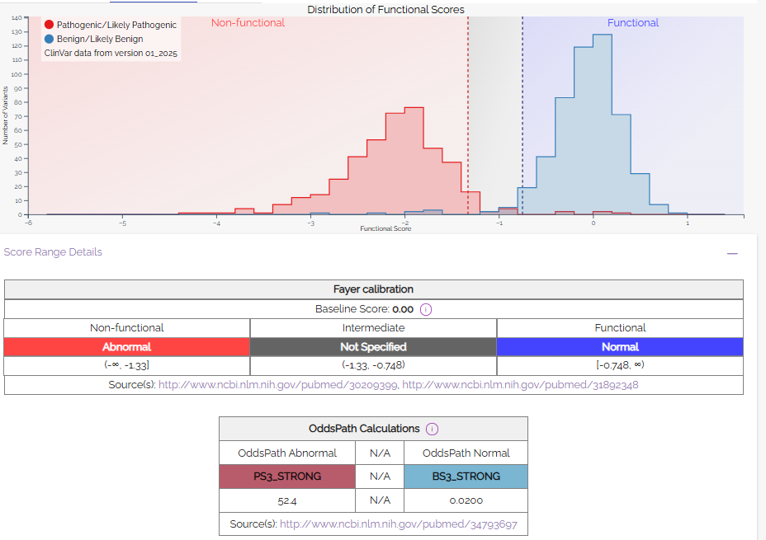
MaveMD integrates with ClinVar and the ClinGen Allele Registry
Displays and exports clinical evidence calibrations compatible with ACMG/AMP variant classification guidelines.
BRCA1 SGE
438,318 variant effect measurements
74 MAVE datasets
32 disease-associated genes
9,330,570 variant effect measurements as of November 11th, 2025
https://www.mavedb.org/mavemd

Slide 28
What can we do to resolve VUS?
Improve standards for variant classification
Share data - Share case observations: submit to ClinVar, publish data, build and share case repositories
Improve predictors of variant impact - Better training datasets; machine learning; gene and mechanism-specific models
Scale the functional assessment of human variation
Volume 111
Issue 1, p.5-10
Jan 2024

Slide 29

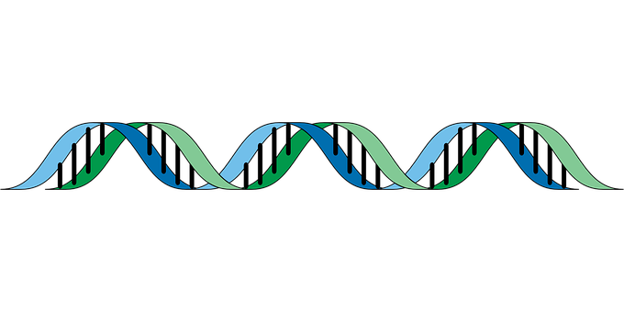

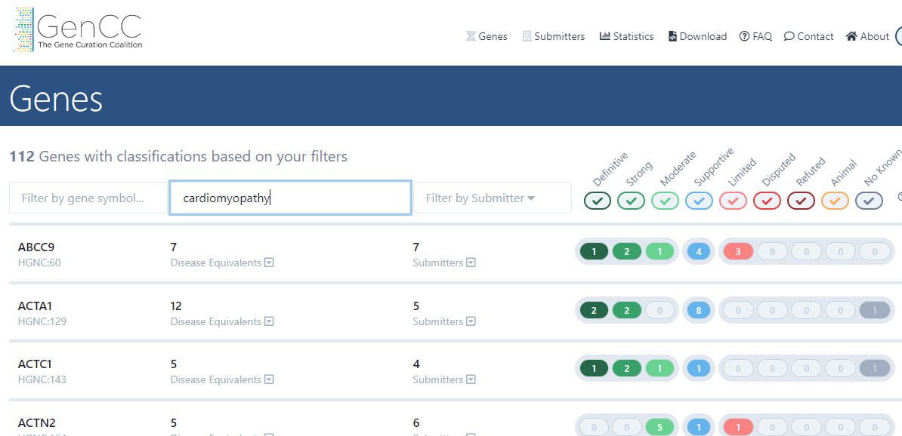

Genome analysis starts with filtration
Number of Variants
~3-5,000,000
10,000s
1000s
100s
10s
Step 1 - Get rid of common variants
Step 2 - Look at variants that are suspicious
De novo (new, not passed from parents)
Variants already reported as pathogenic
Step 3 - Look at variants in genes linked to the person symptoms
0-few candidate causal variants in known or novel genes

Slide 30
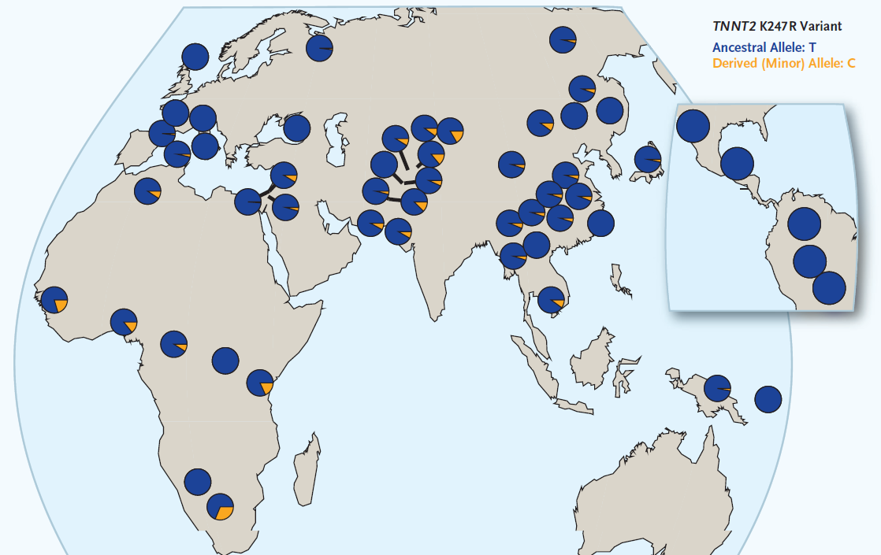
Frequency of TNNT2 K247R Variant in Global Populations
Absent/rare
Common
Manrai AK et al., N Engl J Med 2016; 375:655-65.
Notes:
Variants initially classified as pathogenic, subsequently clearly benign
Variants of freq > 1% in either black or white, associated with cardiomyopathy

Slide 31
Common variant discovery to rule out causality
Despite massive European sample growth in gnomAD v4, very few new common alleles were discovered.
In contrast, despite very modest sample growth in non-European, more common variants are identified

Slide 32

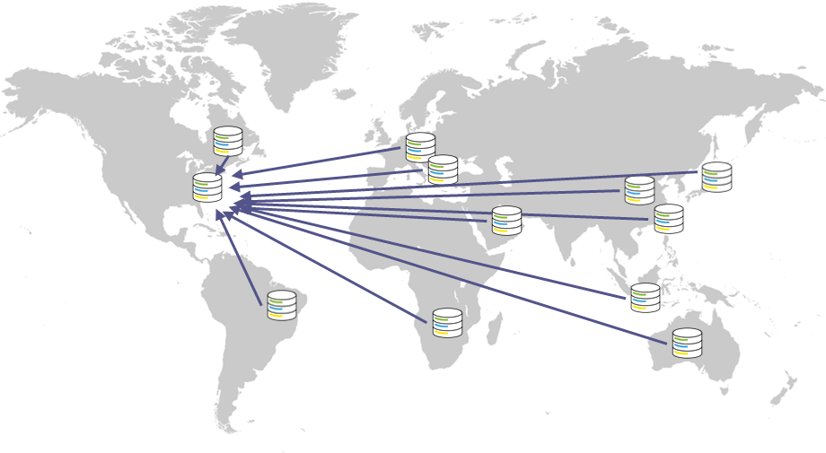
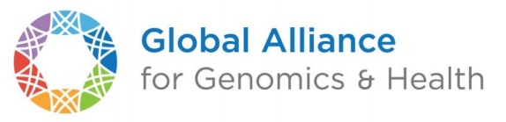
The Future of gnomAD
gnomAD v5:
  Add >415,000 All of Us WGS
gnomAD v6:
  Federated gnomAD
  Each site will process their data according to gnomAD best practices and then share aggregate AFs for representation in gnomAD

Slide 33
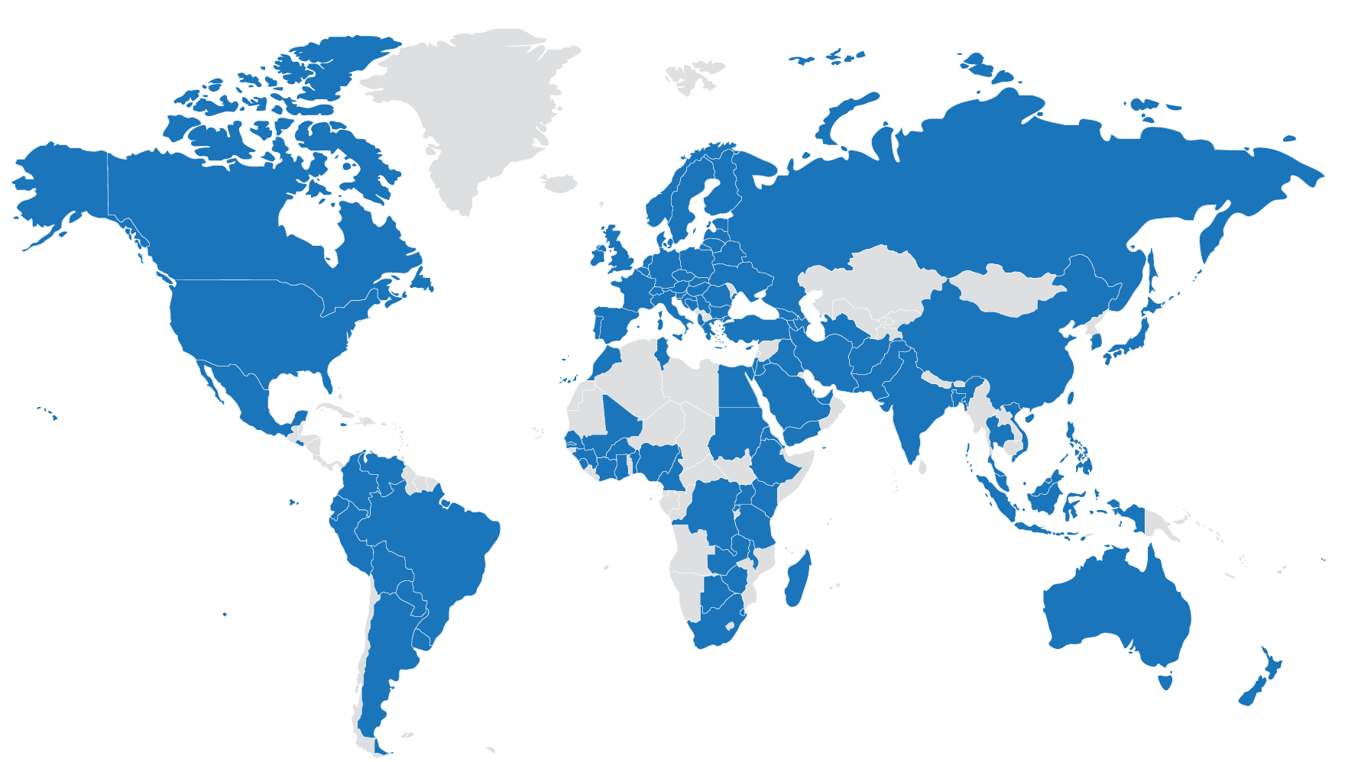

GA4GH: the global standards organization for genomics
GA4GH develops standards and policies for responsible genomic and health-related data sharing
Convene stakeholders
Catalyze data sharing

Slide 34








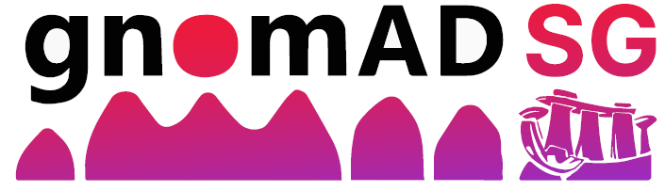
Collaborating Groups for Federated gnomAD
Country/Region | Samples | Source | Lead
Africa | TBD | African Genome Variation Database | Nicky Mulder
Australia | 10,000 | Our DNA | Daniel MacArthur
Austria | TBD | Austrian Human Genome Project | Johannes Zschocke
Brazil | 21,000 | Genomas SUS | Leandro Colli
Canada | 60,000 | Canadian Genomic Data Commons | Jordan Lerner-Ellis
China | 10,000 | Adv. Inst. for Information Technology | Xiao Li
Europe/UK | >100,000 | EGA, ERNRND | Abeer Fadda, Holm Graessner
Germany | 10,000 | Clinical sequencing | Peter Krawitz
Indonesia | TBD | Indonesian Biobank | Meutia Kumaheri
Japan | 100,000 | Tomoku Medical Megabank Organization | Soichi Ogishima
Qatar | 25,000 | Qatar Biobank | Chadi Saad
Singapore | 10,000 | SG10K_Health data | Maxime Hebrard
Taiwan | 1500 | Taiwan Biobank | Jacob Shujui Hsu

Slide 35
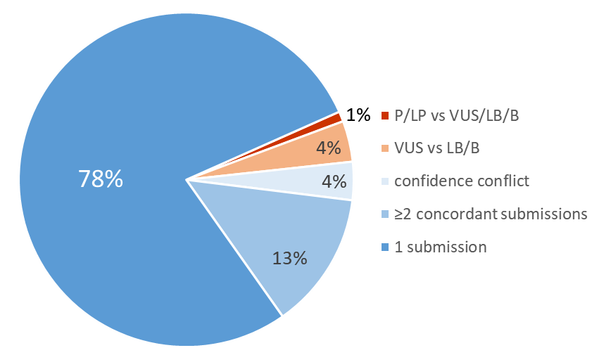
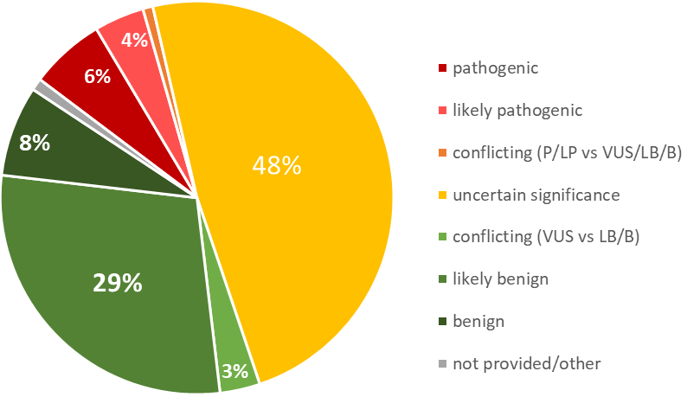
Variants in ClinVar
78% of unique variants in ClinVar have only been submitted by one lab
52% of variants are VUS or conflicting
~33,000 (1%) variants have a medically significant conflict (P/LP vs VUS/LB/B)
By concordance
By category
Data from ClinVar Miner on November 10th, 2025
Notes:
19666 one star only

Slide 36
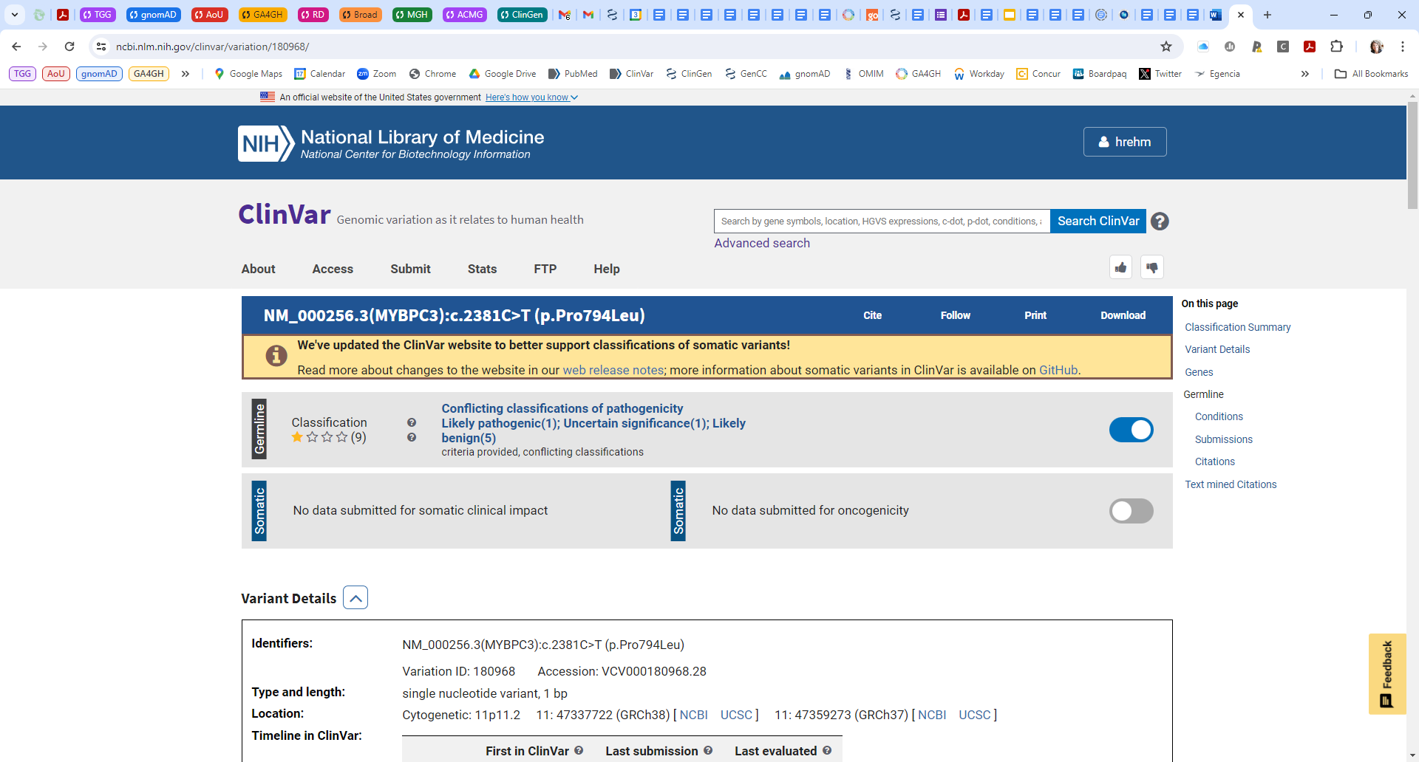
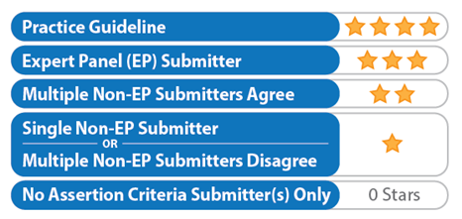
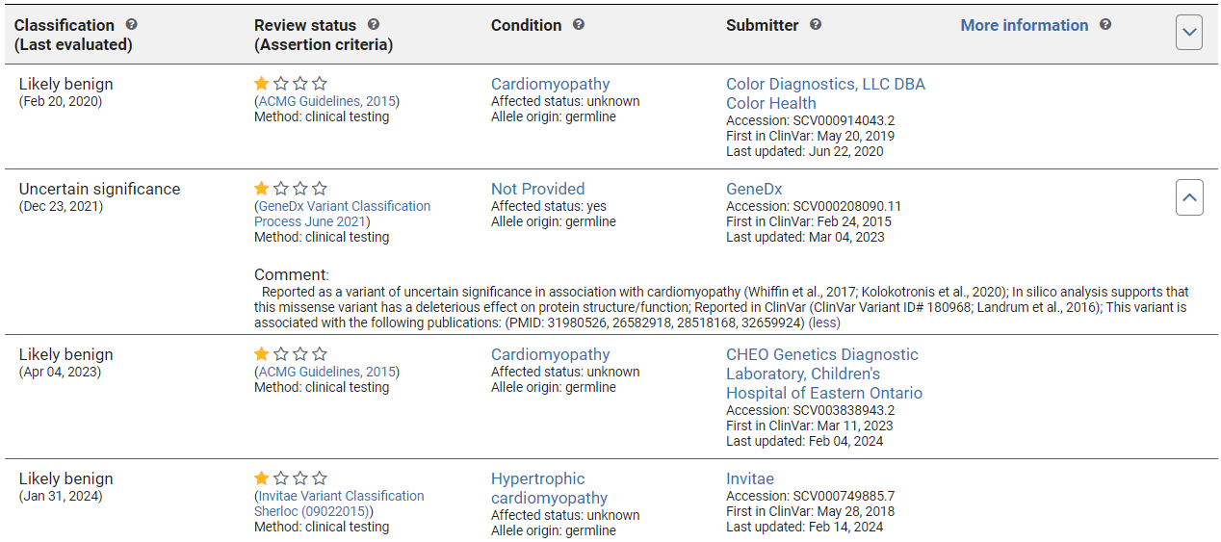
Aggregate Classification
(impacted by submitter status)
Individual
submissions

Slide 37
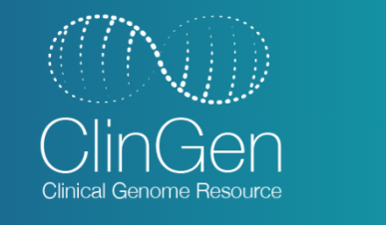
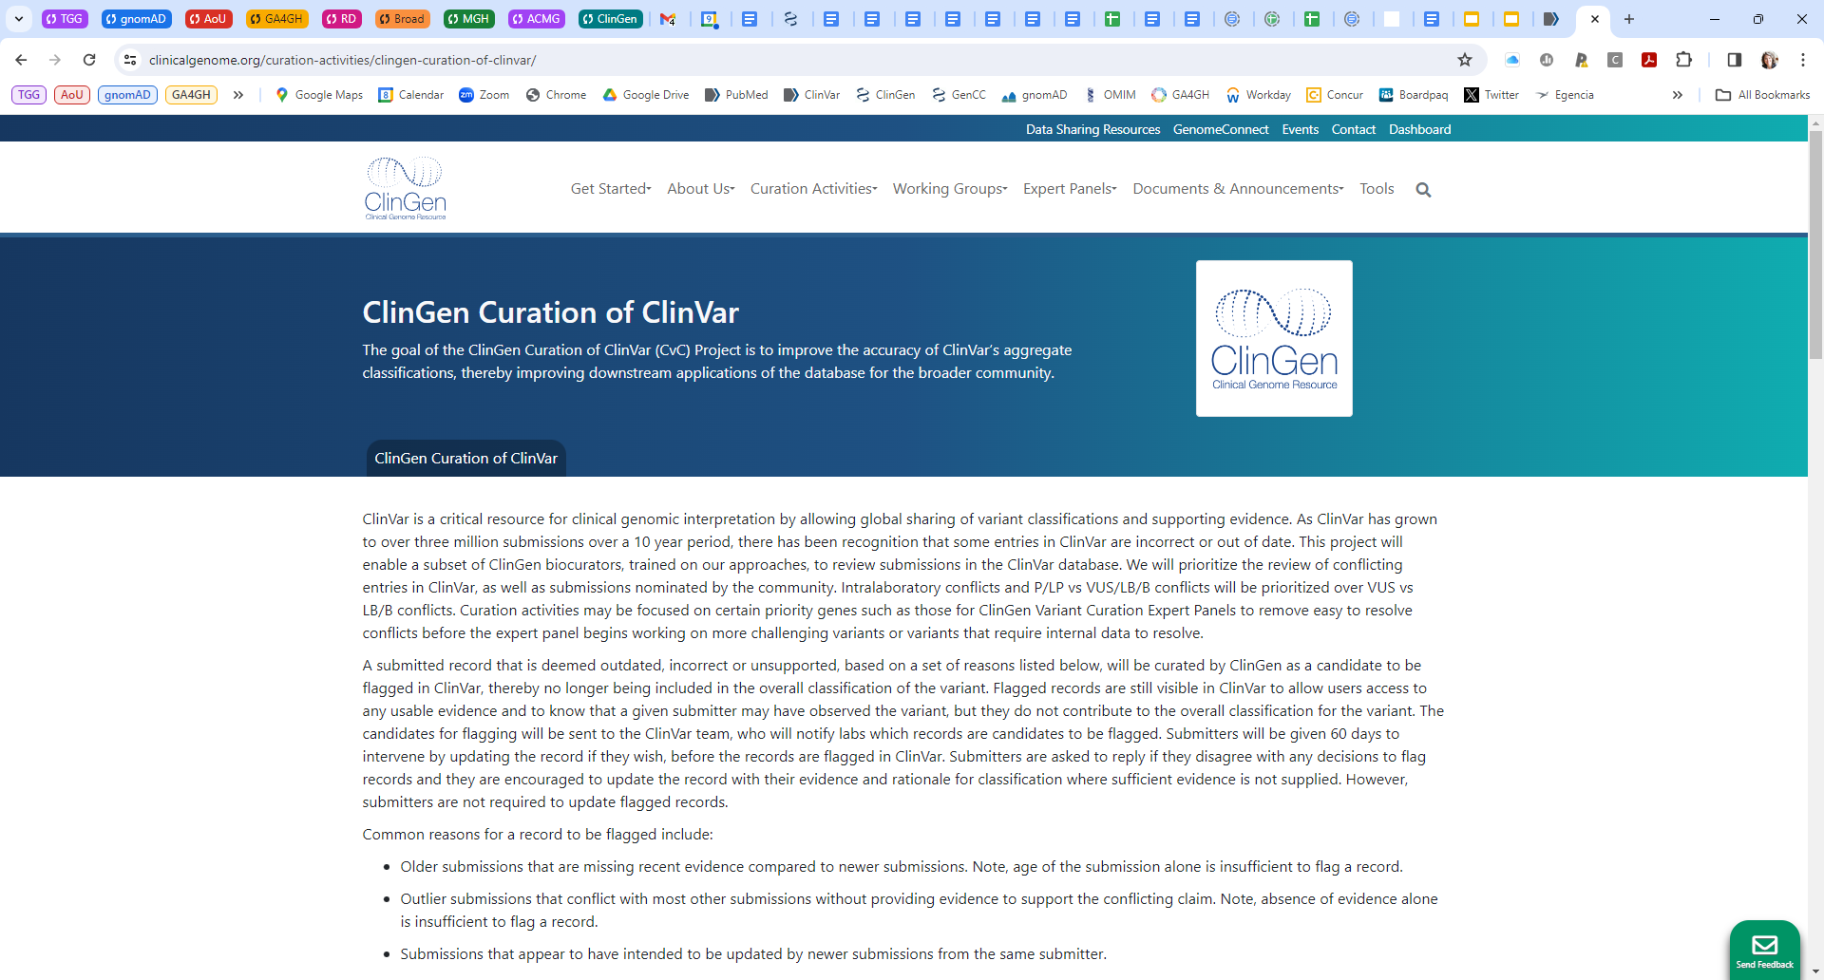
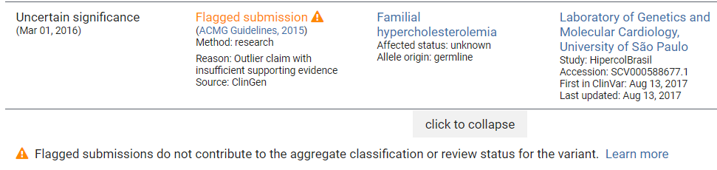

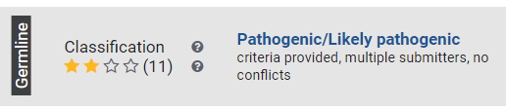
https://clinicalgenome.org/curation-activities/clingen-curation-of-clinvar/
ClinGen curators review old or outlier submissions for ClinVar variants with conflicts or variants nominated by community
curators focus on obvious issues, not requiring formal variant classification
typically include at least 2 qualities (old, outlier, lack of supporting evidence)
SCVs are flagged leading to exclusion from ClinVar’s calculated overall clinical significance classification
Submitters are notified of flagged records and have 60 days to intervene before a flag is live.
Submitters can update a record at anytime, in which case the flag is removed, even after its live.

Slide 38
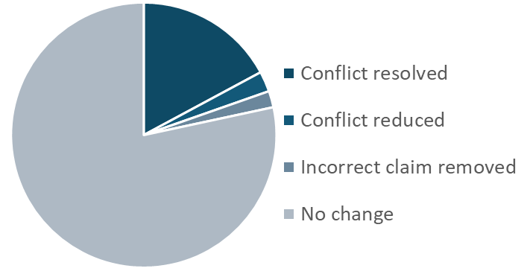
https://clinicalgenome.org/curation-activities/clingen-curation-of-clinvar/
24,284 Records (SCVs) Reviewed
5569 Records Flagged in ClinVar
(4508 unique variants)
17%
2%
2%
78%
3082 conflicts resolved
26 SCVs (~0.5%) were challenged by 21 labs (we retracted 7 of these)
No further challenges in 10 months
Data from November 10th, 2025

Slide 39
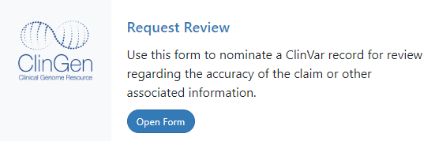
If you find errors in ClinVar, send us the variant.
www.clinicalgenome.org/clingen-curation-clinvar

Slide 40
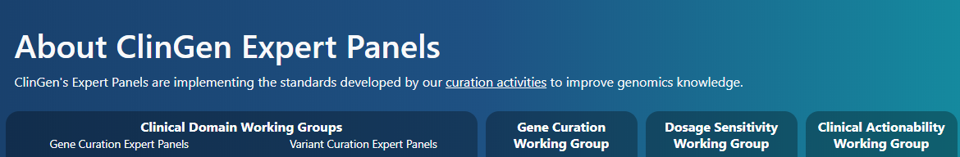
15 Clinical Doman Working Groups
Cardiovascular CDWG
Hearing Loss CDWG
Hemostasis/Thrombosis CDWG
Hereditary Cancer CDWG
Immunology CDWG
Inborn Errors of Metabolism CDWG
Kidney Disease CDWG
Neurodevelopmental Disorders CDWG
Neurological CDWG
Ocular CDWG
Pulmonary CDWG
Rheumatologic Autoimmune Disease
Skeletal Disorders CDWG
Somatic Cancer CDWG
Syndromic CDWG
>76 Variant Curation Expert Panels
(37 VCEPs with final approval)
Create gene-specific variant classification criteria
Collect and contribute evidence for variants
Prioritize conflicting variants and variants with multiple VUS submissions
~2800 volunteers across 66 countries

Slide 41
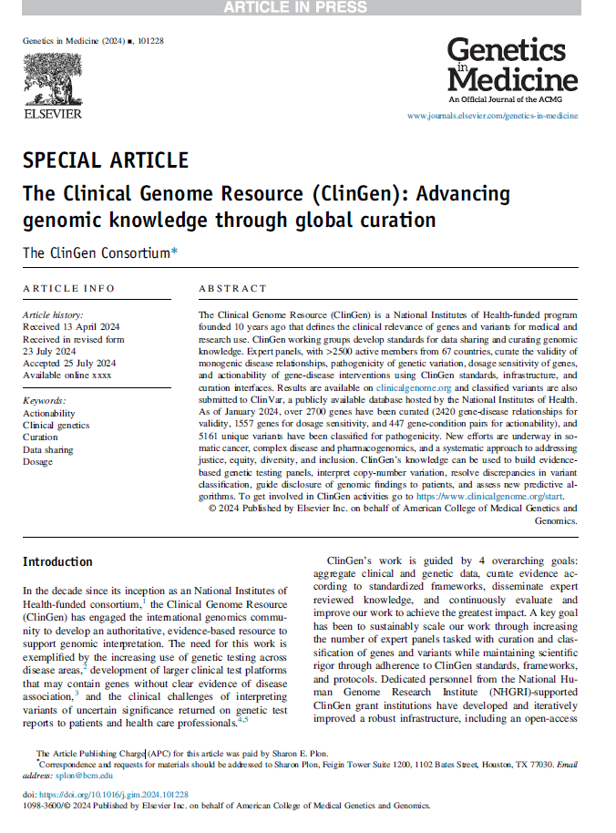

Figure 3. Growth of ClinGen’s expert panels and curation results across funding phases.
PMID: 39404758

Slide 42


Yin et al. Am J Hum Genet. 2024; 111(11):2427-2443. PMID: 39357517
>10,000 variants for APC classified
37% reduction in VUS

Slide 43


Kelly et al. Genet Med. 2018; 20(3):351-359. PMID: 29300372
48% of variants were reclassified through evidence contributed by expert panel members
Notes:
Figure 4. Proband counts from public versus private data sources
Proband counts from private laboratory sources compared to public sources that resulted in a change in classification. Public sources refer to published sources and Oxford Molecular Genetics Laboratory data (Available at https://cardiodb.org/ACGV/). Private data refers to internal data provided by the UK - Brompton & Singapore, SHaRe, LMM, and Invitae laboratories. Numbers within the bar graph represent the proband count by source. From left to right: R453H through G741W changed classification from likely pathogenic to pathogenic. R1045C and E1356K changed from VUS to likely pathogenic.

Slide 44
Challenges
Most case-level data evidence is not accessible in ClinVar
ClinGen Expert panel members contribute evidence manually from internal lab data or through requests to ClinVar submitters – this approach is not scalable

Slide 45



Slide 46


Submission of 3’UTR variant to ClinVar
The heterozygous c.*534T>C variant in CAPN3 was identified, in the compound heterozygous state with a likely pathogenic variant, in three siblings with limb-girdle muscular dystrophy (Broad Institute Rare Genomes Project). Trio genome analysis revealed that this variant was in trans with the likely pathogenic variant.

Slide 47


We received inquiries about this VUS through ClinVar
5 unrelated patients with c.*534T>C variant and another LP variant in CAPN3
All have hyperCKemia and muscle weakness, with onset after adolescence.
At least 2 patients had Western blot in muscle, showing reduced calpain.
RNAseq on two patients showed reduced CAPN3 expression and allelic imbalance
Hypothesis is that the 3’UTR variant creates a new miRNA binding site, leading to the silencing of that allele, and functional assay is underway
Note: These two groups never connected to each other because they had not shared their data publicly

Slide 48
Challenges
Only interpreted variants are in ClinVar
Evidence is often not formatted for scalable analyses
How can we broadly access evidence directly from genomic data?

Slide 49

Federated Approaches for Genomic Data Sharing
Candidate gene matching
Matchmaker Exchange
Variant to genome matching
Variant Level Matching
Boycott KM, Azzariti D, Hamosh A, Rehm HL. Seven years since the launch of the Matchmaker Exchange. Hum Mutat. 2022 43(6):659-667. PMID: 35537081

Slide 50



Slide 51






seqr genomic analysis platform
https://seqr.broadinstute.org
Open source, freely available software for exome and genome analysis on NHGRI’s AnVIL platform
>2,000 people from >100 countries have performed family-based analysis in seqr
>70,000 rare disease genomes/exomes
Any AnVIL-registered user can look up a variant in seqr by going to seqr.broadinstitute.org/summary_data/variant_lookup
Projects can be opted out from variant-level contact – none have opted out to date
Pais et al. seqr: A web-based analysis and collaboration tool for rare disease genomics. Hum Mutat. 2022. PMID: 35266241
Hana
Snow
Ben
Blankenmeister
Lynn
Pais
Larry
Babb
Anne
O’Donnell-Luria

Slide 52


Variant matching in seqr on AnVIL
Variant in
your project
First gene discovery by Variant-Level Matching
Five unrelated families with non-syndromic retinal dystrophy
Variant in
another project

Slide 53


Building a federated variant-level matching (VLM) platform
Goal: Connect rare disease databases through a federated network to allow identification of cases with specified variants/variant types and return phenotype
Databases connect using the GA4GH Beacon v2 API
No data centralization occurs

Slide 54
Building a federated variant-level matching (VLM) platform
Moved to automated authentication through OAuth authorization protocol by Auth0 (awaiting Franklin)
VLM Steering Committee approves a database to connect
Current implementations display aggregate allele counts and provide a link to access phenotype
Variant Matcher
Collaborating Databases
VariantMatcher – Johns Hopkins
Franklin by Genoox
Geno2MP and MyGene2 – U. Wash
seqr and AnVIL – Broad
DNAStack
seqr in Genomics4RD – Canada
RD-Connect, Genomics England, Cavatica/CHOP, Elixer, Epic, BTG,
many more to come…
live
Geno2MP and MyGene2
Broad seqr
approved
Franklin

Slide 55


NBPF10 c.4847A>C
VariantMatcher <> Franklin
First federated connection using GA4GH Beacon v2 API
(used token exchange)

Slide 56






Slide 57

ClinGen Pilot of
VLM Network
Variant | Classification | Matches
NM_001100.4(ACTA1):c.617-5C>A | VUS | Franklin 1 het
NM_001100.4(ACTA1):c.175G>A (p.Glu59Lys) | LP | Franklin 1 het
NM_000252.3(MTM1):c.1353G>A (p.Gln451=) | LP | Franklin 1 het
NM_001005361.3(DNM2):c.1567A>G (p.Arg523Gly) | LP | Franklin 1 het
NM_000540.3(RYR1):c.14815G>A (p.Asp4939Asn) | VUS | Franklin 1 het
NM_000540.3(RYR1):c.13949T>C (p.Leu4650Pro) | VUS | Franklin 1 het
NM_005343.4(HRAS):c.175G>A (p.Ala59Thr) | LP | Franklin 14x het
NM_006767.4(LZTR1):c.1687G>C (p.Glu563Gln) | VUS | Franklin 1x het
NM_006767.4(LZTR1):c.263+1G>A | LP | Franklin 1x het
NM_001100.4(ACTA1):c.1001C>T (p.Pro334Leu) | LP | Franklin 2 het
NM_006767.4(LZTR1):c.1234C>T (p.Arg412Cys) | VUS | Franklin 5x het
NM_006767.4(LZTR1):c.850C>T (p.Arg284Cys) | LP | Franklin 5x het
NM_000540.3(RYR1):c.577T>A (p.Ser193Thr) | VUS | seqr 1 het
NM_033360.4(KRAS):c.194G>T (p.Ser65Ile) | LP | seqr 1x het
NM_030662.3(MAP2K2):c.806C>G (p.Pro269Arg) | VUS | seqr 2x het
NM_006767.4(LZTR1):c.848G>A (p.Arg283Gln) | LP | Franklin 1x het; seqr 1x het
NM_030662.3(MAP2K2):c.692G>T (p.Arg231Leu) | VUS | Franklin 1x het; seqr 4x het
NM_000540.3(RYR1):c.14173G>C (p.Val4725Leu) | VUS | Franklin 5 het; seqr 1 het
NM_000540.3(RYR1):c.9874C>T (p.Pro3292Ser) | VUS | Franklin 6 htz; seqr 6 het
NM_000252.3(MTM1):c.688T>C (p.Trp230Arg) | LP | seqr 1 het; Geno2MP 1 het
NM_006767.4(LZTR1):c.742G>A (p.Gly248Arg) | LP | Franklin 11x het; seqr 1x het; Geno2MP 1x het;
NM_002834.4(PTPN11):c.244A>G (p.Met82Val) | VUS | Franklin 2x het; seqr 4x het; Geno2MP 1x het
NM_000540.3(RYR1):c.619C>T (p.Arg207Cys) | VUS | Franklin 6 het; seqr 2 het; Geno2MP 4 het
NM_000540.3(RYR1):c.4729G>A (p.Ala1577Thr) | VUS | Franklin 9 het; seqr 4 het; Geno2MP 5 het
NM_006767.4(LZTR1):c.1084C>T (p.Arg362Ter) | LP | Franklin 18x het; seqr 5x het; Geno2MP 4x het; VM 1x het
Queried 51 variants (26 VUS, 25 LP) from ClinGen VCEPs
25 (50%) had VLM hits
21 Franklin (1-18 hets)
13 seqr (1-6 hets)
6 Geno2MP/MyGene2 (1-5 hets)
1 VariantMatcher (1 het)
Pam Robertson

Slide 58














Translational Genomics Group
Slides can be found here:
Thank you to the thousands of people who collaborate, curate, and share data across many resources and programs.
http://broad.io/RehmCAGI2025
Funding Support:

