Slide 1

CAGI 7 slide pack guidelines
I agree to my slides being used according to the following terms:
_______Yu-Jen (Jennifer) Lin_______
Authors: please include THIS slide at the beginning of your presentation to indicate that you agree with reuse of your slides in CAGI presentations, according to the terms below, and digitally sign by writing your name above.
At CAGI 7, use of this slide pack is only required for CAGI dataset providers, assessors, and predictors, but all are encouraged to use the annotations for materials they do not want shared publicly.
To disseminate the CAGI results, I encourage all CAGI participants to remix these CAGI slides for inclusion in their oral and poster presentations
CAGI participants may use or publish any content of these slides only in compliance with the CAGI Data Use Agreement
CAGI participants may not cite or publish any content of these slides except with the written permission of the originating author or in the primary CAGI publications
CAGI participants must acknowledge the original authors of these slides and CAGI 7. Include the acknowledgement banner across the bottom
CAGI participants must include the CAGI credits slide in their presentations
Slides with a red slash (no remix) may not be included in a presentation unless all attendees are registered CAGI participants who signed the data use agreement
Slides with a red X over the entire slide may not be used in any circumstances
Slides with a blue slash (embargoed) may not be used unless the embargo is explicitly lifted
Slides without slash or X may be tweeted, tooted, posted, X’d unless flagged with “No tweet” icon
CAGI participants using these slides must explain the “No tweet” icon, which means that the slide content should not be disseminated outside the presenting conference hall. If the presentation venue permits pervasive tweeting, you may not include these slides in your talk
Note for slide authors: we expect all CAGI participants to abide by these restrictions, and will make best effort to ensure they are followed. However, but bear in mind that we have limited means of enforcing them, and therefore the restrictions cannot be guaranteed.

Slide 2
ARSA missense stability prediction challenge identifies computational advances over state-of-the-art variant impact predictors
CAGI 7 ARSA Missense Challenge
Assessment
Yu-Jen (Jennifer) Lin
University of California, Berkeley
jenniferyjlin@berkeley.edu
Created for CAGI 7
genomeinterpretation.org
Yu-Jen (Jennifer) Lin

Slide 3
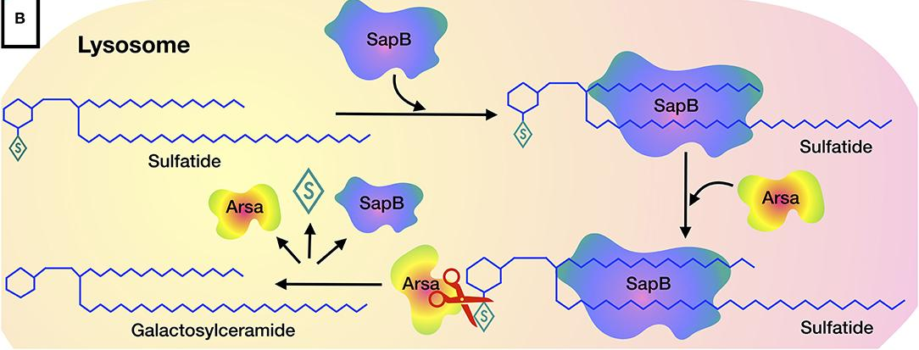
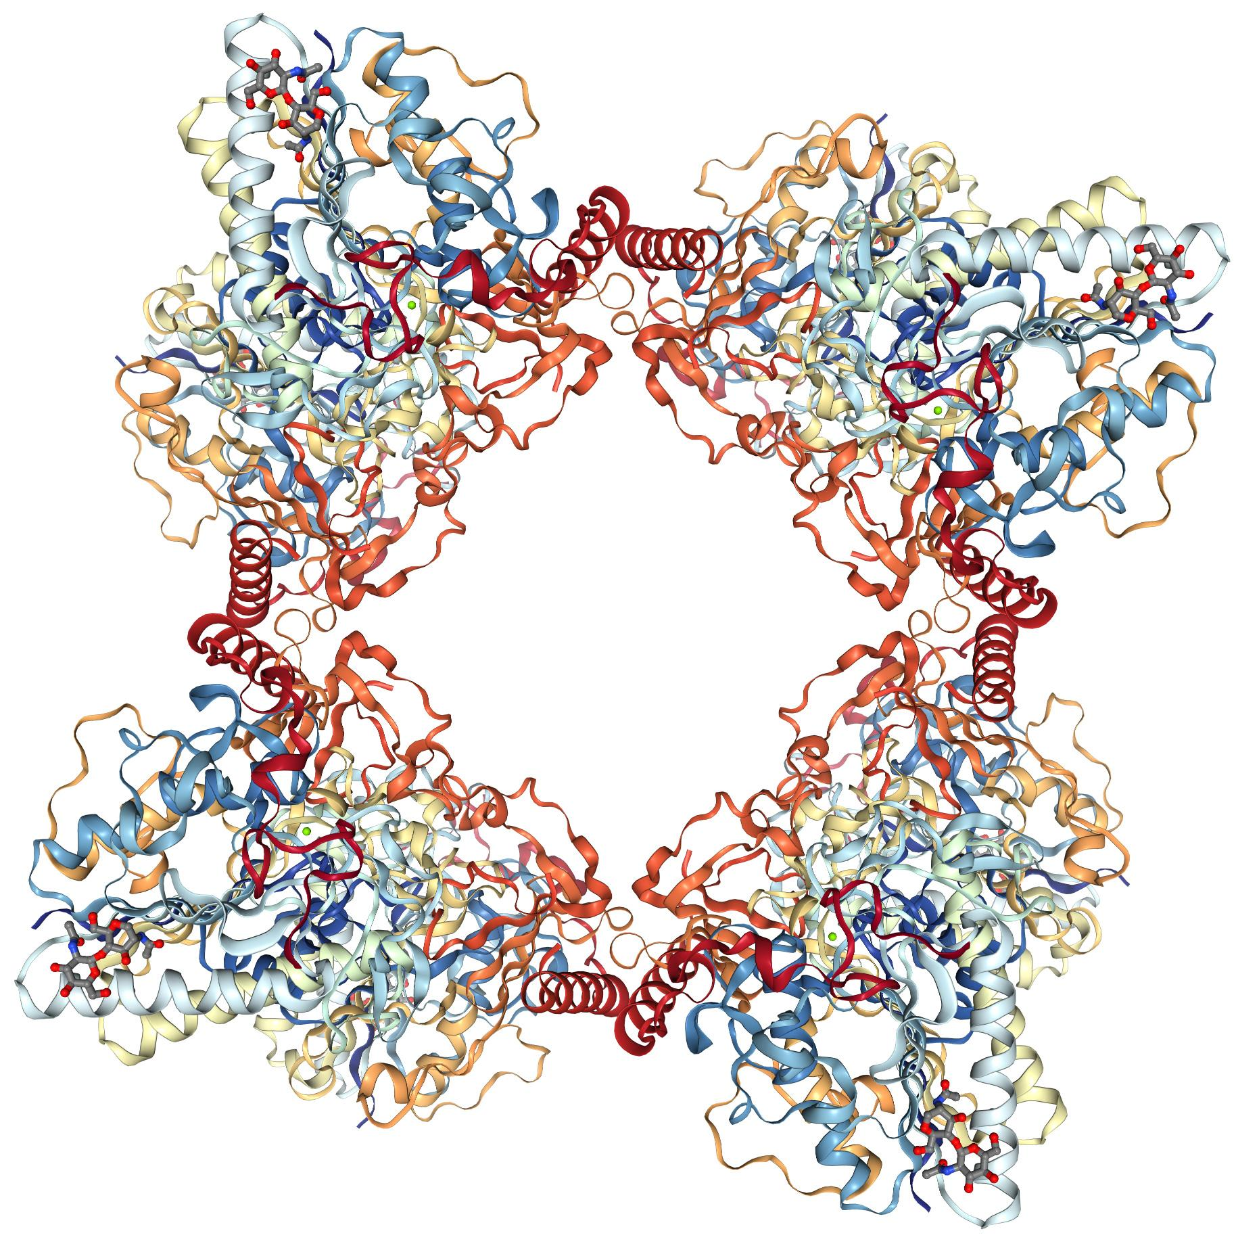
Arylsulfatase A (ARSA) catalyzes lysosomal sulfatide desulfation
Arylsulfatase A (ARSA) is a lysosomal enzyme that hydrolyzes galactose-3-sulfate residues in lipids,
ascorbate-2-sulfate, and phenol sulfates
ARSA
octamer
Shaimardanova et al., 2020
Lukatela et al., 1997
Created for CAGI 7
genomeinterpretation.org
Yu-Jen (Jennifer) Lin

Slide 4
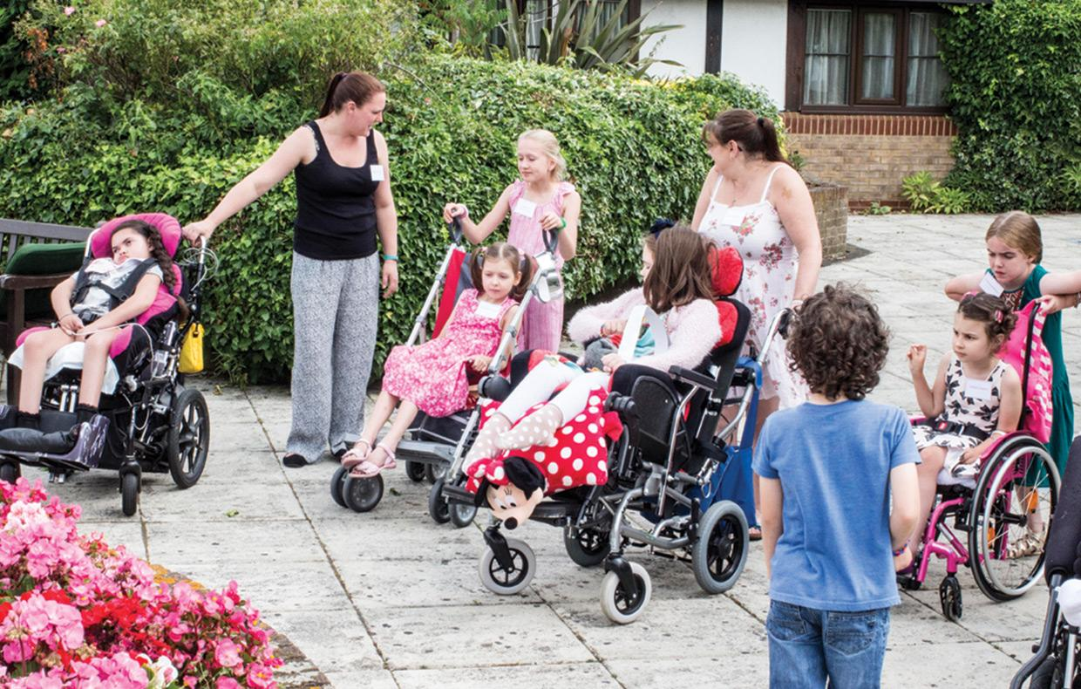
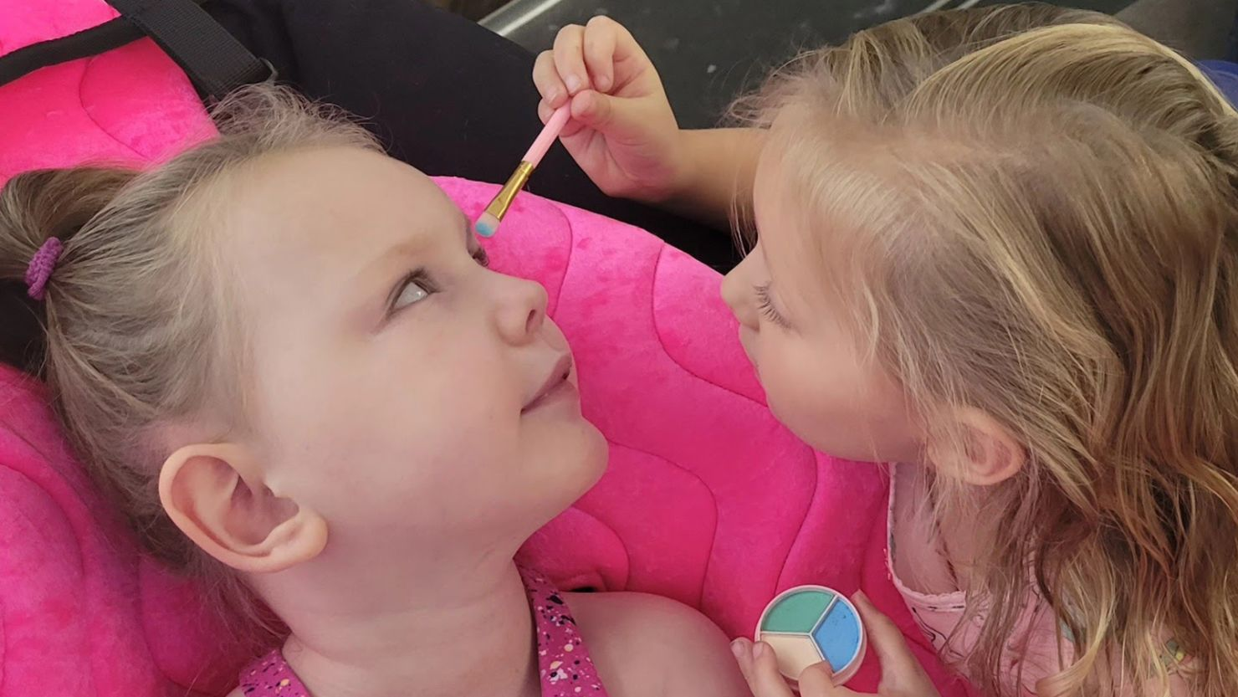
ARSA gene variants can cause the rare neurodegenerative disease MLD
Metachromatic leukodystrophy (MLD) is a rare autosomal recessive neurodegenerative disease caused by deficient sulfatide catabolism, due to variants in the ARSA gene
van Rappard et al., 2015
Early identification of severe ARSA deficiency is critical to newborn treatment decisions
Left: Olivia, 5, is in hospice. Right: Keira, 4, received treatment and has no symptoms.
MLD Support Association in UK
https://www.mldsupportuk.org.uk/about-mld/treatment/
Goodman, 2024. CNN.
Created for CAGI 7
genomeinterpretation.org
Yu-Jen (Jennifer) Lin

Slide 5

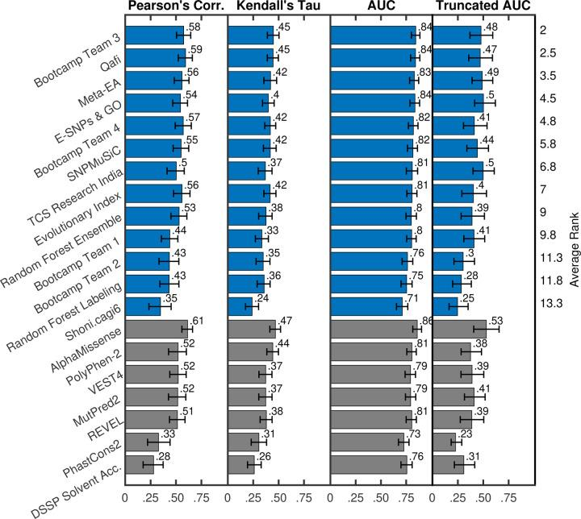
CAGI 6 participants predicted
ARSA enzymatic activity for 219 VUS
Dr. Michael H. Gelb
CAGI 6
predictors
AlphaMissense
VEST4
MutPred2
REVEL
Jain et al., 2025
Created for CAGI 7
genomeinterpretation.org
Yu-Jen (Jennifer) Lin
‹#›

Slide 6
CAGI 7 participants predicted
ARSA protein stability for 8,867 variants
Stability score =
degrades over time; measured at 48 hours
The stability assay does not capture
all pathogenicity mechanisms
  e.g., enzyme active site, multimerization,
  lysosome localization, splicing changes
ARSA variant
_
eGFP
Dr. Michael H. Gelb
mCherry
(internal control)
Created for CAGI 7
genomeinterpretation.org
Yu-Jen (Jennifer) Lin

Slide 7
The ARSA stability dataset spans nearly all possible missense variants
9,216 of 9,272 possible missense variants
from signal peptide R21 to end A509 tested
  349 released to participants
  8,867 withheld as prediction targets
Dr. Michael H. Gelb
Wildtype: 0.784
8,867 withheld
349 released
0
0.2
0.4
0.6
0.8
1.0
Stability score
Created for CAGI 7
genomeinterpretation.org
Yu-Jen (Jennifer) Lin

Slide 8
We assessed 22 teams that contributed 86 CAGI submissions
CAGI participants
  86 valid predictions from 22 teams
Recruited predictors
  AlphaMissense, ESM, SaProt, REVEL, etc
Baseline
  SIFT, CADD
Preliminary assessment today, showing
  Pearson correlation
  Spearman rank correlation
  AUC for late infantile MLD pathogenic
  High specificity AUC for late infantile
Created for CAGI 7
genomeinterpretation.org
Yu-Jen (Jennifer) Lin

Slide 9
We evaluated 109 methods against the experimental stability score
Pearson
Correlation
Spearman
Correlation
AUC
(late infantile)
Truncated AUC
(late infantile)
SaProt
86
CAGI
submissions
AlphaMissense
23
Recruited
methods
(REVEL)
ESM-1v
(CADD)
SIFT
Created for CAGI 7
genomeinterpretation.org
Yu-Jen (Jennifer) Lin

Slide 10
Several methods outperform widely used state-of-the-art predictors
CAGI submissions
Recruited methods
Pearson
Spearman
AUC
Truncated AUC
(REVEL)
(CADD)
Created for CAGI 7
genomeinterpretation.org
Yu-Jen (Jennifer) Lin

Slide 11
Methods yield distinct score distributions
Experimental score
SaProt
Count
Stability score
AlphaMissense
Predicted Stability Score
Created for CAGI 7
genomeinterpretation.org
Yu-Jen (Jennifer) Lin

Slide 12
Top submissions outperform state-of-the-art, achieving AUCs around 0.77
Top methods conti.
Top methods
Created for CAGI 7
genomeinterpretation.org
Yu-Jen (Jennifer) Lin

Slide 13
Top submissions outperform state-of-the-art
Top methods
Top methods conti.
Created for CAGI 7
genomeinterpretation.org
Yu-Jen (Jennifer) Lin

Slide 14
Top predictor groups cluster together, separate from experiments
Experiment
Top-performing methods
Created for CAGI 7
genomeinterpretation.org
Yu-Jen (Jennifer) Lin

Slide 15
We stratified SNV- and MNV-missense variants for separate evaluation
Motivations
  Missense changes from single-nucleotide variants (SNVs) arise more frequently than multi-nucleotide variants (MNVs)
  MNV-induced missense changes
  were more physicochemically divergent,
  were more depleted in highly constrained genes (pLI ≥ 0.9),
  and were under stronger purifying selection
  compared with SNV-induced missense changes
  (Kaplanis, …, Deciphering Developmental Disorders study, 2019)
Because of these, we evaluated methods separately on each
Created for CAGI 7
genomeinterpretation.org
Yu-Jen (Jennifer) Lin

Slide 16
Predictions for SNV-missense variants show stronger agreement with experiment than MNV
Wildtype
Multi-nucleotide
variants (MNVs)
Single-nucleotide variants
(SNVs)
Stability score
SNV-missense variants tend to cause more conservative physicochemical substitutions than MNV
Created for CAGI 7
genomeinterpretation.org
Yu-Jen (Jennifer) Lin

Slide 17
We evaluated variants known to cause pathogenicity via mechanisms other than stability
Motivations
  Methods might predict pathogenicity rather than stability
  Some sites cause disease via mechanisms other than protein stability
We excluded 162 variants known
to cause pathogenicity via mechanisms other than stability
  Active site residues
    C71, K125, H127, S152, H231, K304
  Metal coordination site (Mg²⁺ binding)
    N284
  Splicing-related mutations
    K369N, E384K
Stability score
Created for CAGI 7
genomeinterpretation.org
Yu-Jen (Jennifer) Lin

Slide 18
Predictions for other-mechanism sites showed weak agreement with the experiment
Wildtype
Sites associated
with other
mechanisms
All
Stability score
This highlights the importance of mechanism-aware assessment
All
Other
mechanism
All
Other
mechanism
Created for CAGI 7
genomeinterpretation.org
Yu-Jen (Jennifer) Lin

Slide 19
Conclusions
Sorted by
average rank
Spearman
Correlation
High-throughput ARSA stability data enable assessment of 8,867 missense variants
CAGI participants made computational advances over state-of-the-art
variant impact predictors
Several distinct
approaches succeed
Created for CAGI 7
genomeinterpretation.org
Yu-Jen (Jennifer) Lin

Slide 20



Acknowledgment
Dr. Steven E. Brenner
Dr. John-Marc Chandonia
Yaqi Su
Dr. Michael H. Gelb
Yuexuan Liu
CAGI participants
Dr. Predrag Radivojac
Dr. Shantanu Jain
Dr. Gaia Andreoletti
CAGI assessors
Dr. Joseph Marsh
Dr. Benjamin Livesey
Contact jenniferyjlin@berkeley.edu
Created for CAGI 7
genomeinterpretation.org
Yu-Jen (Jennifer) Lin

