Slide 1
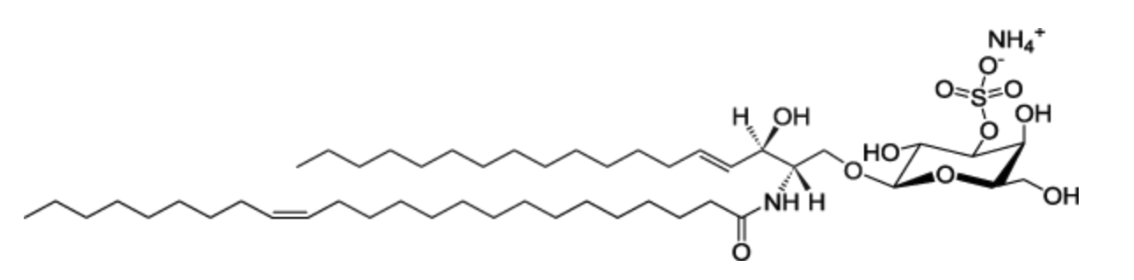
Metachromatic Leukodystrophy (MLD)
Autosomal recessive disease, about 1 in 40K
Deficiency of arylsulfatase A (ARSA), a lysosomal hydrolase that degrades sulfatide in white matter:
Late Infantile (< 2.5 yrs of life) about 70% of the cases, lose all motor skills and die in a few yrs of life.
Early Juvenile (2.6-6 yrs)
Late Juvenile (7-17 yrs)
Adult (> 16 yrs)
Kehrer et al. (2021) Neurology

Slide 2
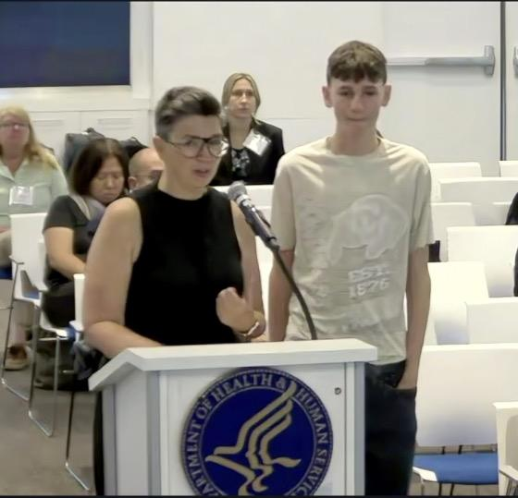
The treatment for MLD was approved by the
FDA and EMA last yr. It is arguably one of
the most amazing medical breakthroughs I have
seen in my life. BUT!!!! it has to be carried out
before onset of symptoms otherwise too late.
Here is mom Amy testifying last year to the
ACHDNC. NBS for MLD works perfectly
(no false positives or negatives). The treatment
is ready to be implemented.
MLD was about to be added to the
federal Recommended Screening Panel (RUSPi)
in May, 2025, but RFKJr dissolved the committee.
So now try to get NBS added state by state.
NY is live, IL, MN, and PA will go live soon,
Norway, Sweden, parts of Germany and Italy are
live.

Slide 3
NBS of MLD is done by measuring elevated sulfatides in DBS by LC-MS/MS followed by
second-tier measure or ARSA enzymatic activity in DBS followed by third-tier genotyping of ARSA
No false positives after ~350,000 screened (USA, UK, Germany, Austria, Italy, Norward), yes none,
10 newborns tested positive for MLD, and all 10 have GENOTYPES (two variants in trans) that have been seen
before in clinical case reports. Genotypes were clear for early onset in 7 of 9 and these patients thus qualified for
gene therapy/HSCT and were thus treated without any neurological signs (nerve conduction, MRI, auditory, gall
bladder), 2 of 7 have genotypes clear for late-onset and do not qualify for gene therapy/HSCT. They would
qualify for HSCT if they develop early signs of disease later in life (presumably a disappointing and high-anxiety
situation for families).
False negatives:
Option 1, run a prospective pilot study for several years (disease is only 1 in 40K, so you have to screen
~100-200K and “see” if you missed anyone, but they won’t get sick for at least 1-2 yrs and who’s to say they will
ever be identified). this is a CRAZY way to evaluate false negatives.
Option 2 is what we did. Went to disease foundations in USA,UK, and Norway and contacted MLD families,
got NEWBORN! DBS from NBS labs that store them since birth. See if they test positive:
17 from USA, 23 from UK, 10 from Norway, 50 out of 50 test positive. Thus, the False negative rate
is essentially zero.
SOMETIMES RETROSPECTIVE IS BETTER THAN PROSPECTIVE !!! Hong et al. (2021) Genet. Med.
Bekri et al (2024) Mole. Genet. Metab.
Laugwitz et al (2024) NEJM

Slide 4
This and many other stories like this make it clear why retention of leftover NEWBORN DBS in NBS labs
is CRITICAL to development of new NBS tests! Get rid of all these DBS and it is game over for NBS.
Without these stored DBS:
1. Test developers like my lab cannot proceed to develop new tests.
2. The false negative rates cannot be reliably determined in a reasonable time frame.
3. NBS labs cannot establish their screen cutoffs and satisfy the regulatory requirements
of the agencies that can shut them down without assay validation.
It is very serious issue when NBS labs are forced to destroy leftover DBS because of some
one-off court order result from some one-off incidence.

Slide 5
We have a perfect biochemical NBS for MLD, but the challenge is to predict the age of onset of MLD
in the first few weeks of life and when no detectable clinical symptoms are observed.
Because the gene therapy (which is near curative) is only approved for the early onset forms
(LI and EJ) but not the late onset forms (LJ and A).
Residual ARSA enzymatic activity in leukocytes can help with disease onset prognosis, but the most
powerful tool we have seems to be the ARSA genotype.
We think about 80% of the NBS positive newborns will have genotypes that are well prognostic for the
age of onset. But for about 20% we expect to see VUS or even ACMG P or LP variants that are poorly
defined by patient case reports.
So this is the reason we started an ARSA MAVE project in the Gelb lab.
For the rest of the talk I am going to tell you about the MAVE data and how well it works as a tool
to unpack genotypes of otherwise uncertain disease prognosis.

Slide 6
Example genotype > phenotype
c.465+1G>A /c.465+1G>A is always late-infantile (the most severe form of ~MLD)
homozyogous for a cononical splice site
c.465+1G>A/p.Pro428Leu is early-juvenile and p.Pro428/p.Pro428Leu is adult
c.465+1G>A/p.Ile181Ser is late-juvenile or adult , p.Ile181Leu/p.Ile181Leu is not MLD as far as we know.
so all 3 variants are ACMG Pathogenic but we expect the residual biochemical function to be:
p.Ile181Ser > p.Pro428Leu > c.465+1G>A
Pathogenic means the variant has been seen in a person with a disease and shown to be a driver
of that disease. But note that all 3 variants above are Pathogenic yet they do not have the same effect
on the degree of function of the protein!!!!!!!!!

Slide 7
MAVE analysis of every possible ARSA missense variants (20 x ~500 = ~10,000)
we used the ingenious VAMP-Seq method from D. Fowler’s lab (Nat. Genet., 2018)
We put all the variants into HEk293 cells and we know they were all there because we used millions
of PacBio long sequence reads to see them all along with the linked DNA barcode that identifies them.
The key is that any given cell expresses only a SINGLE variant.
Expressed as the fusion protein ARSA-eGFP
We interogate the amount of ARSA-eGFP degradation due to protein miss-folding by measuring
the green fluorescence cell by cell using a cell sorter.
We use NGS to get all the barcode read frequencies in cells that have a low amount of green fluorescence,
i.e. low abundance due to missfolding/degradation.

Slide 8
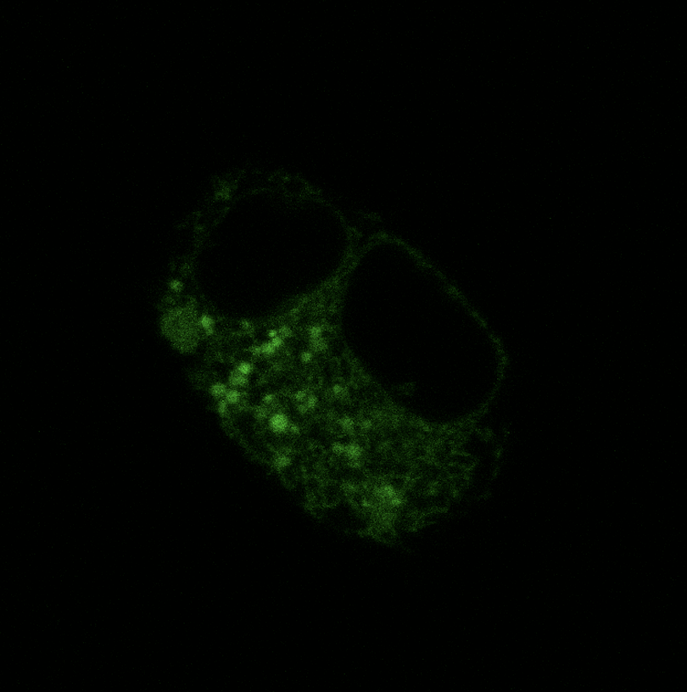
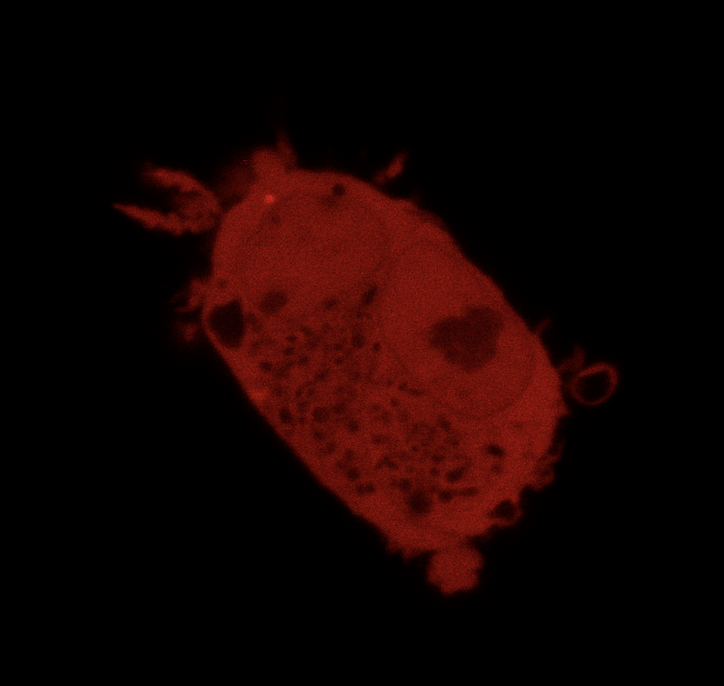
Express ARSAvariant-eGFP fusion protein in HEK293 cells, one variant per cell, also express mCherry
ARSA-eGFP in Lysosomes
mCherry in Cytosol
eGFP losses some but not all of its fluorescence in the acidic environment of the lysosome but we can still see it.

Slide 9
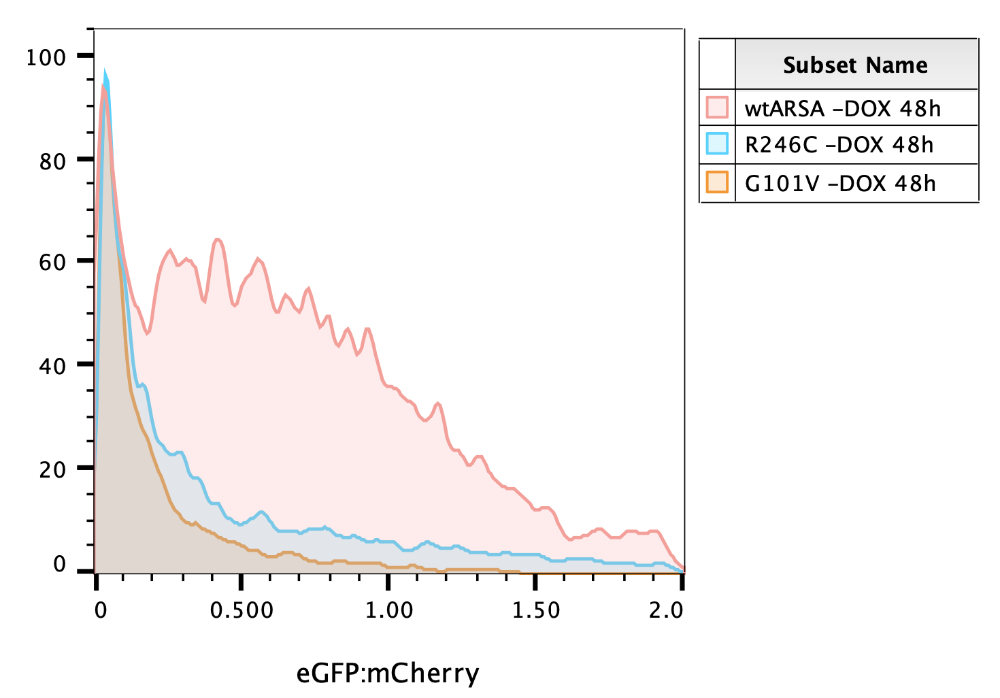

Slide 10
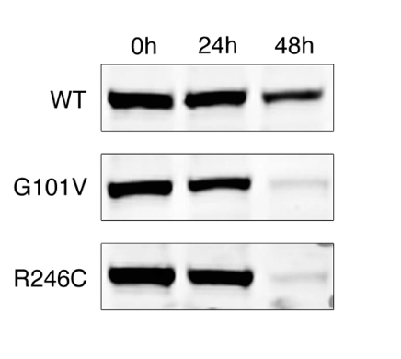
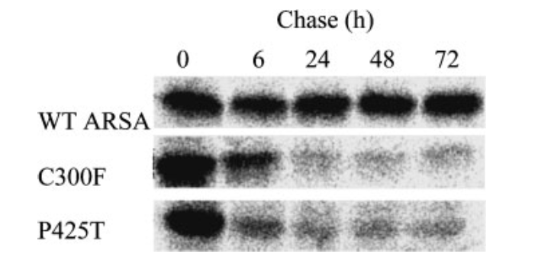
We turn off ARSA-eGFP transcription at time 0 by removing the doxycyclin-inducer of the tet-on promoter,
and we harvest cells at different time points.
We noticed that at 24 hrs essentially all variants were present at ~equal amounts but at 48 hrs they start
to sort out with some dropping in abundance. Different missfolding variants are degraded at different rates.
SO IT TAKES A FEW DAYS FOR MISS-FOLDED PROTEINS TO BECOME DEGRADED
This is also seen in the Western blot analysis.
We are going to use the
abundance of ARSA 48 hrs
after we stopped ARSA
transcription. This is our
in vitro parameter that
we now need to callibrate
with MLD clinical data.
HEK293 system used in our
VAMP-Seq analysis
Marcao et al. (2003) Am. J. Med. Genet.

Slide 11
We measure ARSA abundance at 48 hrs, not ARSA enzymatic activity for every possible missense variant.
But prior to this MAVE study, we put all ARSA missense variants found in gnomD v2 (~250K alleles) 1-by-1 into
HEK293 cells that lacked chromosomal ARSA (CRISPR/Cas9 deletion) and measured ARSA enzymatic activity accurately by
mass spectrometry.
G6PDH activity measured for
all possible missense variants
but yeast growth and stability
in human cells by VAMP-Seq
D. Fowler lab. published

Slide 12
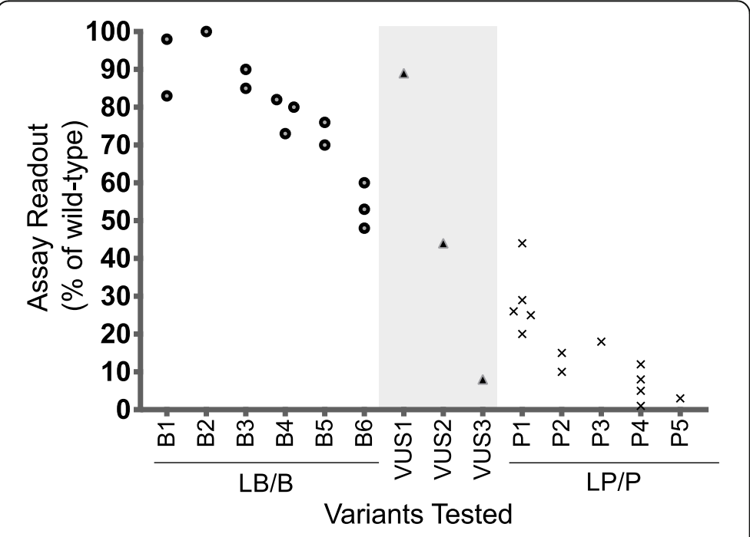
Recommendations for application of the functional evidence PS3/BS3 criterion using the
ACMG/AMP sequence variant interpretation framework
Brnich et al. Genome Biol. 2019
.
.
Note that P/LP variants have a SPAN of in vitro
functional values. This is the expected results.
As you will see in our study of ARSA variants, we
want to go to higher resolution than P, LP, LB, B.
We want to determine the true strength of each
variant on the protein function and to use this
information to predict the SEVERITY of MLD
(age of onset) because the gene therapy is only
approved for early disease, not for late onset.
And we want to do this for the first affected
sib, i.e. not just when the first sib dies.
And remember our biochemical screen never
lies about getting MLD, it is a question of
when. Without this prognosis, this miraculous
gene therapy is useless unless we use the first
sib to prognose the second.
So perfect NBS, perfect treatment, still useless
without good prognosis!!!! YIKES

Slide 13
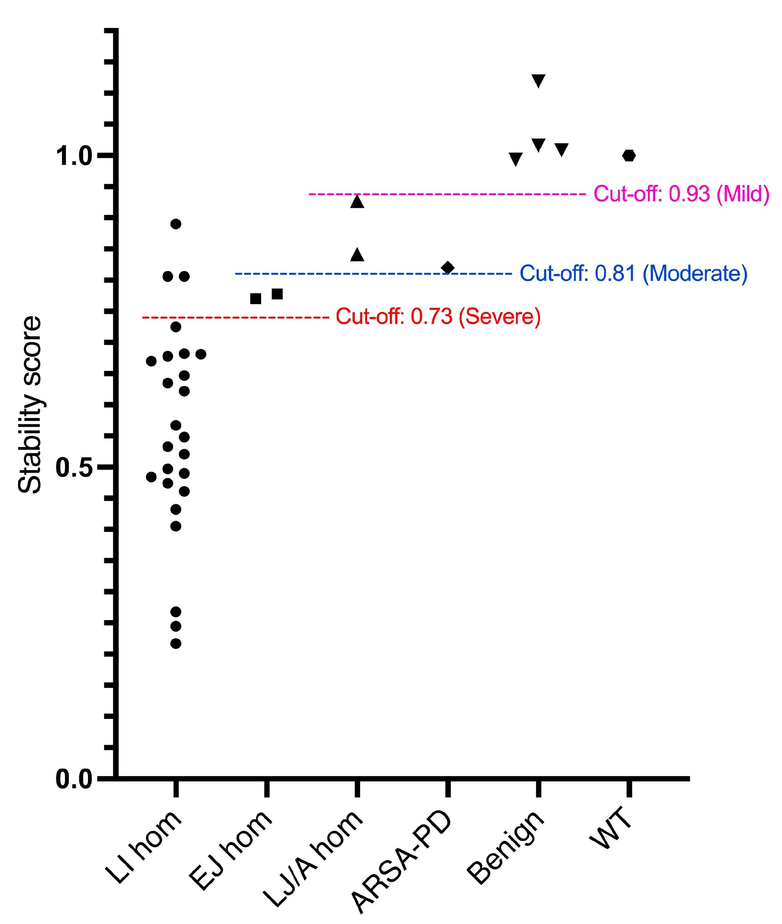
Homozygous missense
Published case reports
MLD is a recessive disease, and The only way we can
tell the real effect of the missense variant on the
stability or enzymatic activity of the variant in terms
of how it relates to MLD disease in humans is:
1. What is the severity of MLD (age of onset)
when the variant is present in the homozygous state?
2. What is the severity of MLD (age of onset) when
the variant is paired with a pLOF variant?
We cannot use compound heterozygotes unless
one variant is pLOF.

Slide 14
Homozygous missense
Published case reports
A214V (activity 0.45%)
N284S (Mg²⁺ coordination, activity 0.01%)
R246H (monomer-monomer interface, activity 0.13%)

Slide 15
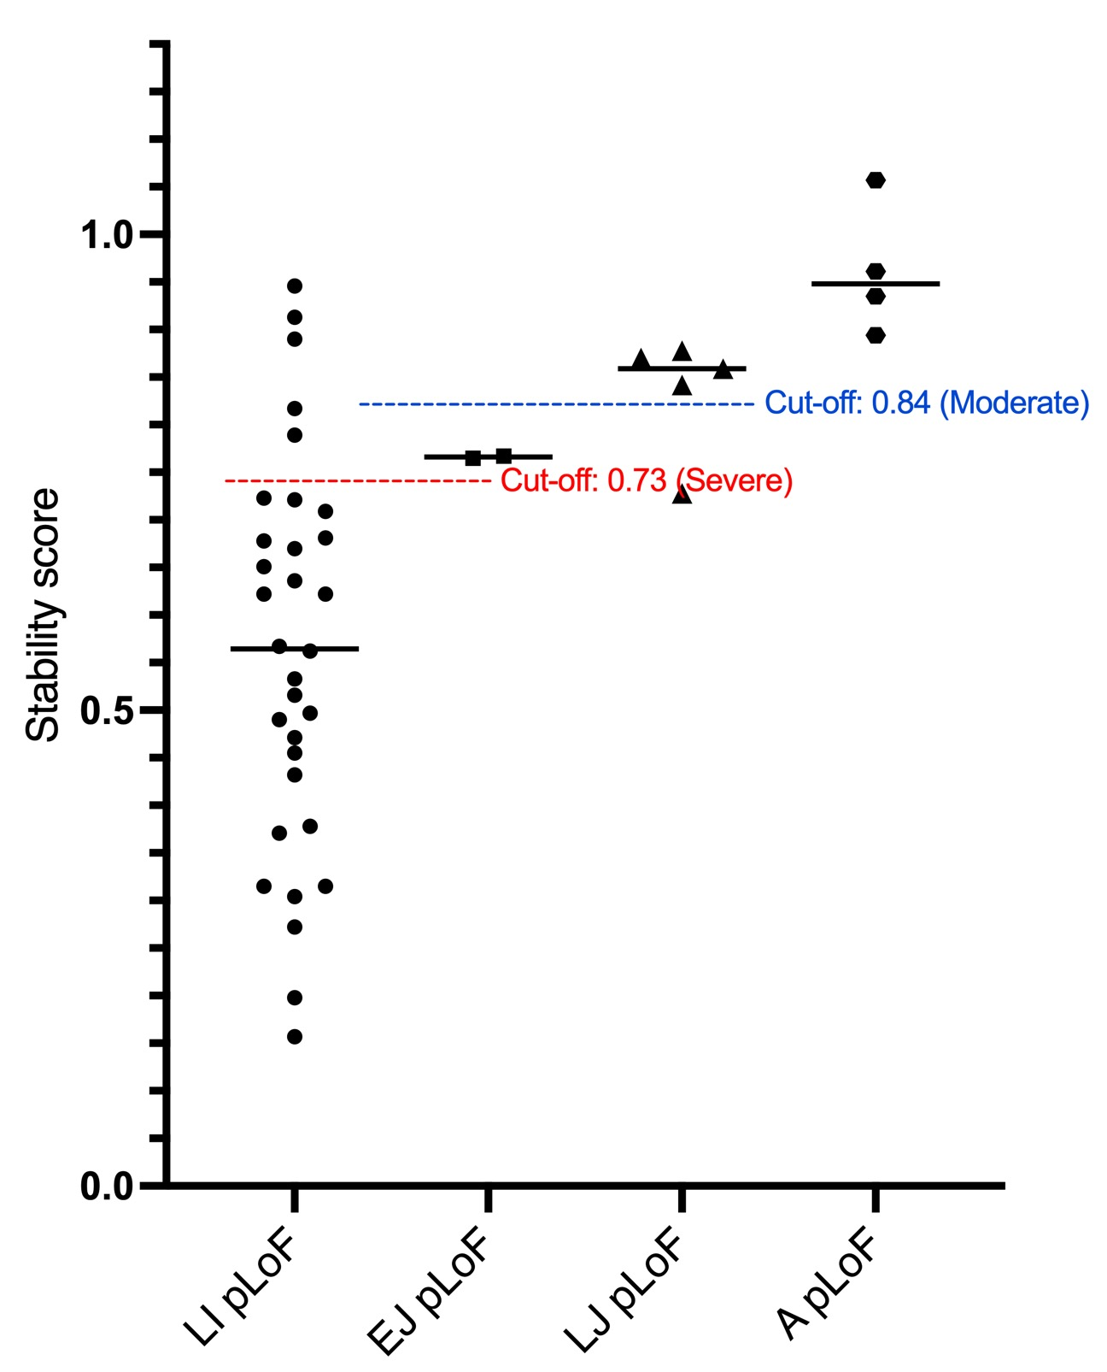
pLoF/missense variants
Published case reports

Slide 16
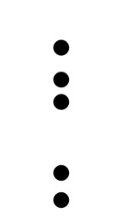
pLoF/missense
Published case reports
A214V (activity 0.45%)
L70P (affect the formylglycine formation at the active site catalytic residue C71; PMID 9760228)
E255K (involved in the active site hydrogen bonding network, activity 0.13%)
D257H (activity 0.01%)
F249S (monomer-monomer interface, activity 0.10%)

Slide 17
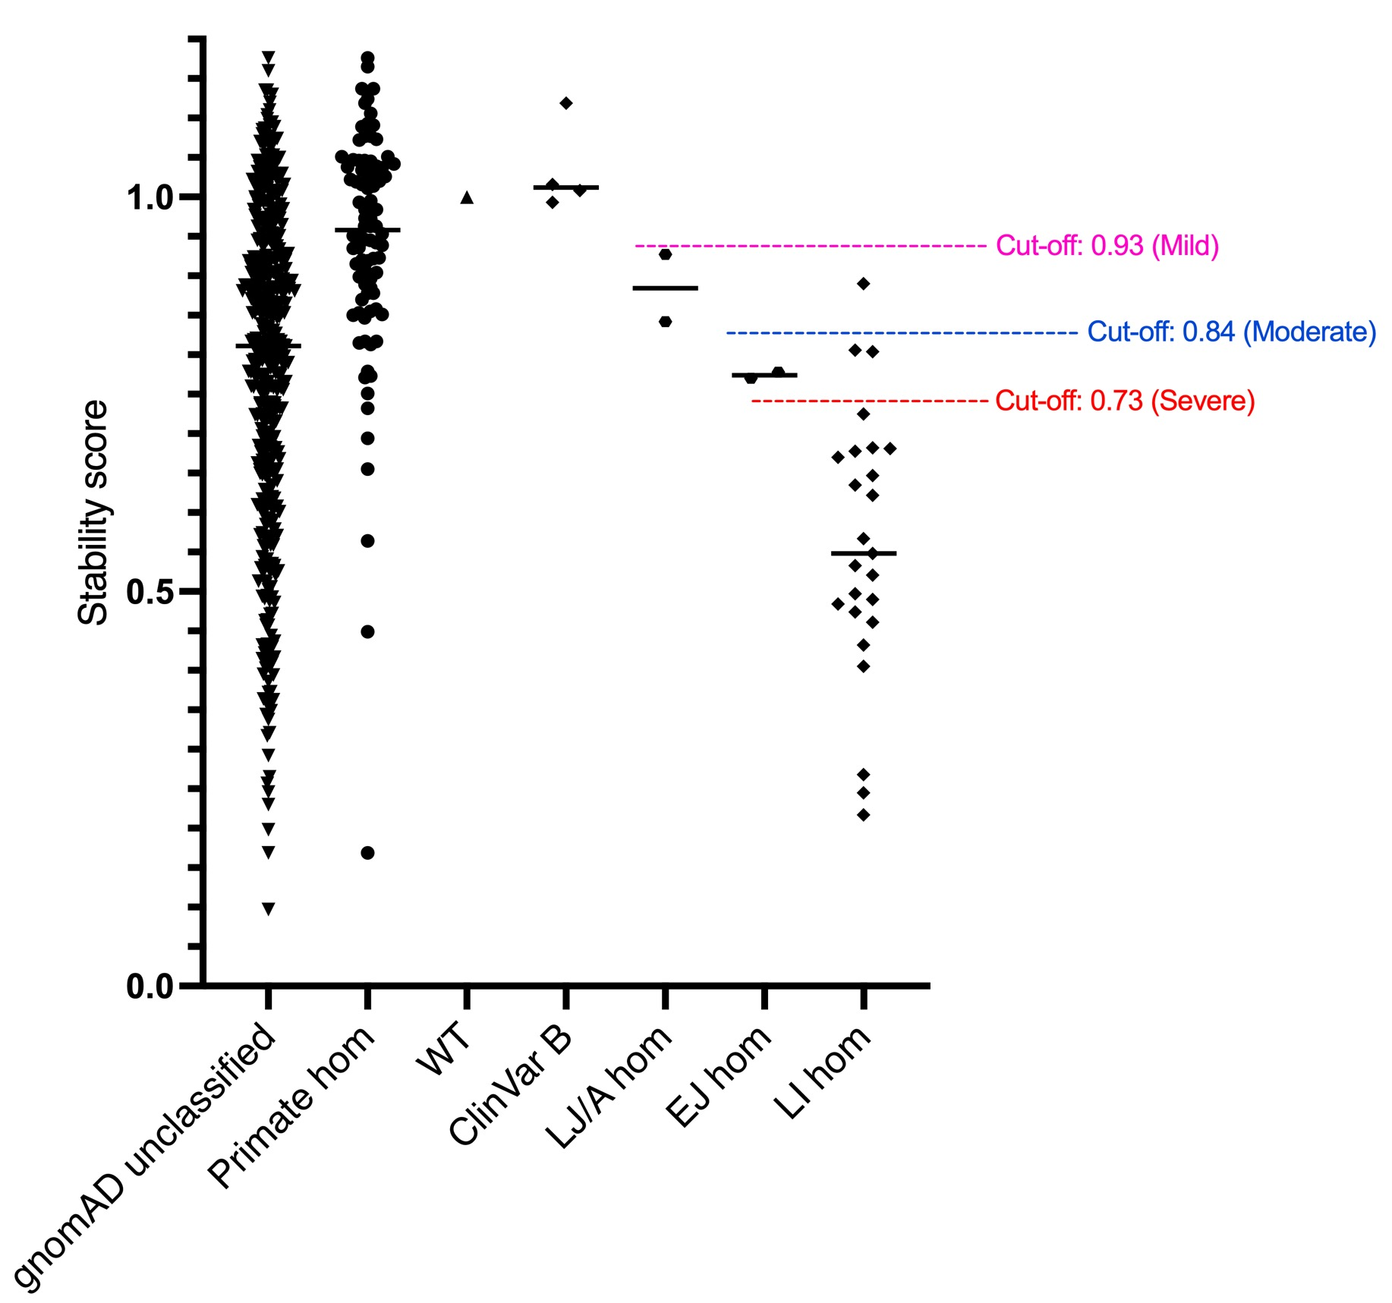
Homozygous missense

Slide 18
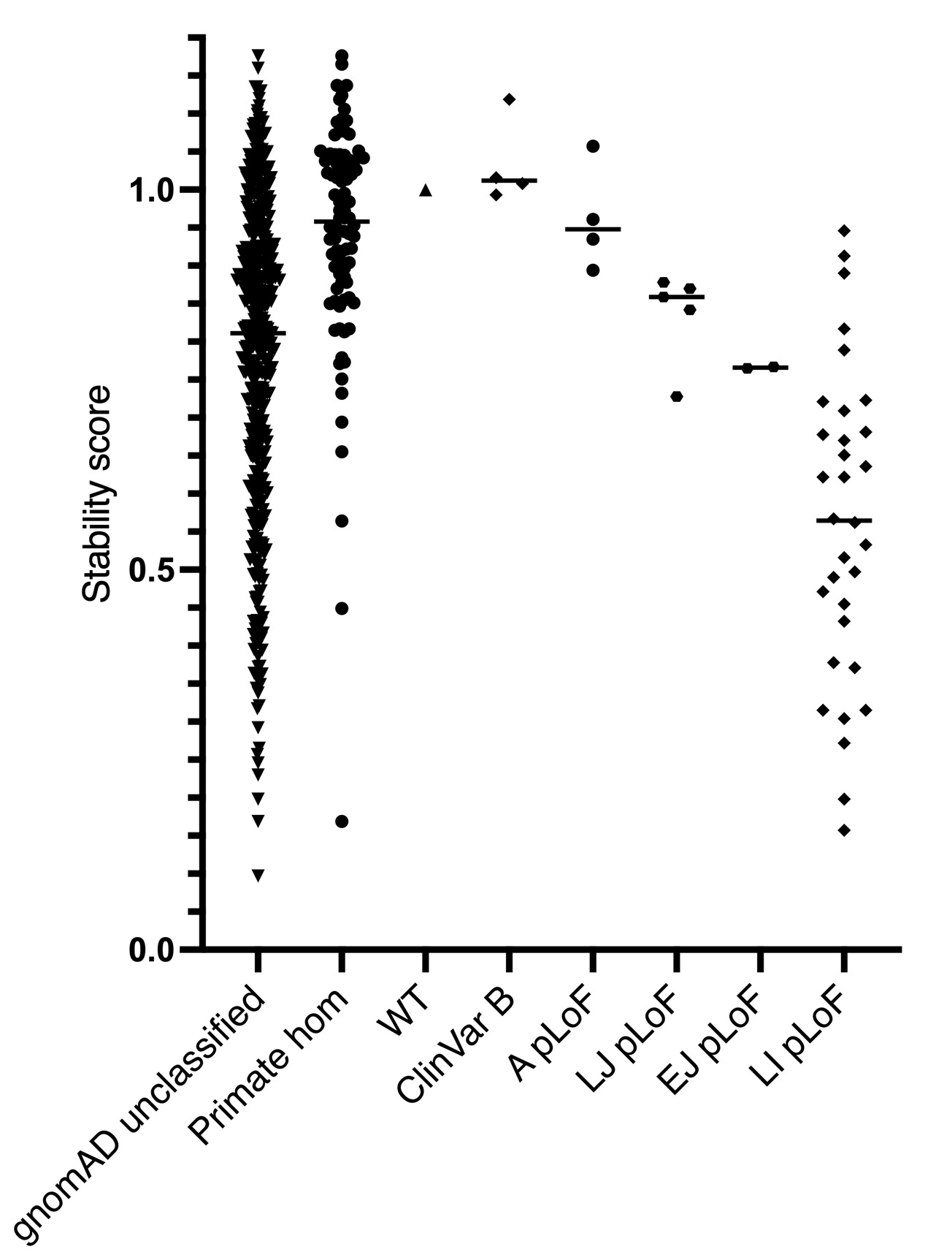
pLoF plot

Slide 19
For the 205 MLD patients, we first applied the European Consensus Guidelines for MLD Genotype
to Phenotype Cytotherapy (2024)
This is the “easy-peasy” genotype analysis where we are highly confident.
age of onset of affected-sib transfers to the next affected sib (i.e. cheating) but remember
we want to treat the first kid in the family.
2. pLOF/pLOF = late-infantile
3. pLOF/variant = age of onset same as the case-report for the same variant
4. pLOF/p.Pro428Leu = early-juvenile this is the most common late-onset Pathogenic variant
5. pLOF/pIle181Ser = adult this is the second most common late-onset Pathogenic variant

Slide 20
Of these 205 MLD patients, the European Consensus. Guidelines can be used on 176 and it predicts
Early (LI + EJ) vs Late (LJ + A) correctly in 92% of these 176, Early qualify for gene therapy, late do not.
Most of the incorrect predictions involve:
p.Pro428Leu where prediction is EJ and patient is LJ or vice versa.
Among the 176 where the European Consensus Guidelines apply, we can apply the ARSA stability/activity data
on those involving at least 1 missense variant, 135 of 176 and we get Early vs Late correct 90% of the time.
Among the 28 patients where we cannot apply the European Consensus Guidelines, we can apply the ARSA
stability/activity data on 25, and we get it correct 92% of the time.
So this VAMP-Seq, ARSA stability and enz activity data is very useful, and maybe the clinicians will like it.
But clinicians are nervous about using in vitro data to pull the trigger on a hematopoietic stem cell transplant/gene therapy.
This is not Robert Green’s biotin pill treatment.

Slide 21
Are clinicians willing to use in vitro data (i.e. MAVES,etc)? Mostly they seem to be reluctant. Let’s see
what Lea and Doug have to say.
Here is what I know for the MLD community.
Remember we are screening by biochemical first (sulfatides and ARSA activity) and genotype last.
We have no false positives and no false negatives, so if you are screen positive you’re gonna get MLD.
The question is when and whether your gonna get HSCT/gene therapy before you have symptoms.
In clinical followup, WBC ARSA activity and urinary sulfatides will be measured to confirm the DBS NBS
results. If genotype gives Early with European Consensus (easy-peasy), HSCT/gene therapy will be offered to the
family otherwise baby will be followed as late-onset cases can benefit from HSCT without gene therapy (but not
nearly as efficacious as with gene therapy).
Suppose genotype is well-understond variant/VUS where VUS is in the stability/enzyme activity range seen for
early-onset MLD?
80% of ~30 expert MLD clinicians surveyed by Gelb would offer gene therapy to the family. 20% said no.
If VUS/VUS and prognosis (timing of MLD onset) comes down to ARSA stability for both variants, I think
the majority of clinicians will wait and see before offering gene therapy, I’m not sure yet.
So you see, clinicians are pretty reluctant to pull the trigger on this kind of intense therapy (expensive and
some mortality), but there is some hope for MAVE.

Slide 22
Imagine we start with WGS first-tier NBS.
1. All current WGS pilot programs state they will not call out VUS.
I am working with the BeginNBS WGS pilot program led by Stephen Kingsmore (Rady’s Children). We
may call out VUS that have low ARSA stability/enzymatic activity scores as we run the pilot for Sidra Medicine
in Qatar. Some people call these “Hot VUS”.
2. Programs that ignore all VUS for ARSA are expected to have a false negative rate of 20-30%. For example,
of the 10 newborns detected by biochemical NBS in Germany/Austria/Norway, 2 would have been missed
because of VUS.
3. The first-tier false positive rate for WGS first-tier NBS will be massive. There are gonna be many cases
of (LP or P )/ (LP or P) that have poor penentrance and may never present with MLD.
4. Second-tier biochemical tests (high sulfatides, low ARSA) will be critical for NBS of MLD by first-tier WGS.
I would say that such orthoganol tests are gonna be critical for any disease analyzed by first-tier WGS !!!

Slide 23
Do we wait for WGS-NBS say 5-10 years to screen for MLD?
NO!!!!
We can add an essentially perfect biochemical MLD NBS now to ongoing NBS panels. The test
is readily multiplexed with current NBS assays (the power of mass spectrometry)
If we wait 5-10 yrs, 100s of kids are going to die in the USA when they could have been
resurrected by gene therapy.
The cost to add biochemical MLD NBS is about 10% of the cost of the treatment. So why
would a country agree to pay for the treament but not the NBS especially when the treatment
will fail without NBS ????!!!!?????
So while I support the evaluation of first-tier WGS to greatly expand NBS panels, I think it is
insane to delay biochemical NBS for MLD now.

Slide 24

Yuexuan Lin, Jessica Simon, Dustin Maly, Doug Fowler (UW)
Laura adang (CHOP), Lucia Laugwitz (U. Tuebingen)
the MLD alliance (~80 scientists worldwide)

Slide 25
extra slides follow

Slide 26
We studies a cohort of 205 MLD patients from CHOP/ U. Tuebingen where we have the age of onset and the genotype. age of onset
Prediction rules for stability data:
  1) Not applicable: pLOF/pLOF
  2) pLOF/missense:
    Stability score of the missense variant < 0.73; predict LI
    Stability score of the missense variant < 0.81; predict EJ
    Else predict late-onset
  3) missense/missense:
    Stability score of both missense variants < 0.73; predict LI
    Stability score of both missense variants < 0.81, predict EJ
    Else predict late-onset

Slide 27
We evaluated the in vitro prediction of age of onset on all patients that had at least 1 missense variant
“Correct prediction” means either:
  Prediction = early onset (LI/EJ); Real onset = early onset (LI/EJ)
  Prediction = late onset (LJ/A); Real onset = late onset (LJ/A)
With stability data only, 97 correct predictions can be made from 122 patients (80%).
With enzyme activity data, 104 correct predictions can be made from 122 patients (85%).

Slide 28
What if we start NBS for MLD using first-tier WGS instead of biochemical?
1. False negative rate if program flat out ignores VUS will be about 30%. So far among ~330K screened
in Germany/Austria, 9 cases of MLD have been confirmed, 7 treated with gene therapy (2 did not qualify because
prognosis is late onset) and 2 of the 7 would have been a false negative because they had VUS.
2. What about the huge number of false positives from first-tier WGS NBS because we often don’t know the
penetrance of P or LP / P or LP. We hopefully all agree that everyone who tests positive will go on to
biochemical testing (sulfatides and WBC ARSA) and then we have the same info as if we did with first-tier
biochemical NBS, but of course we have the false negative issue.
3. Gelb putting on his advocacy hat now.
While we wait 5-10 yrs or more for first-tier WGS NBS to start in some countries, in the USA,~ 100 kids per year are
gonna be diagnosed with MLD and die without the chance to get gene therapy. The cost to add biochemical NBS
is ~10% the cost of the treatment, so why the hell would the country agree to pay for the treatment but not the
NBS?????!!!!??? Shame on the UK NSC for denying to add MLD NBS to their panel. Maybe they are waiting for
WGS, shame on them.

Slide 29
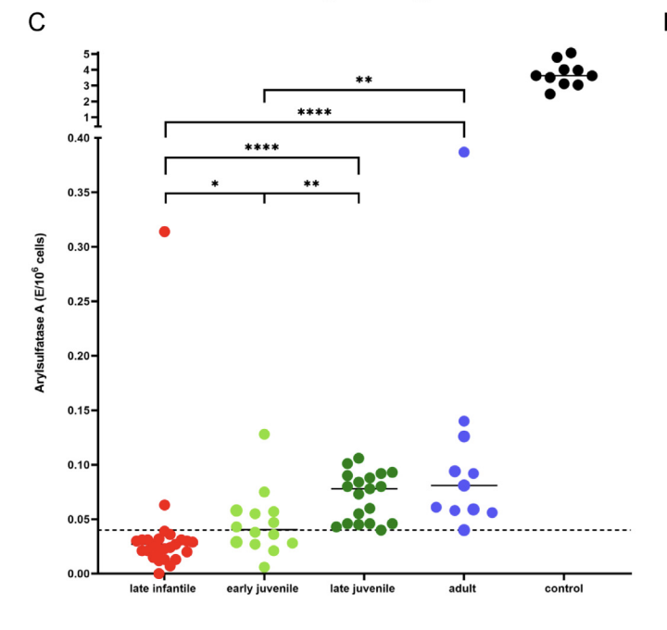
ARSA enzymatic activity of missense variants
~300 missense variants (mostly from gnomAD version with ~250K alleles) expressed 1-by-1 in HEK293 cells
that were devoid of chromosomal ARSA (CRISPR/Cas9 knockout), and measured ARSA enzymatic activity
in cell lysates using the natural sulfatide substrate and mass spec.
Patients with MLD have close to zero ARSA enzymatic activity in DBS on newborn screening cards and
in mixed leukocyte lysates:
Molec. Genet. Metab. (2022) 137, 273.

Slide 32
credit slide with maly folwer yuexuan, jessica, adang, laugwitz, hong

