Slide 1

CAGI 7 slide pack guidelines
I agree to my slides being used according to the following terms:
_______Dean Suhr, MLD Foundation deansuhr@MLDfoundation.org_______
Authors: please include THIS slide at the beginning of your presentation to indicate that you agree with reuse of your slides in CAGI presentations, according to the terms below, and digitally sign by writing your name above.
At CAGI 7, use of this slide pack is only required for CAGI dataset providers, assessors, and predictors, but all are encouraged to use the annotations for materials they do not want shared publicly.
To disseminate the CAGI results, I encourage all CAGI participants to remix these CAGI slides for inclusion in their oral and poster presentations
CAGI participants may use or publish any content of these slides only in compliance with the CAGI Data Use Agreement
CAGI participants may not cite or publish any content of these slides except with the written permission of the originating author or in the primary CAGI publications
CAGI participants must acknowledge the original authors of these slides and CAGI 7. Include the acknowledgement banner across the bottom
CAGI participants must include the CAGI credits slide in their presentations
Slides with a red slash (no remix) may not be included in a presentation unless all attendees are registered CAGI participants who signed the data use agreement
Slides with a red X over the entire slide may not be used in any circumstances
Slides with a blue slash (embargoed) may not be used unless the embargo is explicitly lifted
Slides without slash or X may be tweeted, tooted, posted, X’d unless flagged with “No tweet” icon
CAGI participants using these slides must explain the “No tweet” icon, which means that the slide content should not be disseminated outside the presenting conference hall. If the presentation venue permits pervasive tweeting, you may not include these slides in your talk
Note for slide authors: we expect all CAGI participants to abide by these restrictions, and will make best effort to ensure they are followed. However, but bear in mind that we have limited means of enforcing them, and therefore the restrictions cannot be guaranteed.

Slide 2
Do I Look Good in These Genes?
It all depends on your perspective!

Slide 3


Do I Look Good in These Genes?

Slide 4


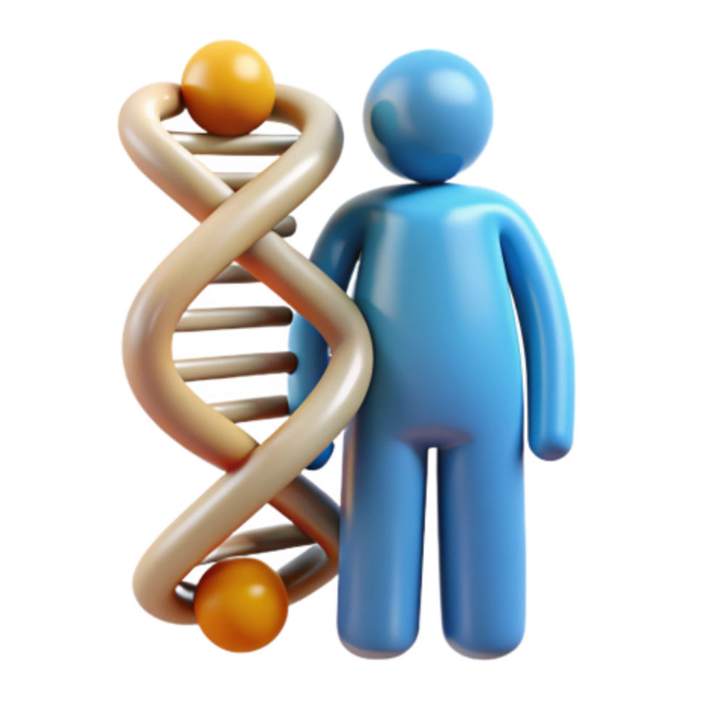
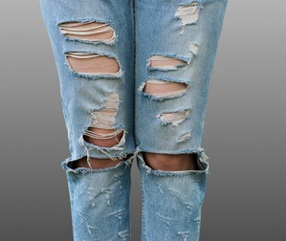
Do I Look Good in These Genes?

Slide 5
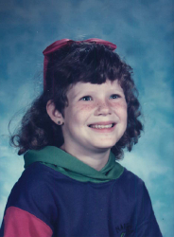
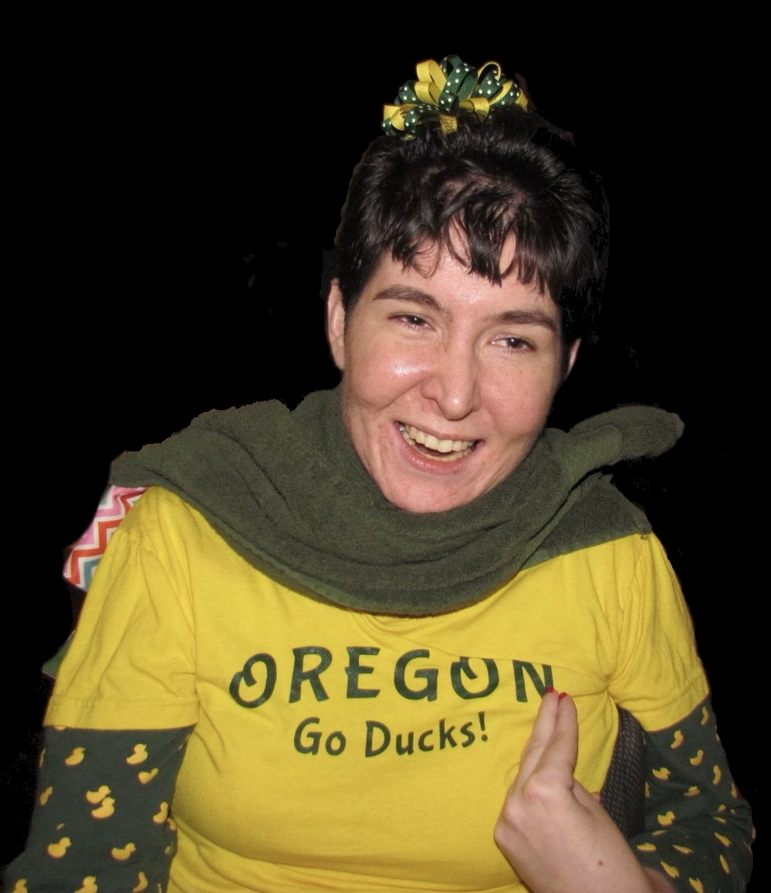
Perspective: Rare Disease Dad (MLD)
1988 – MLD symptoms noticeable
1995 – MLD diagnosis
1999 – World’s first MLD Family Conference®
2005 – started gene therapy work
2007 – started policy work
2008 – started NBS engagement
2024 – FDA approves “curative” gene therapy
in April, RUSP nomination submitted in Aug.
Sept. 2025 – NY starts statewide newborn screening - 1st baby already identified
Darcee …
Passed away at age 10 … 30 years ago
Lindy …
Diagnosed at 14 after 7-year diagnostic odyssey.
Turned 45 in September
Teryn (not pictured), retired RN – pediatric intensive care

Slide 6
MLD – metachromatic leukodystrophy
Ultra-rare inherited neurometabolic terminal condition.
50-60% of patients are infants who will live 5-7 years
4 forms of MLD (gene therapy label)
      Late Infantile – LI (pre-symptomatic)
      Early Juvenile – EJ (pre or early symptomatic)
      Late Juvenile – LJ (not on label)
      Adult – A (not on label)
  Note that most patients are identified today because of symptoms

Slide 7
Perspectives – Researchers
What keeps you up at night?
Passion
publish
promotion
provider
pension
preach
patent
prize
promote
predict
prescribe …
or … is it the Patient?

Slide 8
Perspectives – The list goes on …
Extended family
Clinicians
Regulators
Pharma
Legislators
Public Health
Payors
Investors

Slide 9
Perspectives – MLD (& RD) families
Quality of life ... mobility, cognitive, communication, self-care, independence
Generally risk tolerant ... but making critical decisions under stress, with time urgency, or when not comprehending, is not ideal
Changing role from parent to primary medical care and knowledge
Caregiver burden, skills, confidence
Navigating the medical and reimbursement system
Caring for other children, emotional well-being, spouse, and loss of friends

Slide 10
Perspectives – Society & Ethics
Society
    Often unaware, underinformed, and/or manipulated
    Paying for all medical care
    Demanding health efficiencies (time, cost, & diagnostics)
    Compassionate… especially when it affects their family
Ethics –when to hold firm, and when to consider change

Slide 11


Perspectives – Advocacy
Decades of supporting, funding, and gathering patient data for
approved therapies, diagnostics, access & reimbursement
Family compassion and support
on perhaps the worst days of their lives ... grief, panic,
"educated by Google "
  Honesty & transparency
  Are they hearing, comprehending, able to act, and follow up
  Local support, resources, extended family, medical care team, insurance, etc.
  Life is much more than a sequencing result or phenotype prediction
  Applying our practical experience to their situation
PhD, RD

Slide 12
MLD NBS – Sequencing
4 forms of MLD
    On label
    LI – pre-symptomatic
    EJ - pre or early symptomatic
    Not on label (not reimbursed)
    L J
    Adult
Note that most patients are identified today because of symptoms, that will not be the case with NBS

Slide 13
MLD NBS flow
MS/MS (biochemical)
Sequencing and predicting phenotype
Is NBS a screen, diagnostic confirmation, or the family’s new HMO?
Test/screen results are another data point for FAMILIES to make their own decisions
Who best knows the patient … family … disease … therapy … and how to optimize QoL?

Slide 14
Is your perspective expanded?
Genetics is one of many imperfect tools … VouS updates?
What you conclude during your careers will change lives
  Most will be improvements in QoL and longevity
  But your “proven” processes will create barriers for some and might mean an unnecessary painful death or poor QoL
Ethics, publish or perish, processes
Changing tools, capabilities, understandings
Patient Advocacy is an informed resource
  Patient-informed
  Change and influence policy
  A source of perspective & patient data … we know and can engage patients
  In for the long haul
It’s a balancing act … an informed stake in the ground enables & empowers, we can always improve from there
THANK YOU!

