Slide 1




CAGI7
Conference
December 6-8, 2025
Northeastern University
Boston, MA
@CAGInews

Slide 2
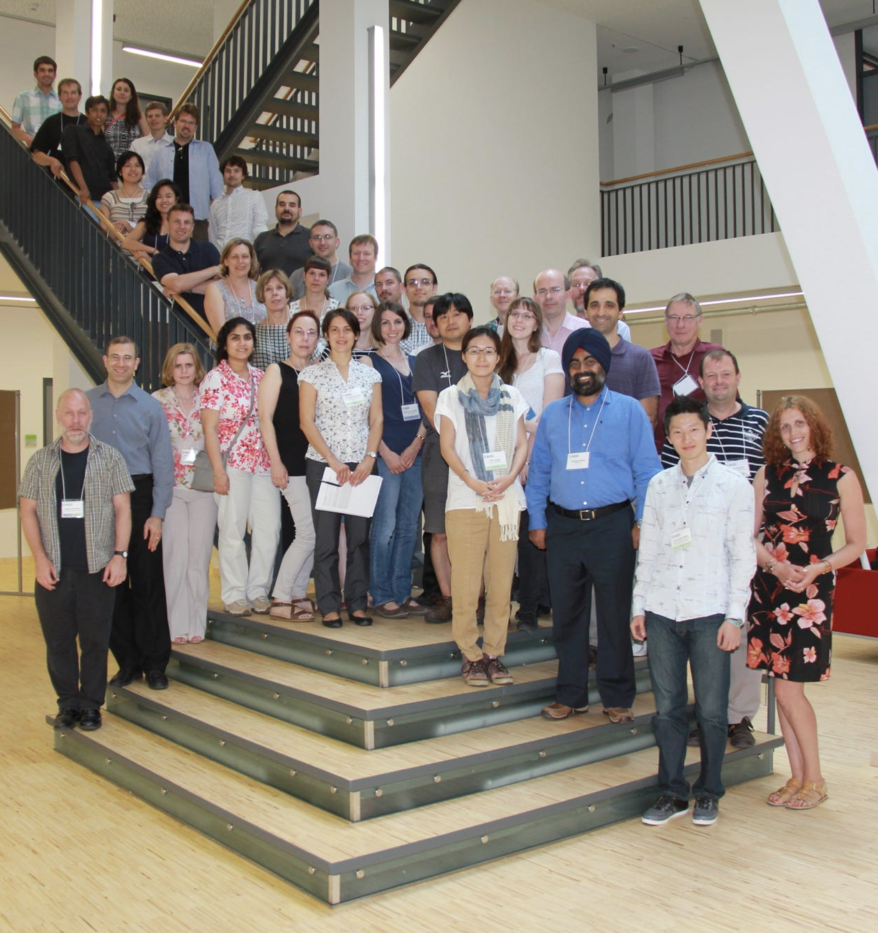
Critical Assessment of Genome Interpretation
CAGI7
CAGI’s mission
Conduct community experiments to assess the state of the art in computational interpretation of genetic variants
Objectives
Evaluate the accuracy of computational methods
Highlight methodological innovation and reveal bottlenecks
Contribute to the development of guidelines for clinical practice
Provide a forum for the dissemination of research results
Promote ethical practices & responsible data governance
CAGI3, Berlin, Germany
Created for CAGI7
genomeinterpretation.org
Predrag Radivojac

Slide 3
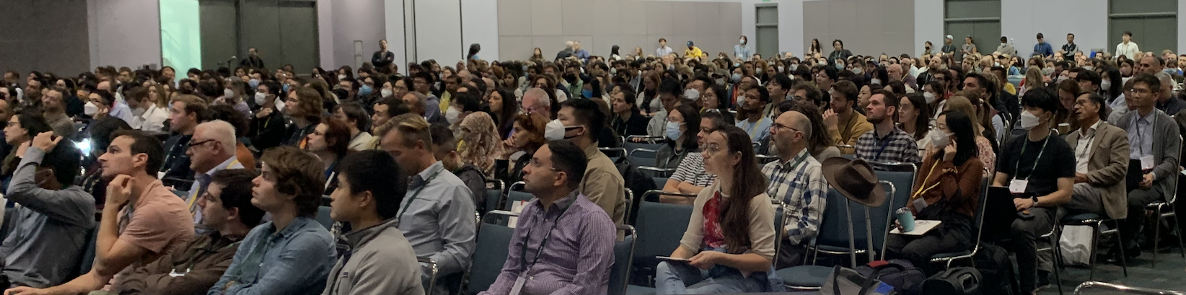
Critical Assessment of Genome Interpretation
CAGI7
CAGI’s mission
Conduct community experiments to assess the state of the art in computational interpretation of genetic variants
Objectives
Evaluate the accuracy of computational methods
Highlight methodological innovation and reveal bottlenecks
Contribute to the development of guidelines for clinical practice
Provide a forum for the dissemination of research results
Promote ethical practices & responsible data governance
ASHG 2022, Los Angeles, USA
CAGI3, Berlin, Germany
Created for CAGI7
genomeinterpretation.org
Predrag Radivojac

Slide 4
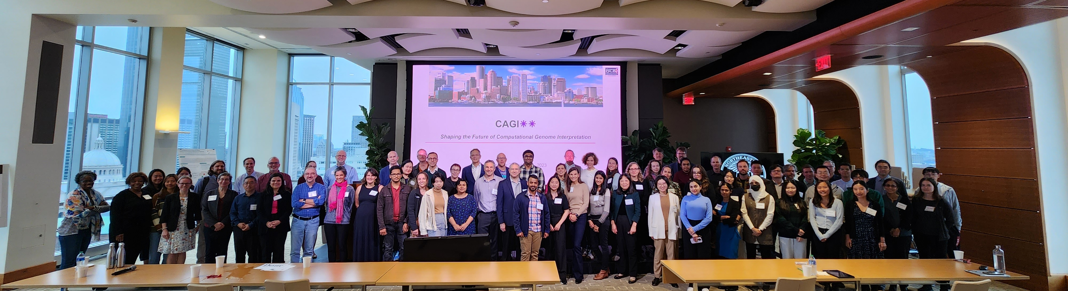
Critical Assessment of Genome Interpretation
CAGI7
CAGI’s mission
Conduct community experiments to assess the state of the art in computational interpretation of genetic variants
Objectives
Evaluate the accuracy of computational methods
Highlight methodological innovation and reveal bottlenecks
Contribute to the development of guidelines for clinical practice
Provide a forum for the dissemination of research results
Promote ethical practices & responsible data governance
CAGI↓↓, Boston, USA
Created for CAGI7
genomeinterpretation.org
Predrag Radivojac

Slide 5
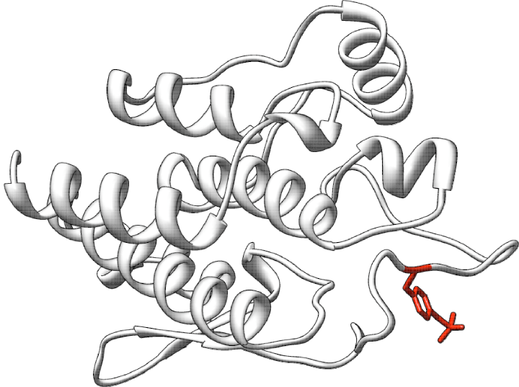
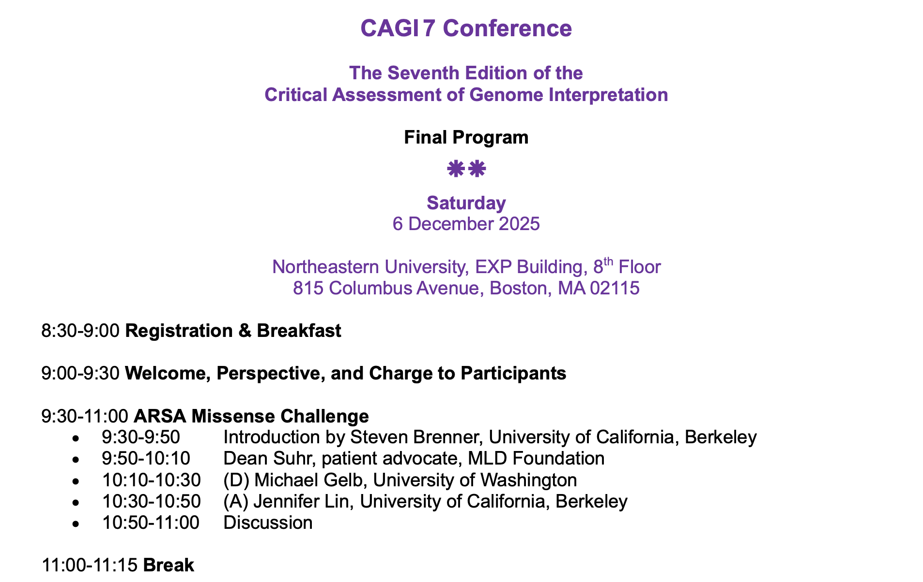
Agenda, Code of Conduct, Accommodations…
Code of Conduct
Accommodations
Fellowships
Posters
Food
Challenge block
• Introduction
• Data provider
• Assessor
• Predictors
Created for CAGI7
genomeinterpretation.org
Predrag Radivojac

Slide 6

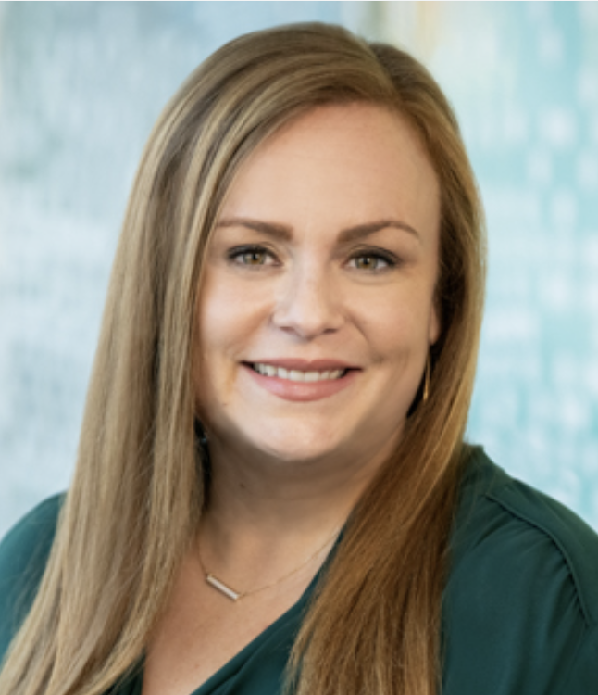
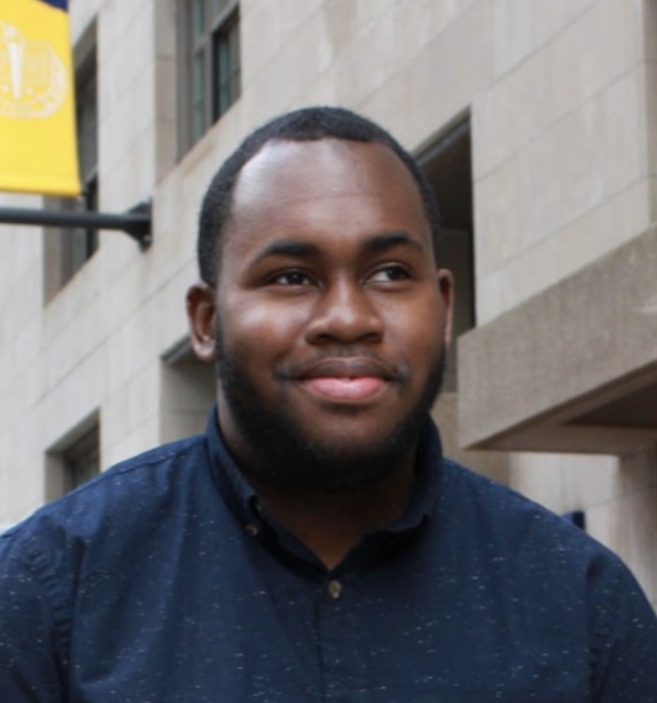
Thank you: Event Organization
CAGI7
Heather Sciacca
Nicole Bekerian
Imad Coulibally
Khoury College of Computer Sciences, Northeastern
Created for CAGI7
genomeinterpretation.org
Predrag Radivojac

Slide 7

Thank you: Sponsors
CAGI7
The CAGI7 Conference was generously supported by:
National Institutes of Health
National Human Genome Research Institute
National Cancer Institute
Created for CAGI7
genomeinterpretation.org
Predrag Radivojac

Slide 8
CAGI7
Conference
December 6-8, 2025
Northeastern University
Boston, MA
@CAGInews

