Slide 1

CAGI slide pack guidelines
I agree to my slides being used according to the following terms:
_______Céline Marquet_______
Authors: please include THIS slide at the beginning of your presentation to indicate that you agree with reuse of your slides in CAGI presentations, according to the terms below, and digitally sign by writing your name above.
To disseminate the CAGI results, I encourage all CAGI participants to remix these CAGI slides for inclusion in their oral and poster presentations
CAGI participants may use or publish any content of these slides only in compliance with the CAGI Data Use Agreement
CAGI participants may not cite or publish any content of these slides except with the written permission of the originating author or in the primary CAGI publications
CAGI participants must acknowledge the original authors of these slides and CAGI 6. Include the acknowledgement banner across the bottom
CAGI participants must include the CAGI credits slide in their presentations
Slides with a red slash (no remix) may not be included in a presentation unless all attendees are registered CAGI participants who signed the data use agreement
Slides with a red X over the entire slide may not be used in any circumstances
Slides with a blue slash (embargoed) may not be used unless the embargo is explicitly lifted
Slides without slash or X may be tweeted unless flagged with the “No tweet” icon.
CAGI participants using these slides must explain the “No tweet” icon, which means that the slide content should not be disseminated outside the presenting conference hall. If the presentation venue permits pervasive tweeting, you may not include these slides in your talk
Note for slide authors: we expect all CAGI participants to abide by these restrictions, and will make best effort to ensure they are followed. However, but bear in mind that we have limited means of enforcing them, and therefore the restrictions cannot be guaranteed.

Slide 2
Permission request regarding CAGI 6 recordings and hybrid presentations
I understand that my presentation as associated with CAGI 6 will be recorded and broadcasted via the internet through CAGI’s designated technology provider.
As the copyright holder to this presentation entitled Céline Marquet, I hereby agree that the copyright for the online broadcast and recording of my presentation be released to CAGI and my recording be uploaded on to the CAGI website.

Slide 3
Embeddings from protein language models predict conservation and variant effects
1/7
Céline Marquet^{1,2*}, Michael Heinzinger^{1,2}, Tobias Olenyi^{1,2},
Christian Dallago^{1,2}, Kyra Erckert^{1,2}, Michael Bernhofer^{1,2}, Dmitrii Nechaev^{1,2} & Burkhard Rost^{1,3}
¹TUM (Technical University of Munich) Department of Informatics, Bioinformatics & Computational Biology - i12, Boltzmannstr. 3, 85748 Garching/Munich, Germany
²TUM Graduate School, Center of Doctoral Studies in Informatics and its Applications (CeDoSIA), Boltzmannstr. 11, 85748 Garching, Germany
³Institute for Advanced Study (TUM-IAS), Lichtenbergstr. 2a, 85748 Garching/Munich, Germany & TUM School of Life Sciences Weihenstephan (TUM-WZW), Alte Akademie 8, Freising, Germany
* Corresponding author: celine.marquet@tum.de
Created for CAGI 6
genomeinterpretation.org
Céline Marquet

Slide 4
Introduction
2/7
Protein Language Models (pLMs):
Deep Learning models trained on protein sequence databases
Learn to predict missing (masked) amino acids from sequence context
Yield representations of protein sequences (embeddings)
Used as input for several prediction tasks (f.e., mutation effects on protein-protein interactions [Zhou et al. 2020], …)
Here: predicting residue conservation and single amino acid variant (SAV) effects
Created for CAGI 6
genomeinterpretation.org
Céline Marquet

Slide 5
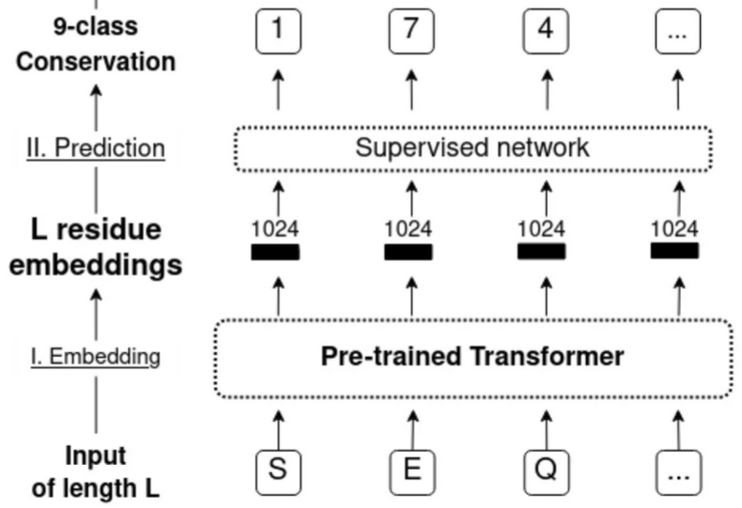
Methods
3/7
Conservation prediction
Input: Embeddings (ProtBert OR ProtT5 [Elnaggar et al. 2021] OR ESM-1b [Rives et al. 2021])
Method: Logistic Regression (LR), Feed-forward NN (FNN), Convolutional NN (CNN)
Output: Probability for 9 ConSurf-DB conservation classes [Ben Chorin et al. 2020]
Created for CAGI 6
genomeinterpretation.org
Céline Marquet

Slide 6
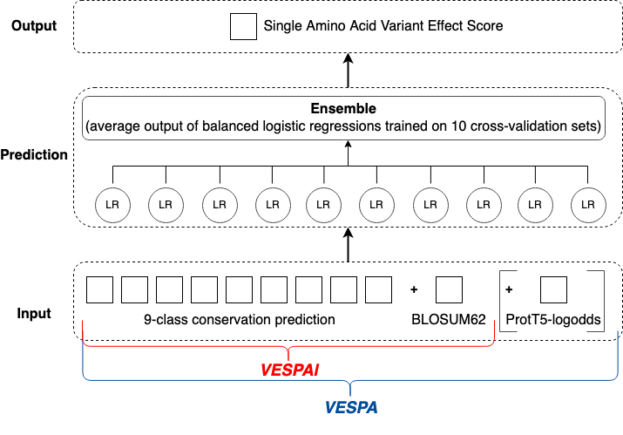
Methods
5/7
Variant Effect Score Prediction without Alignments
Created for CAGI 6
genomeinterpretation.org
Céline Marquet

Slide 7
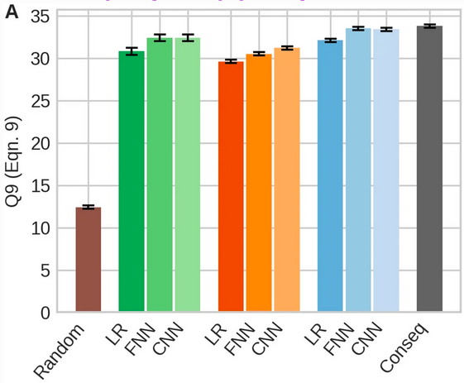
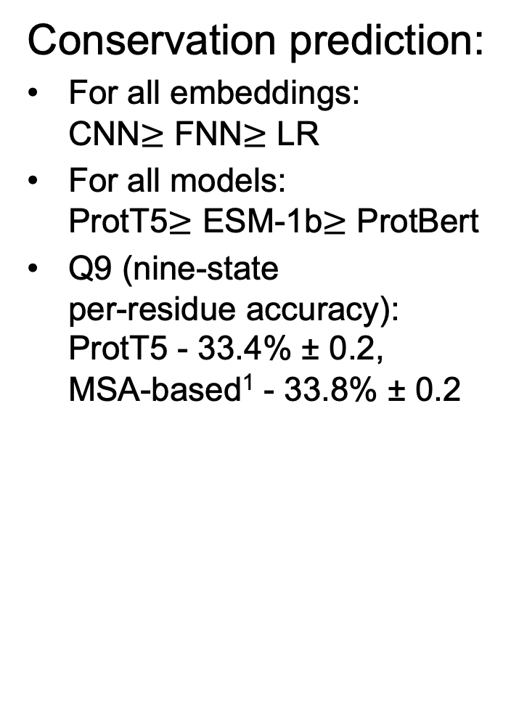
Results
4/7
Conservation prediction:
For all embeddings:
CNN$≥$ FNN$≥$ LR
For all models:
ProtT5$≥$ ESM-1b$≥$ ProtBert
Q9 (nine-state
per-residue accuracy):
ProtT5 - 33.4% ± 0.2,
MSA-based¹ - 33.8% ± 0.2
¹ConSeq [Berezin et al. 2004] with MMseqs2 [Steinegger and Söding 2018] and PSI-BLAST [Altschul et al. 1997]
Created for CAGI 6
genomeinterpretation.org
Céline Marquet

Slide 8
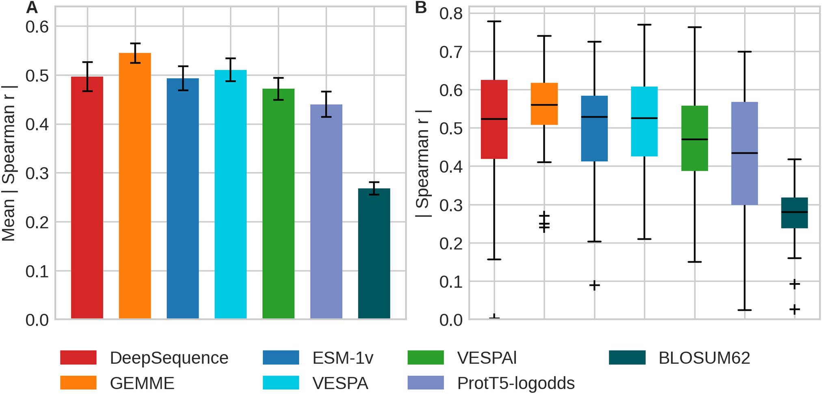
Results
6/7
SAV effect prediction:
Spearman correlation between SAV effect prediction and 39 deep mutational scanning experiments.
Methods: DeepSequence [Riesselman et al. 2018], GEMME [Laine et al. 2019], ESM-1v [Meier et al. 2021], VESPA , VESPAl, ProtT5-logodds, BLOSUM62 [Henikoff and Henikoff 1992]
Mean absolute Spearman correlation. Error bars: 0.95 confidence interval
Boxplots for absolute Spearman correlation. Medians black horizontal bars; whiskers at 1.5 interquartile range
Created for CAGI 6
genomeinterpretation.org
Céline Marquet

Slide 9
Conclusion
7/7
Speed:
VESPAl predicted all human proteome SAVs in 40 minutes with precomputed embeddings
(95 minutes without precomputed embeddings, 1 Nvidia Quadro RTX 8000)
Performance:
Embedding-based methods competitive with MSA-based methods for conservation and SAV effect prediction
Created for CAGI 6
genomeinterpretation.org
Céline Marquet

