Slide 1

CAGI slide pack guidelines
I agree to my slides being used according to the following terms:
_______Brynja Matthiasardottir, Chiao-Feng Lin, Stephen M. Mount_______
Authors: please include THIS slide at the beginning of your presentation to indicate that you agree with reuse of your slides in CAGI presentations, according to the terms below, and digitally sign by writing your name above.
To disseminate the CAGI results, I encourage all CAGI participants to remix these CAGI slides for inclusion in their oral and poster presentations
CAGI participants may use or publish any content of these slides only in compliance with the CAGI Data Use Agreement
CAGI participants may not cite or publish any content of these slides except with the written permission of the originating author or in the primary CAGI publications
CAGI participants must acknowledge the original authors of these slides and CAGI 6. Include the acknowledgement banner across the bottom
CAGI participants must include the CAGI credits slide in their presentations
Slides with a red slash (no remix) may not be included in a presentation unless all attendees are registered CAGI participants who signed the data use agreement
Slides with a red X over the entire slide may not be used in any circumstances
Slides with a blue slash (embargoed) may not be used unless the embargo is explicitly lifted
Slides without slash or X may be tweeted unless flagged with the “No tweet” icon.
CAGI participants using these slides must explain the “No tweet” icon, which means that the slide content should not be disseminated outside the presenting conference hall. If the presentation venue permits pervasive tweeting, you may not include these slides in your talk
Note for slide authors: we expect all CAGI participants to abide by these restrictions, and will make best effort to ensure they are followed. However, but bear in mind that we have limited means of enforcing them, and therefore the restrictions cannot be guaranteed.

Slide 2
Permission request regarding CAGI 6 recordings and hybrid presentations
I understand that my presentation as associated with CAGI 6 will be recorded and broadcasted via the internet through CAGI’s designated technology provider.
As the copyright holder to this presentation entitled “Predicting splicing disruption from variants of unknown significance”, I hereby agree that the copyright for the online broadcast and recording of my presentation be released to CAGI and my recording be uploaded on to the CAGI website.

Slide 3
CAGI6
Berkeley 2022 –splicing VUS.
Steve Mount
University of Maryland
team: UMSplicing
Brynja Matthiasardottir
Chiao-Feng Lin (DNAnexus)

Slide 4
outline
Classes of splicing signal and splice site predictors
Splicing mutation outcomes
intron retention, exon skipping, cryptic splice site activation, alternative splice site switch, cryptic exon activation
Current methods including SpliceAI
Splicing-VUS
Model 1: SpliceAI with a threshold
Model 2: Multilayered analysis using domain knowledge

Slide 5
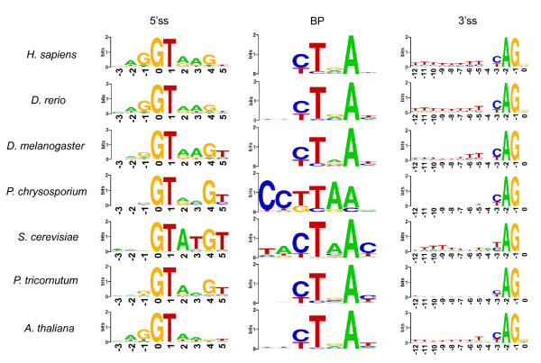
Classes of splice site signal
‘invariant’ dinucleotides (GT-AG)
core splicing signals
auxiliary splicing signals
context

Slide 6
‘invariant’ dinucleotides (GT-AG)
core splicing signals
Many variant impact callers only recognize GT or AG mutations as splicing mutations
Consensus sequences can be scored by PWMs using information content.
MaxEnt (Yeo and Burge 2004)

Slide 7
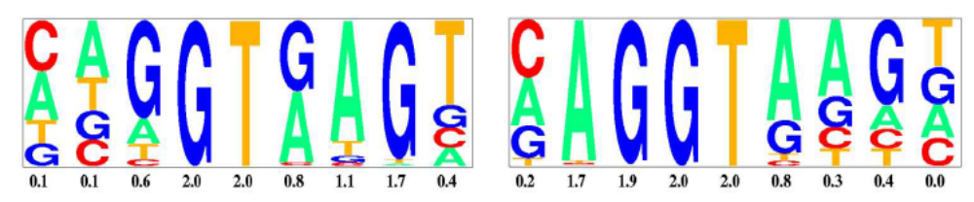
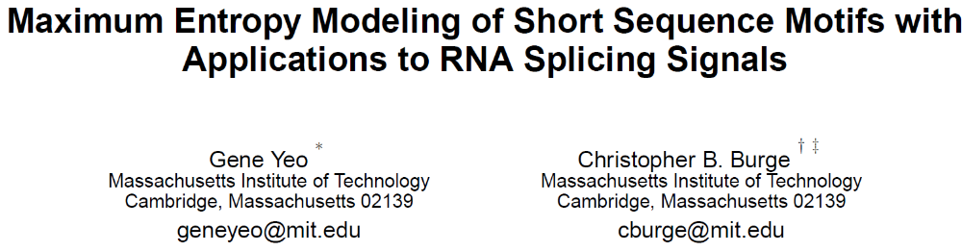
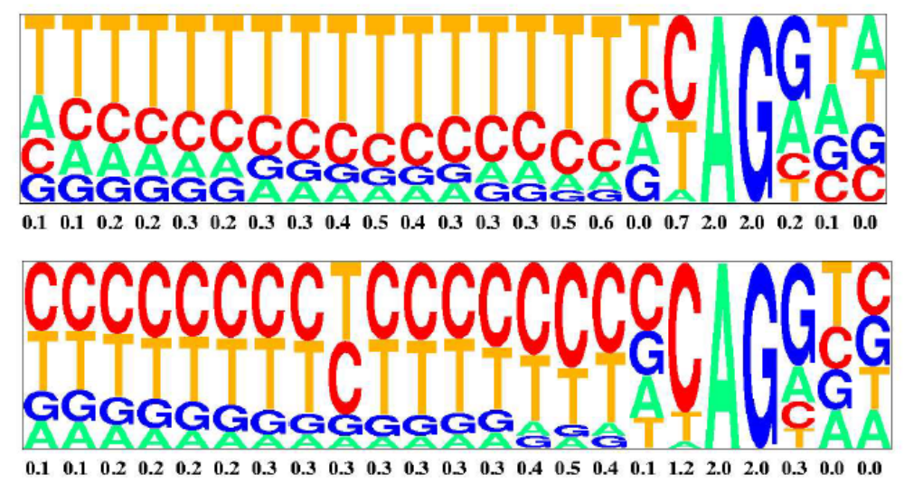
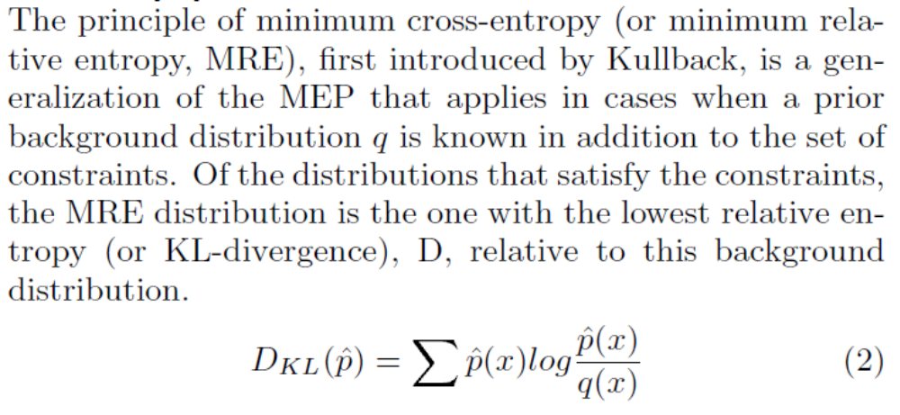

Slide 8
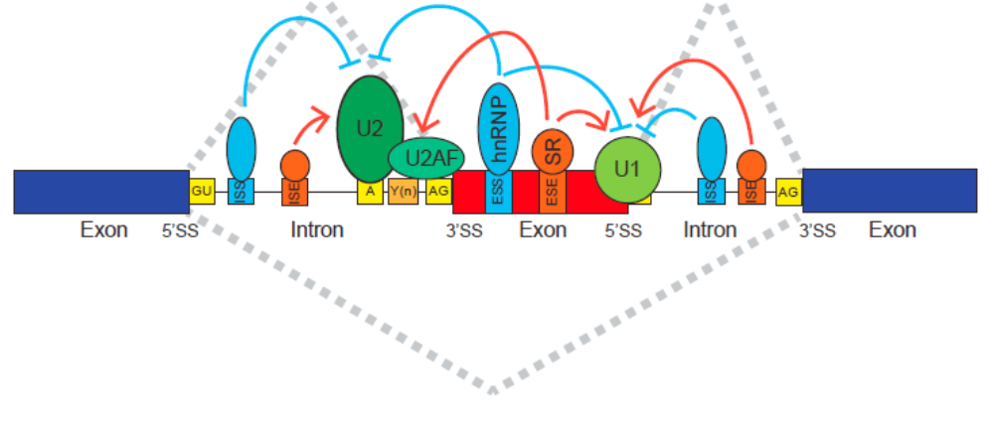
Classes of splice site signal
‘invariant’ dinucleotides (GT-AG)
core splicing signals
auxiliary splicing signals
context
Image from The Expanding Landscape of Alternative Splicing Variation in Human Populations.
by: Eddie Park, Zhicheng Pan, Zijun Zhang, Lan Lin, Yi Xing
American journal of human genetics, Vol. 102, No. 1. (04 January 2018), pp. 11-26

Slide 9
Auxiliary splicing signals
HMMs
SplicePort (2006) – a feature generation algorithm
Exonic splicing enhancers
Intronic splicing enhancers
Exonic splicing suppressors
Intronic splicing enhancers
Linear scoring
Limited window

Slide 10
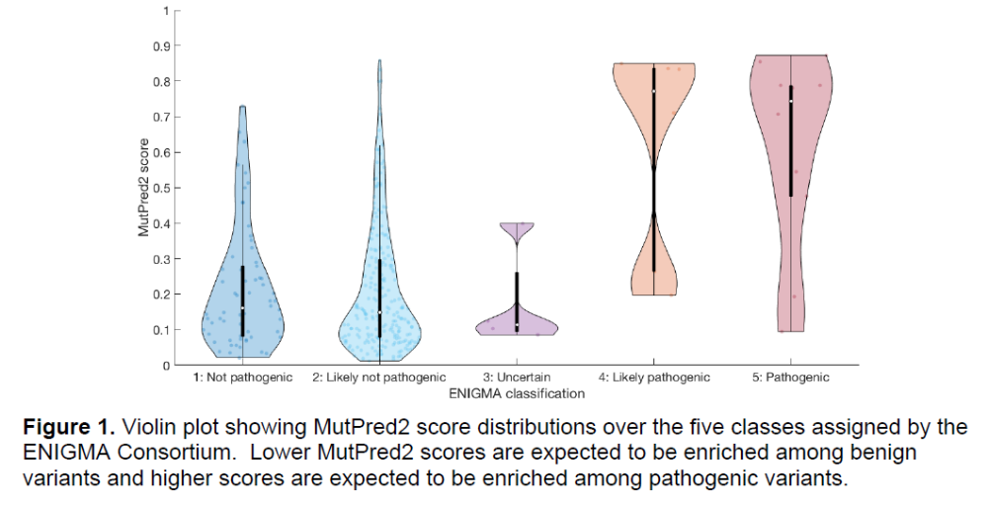
Missense and synonymous mutations are often ESE or ESS or cryptic splice site activation mutations.
Exonic splicing mutations?

Slide 11
Classes of splice site signal
Vs.
‘invariant’ dinucleotides (GT-AG)
core splicing signals
auxiliary splicing signals
context

Slide 12
Splicing mutation outcomes
Intron retention
X

Slide 13
Splicing mutation outcomes
X
exon skipping
Exon skipping

Slide 14
Splicing mutation outcomes
X
cryptic site activation
Cryptic site activation (or choice)
or

Slide 15
Splicing mutation outcomes
cryptic exon activation
X

Slide 16
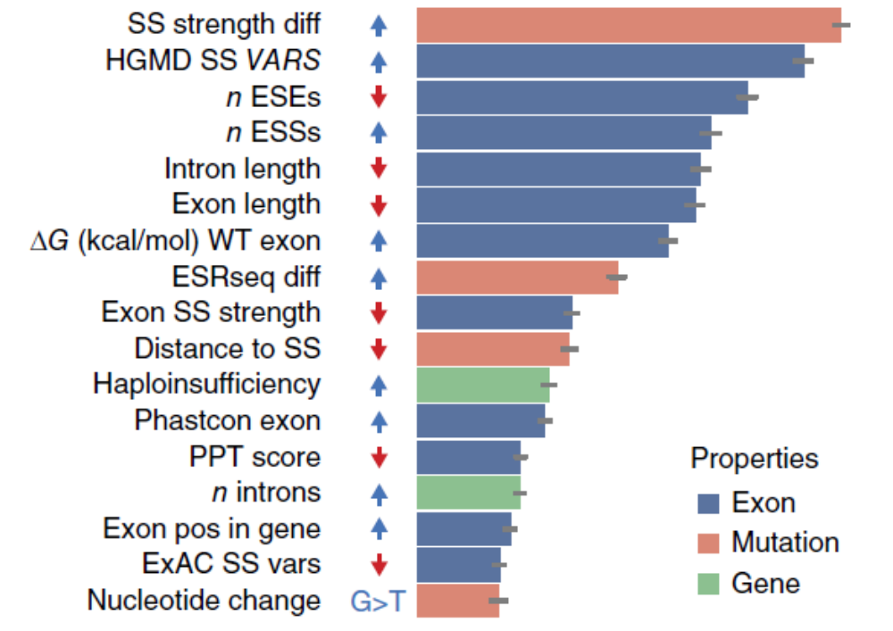
Context and machine learning
Neural networks and other complex machine learning.
Features predictive of results from high throughput assays.
Data from Fairbrother group
(MaPSy challange)
Figure from Fairbrother group
(MaPSy challange)

Slide 17
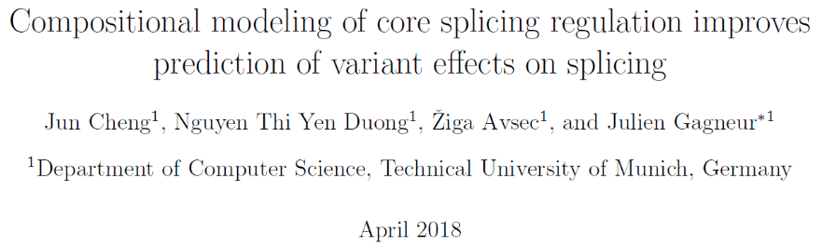
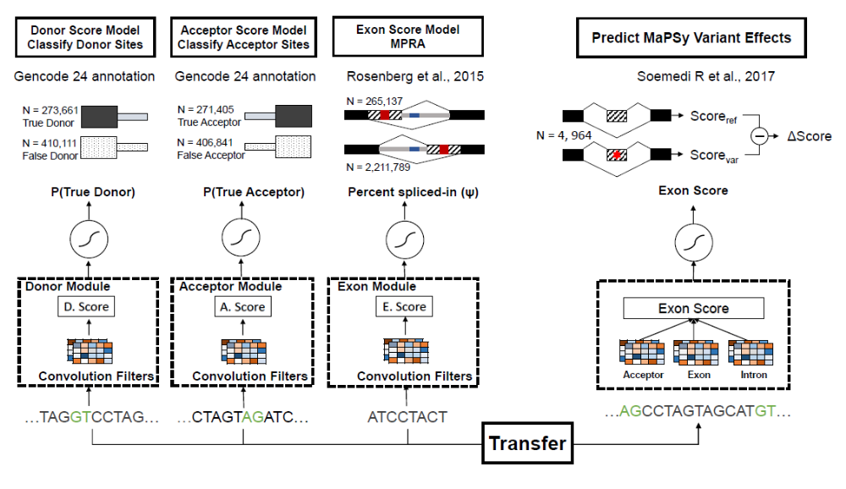
MMsplice – CAGI5

Slide 18
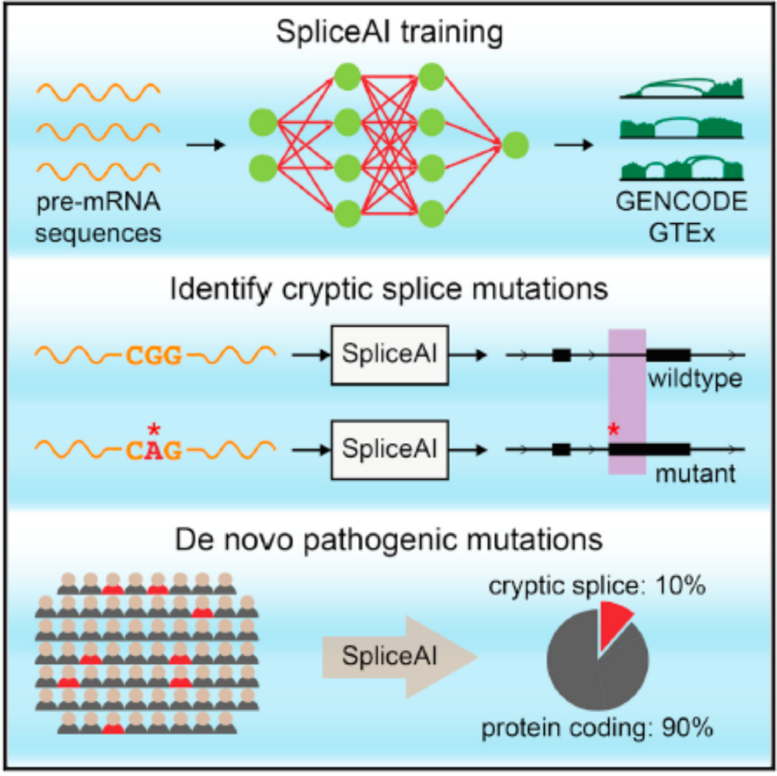
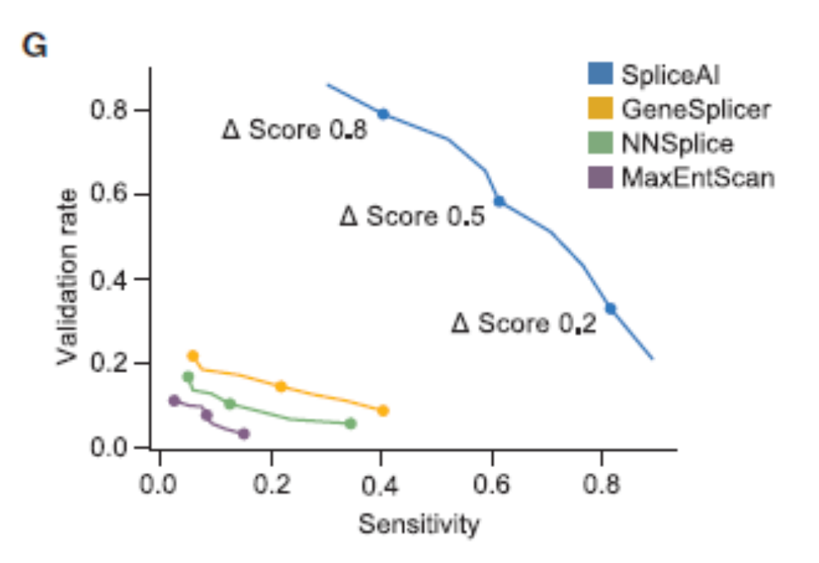
SpliceAI from Illumina

Slide 19
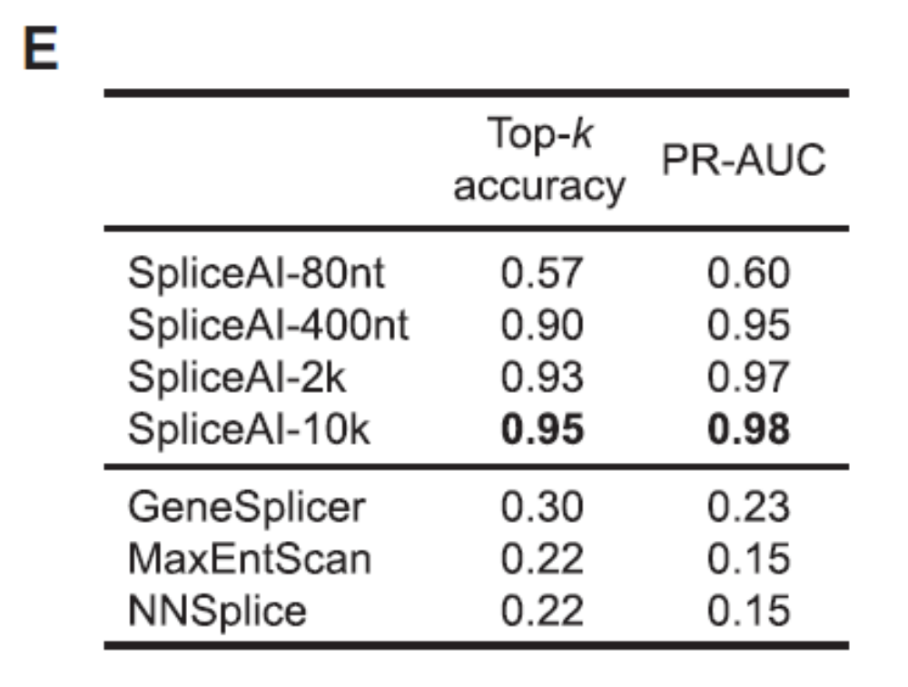
Context
SpliceAI was developed on four window sizes. More sequence gives a significant improvement, even beyond the length of typical introns.

Slide 20
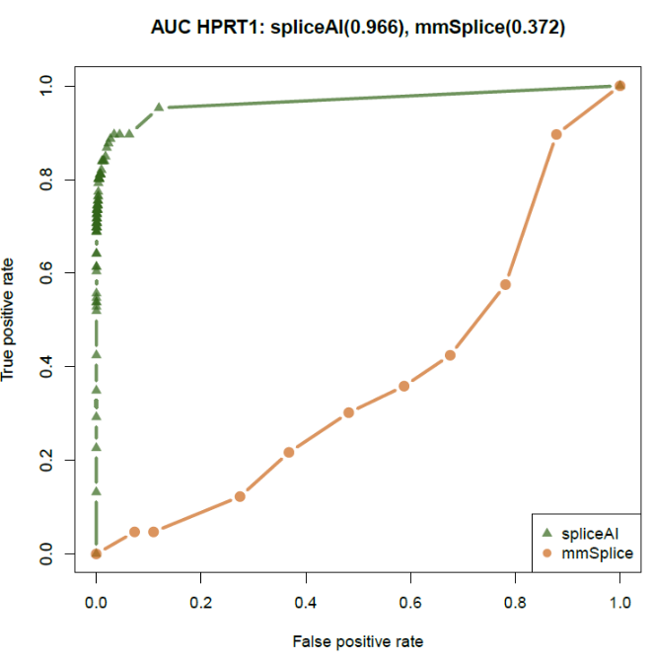
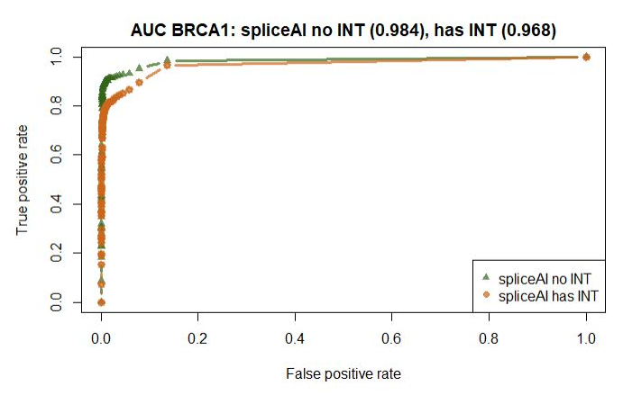
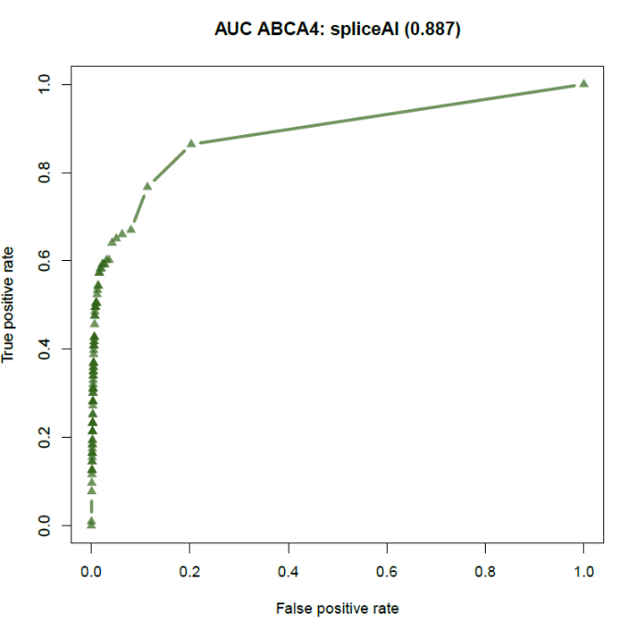
Application of SpliceAI to three carefully chosen genes
HPRT
AUC 0.966
Chosen for nearly saturating mutagenesis in classical cell culture work
BRCA1
AUC 0.984
Chosen for nearly saturating mutagenesis by genome editing.
ABCA4
AUC 0.887
Chosen because of an abundance of deep exon mutations activating cryptic exons

Slide 21
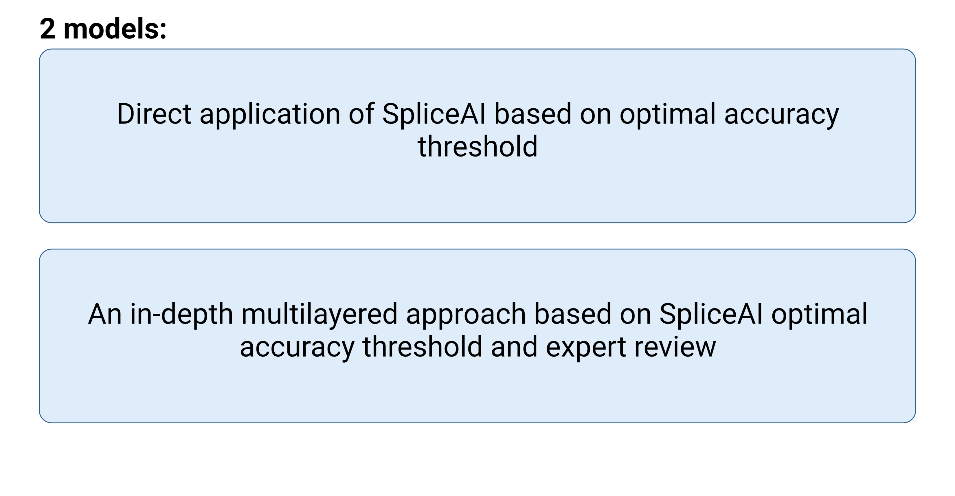
Methods – UMSplice team
Created for CAGI 6
genomeinterpretation.org
Brynja Matthiasardottir

Slide 22
SpliceAI gives four scores to each variant:
Scores (DS) for
Acceptor Gain (AG), Acceptor Loss (AL), Donor Loss (DL), and Donor Gain (DG)
Positions (DP) of the affected site are also provided.
Scores range from 0 to1. We used the maximum of these four scores.
DS_AG | DS_AL | DS_DG | DS_DL | DP_AG | DP_AL | DP_DG | DP_DL
0.17 | 0.65 | 0 | 0 | 11 | 3 | 27 | 25
0 | 0 | 0.07 | 0.75 | 5 | 26 | -12 | 5
0 | 0 | 0 | 0.01 | -42 | -1 | -26 | -1
0 | 0 | 0 | 0 | -8 | -2 | 6 | -2
0 | 0 | 0 | 0 | -21 | 36 | 38 | 1
0 | 0 | 0 | 0 | 27 | -10 | -10 | -37
0 | 0.01 | 0 | 0 | -11 | 6 | 18 | 4
0 | 0 | 0 | 0 | -28 | 12 | -29 | -25
0.06 | 0.99 | 0 | 0 | -16 | -2 | -16 | -10
0 | 0.01 | 0.24 | 0.03 | 2 | 1 | 2 | -25

Slide 23
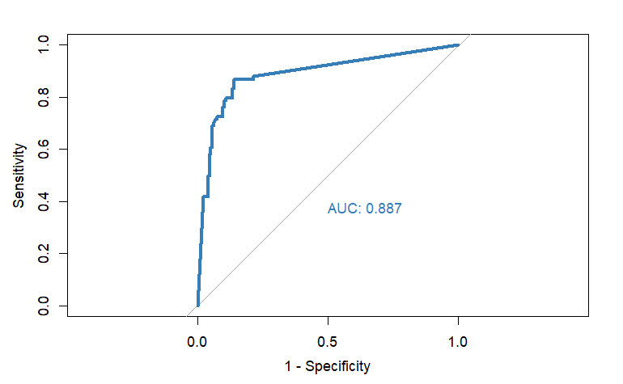
Methods
Optimal accuracy threshold, SpliceAI
Training set: 257 previously validated variants (Wai et al., 2020)
Threshold
0.21
Created for CAGI 6
genomeinterpretation.org
Brynja Matthiasardottir

Slide 24
Our second model: a multilayered approach
Subjective score based on
  SpliceAI scores (optimal threshold 0.21)
  MaxEnt scores
  100 Vertebrate Conservation scores (UCSC)
  CADD scores
  gnomAD count
  Manual review
Manual review of the 8 false negatives and 12 false positives in the training set

Slide 25
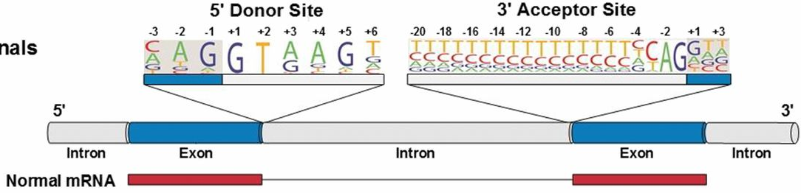
Multilayered approach
VariantID | SpliceAI-Max | gnomad_ count | CADD PHRED | 100 vert | Comments | Score | Confidence | Classification
NM_006231.4: c.1337G>A | 0.06 | 65 | 25 | 7.76 | High missense, high Gnom, low SpliceAI | 0.02 | 0.9 | 0
NM_007294.3: c.301+1G>A | 0.67 | 1 | 32 | 4.61 | GT | 0.95 | 0.95 | 1
NM_001370259.2:c.655-6C>A | 0.51 | 775 | 5 | 0.31 | Tolerated | 0.4 | 0.4 | 1 > 0
NM_000059.3: c.620C>T | 0.28 | 2 | 27 | 6.22 | Missense T-> I, | 0.3 | 0.3 | 1 > 0
NM_007294.3: c.4675+4A>C | 0.26 | 0 | 20 | 1.27 | Weakened donor site, MaxEnt 6.84 to 4.64. Defer to SpliceAI | 0.7 | 0.6 | 1

Slide 26
Conclusions and FUTURE DIRECTIONS
SpliceAI is good but not perfect
Formalize the analysis of exceptions to improve assessment

