Slide 1

CAGI slide pack guidelines
I agree to my slides being used according to the following terms:
_______Zhao Group_______
Authors: please include THIS slide at the beginning of your presentation to indicate that you agree with reuse of your slides in CAGI presentations, according to the terms below, and digitally sign by writing your name above.
To disseminate the CAGI results, I encourage all CAGI participants to remix these CAGI slides for inclusion in their oral and poster presentations
CAGI participants may use or publish any content of these slides only in compliance with the CAGI Data Use Agreement
CAGI participants may not cite or publish any content of these slides except with the written permission of the originating author or in the primary CAGI publications
CAGI participants must acknowledge the original authors of these slides and CAGI 6. Include the acknowledgement banner across the bottom
CAGI participants must include the CAGI credits slide in their presentations
Slides with a red slash (no remix) may not be included in a presentation unless all attendees are registered CAGI participants who signed the data use agreement
Slides with a red X over the entire slide may not be used in any circumstances
Slides with a blue slash (embargoed) may not be used unless the embargo is explicitly lifted
Slides without slash or X may be tweeted unless flagged with the “No tweet” icon.
CAGI participants using these slides must explain the “No tweet” icon, which means that the slide content should not be disseminated outside the presenting conference hall. If the presentation venue permits pervasive tweeting, you may not include these slides in your talk
Note for slide authors: we expect all CAGI participants to abide by these restrictions, and will make best effort to ensure they are followed. However, but bear in mind that we have limited means of enforcing them, and therefore the restrictions cannot be guaranteed.

Slide 2
Permission request regarding CAGI 6 recordings and hybrid presentations
I understand that my presentation as associated with CAGI 6 will be recorded and broadcasted via the internet through CAGI’s designated technology provider.
As the copyright holder to this presentation entitled “Zhao Group CAGI 6 PRS Challenge Result”, I hereby agree that the copyright for the online broadcast and recording of my presentation be released to CAGI and my recording be uploaded on to the CAGI website.

Slide 3
Comparison of PRS methods for predicting Alzheimer’s’ Disease
Chi Zhang¹, Yixuan Ye², Hongyu Zhao^{1,2,}*
1. Department of Biostatistics, Yale School of Public Health, CT, USA
2. Program of Computational Biology and Bioinformatics, Yale University, CT, USA
*Correspondence: hongyu.zhao@yale.edu
Created for CAGI 6
genomeinterpretation.org
Zhao group

Slide 4
Background
Outline
Results
PRS Models
Data Set
Created for CAGI 6
genomeinterpretation.org
Zhao group

Slide 5
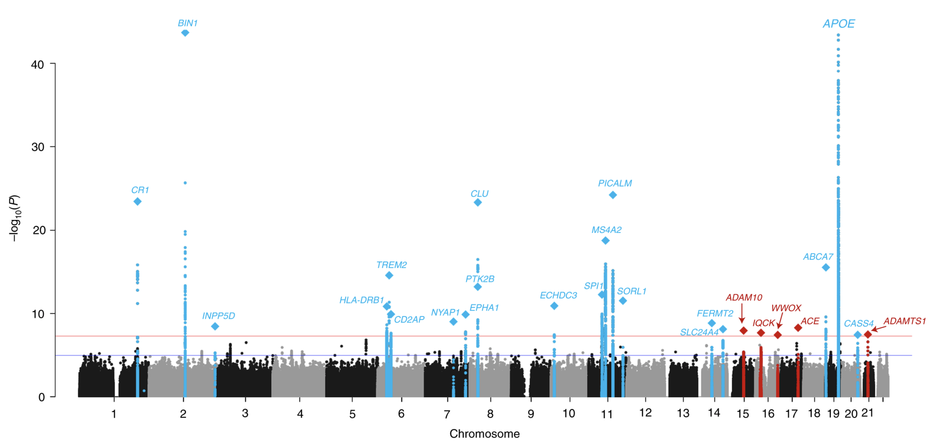
Background: Alzheimer’s disease
Alzheimer's disease (AD), is a neurodegenerative disorder progressing from memory loss to profound dementia and death within an average of eight years
Prince M et al., 2013 & Avramopoulos D.,2009; Kunkle BW et al., 2019
Created for CAGI 6
genomeinterpretation.org
Zhao group

Slide 6
Background: Alzheimer’s disease
The APOE gene is involved in making a protein that helps carry cholesterol and other types of fat in the bloodstream.
APOE ε2 (8.4%):
relatively rare
may provide some protection against the disease
APOE ε3 (77.9%):
most common allele
neither decreasing nor increasing risk.
APOE ε4 (13.7%):
increase risk for Alzheimer's disease and lowers the age of onset.
Having one copy of ε4 (ε3 / ε4 ) can increase the risk by 2 to 3 times while two copies (ε4 / ε4 ) can increase the risk by 12 times.
Michaelson, D.M et al 2014 &
Strittmatter Wj et al., 1993
Created for CAGI 6
genomeinterpretation.org
Zhao group

Slide 7
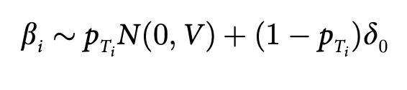
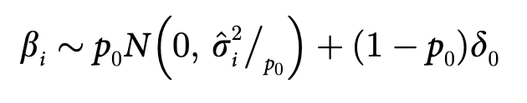
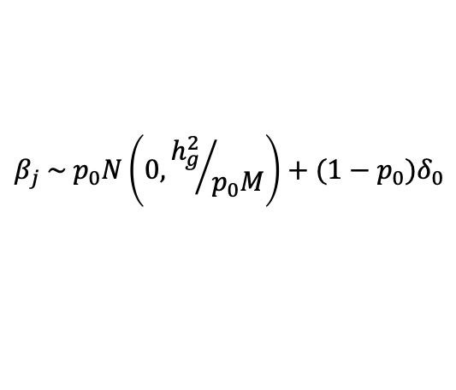

PRS Models Review
P+T
LD pruning and thresholding.
LDPred
$$β_{j} \sim p_{0}N\left(0, {h_{g}^{2}}/{p_{0}M}\right)+(1−p_{0})δ_{0}$$
PRS-CS
$$β_{j} \sim N\left(0, \frac{σ^{2}}{N}φψ_{j}\right)$$
AnnoPred
Tian Ge et. , 2019 ; Yiming Hu et. , 2017; BJ Vilhjálmsso et. , 2015
Created for CAGI 6
genomeinterpretation.org
Zhao group

Slide 8
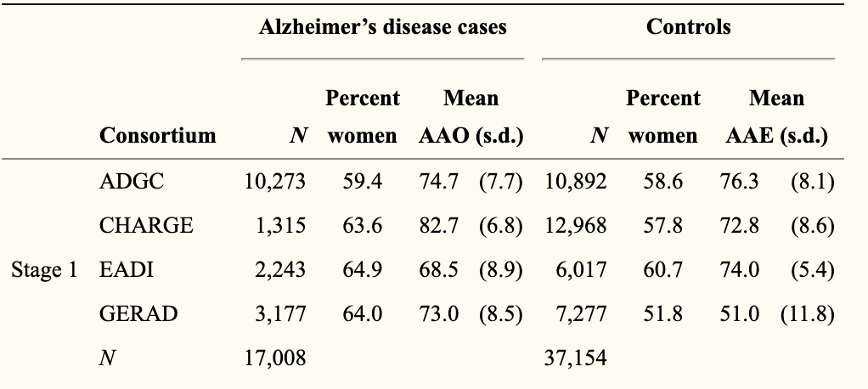
Training data
IGAP Stage 1 GWAS
Clinically diagnosed AD and AD-by-proxy meta GWAS
 | Cases/AD-by-proxy | Controls
PGC-ALZ | 2,224 | 1,855
ADSP | 5,771 | 5,136
IGAP Stage 1 | 17,008 | 37,154
UKB | 47,793 | 328,320
Total | 71,880 | 383,378
Lambert et al 2013 ; Iris E. Jansen et.al , 2017
Created for CAGI 6
genomeinterpretation.org
Zhao group

Slide 9
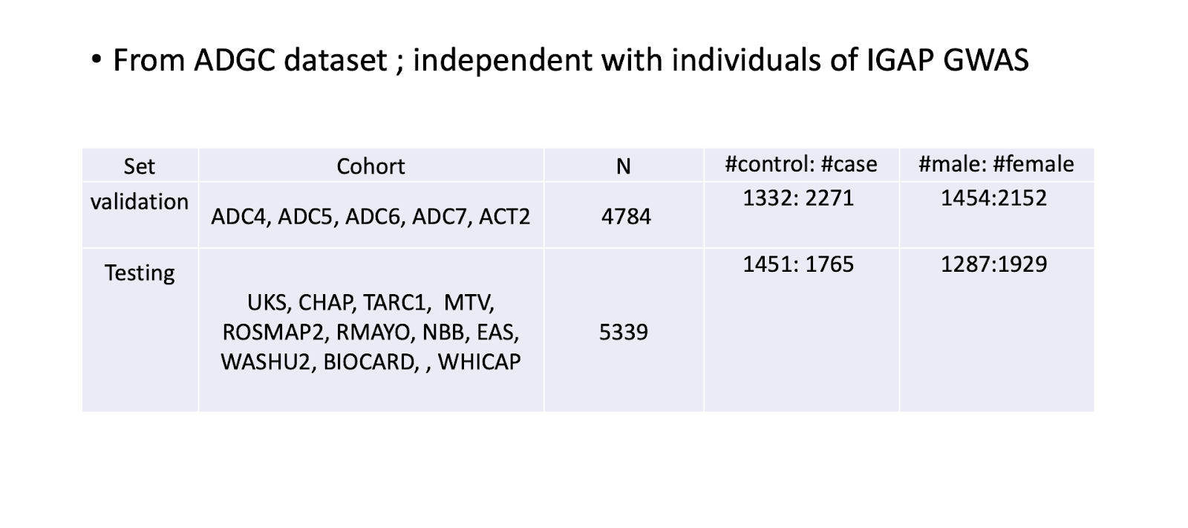
Validation and Testing Dataset
Created for CAGI 6
genomeinterpretation.org
Zhao group

Slide 10
Prediction
IGAP GWAS/
meta-GWAS
GWAS excluding SNPS from APOE region
PRS models
Logistic regression
APOE ε4+ APOE ε2+age+sex
Polygenic risk scores
Created for CAGI 6
genomeinterpretation.org
Zhao group

Slide 11
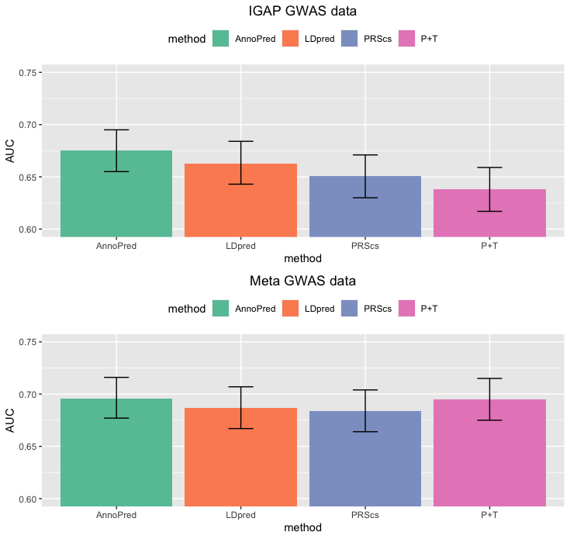
No remix
Results:
Created for CAGI 6
genomeinterpretation.org
Zhao group

Slide 12

Acknowledge
- PI: Dr. Hongyu Zhao
- Co-authors: Dr. Yixuan Ye
- CAGI6 organizers:
Created for CAGI 6
genomeinterpretation.org
Zhao group

