Slide 1

CAGI slide pack guidelines
I agree to my slides being used according to the following terms:
_______Yuanfei Sun and Yang Shen_______
Authors: please include THIS slide at the beginning of your presentation to indicate that you agree with reuse of your slides in CAGI presentations, according to the terms below, and digitally sign by writing your name above.
To disseminate the CAGI results, I encourage all CAGI participants to remix these CAGI slides for inclusion in their oral and poster presentations
CAGI participants may use or publish any content of these slides only in compliance with the CAGI Data Use Agreement
CAGI participants may not cite or publish any content of these slides except with the written permission of the originating author or in the primary CAGI publications
CAGI participants must acknowledge the original authors of these slides and CAGI 6. Include the acknowledgement banner across the bottom
CAGI participants must include the CAGI credits slide in their presentations
Slides with a red slash (no remix) may not be included in a presentation unless all attendees are registered CAGI participants who signed the data use agreement
Slides with a red X over the entire slide may not be used in any circumstances
Slides with a blue slash (embargoed) may not be used unless the embargo is explicitly lifted
Slides without slash or X may be tweeted unless flagged with the “No tweet” icon.
CAGI participants using these slides must explain the “No tweet” icon, which means that the slide content should not be disseminated outside the presenting conference hall. If the presentation venue permits pervasive tweeting, you may not include these slides in your talk
Note for slide authors: we expect all CAGI participants to abide by these restrictions, and will make best effort to ensure they are followed. However, but bear in mind that we have limited means of enforcing them, and therefore the restrictions cannot be guaranteed.

Slide 2
Permission request regarding CAGI 6 recordings and hybrid presentations
I understand that my presentation as associated with CAGI 6 will be recorded and broadcasted via the internet through CAGI’s designated technology provider.
As the copyright holder to this presentation entitled “Zero-Shot Variant Effect Prediction with Protein Language Models”, I hereby agree that the copyright for the online broadcast and recording of my presentation be released to CAGI and my recording be uploaded on to the CAGI website.

Slide 3
Zero-Shot Variant Effect Prediction with Protein Language Models
Yuanfei Sun and Yang Shen
Texas A&M University
Created for CAGI 6
genomeinterpretation.org
Sun & Shen

Slide 4
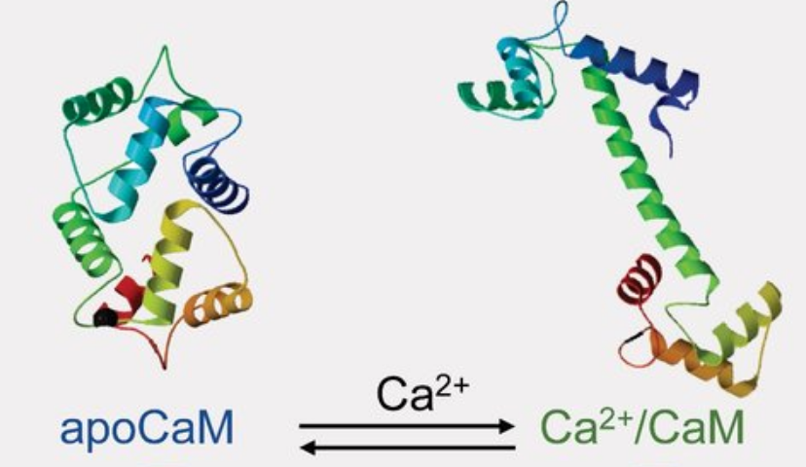
The Calmodulin Challenge
(O’Day 2019)
Given: Denaturization profiles, T_{m}, and %unfold in either state
for 3 CaM homolog and WT CaM
Desired: T_{m}, and %unfold in either state plus stabilization
for each CaM variant
Created for CAGI 6
genomeinterpretation.org
Sun & Shen

Slide 5
Structure-Based Principle-Driven Approach?
CAGI5 FXN deja vu?
(O’Day 2019)
iCFN for Multi-State Protein Design (2018)
Predict: △G in either state and △△G for each protein
Desired: T_{m}, and %unfold at either state plus stabilization
for each CaM variant
Given data
Created for CAGI 6
genomeinterpretation.org
Sun & Shen

Slide 6
Structure-Based Principle-Driven Approach?
CAGI5 FXN deja vu?
(O’Day 2019)
iCFN for Multi-State Protein Design (2018)
Predict: △G in either state and △△G for each protein
Desired: T_{m}, and %unfold at either state plus stabilization
for each CaM variant
Given data
Small
Created for CAGI 6
genomeinterpretation.org
Sun & Shen

Slide 7
A Common Data Challenge to
Genome Interpretation
Experimental “labels” are much more expensive and rare compared to variant sequences
  Data-hungry models facing small data
Experimental labels are context- and protocol-specific
  Data-specific models lacking transferrable knowledge
Created for CAGI 6
genomeinterpretation.org
Sun & Shen

Slide 8
Strategy: Training Models without Labels?
There are abundant sequence data without labels!
  Inferring fitness landscape/predictor from the products of natural evolution (“zero-shot”)
The “pre-trained” predictor can be “fine-tuned” for
  specific protein families
  specific experimental labels (enough w/ few: “few-shot”)
Created for CAGI 6
genomeinterpretation.org
Sun & Shen

Slide 9
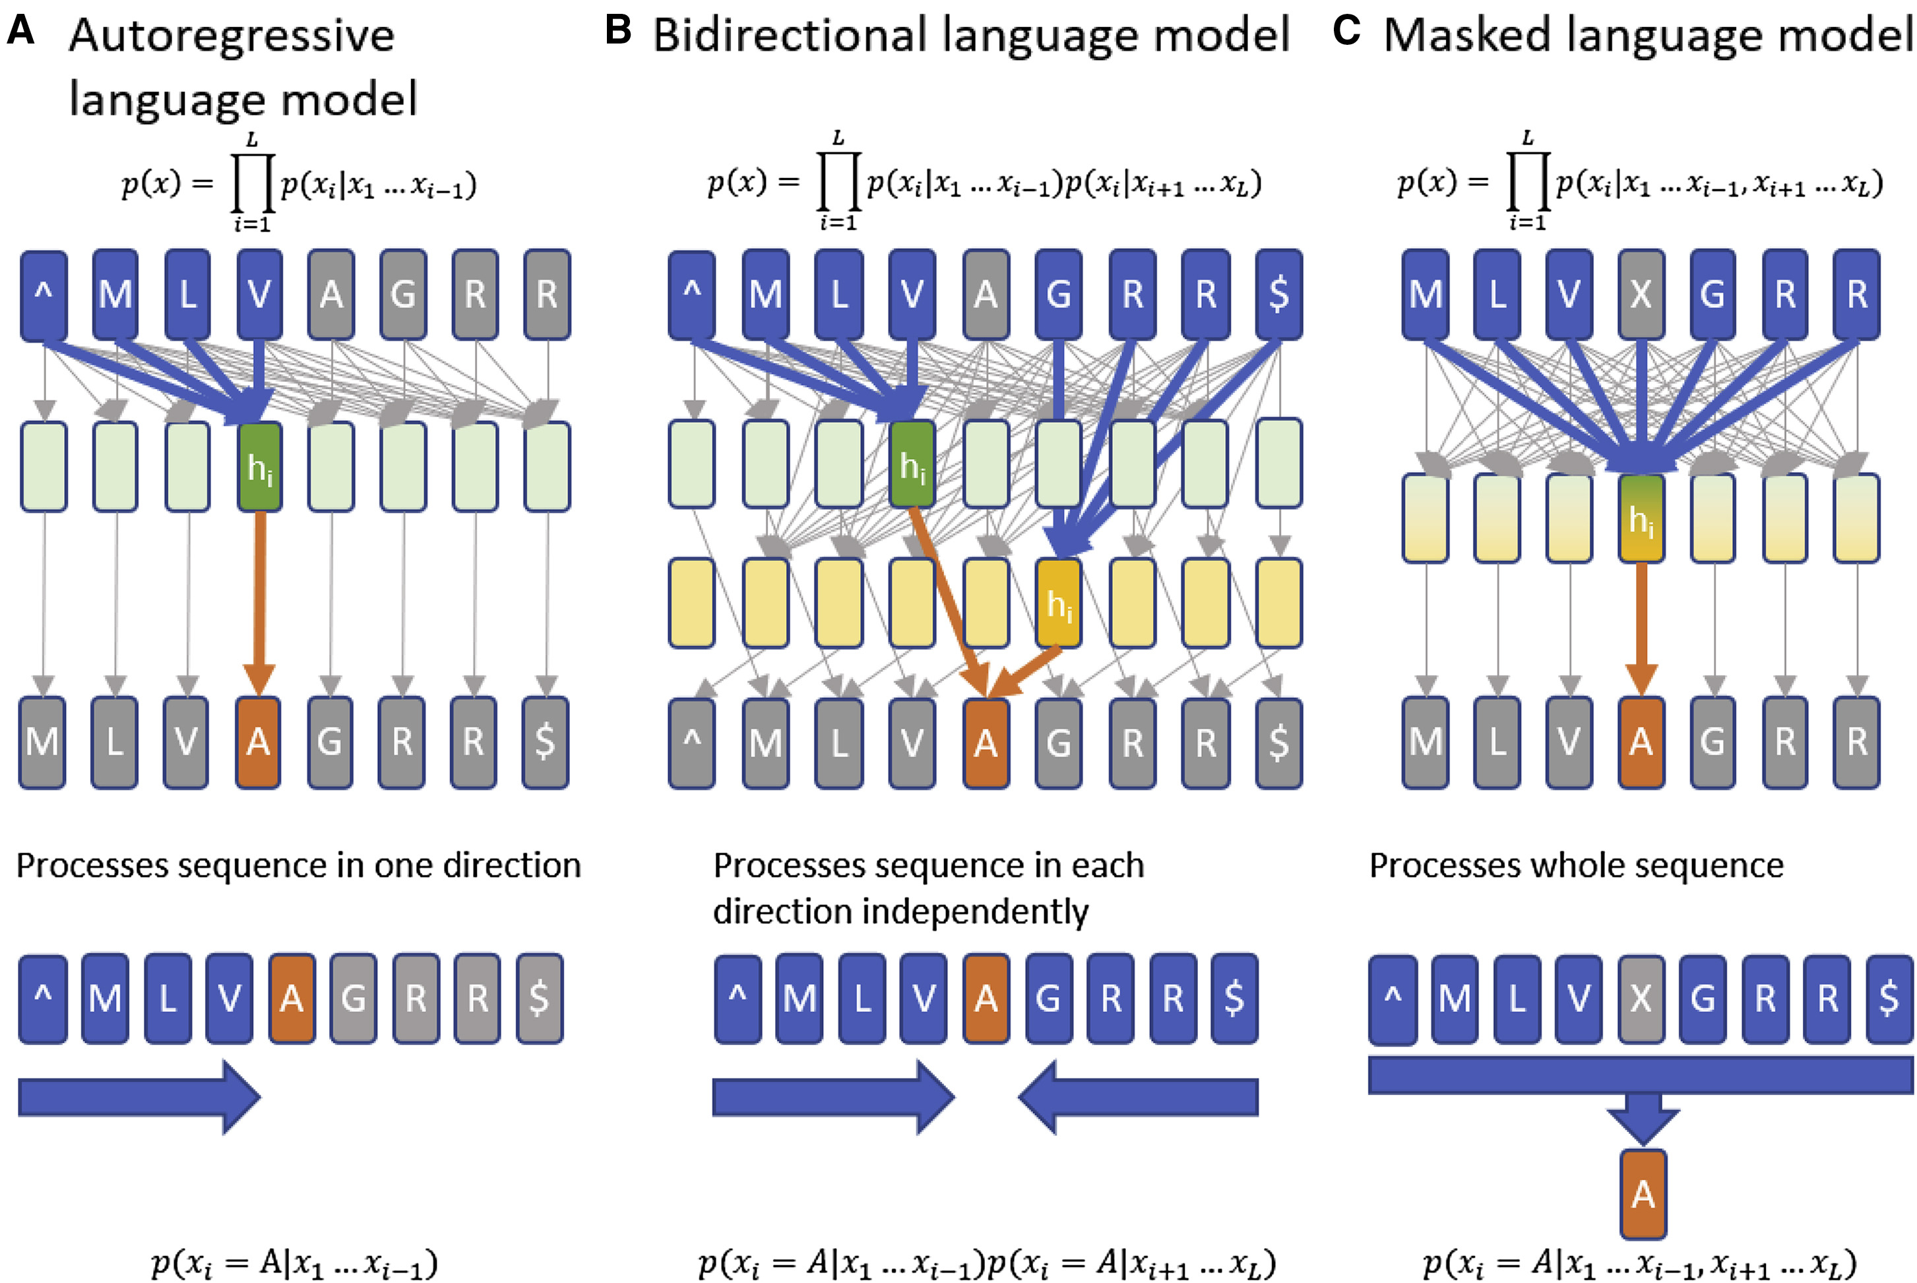
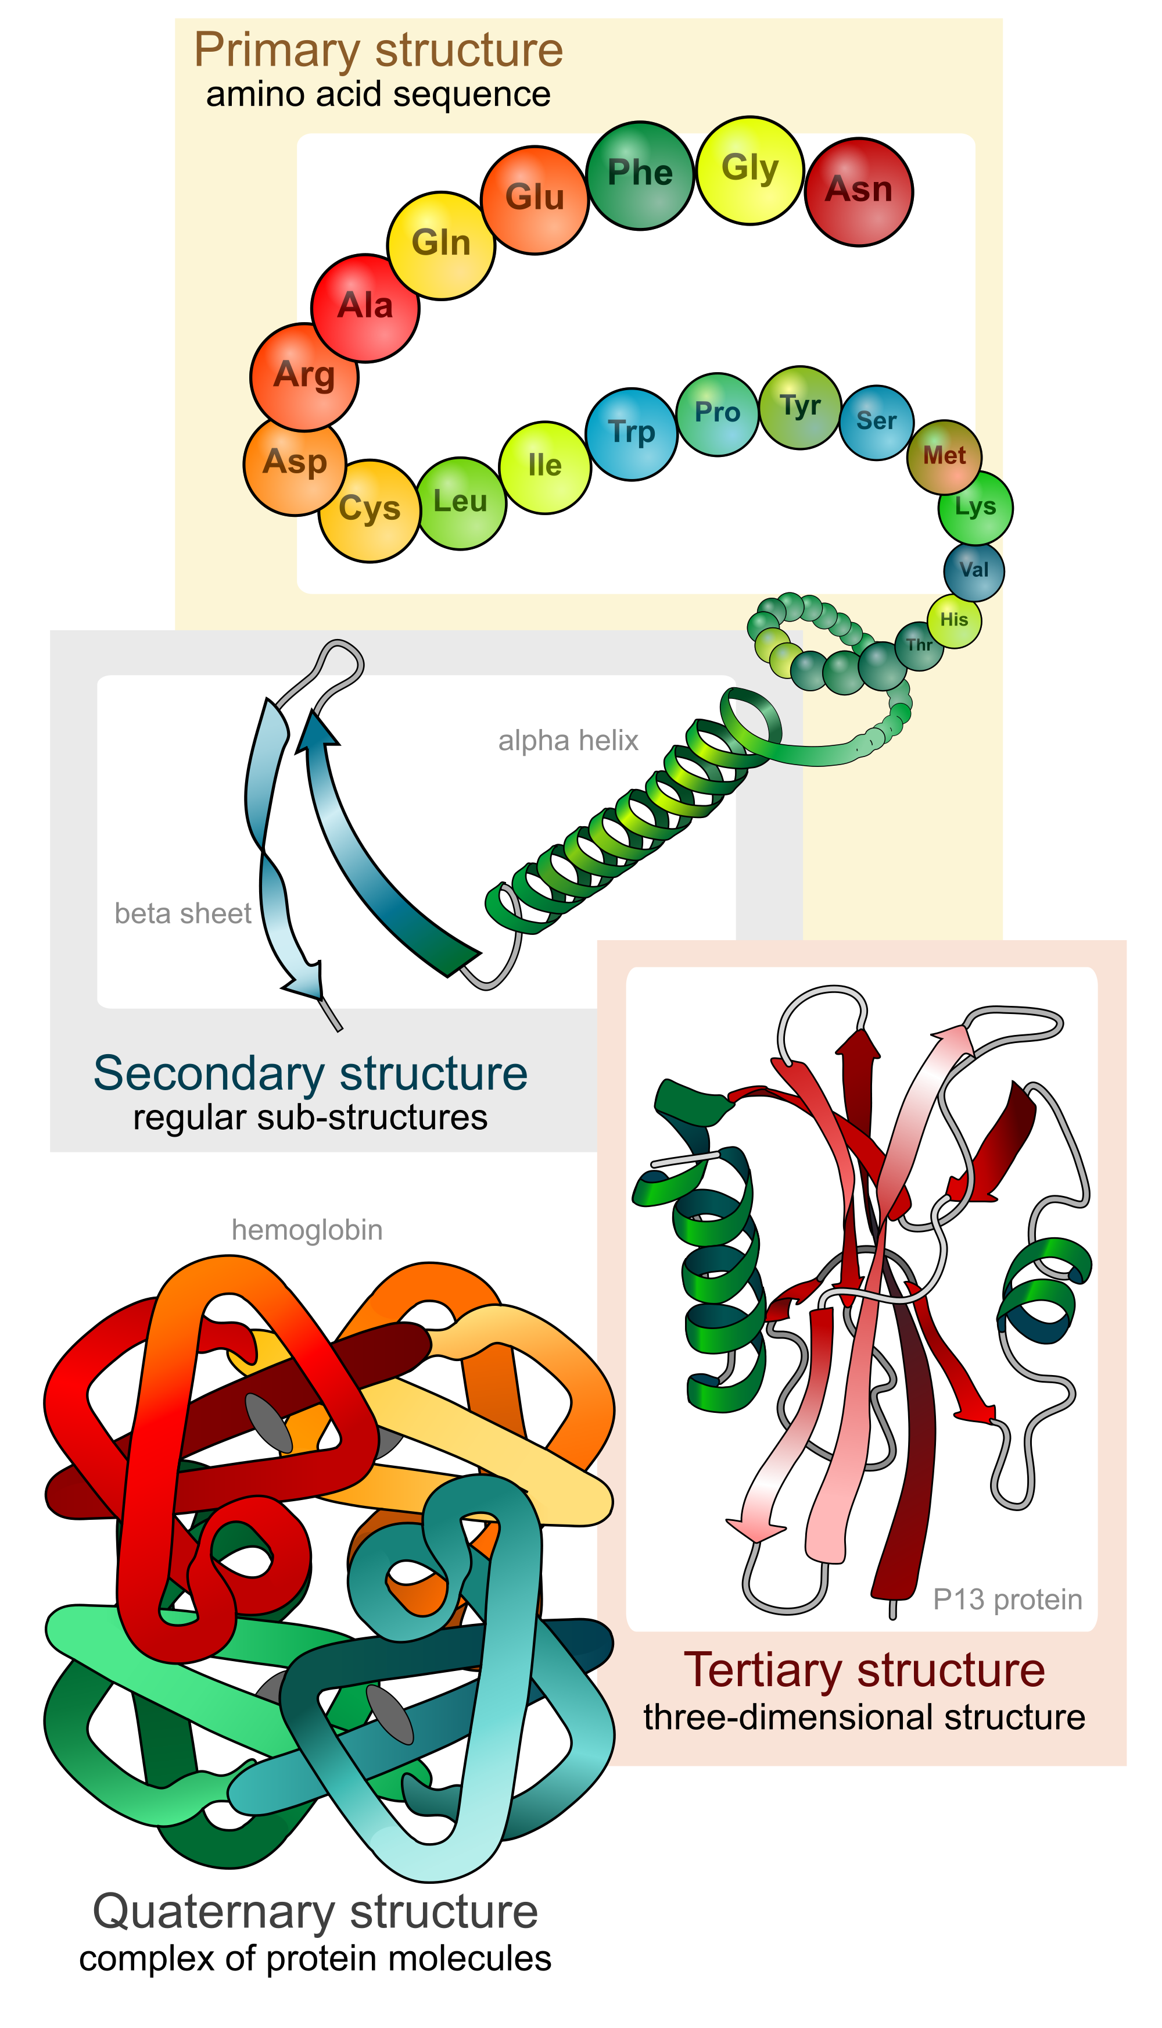

New Tools for Zero-Shot Variant Effect Prediction
Recent developments in natural language processing, especially Transformers since 2018, have rippled into modeling “the protein language”
Function
reflect
Evolution
…
Protein Sequences
(Bepler and Berger 2021)
Created for CAGI 6
genomeinterpretation.org
Sun & Shen

Slide 10
New Tools for Zero-Shot Variant Effect Prediction
Recent developments in natural language processing, especially Transformers since 2018, have rippled into modeling “the protein language”
Model name | Dataset | Dataset Size | Model Size (# param) | Model type
UniRep | UniRef50 | 24M seqs | 18M | multiplicative LSTM
TAPE | Pfam | 32M seqs | 38M | Transformer encoder
ESM-1b | UniRef50/S 2018_03 | 27M seqs | 650M | Transformer encoder
Created for CAGI 6
genomeinterpretation.org
Sun & Shen

Slide 11
New Tools for Zero-Shot Variant Effect Prediction
Recent developments in natural language processing, especially Transformers since 2018, have rippled into modeling “the protein language”
Model name | Dataset | Dataset Size | Model Size (# param) | Model type
UniRep | UniRef50 | 24M seqs | 18M | multiplicative LSTM
TAPE | Pfam | 32M seqs | 38M | Transformer encoder
ESM-1b | UniRef50/S 2018_03 | 27M seqs | 650M | Transformer encoder
Our models | Pfam_rp15 Pfam_rp75 (v32) | 12M seqs 68M seqs | B1:92M, B2:50M, B3:36M, B4:23M | Transformer encoder
Created for CAGI 6
genomeinterpretation.org
Sun & Shen

Slide 12
Sequence-Based Data-Driven Protocol
Pretrain bidirectional transformer encoder (BERT) with pfam representative proteome domain sequence data (at 15% and 75% level)
  Masked residue prediction as the self-supervision task.
Finetune the model for each protein with its family sequences of pfam_uniprotKB with the same task.
  To reduce the impact of sample bias, we weigh each sequence according to its identity to others.
Var
log
(Calmodulin, HMBS, STK11, MTFHR)
WT
Created for CAGI 6
genomeinterpretation.org
Sun & Shen

Slide 13
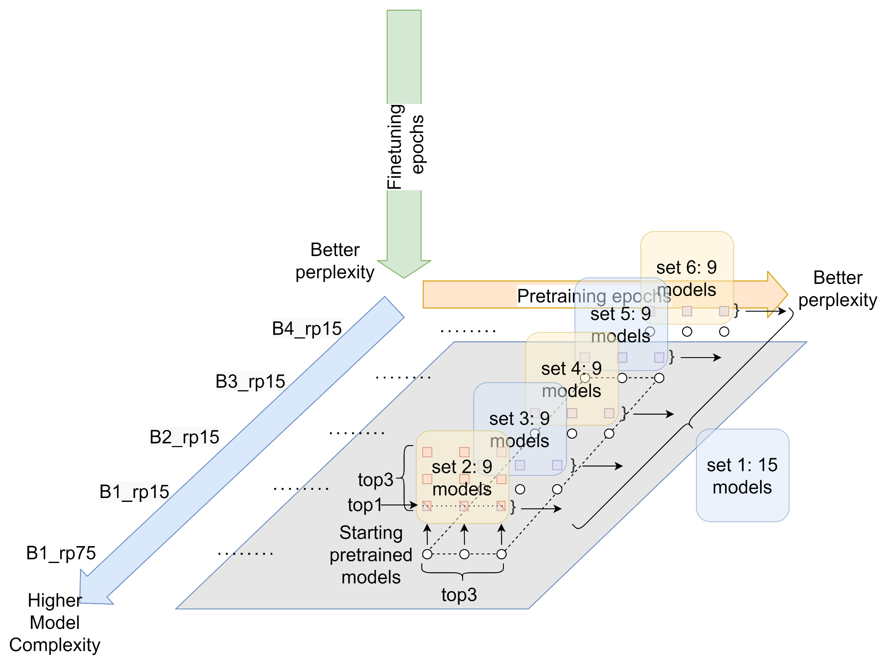
Ensemble Models for Various Prediction Sets
Created for CAGI 6
genomeinterpretation.org
Sun & Shen

Slide 14
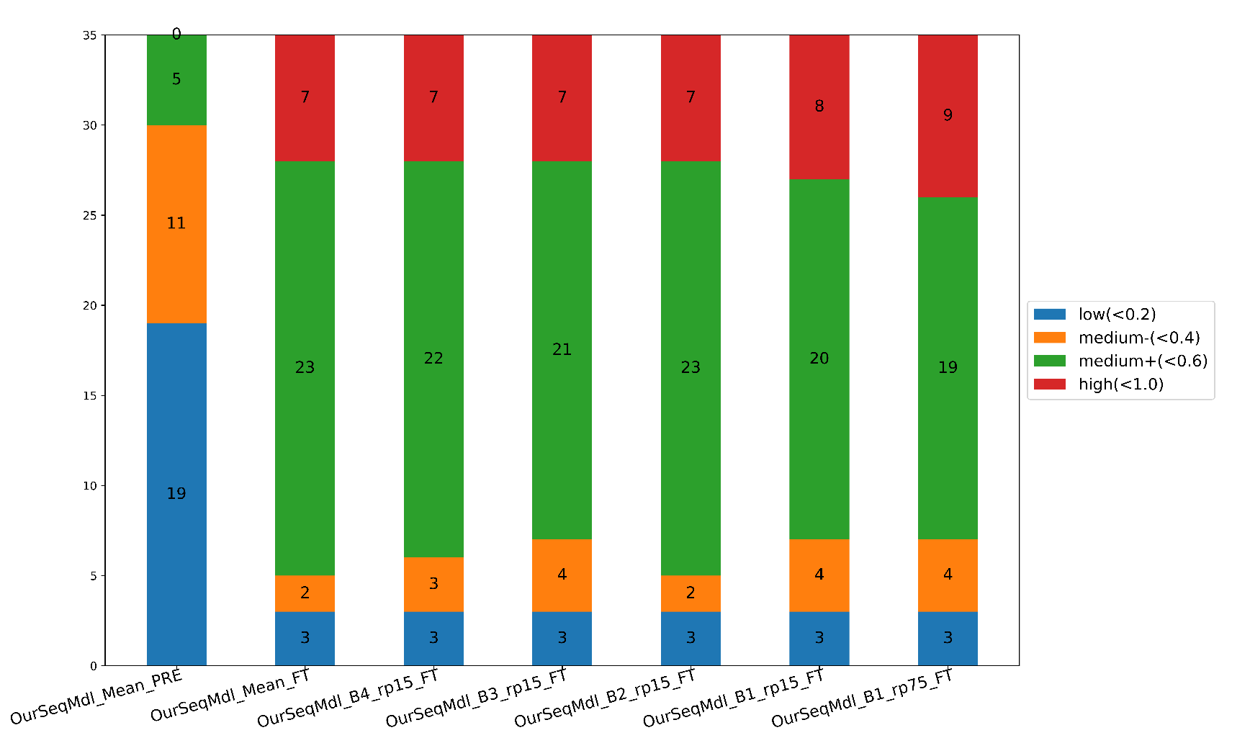
Family-Specific Finetune Boosts Fitness Prediction
(35 benchmark datasets)
Created for CAGI 6
genomeinterpretation.org
Sun & Shen

Slide 15
Impact of Model Size & Pretraining Data Size
(35 benchmark datasets)
Created for CAGI 6
genomeinterpretation.org
Sun & Shen

Slide 16
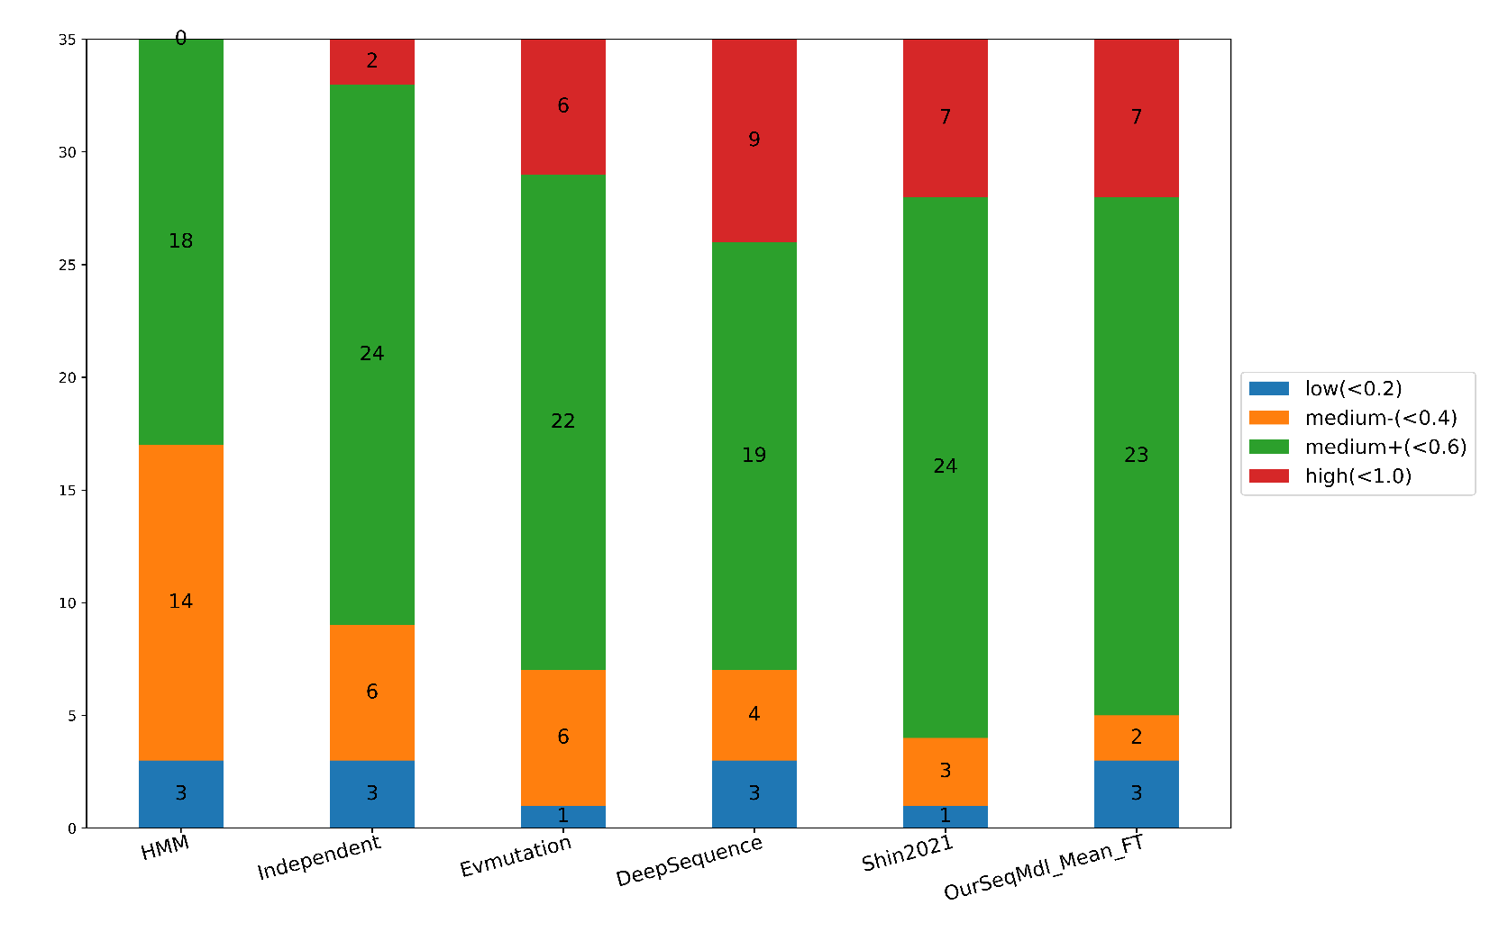
Comparison to Other “Zero-Shot” Models
(35 benchmark datasets)
Created for CAGI 6
genomeinterpretation.org
Sun & Shen

Slide 17
What Could Be Improved?
Few-shot learning
  Use labels of CaM homologs / WT
Beyond amino-acid sequences
  Use structures
…
Created for CAGI 6
genomeinterpretation.org
Sun & Shen

Slide 18



Acknowledgement
Group Members: Yuanfei Sun, Shaowen Zhu, Yuning You, Rujie Yin, Wuwei Tan …
Ph.D. student and postdoc openings
https://shen-lab.github.io
Created for CAGI 6
genomeinterpretation.org
Sun & Shen

