Slide 1

CAGI slide pack guidelines
I agree to my slides being used according to the following terms:
_______Jules Jacobsen & Damian Smedley_______
Authors: please include THIS slide at the beginning of your presentation to indicate that you agree with reuse of your slides in CAGI presentations, according to the terms below, and digitally sign by writing your name above.
To disseminate the CAGI results, I encourage all CAGI participants to remix these CAGI slides for inclusion in their oral and poster presentations
CAGI participants may use or publish any content of these slides only in compliance with the CAGI Data Use Agreement
CAGI participants may not cite or publish any content of these slides except with the written permission of the originating author or in the primary CAGI publications
CAGI participants must acknowledge the original authors of these slides and CAGI 6. Include the acknowledgement banner across the bottom
CAGI participants must include the CAGI credits slide in their presentations
Slides with a red slash (no remix) may not be included in a presentation unless all attendees are registered CAGI participants who signed the data use agreement
Slides with a red X over the entire slide may not be used in any circumstances
Slides with a blue slash (embargoed) may not be used unless the embargo is explicitly lifted
Slides without slash or X may be tweeted unless flagged with the “No tweet” icon.
CAGI participants using these slides must explain the “No tweet” icon, which means that the slide content should not be disseminated outside the presenting conference hall. If the presentation venue permits pervasive tweeting, you may not include these slides in your talk
Note for slide authors: we expect all CAGI participants to abide by these restrictions, and will make best effort to ensure they are followed. However, but bear in mind that we have limited means of enforcing them, and therefore the restrictions cannot be guaranteed.

Slide 2
Permission request regarding CAGI 6 recordings and hybrid presentations
I understand that my presentation as associated with CAGI 6 will be recorded and broadcasted via the internet through CAGI’s designated technology provider.
As the copyright holder to this presentation entitled “Exomiser - Phenotype-driven genome analysis for rare disease diagnosis and discovery”, I hereby agree that the copyright for the online broadcast and recording of my presentation be released to CAGI and my recording be uploaded on to the CAGI website.

Slide 3

Phenotype-driven genome analysis for rare disease diagnosis and discovery
Jules Jacobsen & Damian Smedley
CAGI6-RGP 2022-05-15

Slide 4


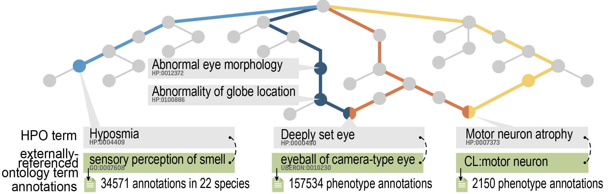
Human Phenotype Ontology

Slide 5
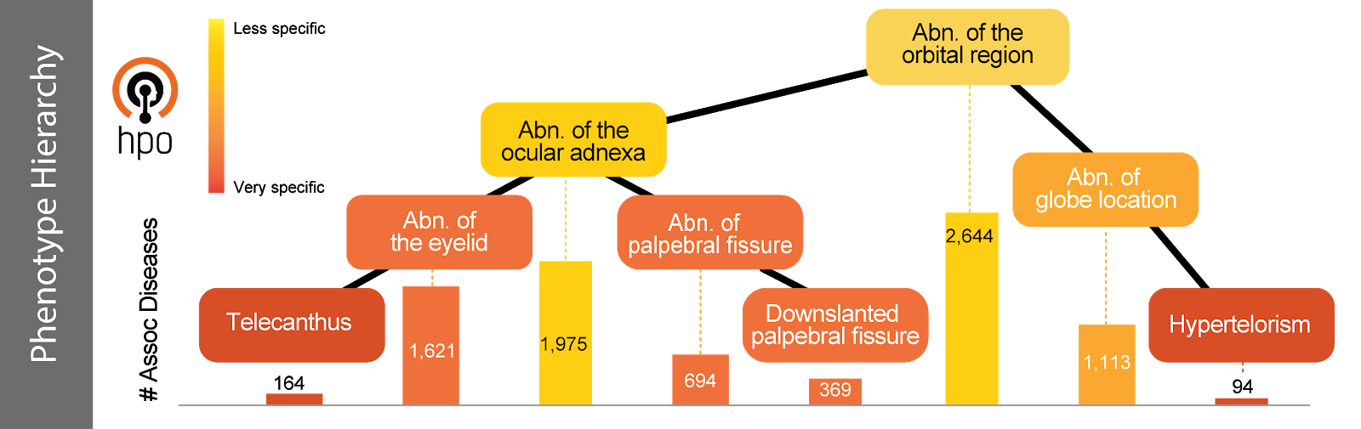
HPO Disease phenotype annotations

Slide 6
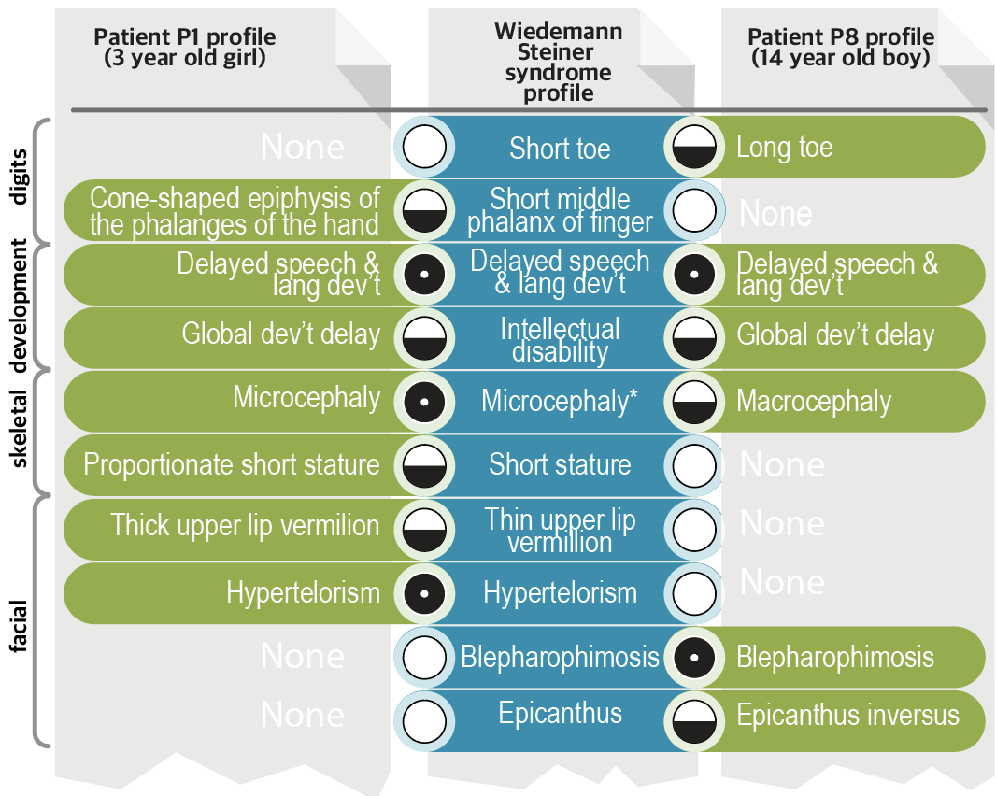
‘Fuzzy’ phenotype matching example

Slide 7
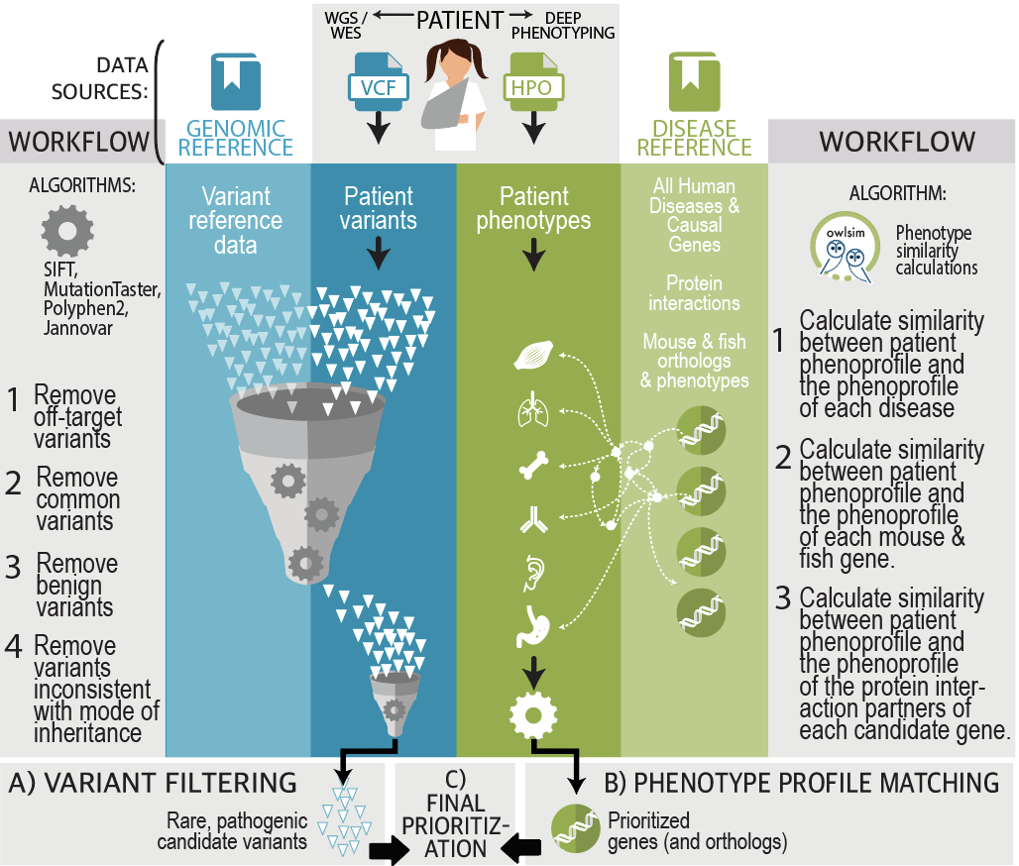
Exomiser Overview
Contains tools for:
Variant filtering
Gene filtering
Phenotype-profile matching
Variant, gene and phenotype scores from these are combined to produce final Exomiser combined score used for ranking the results.

Slide 8
CAGI6 RGP Exomiser Setup
Exomiser 13.0.0 (latest-release)
Latest data release at the time: 2109 (Sep 2021)
‘Local’ allele frequency file created from non-training data where AC > 1 (N = 86)
All samples run through 5 Exomiser models, submitted max top 100 variants with scores > 0.2 per case (not all models returned results for all cases)

Slide 9
CAGI6 RGP Exomiser Model Settings
Model | Rare | Pathogenic | Segregates | Protein-coding | Non-coding | PASS | Human only | All models | Incomplete penetrance
1 (Exomiser)
2
3
4
5 (Genomiser)

Slide 10
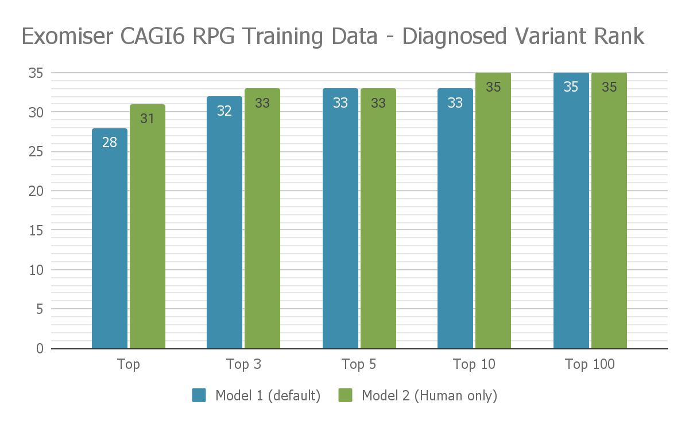
CAGI6 RGP Exomiser Training Performance

Slide 11
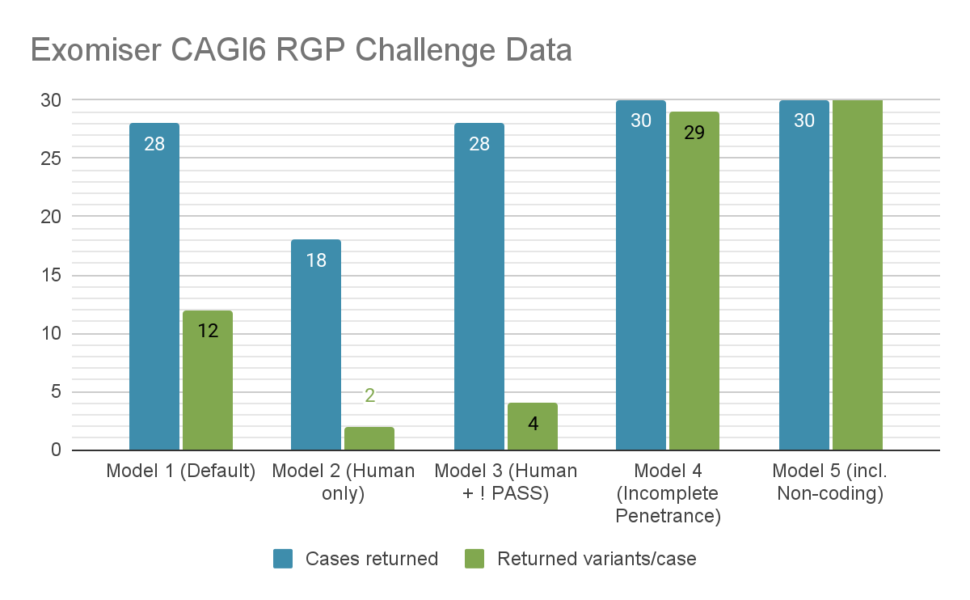
CAGI6 RGP Exomiser Prediction Data

Slide 12





Team Exomiser - Acknowledgements
Damian Smedley, Jules Jacobsen, Valentina Cipriani, Letizia Vestito - Queen Mary University of London
Peter Robinson, Daniel Danis - Jackson Lab
Chris Mungall - LBNL
Melissa Haendel - University of Colorado
Funding
NIH Office of the Director Grant 5R24OD011883
NIH-UDP: HHSN268201300036C, HHSN268201400093P, NCI/Leidos #15X143
National Institute of Child Health and Human Development of the NIH 1R01HD103805-01

Slide 13
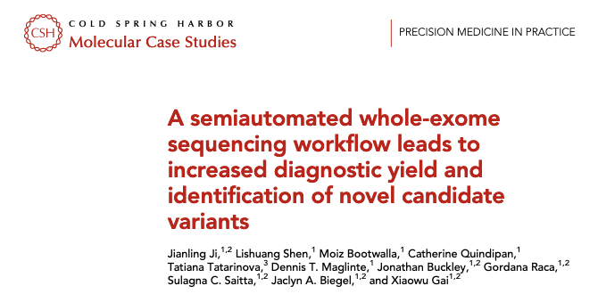
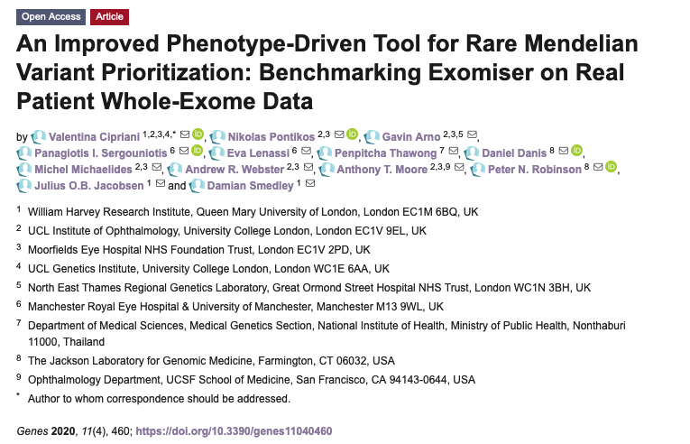
Confirmation in a clinical diagnostic setting
WES diagnostic workflow, incorporating DRAGEN pipeline and Exomiser at the Children's Hospital, Los Angeles - report on 106 cases.
Enabled them to diagnose 28% of singletons and 41% of duo or larger families with many results returned within a week
Exomiser ranked 72 % of diagnoses as the top candidate and 93% in top 6
Four diagnoses originally prioritised by Exomiser despite lack of a published disease association at the time. Confirming publications appeared shortly after.
134 whole-exomes from patients with a range of rare retinal diseases and known molecular diagnosis.
Diagnoses were the top candidate in 74% of cases and top 5 in 94%

Slide 14
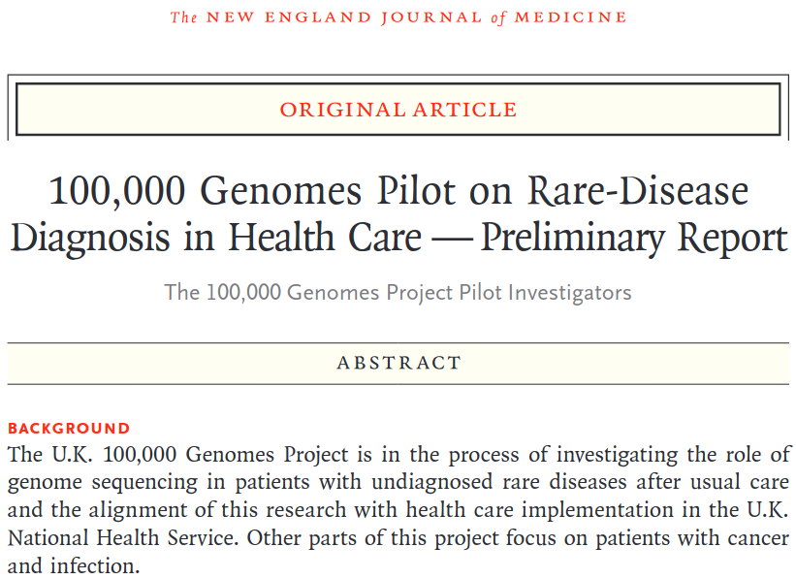
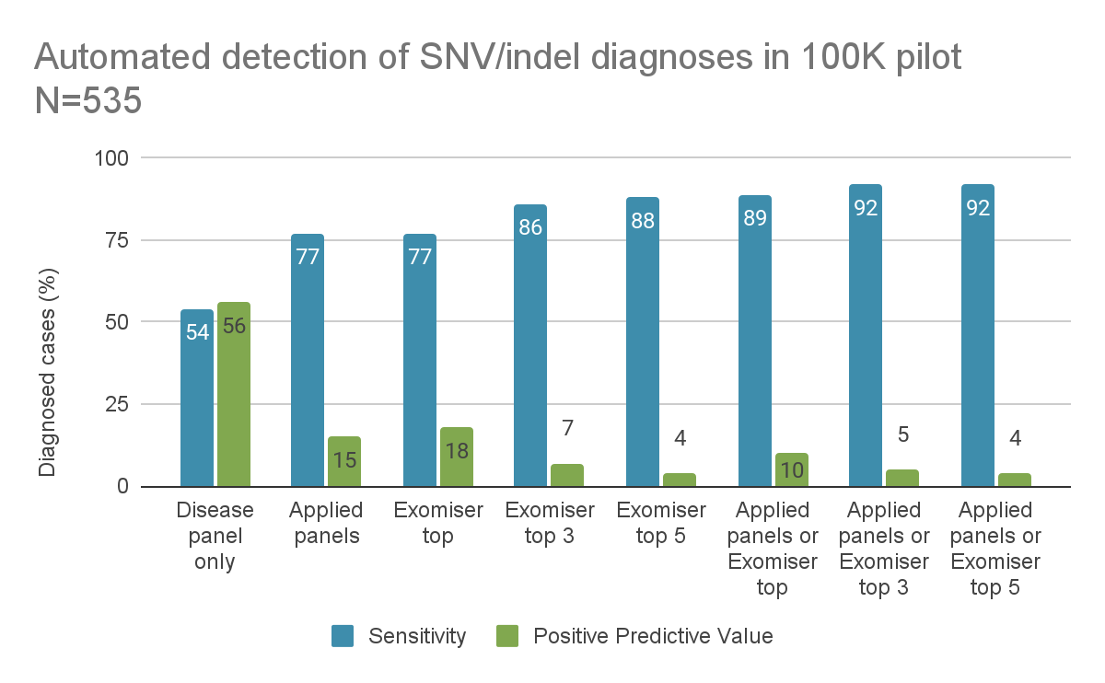
Confirmation in a clinical diagnostic setting
4660 participants (2183 probands, 2477 family members),
161 disorders across a broad spectrum of rare diseases
535 (25%) had positive reports from automated process (panels + Exomiser)

