Slide 1

CAGI slide pack guidelines
I agree to my slides being used according to the following terms:
___Emil Alexov_______
Authors: please include THIS slide at the beginning of your presentation to indicate that you agree with reuse of your slides in CAGI presentations, according to the terms below, and digitally sign by writing your name above.
To disseminate the CAGI results, I encourage all CAGI participants to remix these CAGI slides for inclusion in their oral and poster presentations
CAGI participants may use or publish any content of these slides only in compliance with the CAGI Data Use Agreement
CAGI participants may not cite or publish any content of these slides except with the written permission of the originating author or in the primary CAGI publications
CAGI participants must acknowledge the original authors of these slides and CAGI 6. Include the acknowledgement banner across the bottom
CAGI participants must include the CAGI credits slide in their presentations
Slides with a red slash (no remix) may not be included in a presentation unless all attendees are registered CAGI participants who signed the data use agreement
Slides with a red X over the entire slide may not be used in any circumstances
Slides with a blue slash (embargoed) may not be used unless the embargo is explicitly lifted
Slides without slash or X may be tweeted unless flagged with the “No tweet” icon.
CAGI participants using these slides must explain the “No tweet” icon, which means that the slide content should not be disseminated outside the presenting conference hall. If the presentation venue permits pervasive tweeting, you may not include these slides in your talk
Note for slide authors: we expect all CAGI participants to abide by these restrictions, and will make best effort to ensure they are followed. However, but bear in mind that we have limited means of enforcing them, and therefore the restrictions cannot be guaranteed.

Slide 2
Permission request regarding CAGI 6 recordings and hybrid presentations
I understand that my presentation as associated with CAGI 6 will be recorded and broadcasted via the internet through CAGI’s designated technology provider.
As the copyright holder to this presentation entitled “SAAFEC-SEQ: a sequence-based method for predicting folding free energy caused by mutation”, I hereby agree that the copyright for the online broadcast and recording of my presentation be released to CAGI and my recording be uploaded on to the CAGI website.

Slide 3
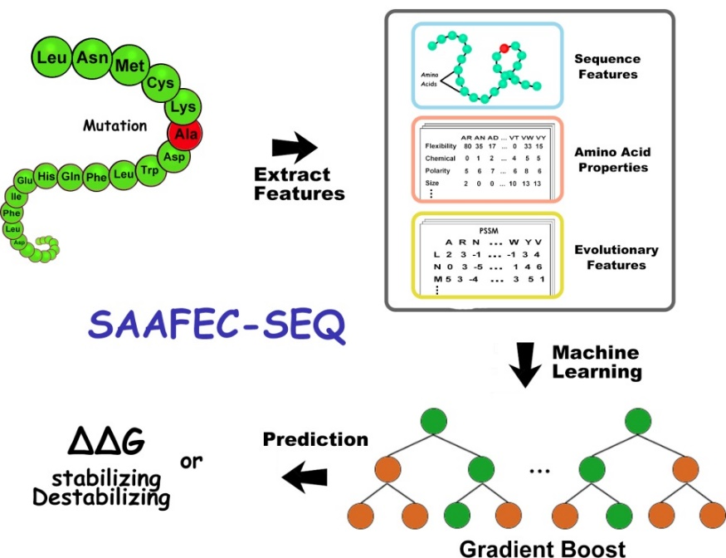
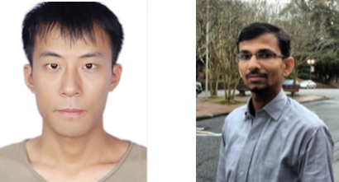
Single Amino Acid Folding free Energy Changes (SAAFEC) Predicting the Effect of Single Point Mutations on Protein Folding Free Energy Using a Knowledge-Modified MM/PBSA Approach
SAAFEC-SEQ: A Sequence-based Method for Predicting the Effect of Single Point Mutations on Protein Thermodynamic Stability
SAAFEC-SEQ uses gradient boosting decision tree repressor to encode physicochemical properties, sequence features and evolutionary information to compute the change in stability free energy resulting from single mutations.
SAAFEC-SEQ Technical points
Training Set | Protherm database 2648 single point mutations from 131 proteins
Input Features | physicochemical properties sequence evolutionary information
Method | Xgboost(GBDT)
Blind sets | S276, p53, PTEN and TPMT
Gen et al., Int J Mol Sci. 2021;22(2):606.
Dr. Gen Li
Dr. Shailesh Panday

Slide 4
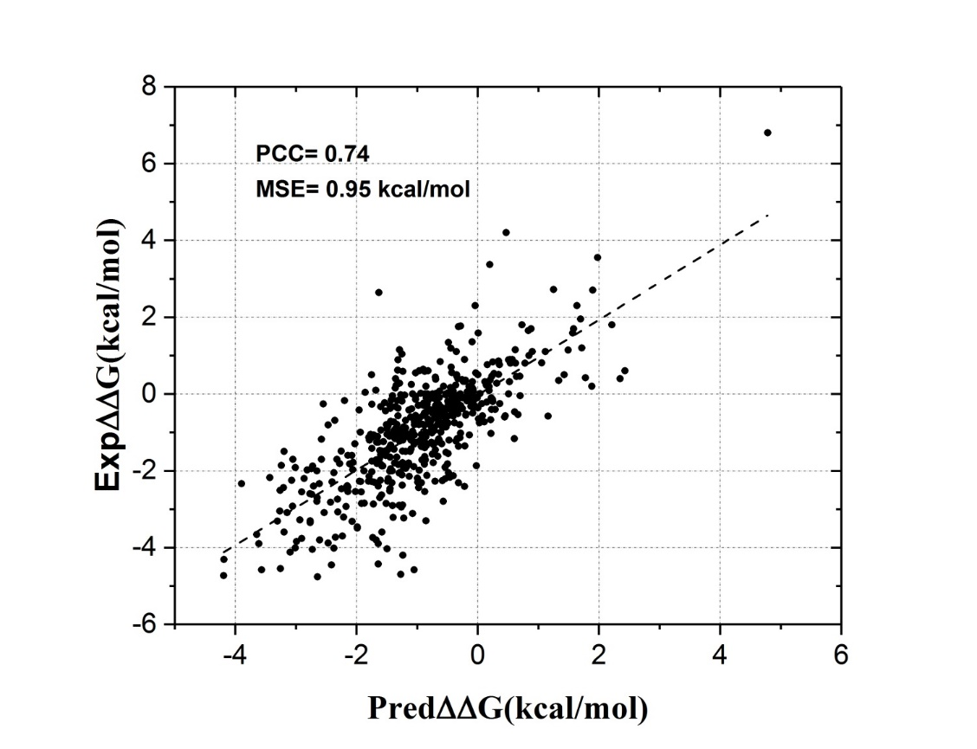
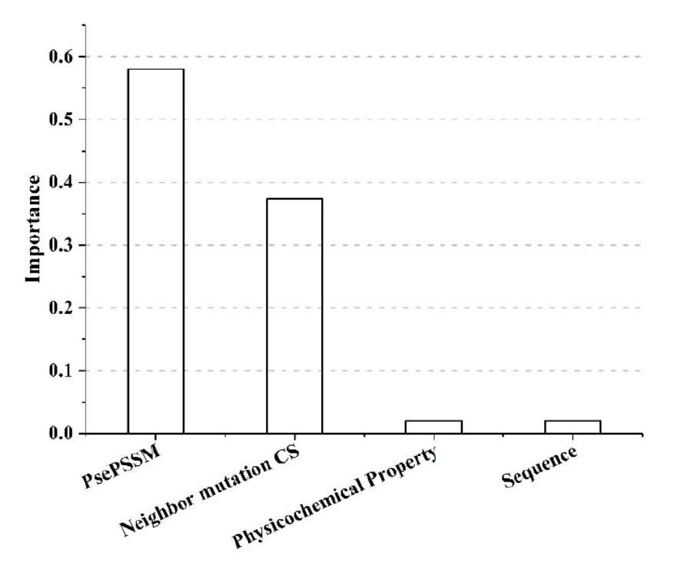
Performance of SAAFEC-SEQ on the training set
(left) SAAFEC-SEQ predicted ΔΔG against experimental ΔΔG in case of 20% of mutations as test set; (right) features importance.
Gen et al., Int J Mol Sci. 2021;22(2):606.

Slide 5
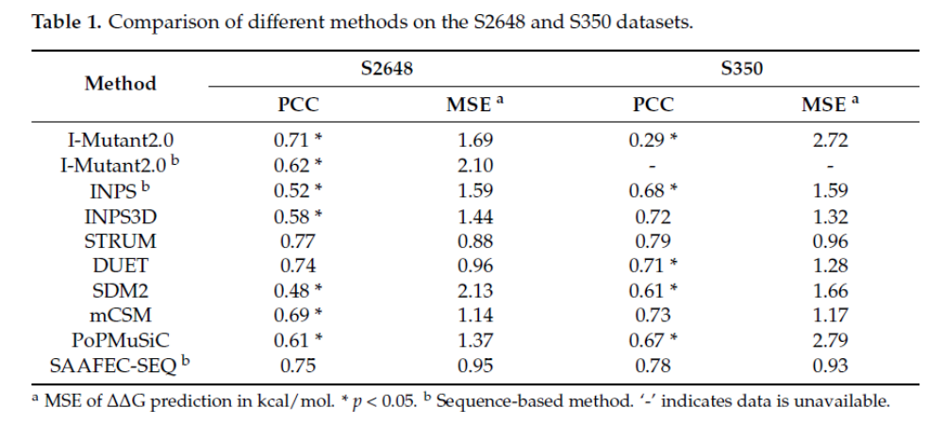
Performance comparison
The S350 dataset is a randomly selected subset from the S2648 dataset, which most of
the methods have used for benchmarking. We trained SAAFEC-SEQ on the 2298 DDGs (after removing S350 from S2648) and tested it on S350.
Furthermore, we randomly selected 20% of S2648 as testing set with sequence
identity <30% to any seq. in the training set – PCC=.66 and MSE = 1.34kcal/mol.

Slide 6
Comparison of different methods on the p53 and S276 datasets.
Method | p53 |  | S276
 | PCC | MSEª | PCC | MAEª
BoostDDG | 0.49 | 3.57 | 0.51 | 0.78
EASE-MM | 0.59 | 2.68 | 0.40 | 0.91
I-Mutant2.0 | 0.35 | 3.05 | 0.39 | 1.08
INPS | 0.69 | 2.29 | 0.47 | 0.89
STRUM | 0.47 | 3.29 | 0.45 | 0.88
SAAFEC-SEQ | 0.70 | 1.91 | 0.46 | 0.87
ªMSE/MAE of ΔΔG predictions in kcal/mol.
S276. This blind data set was collected from Cao’s et al. work [29], which includes 276 unique single point missense entries in 37 different proteins. None of them is in the training or validation set.
P53: mutations within the DNA binding domain of the tumor suppressor protein p53, which
thermodynamic effects have been experimentally determined [46–48]. As in the previous
case, none of them appeared in our training set.

Slide 7
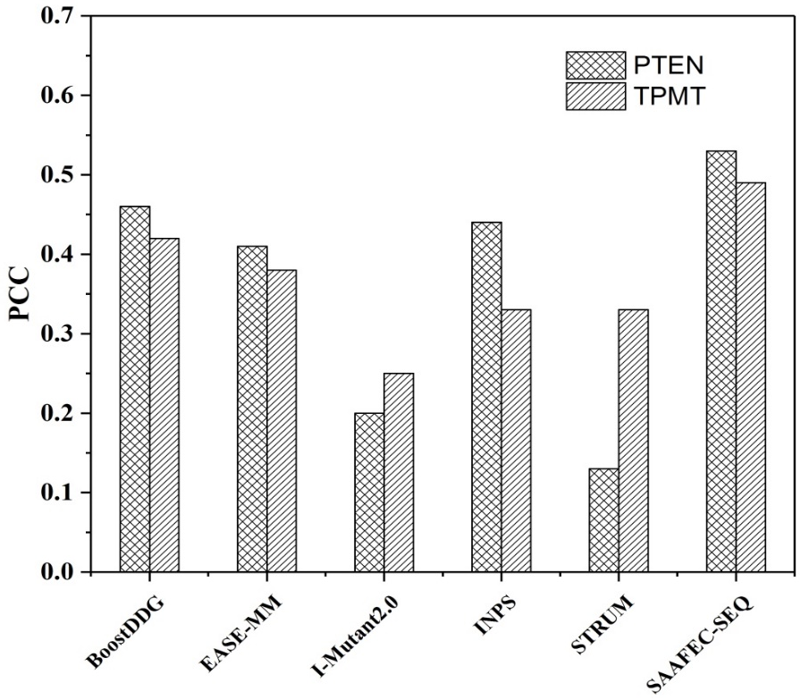
The performance of SAAFEC-SEQ and other methods on two proteins (CAGI sets: PTEM and TPMT) without 3D structure
Total of 7363
missense mutations: PTEN (3736)
and TPMT (3627).
Figure 2. Performance comparison of SAAFEC-SEQ with other existing sequence-based methods on PTEN and TPMT datasets.
The SAAFEC-SEQ has been implemented into a user-friendly webserver and a standalone code both are freely available at http://compbio.clemson.edu/SAAFEC-SEQ/index.php.
Gen et al., Int J Mol Sci. 2021;22(2):606.

Slide 8


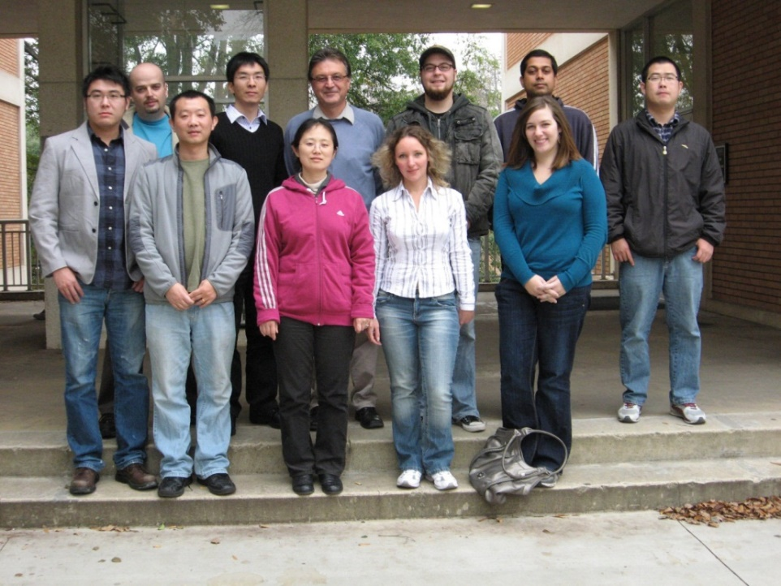
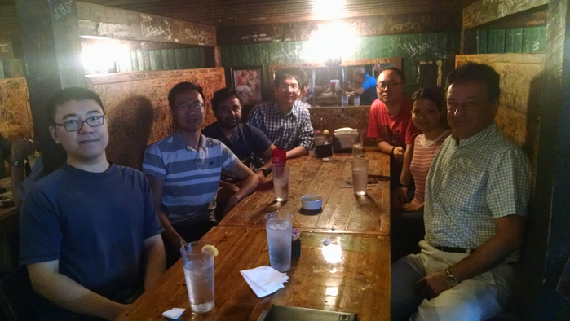
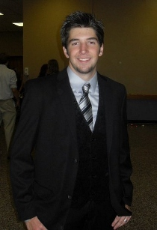
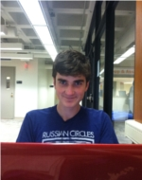
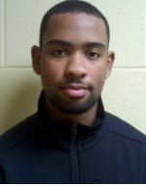
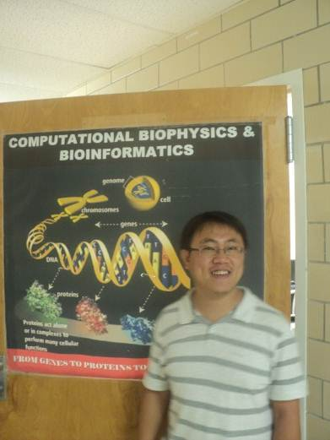
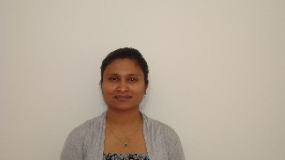

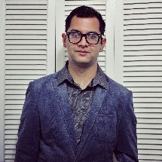


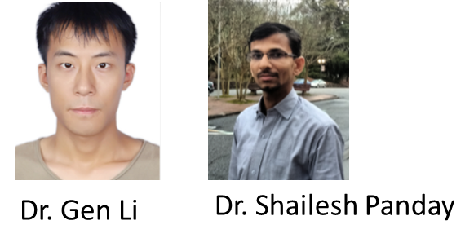

Acknowledgements
http://compbio.clemson.edu/
NSF

