Slide 1

CAGI slide pack guidelines
I agree to my slides being used according to the following terms:
_______Zhao Group_______
Authors: please include THIS slide at the beginning of your presentation to indicate that you agree with reuse of your slides in CAGI presentations, according to the terms below, and digitally sign by writing your name above.
To disseminate the CAGI results, I encourage all CAGI participants to remix these CAGI slides for inclusion in their oral and poster presentations
CAGI participants may use or publish any content of these slides only in compliance with the CAGI Data Use Agreement
CAGI participants may not cite or publish any content of these slides except with the written permission of the originating author or in the primary CAGI publications
CAGI participants must acknowledge the original authors of these slides and CAGI 6. Include the acknowledgement banner across the bottom
CAGI participants must include the CAGI credits slide in their presentations
Slides with a red slash (no remix) may not be included in a presentation unless all attendees are registered CAGI participants who signed the data use agreement
Slides with a red X over the entire slide may not be used in any circumstances
Slides with a blue slash (embargoed) may not be used unless the embargo is explicitly lifted
Slides without slash or X may be tweeted unless flagged with the “No tweet” icon.
CAGI participants using these slides must explain the “No tweet” icon, which means that the slide content should not be disseminated outside the presenting conference hall. If the presentation venue permits pervasive tweeting, you may not include these slides in your talk
Note for slide authors: we expect all CAGI participants to abide by these restrictions, and will make best effort to ensure they are followed. However, but bear in mind that we have limited means of enforcing them, and therefore the restrictions cannot be guaranteed.

Slide 2
Permission request regarding CAGI 6 recordings and hybrid presentations
I understand that my presentation as associated with CAGI 6 will be recorded and broadcasted via the internet through CAGI’s designated technology provider.
As the copyright holder to this presentation entitled “Zhao Group CAGI 6 PRS Challenge Result”, I hereby agree that the copyright for the online broadcast and recording of my presentation be released to CAGI and my recording be uploaded on to the CAGI website.

Slide 3
Zhao Group CAGI 6-PRS Challenge Result
Chi Zhang¹, Yixuan Ye², Geyu Zhou², Hongyu Zhao^{1,2,}*
1. Department of Biostatistics, Yale School of Public Health, CT, USA
2. Program of Computational Biology and Bioinformatics, Yale University, CT, USA
*Correspondence: hongyu.zhao@yale.edu
Created for CAGI 6
genomeinterpretation.org
Zhao group

Slide 4
Background
Outline
Results
PRS Models
Data Set
Created for CAGI 6
genomeinterpretation.org
Zhao group

Slide 5

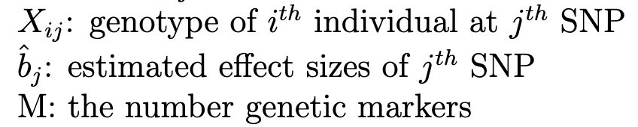
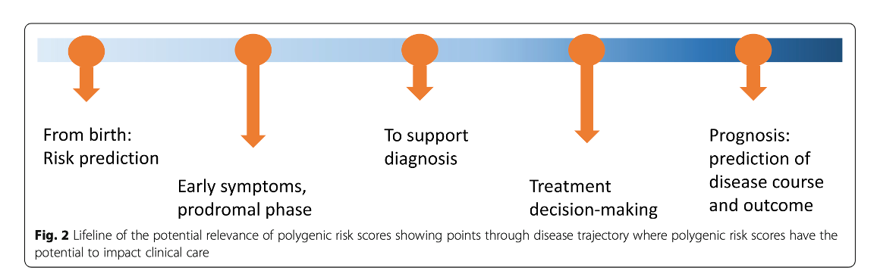
Background: PRS
Sum of the effects of genetic markers: measuring the genetic risk of a trait or a disorder
Created for CAGI 6
genomeinterpretation.org
Zhao group
Calthryn et al., 2020
Notes:
predicting an individual’s phenotype from genetic information
great promise for disease prevention, monitoring, and treatment.

Slide 6
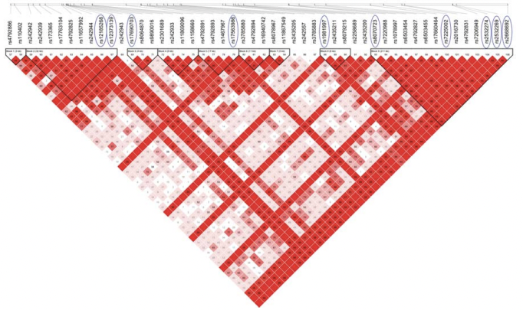
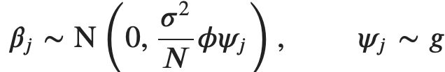
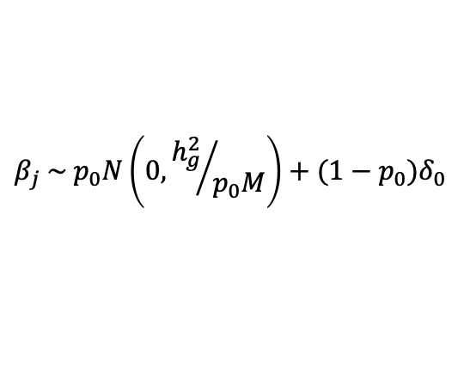
PRS Models Review
P+T
LD pruning and thresholding.
LDPred
$$β_{j} \sim p_{0}N\left(0, {h_{g}^{2}}/{p_{0}M}\right)+(1−p_{0})δ_{0}$$
$h_{g}^{2}$: heritability; $M$: total number of variants.
Linkage Disequilibrium (LD)
PRS-CS
ϕ : global scaling parameter that is shared across all effect sizes
ψ_{j} : local, marker-specific parameter
g : absolutely continuous mixing density function.
Created for CAGI 6
genomeinterpretation.org
Zhao group
Tian Ge et. , 2019 ; BJ Vilhjálmsso et. , 2015
Notes:
PRScs: It infers posterior SNP effect sizes from summary statistics using a continuous shrinkage prior. It has one hyper-parameter, the global shrinkage parameter, which models the overall sparseness of the genetic architecture. And the local, marker-specific parameter follows an absolutely continuous mixing density function.
Ldpred: LDpred assigns a point-normal prior to SNP effect sizes, where the proportion of causal variants is a tunable parameter.
AnnoPred:In the AnnoPred model, It incorporated annotations that covered a variety of genomic features.
Same as LDpred, it also assigns a point-normal prior to SNP effect size. It proposed two different priors for SNP effect sizes to add flexibility against different genetic architecture. n the first prior, they assumed the same proportion of causal SNPs but different effect sizes across annotation categories. In the second prior, they assumed different proportions of causal SNPs but the same effect size across annotation categories.

Slide 7
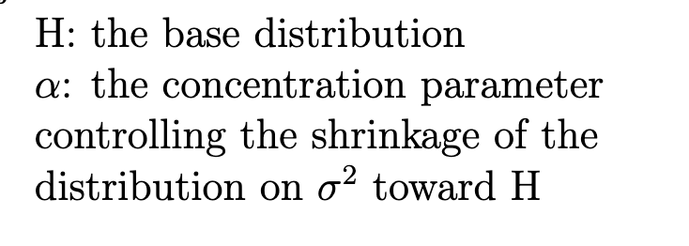

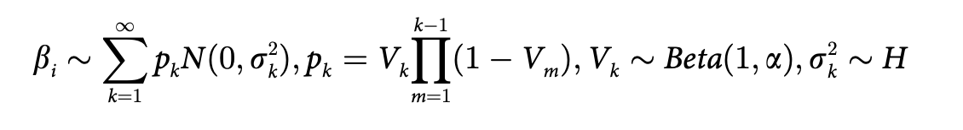



In-house PRS Models
SDPR
Dirichlet Process Prior :
The stick-breaking representation: infinite Gaussian mixture model
Created for CAGI 6
genomeinterpretation.org
Zhao group
Geyu Zhou et. , 2021
Notes:
Dirichlet process has several equivalent probabilistic representations,
The stick-breaking representation
the infinite Gaussian mixture model
learns the shape of the genetic contribution without making any explicit assumptions.
In practice, truncation needs to be applied so that the maximum number of components of the mixture model is finite. We found that setting the maximum components to 1000 was sufficient for our simulation and real data application
make explicit assumptions on the underlying genetic architecture and need a separate validation data set for parameter tuning
learns the shape of the genetic contribution without making any explicit assumptions.
refine the commonly used likelihood assumption to deal with the discrepancy between summary statistics and external reference panel
tilize functional annotation information to accurately estimate SNPs’ effect sizes.
an additive assumption for heritability in overlapped annotations
Based on per-SNP heritability estimates, we propose two different priors for SNP effect sizes to add flexibility against different genetic architecture.
For the first prior, we assume that SNP effect size follows a spike-and-slab distribution
per-SNP heritability from each annotation category

Slide 8
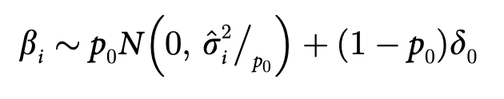
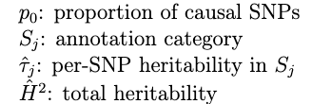


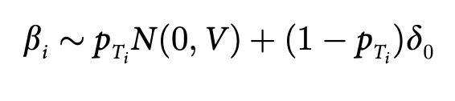
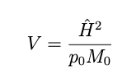
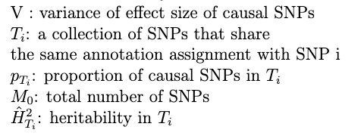
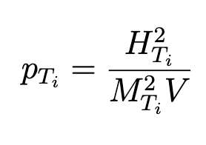


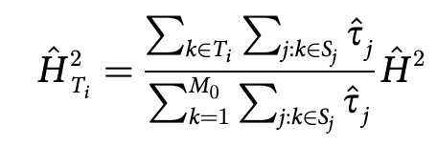
In-house PRS Models
AnnoPred
First prior: same proportion of causal SNPs; different effect sizes across annotation
Second prior: different proportion of causal SNPs; the same effect sizes across annotation
Created for CAGI 6
genomeinterpretation.org
Zhao group
Yiming Hu et. , 2017
Notes:
great variation in the genetic architecture underlying different complex traits, including the number of genetic variants involved and the distribution of the effect sizes of genetic variants
the wide diversity of genetic architecture across different traits
make explicit assumptions on the underlying genetic architecture and need a separate validation data set for parameter tuning
learns the shape of the genetic contribution without making any explicit assumptions.
refine the commonly used likelihood assumption to deal with the discrepancy between summary statistics and external reference panel
leverage the block structure of the reference linkage disequilibrium matrix for implementation of a parallel algorithm
adaptive to different genetic architectures, statistically robust, and computationally efficient.
tilize functional annotation information to accurately estimate SNPs’ effect sizes.
an additive assumption for heritability in overlapped annotations
Based on per-SNP heritability estimates, we propose two different priors for SNP effect sizes to add flexibility against different genetic architecture.
For the first prior, we assume that SNP effect size follows a spike-and-slab distribution
per-SNP heritability from each annotation category

Slide 9
Validation and Testing Dataset
502,618 Participants aged 40–69 years
226,522 excluded:
15,223 lack of genetic data
373 discordance between reported and genotype inferred sex
378 poor heterozygosity or missingness
471 sex chromosome aneuploidies
78,208 not of white British descent
131,869 with at least one relative identified
276,096 independent British participants
92,928 Validation set
183,168 Testing set
Created for CAGI 6
genomeinterpretation.org
Zhao group

Slide 10
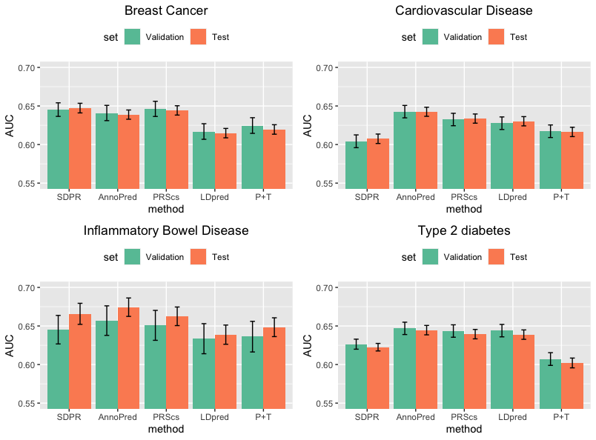
Results:
Created for CAGI 6
genomeinterpretation.org
Zhao group

Slide 11
Summary
      We proposed two in-house PRS frameworks: SDPR/AnnoPred
      The SDPR and AnnoPred codes are both available online:
        https://github.com/eldronzhou/SDPR
        https://github.com/yiminghu/AnnoPred
      Our AnnoPred PRS weights for CAD and T2D are available in PGS Catalog: PGP000252.
Relevant papers from Zhao group: Hu et al., 2017; Zhou et al., 2021; Ye et al., 2021
Created for CAGI 6
genomeinterpretation.org
Zhao group

Slide 12
Acknowledge
- PI: Dr. Hongyu Zhao
- Co-authors: Dr. Yixuan Ye, Dr. Geyu Zhou, Dr. Yiming Hu
- CAGI6 organizers:
Created for CAGI 6
genomeinterpretation.org
Zhao group

Slide 13
Supplementary Tables:
Performance of PRS by different methods for BC
Method | AUC | AUC_LL | AUC_UL | Parameters | Dataset
SDPR | 0.6453 | 0.6365 | 0.6541 | - | Validation set
AnnoPred | 0.6409 | 0.6310 | 0.6508 | Tier1, pT, p=0.03 | Validation set
Ldpred | 0.6169 | 0.6068 | 0.6270 | p=0.1 | Validation set
P+T | 0.6246 | 0.6145 | 0.6348 | r2=0.3, p=5e-04 | Validation set
PRScs | 0.6463 | 0.6364 | 0.6561 | - | Validation set
SDPR | 0.6473 | 0.6410 | 0.6536 | - | Testing set
AnnoPred | 0.6388 | 0.6328 | 0.6448 | Tier1, pT, p=0.03 | Testing set
Ldpred | 0.6148 | 0.6087 | 0.6209 | p=0.1 | Testing set
P+T | 0.6195 | 0.6134 | 0.6257 | r2=0.3, p=5e-04 | Testing set
PRScs | 0.6443 | 0.6382 | 0.6503 | - | Testing set
Created for CAGI 6
genomeinterpretation.org
Zhao group

Slide 14
Supplementary Tables:
Performance of PRS by different methods for CAD
Method | AUC | AUC_LL | AUC_UL | Parameters | Dataset
SDPR | 0.6042 | 0.5960 | 0.6125 | - | Validation set
AnnoPred | 0.6427 | 0.6346 | 0.6507 | Tier2, pT, p=0.003 | Validation set
Ldpred | 0.6277 | 0.6195 | 0.6358 | p=0.001 | Validation set
P+T | 0.6173 | 0.6091 | 0.6254 | r2=0.8, p=0.05 | Validation set
PRScs | 0.6324 | 0.6244 | 0.6405 | - | Validation set
SDPR | 0.6075 | 0.6014 | 0.6136 | - | Testing set
AnnoPred | 0.6425 | 0.6366 | 0.6484 | Tier2, pT, p=0.003 | Testing set
Ldpred | 0.6302 | 0.6242 | 0.6362 | p=0.001 | Testing set
P+T | 0.6163 | 0.6103 | 0.6224 | r2=0.8, p=0.05 | Testing set
PRScs | 0.6336 | 0.6277 | 0.6396 | - | Testing set
Created for CAGI 6
genomeinterpretation.org
Zhao group

Slide 15
Supplementary Tables:
Performance of PRS by different methods for IBD
Method | AUC | AUC_LL | AUC_UL | Parameters | Dataset
SDPR | 0.6452 | 0.6267 | 0.6637 | - | Validation set
AnnoPred | 0.6570 | 0.6378 | 0.6761 | Tier3, pT, p=0.003 | Validation set
Ldpred | 0.6335 | 0.6140 | 0.6530 | p=0.01 | Validation set
P+T | 0.6362 | 0.6163 | 0.6560 | r2=0.2, p=5e-04 | Validation set
PRScs | 0.6508 | 0.6314 | 0.6702 | - | Validation set
SDPR | 0.6658 | 0.6521 | 0.6794 | - | Testing set
AnnoPred | 0.6744 | 0.6624 | 0.6863 | Tier3, pT, p=0.003 | Testing set
Ldpred | 0.6388 | 0.6263 | 0.6512 | p=0.01 | Testing set
P+T | 0.6484 | 0.6362 | 0.6606 | r2=0.2, p=5e-04 | Testing set
PRScs | 0.6626 | 0.6505 | 0.6746 | - | Testing set
Created for CAGI 6
genomeinterpretation.org
Zhao group

Slide 16
Supplementary Tables:
Performance of PRS by different methods for T2D
Method | AUC | AUC_LL | AUC_UL | Parameters | Dataset
SDPR | 0.6264 | 0.6199 | 0.6329 | - | Validation set
AnnoPred | 0.6469 | 0.6389 | 0.6549 | Tier3, pT, p=0.003 | Validation set
Ldpred | 0.6439 | 0.6359 | 0.6520 | p=0.003 | Validation set
P+T | 0.6071 | 0.5989 | 0.6154 | r2=0.8, p=0.05 | Validation set
PRScs | 0.6435 | 0.6354 | 0.6515 | - | Validation set
SDPR | 0.6224 | 0.6176 | 0.6274 | - | Testing set
AnnoPred | 0.6446 | 0.6385 | 0.6507 | Tier3, pT, p=0.003 | Testing set
Ldpred | 0.6388 | 0.6327 | 0.6449 | p=0.003 | Testing set
P+T | 0.6020 | 0.5957 | 0.6084 | r2=0.8, p=0.05 | Testing set
PRScs | 0.6394 | 0.6333 | 0.6455 | - | Testing set
Created for CAGI 6
genomeinterpretation.org
Zhao group

