Slide 1

CAGI slide pack guidelines
I agree to my slides being used according to the following terms:
_______Yaqiong WANG_______
Authors: please include THIS slide at the beginning of your presentation to indicate that you agree with reuse of your slides in CAGI presentations, according to the terms below, and digitally sign by writing your name above.
To disseminate the CAGI results, I encourage all CAGI participants to remix these CAGI slides for inclusion in their oral and poster presentations
CAGI participants may use or publish any content of these slides only in compliance with the CAGI Data Use Agreement
CAGI participants may not cite or publish any content of these slides except with the written permission of the originating author or in the primary CAGI publications
CAGI participants must acknowledge the original authors of these slides and CAGI 6. Include the acknowledgement banner across the bottom
CAGI participants must include the CAGI credits slide in their presentations
Slides with a red slash (no remix) may not be included in a presentation unless all attendees are registered CAGI participants who signed the data use agreement
Slides with a red X over the entire slide may not be used in any circumstances
Slides with a blue slash (embargoed) may not be used unless the embargo is explicitly lifted
Slides without slash or X may be tweeted unless flagged with the “No tweet” icon.
CAGI participants using these slides must explain the “No tweet” icon, which means that the slide content should not be disseminated outside the presenting conference hall. If the presentation venue permits pervasive tweeting, you may not include these slides in your talk
Note for slide authors: we expect all CAGI participants to abide by these restrictions, and will make best effort to ensure they are followed. However, but bear in mind that we have limited means of enforcing them, and therefore the restrictions cannot be guaranteed.

Slide 2
Permission request regarding CAGI 6 recordings and hybrid presentations
I understand that my presentation as associated with CAGI 6 will be recorded and broadcasted via the internet through CAGI’s designated technology provider.
As the copyright holder to this presentation entitled Yaqiong Wang, I hereby agree that the copyright for the online broadcast and recording of my presentation be released to CAGI and my recording be uploaded on to the CAGI website.

Slide 3
Interpreting the functional impacts of splicing variants of genetics diseases
Yaqiong Wang
Children’s Hospital of Fudan University
2022/5/16

Slide 4
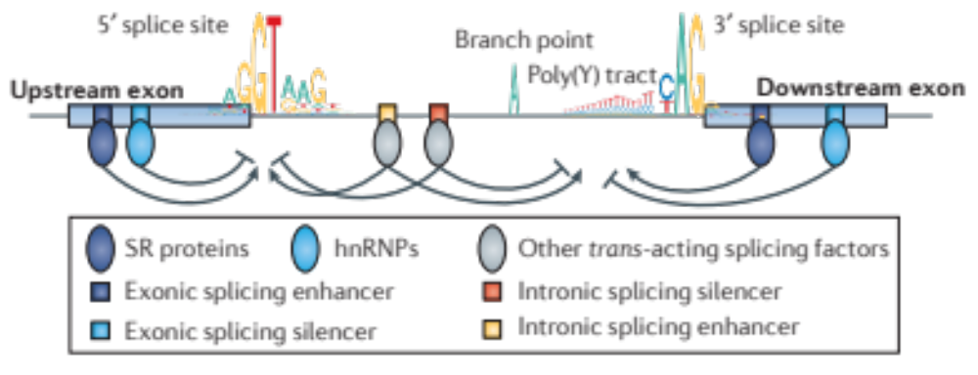
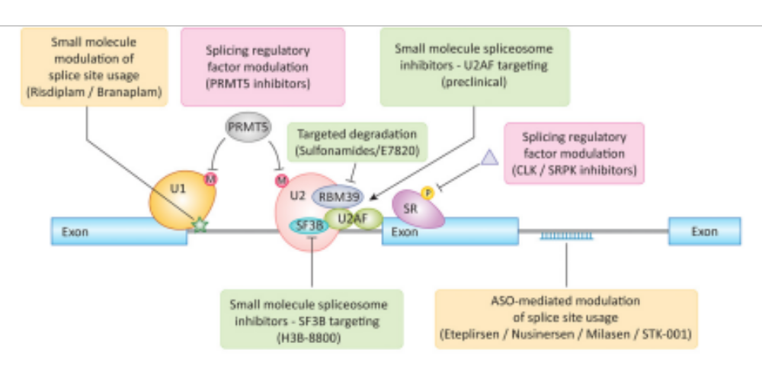
RNA splicing is a complex and precisely regulated process
Mutations
Dvinge et.al, Nat Rev Cancer. 2016; 16(7)
Diseases
Drugs
Trends in Pharmacological Sciences. 2022; 43(5)
Created for CAGI 6
genomeinterpretation.org
Yaqiong Wang
Notes:
Splicing of mRNA precursors is required for the maturation of almost all human mRNAs, and furthermore is a key step in the regulation of expression of many genes. Alternative splicing, whereby a pre-mRNA can be processed into different mature mRNAs via splice site selection, enables multiple potential protein products to be generated from a single gene and thereby expands the cellular proteome. RNA splicing is essential for processing pre-mRNA transcribed from the more than 90% of human protein-coding genes that contain more than one exon into mature mRNAs before translation into proteins13,14. Intron excision is facilitated by short sequence motifs in the pre-mRNA, in particular at boundaries between the upstream exon and intron (the 5′ splice site) and the intron and downstream exon (the 3′ splice site) (FIG. 1a). Although splicing itself is catalysed by RNA18, the proper recognition of splice sites relies on RNA–RNA, RNA– protein and protein–protein interactions.

Slide 5
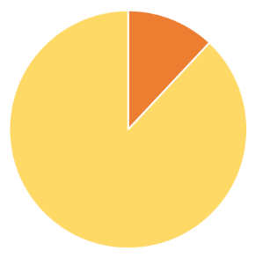
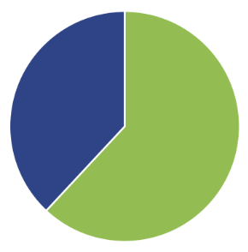
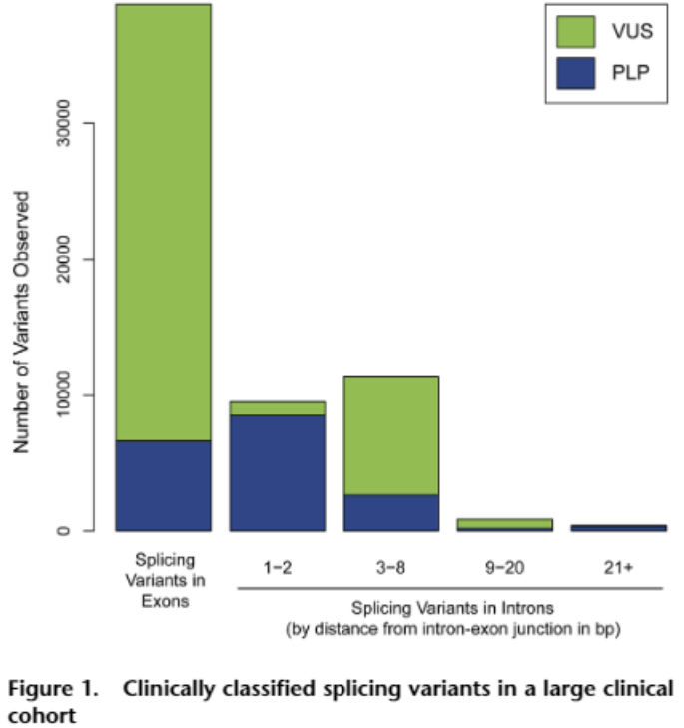
Impacts of most splicing variants are unknown
No Tweet
Experimental Assays
62%
VUS
RT-PCR
mini-gene report assay (2005)
RNA-seq
massively parallel reporter assays (MPRAs)
  MaPSy (2017)
  Vex-seq (2018)
12% splicing
ClinVar
P/LP/VUS variants
(N=378,468)
Computational Tools
MaxEnt (2004)
Human Splicing Finder (2009)
SPANR/SPIDEX (2014)
dbscSNV (2014)
HAL (2015)
Splice-AI (2019)
SCAP (2019)
MMSplice (2019)
MTSplice (2021)
CADD-splice (2021)
SQUARIL (2021)
...
52,047 patients, 22,344 splicing variants
Truty et al, Am J Hum Genet, 2021, 108, 696–708
Created for CAGI 6
genomeinterpretation.org
Yaqiong Wang

Slide 6
Model Design
Training dataset
No Tweet
Splicing Variants
Benign Variants
80 different features
Splicing predictions
SpliceAI, MMSplice, dbscSNV, SCAP, CADD
Regulatory sequences
RBP binding motifs, Branch-point site
Genetic context
Distance to acceptor/donor, GC content,
GpG content
Conservation
Phylop, PhCons, GERP, MAF
Chromosome modification
H3K4Me, H3K9Ac
Annotation (VEP)
Model1
Model2
Model3
Gradient Boosting (caret)
Validation dataset
Splicing Variants
Benign Variants
Assessment Metrics
ROC, Precision-recall curve
Testing dataset
Created for CAGI 6
genomeinterpretation.org
Yaqiong Wang

Slide 7
Distributions of splicing and control variants
No Tweet
Training dataset
8314 splicing variants
Danis et al, (2021)
control variants
ClinVar Benign/Likely Begin
Validation dataset
85 splicing variants
172 control variants
Wai et al, (2020)
Testing dataset
64 variants
Created for CAGI 6
genomeinterpretation.org
Yaqiong Wang
Notes:
To train a machine model to identify the variants that impact splicing, we used a large dataset with more than 8000 known splicing variants reported in the literatures and we also built a control dataset by using the high confidence benign or likely benign variants from ClinVar. The machine models were then validated on the dataset with 257 variants from the paper published on the genetics in medicine journal in 2020 by the splicing and disease working group. Because we think the larger dataset could provide more information for , especially for capturing important features of variants from those non-canonical splicing sites. Instead of training models directly on After tuning and validate the models on this validation dataset. The final model was run for the 64 variants provided the CAGI 6 splicing challenge.

Slide 8
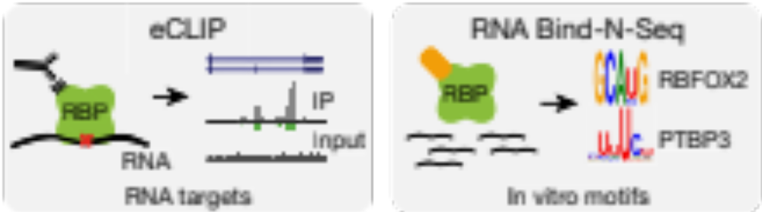



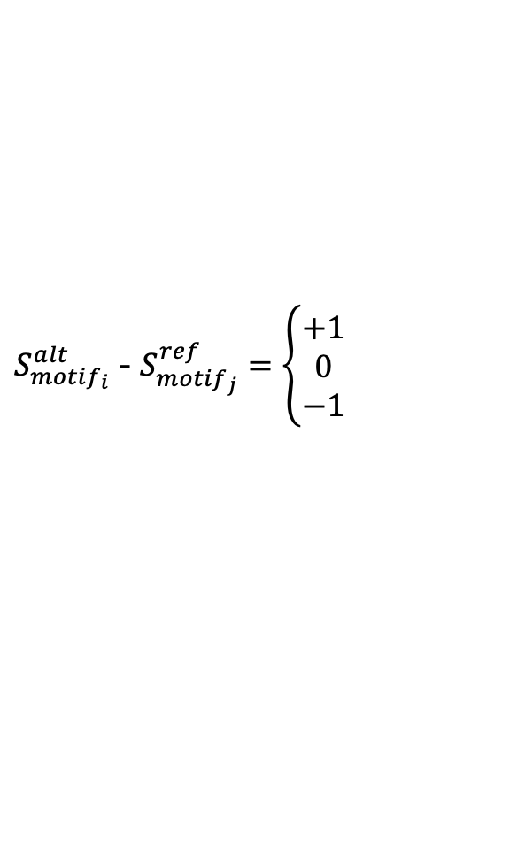

Integrating information of RNA protein binding motifs
Ref: ATCGATCCGACC
Alt: ATCGAACCGACC
No Tweet
$${motif}_{1}$$
.
.
.
$${motif}_{6}$$
$${motif}_{1}$$
.
.
.
Van Nostrand, et al. A large-scale binding and functional map of human RNA-binding proteins. Nature 583, 711–719 (2020).
$${motif}_{6}$$
For each RBP:
$S_{{motif}_{i}}^{alt}$ - $S_{{motif}_{j}}^{ref}=\left\{\begin{aligned}+1 \\ 0 \\ −1\end{aligned}\right.$
Motif Gain
No Change
Motif Loss
Created for CAGI 6
genomeinterpretation.org
Yaqiong Wang

Slide 9
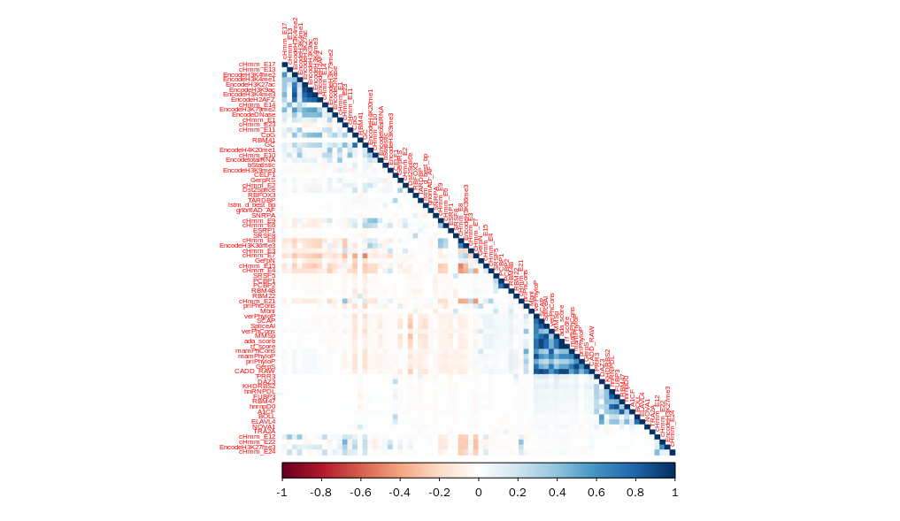
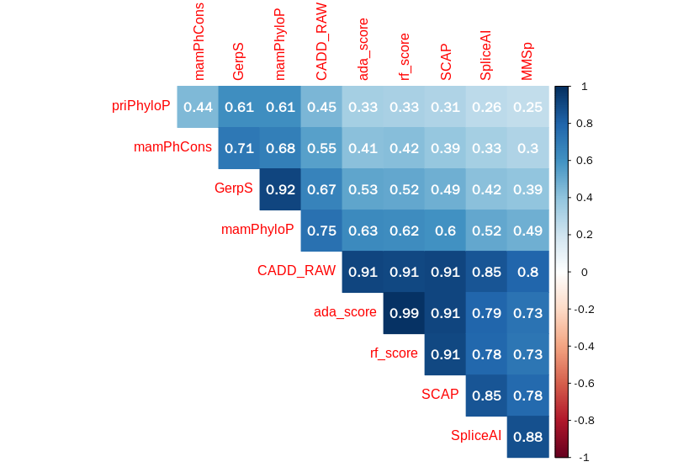
Splicing scores are highly correlated
No Tweet
Epigenetic modifications
RBPs
Created for CAGI 6
genomeinterpretation.org
Yaqiong Wang

Slide 10
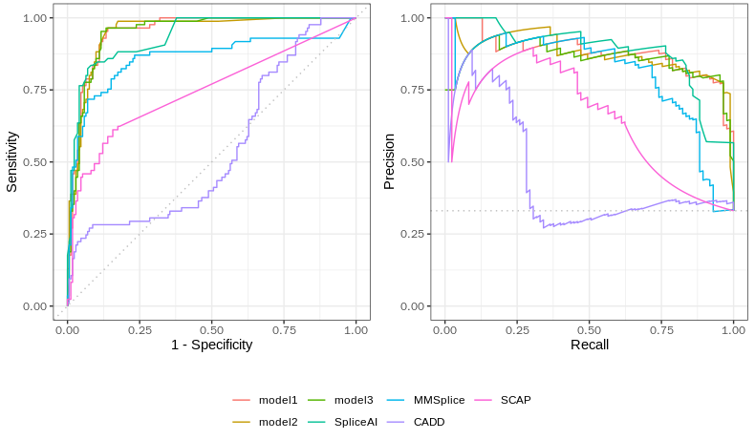
Model Performance
No Tweet
ROC
PR
model1 (0.951)
model2 (0.949)
model3 (0.948)
SpliceAI (0.936)
MMSplice(0.860)
SCAP (0.747)
CADD (0.544)
model1 (0.881)
model2 (0.876)
model3 (0.854)
SpliceAI (0.883)
MMSplice(0.804)
SCAP (0.651)
CADD (0.454)
Created for CAGI 6
genomeinterpretation.org
Yaqiong Wang
Notes:
6513Add AUC values to the plots

Slide 11
Conclusions
No Tweet
Our ensembled models showed a comparable performance to SpliceAI on the validation datasets
Integrating RBP-binding motif information slightly improved model performance
Limitations
Limited and unbalance datasets
Did not predict splicing products for the variants
Did not consider the tissue specific expression patterns
Future plans
Collecting larger dataset for model development
Building gene/disease-specific models
Combination with other types of variants
Created for CAGI 6
genomeinterpretation.org
Yaqiong Wang

Slide 12
Acknowledgments
UC Berkeley
Zhiqiang Hu
Children’s Hospital of Fudan University
Yulan Lu, Xinran Dong, Xiao Wang
Splicing VUS Challenge Data Providers
Diana Baralle, Jenny Lord, Andrew Douglas, Htoo Wai, David J Bunyan
CAGI 6 Organizers
Steven E. Brenner, Predrag Radivojac, Constantina Bakolitsa

