Slide 1

CAGI slide pack guidelines
I agree to my slides being used according to the following terms:
Vicente A. Yépez
Authors: please include THIS slide at the beginning of your presentation to indicate that you agree with reuse of your slides in CAGI presentations, according to the terms below, and digitally sign by writing your name above.
To disseminate the CAGI results, I encourage all CAGI participants to remix these CAGI slides for inclusion in their oral and poster presentations
CAGI participants may use or publish any content of these slides only in compliance with the CAGI Data Use Agreement
CAGI participants may not cite or publish any content of these slides except with the written permission of the originating author or in the primary CAGI publications
CAGI participants must acknowledge the original authors of these slides and CAGI 6. Include the acknowledgement banner across the bottom
CAGI participants must include the CAGI credits slide in their presentations
Slides with a red slash (no remix) may not be included in a presentation unless all attendees are registered CAGI participants who signed the data use agreement
Slides with a red X over the entire slide may not be used in any circumstances
Slides with a blue slash (embargoed) may not be used unless the embargo is explicitly lifted
Slides without slash or X may be tweeted unless flagged with the “No tweet” icon.
CAGI participants using these slides must explain the “No tweet” icon, which means that the slide content should not be disseminated outside the presenting conference hall. If the presentation venue permits pervasive tweeting, you may not include these slides in your talk
Note for slide authors: we expect all CAGI participants to abide by these restrictions, and will make best effort to ensure they are followed. However, but bear in mind that we have limited means of enforcing them, and therefore the restrictions cannot be guaranteed.

Slide 2
Permission request regarding CAGI 6 recordings and hybrid presentations
I understand that my presentation as associated with CAGI 6 will be recorded and broadcasted via the internet through CAGI’s designated technology provider.
As the copyright holder to this presentation entitled Gene prioritization for rare diseases integrating genotype, RNA-seq and phenotype, I hereby agree that the copyright for the online broadcast and recording of my presentation be released to CAGI and my recording be uploaded on to the CAGI website.

Slide 3


Gene prioritization for rare diseases integrating
genotype, RNA-seq and phenotype
Vicente A. Yépez, PhD
Gagneur lab
Department of Informatics
Technical University of Munich
May 15th, 2022
Created for CAGI 6
genomeinterpretation.org
V. Yépez

Slide 4
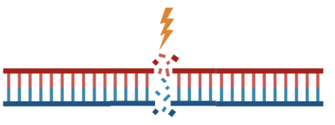
Select 2 rare variants with the highest impact per gene
Prioritize variants given:
VEP high impact - stop, frameshift, splice site
Clinical significance
Deleteriousness
Splice impact
Evolutionary constraint
Mono-allelic expression (with RNA-seq data)
gnomAD, OMIM, ClinVar
CADD: Rentzsch et al, Genome Med, 2021
SpliceAI: Jaganathan et al, Cell, 2019
EVE: Frazer et al, Nature, 2021
Created for CAGI 6
genomeinterpretation.org
V. Yépez

Slide 5

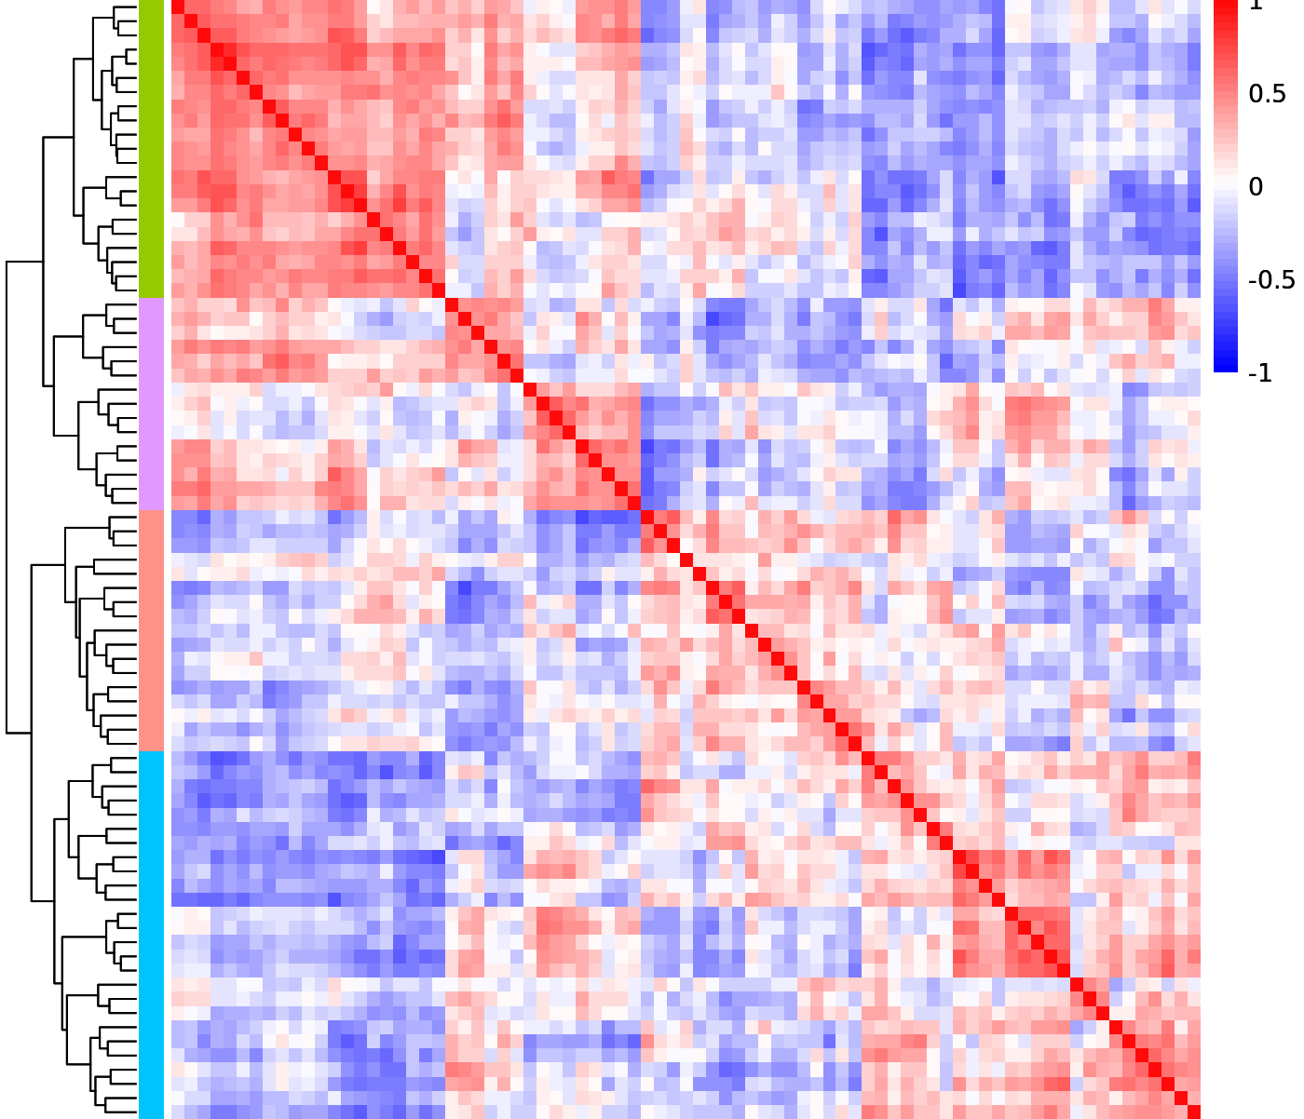
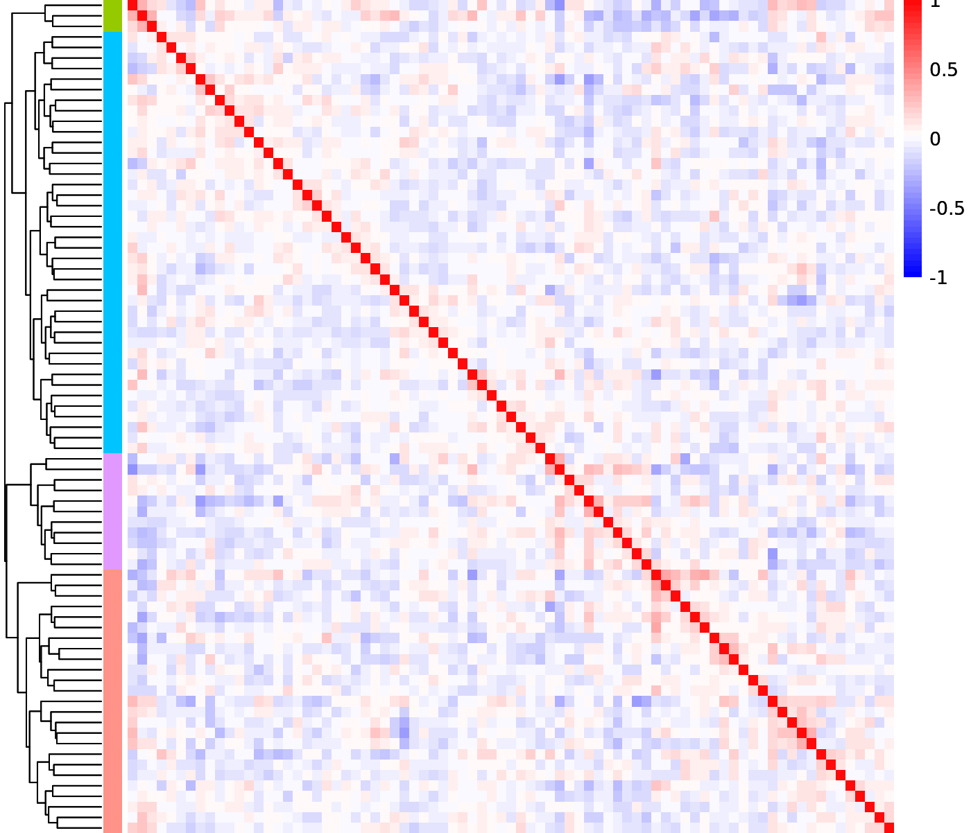
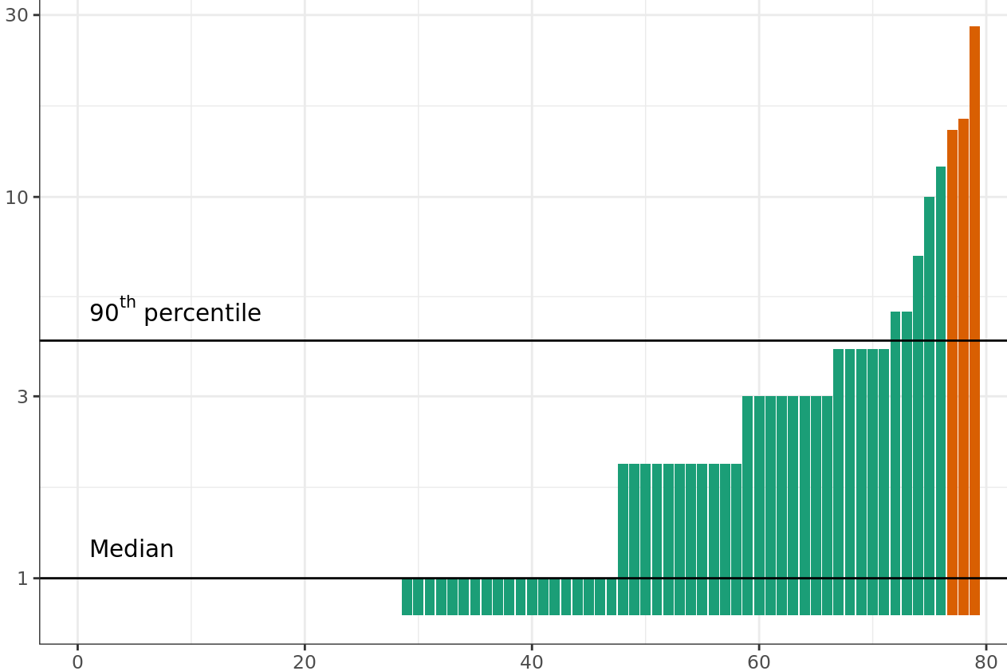
Aberrant expression detection using OUTRIDER
Brechtmann et al, AJHG, 2018
11,239 genes detected
OUTRIDER:
  Denoising autoencoder to remove sample covariation
  Negative binomial loss
Median of 1 outlier per sample (FDR <0.05)
Correlation of Raw Counts
Correlation of Normalized Counts
Aberrantly expressed genes
Sample Rank
Created for CAGI 6
genomeinterpretation.org
V. Yépez

Slide 6

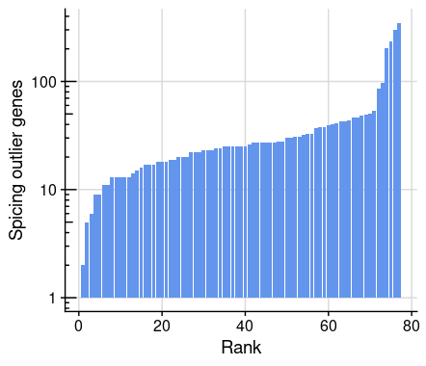
Aberrant splicing detection using FRASER
>200K expressed junctions
FRASER:
  Denoising autoencoder
  Beta binomial loss
Most samples exhibit 20-50 aberrantly spliced genes:
  FDR <0.05
  Effect size > 0.3
Mertes, Scheller et al, Nat Commun, 2021
Created for CAGI 6
genomeinterpretation.org
V. Yépez

Slide 7

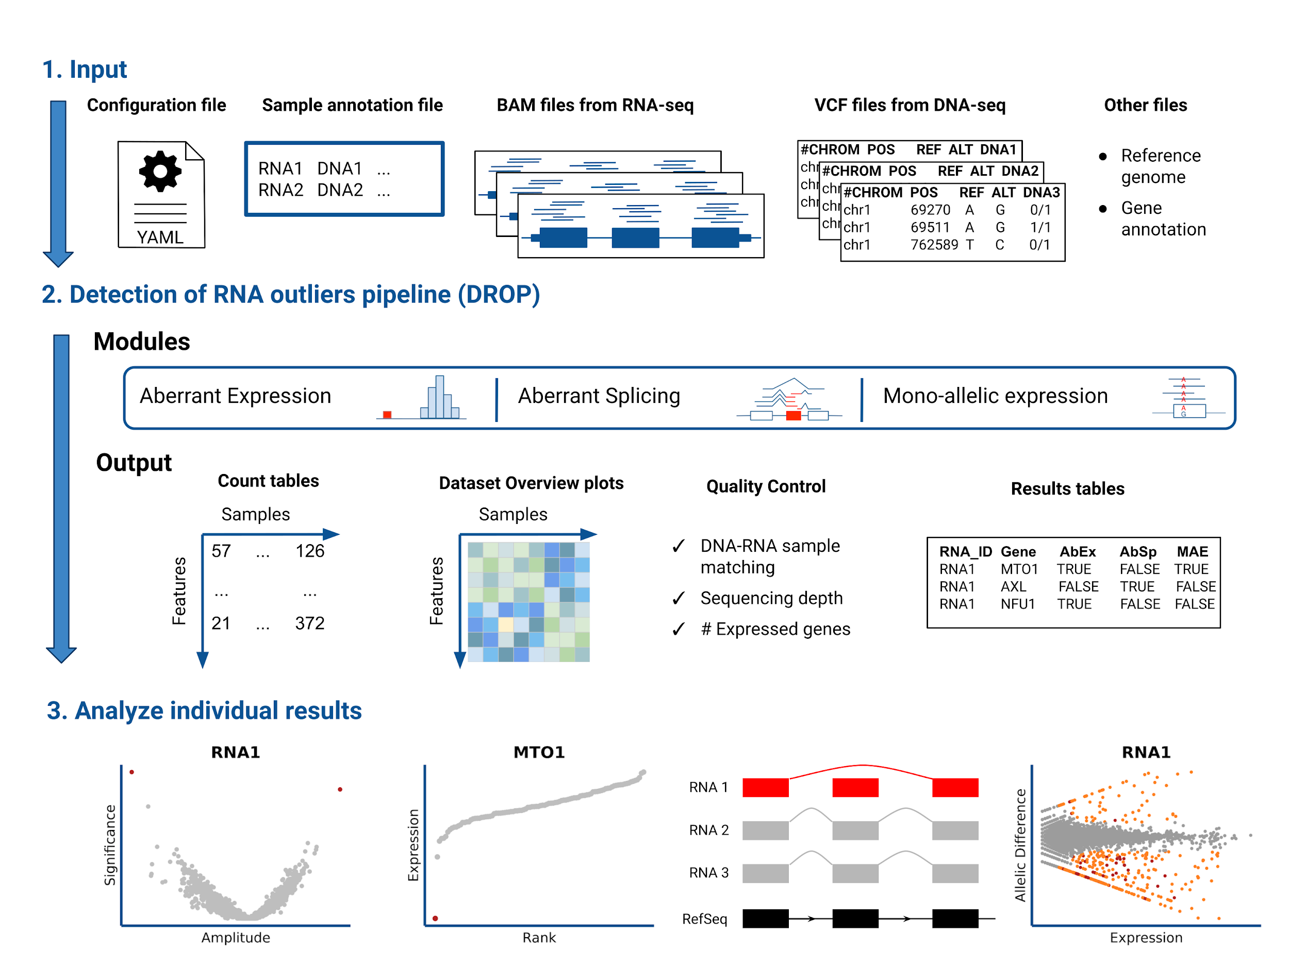
Integrative workflow to automate outlier detection - DROP
DNA and RNA-seq raw sequencing files
github.com/gagneurlab/drop
Yépez et al, Nat Protoc, 2021
1-2 days to run a cohort of >100 samples
Quality control and web reports
After set up, executable with 1 command
Negative binomial test
Created for CAGI 6
genomeinterpretation.org
V. Yépez

Slide 8
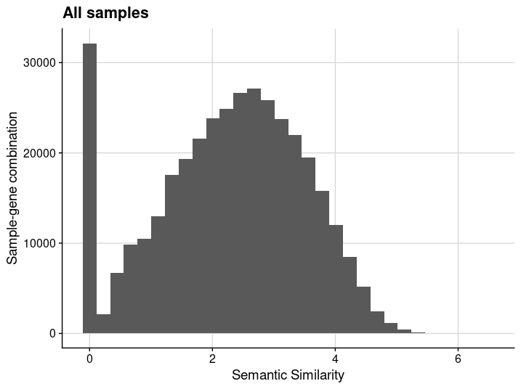

Integrate phenotype using HPO-based semantic similarity
Compute a similarity score between the phenotype of a patient and the phenotype associated to a gene
HPO terms: https://hpo.jax.org
PCAN: Phenotype Consensus Analysis. Godard and Page, BMC Bioinformatics, 2016
Created for CAGI 6
genomeinterpretation.org
V. Yépez

Slide 9
Predictive model using known pathogenic variants
Causal Gene | Sample | Gene | Gene expressed | Under expression | Over expression | Aberrant Splicing | Semantic Similarity | OMIM gene | Variant 1 annotations | Variant 2 annotations
True | P1 | G1 | T | T | F | T | 4.12 | T | …. | ….
⋮
True | P111 | G7 | T | T | F | F | 4.82 | T | …. | ….
False | S1 | G1 | T | F | F | F | 1.03 | T | …. | ….
⋮
False | S79 | G12K | F | F | F | F | 1.19 | F | …. | ….
111 solved mito disease samples
Test cohort (SickKids): all sample - gene combinations
with at least 1 rare variant
y ~ X causal gene ~ variant-level + gene-level annotations
Fit the model using XGBoost (eXtreme Gradient Boosting)
Output: 1 score per gene-sample combination
111 samples from: Stenton et al, medRxiv, 2021
Kopajitch, Smirnov, Stenton et al, medRxiv, 2021
Yépez, Gusic, et al, Genome Med, 2022
Created for CAGI 6
genomeinterpretation.org
V. Yépez

Slide 10
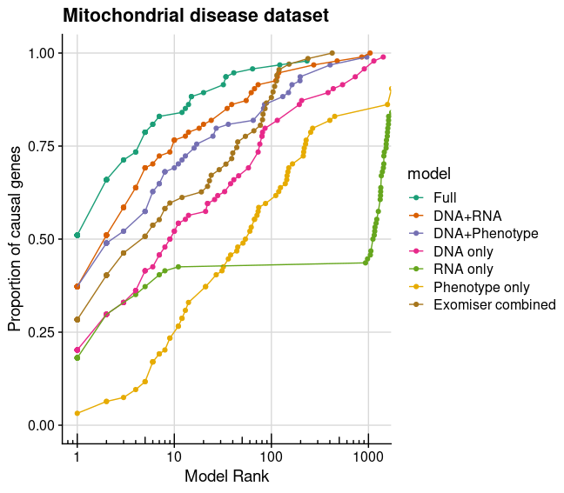
Great performance in external rare mitochondrial disease dataset
Among the top 5 hits from the model integrating all features (Full) are 80% of the known disease causal genes from a cohort of diagnosed mitochondrial disease patients (N=111)
All features contribute to the model
Our model ranks causal genes higher than Exomiser
Exomiser: Robinson et al, Genome Res, 2014
Created for CAGI 6
genomeinterpretation.org
V. Yépez

Slide 11
Cases with high scores in the SickKids cohort
Sample | Gene | Score | Aberrant Expression | Aberrant splicing
P1 | SMS | 0.14 | no | Exon skipping
P2 | STUB1 | 0.61 | 33% reduction | none
P1 suffers from Snyder-Robinson Syndrome:
1st ranked gene in P1: SMS
SMS causes Snyder-Robinson Syndrome
WGS not provided. Variant(s) obtained through RNA-seq variant calling implemented in DROP
STUB1 causes causes Spinocerebellar ataxia:
matches P2’s phenotype, dominant
variant already reported as pathogenic
Created for CAGI 6
genomeinterpretation.org
V. Yépez

Slide 12
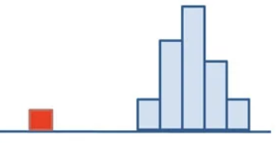
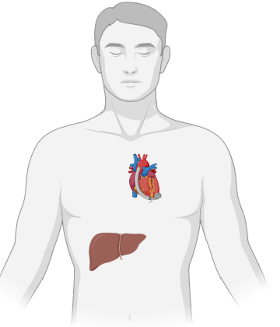
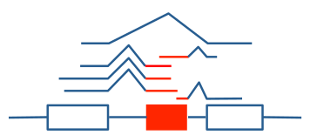
Take home: model integrating genotype, RNA-seq and phenotype to predict pathogenicity
Minor allele frequency
Impact (e.g. stop, frameshift)
Clinical significance
Deleteriousness
Evolutionary constraint
Mono-allelic expression
Aberrant expression
Aberrant splicing
Standardized phenotype
Fast to set up
Ready to apply to other cohorts!
Code publicly available: https://github.com/gagneurlab/cagi6_sickkids
XGBoost
Pathogenicity score for each sample-gene
Created for CAGI 6
genomeinterpretation.org
V. Yépez

Slide 13



Acknowledgements
Technical University of Munich
Julien Gagneur
Ines Scheller
Karoline Lutz
TUM/GHGA
Christian Mertes
Nicholas Smith
Helmholtz Zentrum Munich / TUM
Holger Prokisch, Mirjana Gusic, Robert Kopajtich, Dmitrii Smirnov, Sarah Stenton
SickKids Genome Clinic, Centre for Genetic Medicine of the Hospital for Sick Children, Toronto
CAGI6 organizers
All the patients included in the study and their families
Created for CAGI 6
genomeinterpretation.org
V. Yépez

