Slide 1
Improving VARITY missense variant effect predictions using newly-classified clinical variants
Yingzhou (Joe) Wu
Computer Science Graduate Program
University of Toronto

Slide 2
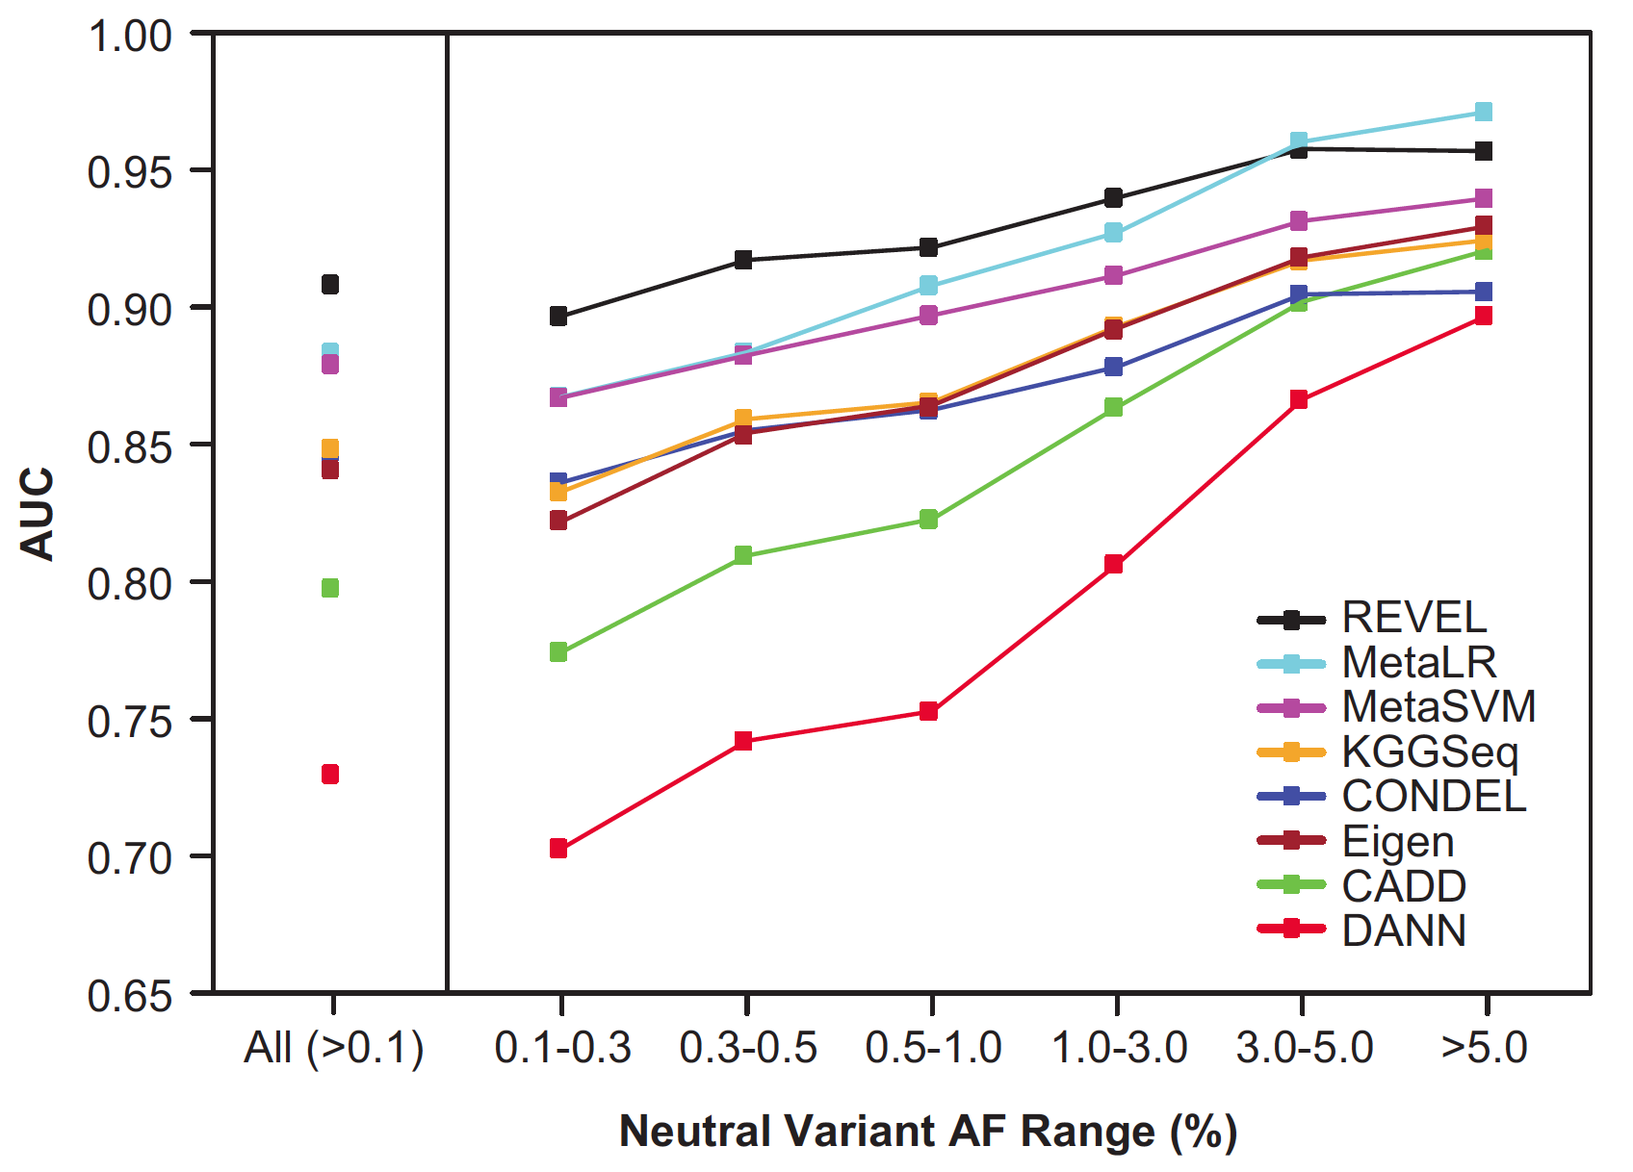
Challenge for computational pathogenicity predictors
It is harder to distinguish disease variants (mostly rare) from rare benign variants than from common benign variants.
Ioannidis, N. M. et al., AJHG, 2016.
VARITY : A supervised variant pathogenicity classifier optimized for predicting rare human missense variants.
Wu et al., American Journal of Human Genetics , 2021

Slide 3
Outline
1
VARITY framework and VARITY model
2
VARITY_Sherloc model
3
Summary and outlook

Slide 4
VARITY framework overview
All training data
High quality
Rest are of uncertain quality
Label Accuracy
Data Representativity
Data Quality
Should I include data with uncertain quality in training?

Slide 5
VARITY framework overview
All available training examples
(regardless their quality)
‘Core’ sets
(High quality)
‘Add-on’ sets
(Uncertain quality)
Differential weighting
‘Core’ sets
(High quality)
Full weight
Zero weight
‘Add-on’ sets
(Uncertain quality)
Weighted training examples
Final Model
(best at predicting the examples in ‘Core’ sets)

Slide 6
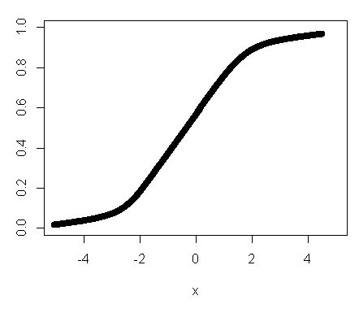


VARITY framework weighting function
‘Core’ sets
(High quality)
‘Add-on’ sets
(Uncertain quality)
Validation
Training
Add-on Training
10%
Fold 1 - 90% core examples
add-on examples
Measure
Performance
10%
Fold 2 - 90% core examples
add-on examples
…
10%
Fold 10 - 90% core examples
add-on examples
Algorithm level hyperparameters
Weighting function hyperparameters
Assign weights using logistic function for each set
Number of trees
Tree depth
……
Quality informative
property
Differential weight
$$f\left(x\right)=\frac{L}{1+ e^{−k(x−x_{0})}}$$
$L$, $k$, $x_{0} as weighting hyperparameters$
Wights are optimized by tunning weighting hyperparameters

Slide 7
Quality informative properties in VARITY model
Data Quality
Label Accuracy
Data Representativity
ClinVAR review stars
Number of Homozygous
Allele
Frequency
ClinVAR
gnomAD
HGMD
HumsaVAR

Slide 8

VARITY_R and VRITY_ER Model
All missense variants from ~4,000 human disease proteins with available pathogenicity annotation
Core Variants
(High Quality)
Attributes of variant set
Add-on Variants
(Uncertain Quality)
Core sets (Training / Test)
(High Quality)
Add-on sets
(Uncertain Quality)
Source: Annotation database
Label:
(+) : Putatively pathogenic
ClinVar (-NR)
ClinVar (+NR)
ClinVAR rare variants
(-) : Putatively benign
All other variants
ClinVar (-R)
ClinVar (+R)
gnomAD (-R)
gnomAD (-NR)
Rarity:
(R) : Rare (MAF < 𝚹)
HGMD (+)
HumsaVar (+)
Annotation accuracy
Representativity
(NR) : Not Rare (MAF >= 𝚹)
HumsaVar (-R)
HumsaVar (-NR)
Assign weights using logistic function for each set
MAVE (+)
MAVE (-)
Quality informative
property
Differential weight
$$f\left(x\right)=\frac{L}{1+ e^{−k(x−x_{0})}}$$
ClinVar (-NR)
ClinVar (+NR)
$L$, $k$, $x_{0} tuned as hyperparameters$
gnomAD (-R)
gnomAD (-NR)
ClinVar (-R)
ClinVar (+R)
Full weight
Zero weight
HGMD (+)
HumsaVar (+)
VARITY_R model: 𝚹 = 0.5%
HumsaVar (-R)
HumsaVar (-NR)
VARITY_ER model: 𝚹 = 10⁻⁶
MAVE (+)
MAVE (-)
VARITY Models
(gradient boosted trees)

Slide 9
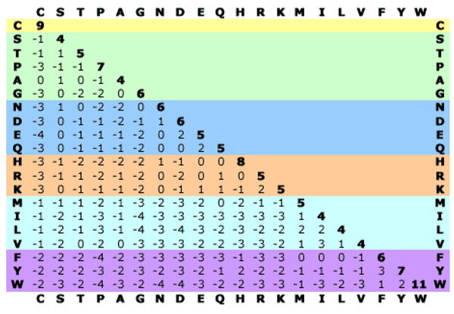
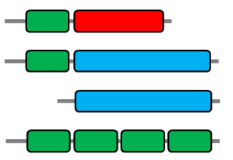
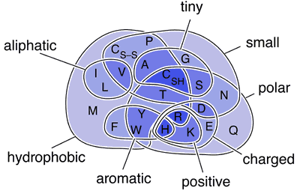
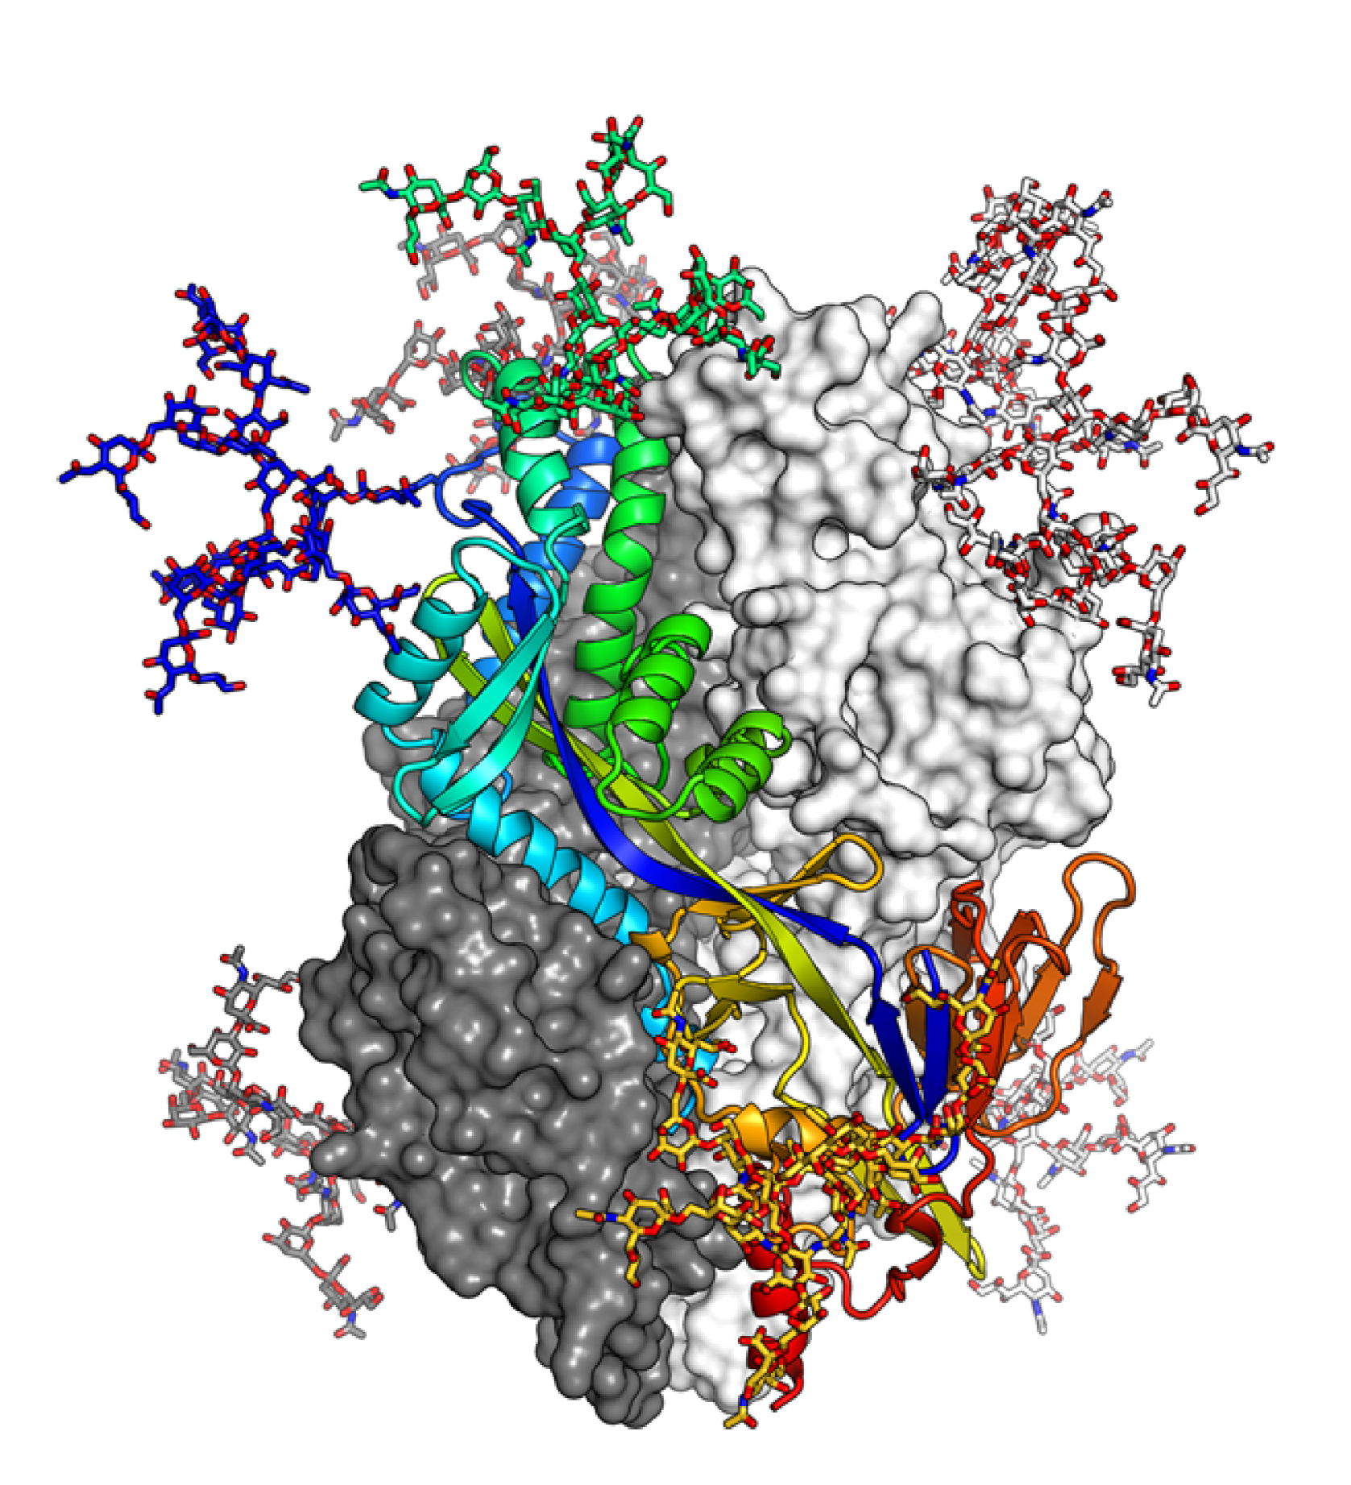
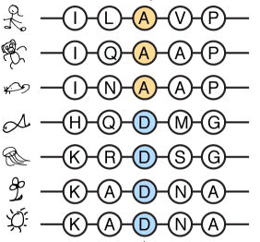
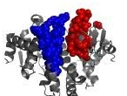
VARITY model data features
BLOSUM
Pfam Domain
Physical-chemical
properties
Conservation
Structure
Protein-protein
Interaction
(SIFT, EVMutation…..)
(Second structure…..)
(Buried surface area by interaction partners)

Slide 10
VARITY model data features
Avoid features that may cause inflated performance
Circularity
meta-features
(supervised)
Test Data
May have seen
Bias
Gene/regional
level features
Test Data
May have seen other variants in the same gene/region in training data

Slide 11
Performance measure (AUROC, AUBPRC, R90BP)
Recall at 90% balanced precision (R90BP)
1
0.9
Recall at 90% precision
Precision
Balanced Precision
Recall curve
0.5
Precision
Recall curve
Prior
0
Recall
1
$$Balanced Precision=\frac{precision∗(1−prior)}{precision∗\left(1−prior\right)+\left(1−precision\right)∗prior}$$

Slide 12
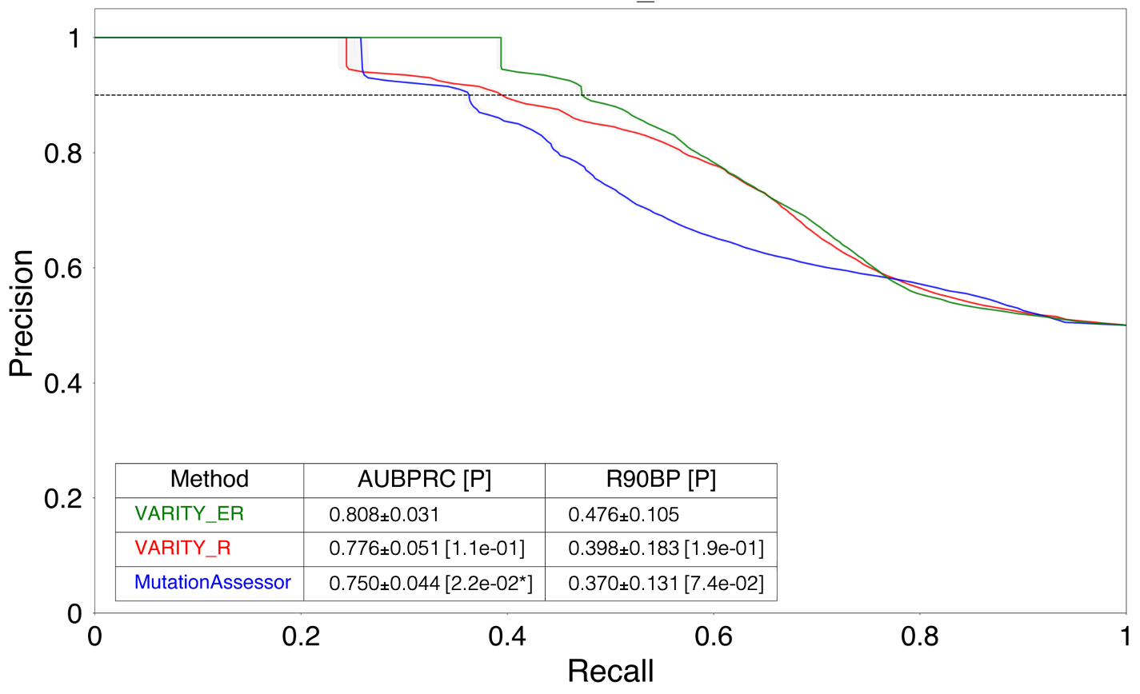
VARITY performance on de novo variants
215 rare de novo variants in neurodevelopmental disorder case-control studies
(188 cases and 27 controls)
(Statistical significance: P-Value < 0.05 based on 2,000 bootstrapping)
Note: 23 previous methods were compared, only the best non-VARITY method is shown.

Slide 13
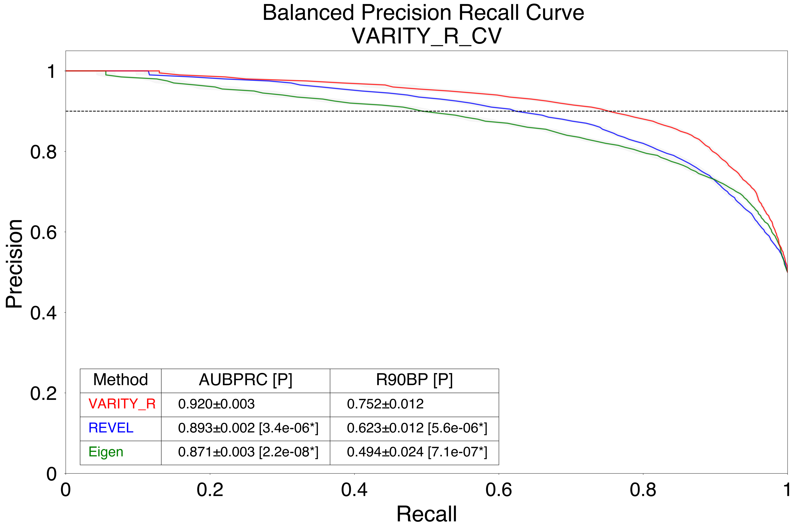
VARITY performance on the ‘Core” set of rare variants
9,719 ‘core’ set of rare variants from ClinVAR (MAF < 0.5%)
(excluded HGMD variants; 5,912 pathogenic and 3,807 benign variants)
(Statistical significance: P-Value < 0.05, paired t test)
10-fold nested Cross Validation
R90BP difference : 0.13
VARITY_R recovered 21% more pathogenic variants than the best no-VARITY method REVEL.
Note: 23 previous methods were compared, only the best and second-best non-VARITY methods are shown.

Slide 14
Outline
1
VARITY model and VARITY framework
2
VARITY_Sherloc
3
Summary and outlook

Slide 15
VARITY_Sherloc
All training examples
(regardless their quality)
‘Core’ sets
Invitae training set
‘Add-on’ sets
All other variants
Differential weighting
‘Core’ sets
Invitae training set
Full weight
Zero weight
‘Add-on’ sets
All other variants
Weighted training examples
VARITY_Sherloc

Slide 16
VARITY_Sherloc performance
Models | Training data | Features
VARITY_Sherloc_1 | Invitae training set VARITY training set | VARITY Features plus extra meta features
VARITY_Sherloc_2 | Invitae training set VARITY training set | VARITY Features
VARITY_R | VARITY training Set | VARITY Features
Performance on Sherloc validation set
VARITY_Sherloc_1 > VARITY_Sherloc_2 > VARITY_R

Slide 17
Summary and outlook
VARITY model: A supervised variant pathogenicity classifier optimized for predicting rare human missense variants.
VARITY_sherloc model: A improved VARITY missense variant effect predictor using newly-classified clinical variants
VARITY Framework
All missense variants with available pathogenicity annotation
Core Variants
(High Quality)
Add-on Variants
(Uncertain Quality)
  Specific type of variants
Rare variants
Gain of function variants
Membrane protein variants
  Rest of other variants
Differential weighting
A Model optimized for predicting
  Specific type of variants

Slide 18
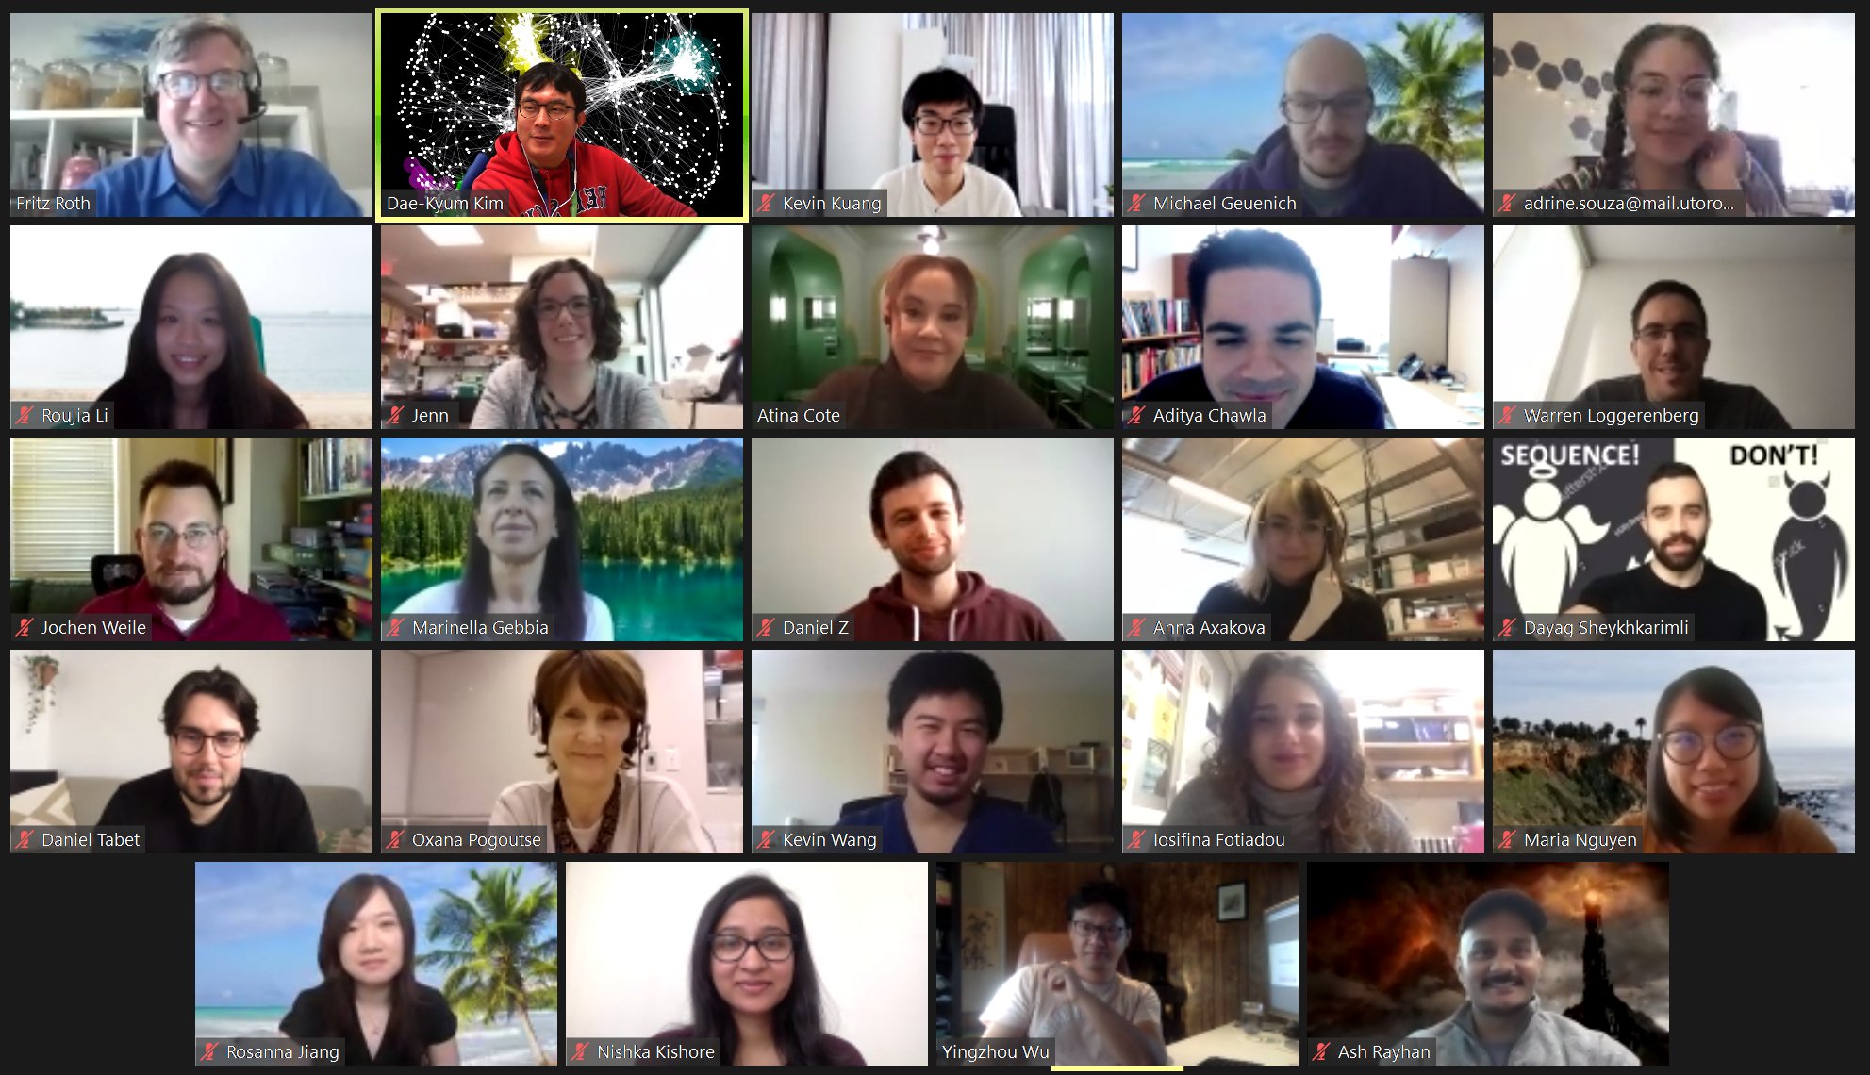
Thank You
Supervisor: Fritz Roth
Roth lab members

