Slide 1
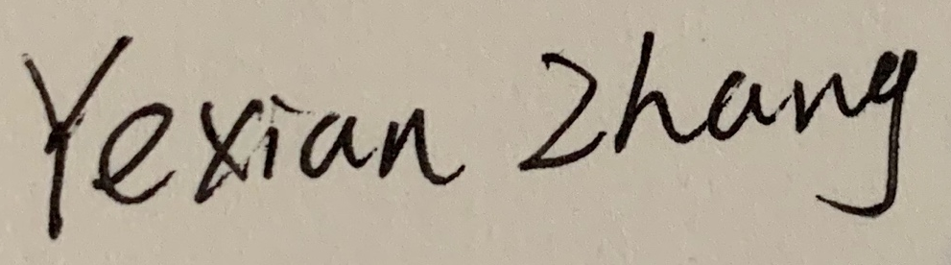

CAGI slide pack guidelines
I agree to my slides being used according to the following terms:
______________
Authors: please include THIS slide at the beginning of your presentation to indicate that you agree with reuse of your slides in CAGI presentations, according to the terms below, and digitally sign by writing your name above.
To disseminate the CAGI results, I encourage all CAGI participants to remix these CAGI slides for inclusion in their oral and poster presentations
CAGI participants may use or publish any content of these slides only in compliance with the CAGI Data Use Agreement
CAGI participants may not cite or publish any content of these slides except with the written permission of the originating author or in the primary CAGI publications
CAGI participants must acknowledge the original authors of these slides and CAGI 6. Include the acknowledgement banner across the bottom
CAGI participants must include the CAGI credits slide in their presentations
Slides with a red slash (no remix) may not be included in a presentation unless all attendees are registered CAGI participants who signed the data use agreement
Slides with a red X over the entire slide may not be used in any circumstances
Slides with a blue slash (embargoed) may not be used unless the embargo is explicitly lifted
Slides without slash or X may be tweeted unless flagged with the “No tweet” icon.
CAGI participants using these slides must explain the “No tweet” icon, which means that the slide content should not be disseminated outside the presenting conference hall. If the presentation venue permits pervasive tweeting, you may not include these slides in your talk
Note for slide authors: we expect all CAGI participants to abide by these restrictions, and will make best effort to ensure they are followed. However, but bear in mind that we have limited means of enforcing them, and therefore the restrictions cannot be guaranteed.

Slide 2
Permission request regarding CAGI 6 recordings and hybrid presentations
I understand that my presentation as associated with CAGI 6 will be recorded and broadcasted via the internet through CAGI’s designated technology provider.
As the copyright holder to this presentation entitled [Prediction of Neurodevelopmental Disorders and Pathogenic Variants from Gene Panel Sequences
], I hereby agree that the copyright for the online broadcast and recording of my presentation be released to CAGI and my recording be uploaded on to the CAGI website.

Slide 3
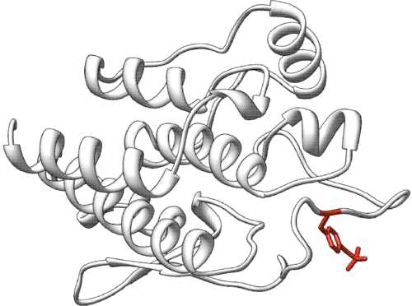


Prediction of Neurodevelopmental Disorders and Pathogenic Variants from Gene Panel Sequences
Yexian Zhang, Postdoctoral Fellow
Supervisor: Prof. Maggie Haitian Wang
The Chinese University of Hong Kong Shenzhen Research Institute, Shenzhen, China.
The Chinese University of Hong Kong, Hong Kong SAR, China.
Created for CAGI 6
genomeinterpretation.org
Yexian Zhang

Slide 4
Variant Filtering and Prioritizing
VCFs
Variant Annotation
(1) VEP
(2) REVEL
Variant Filtering
(1) absent or with a MAF < 5% in 1000 Genomes Project data.
(2) not homozygous reference alleles.
(3) present in only one sample.
(4) protein-altering variants.
Variant Prioritizing
(1) ClinVar (pathogenic/likely pathogenic )
(2) REVEL score
(3) phenotype-specific Phenolyzer score
This method identified 210 putative causative variants in training data, and a total amount of 36 out of 53 well predicted variants.
Created for CAGI 6
genomeinterpretation.org
Yexian Zhang

Slide 5
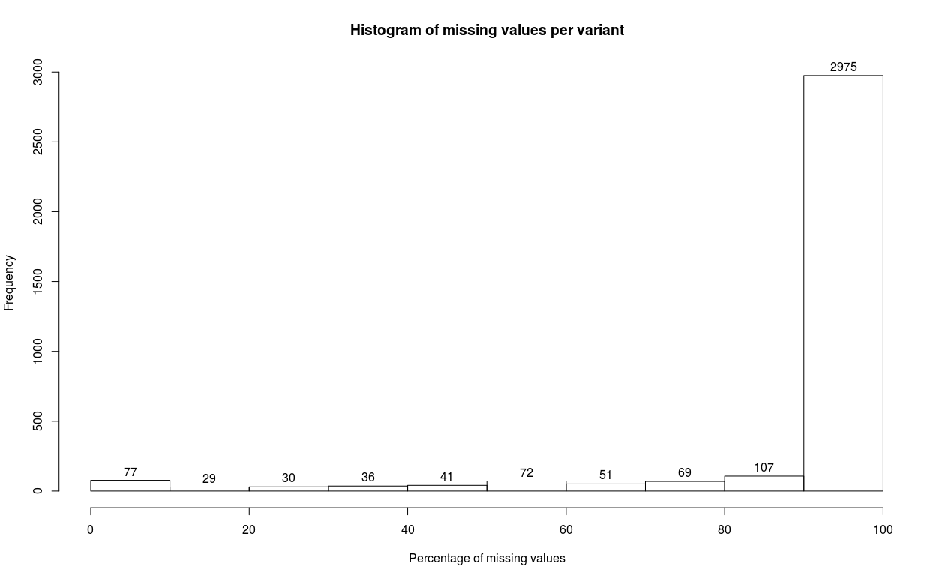
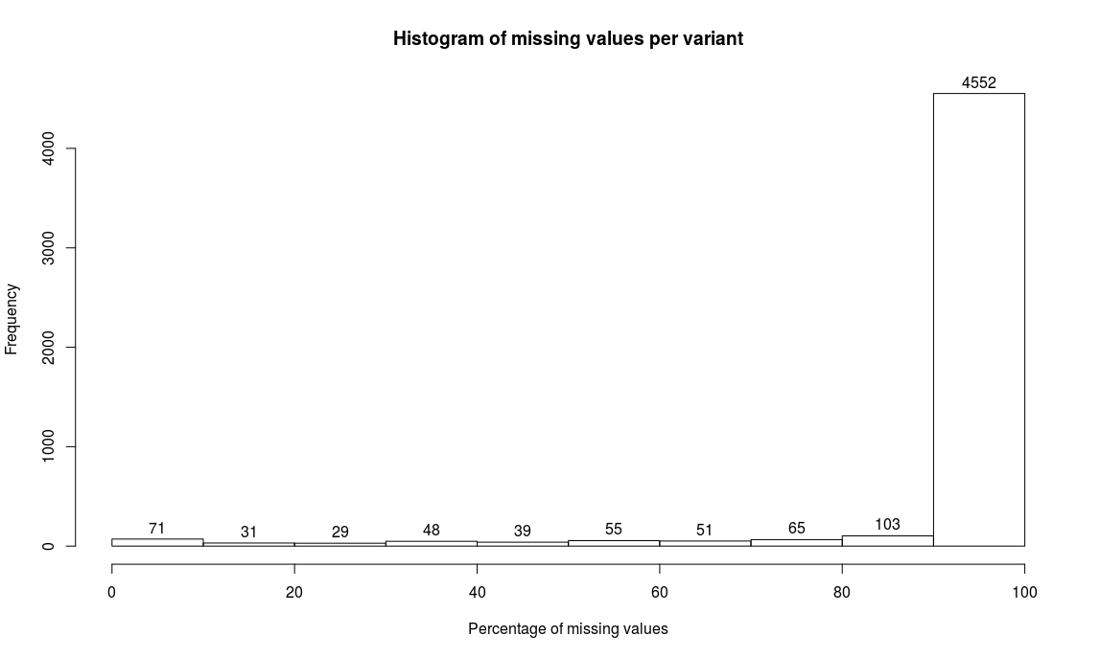
Quality Control
After separately merging the 150 training samples and the 422 test samples, there was 3,487 and 5,045 variants, respectively.
(a)
(b)
Figure 1. Histogram of missing values per variant. (a) The 150 training samples. (b) The 422 test samples.
Created for CAGI 6
genomeinterpretation.org
Yexian Zhang

Slide 6
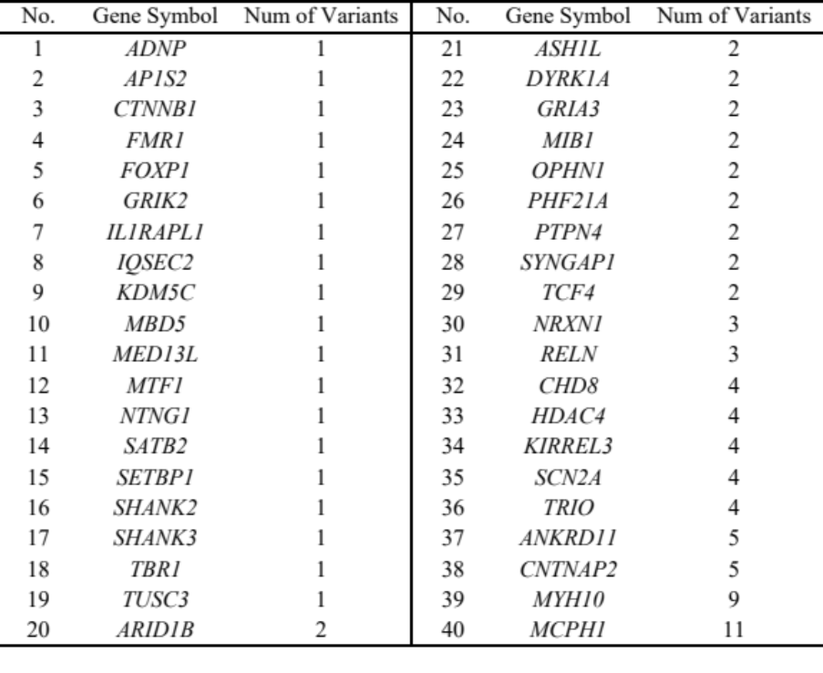
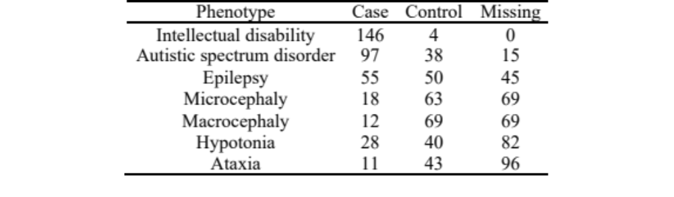
Quality Control
The variants with missing rate more than 20% were removed, leaving a total 95 variants (located in 40 genes) that exist in both the training and test set. Imputation was conducted based on the distribution of variant counts.
Table 1. The number of variants per gene.
Table 2. Sample distribution of the 150 training samples.
Created for CAGI 6
genomeinterpretation.org
Yexian Zhang

Slide 7
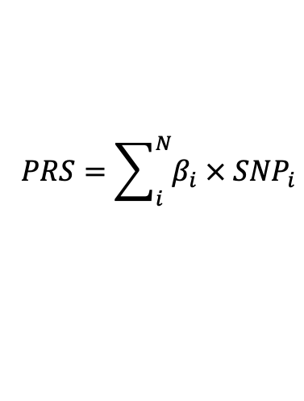
Polygenic Risk Scores
Method 1 : The autistic spectrum disorder (ASD) and epilepsy with existing GWAS summary statistics were eligible for our analysis. The Childhood IQ GWAS summary statistics was used for Intellectual disability. For other phenotypes, the effect sizes were derived from training dataset by logistic regression analysis.
Method 2 : The allele effect sizes were derived from training dataset by logistic regression analysis for each phenotype.
$$PRS=\sum_{i}^{N}{β_{i} × {SNP}_{i}}$$
${SNP}_{i}$ is the allele counts of the i-$th$ SNP, $β_{i}$ is its estimated effect size.
Testing dataset
GWAS summary statistics
Training dataset
Polygenic risk scores
Predictive
Model
Effect sizes from training dataset
Predictions
Created for CAGI 6
genomeinterpretation.org
Yexian Zhang

Slide 8
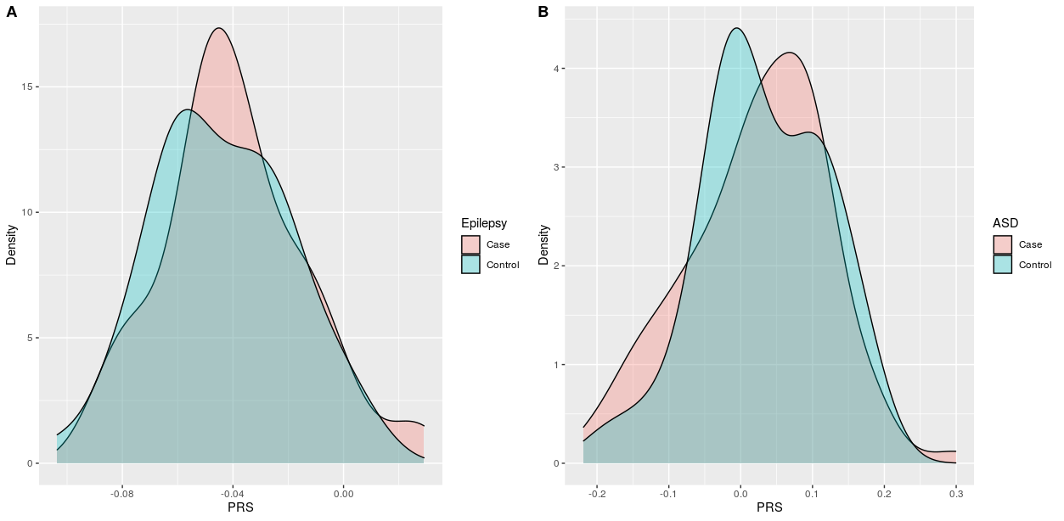
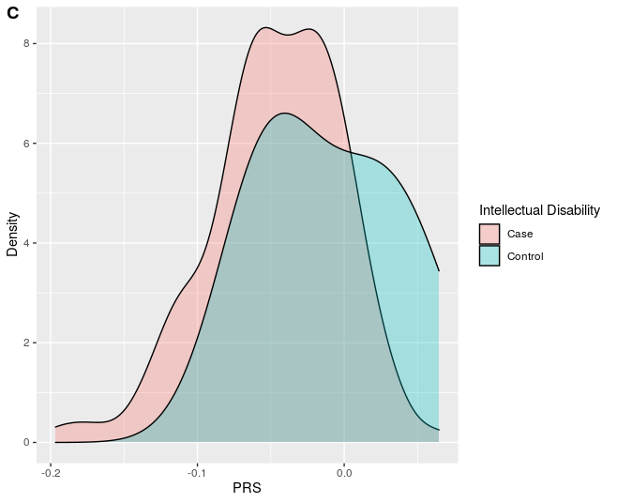
Polygenic Risk Scores
In order to derive PRS for each of the 7 neurodevelopmental presentations, the previously associated variants were extracted by searching:
(1) NHGRI-EBI GWAS Catalog (https://www.ebi.ac.uk/gwas/).
(2) IEU Open GWAS platform (https://gwas.mrcieu.ac.uk/).
(3) GWAS Atlas (https://atlas.ctglab.nl/).
Figure 2. PRS density plot.
Table 3. Details of GWAS used for calculating PRS.
Phenotype | Cases | Controls | SNPs in PRS* | Source
Epilepsy | 15,212 | 29,677 | 36 | [1]
Autistic spectrum disorder | 18,382 | 27,969 | 63 | [2]
Childhood IQ | 12,441 |  | 36 | [3]
* PRS derived from genome-wide significant hit (p-value < 5x10⁻⁸)
[1] Consortium, The International League Against Epilepsy. "Genome-wide mega-analysis identifies 16 loci and highlights diverse biological mechanisms in the common epilepsies." Nature communications 9 (2018).
[2] Grove, Jakob et al. "Identification of common genetic risk variants for autism spectrum disorder." Nature genetics 51, no. 3 (2019): 431-444.
[3] Benyamin, et al. "Childhood intelligence is heritable, highly polygenic and associated with FNBP1L." Molecular psychiatry 19, no. 2 (2014): 253-258.
Created for CAGI 6
genomeinterpretation.org
Yexian Zhang

Slide 9
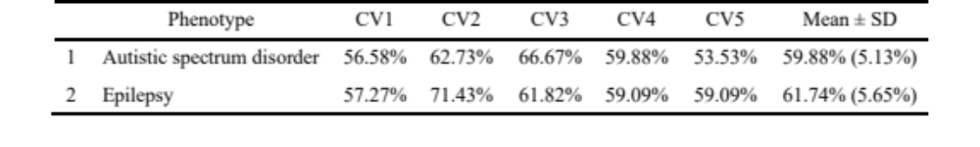
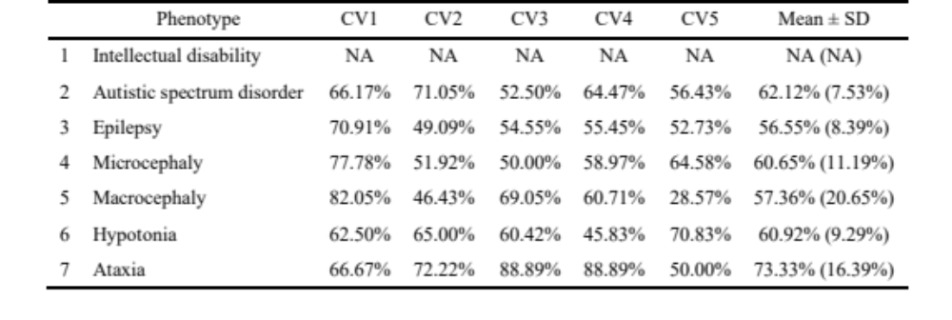
Polygenic Risk Scores
Table 4. AUCs of the 5-fold cross validation, the effect sizes were derived from published GWAS summary.
Table 5. AUCs of the 5-fold cross validation using the PRS model, the effect sizes were derived from training dataset by logistic regression analysis.
Created for CAGI 6
genomeinterpretation.org
Yexian Zhang

