Slide 1

CAGI slide pack guidelines
I agree to my slides being used according to the following terms:
_______Yun S. Song_______
Authors: please include THIS slide at the beginning of your presentation to indicate that you agree with reuse of your slides in CAGI presentations, according to the terms below, and digitally sign by writing your name above.
To disseminate the CAGI results, I encourage all CAGI participants to remix these CAGI slides for inclusion in their oral and poster presentations
CAGI participants may use or publish any content of these slides only in compliance with the CAGI Data Use Agreement
CAGI participants may not cite or publish any content of these slides except with the written permission of the originating author or in the primary CAGI publications
CAGI participants must acknowledge the original authors of these slides and CAGI 6. Include the acknowledgement banner across the bottom
CAGI participants must include the CAGI credits slide in their presentations
Slides with a red slash (no remix) may not be included in a presentation unless all attendees are registered CAGI participants who signed the data use agreement
Slides with a red X over the entire slide may not be used in any circumstances
Slides with a blue slash (embargoed) may not be used unless the embargo is explicitly lifted
Slides without slash or X may be tweeted unless flagged with the “No tweet” icon.
CAGI participants using these slides must explain the “No tweet” icon, which means that the slide content should not be disseminated outside the presenting conference hall. If the presentation venue permits pervasive tweeting, you may not include these slides in your talk
Note for slide authors: we expect all CAGI participants to abide by these restrictions, and will make best effort to ensure they are followed. However, but bear in mind that we have limited means of enforcing them, and therefore the restrictions cannot be guaranteed.

Slide 2
Permission request regarding CAGI 6 recordings and hybrid presentations
I understand that my presentation as associated with CAGI 6 will be recorded and broadcasted via the internet through CAGI’s designated technology provider.
As the copyright holder to this presentation entitled [Transfer learning for variant effect prediction], I hereby disagree that the copyright for the online broadcast and recording of my presentation be released to CAGI and my recording be uploaded on to the CAGI website.

Slide 3
Transfer learning for variant effect prediction
CAGI6 HMBS Challenge
Milind Jagota, Antoine Koehl, Ryan Chung, Roshan
Rao, Eyes Robson, Nilah Ioannidis, Yun S. Song
University of California, Berkeley

Slide 4
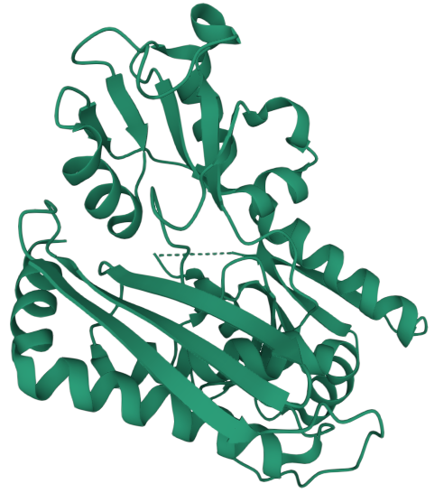
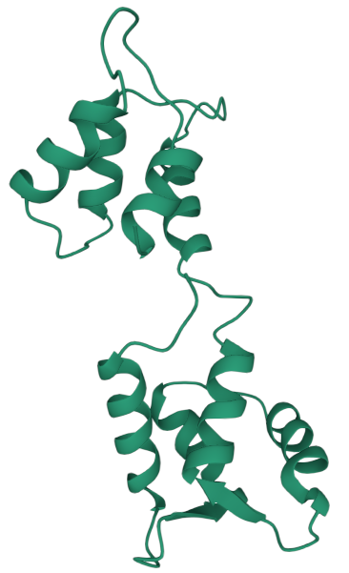
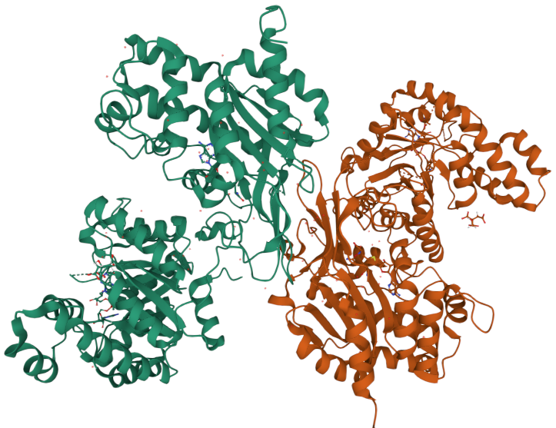
Key Ideas
Leverage recent unsupervised ML Models
  Protein Language Models
  Variational Autoencoder
Incorporate biophysical information
  Physicochemical properties of amino acids
  3D contact map
Cross-protein transfer learning
  HMBS
  MTHFR
  from CAGI6
  CALM1
  from CAGI5
Created for CAGI 6
genomeinterpretation.org
Yun S. Song

Slide 5
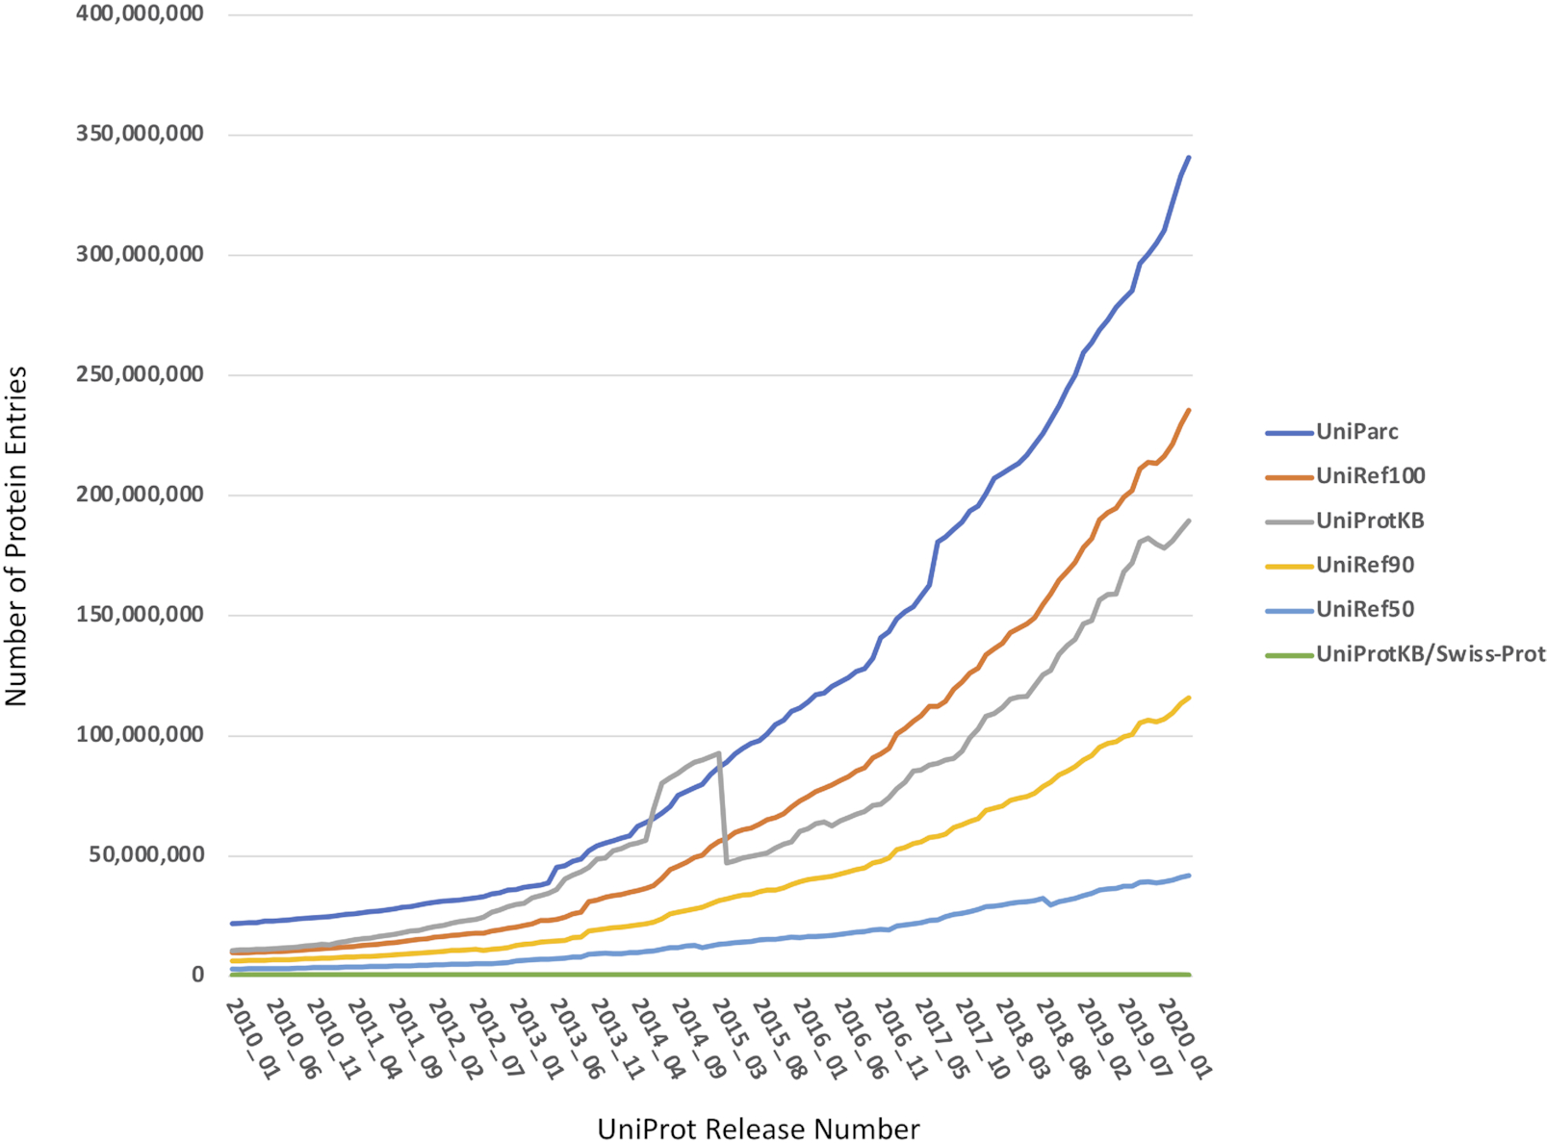
Massive-Scale Protein Sequence Data
Sequencing is cheap
Functional annotation is still expensive and time-consuming
Source: The UniProt Consortium, Nucleic Acids Res. 2021. https://doi.org/10.1093/nar/gkaa1100
Created for CAGI 6
genomeinterpretation.org
Yun S. Song

Slide 6
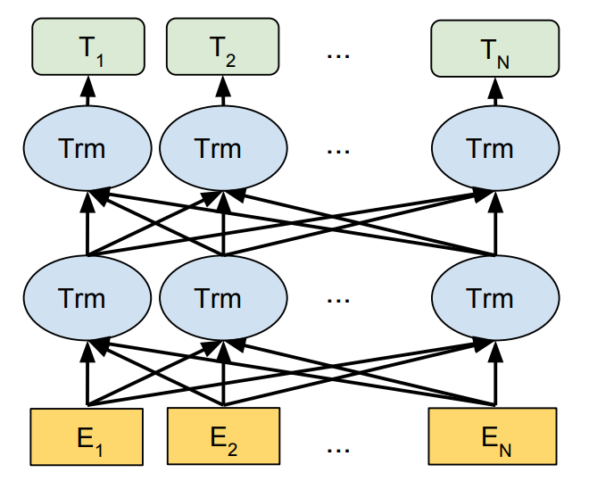
Self-Supervised Learning
Sequence Database
Language Model
High-dim Embedding
BERT. Devlin et al. (2018)
Expected to contain significant biological information
Pre-train on massive protein databases to automatically learn complex features and their interactions directly from sequence data
Meaningful protein representations that facilitate downstream prediction tasks.
Created for CAGI 6
genomeinterpretation.org
Yun S. Song

Slide 7
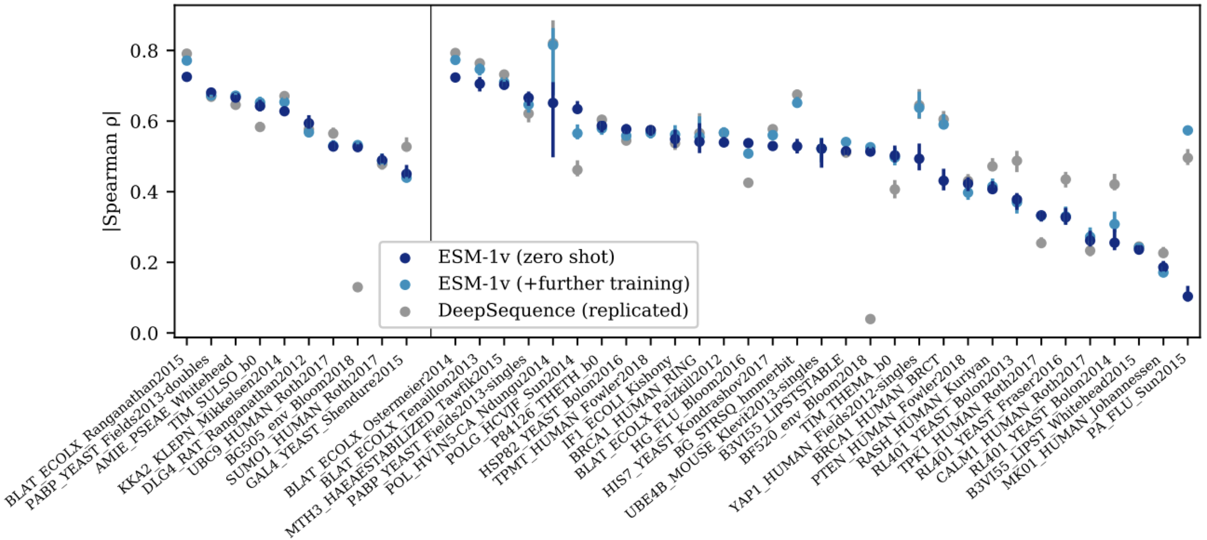
ESM-1v
Facebook AI Research (Meier et al. NeurIPS, 2021) pre-trained a protein language model on UniRef90.
Its variant effect prediction performance is comparable to the state-of-the-art on DMS data.
DeepSequence is a method based on VAE
Figure from Meier et al. (2021)
Created for CAGI 6
genomeinterpretation.org
Yun S. Song

Slide 8
Our Model
An ensemble of 100 linear models.
Each trained on 70% of positions sampled randomly from each of MTHFR and CALM1.
Shared regression coefficients between proteins, except for intercepts.
Prediction: an average over the ensemble.
Synonymous variant: the best predicted score of any missense variant at the position.
Nonsense variant: the worst predicted score.
Uncertainty: standard deviation over the ensemble.
Created for CAGI 6
genomeinterpretation.org
Yun S. Song

Slide 9
Features from Exiting Methods
Existing variant effect predictors:
  DeepSequence requires an MSA to make predictions.
  ESM-1v requires only a single sequence.
  REVEL (Ioannidis et al. 2016) ensembles several quantities.
Amino acid descriptors
  PCs from VHSE-scales (Mei et al. 2005) which capture hydrophobic, steric, and electronic properties.
  BLOSUM scores obtained by Georgiev (2009) from physicochemical properties and the BLOSUM62 matrix.
Created for CAGI 6
genomeinterpretation.org
Yun S. Song

Slide 10
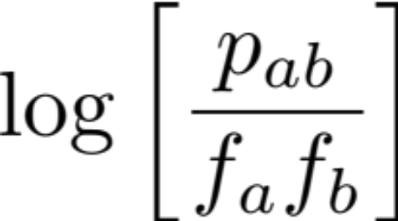
New Feature based on 3D contact map + MSA
Prediction site
In contact with site i
i
A
A
A
A
R
R
R
R
R
G
G
k
L
L
V
A
L
L
L
V
V
L
L
Wildtype
We used the top 2 contact sites, ranked by the number of wildtype alleles at those sites.
MSA
Created for CAGI 6
genomeinterpretation.org
Yun S. Song

Slide 11
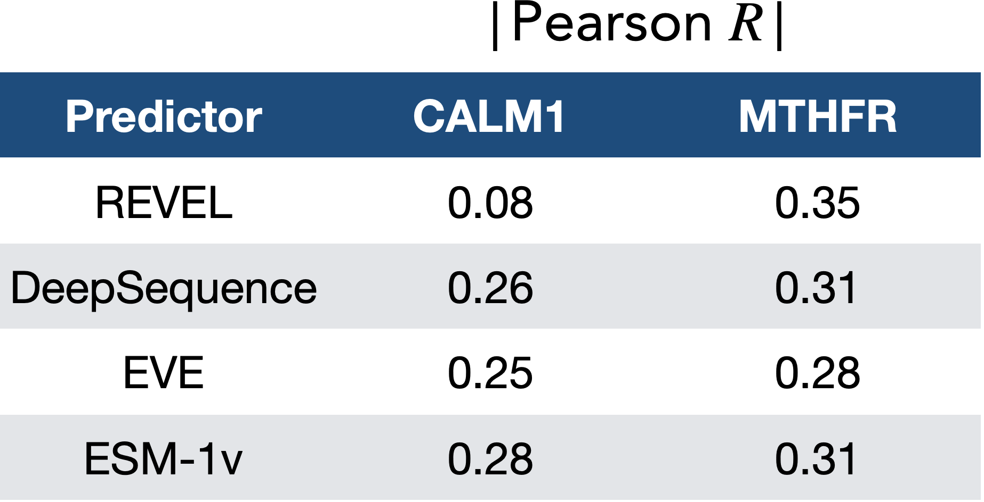
Testing Transfer Learning
  CALM1
  MTHFR
When train on CALM1 and applied to MTHFR,
our transfer model obtained R = 0.49 for MTHFR
Created for CAGI 6
genomeinterpretation.org
Yun S. Song

Slide 12
Validation for HMBS
ClinVar.
Variants (collected from UniProtKB) that are known to be associated with acute intermittent porphyria (AIP).
Please see Milind Jagota’s presentation later today.
Created for CAGI 6
genomeinterpretation.org
Yun S. Song

Slide 13
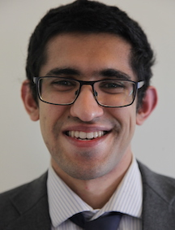





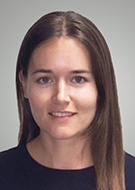
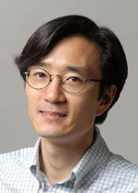

CalVEIR Team
Cal Variant Effect Interpretation Research
  Milind Jagota
  Antoine Koehl
  Ryan Chung
  Roshan Rao
  Eyes Robson
  Nilah Ioannidis
  Yun S. Song
Created for CAGI 6
genomeinterpretation.org
Yun S. Song

Slide 14
Title
No remix
This slide cannot be used except for viewing by registered CAGI participants
Created for CAGI 6
genomeinterpretation.org
An Author

Slide 15
Title
CAGI meeting ONLY
This slide cannot be used outside of the CAGI meeting.
We do not anticipate many slides of this nature
Created for CAGI 6
genomeinterpretation.org
An Author

Slide 16
Title
Embargoed
Until embargoed data are released, this slide cannot be used except for viewing by registered CAGI participants
Created for CAGI 6
genomeinterpretation.org
An Author

Slide 17
Title
No Tweet
This slide can be remixed and used in oral and poster presentations by any CAGI participant, consistent with limitations on slide 1
However, it is intended for participants of the conference hall and the CAGI live hybrid meeting only. Its content should not be tweeted, discussed, or otherwise shared outside of the conference hall
Do not use this slide in venues that give blanket permission for tweeting
Created for CAGI 6
genomeinterpretation.org
An Author

