Slide 1

CAGI slide pack guidelines
I agree to my slides being used according to the following terms:
_______Nurdan KURU_______
Authors: please include THIS slide at the beginning of your presentation to indicate that you agree with reuse of your slides in CAGI presentations, according to the terms below, and digitally sign by writing your name above.
To disseminate the CAGI results, I encourage all CAGI participants to remix these CAGI slides for inclusion in their oral and poster presentations
CAGI participants may use or publish any content of these slides only in compliance with the CAGI Data Use Agreement
CAGI participants may not cite or publish any content of these slides except with the written permission of the originating author or in the primary CAGI publications
CAGI participants must acknowledge the original authors of these slides and CAGI 6. Include the acknowledgement banner across the bottom
CAGI participants must include the CAGI credits slide in their presentations
Slides with a red slash (no remix) may not be included in a presentation unless all attendees are registered CAGI participants who signed the data use agreement
Slides with a red X over the entire slide may not be used in any circumstances
Slides with a blue slash (embargoed) may not be used unless the embargo is explicitly lifted
Slides without slash or X may be tweeted unless flagged with the “No tweet” icon.
CAGI participants using these slides must explain the “No tweet” icon, which means that the slide content should not be disseminated outside the presenting conference hall. If the presentation venue permits pervasive tweeting, you may not include these slides in your talk
Note for slide authors: we expect all CAGI participants to abide by these restrictions, and will make best effort to ensure they are followed. However, but bear in mind that we have limited means of enforcing them, and therefore the restrictions cannot be guaranteed.

Slide 2
Permission request regarding CAGI 6 recordings and hybrid presentations
I understand that my presentation as associated with CAGI 6 will be recorded and broadcasted via the internet through CAGI’s designated technology provider.
As the copyright holder to this presentation entitled [PHACT: Phylogeny-aware computing of tolerance for missense mutations], I hereby agree that the copyright for the online broadcast and recording of my presentation be released to CAGI and my recording be uploaded on to the CAGI website.

Slide 3


PHACT - PHYLOGENY-AWARE COMPUTING OF TOLERANCE FOR MISSENSE MUTATIONS*
Nurdan KURU, Onur DERELİ, Emrah AKKOYUN, Aylin BİRCAN, Öznur TAŞTAN, Ogün ADEBALİ
* Under revision (Molecular Biology and Evolution)
Created for CAGI 6
genomeinterpretation.org
Nurdan KURU

Slide 4
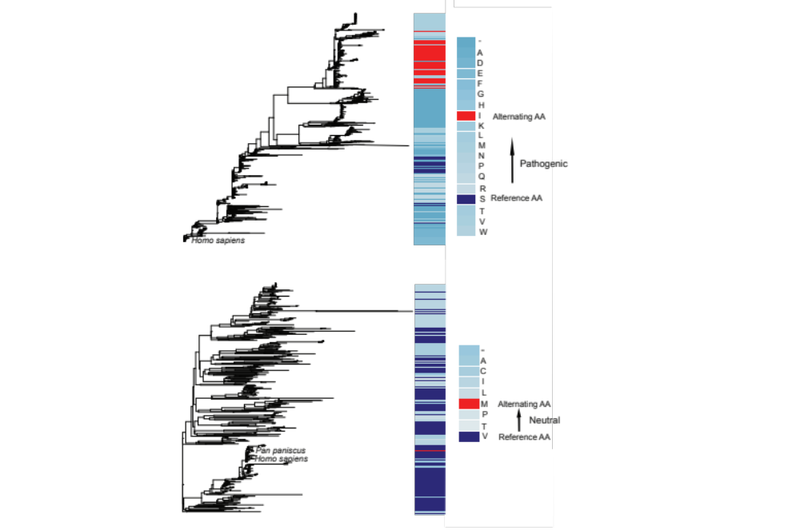
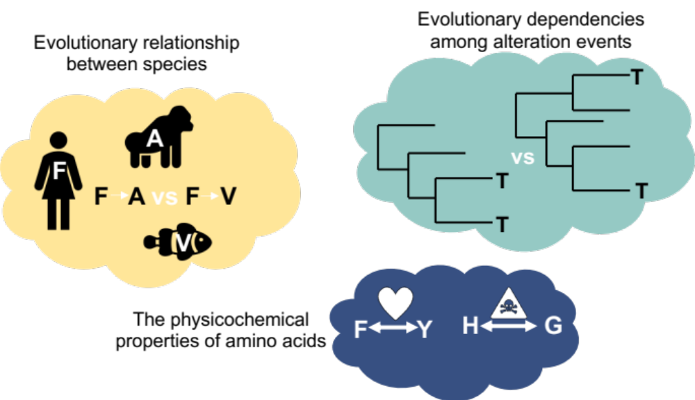
INTRODUCTION
WE CONSIDER
Created for CAGI 6
genomeinterpretation.org
Nurdan KURU

Slide 5
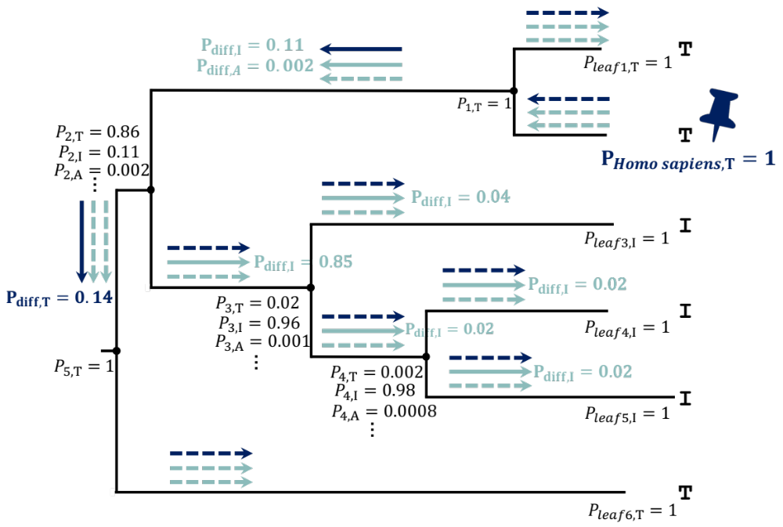
ALGORITHM
Created for CAGI 6
genomeinterpretation.org
Nurdan KURU

Slide 6
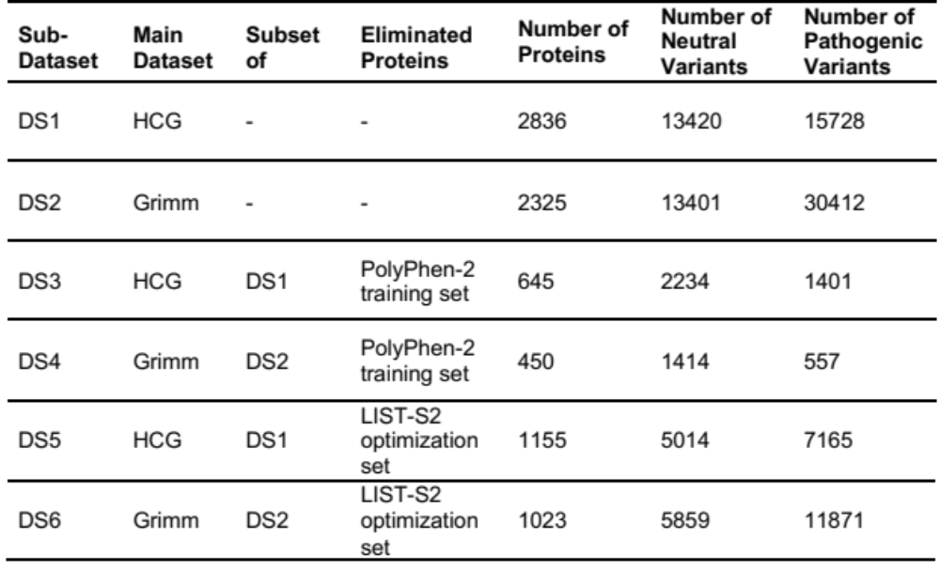
DATASETS
Created for CAGI 6
genomeinterpretation.org
Nurdan KURU

Slide 7
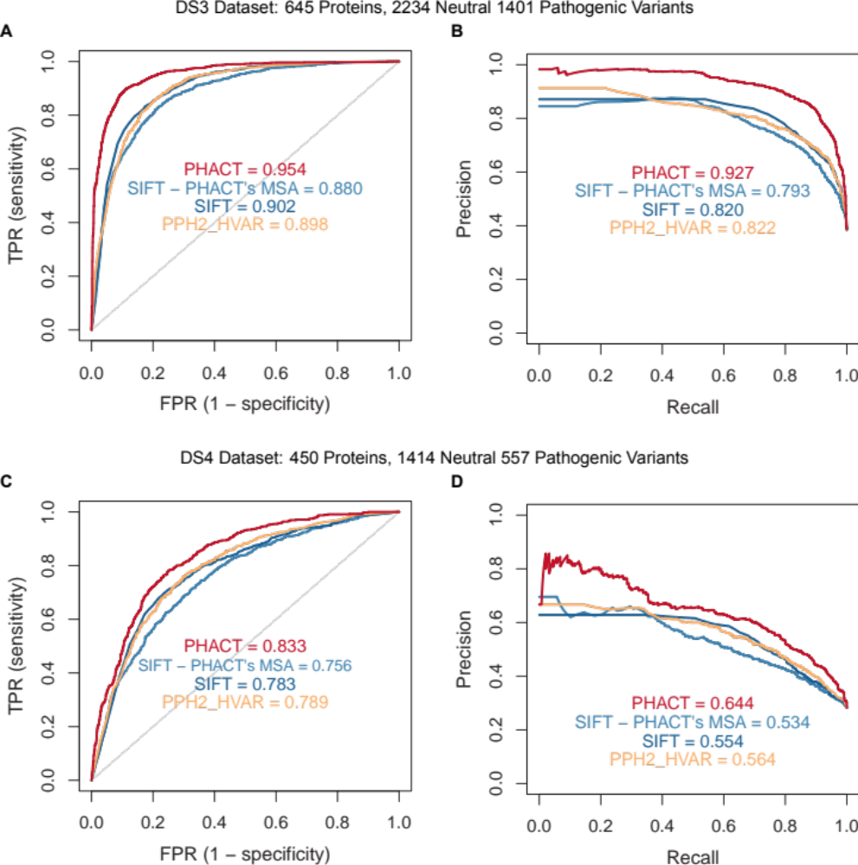
RESULTS
DS3 - 645 Proteins
2234 Neutral & 1401 Pathogenic Variants
Created for CAGI 6
genomeinterpretation.org
Nurdan KURU

Slide 8
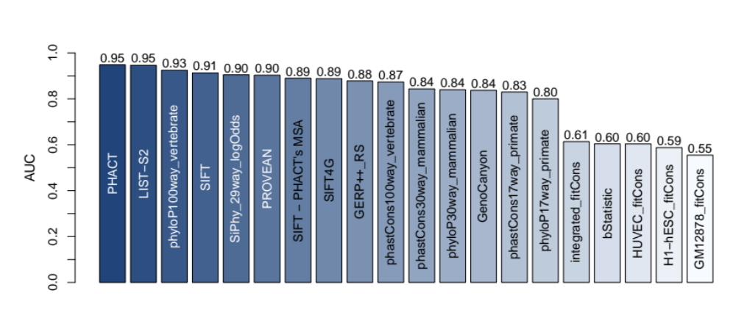
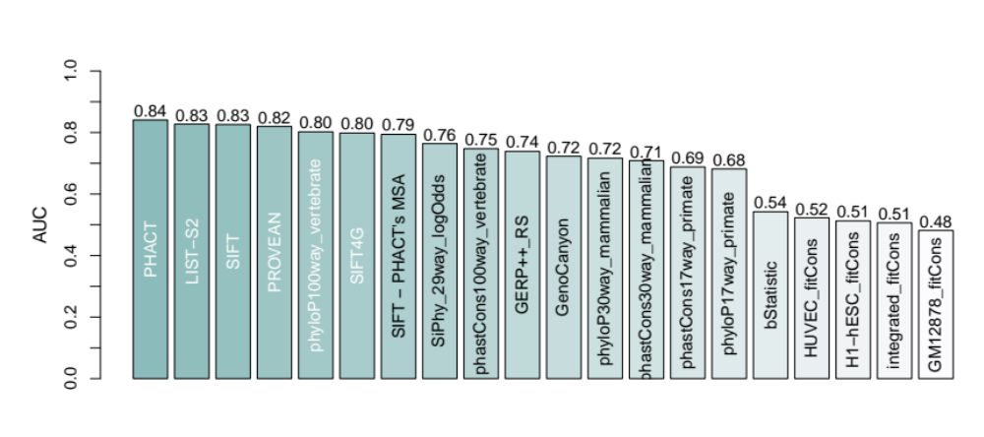
DS5 - 1155 Proteins
5014 Neutral & 7165 Pathogenic Variants
DS6 - 1023 Proteins
5859 Neutral & 11871 Pathogenic Variants
Created for CAGI 6
genomeinterpretation.org
Nurdan KURU

Slide 9
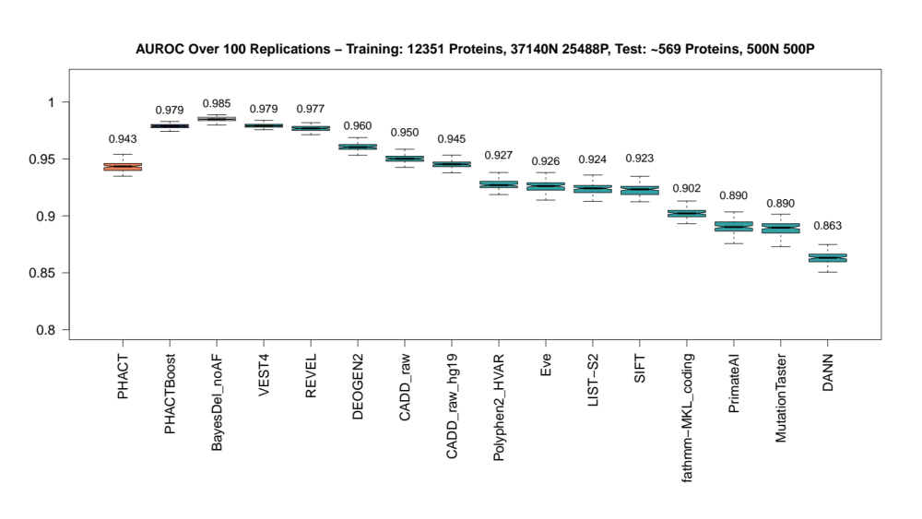
CONCLUSION
PHACT can achieve better predictive performances than do the benchmark algorithms over different datasets.
PHACT, which exploits the information stemming from the phylogenetic tree showed higher predictive performances in AUC, AUPR, MCC, F1 score and balanced accuracy measures.
ONGOING WORK
A supervised machine learning algorithm based on PHACT
Coevolution addition to PHACT
Web server
Initial results
Created for CAGI 6
genomeinterpretation.org
Nurdan KURU

Slide 10
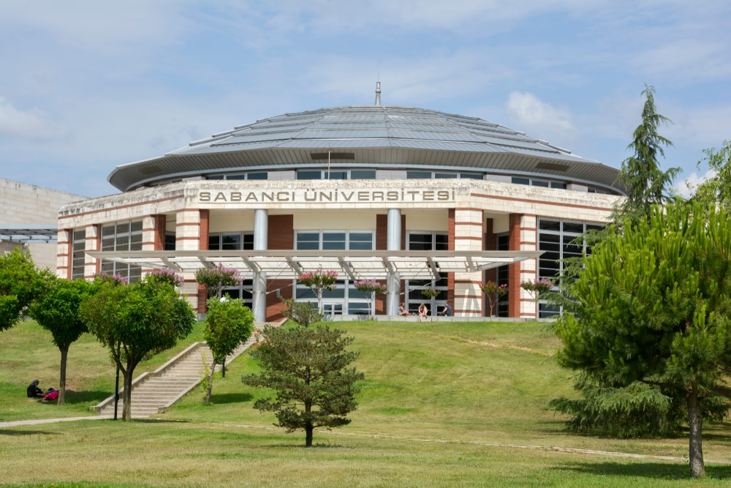
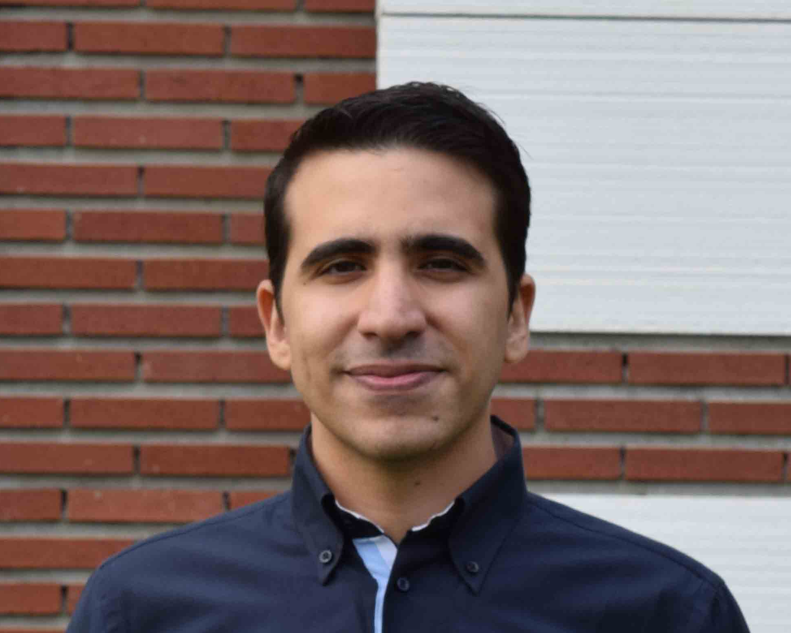
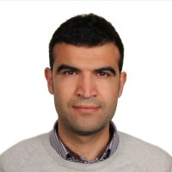
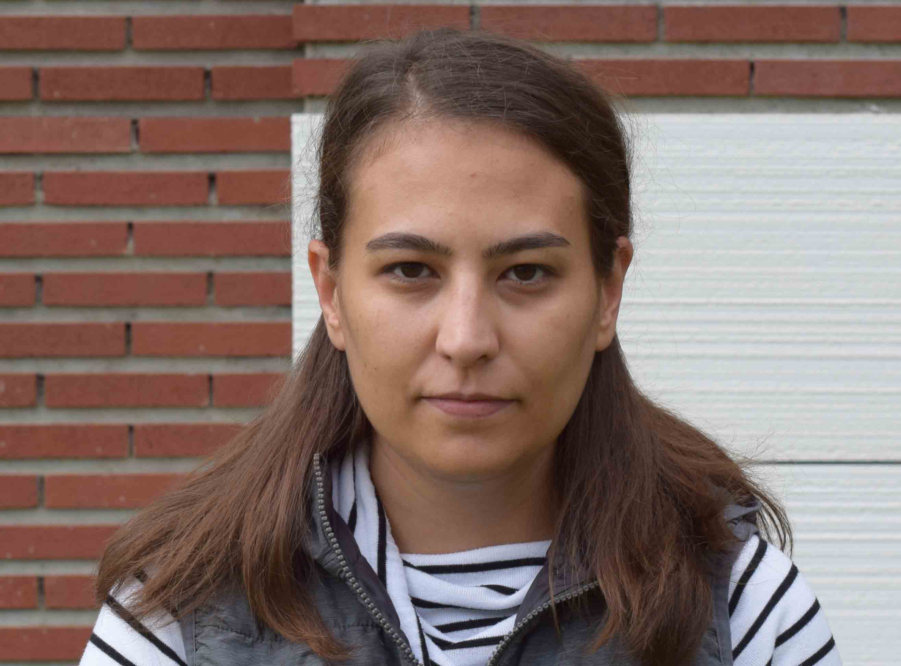
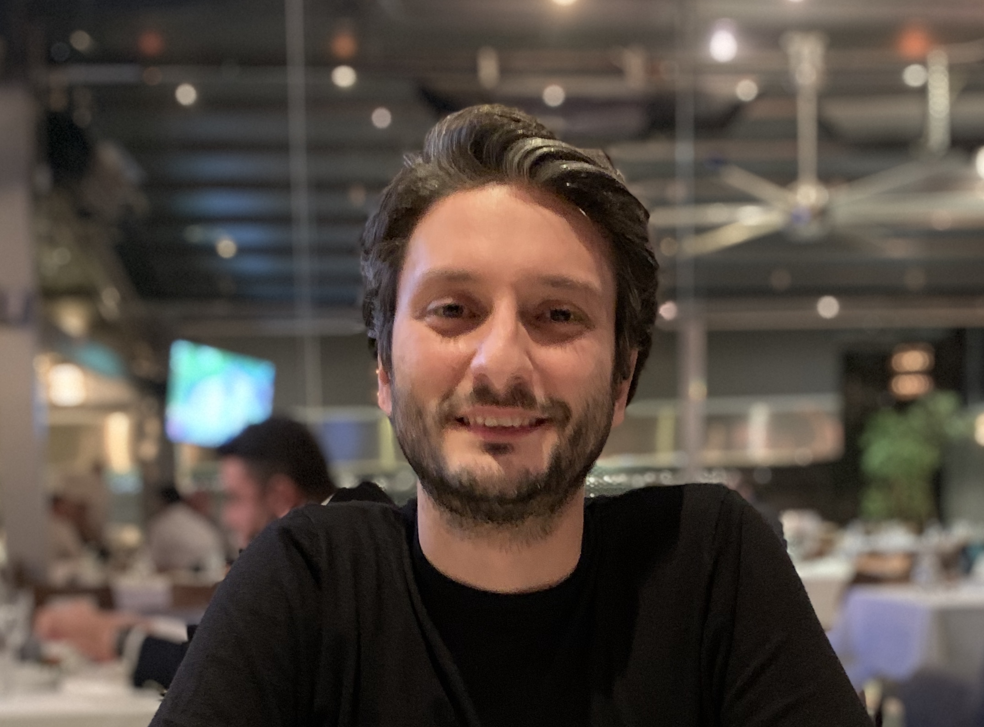
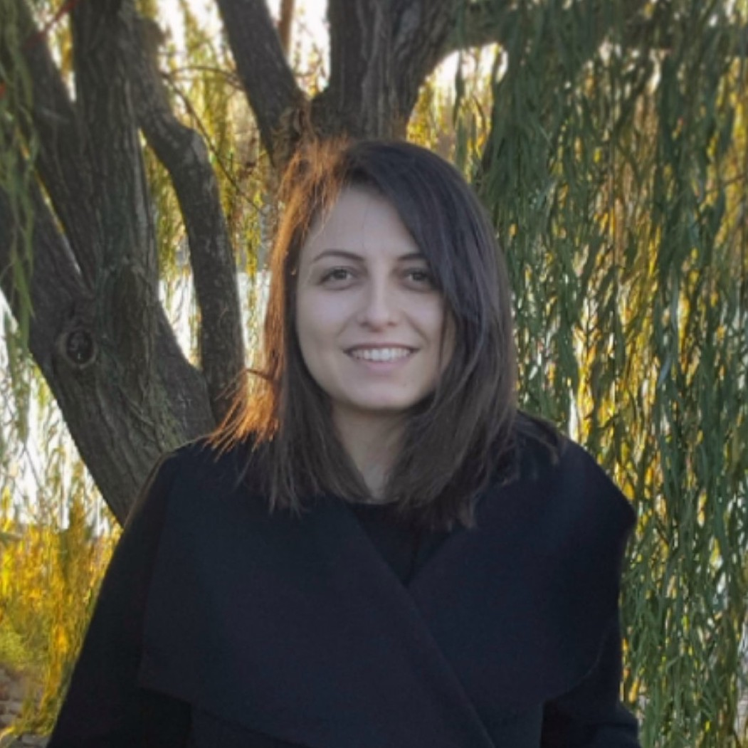


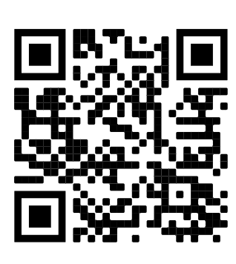

TEAM
Ogün Adebali (PI)
Emrah Akkoyun (Postdoc)
Aylin Bircan (PhD Candidate)
Onur Dereli (Postdoc)
Nurdan Kuru (Postdoc)
Öznur Taştan (Researcher)
ACKNOWLEDGEMENTS
SCAN FOR
GITHUB PAGE
(Health Institutes of Turkey)
Created for CAGI 6
genomeinterpretation.org
Nurdan KURU

