Slide 1

CAGI slide pack guidelines
I agree to my slides being used according to the following terms:
_______Carlos Rodrigues_______
Authors: please include THIS slide at the beginning of your presentation to indicate that you agree with reuse of your slides in CAGI presentations, according to the terms below, and digitally sign by writing your name above.
To disseminate the CAGI results, I encourage all CAGI participants to remix these CAGI slides for inclusion in their oral and poster presentations
CAGI participants may use or publish any content of these slides only in compliance with the CAGI Data Use Agreement
CAGI participants may not cite or publish any content of these slides except with the written permission of the originating author or in the primary CAGI publications
CAGI participants must acknowledge the original authors of these slides and CAGI 6. Include the acknowledgement banner across the bottom
CAGI participants must include the CAGI credits slide in their presentations
Slides with a red slash (no remix) may not be included in a presentation unless all attendees are registered CAGI participants who signed the data use agreement
Slides with a red X over the entire slide may not be used in any circumstances
Slides with a blue slash (embargoed) may not be used unless the embargo is explicitly lifted
Slides without slash or X may be tweeted unless flagged with the “No tweet” icon.
CAGI participants using these slides must explain the “No tweet” icon, which means that the slide content should not be disseminated outside the presenting conference hall. If the presentation venue permits pervasive tweeting, you may not include these slides in your talk
Note for slide authors: we expect all CAGI participants to abide by these restrictions, and will make best effort to ensure they are followed. However, but bear in mind that we have limited means of enforcing them, and therefore the restrictions cannot be guaranteed.

Slide 2
Permission request regarding CAGI 6 recordings and hybrid presentations
I understand that my presentation as associated with CAGI 6 will be recorded and broadcasted via the internet through CAGI’s designated technology provider.
As the copyright holder to this presentation entitled [Computational Tools to Predict Protein Stability Changes Upon Missense Mutations], I hereby agree/disagree [agree] that the copyright for the online broadcast and recording of my presentation be released to CAGI and my recording be uploaded on to the CAGI website.

Slide 3
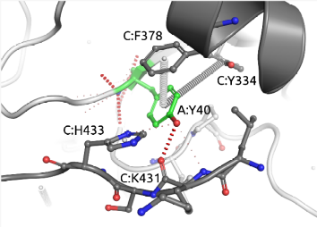
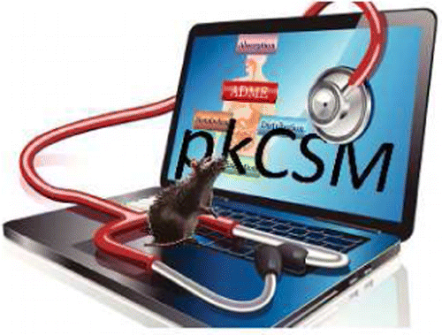
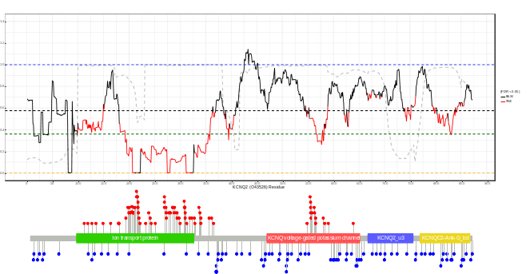
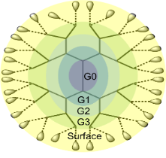
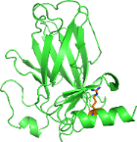
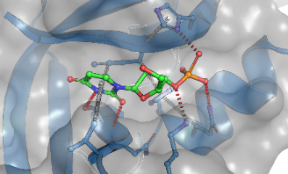
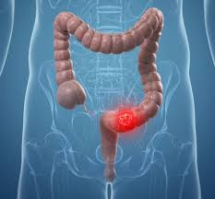
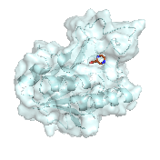
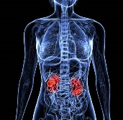
Computational Biology and Clinical Informatics Laboratory
Molecular Interactions
Small molecules
Mutational Effects
Mutational Tolerance
MTR-viewer
MTR-3D
Calculate and display intra and intermolecular interactions
Arpeggio
Small molecule ADMET
pkCSM
Kinase Activating Mutations
Kinact
Protein Stability
mCSM
DUET
SDM2
DynaMut
DynaMut2
ThermomutDB
Nanoparticle pharmacokinetics
DendPoint
Rapid Virtual Screening
EasyVS
Small molecule activity
pdCSM-cancer
pdCSM-ppi
kinCSM
PPIs
mCSM-PPI
mCSM-PPI2
mmCSM-PPI
Protein-NA Interaction
mCSM-NA
mCSM-NA2
Protein-Ligand Binding Affinities
CSM-lig
Clinical Genomics
Antimicrobial resistance
Suspect-BDQ
Suspect-PZA
Cancer risk
Symphony
STRUMMR
StrumNHEJ
http://biosig.unimelb.edu.au/
Created for CAGI 6
genomeinterpretation.org
Carlos Rodrigues

Slide 4
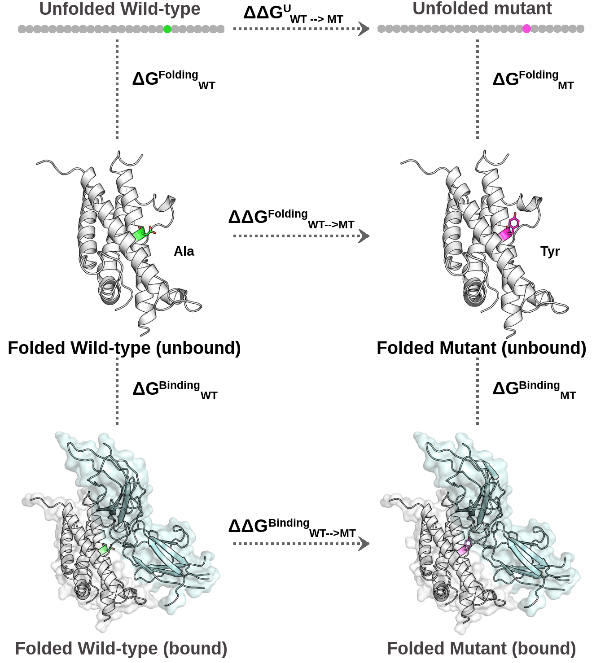
Understanding Mutations
ΔG^{Folding} = ΔH - TΔS
H : Enthalpy
T : Temperature
S : Entropy
ΔG^{Binding} = - RT ln(K_{D})
R : Ideal Gas constant (~1.9872 cal/K·mol)
T : Temperature
K_{D}: [M₁][M₂]/[M₁ . M₂]
M₁: Molecule 1
M₂: Molecule 2
Created for CAGI 6
genomeinterpretation.org
Carlos Rodrigues

Slide 5
Understanding Mutations – CAGI6 Calmodulin Challenge
ΔG^{Folding} = ΔH - TΔS
H : Enthalpy
T : Temperature
S : Entropy
ΔG^{Binding} = - RT ln(K_{D})
R : Ideal Gas constant (~1.9872 cal/K·mol)
T : Temperature
K_{D}: [M₁][M₂]/[M₁ . M₂]
M₁: Molecule 1
M₂: Molecule 2
Created for CAGI 6
genomeinterpretation.org
Carlos Rodrigues

Slide 6
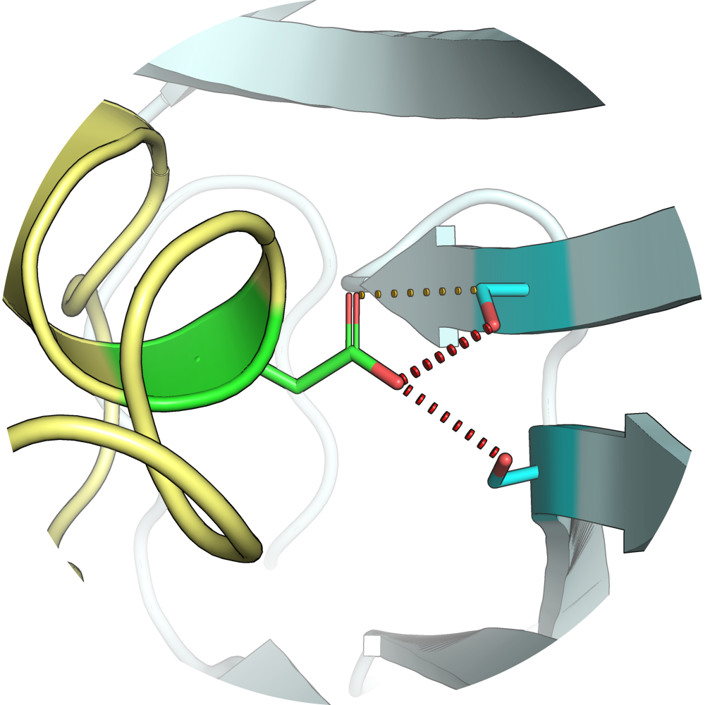
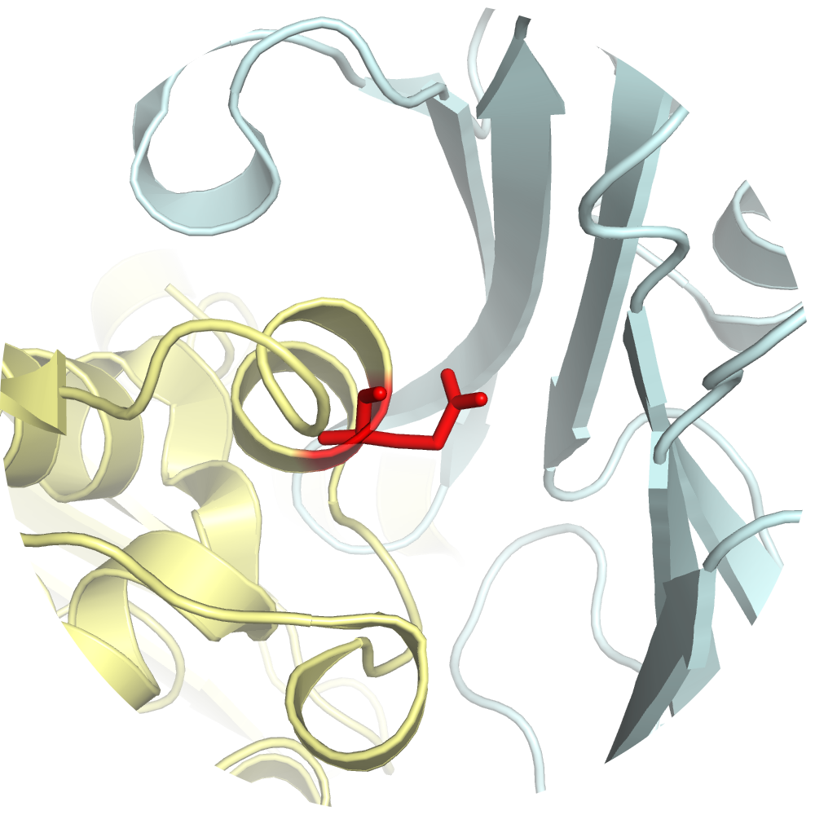
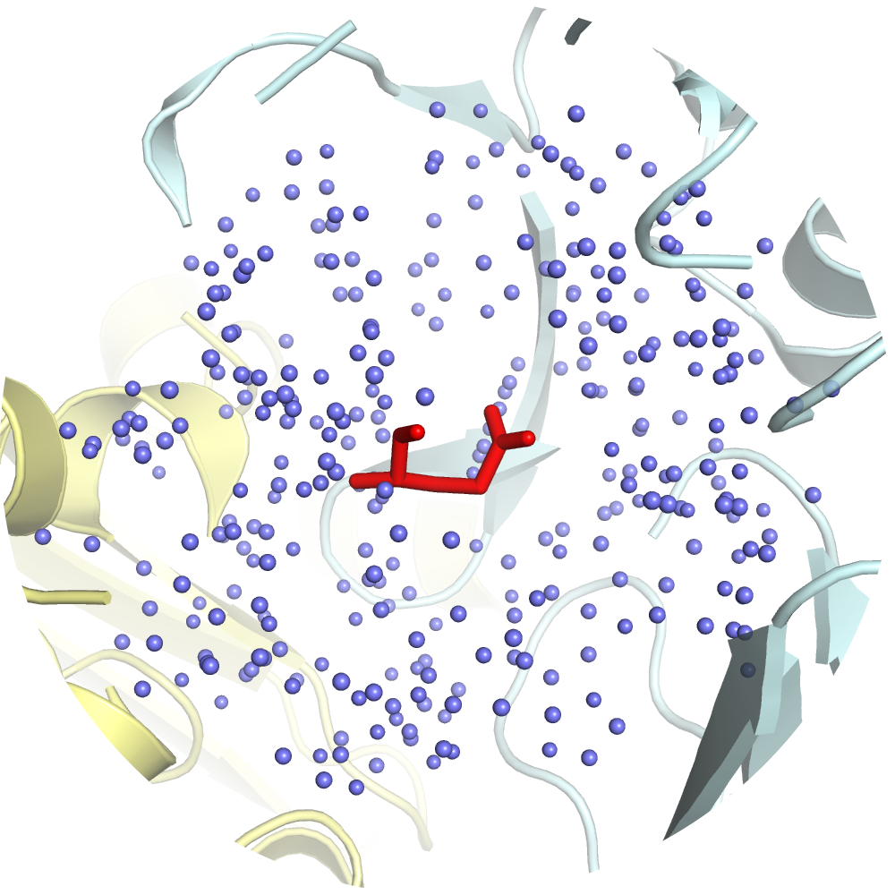
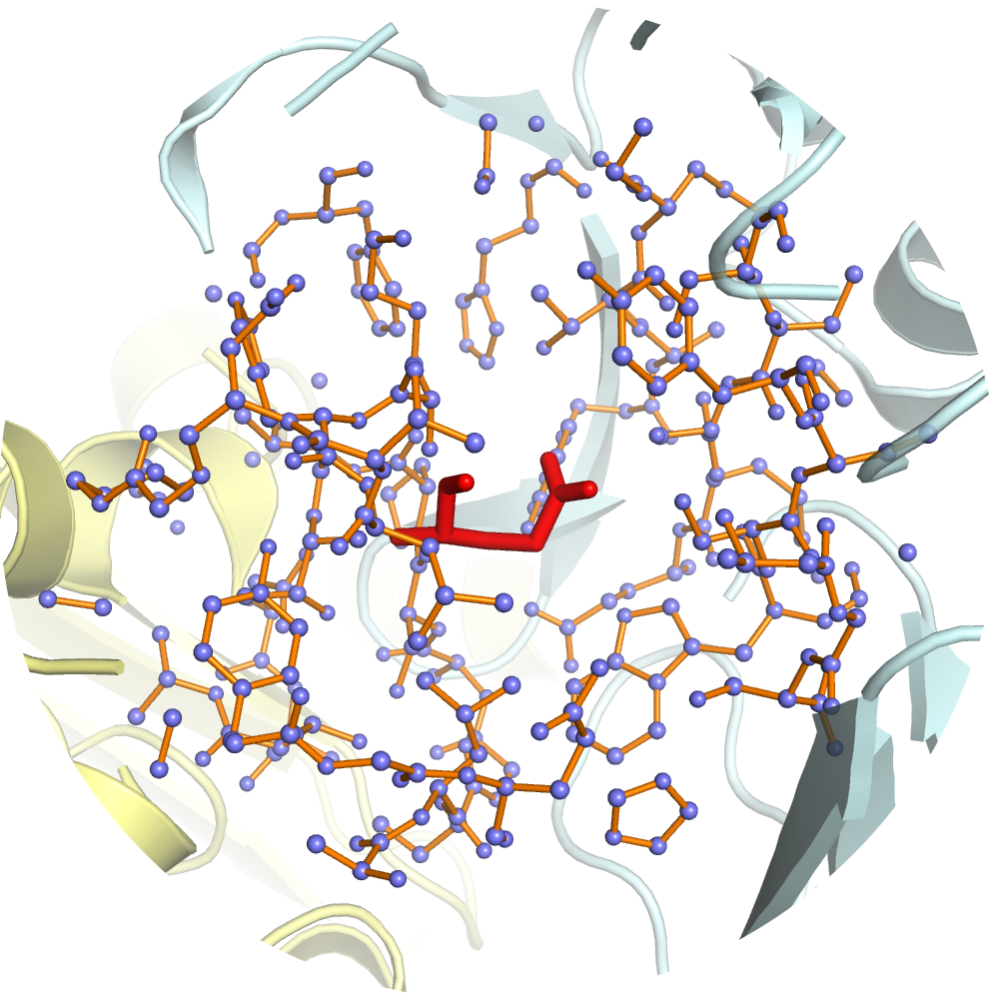
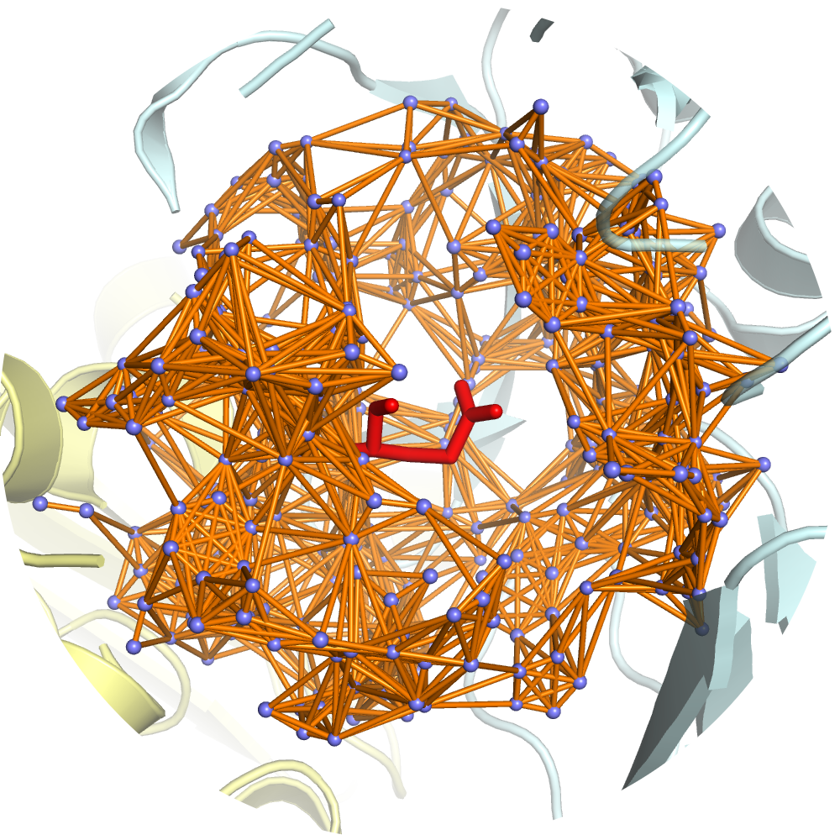
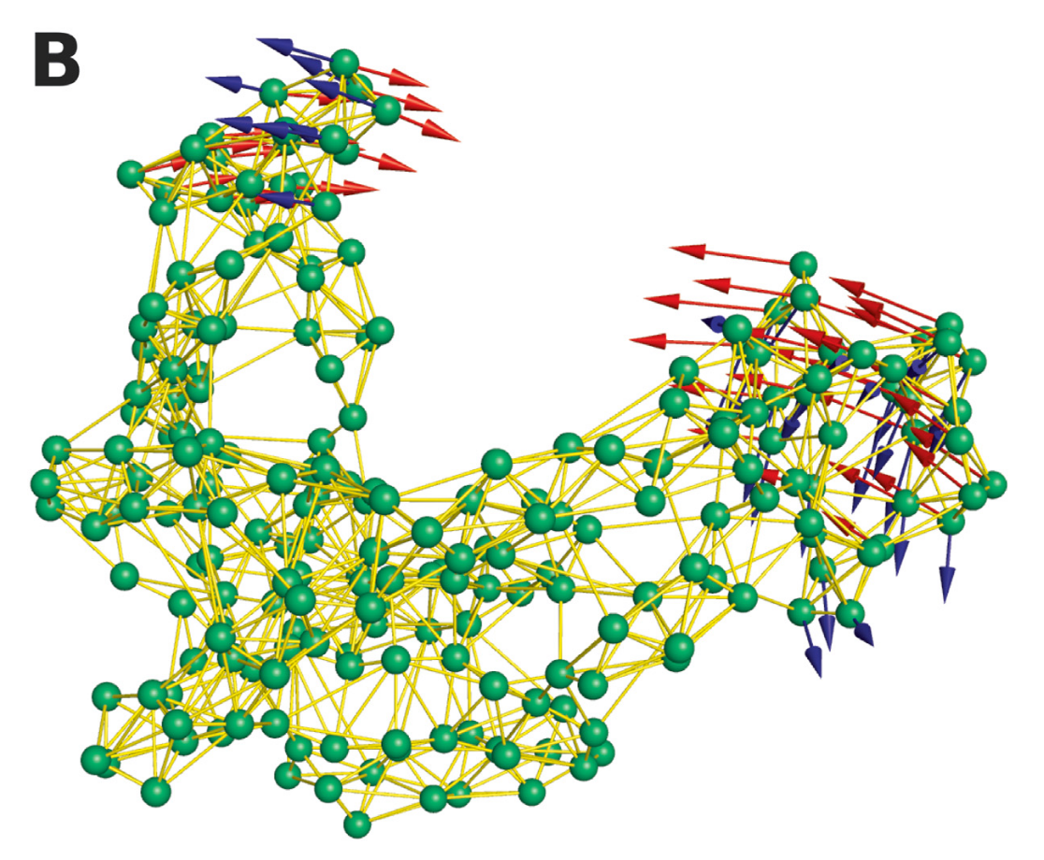
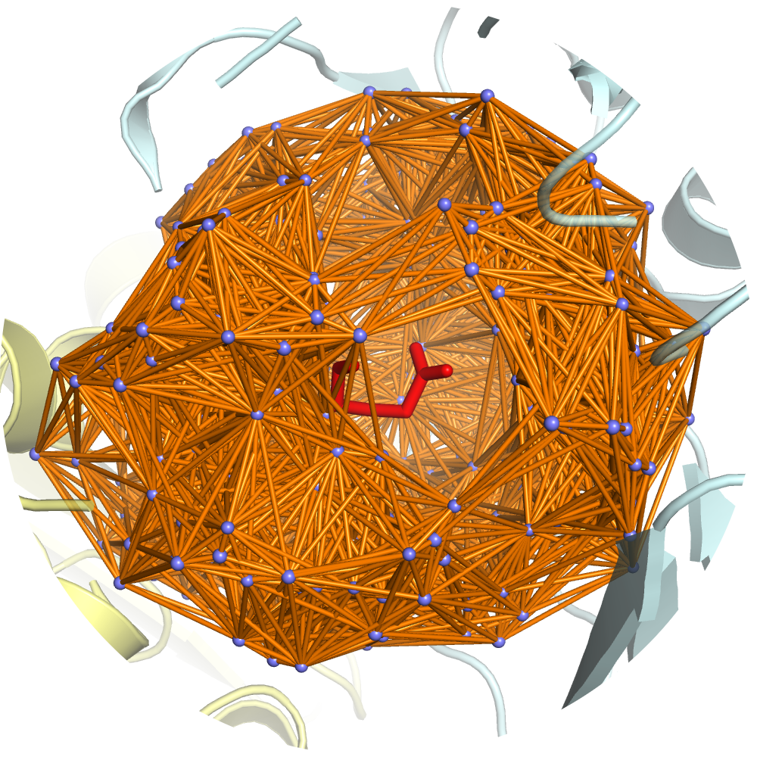
Protein Structure
A
B
Jubb et al., 2017
C
D
E
Frappier, V., et al., 2015
Pires et al., 2013
Created for CAGI 6
genomeinterpretation.org
Carlos Rodrigues

Slide 7
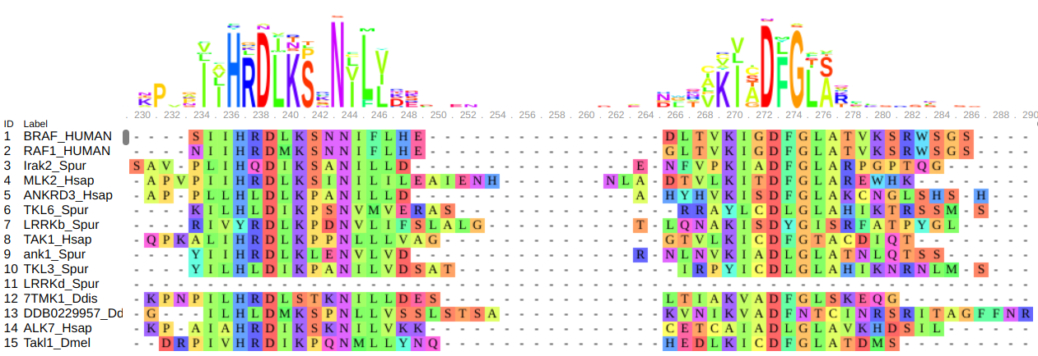
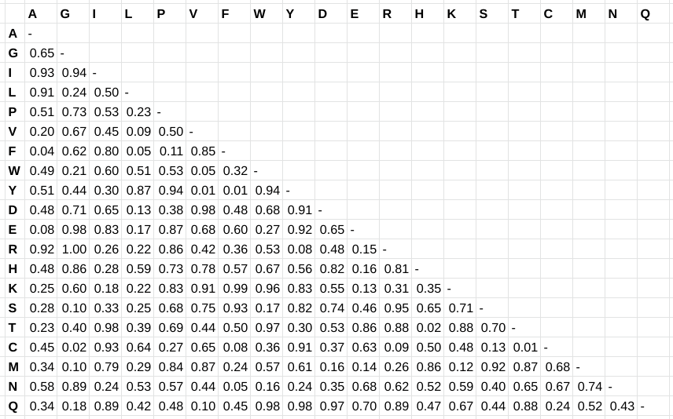
Protein Sequence
>BRAF_HUMAN
SASAAQPAKNVEKDYIVGFKSGVKTASVKKDIIKESGGKVDKQFRIINAAKAKLDKEA
LKEVKNDPDVAYVEEDHVAHALAQTVPYGIPLIKADKVQAQGFKGANVKVAVLDTGI
QASHPDLNVVGGASFVAGEAYNTDGNGHGTHVAGTVAALDNTTGVLGVAPSVSLY
AVKVLNSSGSGSYSGIVSGIEWATTNGMDVINMSLGGASGSTAMKQAVDNAYARG
VVVVAAAGNSGSSGNTNTIGYPAKYDSVIAVGAVDSNSNRASFSSVGAELEVMAPG
AGVYSTYPTNTYATLNGTSMASPHVAGAAALILSKHPNLSASQVRNRLSSTATYLGS
SFYYGKGLINVEAAAQ
Created for CAGI 6
genomeinterpretation.org
Carlos Rodrigues

Slide 8
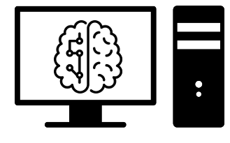
Machine Learning Workflow
Structure
Sequence
A
B
C
D
E
Created for CAGI 6
genomeinterpretation.org
Carlos Rodrigues

Slide 9
CAGI6 Calmodulin Challenge
APO structure of CaM
  PDB: 1DMO
CaM under Ca²⁺-saturating conditions
  PDB: 1CLL
Changes in the Gibbs Free Energy of Folding (ΔΔG) were used as direct measures of melting temperature values
ID | Name | Description
1 | DUET | biosig.unimelb.edu.au/duet
2 | ENCoM | biosig.unimelb.edu.au/dynamut
3 | mCSM | biosig.unimelb.edu.au/mcsm
4 | SDM | biosig.unimelb.edu.au/sdm
5 | DynaMut | biosig.unimelb.edu.au/dynamut
6 | DynaMut2 | biosig.unimelb.edu.au/dynamut2
Created for CAGI 6
genomeinterpretation.org
Carlos Rodrigues

Slide 10


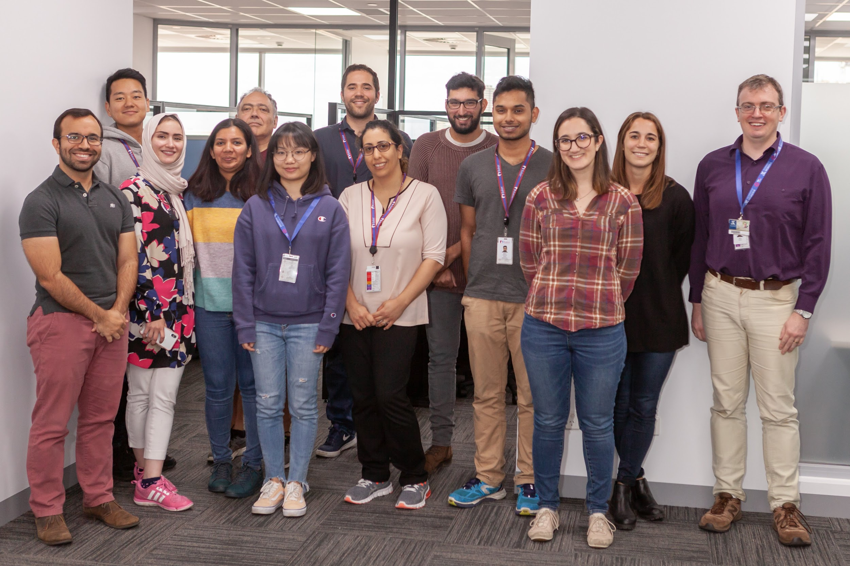









Acknowledgements
biosig.unimelb.edu.au
carlos.rodrigues@baker.edu.au
@carlosmr12
Created for CAGI 6
genomeinterpretation.org
Carlos Rodrigues

