Slide 1
CAGI slide pack guidelines
I agree to my slides being used according to the following terms:
_______Predrag Radivojac_______
Authors: please include THIS slide at the beginning of your presentation to indicate that you agree with reuse of your slides in CAGI presentations, according to the terms below, and digitally sign by writing your name above.
To disseminate the CAGI results, I encourage all CAGI participants to remix these CAGI slides for inclusion in their oral and poster presentations
CAGI participants may use or publish any content of these slides only in compliance with the CAGI Data Use Agreement
CAGI participants may not cite or publish any content of these slides except with the written permission of the originating author or in the primary CAGI publications
CAGI participants must acknowledge the original authors of these slides and CAGI 2013. Include the acknowledgement banner across the bottom
CAGI participants must include the CAGI credits slide in their presentations
Slides with a red slash (no remix) may not be included in a presentation unless all attendees are registered CAGI participants who signed the data use agreement
Slides with a red X over the entire slide may not be used in any circumstances
Slides with a blue slash (embargoed) may not be used unless the embargo is explicitly lifted
Slides without slash or X may be tweeted unless flagged with the “No tweet” icon.
CAGI participants using these slides must explain the “No tweet” icon, which means that the slide content should not be disseminated outside the presenting conference hall. If the presentation venue permits pervasive tweeting, you may not include these slides in your talk
Note for slide authors: we expect all CAGI participants to abide by these restrictions, and will make best effort to ensure they are followed. However, but bear in mind that we have limited means of enforcing them, and therefore the restrictions cannot be guaranteed.

Slide 2
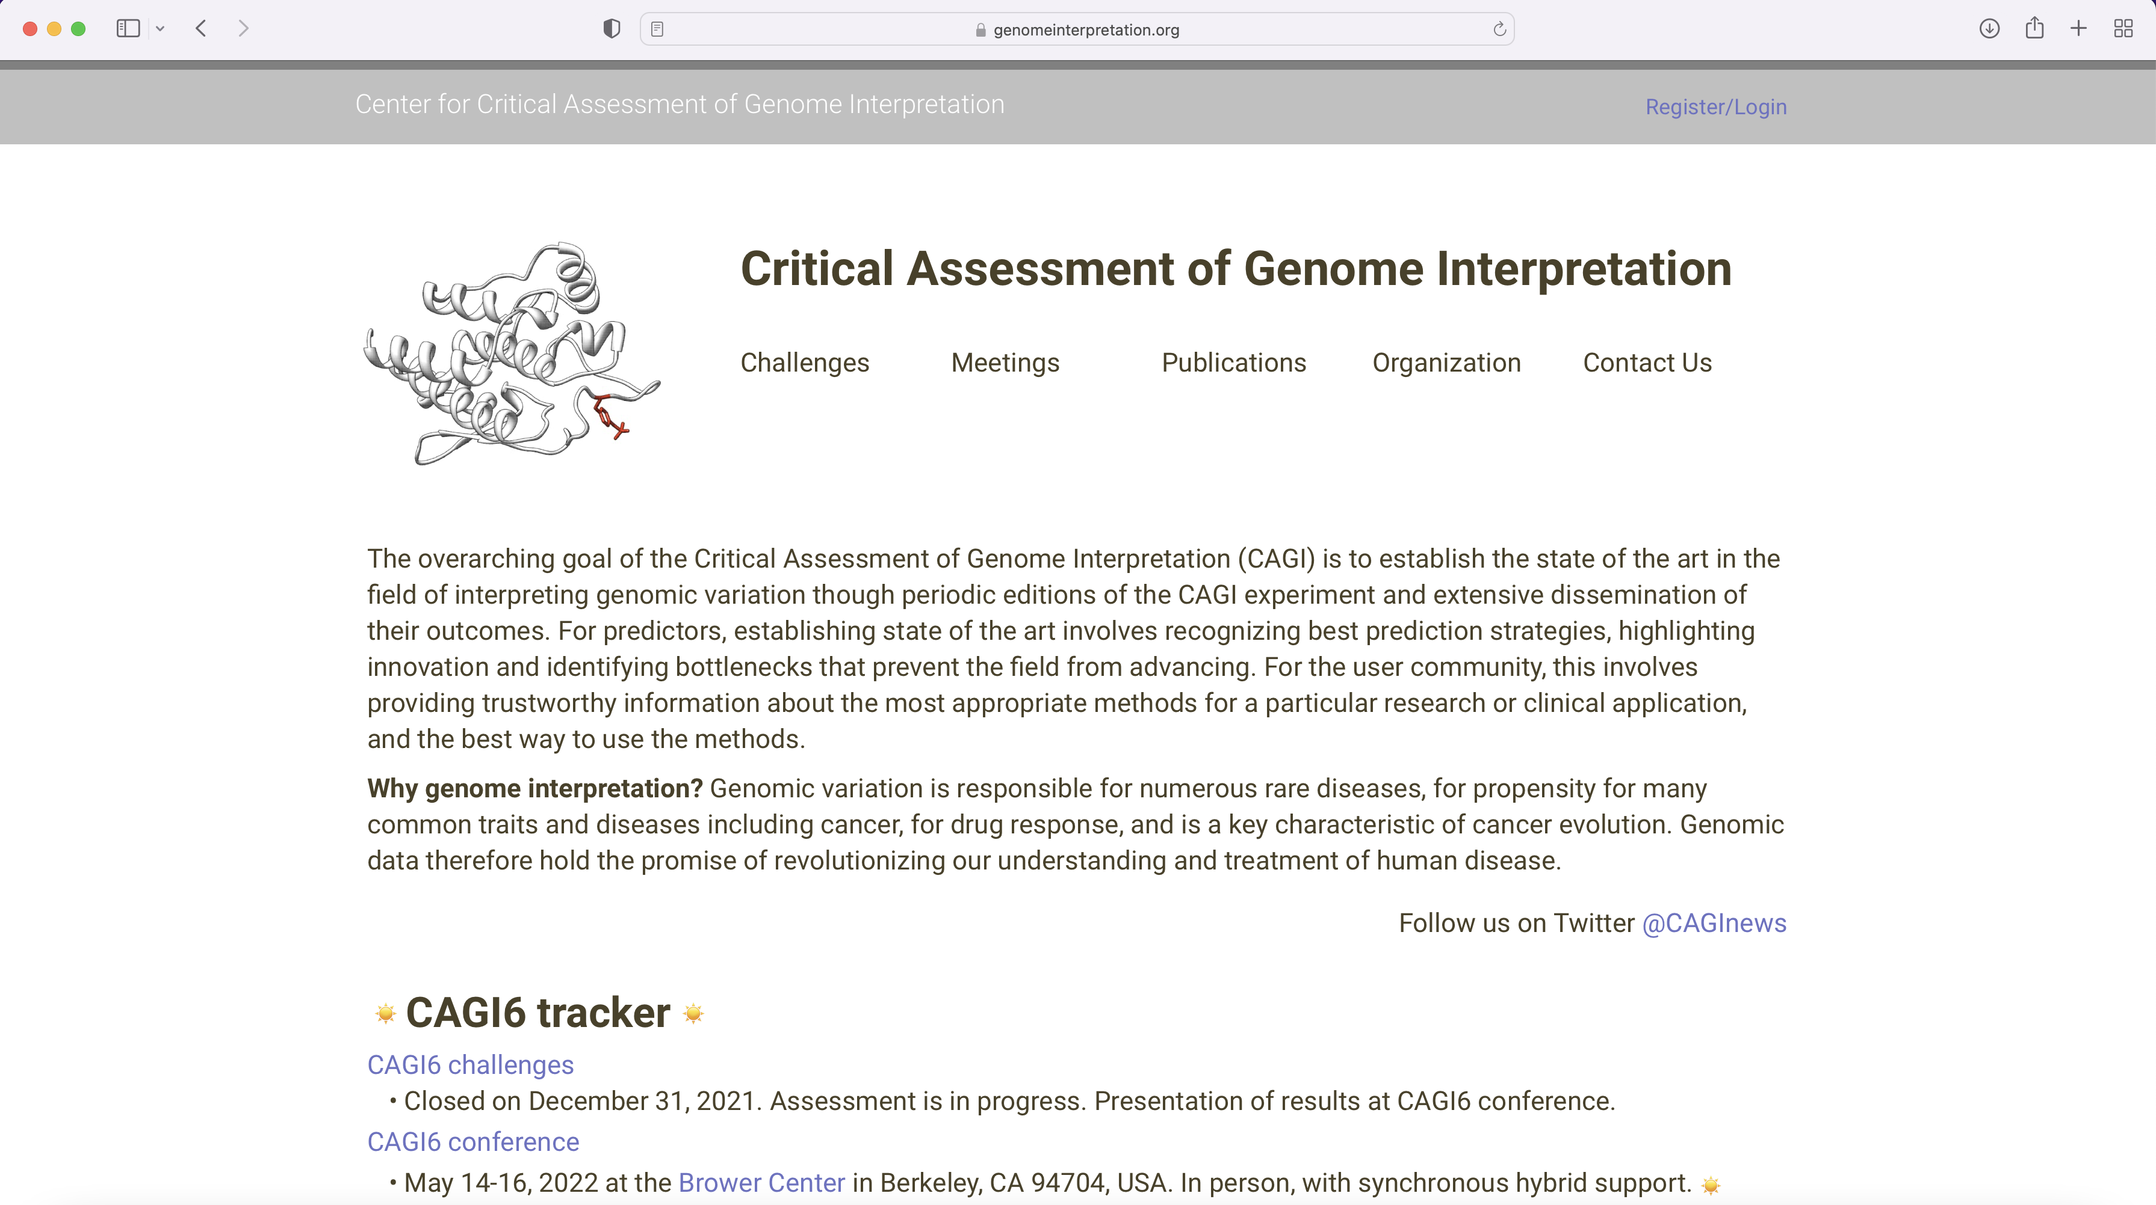
CAGI Web Site

Slide 3
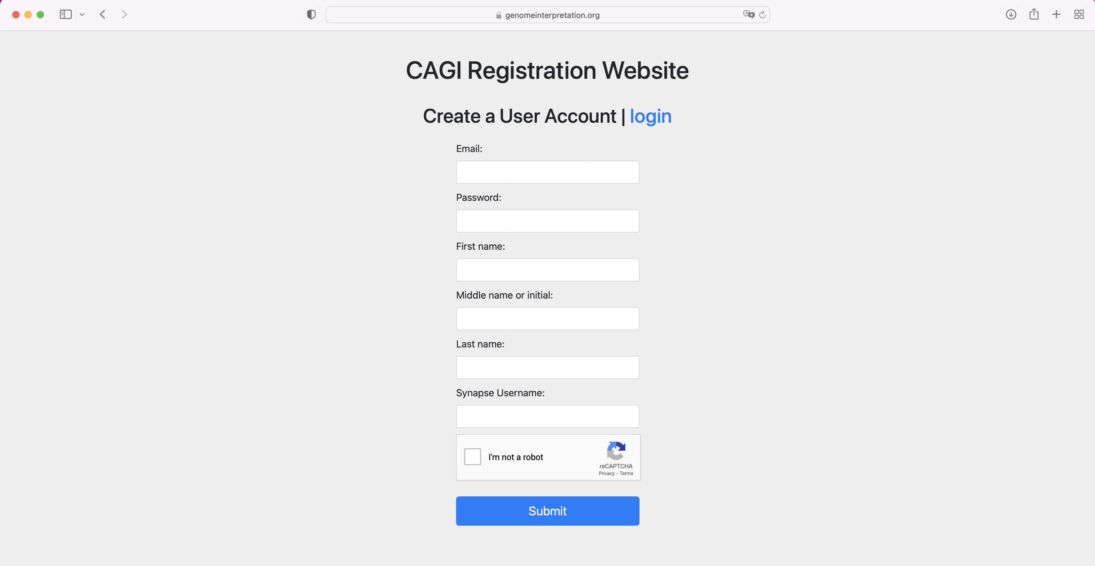
CAGI Web Site
Credit: Shawn Peng, Akash Kamandula

Slide 4
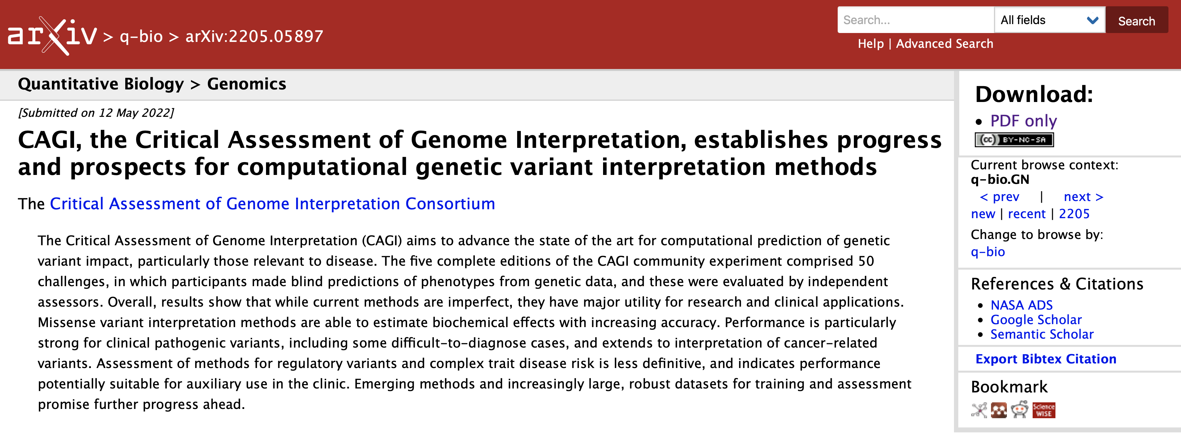
CAGI Summary Paper
Analysis & writing: Shantanu Jain⁺, Constantina Bakolitsa⁺, Steven Brenner*, Predrag Radivojac*, John Moult*
Categories: Analysis and writing, CAGI organizers, Informatics infrastructure & support, Predictors, Challenge data providers, Ethics forum, Assessors, Advisory board & council, CAGI chairs
Details on Sunday, paper available from CAGI web site

Slide 5
CAGI6 Challenges
13 CAGI6 challenges
  Challenge development: Late 2020, Spring 2021
  Challenge season: May 2021 through December 2021
  Recruitment of predictors: VIPdb, PubMed, recommendations, word of mouth
  Preassessment meeting: January 2021
  Submission portal (Synapse)
  Conference
7 missense, 5 clinical, 3 cancer, 1 splicing
One missense had data issues, two to be evaluated at CAGI*
Ethics forum involved in setting up challenges
Data distribution/sharing, data types, closed environment

Slide 6
CAGI6 in Numbers
CAGI6 challenges: 13
Total CAGI6 participants (registered & validated): 192
Total groups registered for challenges: 219
Total group submissions: >500
Unique groups registered for challenges: 71
Unique group submissions: 51
Unique countries: 17

Slide 7
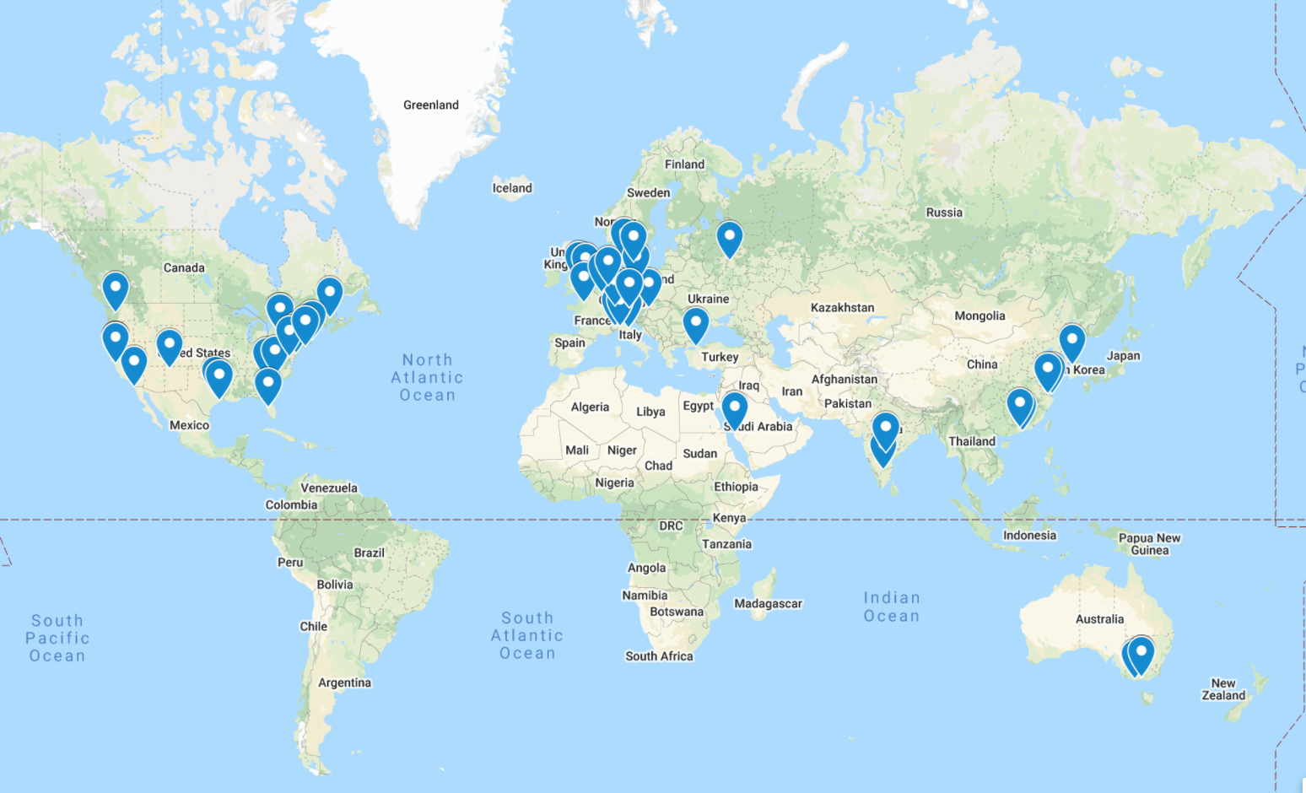
CAGI6: 51 groups, >500 models, 17 countries
Notes:
Participation in CAGI6 reached an all-time high, with 51 unique groups submitting a total of over 500 models,
an increase of 23% compared to the previous record (40 groups in CAGI4). The expansion of new methods
goes some way towards explaining this increase. The past few years have seen the development of several
new splicing predictors; some of these, such as SPiCE and SQRLS, entered the CAGI6 splicing challenge, as
did a developer of splicing metapredictors. Polygenic risk scores comprise another new area of development,
and almost all predictors who submitted in the CAGI6 PRS challenge were new participants. New missense
developers, such as MISTIC, also entered this round of CAGI, as did several new biotech companies, including
3billion from South Korea and Nostos Genomics from Germany. In other cases, data providers (Invitae, Roth lab), also participated as predictors for the first time in CAGI.

Slide 8
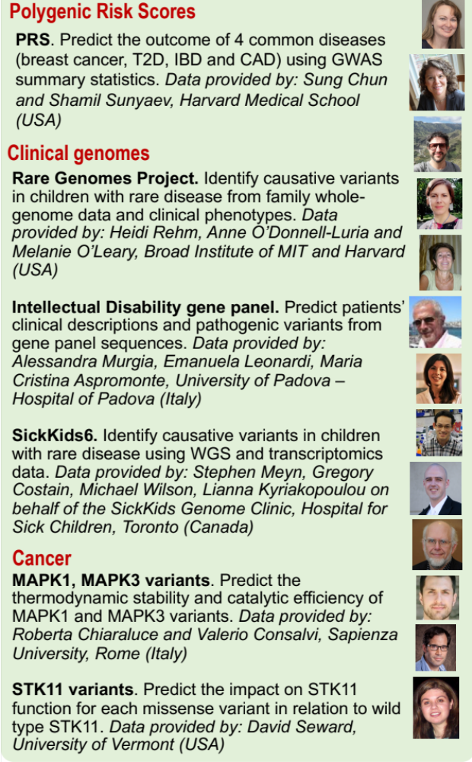
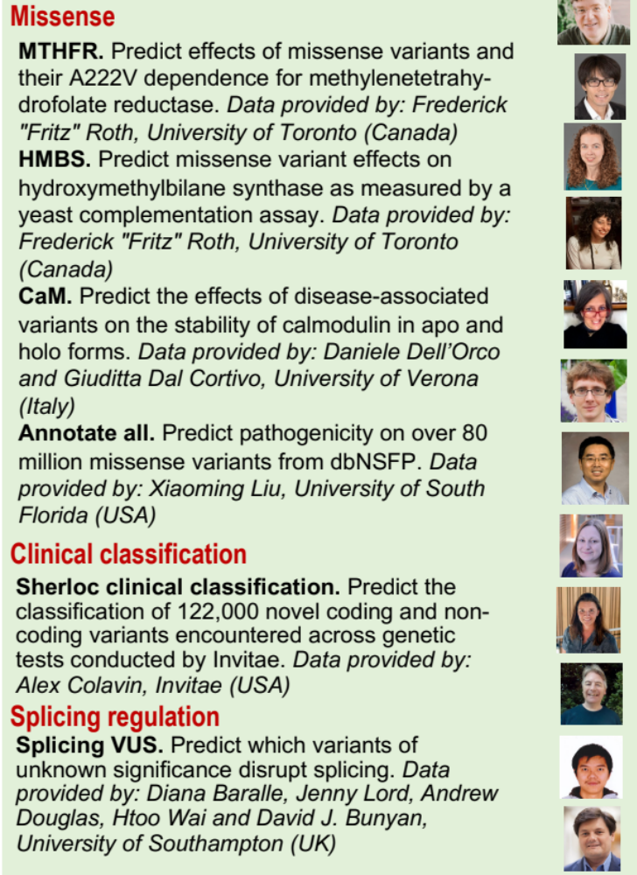
CAGI6 challenges

Slide 9
CAGI6 Group Registrations and Submissions

Slide 10
CAGI6 Participation Rate

Slide 12
CAGI slide pack guidelines
I agree to my slides being used according to the following terms:
_______Constantina Bakolitsa_______
Authors: please include THIS slide at the beginning of your presentation to indicate that you agree with reuse of your slides in CAGI presentations, according to the terms below, and digitally sign by writing your name above.
To disseminate the CAGI results, I encourage all CAGI participants to remix these CAGI slides for inclusion in their oral and poster presentations
CAGI participants may use or publish any content of these slides only in compliance with the CAGI Data Use Agreement
CAGI participants may not cite or publish any content of these slides except with the written permission of the originating author or in the primary CAGI publications
CAGI participants must acknowledge the original authors of these slides and CAGI 2013. Include the acknowledgement banner across the bottom
CAGI participants must include the CAGI credits slide in their presentations
Slides with a red slash (no remix) may not be included in a presentation unless all attendees are registered CAGI participants who signed the data use agreement
Slides with a red X over the entire slide may not be used in any circumstances
Slides with a blue slash (embargoed) may not be used unless the embargo is explicitly lifted
Slides without slash or X may be tweeted unless flagged with the “No tweet” icon.
CAGI participants using these slides must explain the “No tweet” icon, which means that the slide content should not be disseminated outside the presenting conference hall. If the presentation venue permits pervasive tweeting, you may not include these slides in your talk
Note for slide authors: we expect all CAGI participants to abide by these restrictions, and will make best effort to ensure they are followed. However, but bear in mind that we have limited means of enforcing them, and therefore the restrictions cannot be guaranteed.

Slide 13
CAGI 6 conference numbers & logistics
Fellowships: 14 applications, 7 travel fellowships awarded, 5 accepted
Attendance: 50:50 in-person:remote
Program: some surprises possible
Remote speakers: please present normally (screenshare)
Posters: see registration desk for boards/tripods
All breaks at terrace
Special thanks to: Akash Kamandula, Shawn Peng (CAGI website), Chris & Jason Maze

