Slide 1

CAGI slide pack guidelines
I agree to my slides being used according to the following terms:
_______Kyoungyeul Lee, Junwoo Woo, Dong-wook Kim_______
Authors: please include THIS slide at the beginning of your presentation to indicate that you agree with reuse of your slides in CAGI presentations, according to the terms below, and digitally sign by writing your name above.
To disseminate the CAGI results, I encourage all CAGI participants to remix these CAGI slides for inclusion in their oral and poster presentations
CAGI participants may use or publish any content of these slides only in compliance with the CAGI Data Use Agreement
CAGI participants may not cite or publish any content of these slides except with the written permission of the originating author or in the primary CAGI publications
CAGI participants must acknowledge the original authors of these slides and CAGI 6. Include the acknowledgement banner across the bottom
CAGI participants must include the CAGI credits slide in their presentations
Slides with a red slash (no remix) may not be included in a presentation unless all attendees are registered CAGI participants who signed the data use agreement
Slides with a red X over the entire slide may not be used in any circumstances
Slides with a blue slash (embargoed) may not be used unless the embargo is explicitly lifted
Slides without slash or X may be tweeted unless flagged with the “No tweet” icon.
CAGI participants using these slides must explain the “No tweet” icon, which means that the slide content should not be disseminated outside the presenting conference hall. If the presentation venue permits pervasive tweeting, you may not include these slides in your talk
Note for slide authors: we expect all CAGI participants to abide by these restrictions, and will make best effort to ensure they are followed. However, but bear in mind that we have limited means of enforcing them, and therefore the restrictions cannot be guaranteed.

Slide 2
Permission request regarding CAGI 6 recordings and hybrid presentations
I understand that my presentation as associated with CAGI 6 will be recorded and broadcasted via the internet through CAGI’s designated technology provider.
As the copyright holder to this presentation entitled “Finding causal variants using combined scores”, I hereby agree that the copyright for the online broadcast and recording of my presentation be released to CAGI and my recording be uploaded on to the CAGI website.

Slide 3
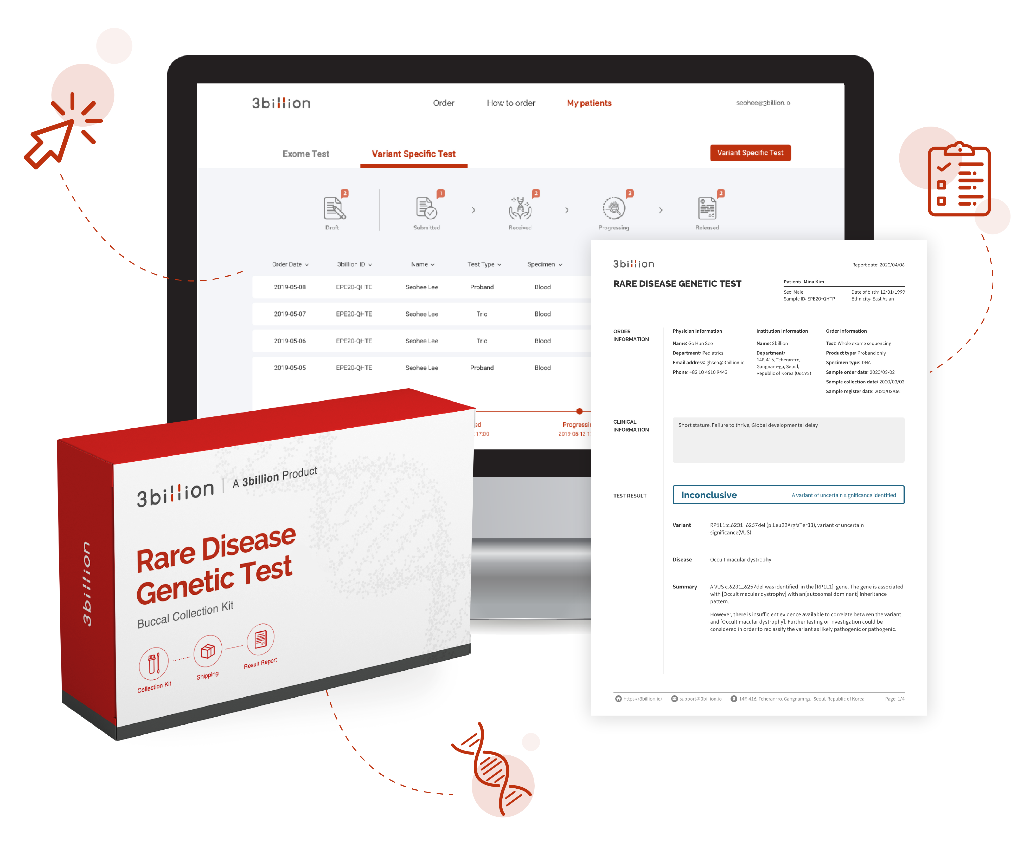
From 3billion bases to 1 answer
Kyoungyeul Lee
Notes:
Hi, my name is Kyoungyeul Lee, and I’m from 3billion, a start-up company in South Korea.
Our mission at 3billion is to help end the diagnostic odyssey for genetic disease patients around the globe.

Slide 4
Overall concept
Finding causal variants using combined scores
  EVIDENCE score
  Symptom similarity
  3Cnet score
Train a predictive model using in-house patient data to find the causal variants
  Model) sigmoid model, logistic regression
  Features) EVIDENCE, Symptom, 3Cnet scores
  Label) binary classification of variants
    Positive: confirmed causal variants of patients
    Negative: other variants of patients
Created for CAGI 6
genomeinterpretation.org
Kyoungyeul Lee
Notes:
For the SickKids task, we combined three different scores into a single one that represents the likelihood of a patient’s variant to be the causal one behind their disease.
I’m going to cover the details regarding the data, features used, and model training in this presentation.

Slide 5
EVIDENCE score
We developed streamlined variant prioritization software program, EVIDENCE¹, to prioritize variants based on ACMG/AMP guideline
The ACMG/AMP developed a guideline² for the interpretation of genetic variants, providing 28 criteria regarding pathogenicity.
EVIDENCE can interpret variants accurately and consistently by annotating specific ACMG criteria to each variant.
EVIDENCE combines these criteria into the probability score of pathogenicity³ according to a naive Bayesian framework.
1) Tavtigian, S. V et al. Modeling the ACMG/AMP variant classification guidelines as a Bayesian classification framework. Genet. Med. 20, 1054–1060 (2018).
2) Richards, S. et al. Standards and guidelines for the interpretation of sequence variants: A joint consensus recommendation of the American College of Medical Genetics and Genomics and the Association for Molecular Pathology. Genet. Med. 17, 405–424 (2015).
3) Seo, G. H. et al. Diagnostic yield and clinical utility of whole exome sequencing using an automated variant prioritization system, EVIDENCE. Clin. Genet. 98, 562–570 (2020).
Created for CAGI 6
genomeinterpretation.org
Kyoungyeul Lee
Notes:
The EVIDENCE score is a bayesian score calculated using EVIDENCE, 3billion’s in-house bioinformatics pipeline, streamlined for variant annotation and prioritization.
The annotation is based on the 28 criteria developed by the ACMG conference and is a fully automated process.
EVIDENCE annotates variants according to specific ACMG criteria by integrating information from various databases.
Also, it combines these criteria to calculate the probability for the variant to be pathogenic.
You can read more about EVIDENCE at the third reference listed below.

Slide 6
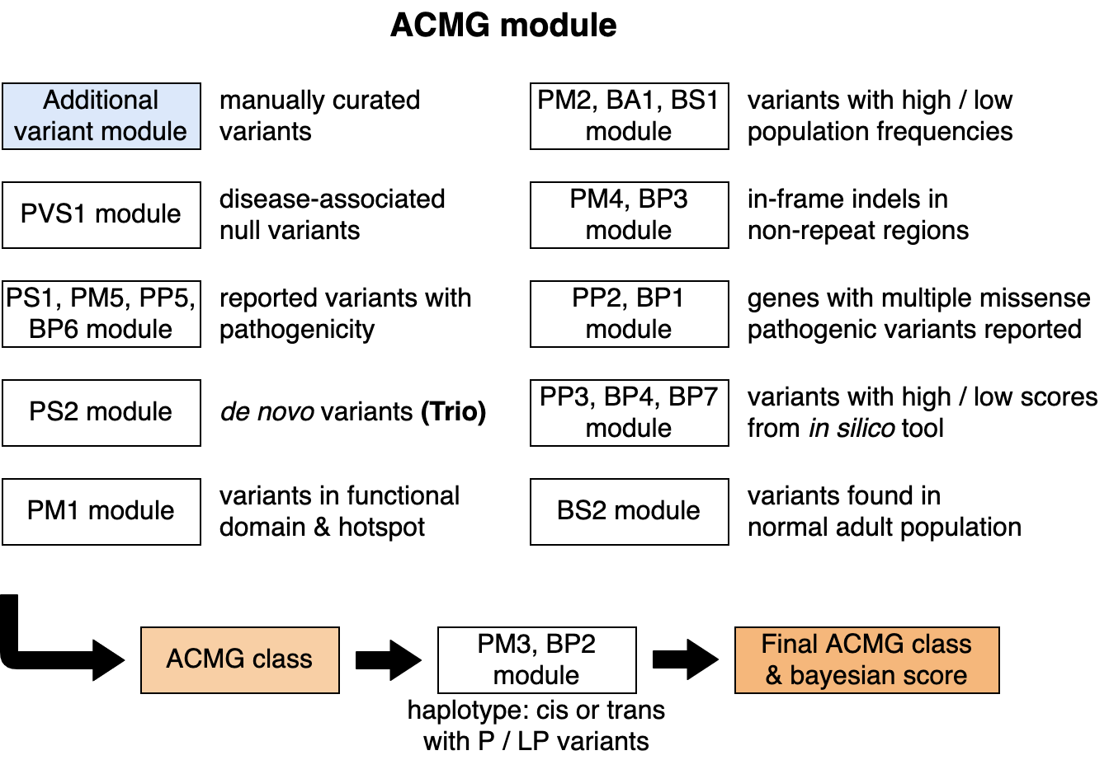
EVIDENCE score
Scheme of the EVIDENCE scoring system
Not used
in this project
Figure. EVIDENCE score: a bayesian score based on ACMG criteria
Created for CAGI 6
genomeinterpretation.org
Kyoungyeul Lee
Notes:
The scheme of the EVIDENCE scoring system consists of crieteria annotation and bayesian score calcuation.
There are different modules and databases responsible for each different ACMG criteria.
The EVIDENCE score is calculated according to the variant’s set of annotated criteria.

Slide 7
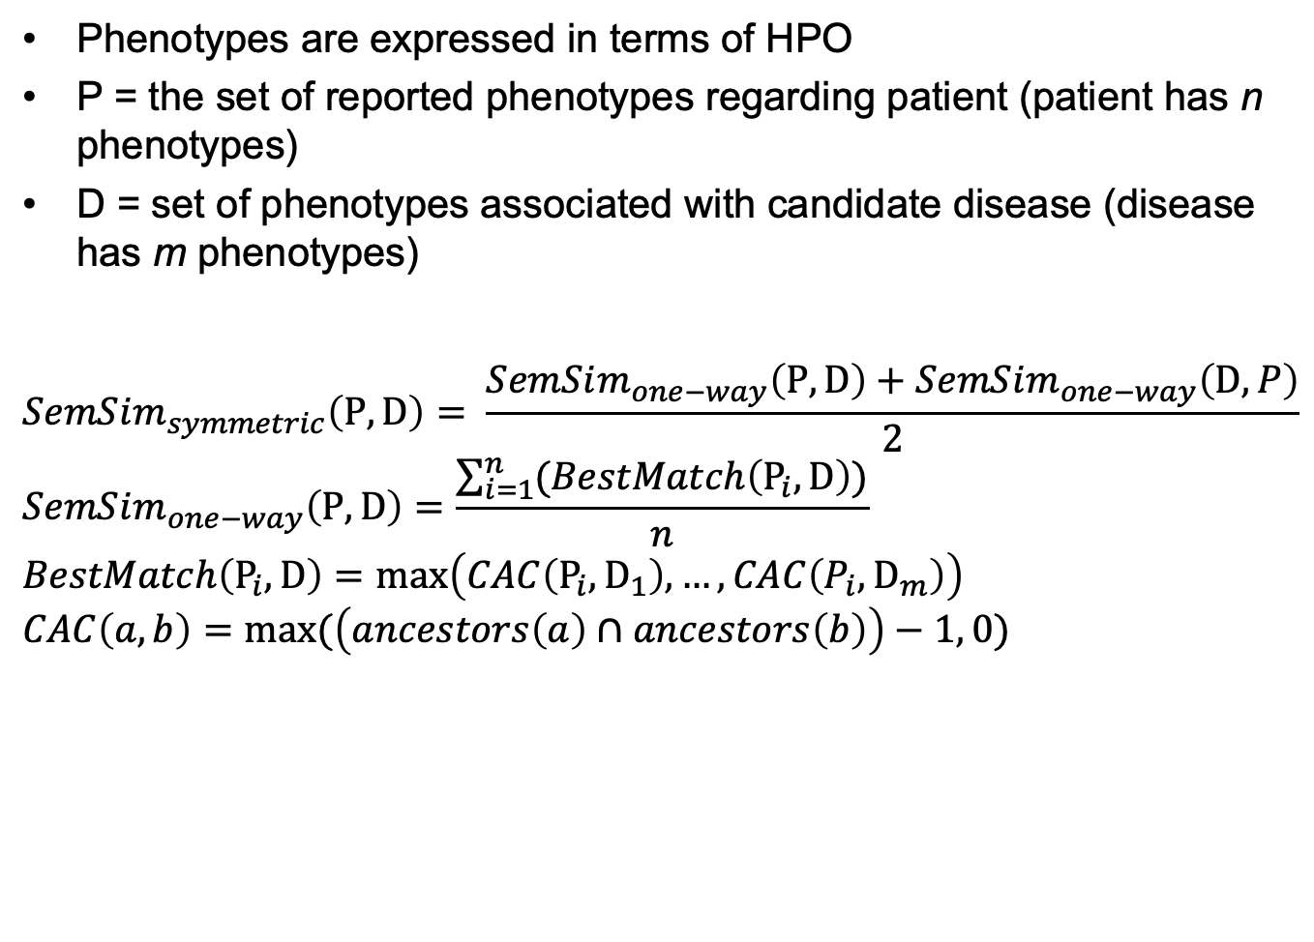
Symptom similarity ⁴
Phenotypes are expressed in terms of HPO
P = the set of reported phenotypes regarding patient (patient has n phenotypes)
D = set of phenotypes associated with candidate disease (disease has m phenotypes)
$$SemSim_{symmetric}\left(P,D\right)= \frac{SemSim_{one−way}\left(P,D\right)+SemSim_{one−way}\left(D,P\right)}{2}$$
$$SemSim_{one−way}\left(P,D\right)=\frac{\sum_{i=1}^{n}{(BestMatch\left(P_{i}, D\right))}}{n}$$
$$BestMatch\left(P_{i}, D\right)=\max\left(CAC\left(P_{i}, D_{1}\right), …,CAC\left(P_{i}, D_{m}\right)\right)$$
$$CAC\left(a,b\right)=max⁡(\left(ancestors\left(a\right)∩ancestors\left(b\right)\right)−1, 0)$$
4) Köhler, Sebastian et al. “Clinical diagnostics in human genetics with semantic similarity searches in ontologies.” American journal of human genetics vol. 85,4 (2009).
Created for CAGI 6
genomeinterpretation.org
Kyoungyeul Lee
Notes:
Symptom similarity is another score considered in variant prioritization that takes into account the patient’s reported symptoms.
It quantifies the semantic similarity between the known symptoms of candidate disorders, and those of patients.
Instead using information content as done in the original paper referenced below,
we simply counted the number of common ancestor between two symptoms expressed in terms of the Human Phenotype Ontology, HPO.
Here, P represents the set of reported patient phenotypes while D represents the set of phenotypes associated with a candidate diease.
We calculated the average similarity between those two groups.

Slide 8
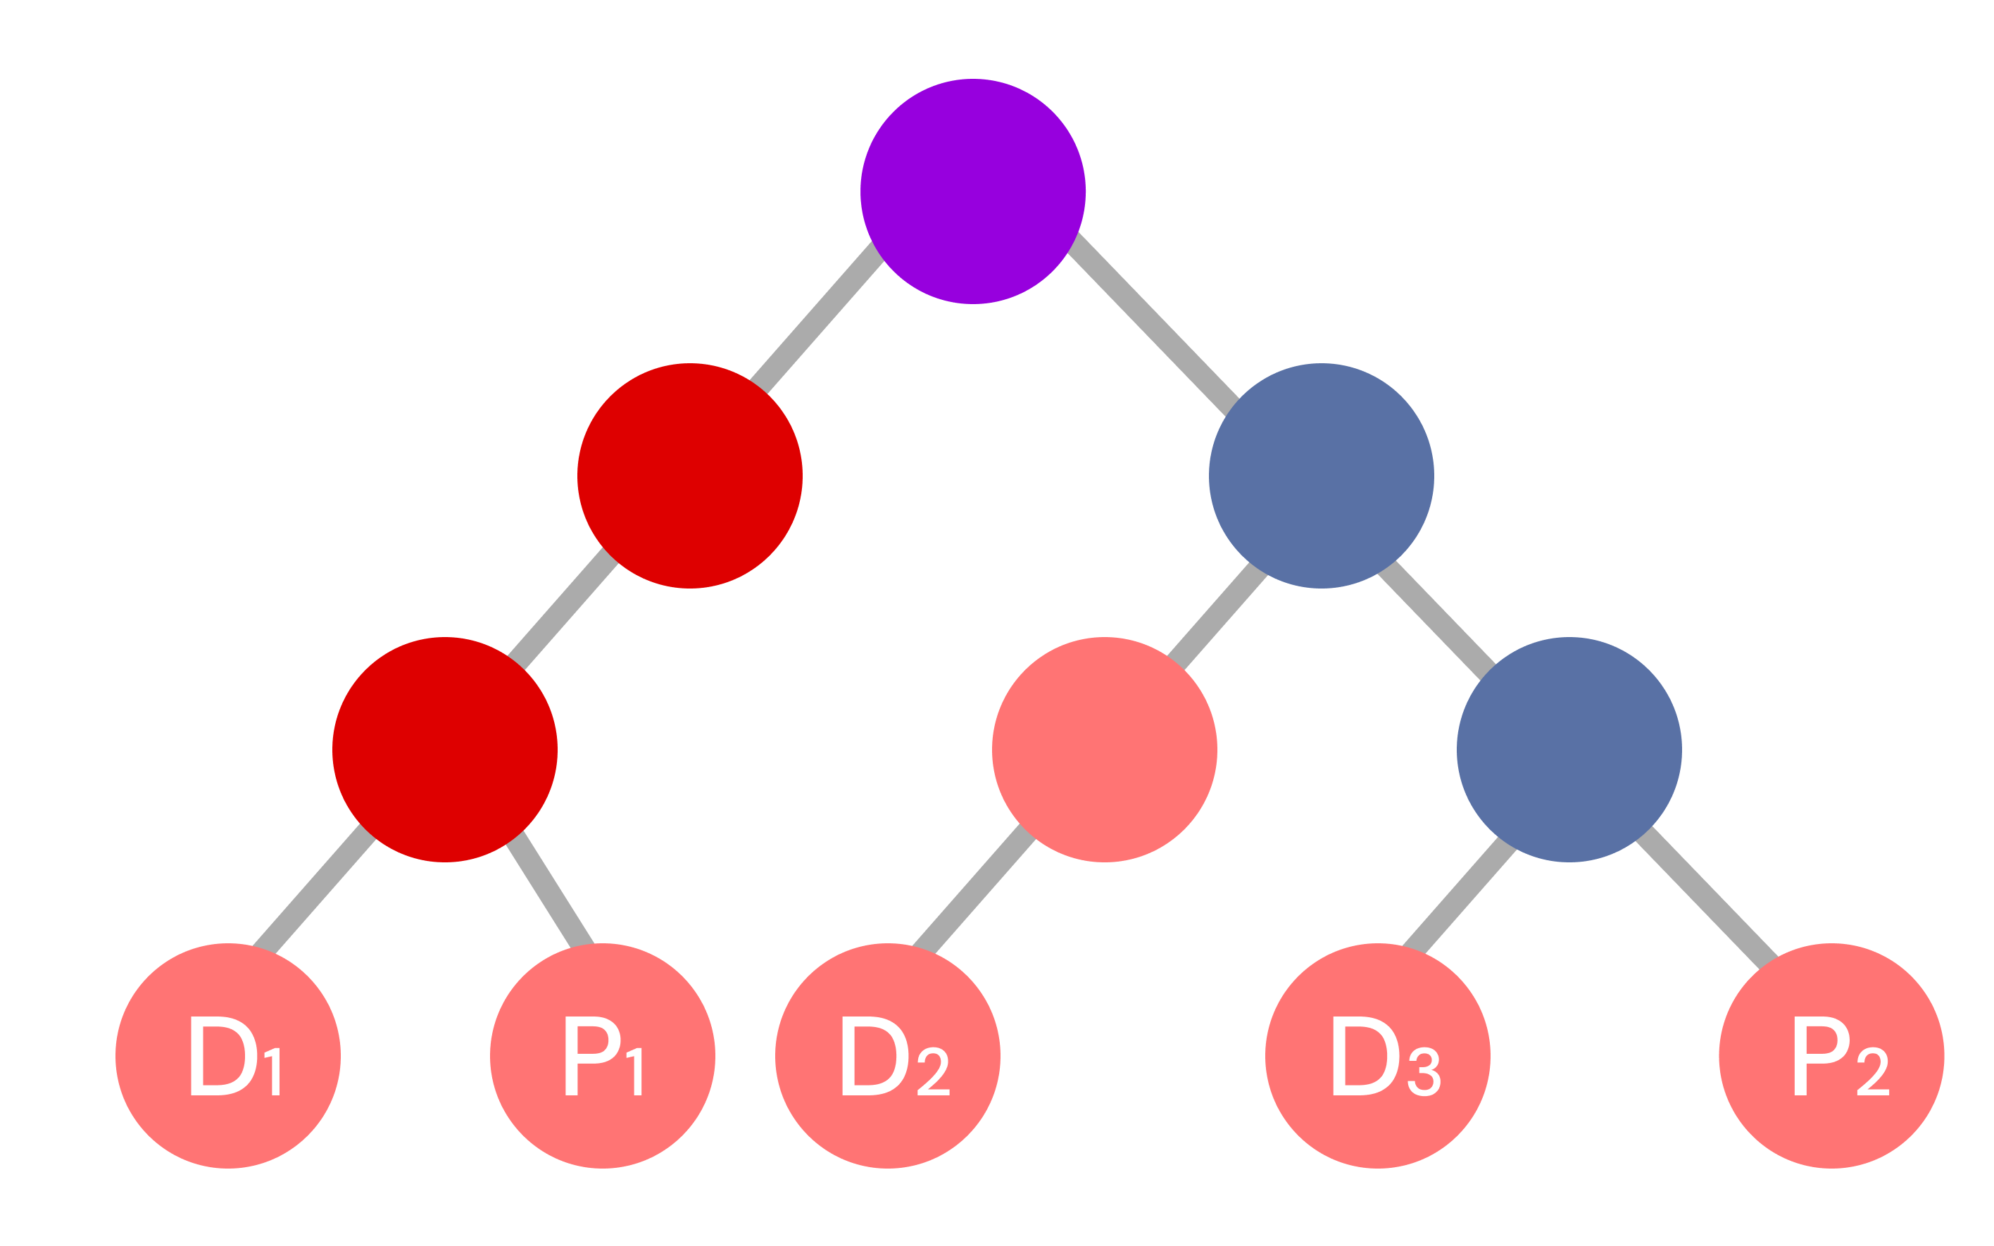
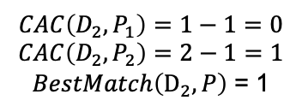
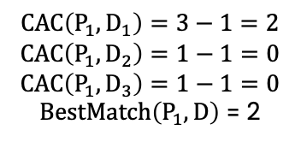

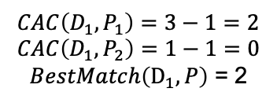


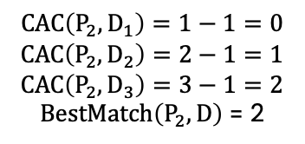
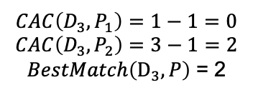
Symptom similarity
Example
$$CAC\left(D_{1},P_{1}\right)=3−1=2$$
$$CAC\left(D_{1},P_{2}\right)=1−1=0$$
$BestMatch\left(D_{1}, P\right)$ = 2
$$CAC\left(D_{2},P_{1}\right)=1−1=0$$
$$CAC\left(D_{2},P_{2}\right)=2−1=1$$
$BestMatch\left(D_{2}, P\right)$ = 1
$$CAC\left(D_{3},P_{1}\right)=1−1=0$$
$$CAC\left(D_{3},P_{2}\right)=3−1=2$$
$BestMatch\left(D_{3}, P\right)$ = 2
$$SemSim_{one−way}\left(D,P\right)= \frac{2+1+2}{3}=1.6$$
$$CAC\left(P_{1},D_{1}\right)=3−1=2$$
$$CAC\left(P_{1},D_{2}\right)=1−1=0$$
$$CAC\left(P_{1},D_{3}\right)=1−1=0$$
$BestMatch\left(P_{1}, D\right)$ = 2
$$CAC\left(P_{2},D_{1}\right)=1−1=0$$
$$CAC\left(P_{2},D_{2}\right)=2−1=1$$
$$CAC\left(P_{2},D_{3}\right)=3−1=2$$
$BestMatch\left(P_{2}, D\right)$ = 2
$$SemSim_{one−way}\left(P,D\right)= \frac{2+2}{2}=2$$
$$SemSim_{symmetric}\left(P,D\right)= \frac{2+1.6}{2}=1.8$$
Figure. Calculation of symptom similarity based on HPO tree
Created for CAGI 6
genomeinterpretation.org
Kyoungyeul Lee
Notes:
This figure is an example of how to calculate the symptom similarity.
It takes a bit to explain, so I’ll come back to it at the end if I have time.

Slide 9
3Cnet score ⁵
Amino-acid sequences around the variant sites are passed through 3Cnet to generate predicted pathogenicity scores
Almost all types variants in exon can be evaluated including missense, start-lost, stop-gain, frameshift variants
3Cnet uses 3 different genomic databases to train the pathogenicity of variants
  Clinical data: pathogenic and benign variant information from ClinVar database
  Common variants: common variant information from GnomAD database
  Conservation data: variants reflecting evolutionary constraints from UniRef database
5) Dhong-Gun Won et al. 3Cnet: pathogenicity prediction of human variants using multitask learning with evolutionary constraints, Bioinformatics, Volume 37, Issue 24, 15 December (2021)
Created for CAGI 6
genomeinterpretation.org
Kyoungyeul Lee
Notes:
Finally, our method uses scores generated using 3Cnet, a sequence-based deep learning model that predicts variant pathogenicity, to further refine priorities.
It assesses each variant by the amino-acid sequence around the mutation site using recursive deep neural networks.
It can evaluate almost all types of variants in exons including missense, start-lost, stop-gain, and frameshift variants, and many others.
A characteristic trait of 3Cnet is that it makes use of 3 different genomic databases to avoid overfitting of the network using multi-task learning.
You can learn more about the methodology and code at the published paper below.

Slide 10
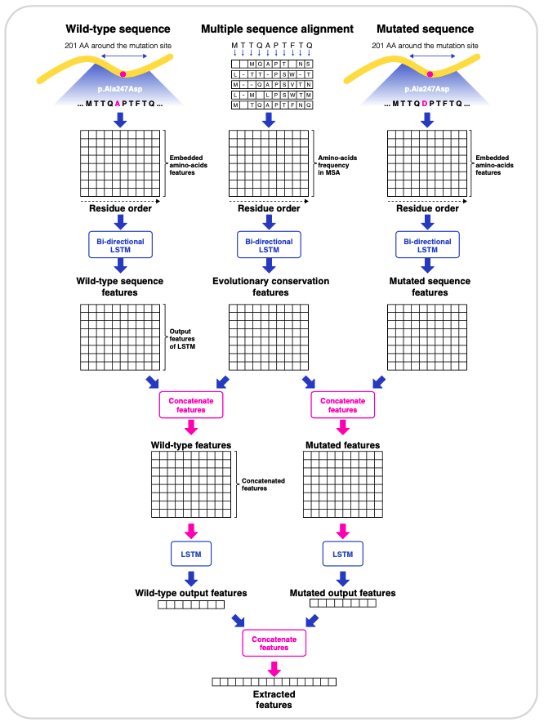
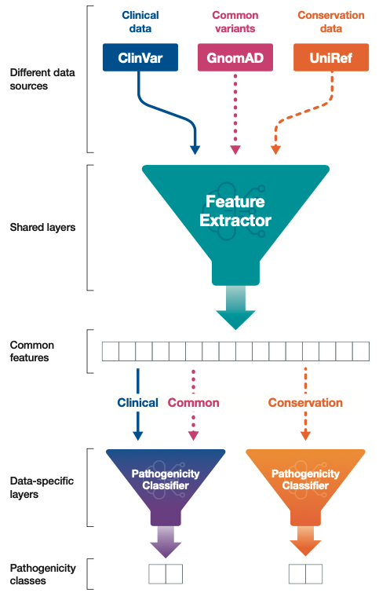
3Cnet score
Figure. 3Cnet architecture scoring variants based on protein sequences
Created for CAGI 6
genomeinterpretation.org
Kyoungyeul Lee
Notes:
This figure represents the network architecure of 3Cnet and the multi-task learning process to train the different data.
(more details)

Slide 11

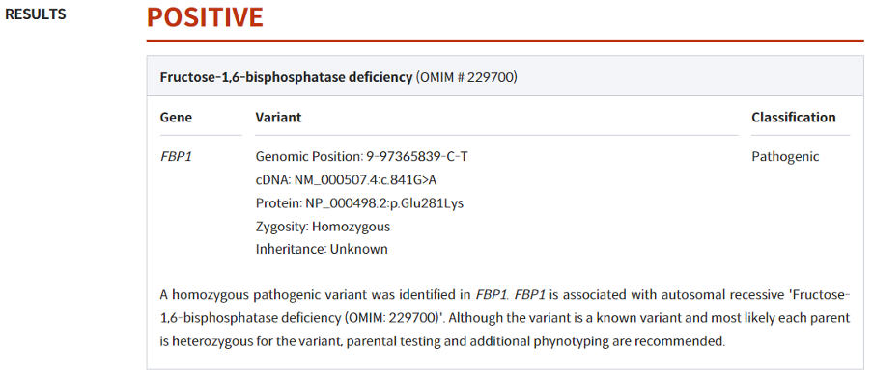
In-house confirmed variants
Confirmed variants = reported positive variants accepted by the doctor in charge.
  The latest data with 2,171 patients and 2,458 variants have been confirmed
Figure. Reported variants are confirmed by medical doctors
Created for CAGI 6
genomeinterpretation.org
Kyoungyeul Lee
Notes:
We trained a supervised model using the three scores mentioned as features, and patients’ confirmed variants as labels.
Confirmed variants are those reported by EVIDENCE which are then accepted by the patient’s care provider.
The training set we used contains 2,171 patients confirmed of 2,458 variants.

Slide 12
How to train and test data
Predictive models were trained using the EVIDENCE scores, semantic similarity, and 3Cnet scores of variants as features.
Clinically confirmed variants (interpreted in accordance with the ACMG guidelines) were labeled as the positive (causal) variants.
Two types of models were trained
  Sigmoid model: simple multiplication of scores using sigmoid activation
  Logistic regression model: the logistic regression trained using the confirmed variants as postives and other variants as negatives
The model performance was evaluated based on the top-K recall of patients at the variant level of resolution.
  Top-K recall = the proportion of patients with their causal variants found within the first K variants when sorted by the final combined score.
Created for CAGI 6
genomeinterpretation.org
Kyoungyeul Lee
Notes:
Based on the in-house confired cases, we trained a predictive model using the EVIDENCE, Symptom, and 3Cnet scores as features.
Confirmed variants were labeled as positive while the patient’s other remaining variants were labled as negative.
There were two models we developed: a sigmoid model, which is a simple multiplication of scores using sigmoid activation, and the other, a logistic regression model.
We evaluated the performance of the models based on top-k recall, which indicates the proportion of patients with their causal variants found
Within the first K variants when sorted by the combined score.

Slide 13
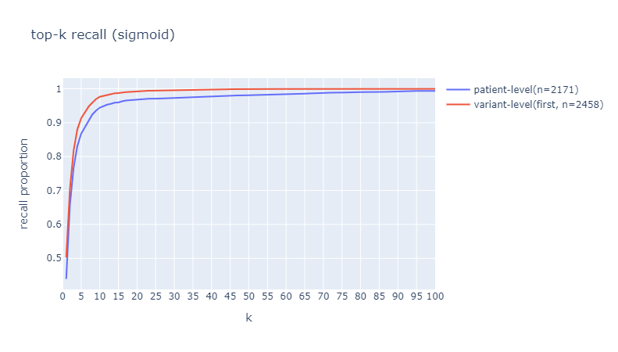
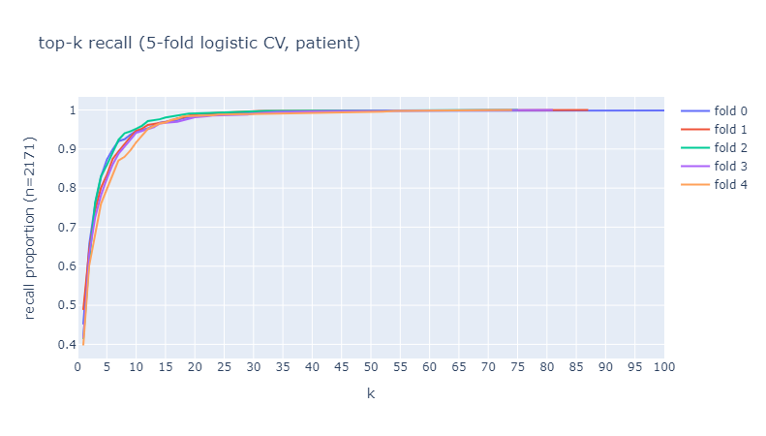
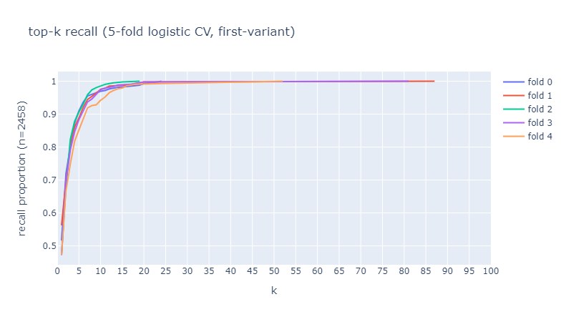
Test results
Sigmoid model
Top-5 recall:
Variant = 92%
Patient = 87%
Logistic regression model
Figure. Top-k recall of patients and variants for confirmed cases
Created for CAGI 6
genomeinterpretation.org
Kyoungyeul Lee
Notes:
We can see the test results in this figure.
Please note that top-5 recall to find the causal variant is around 92%
and the recall to find all the causal variants for each patient was 87%.
Below is the result of 5-fold cross validation of logistic regression model. Left is recall for variants, the right is for patients.

Slide 14

Acknowledgement
Dong-wook Kim
(Derrick)
Kyoungyeul Lee
(Kyle)
Junwoo Woo
(Isaac)
Created for CAGI 6
genomeinterpretation.org
Kyoungyeul Lee
Notes:
Thank you for listening

