Slide 1

CAGI slide pack guidelines
I agree to my slides being used according to the following terms:
Giulia Babbi, Castrense Savojardo, Samuele Bovo, Davide Baldazzi,
Pier Luigi Martelli and Rita Casadio
Authors: please include THIS slide at the beginning of your presentation to indicate that you agree with reuse of your slides in CAGI presentations, according to the terms below, and digitally sign by writing your name above.
To disseminate the CAGI results, I encourage all CAGI participants to remix these CAGI slides for inclusion in their oral and poster presentations
CAGI participants may use or publish any content of these slides only in compliance with the CAGI Data Use Agreement
CAGI participants may not cite or publish any content of these slides except with the written permission of the originating author or in the primary CAGI publications
CAGI participants must acknowledge the original authors of these slides and CAGI 6. Include the acknowledgement banner across the bottom
CAGI participants must include the CAGI credits slide in their presentations
Slides with a red slash (no remix) may not be included in a presentation unless all attendees are registered CAGI participants who signed the data use agreement
Slides with a red X over the entire slide may not be used in any circumstances
Slides with a blue slash (embargoed) may not be used unless the embargo is explicitly lifted
Slides without slash or X may be tweeted unless flagged with the “No tweet” icon.
CAGI participants using these slides must explain the “No tweet” icon, which means that the slide content should not be disseminated outside the presenting conference hall. If the presentation venue permits pervasive tweeting, you may not include these slides in your talk
Note for slide authors: we expect all CAGI participants to abide by these restrictions, and will make best effort to ensure they are followed. However, but bear in mind that we have limited means of enforcing them, and therefore the restrictions cannot be guaranteed.

Slide 2
Permission request regarding CAGI 6 recordings and hybrid presentations
I understand that my presentation as associated with CAGI 6 will be recorded and broadcasted via the internet through CAGI’s designated technology provider.
As the copyright holder to this presentation entitled “Predicting the effects of missense variations and the case of MTHFR deficiency”, I hereby agree that the copyright for the online broadcast and recording of my presentation be released to CAGI and my recording be uploaded on to the CAGI website.

Slide 3
Predicting the effects of missense variations and the case of MTHFR deficiency
Giulia Babbi, Castrense Savojardo, Samuele Bovo, Davide Baldazzi, Pier Luigi Martelli and Rita Casadio
Biocomputing Group,
FABIT, University of Bologna, Italy
Created for CAGI 6
genomeinterpretation.org
Babbi G et al.

Slide 4
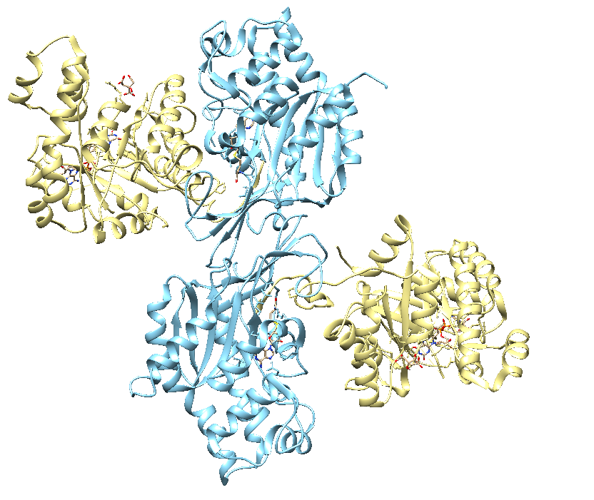
Study case: MTHFR protein
Methylenetetrahydrofolate reductase (MTHFR; EC 1.5.1.20, 656aa) catalyzes the production of 5-methyltetrahydrofolate.
Diseases: homocystinuria, homocysteinemia, developmental delay, severe mental retardation, psychiatric disturbances, and late-onset neurodegenerative disorders.
Figure1. Homodimer of MTHFR protein. The catalytic and regulatory domains are depicted in yellow and pale blue, respectively, on the MTHFR PDB 6FXC.
The CAGI challenge was to predict the functional effects of 8,695 MTHFR missense variants in two different settings:
for the wildtype protein,
for the protein with the common Ala222Val variant.
We analyzed 72 missense variants associated with disease.
Created for CAGI 6
genomeinterpretation.org
Babbi G et al.

Slide 5
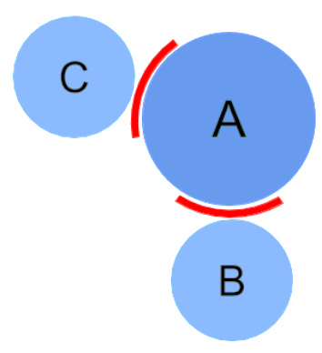
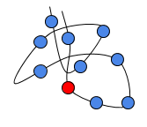
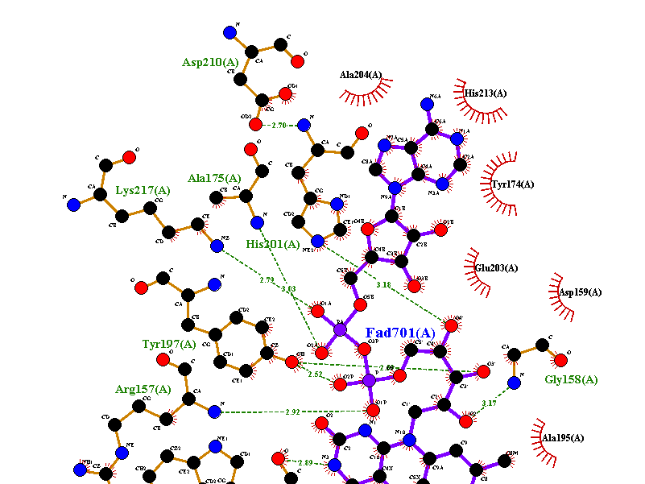
METHODS
for analyzing the effect of missense variants
protein-protein interactions
domain-domain interfaces
DeepREX (deeprex.biocomp.unibo.it)
ISPRED4 (ispred4.biocomp.unibo.it)
Consensus of
INSP/INPS-MD (inpsmd.biocomp.unibo.it)
FoldX (foldxsuite.crg.eu)
PoPMuSiC2 (ezyme.com)
protein stability
expert-curated analysis of protein structure
LigPlot (www.ebi.ac.uk/thornton-srv/software/LIGPLOT)
Manual curation
Created for CAGI 6
genomeinterpretation.org
Babbi G et al.

Slide 6
METHODS
for classifying missense variants leading to disease insurgence
likelihood of being disease-related
SNPs&GO (http://snps-and-go.biocomp.unibo.it)
select possible causative variants
on more genes
eDGAR (http://edgar.biocomp.unibo.it)
PhenPath (http://phenpath.biocomp.unibo.it)
enriching for functional annotations
NETGE-PLUS (http://net-ge2.biocomp.unibo.it)
Other tools and webservers at:
http://lipid.biocomp.unibo.it/predictors.html
Created for CAGI 6
genomeinterpretation.org
Babbi G et al.

Slide 7
Study case: MTHFR protein
We analyse 72 missense variants of human MTHFR protein
associated with the disease “MTHFR deficiency”.
ISPRED4
44 interacting sites, 17 of which at the interface between the two regulatory domains of the homodimer
3 are in positions related to missense variants associated with disease (G387D, Y506D, L628T)
protein-protein interactions
domain-domain interfaces
promote protein destabilization of the functional protein homodimeric complex
Consensus of INPS-MD, FoldX, PoPMuSiC2
threshold value ΔΔG ≤ -1 kcal/mol
42/72 disease-related variants decrease protein stability, according to at least 2/3 predictors.
protein stability
affect protein stability
expert-curated analysis of protein structure
LigPlot and Manual curation
Among the 27 remaining variants, 7 are in the NAD(P)H binding site and 7 are in the FAD binding site
decrease the binding affinity without perturbing the protein stability
Created for CAGI 6
genomeinterpretation.org
Babbi G et al.

Slide 8

http://lipid.biocomp.unibo.it
Created for CAGI 6
genomeinterpretation.org
Babbi G et al.

