Slide 1

CAGI slide pack guidelines
I agree to my slides being used according to the following terms:
__Predrag Radivojac__
Authors: please include THIS slide at the beginning of your presentation to indicate that you agree with reuse of your slides in CAGI presentations, according to the terms below, and digitally sign by writing your name above.
To disseminate the CAGI results, I encourage all CAGI participants to remix these CAGI slides for inclusion in their oral and poster presentations
CAGI participants may use or publish any content of these slides only in compliance with the CAGI Data Use Agreement
CAGI participants may not cite or publish any content of these slides except with the written permission of the originating author or in the primary CAGI publications
CAGI participants must acknowledge the original authors of these slides and CAGI 6. Include the acknowledgement banner across the bottom
CAGI participants must include the CAGI credits slide in their presentations
Slides with a red slash (no remix) may not be included in a presentation unless all attendees are registered CAGI participants who signed the data use agreement
Slides with a red X over the entire slide may not be used in any circumstances
Slides with a blue slash (embargoed) may not be used unless the embargo is explicitly lifted
Slides without slash or X may be tweeted unless flagged with the “No tweet” icon.
CAGI participants using these slides must explain the “No tweet” icon, which means that the slide content should not be disseminated outside the presenting conference hall. If the presentation venue permits pervasive tweeting, you may not include these slides in your talk
Note for slide authors: we expect all CAGI participants to abide by these restrictions, and will make best effort to ensure they are followed. However, but bear in mind that we have limited means of enforcing them, and therefore the restrictions cannot be guaranteed.

Slide 2
Permission Request Regarding CAGI6 Recordings
and Hybrid Presentations
I understand that my presentation as associated with CAGI6 will be recorded and broadcasted via the internet through CAGI’s designated technology provider.
As the copyright holder to this presentation entitled “Review of the First Decade of CAGI”, I hereby agree that the copyright for the online broadcast and recording of my presentation be released to CAGI and my recording be uploaded on to the CAGI website.

Slide 3


(A Quick) Review of the First Decade of CAGI
Predrag Radivojac
Northeastern University

Slide 4
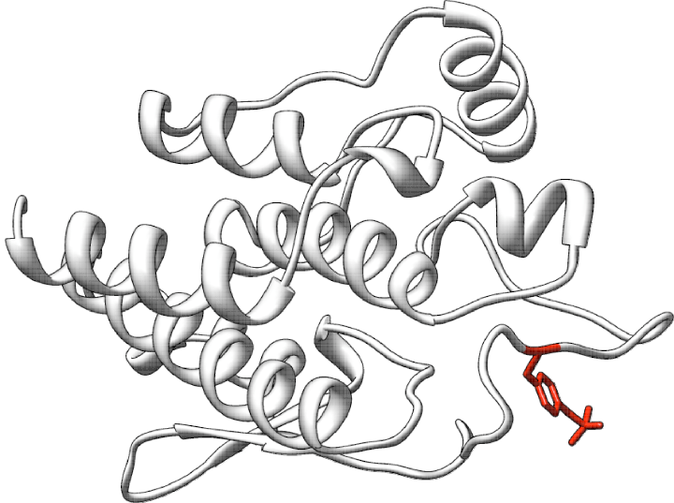

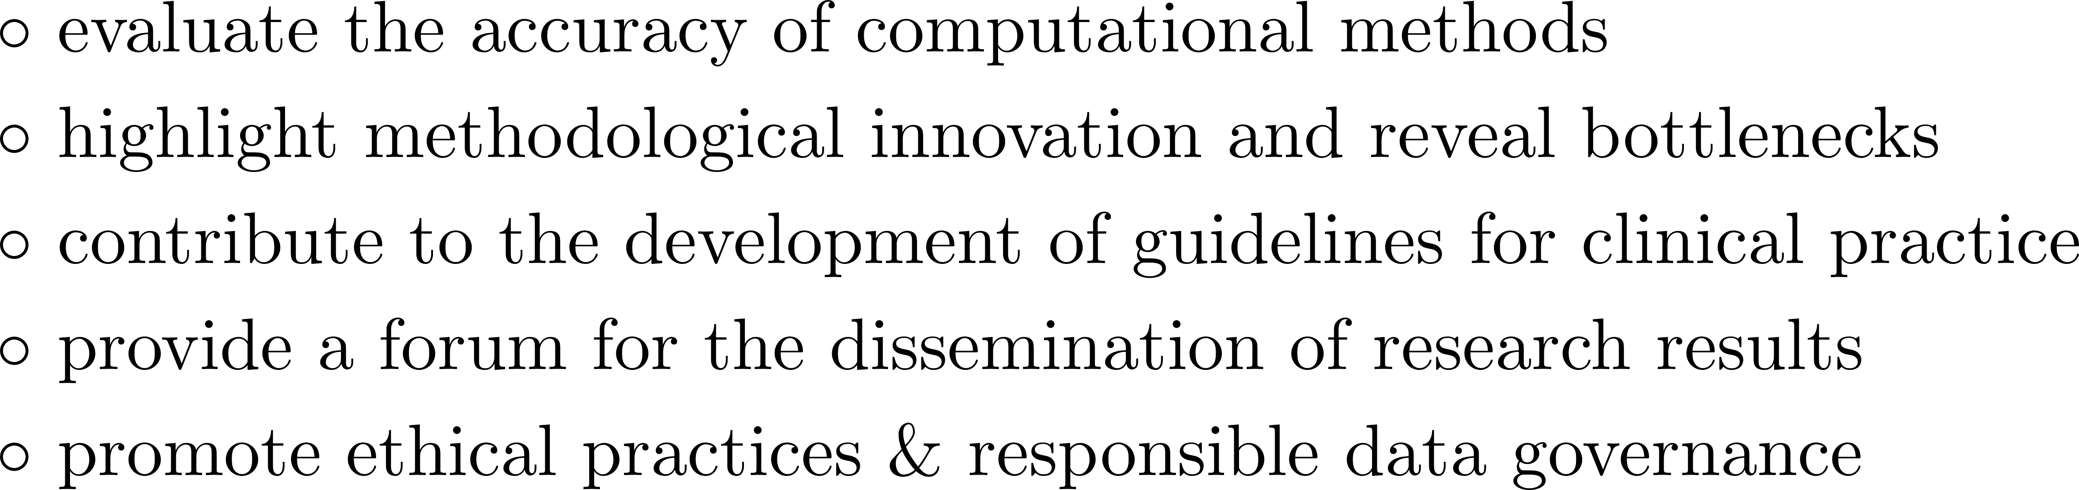
Overview

Slide 5


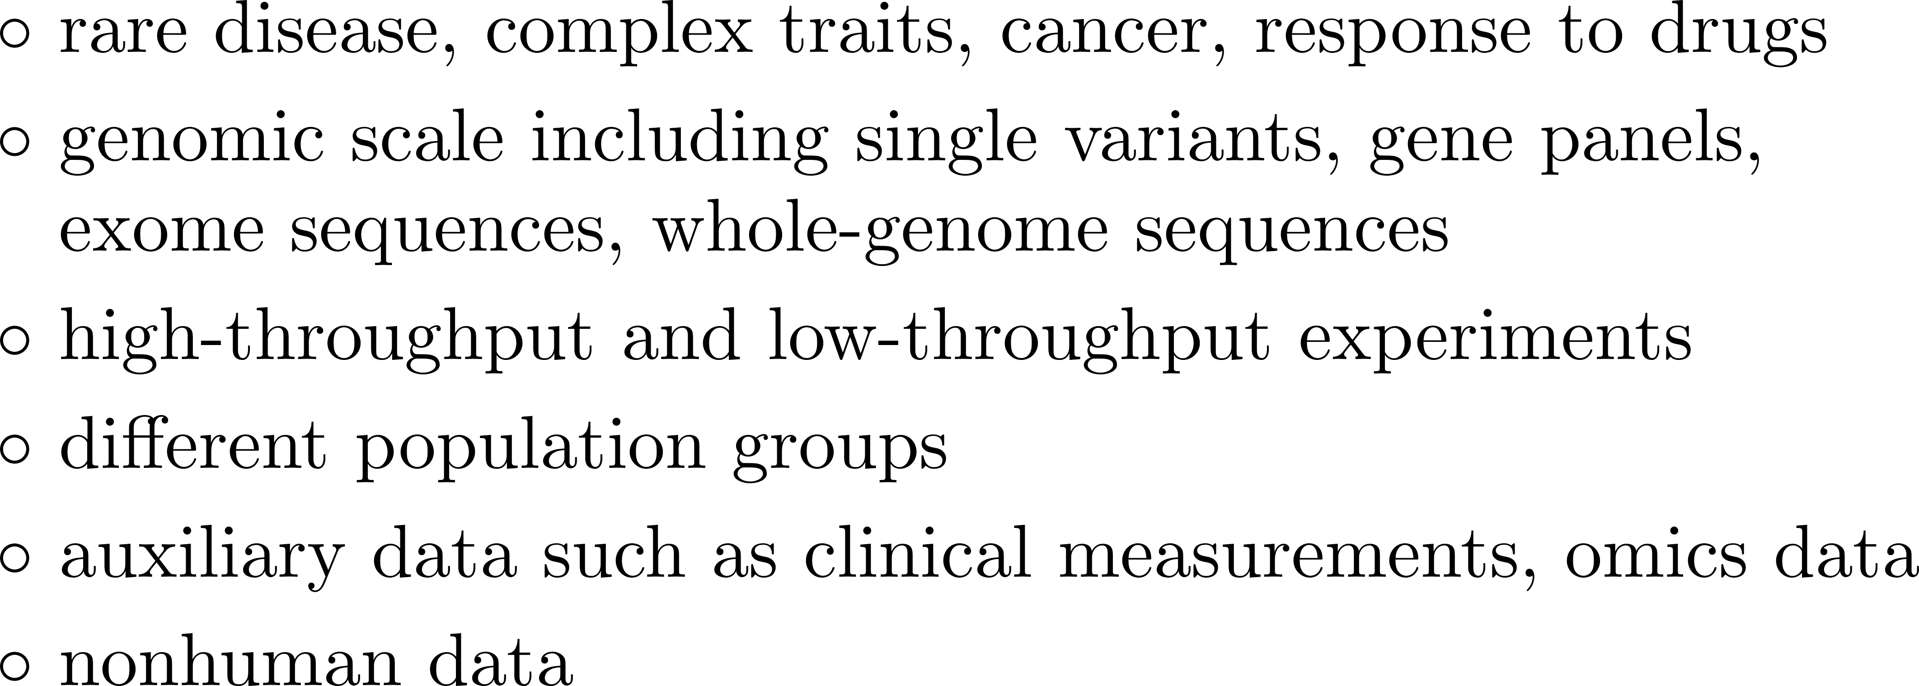
Overview

Slide 6
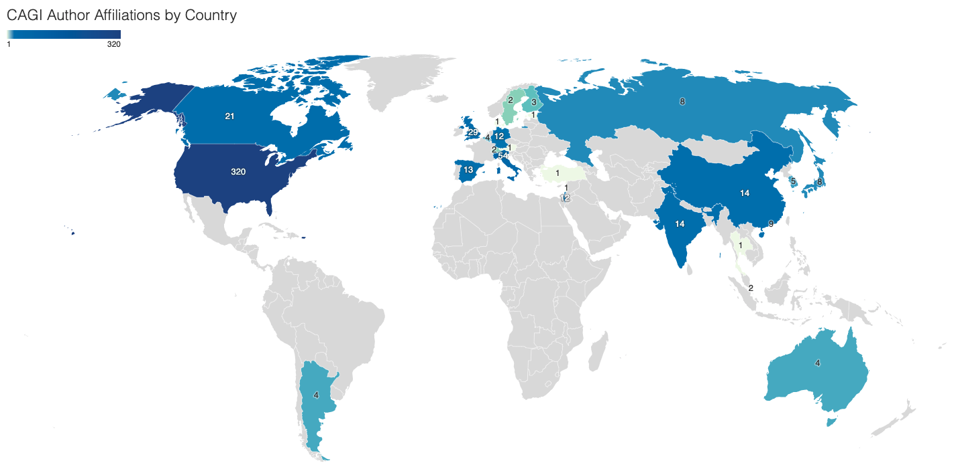
Participation

Slide 7
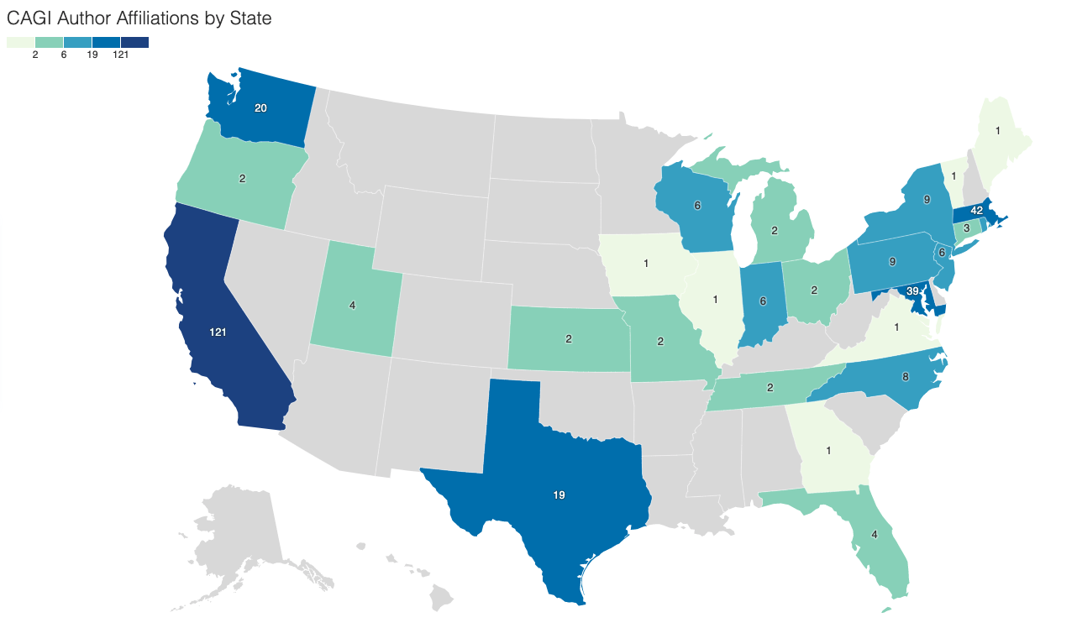
Participation

Slide 8
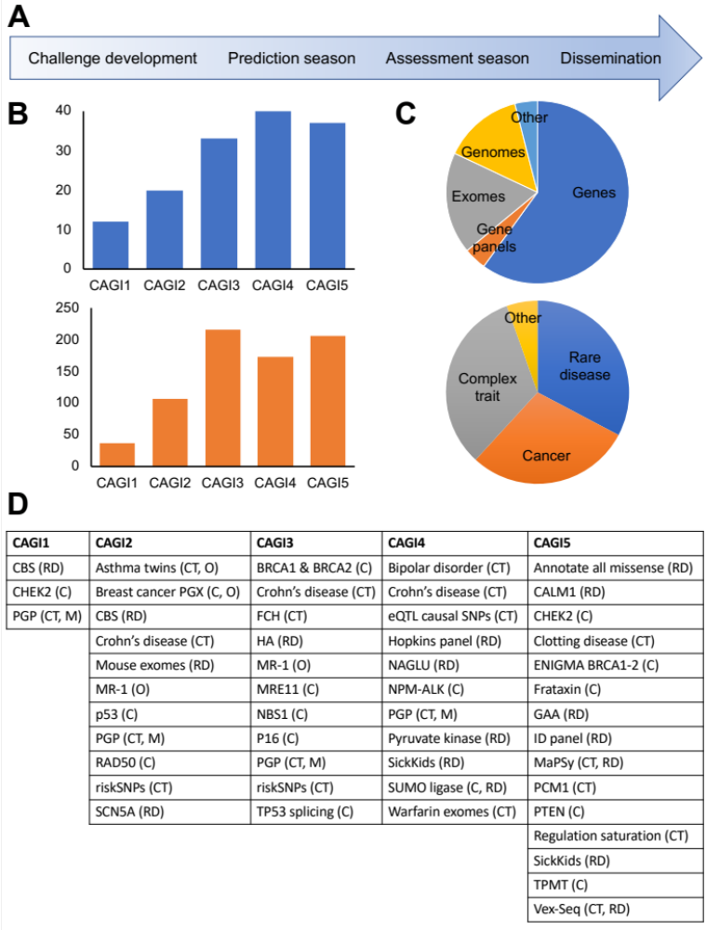




Challenges

Slide 9
Prediction of Pathogenicity for Missense Variants

Slide 10
Prediction of Pathogenicity for Missense Variants

Slide 11
Prediction of Pathogenicity for Missense Variants

Slide 12
Prediction of Pathogenicity for Missense Variants

Slide 13


Predicting Biochemical Effects for Missense Variants

Slide 14
Predicting Biochemical Effects for Missense Variants

Slide 15
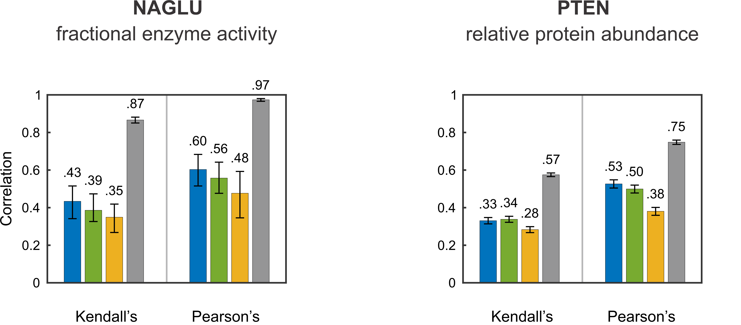
Predicting Biochemical Effects for Missense Variants

Slide 16
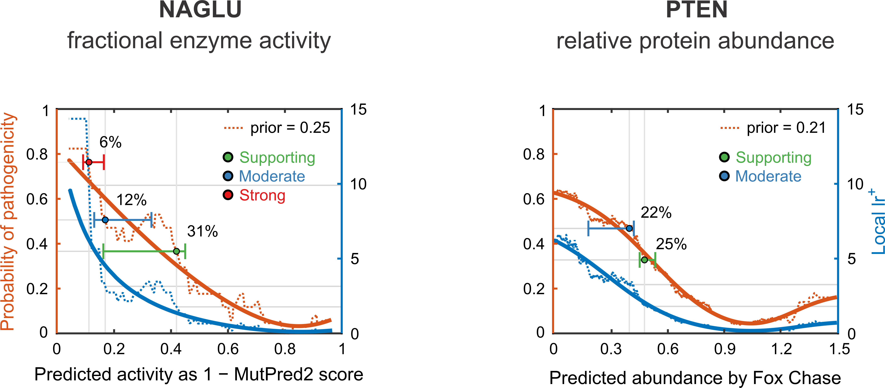
Predicting Biochemical Effects for Missense Variants

Slide 17
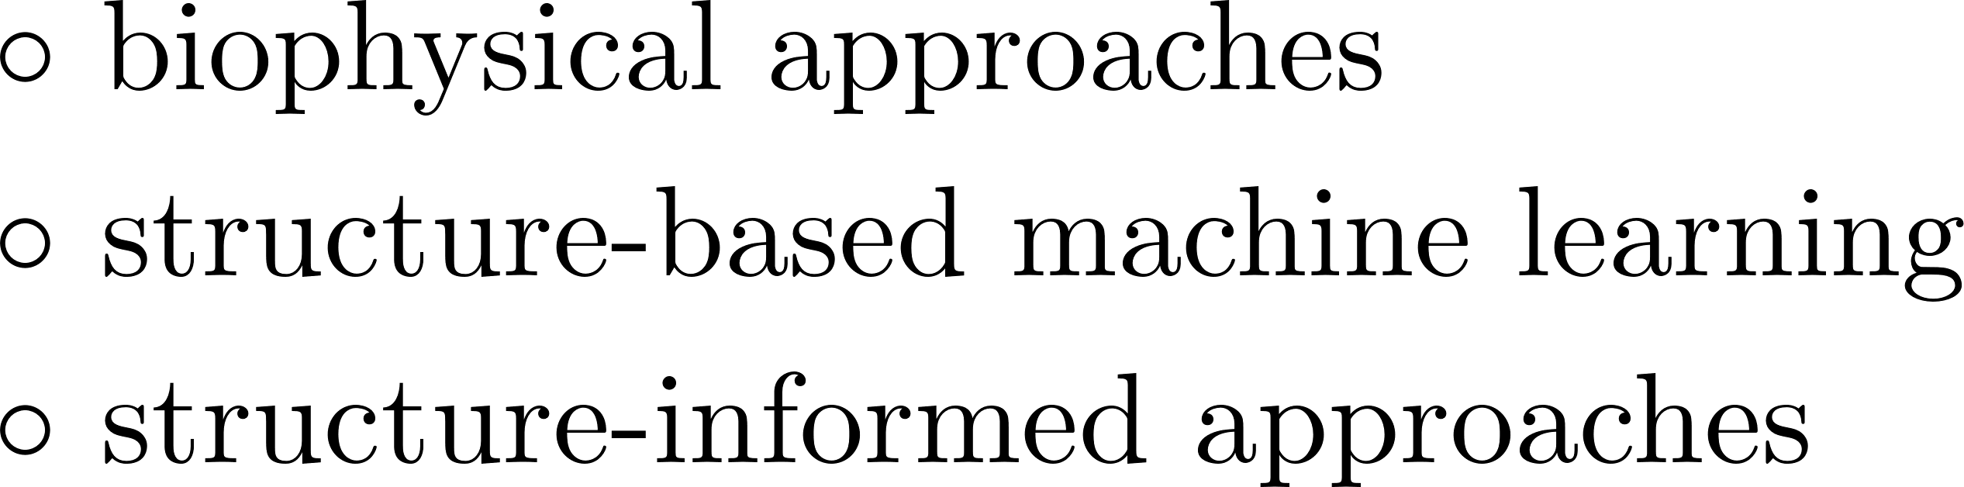

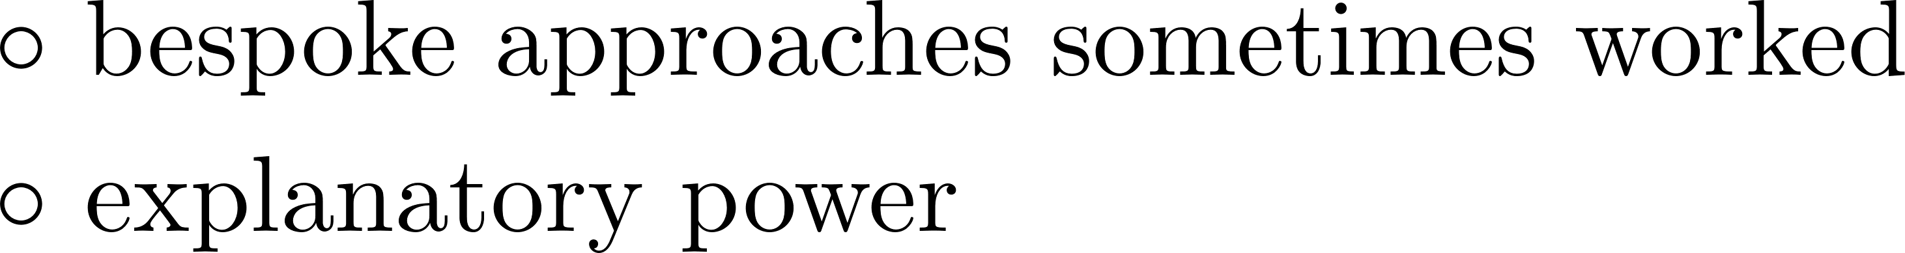

Performance of Structure-Based Approaches

Slide 18
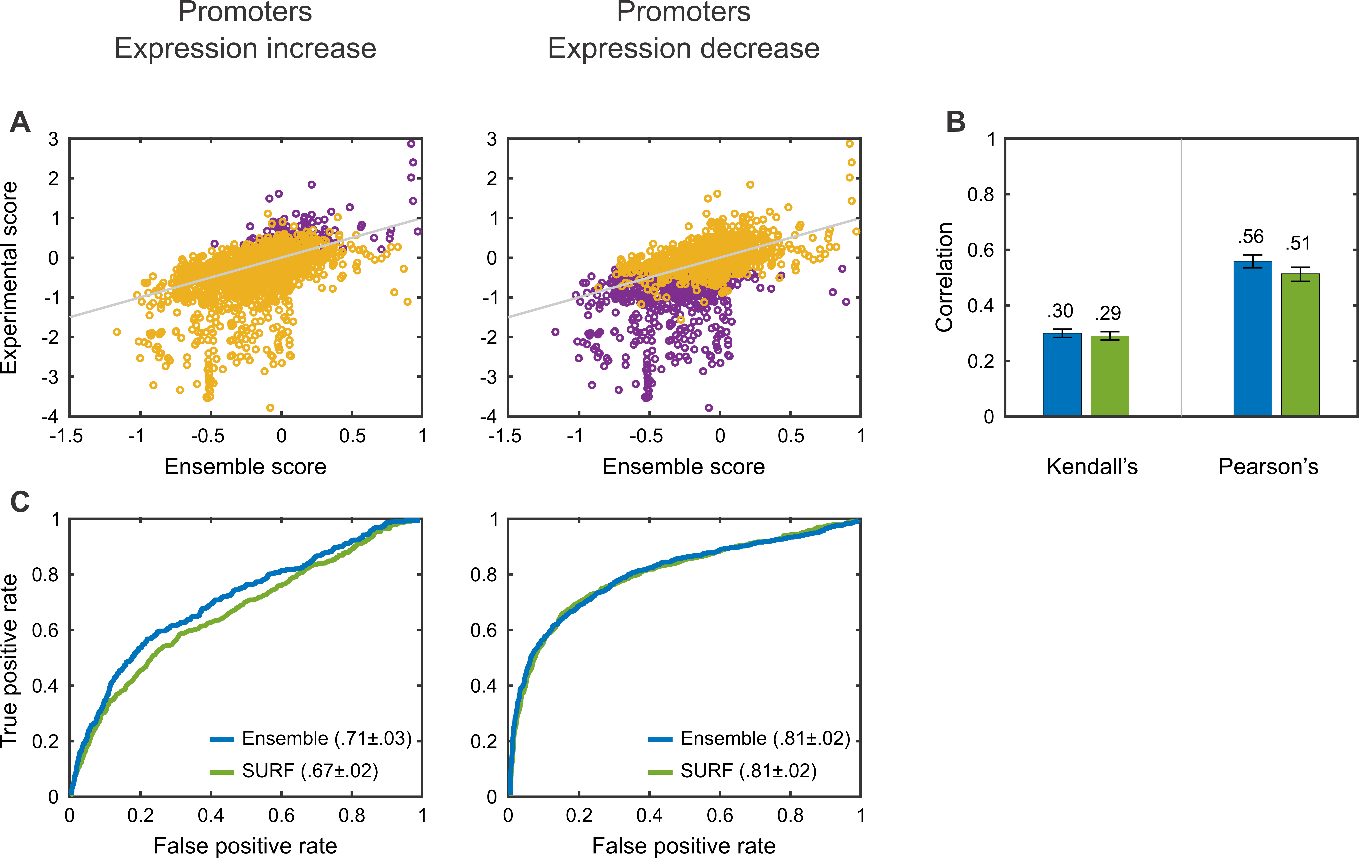
Predicting Regulatory Effects

Slide 19
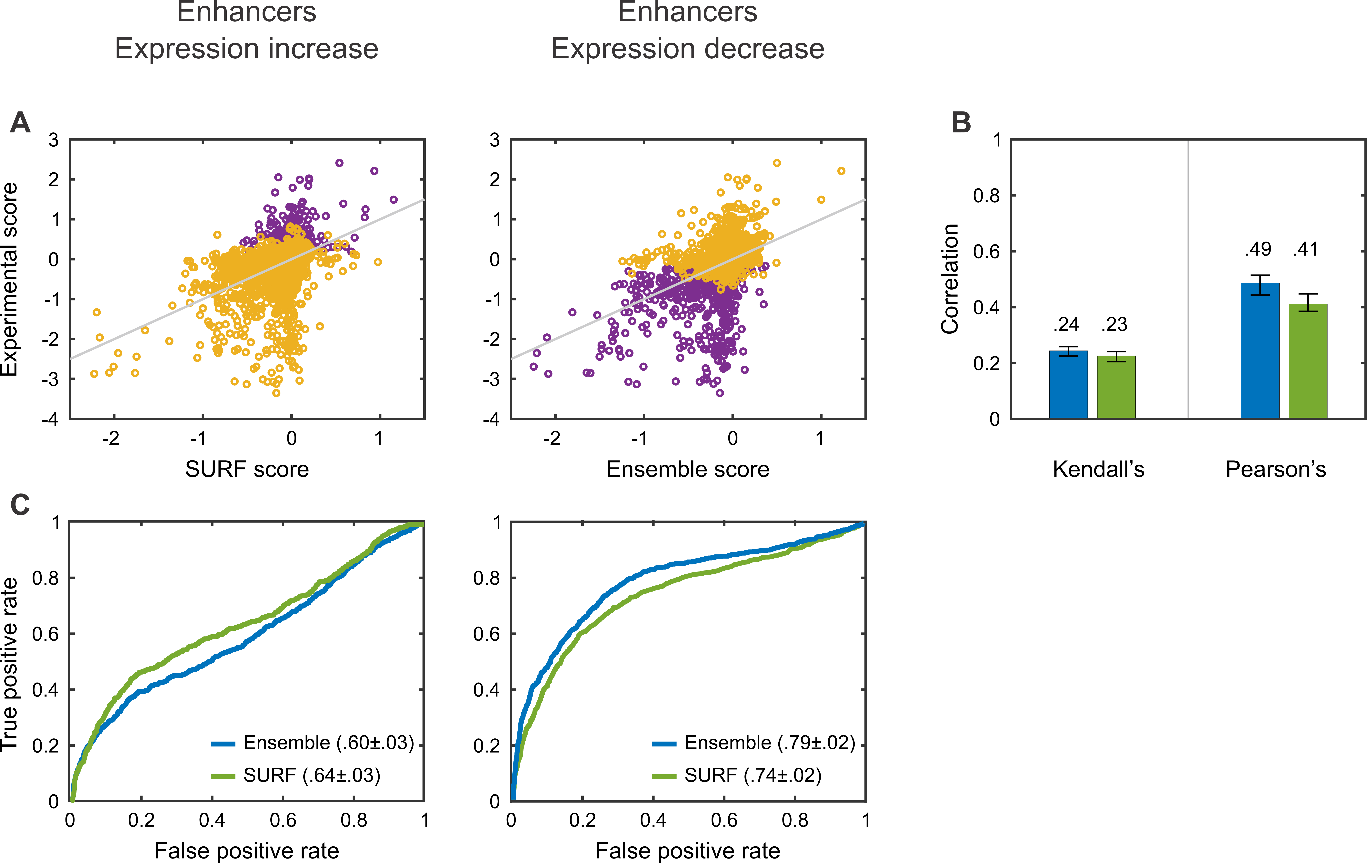
Predicting Regulatory Effects

Slide 20
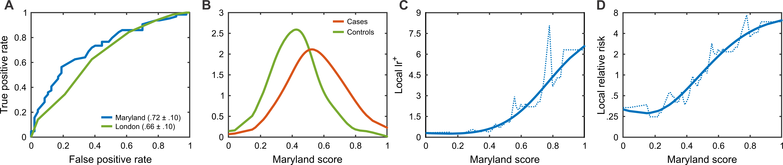
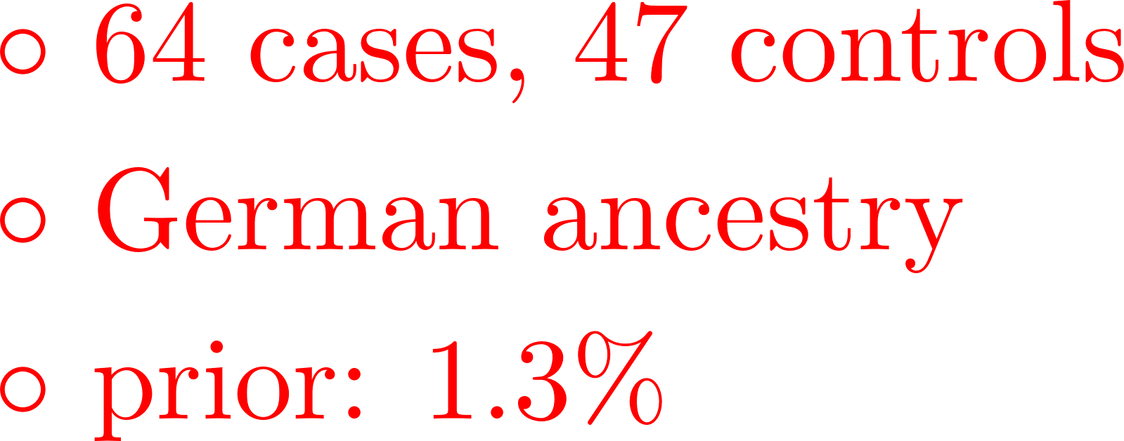
Predicting Complex Phenotypes

Slide 21

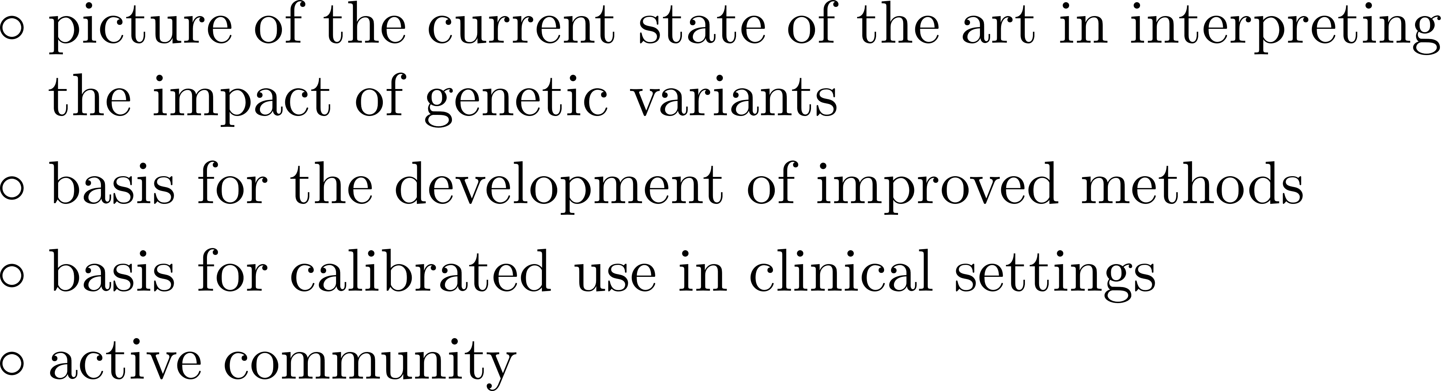


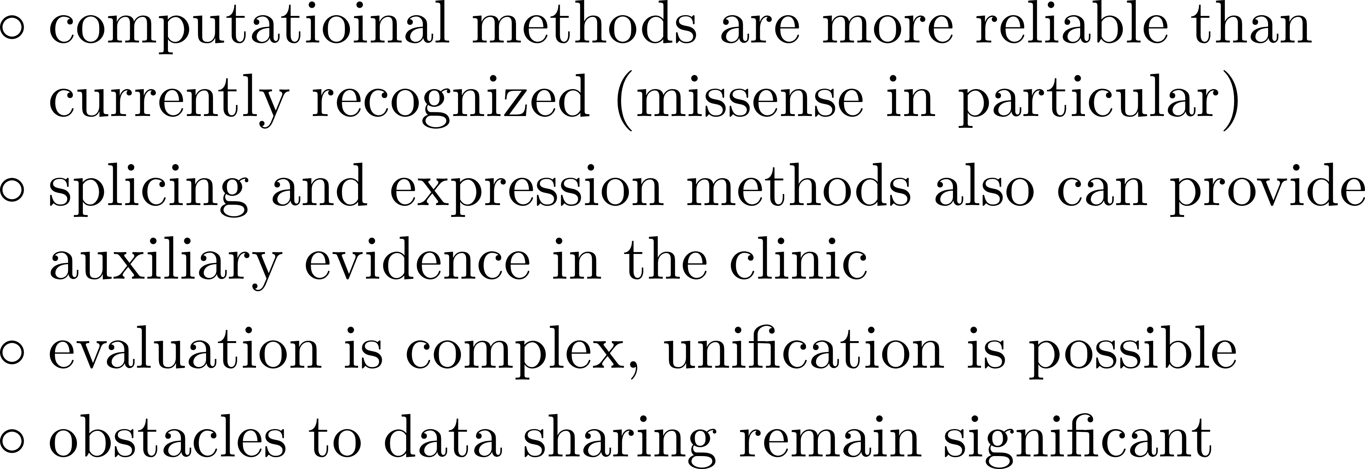
Discussion

Slide 22




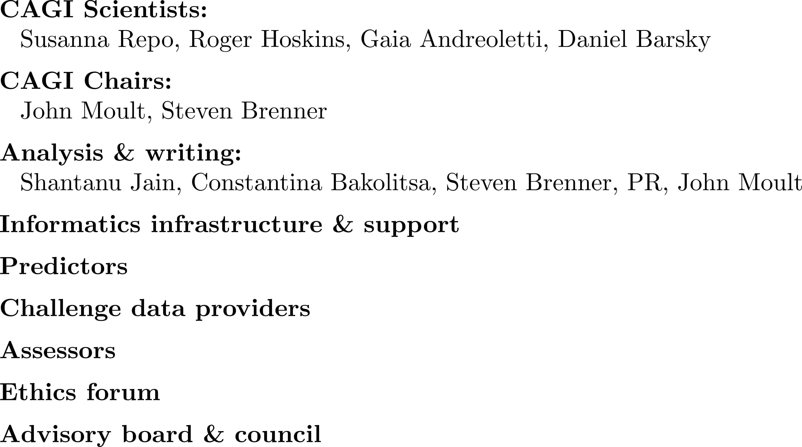

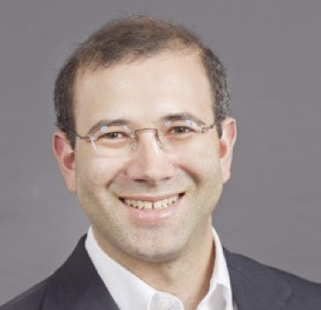

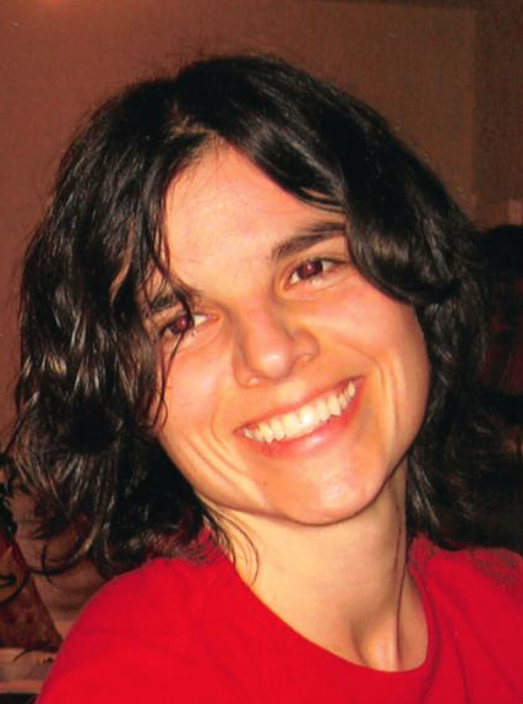
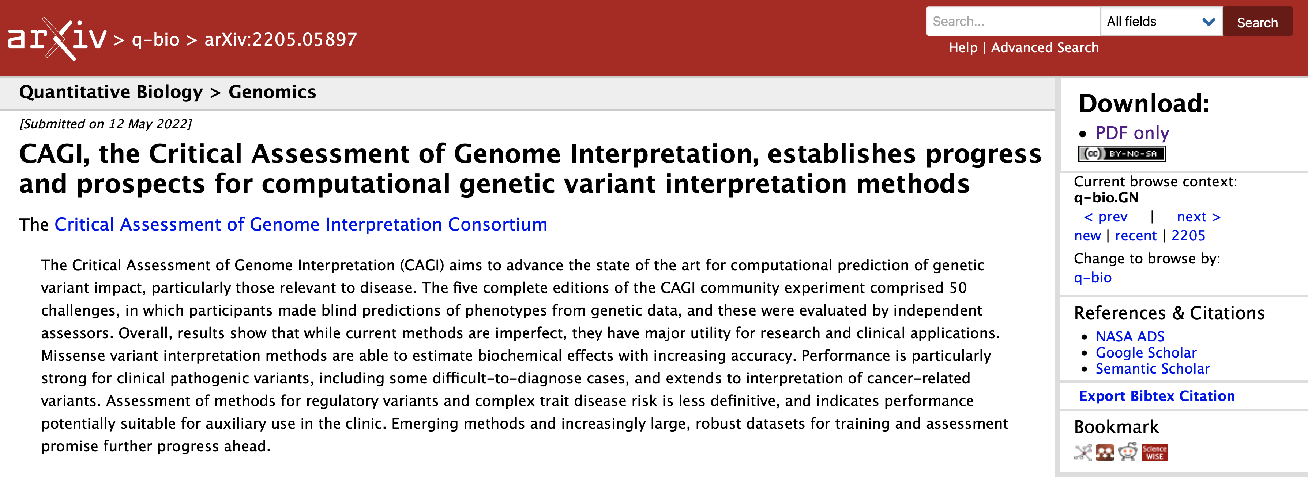
Many Contributors. Thank you!

