Slide 1

CAGI slide pack guidelines
I agree to my slides being used according to the following terms:
_______Yixuan Ye_______
Authors: please include THIS slide at the beginning of your presentation to indicate that you agree with reuse of your slides in CAGI presentations, according to the terms below, and digitally sign by writing your name above.
To disseminate the CAGI results, I encourage all CAGI participants to remix these CAGI slides for inclusion in their oral and poster presentations
CAGI participants may use or publish any content of these slides only in compliance with the CAGI Data Use Agreement
CAGI participants may not cite or publish any content of these slides except with the written permission of the originating author or in the primary CAGI publications
CAGI participants must acknowledge the original authors of these slides and CAGI 6. Include the acknowledgement banner across the bottom
CAGI participants must include the CAGI credits slide in their presentations
Slides with a red slash (no remix) may not be included in a presentation unless all attendees are registered CAGI participants who signed the data use agreement
Slides with a red X over the entire slide may not be used in any circumstances
Slides with a blue slash (embargoed) may not be used unless the embargo is explicitly lifted
Slides without slash or X may be tweeted unless flagged with the “No tweet” icon.
CAGI participants using these slides must explain the “No tweet” icon, which means that the slide content should not be disseminated outside the presenting conference hall. If the presentation venue permits pervasive tweeting, you may not include these slides in your talk
Note for slide authors: we expect all CAGI participants to abide by these restrictions, and will make best effort to ensure they are followed. However, but bear in mind that we have limited means of enforcing them, and therefore the restrictions cannot be guaranteed.

Slide 2
Permission request regarding CAGI 6 recordings and hybrid presentations
I understand that my presentation as associated with CAGI 6 will be recorded and broadcasted via the internet through CAGI’s designated technology provider.
As the copyright holder to this presentation entitled “Joint modeling of multi-population data and functional annotations to increase accuracy of polygenic risk prediction”, I hereby agree that the copyright for the online broadcast and recording of my presentation be released to CAGI and my recording be uploaded on to the CAGI website.

Slide 3
Joint modeling of multi-population data and functional annotations to increase accuracy of polygenic risk prediction
Yixuan Ye (@YixuanYe1), May 2022
Zhao Lab, Yale Computational Biology and Bioinformatics
Created for CAGI 6
genomeinterpretation.org
Yixuan Ye

Slide 4
Background
Clinical use of current polygenic risk scores may exacerbate health disparities
Prediction accuracy relative to European individuals across 17 traits and 5 continental populations.
Ancestry of GWAS participants over time, as compared with the global population.
2019, Martin et al.
2019, Alicia et al.
Created for CAGI 6
genomeinterpretation.org
Yixuan Ye

Slide 5
Background
Challenges in transferability of genetic data across population
2019, Alicia et al.
Build well-powered GWAS resources for diverse populations
Develop novel statistical methods to better integrate information from diverse populations in risk prediction
Created for CAGI 6
genomeinterpretation.org
Yixuan Ye

Slide 6
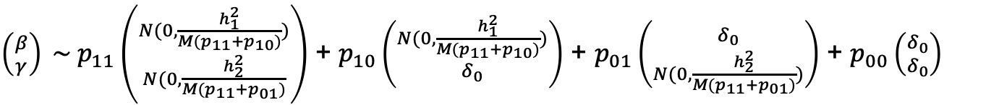
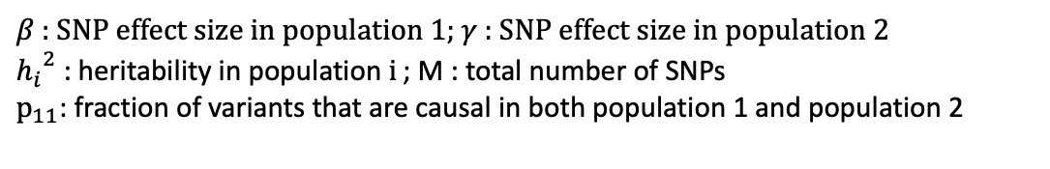

Methods
xPred (Cross-population Prediction)
$\left({β \atop γ}\right) \sim p_{11}\left({N(0, \frac{h_{1}^{2}}{M(p_{11}+p_{10})}) \atop N(0, \frac{h_{2}^{2}}{M(p_{11}+p_{01})}}\right)$ + $p_{10}\left({N(0, \frac{h_{1}^{2}}{M(p_{11}+p_{10})}) \atop δ_{0}}\right)$ + $p_{01}\left({δ_{0} \atop N(0, \frac{h_{2}^{2}}{M(p_{11}+p_{01})})}\right)$ + $p_{00}\left({δ_{0} \atop δ_{0}}\right)$
$$p_{ }\sim Dirichlet(α)$$
$β$ : SNP effect size in population 1; $γ$ : SNP effect size in population 2
${h_{i}}^{2}$: heritability in population $i_{ }$; M : total number of SNPs
$p_{11}$: fraction of variants that are causal in both population 1 and population 2
Created for CAGI 6
genomeinterpretation.org
Yixuan Ye

Slide 7
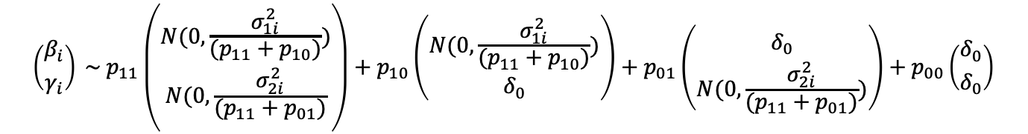
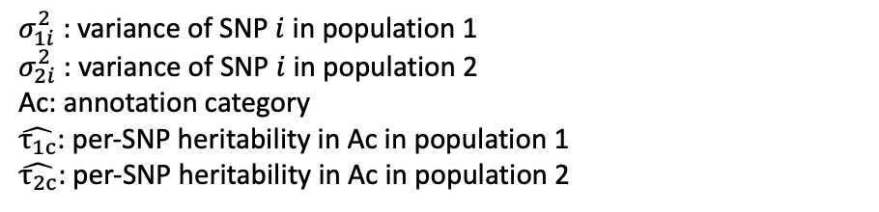
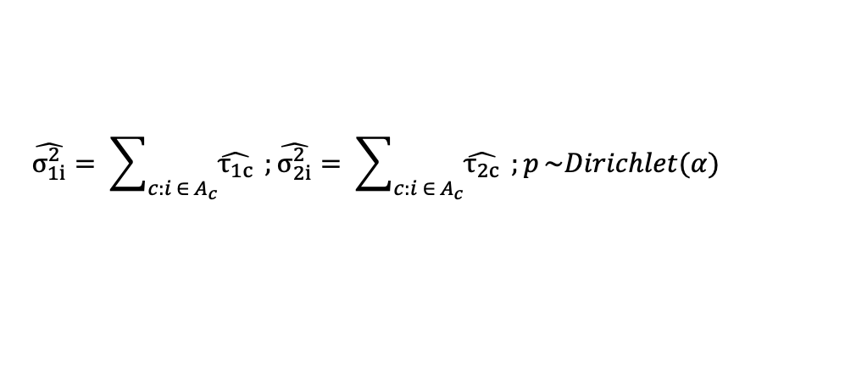
Methods
xPred-anno (Cross-population Prediction with Annotation)
$$\left({β_{i} \atop γ_{i}}\right) \sim p_{11}\left({N(0, \frac{σ_{1i}^{2}}{(p_{11}+p_{10})}) \atop N(0, \frac{σ_{2i}^{2}}{(p_{11}+p_{01})}}\right)+p_{10}\left({N(0, \frac{σ_{1i}^{2}}{(p_{11}+p_{10})}) \atop δ_{0}}\right)+p_{01}\left({δ_{0} \atop N(0, \frac{σ_{2i}^{2}}{(p_{11}+p_{01})})}\right)+p_{00}\left({δ_{0} \atop δ_{0}}\right)$$
$$\hat{σ_{1i}^{2}}= \sum_{c:i ∈ A_{c}}{\hat{τ_{1c}}} ;\hat{σ_{2i}^{2}}= \sum_{c:i ∈ A_{c}}{\hat{τ_{2c}}} ;p_{ }\sim Dirichlet(α)$$
$σ_{1i}^{2}$ : variance of SNP $i$ in population 1
$σ_{2i}^{2}$ : variance of SNP $i$ in population 2
Ac: annotation category
$\hat{τ_{1c}}$: per-SNP heritability in Ac in population 1
$\hat{τ_{2c}}$: per-SNP heritability in Ac in population 2
Created for CAGI 6
genomeinterpretation.org
Yixuan Ye

Slide 8
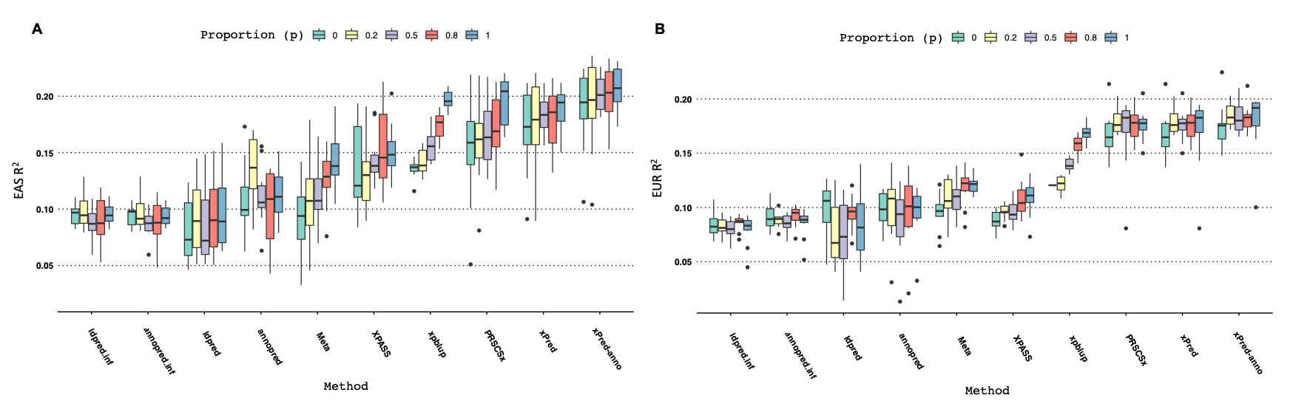
Simulations
EAS/EUR, the proportion of causal variants: 0.001, heritability: 0.3
HapMap3: EAS (N = 50,000)
HapMap3: EUR (N = 50,000)
Created for CAGI 6
genomeinterpretation.org
Yixuan Ye

Slide 9
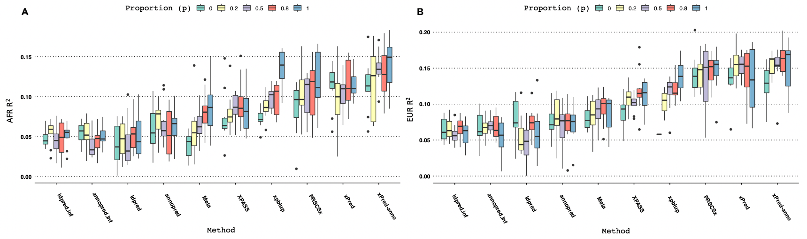
Simulations
AFR/EUR, the proportion of causal variants: 0.001, heritability: 0.3
HapMap3: AFR (N = 50,000)
HapMap3: EUR (N = 50,000)
Created for CAGI 6
genomeinterpretation.org
Yixuan Ye

Slide 10
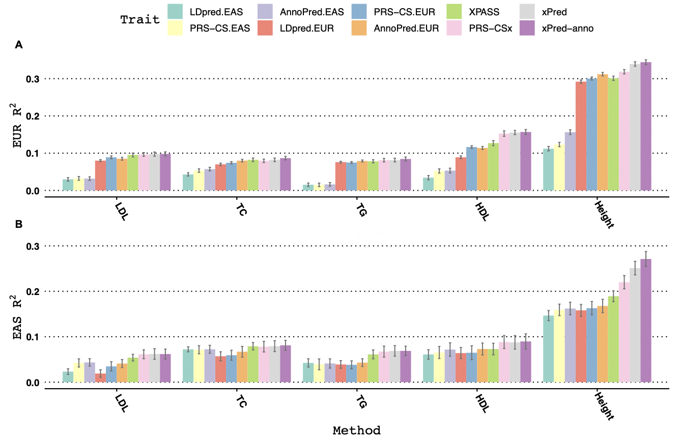
Real Data Applications
A
B
Created for CAGI 6
genomeinterpretation.org
Yixuan Ye

Slide 11
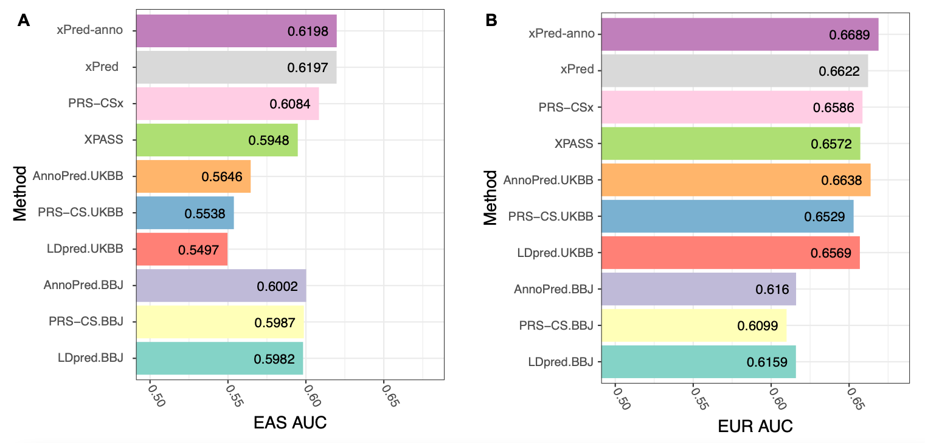
Real Data Applications
T2DM (EAS: 139/2225; EUR: 581/9419)
Created for CAGI 6
genomeinterpretation.org
Yixuan Ye

Slide 12
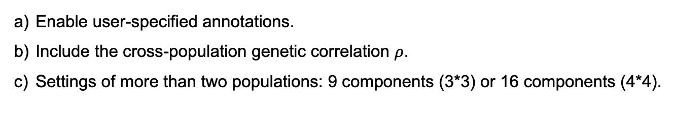
Summary
      We proposed two novel multi-populations PRS frameworks: xPred/xPred-anno that hold the promise of improving risk stratifications for non-European populations.
      The frameworks are flexible for further extensions:
      Enable user-specified annotations.
      Include the cross-population genetic correlation $ρ$.
      Settings of more than two populations: 9 components (3*3) or 16 components (4*4).
      Acknowledgement
Dr. Hongyu Zhao
Dr. Yiliang Zhang, Leqi Xu, Dr. Wei Jiang, Chi Zhang, Geyu Zhou
！
A
N
K
T
H
S
Created for CAGI 6
genomeinterpretation.org
Yixuan Ye

