Slide 1

CAGI slide pack guidelines
I agree to my slides being used according to the following terms:
______ Turina P, Petrosino M, Cicconardi A, Novak L, Pasquo A, _______
______Chiaraluce R, Consalvi V, Capriotti E*_______
Authors: please include THIS slide at the beginning of your presentation to indicate that you agree with reuse of your slides in CAGI presentations, according to the terms below, and digitally sign by writing your name above.
To disseminate the CAGI results, I encourage all CAGI participants to remix these CAGI slides for inclusion in their oral and poster presentations
CAGI participants may use or publish any content of these slides only in compliance with the CAGI Data Use Agreement
CAGI participants may not cite or publish any content of these slides except with the written permission of the originating author or in the primary CAGI publications
CAGI participants must acknowledge the original authors of these slides and CAGI 6. Include the acknowledgement banner across the bottom
CAGI participants must include the CAGI credits slide in their presentations
Slides with a red slash (no remix) may not be included in a presentation unless all attendees are registered CAGI participants who signed the data use agreement
Slides with a red X over the entire slide may not be used in any circumstances
Slides with a blue slash (embargoed) may not be used unless the embargo is explicitly lifted
Slides without slash or X may be tweeted unless flagged with the “No tweet” icon.
CAGI participants using these slides must explain the “No tweet” icon, which means that the slide content should not be disseminated outside the presenting conference hall. If the presentation venue permits pervasive tweeting, you may not include these slides in your talk
Note for slide authors: we expect all CAGI participants to abide by these restrictions, and will make best effort to ensure they are followed. However, but bear in mind that we have limited means of enforcing them, and therefore the restrictions cannot be guaranteed.

Slide 2
Permission request regarding CAGI 6 recordings and hybrid presentations
I understand that my presentation as associated with CAGI 6 will be recorded and broadcasted via the internet through CAGI’s designated technology provider.
As the copyright holder to this presentation entitled Assessing the predictions of the MAPK challenges, I hereby agree that the copyright for the online broadcast and recording of my presentation be released to CAGI and my recording be uploaded on to the CAGI website.

Slide 3
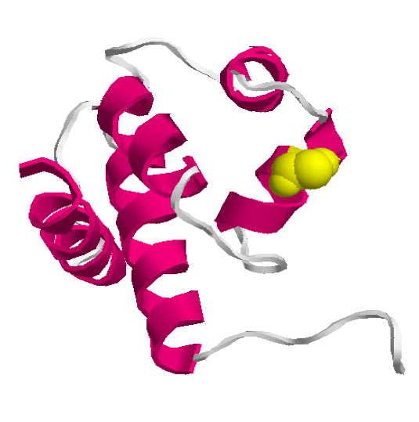
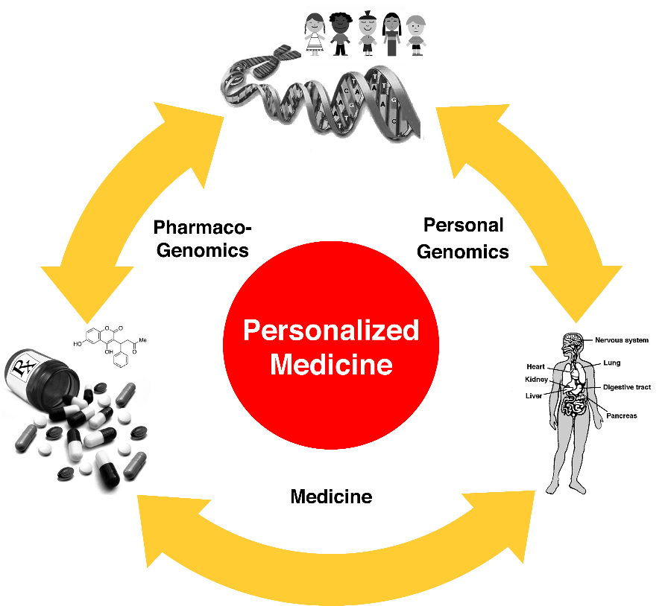
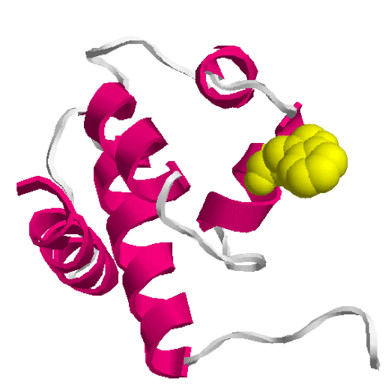
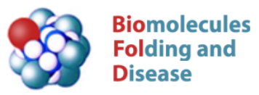
Assessing the predictions of the MAPK challenges
Turina P¹, Petrosino M ², Cicconardi A¹, Novak L², Pasquo A³,
Chiaraluce R², Consalvi V ², Capriotti E¹*
¹ Department of Pharmacy and Biotechnology (FaBiT), University of Bologna. Bologna (Italy)
² Department of Biochemical Sciences, Sapienza University of Rome, Rome (Italy)
³ ENEA CR Frascati, Diagnostics and Metrology Laboratory FSN-TECFIS-DIM, Frascati (Italy)
Contact: emidio,capriotti@unibo.it
CAGI 6 Conference
14-16 May, 2022 – Berkeley (CA) USA
Native
Mutant

Slide 4
MAPK1/MAPK3 Challenges
MAPK1 (ERK2) and MAPK3 (ERK1) are active serine/threonine kinase that regulates cell proliferation, transcription, differentiation, and cell cycle progression.
The MAPKs are activated by phosphorylation of two residues (Thr and Tyr). The stabilities and activities of a set of mutants was assessed for both phosphorylated and unphosphorylated forms.
For each variant in both forms, participants are asked to predict:
ΔΔGH20 for unphosphorylated and phosphorylated forms
catalytic efficiency (kcat/km)mut/(kcat/km)wt
Data providers:
Roberta Chiaraluce and Valerio Consalvi, Sapienza University, Rome (Italy)
Created for CAGI 6
genomeinterpretation.org
Capriotti E

Slide 5
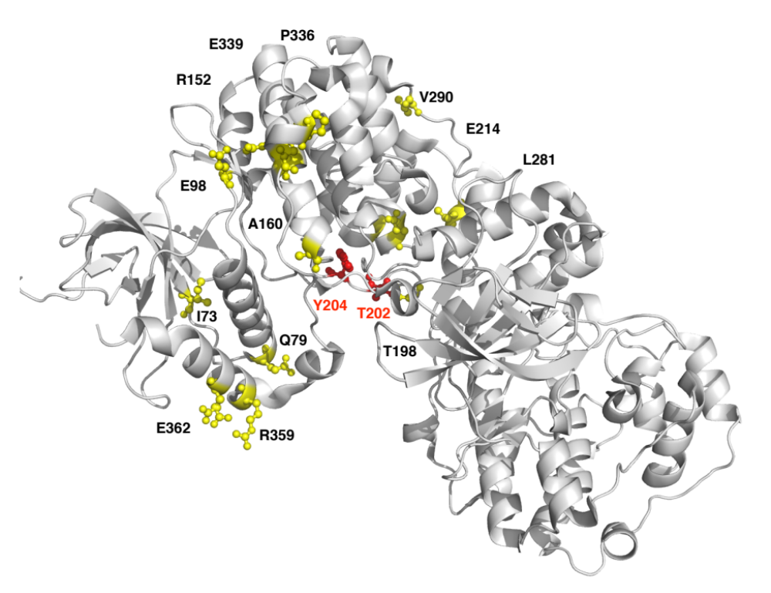
MAPK3 Unphosphorylated
Protein structure 4QTB structure (Resolution: 1.40 Å)
Created for CAGI 6
genomeinterpretation.org
Capriotti E

Slide 6
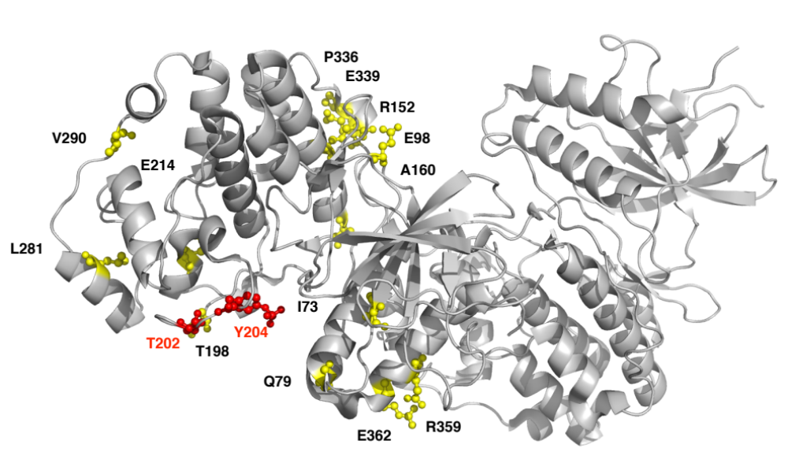
MAPK3 Phosphorylated
Protein structure 2ZOQ structure (Resolution: 2.39 Å)
Created for CAGI 6
genomeinterpretation.org
Capriotti E

Slide 7
MAPK3 Average Data
Embargoed
 | Unphosphorylated |  | Phosphorylated
 | ∆GH20 (kcal/mol) | ∆∆GH20 (kcal/mol) | ∆GH20 (kcal/mol) | ∆∆GH20 (kcal/mol) | Act kcat/kM | Actmut/ Actwt
WT | 6.1 ± 0.72 | - | 7.79 ± 0.76 | - | 0.65 | -
p.I73M | 9.64 ± 2.05 | 3.54 ± 2.17 | 8.51 ± 2.39 | 0.72 ± 2.51 | 0.32 | 0.5
p.Q79H | 7.06 ± 1.35 | 0.96 ± 1.53 | 6.71 ± 1.23 | -1.08 ± 1.45 | 0.05 | 0.07
p.E98K | 6.91 ± 1.32 | 0.81 ± 1.5 | 7.49 ± 0.21 | -0.3 ± 0.79 | 1.08 | 1.67
p.A160T | 11.9 ± 1.6 | 5.79 ± 1.75 | 5.68 ± 0.42 | -2.11 ± 0.87 | 0.6 | 0.93
p.T198I | 5.26 ± 1.01 | -0.84 ± 1.24 | 9.68 ± 1.34 | 1.89 ± 1.54 | 3.28 | 5.08
p.E214D | 5.37 ± 0.68 | -0.73 ± 0.99 | 6.12 ± 0.38 | -1.67 ± 0.85 | 0.06 | 0.09
p.L281I | 9.58 ± 0.93 | 3.48 ± 1.18 | 7.43 ± 0.54 | -0.36 ± 0.93 | 0.42 | 0.64
p.V290A | 9.21 ± 1.46 | 3.11 ± 1.63 | 4.47 ± 0.63 | -3.32 ± 0.99 | 0.09 | 0.14
p.P336Q | 6.78 ± 0.48 | 0.68 ± 0.87 | 8.45 ± 1.64 | 0.66 ± 1.81 | 0.23 | 0.35
p.E339V | 8.87 ± 2.81 | 2.77 ± 2.9 | 8.6 ± 0.79 | 0.81 ± 1.1 | 0.37 | 0.57
p.R359W | 6.28 ± 0.73 | 0.18 ± 1.03 | 6.37 ± 0.77 | -1.42 ± 1.08 | 0.46 | 0.72
p.E362Q | 6.65 ± 0.56 | 0.55 ± 0.91 | 6.49 ± 0.91 | -1.3 ± 1.19 | 0.17 | 0.27
Created for CAGI 6
genomeinterpretation.org
Capriotti E

Slide 8
Comparing stability measures for MAPK3
Embargoed
Created for CAGI 6
genomeinterpretation.org
Capriotti E

Slide 9
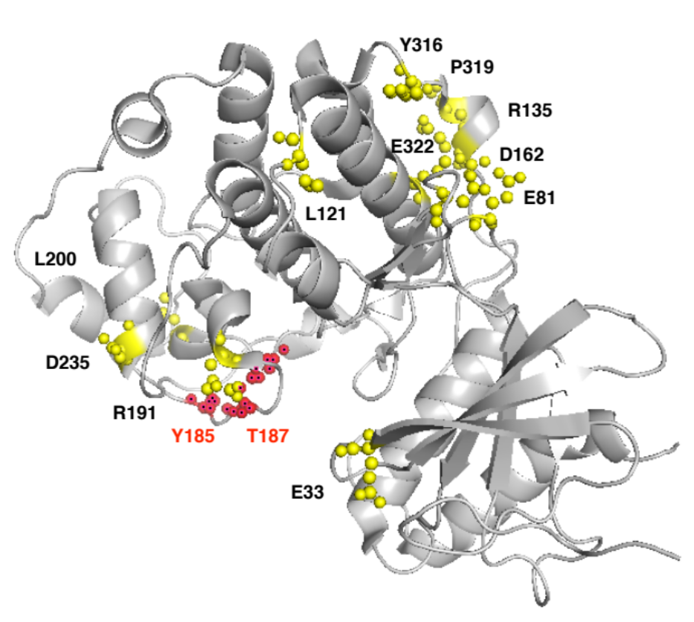
MAPK1 Unphosphorylated
Protein structure 1TVO structure (Resolution: 2.50 Å)
Created for CAGI 6
genomeinterpretation.org
Capriotti E

Slide 10
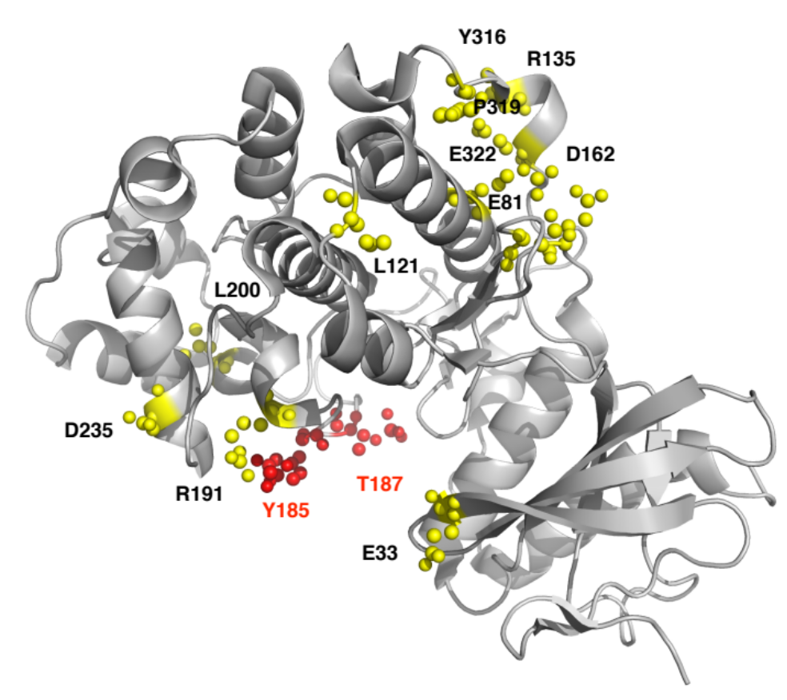
MAPK1 Phosphorylated
Protein structure 5V60 structure (Resolution: 2.18 Å)
Created for CAGI 6
genomeinterpretation.org
Capriotti E

Slide 11
MAPK1 Average Data
Embargoed
 | Unphosphorylated |  | Phosphorylated
 | ∆GH20 (kcal/mol) | ∆∆GH20 (kcal/mol) | ∆GH20 (kcal/mol) | ∆∆GH20 (kcal/mol) | Act kcat/kM | Actmut/ Actwt
WT | 2.65 ± 0.15 | - | 2.59 ± 0.14 | - | 1.215 | 1
p.E33Q | 2.89 ± 0.19 | 0.24 ± 0.23 | 2.27 ± 0.14 | -0.32 ± 0.20 | 0.508 | 0.42
p.E81K | 1.95 ± 0.15 | -0.71 ± 0.21 | 2.45 ¬± 0.17 | -0.14 ± 0.22 | 0.47 | 0.39
p.L121I | 2.78 ± 0.18 | 0.13 ± 0.23 | 2.28 ± 0.13 | -0.31 ± 0.19 | 0.01 | 8. 3E-03
p.R135K | 2.50 ± 0.16 | -0.15 ± 0.22 | 2.24 ± 0.12 | -0.35 ± 0.18 | 4.578 | 3.77
p.D162G | 2.48 ± 0.11 | -0.17 ± 0.19 | 2.13 ± 0.11 | - | 6.50E-04 | 5.0E-04
p.R191H | 3.64 ± 0.54 | 0.99 ± 0.56 | 2.43 ± 1.05 | -0.16 ± 1.06 | 3.64E-04 | 3E-04
p.L200F | 2.58 ± 0.12 | -0.07 ± 0.19 | 2.59 ± 0.19 | 0.00 ± 0.24 | 7.52E-03 | 6.2E-03
p.D235V | 2.47 ± 0.13 | -0.18 ± 0.20 | 2.09 ± 0.14 | -0.50 ± 0.20 | 0.078 | 0.064
p.Y316F | 2.66 ± 0.17 | 0.01 ± 0.23 | 1.92 ± 0.11 | -0.67 ± 0.18 | 4.35 | 3.58
p.P319S | 2.20 ± 0.17 | -0.45 ± 0.20 | 2.26 ± 0.16 | -0.33 ± 0.21 | 0.085 | 0.07
p.E322V | 2.14 ± 0.15 | -0.51 ± 0.21 | 2.15 ± 0.12 | -0.44 ± 0.18 | 1.352 | 1.11
Created for CAGI 6
genomeinterpretation.org
Capriotti E

Slide 12
Comparing stability measures for MAPK1
Embargoed
Created for CAGI 6
genomeinterpretation.org
Capriotti E

