Slide 1

CAGI slide pack guidelines
I agree to my slides being used according to the following terms:
_______Jing Zhang, Lisa N. Kinch, Qian Cong, Nick V. Grishin_______
Authors: please include THIS slide at the beginning of your presentation to indicate that you agree with reuse of your slides in CAGI presentations, according to the terms below, and digitally sign by writing your name above.
To disseminate the CAGI results, I encourage all CAGI participants to remix these CAGI slides for inclusion in their oral and poster presentations
CAGI participants may use or publish any content of these slides only in compliance with the CAGI Data Use Agreement
CAGI participants may not cite or publish any content of these slides except with the written permission of the originating author or in the primary CAGI publications
CAGI participants must acknowledge the original authors of these slides and CAGI 6. Include the acknowledgement banner across the bottom
CAGI participants must include the CAGI credits slide in their presentations
Slides with a red slash (no remix) may not be included in a presentation unless all attendees are registered CAGI participants who signed the data use agreement
Slides with a red X over the entire slide may not be used in any circumstances
Slides with a blue slash (embargoed) may not be used unless the embargo is explicitly lifted
Slides without slash or X may be tweeted unless flagged with the “No tweet” icon.
CAGI participants using these slides must explain the “No tweet” icon, which means that the slide content should not be disseminated outside the presenting conference hall. If the presentation venue permits pervasive tweeting, you may not include these slides in your talk
Note for slide authors: we expect all CAGI participants to abide by these restrictions and will make best effort to ensure they are followed. However, but bear in mind that we have limited means of enforcing them, and therefore the restrictions cannot be guaranteed.

Slide 2
Permission request regarding CAGI 6 recordings and hybrid presentations
I understand that my presentation as associated with CAGI 6 will be recorded and broadcasted via the internet through CAGI’s designated technology provider.
As the copyright holder to this presentation entitled “Assessment of HMBS challenge”, I hereby agree that the copyright for the online broadcast and recording of my presentation be released to CAGI and my recording be uploaded on to the CAGI website.

Slide 3
Assessment of the HMBS challenge
Jing Zhang and Qian Cong
Grishin lab and Cong lab
University of Texas Southwestern Medical Center

Slide 4
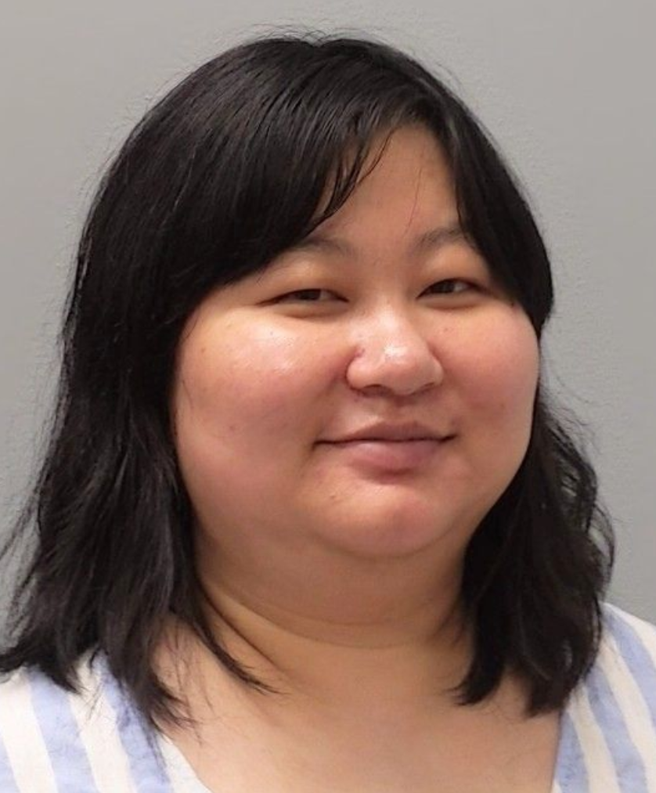
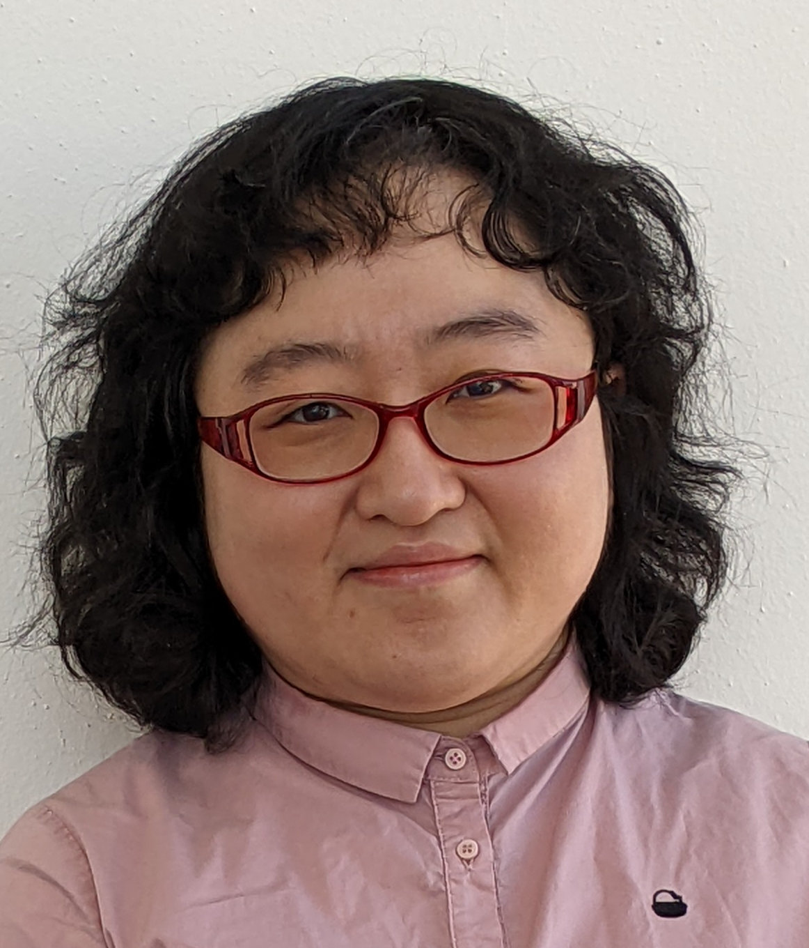
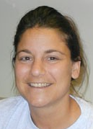
The Assessment Team
Jing Zhang
Qian Cong
Lisa N. Kinch
Created for CAGI 6
genomeinterpretation.org
Nick V. Grishin

Slide 5
Dataset for the HMBS challenge
High-accuracy subset of 6591 variants
5963 missense
317 nonsense
310 synonymous
Three independent replicates for each variant
Created for CAGI 6
genomeinterpretation.org
Jing Zhang

Slide 6
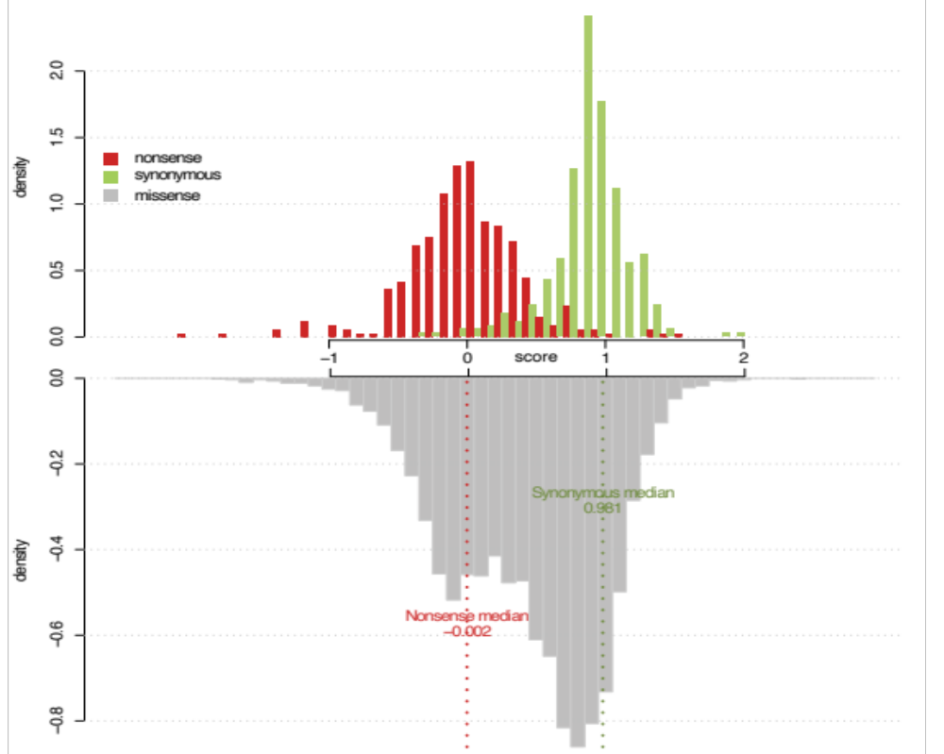
Fitness score distributions of nonsense, synonymous and missense mutations
From the CAGI6 website
Created for CAGI 6
genomeinterpretation.org
Jing Zhang

Slide 7
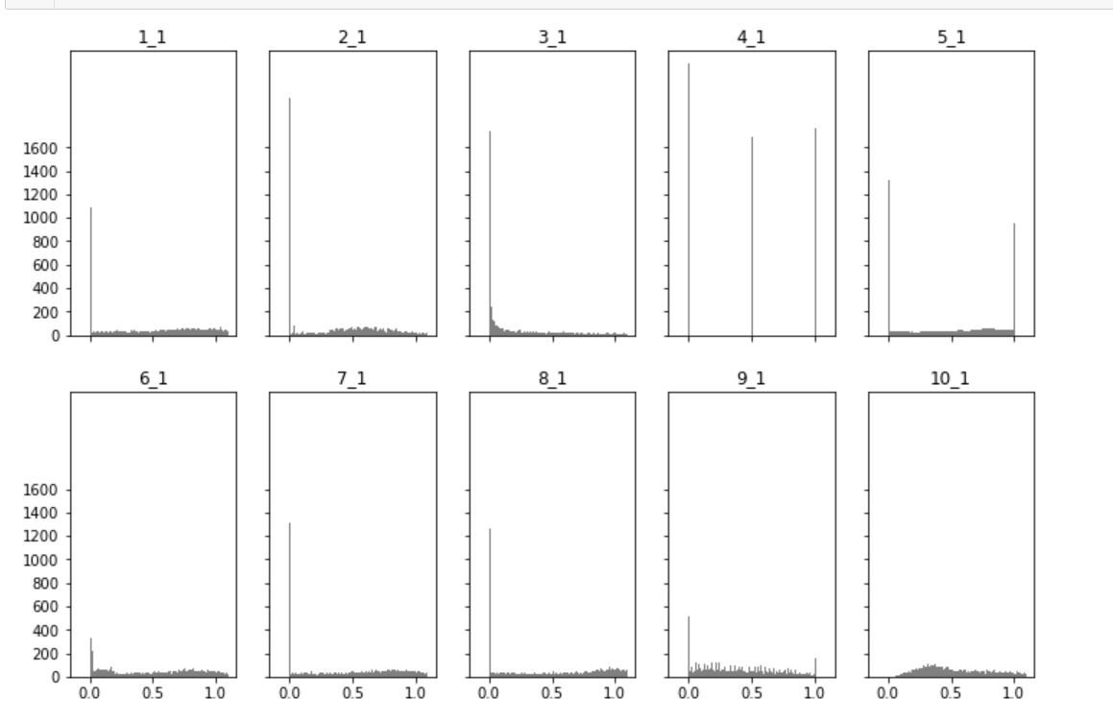
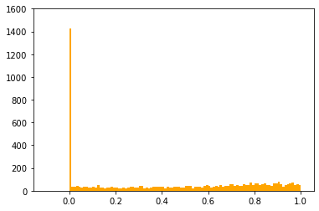
Distributions of predicted fitness scores
Experiment
count
score
1. Distributions of predicted scores from most groups are very different from experimental scores
2. Team3 even has predicted scores larger than 10000!!!
3. Team1 and Team8 have negative scores (can transform to 0)
Created for CAGI 6
genomeinterpretation.org
Jing Zhang

Slide 8
Problems with distribution of predicted scores
Only one group has distribution of predicted scores very similar to the distribution of experimental scores
Differences in distributions wouldn’t matter for evaluation measures based on comparing ranks, but for measures based on values, for example, RMSD, assessors had to transform prediction scores
Maybe it is better to implement a checking step at prediction submission stage to ensure the predicted values are in the range of 0 -- 1?
Created for CAGI 6
genomeinterpretation.org
Jing Zhang

Slide 9
Quantile normalization of predicted values
to match experimental values
Assign experimental value to mutation
Mutations ranked by predicted scores
Experimental values ranked low-to-high
mutation | Pred transformed
S56K | 0
A165D | 0.12
K45F | 0.21
C89G | 0.34
L214A | 0.48
mutation | Pred score | Pred rank
S56K | 0 | 1
A165D | 0.7 | 2
K45F | 0.9 | 3
C89G | 1.4 | 4
L214A | 3.2 | 5
Exp rank | Exp score
1 | 0
2 | 0.12
3 | 0.21
4 | 0.34
5 | 0.48
Created for CAGI 6
genomeinterpretation.org
Jing Zhang

Slide 10
General idea about what evaluation methods to use
1. Categorize mutations: deleterious, wild-type.
Performance on a binary classification.
E.g., using ROC curves and areas under them.
2. Quantitative prediction of mutation effects:
Comparison of values and their ranks.
E.g., Kendall tau or RMSD-like measures.
Created for CAGI 6
genomeinterpretation.org
Jing Zhang

Slide 11
Performance Evaluation
Since no single score captures all aspects of predictions,
we used many scores measuring different properties
1. Rank-based scores. These don’t depend on the scale of predictions.
2. Value-based scores computed on predictions transformed by us.
3. Value-based scores computed on original predictions.
Created for CAGI 6
genomeinterpretation.org
Jing Zhang

Slide 12
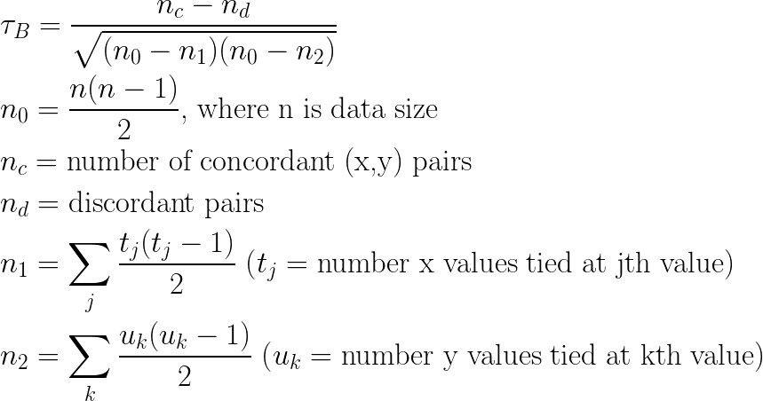

Description of each measure
Rank-based
Kendall Tau-b
Spearman’s rank correlation
ρ is correlation;
cov: covariance between rank variables
σ : standard deviation of rank variables.
Created for CAGI 6
genomeinterpretation.org
Jing Zhang

Slide 13

Description of each measure
ROC (Receiver operating characteristic) of deleterious mutations
It is plot of the true positive rate versus the false positive. Mutations with experimental scores less than 0.3 are regarded as deleterious mutations (true). Others are not-deleterious (false) Mutations are ranked by their predicted scores from low to high, that is, from most mutations predicted to be deleterious to least deleterious. The area under the curve was used as measure.
ROC (Receiver operating characteristic) of mild/no effects mutations
It is plot of the true positive rate versus the false positive. Mutations with experimental scores more than 0.8 are regarded as mild/wild mutations (true). Predictions from each group are ranked from high to low that is, from least affecting mutations to most deleterious mutations. The area under the curve was used as measure.
Value-based
MCC (Matthews correlation coefficient)
Created for CAGI 6
genomeinterpretation.org
Jing Zhang

Slide 14

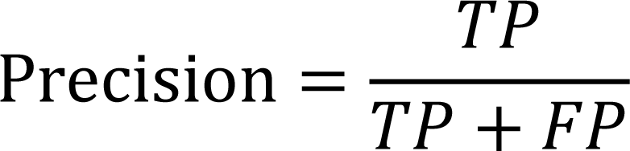
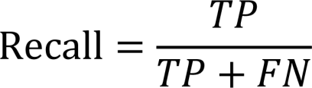

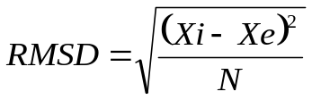
Description of each measure
F1 score
Mutations are classified into 3 categories based on predicted and experimental scores. <=0.3: highly deleterious, 0.3~0.8: moderately deleterious, 0.8~: benign. The mutations classified in the same categories by experimental scores and predicted scores are considered correctly predicted.
Pearson correlation coefficient
cov is covariance of X and Y
σ is standard deviation
RMSD (Root-mean-square deviation)
Xi is predictive scores
Xe is experimental scores
N is the number of mutations
Value difference test
It is the area under the curve of the percentage of mutations against the absolute difference between experimental score and predicted score of mutations.
Created for CAGI 6
genomeinterpretation.org
Jing Zhang

Slide 15
We added controls!
“Control ought to be stupid.”
V. M. Stepanov
(1) Positive control
To answer the question:
How do errors in experimental measurements affect the scores?
I251K 1.24 +/- 0.32
mean
standard deviation
assume Gaussian distribution
Generate a “perfect” prediction:
for each mutation, generate a Gaussian random variable with the mean and standard deviation set to experimental values
Created for CAGI 6
genomeinterpretation.org
Jing Zhang

Slide 16

We added controls!
“Control ought to be stupid.”
V. M. Stepanov
(2) Negative control
To answer the question:
How does a predictor based on amino acid usage in positions of
a multiple sequence alignment compares to submitted predictions?
Generate a “dummy” prediction:
for each mutation, compute the score:
Pw, the probability of wild type or Pm mutated residue in multiple sequence alignment; q, the background amino acid frequencies of Robinson and Robinson. If more than one mutation – add these values. Rank mutations by these scores and assign experimental value with that rank (the same as quantile transformation we apply to predictions).
Created for CAGI 6
genomeinterpretation.org
Jing Zhang

Slide 17
ROC curve (deleterious vs others)
Score <=0.3: deleterious (2043, wild-type less than 5%)
Score >=0.8: wild-type (2094, nonsense less than 5%)
Created for CAGI 6
genomeinterpretation.org
Jing Zhang

Slide 18
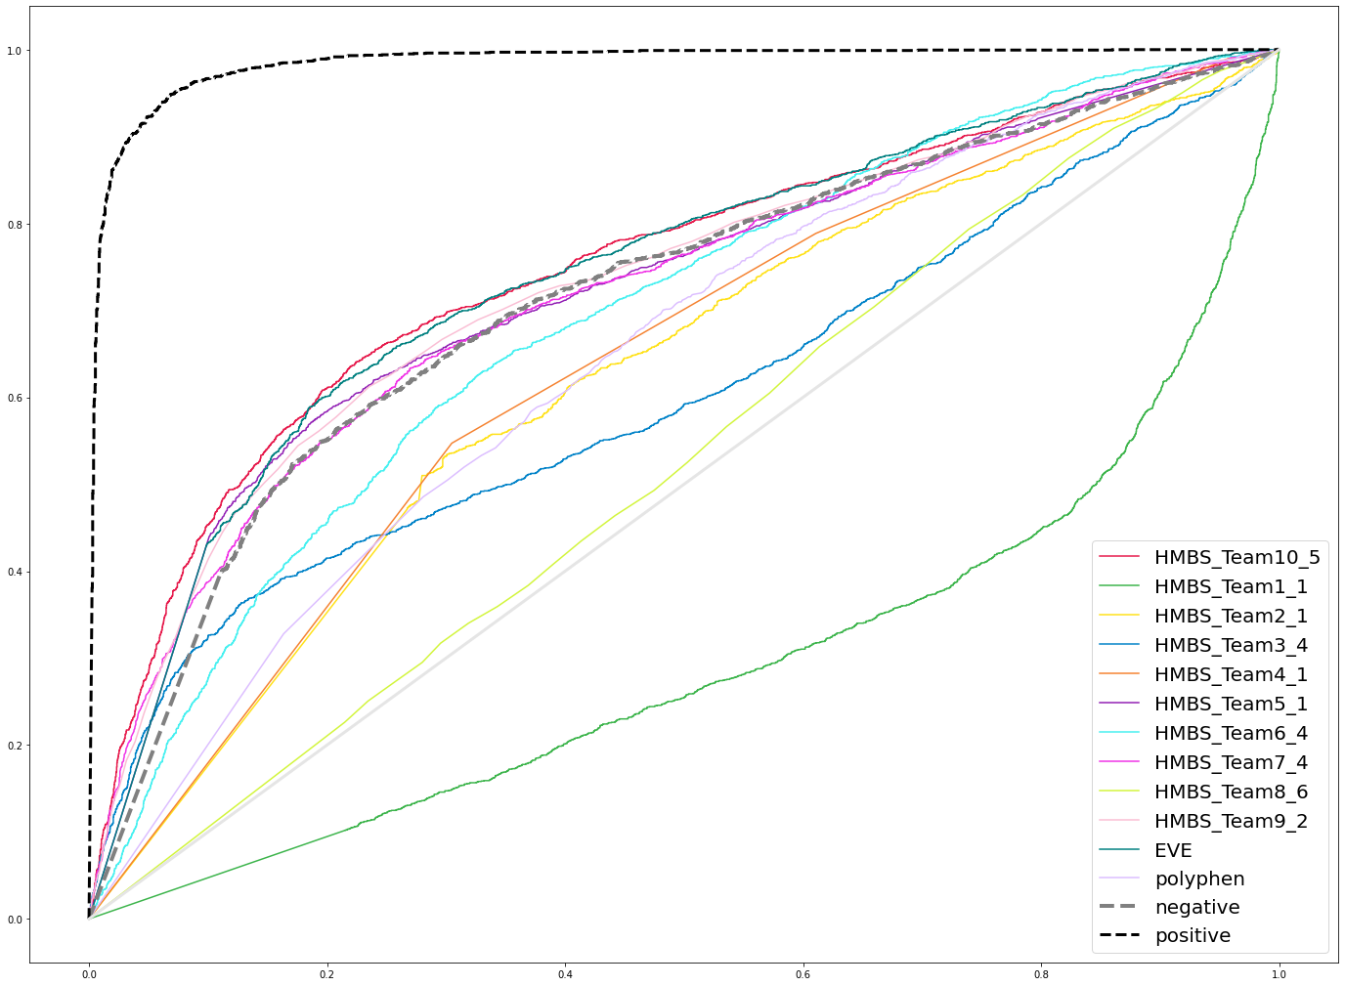
ROC curve (deleterious vs others)
Created for CAGI 6
genomeinterpretation.org
Jing Zhang

Slide 19
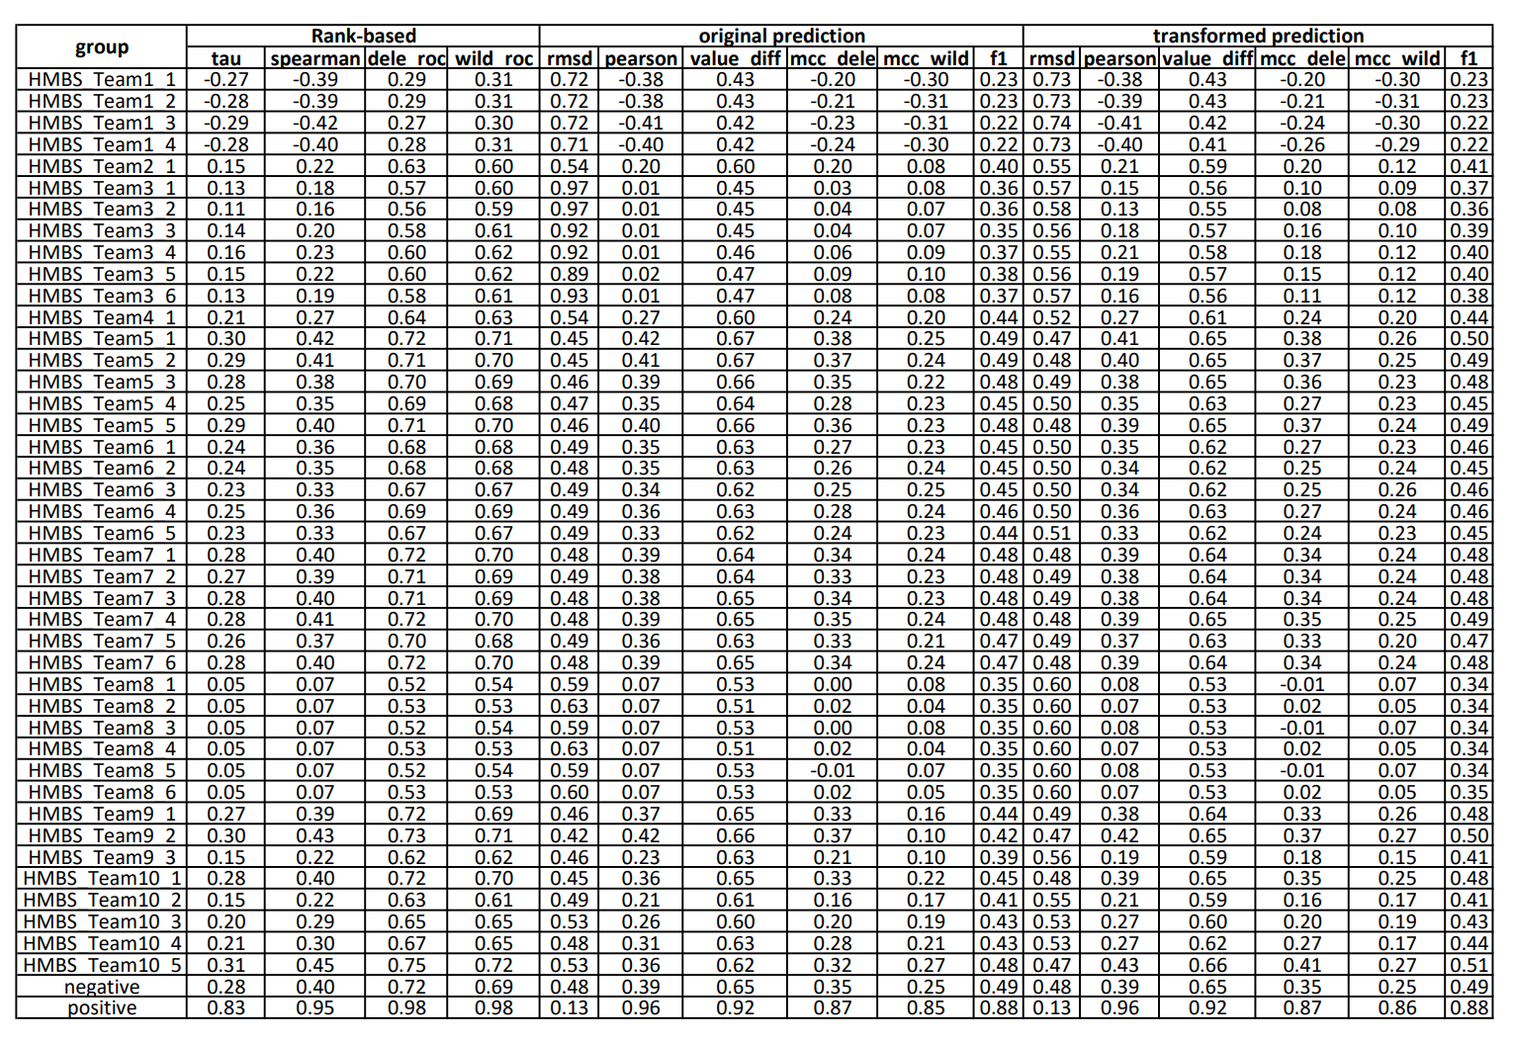
Scores table
Created for CAGI 6
genomeinterpretation.org
Jing Zhang

Slide 20
Combine Scores:
Average Z-scores within each category;
Sum for categories in each subset;
Categories
Created for CAGI 6
genomeinterpretation.org
Jing Zhang

Slide 21
Final ranks
group | Z score | rank
positive | 12.39
HMBS_Team5_1 | 2.84 | 1
HMBS_Team10_5 | 2.70 | 2
HMBS_Team5_2 | 2.65 | 3
HMBS_Team9_2 | 2.60 | 4
HMBS_Team5_5 | 2.55 | 5
negative | 2.46
HMBS_Team7_4 | 2.46 | 6
HMBS_Team10_1 | 2.40 | 7
HMBS_Team7_6 | 2.39 | 8
HMBS_Team7_1 | 2.38 | 9
HMBS_Team7_3 | 2.36 | 10
HMBS_Team5_3 | 2.35 | 11
HMBS_Team7_2 | 2.26 | 12
HMBS_Team9_1 | 2.18 | 13
HMBS_Team7_5 | 1.99 | 14
HMBS_Team6_4 | 1.83 | 15
HMBS_Team5_4 | 1.81 | 16
HMBS_Team6_1 | 1.74 | 17
HMBS_Team6_2 | 1.71 | 18
HMBS_Team6_3 | 1.60 | 19
HMBS_Team6_5 | 1.46 | 20
group | sum zscore | rank
HMBS_Team10_4 | 1.22 | 21
HMBS_Team4_1 | 0.88 | 22
HMBS_Team10_3 | 0.76 | 23
HMBS_Team9_3 | 0.25 | 24
HMBS_Team10_2 | 0.20 | 25
HMBS_Team2_1 | -0.03 | 26
HMBS_Team3_5 | -1.32 | 27
HMBS_Team3_4 | -1.37 | 28
HMBS_Team3_3 | -1.70 | 29
HMBS_Team3_6 | -1.74 | 30
HMBS_Team8_5 | -2.00 | 31
HMBS_Team8_1 | -2.00 | 32
HMBS_Team8_3 | -2.00 | 33
HMBS_Team3_1 | -2.05 | 34
HMBS_Team8_6 | -2.05 | 35
HMBS_Team8_2 | -2.17 | 36
HMBS_Team8_4 | -2.17 | 37
HMBS_Team3_2 | -2.22 | 38
HMBS_Team1_1 | -7.17 | 39
HMBS_Team1_2 | -7.27 | 40
HMBS_Team1_4 | -7.44 | 41
HMBS_Team1_3 | -7.53 | 42
Created for CAGI 6
genomeinterpretation.org
Jing Zhang

Slide 22
Statistics and confidence
To estimate the confidence of performance of predictors, we simulated 50 experimental datasets assuming the experimental score for each mutation has a distribution
Guassian~(exp score, exp stderr)
For each simulated dataset, 100 bootstrap replicates on mutations were generated. In total, we have 5000 datasets to compute confidence intervals and head-to-head tests.
Created for CAGI 6
genomeinterpretation.org
Jing Zhang

Slide 23
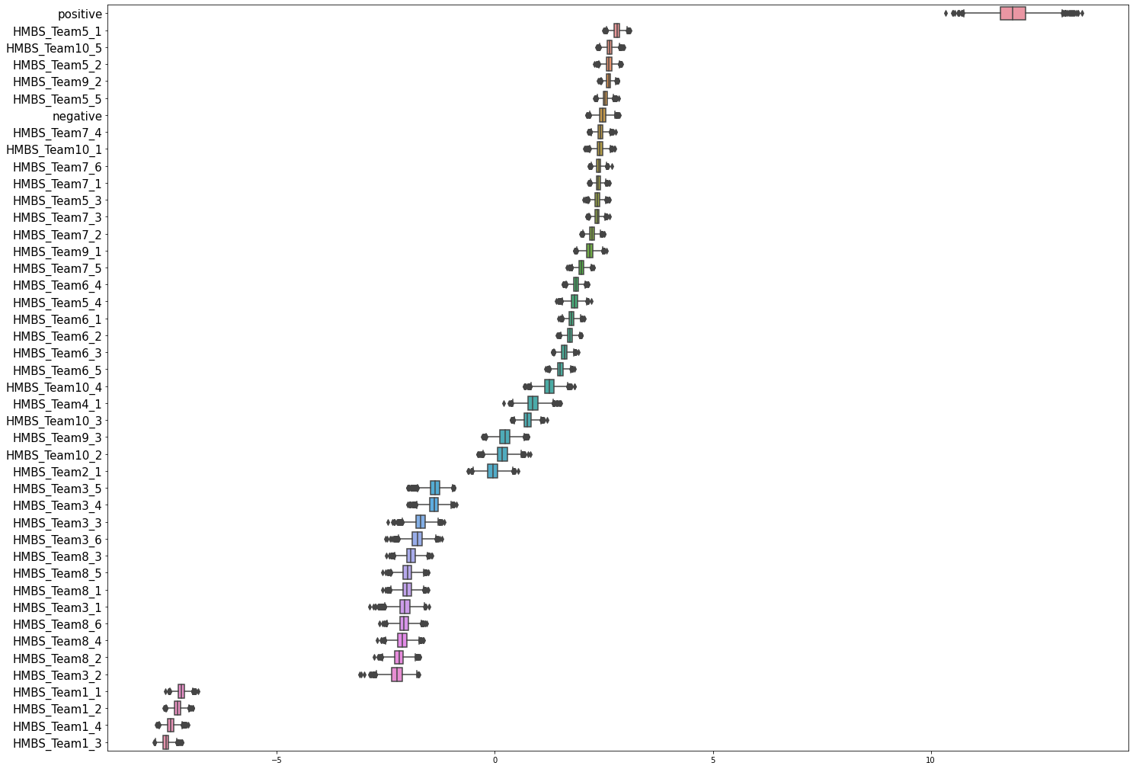
Z score
Created for CAGI 6
genomeinterpretation.org
Jing Zhang

Slide 24
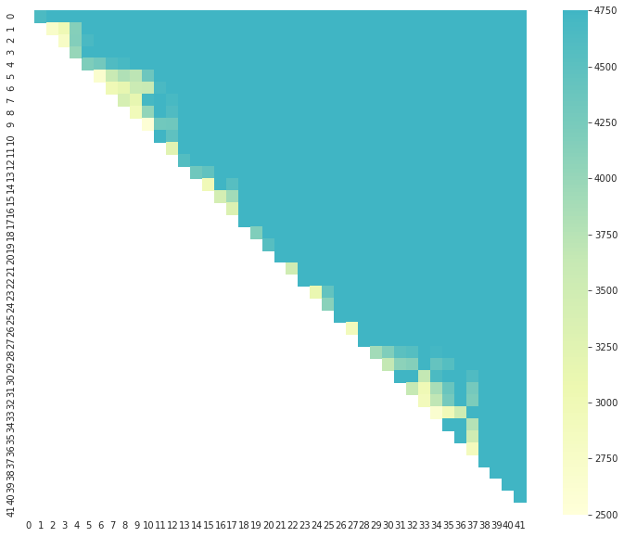
Head 2 head test
Count the number of simulated datasets one prediction wins over the other
HMBS_Team5_1
HMBS_Team10_5
HMBS_Team5_2
HMBS_Team9_2
HMBS_Team5_5
HMBS_Team7_4
HMBS_Team10_1
HMBS_Team7_6
HMBS_Team7_1
HMBS_Team5_3
HMBS_Team7_3
HMBS_Team7_2
HMBS_Team9_1
HMBS_Team7_5
HMBS_Team6_4
HMBS_Team5_4
HMBS_Team6_1
HMBS_Team6_2
HMBS_Team6_3
HMBS_Team6_5
HMBS_Team10_4
HMBS_Team4_1
HMBS_Team10_3
HMBS_Team9_3
HMBS_Team10_2
HMBS_Team2_1
HMBS_Team3_5
HMBS_Team3_4
HMBS_Team3_3
HMBS_Team3_6
HMBS_Team8_3
HMBS_Team8_5
HMBS_Team8_1
HMBS_Team3_1
HMBS_Team8_6
HMBS_Team8_4
HMBS_Team8_2
HMBS_Team3_2
HMBS_Team1_1
HMBS_Team1_2
HMBS_Team1_4
HMBS_Team1_3
Created for CAGI 6
genomeinterpretation.org
Jing Zhang

Slide 25
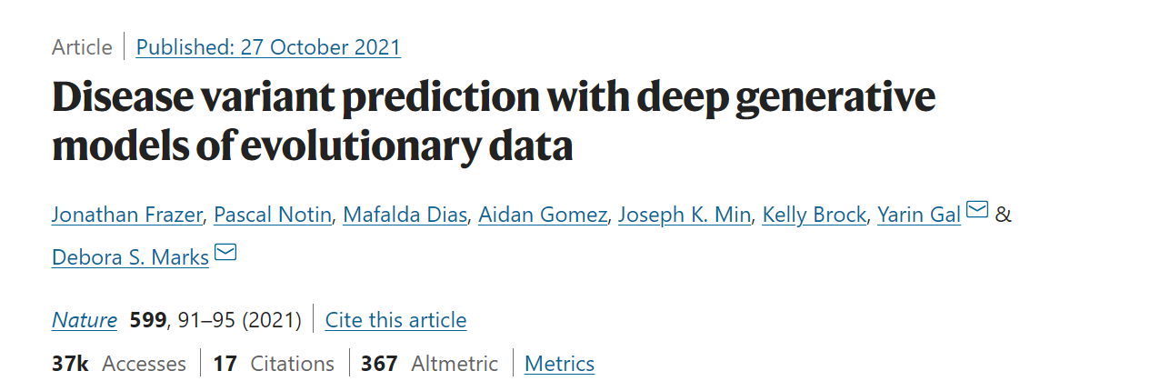
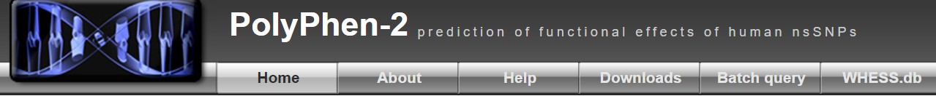
Introduced two other published methods
EVE (evolutionary model of variant effect)
We downloaded EVE predictions from their website and find not all positions have predictions. Thus, when including EVE, we only focus on variants EVE and all groups have predictions. (5269 variants)
2. Polyphen
Created for CAGI 6
genomeinterpretation.org
Jing Zhang

Slide 26
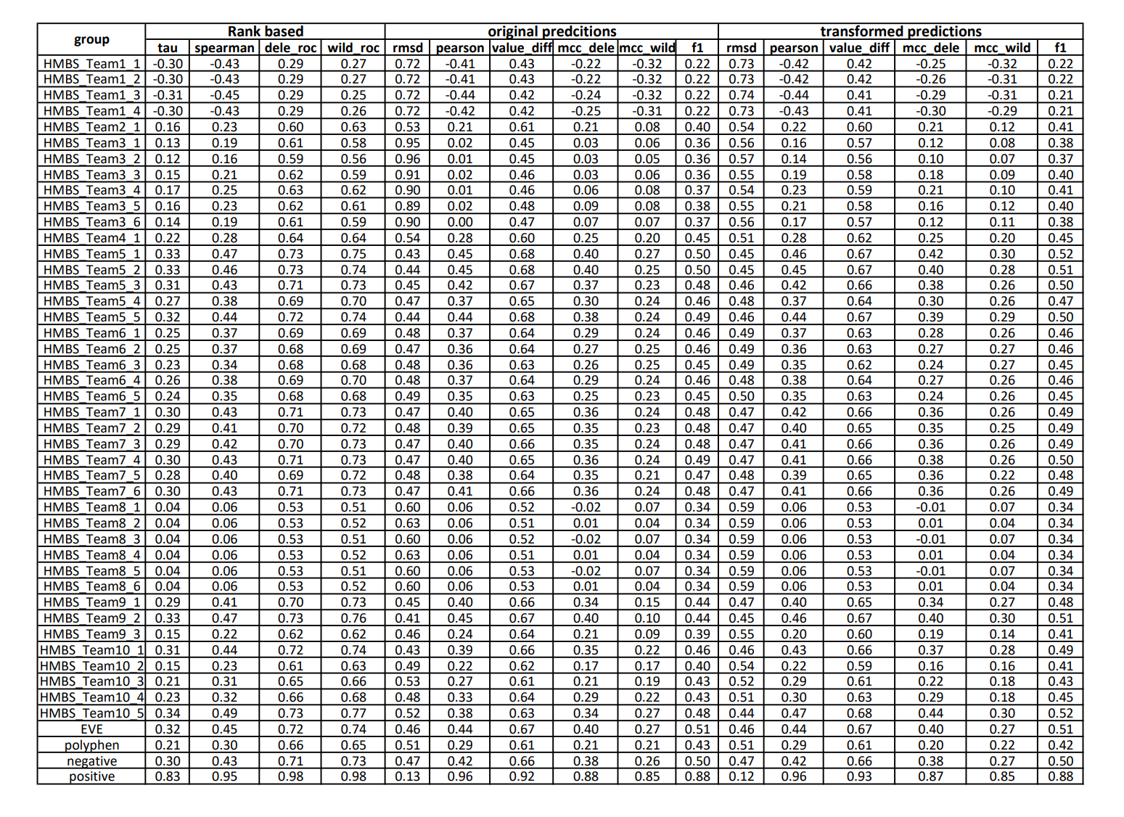
Created for CAGI 6
genomeinterpretation.org
Jing Zhang

Slide 27
Ranks with additional methods
group | Z score | rank
positive | 8.302914
HMBS_Team5_1 | 2.36597 | 1
HMBS_Team5_2 | 2.257779 | 2
EVE | 2.20315
HMBS_Team5_5 | 2.124699 | 3
HMBS_Team10_5 | 2.075479 | 4
HMBS_Team9_2 | 2.046554 | 5
negative | 2.00796
HMBS_Team5_3 | 2.00063 | 6
HMBS_Team10_1 | 1.930936 | 7
HMBS_Team7_4 | 1.91483 | 8
HMBS_Team7_6 | 1.871497 | 9
HMBS_Team7_1 | 1.850363 | 10
HMBS_Team7_3 | 1.849567 | 11
HMBS_Team7_2 | 1.74582 | 12
HMBS_Team7_5 | 1.643614 | 13
HMBS_Team9_1 | 1.602609 | 14
HMBS_Team5_4 | 1.426325 | 15
HMBS_Team6_4 | 1.364801 | 16
HMBS_Team6_1 | 1.283418 | 17
HMBS_Team6_2 | 1.274327 | 18
HMBS_Team10_4 | 1.114501 | 19
HMBS_Team6_3 | 1.066503 | 20
group | sum zscore | rank
HMBS_Team6_5 | 1.040354 | 21
HMBS_Team4_1 | 0.5886 | 22
HMBS_Team10_3 | 0.581351 | 23
polyphen | 0.535666
HMBS_Team9_3 | 0.226538 | 24
HMBS_Team10_2 | 0.112392 | 25
HMBS_Team2_1 | 0.045384 | 26
HMBS_Team3_4 | -1.14204 | 27
HMBS_Team3_5 | -1.18804 | 28
HMBS_Team3_3 | -1.43413 | 29
HMBS_Team3_6 | -1.4991 | 30
HMBS_Team8_6 | -1.67795 | 31
HMBS_Team3_1 | -1.7205 | 32
HMBS_Team8_5 | -1.75618 | 33
HMBS_Team8_1 | -1.7643 | 34
HMBS_Team8_3 | -1.7646 | 35
HMBS_Team8_2 | -1.78752 | 36
HMBS_Team8_4 | -1.78752 | 47
HMBS_Team3_2 | -1.89102 | 38
HMBS_Team1_1 | -5.47057 | 39
HMBS_Team1_2 | -5.51217 | 40
HMBS_Team1_4 | -5.60663 | 41
HMBS_Team1_3 | -5.70229 | 42
First 3 best-performing groups do not change and the performance of EVE is on par with them only worse than group 5
6 groups outperform polyphen
Created for CAGI 6
genomeinterpretation.org
Jing Zhang

Slide 28
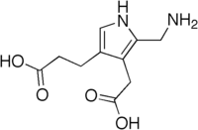
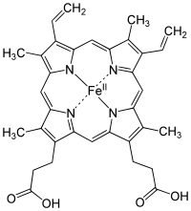
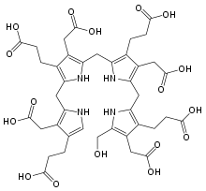
HMBS in the Heme Biosynthetic Pathway
Mitochondria Cytoplasm
Hydroxymethylbilane Synthase (HMBS)
Reaction
Succinyl-CoA +
glycine
ALAS
δ-amino-levulinic
acid
δ-amino-levulinic
acid
ALAD
Porphobilinogen
HMBS
Hydroxymethylbilane
Heme
UROS
Uroporphyrinogen III
FECH
UROD
Proto-porphyrin IX
PPOX
Proto-porphyrin-ogen IX
Proto-porphyrin-ogen IX
CPOX
Coproporphyrinogen III
Created for CAGI 6
genomeinterpretation.org
Lisa N. Kinch

Slide 29
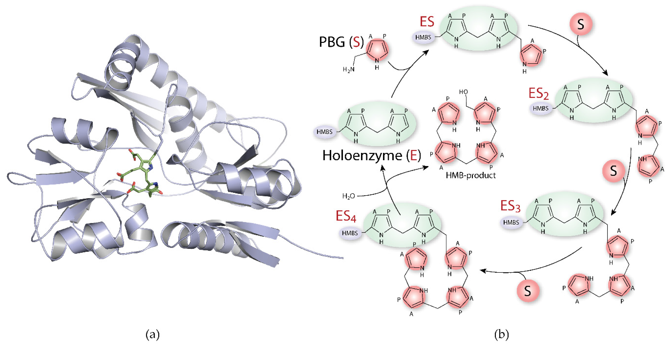
Catalytic mechanism of HMBS

Slide 30
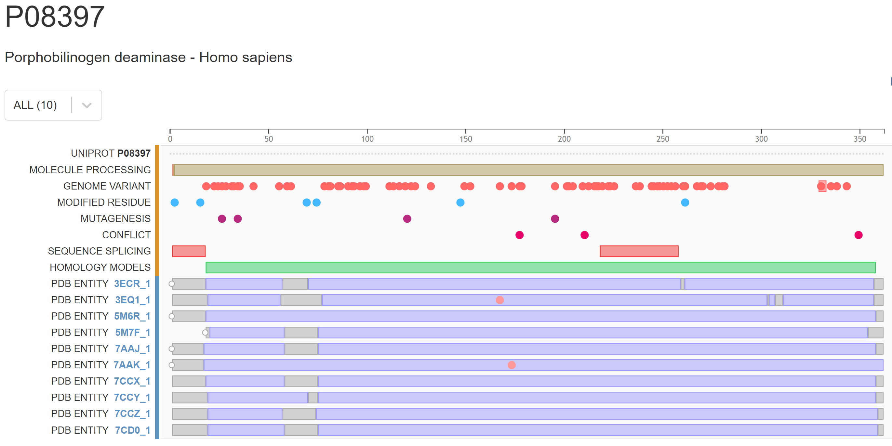
HMBS Experimental Structures
10 Structures with different ligands/mutations/states
Created for CAGI 6
genomeinterpretation.org
Lisa N. Kinch

Slide 31
HMBS Experimental Structures
10 Structures with different ligands/mutations/states
Mobile
Loop
Created for CAGI 6
genomeinterpretation.org
Lisa N. Kinch

Slide 32
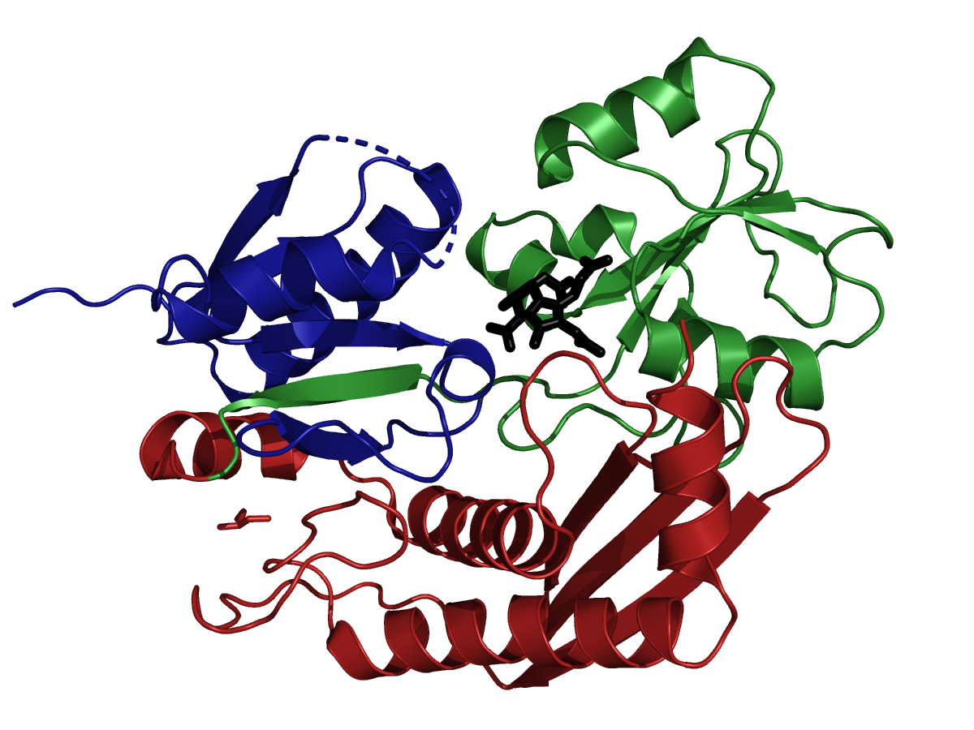
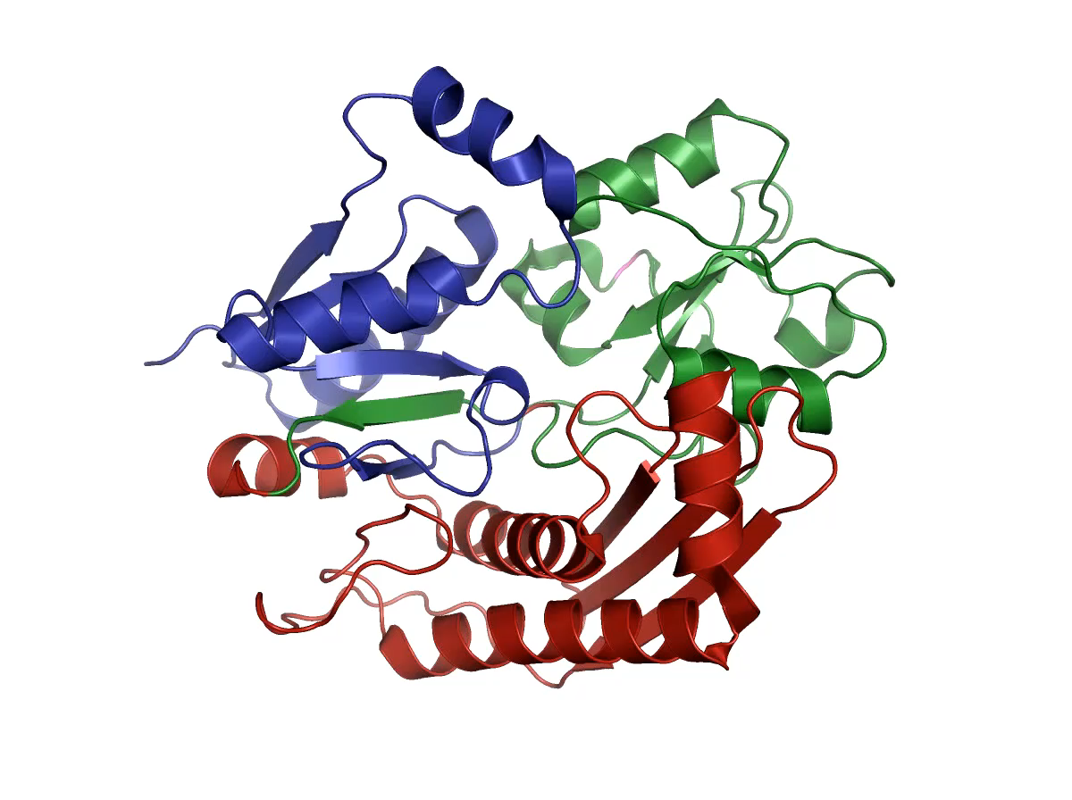
HMBS Domain Organization
18
126
217
356
Periplasmic binding protein-like II
Periplasmic binding protein-like II
dsRBD-like
Mobile loop near active site
Reaction intermediate conformation
R173W ES2
conformation
7aaj bound to Cofactor
Created for CAGI 6
genomeinterpretation.org
Lisa N. Kinch

Slide 33
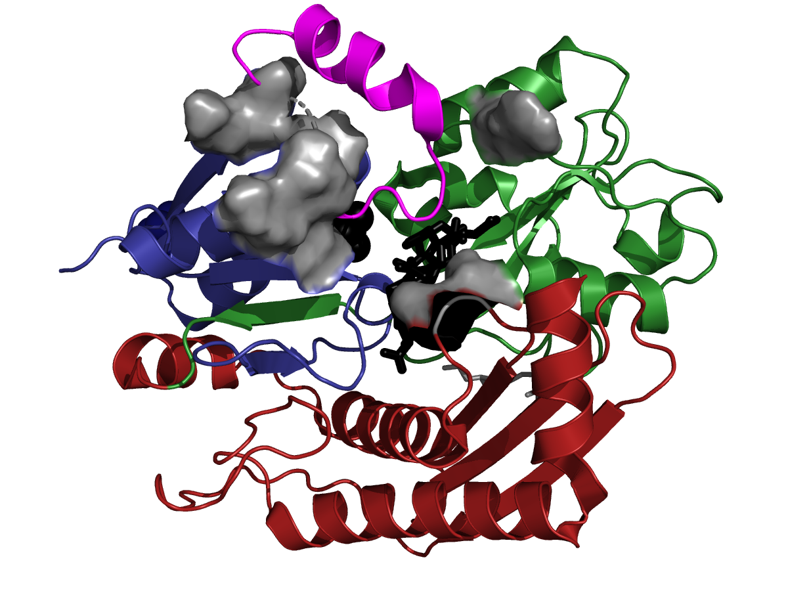
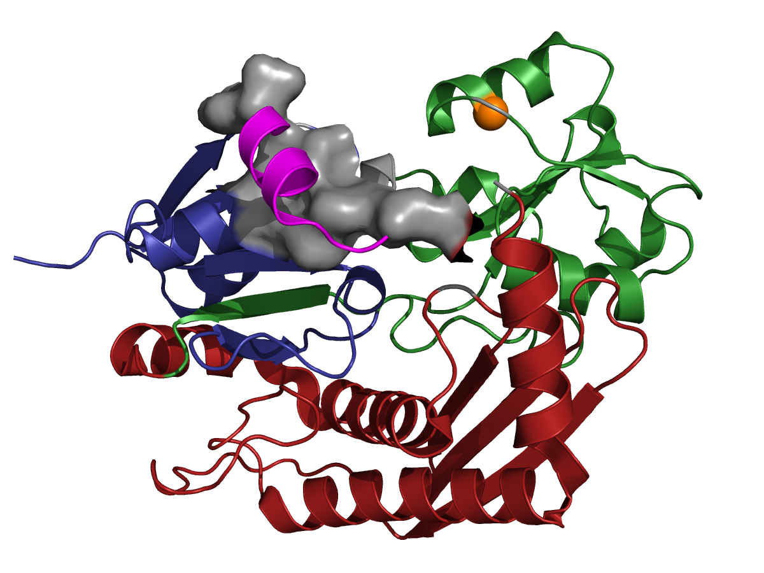
HMBS Functional Residues: position the loop
Residues <4Å in gray surface
These residues may be far from the active site
R173W
Reaction Intermediate Conformation 5m6r
Mutant ES2 Intermediate Conformation 7aak
Created for CAGI 6
genomeinterpretation.org
Lisa N. Kinch

Slide 34
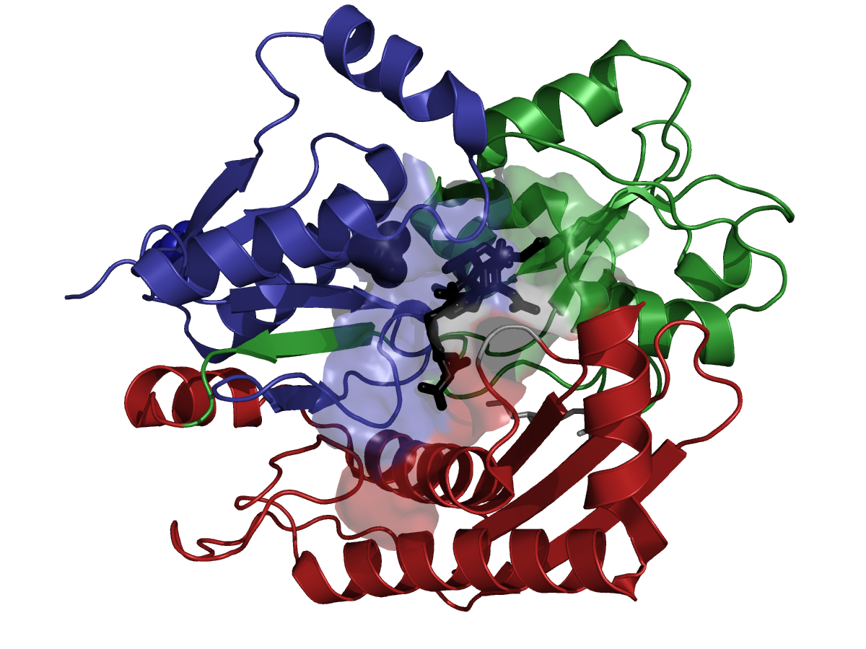
HMBS Functional Residues: bind ligands
These residues surround the active site
Created for CAGI 6
genomeinterpretation.org
Lisa N. Kinch

Slide 35
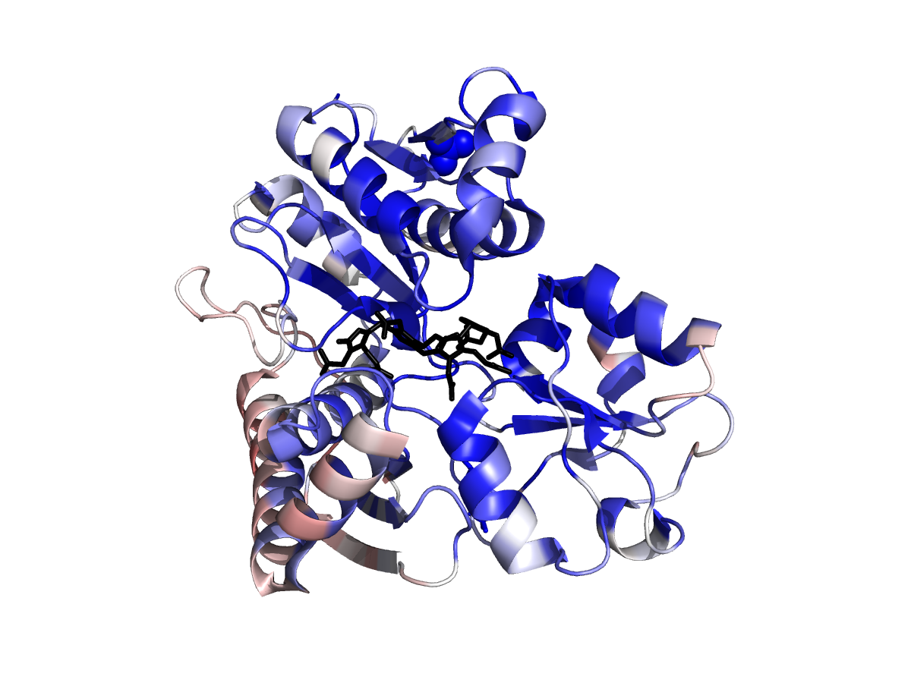
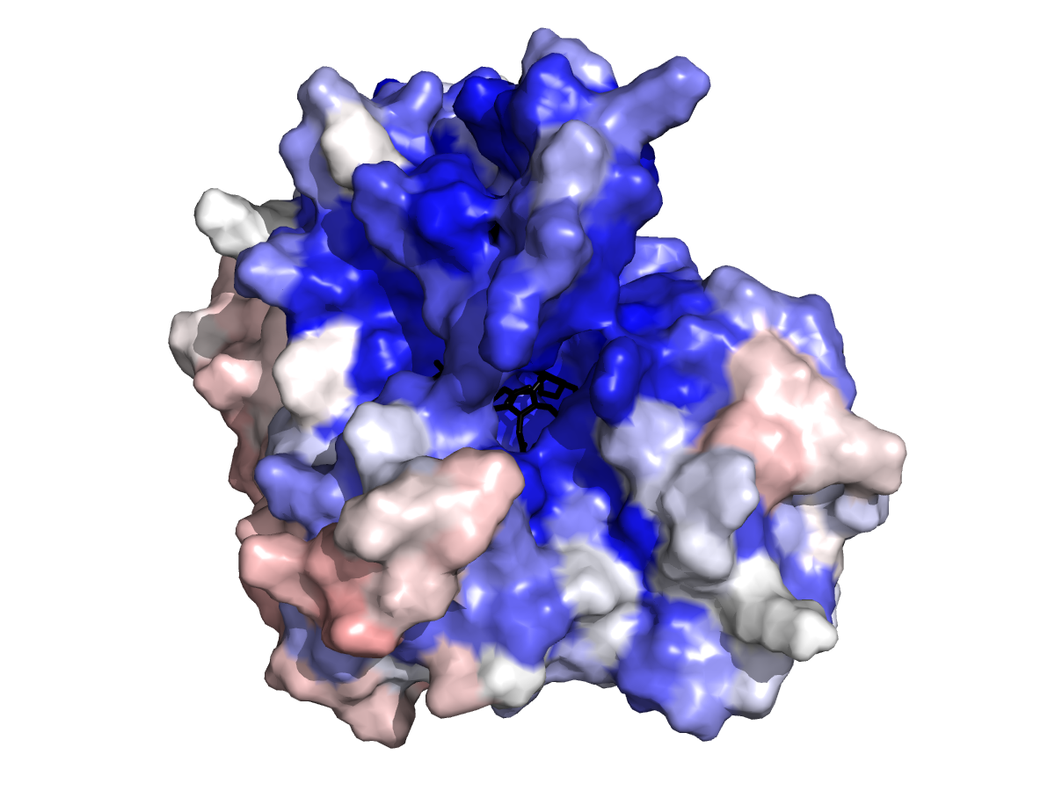
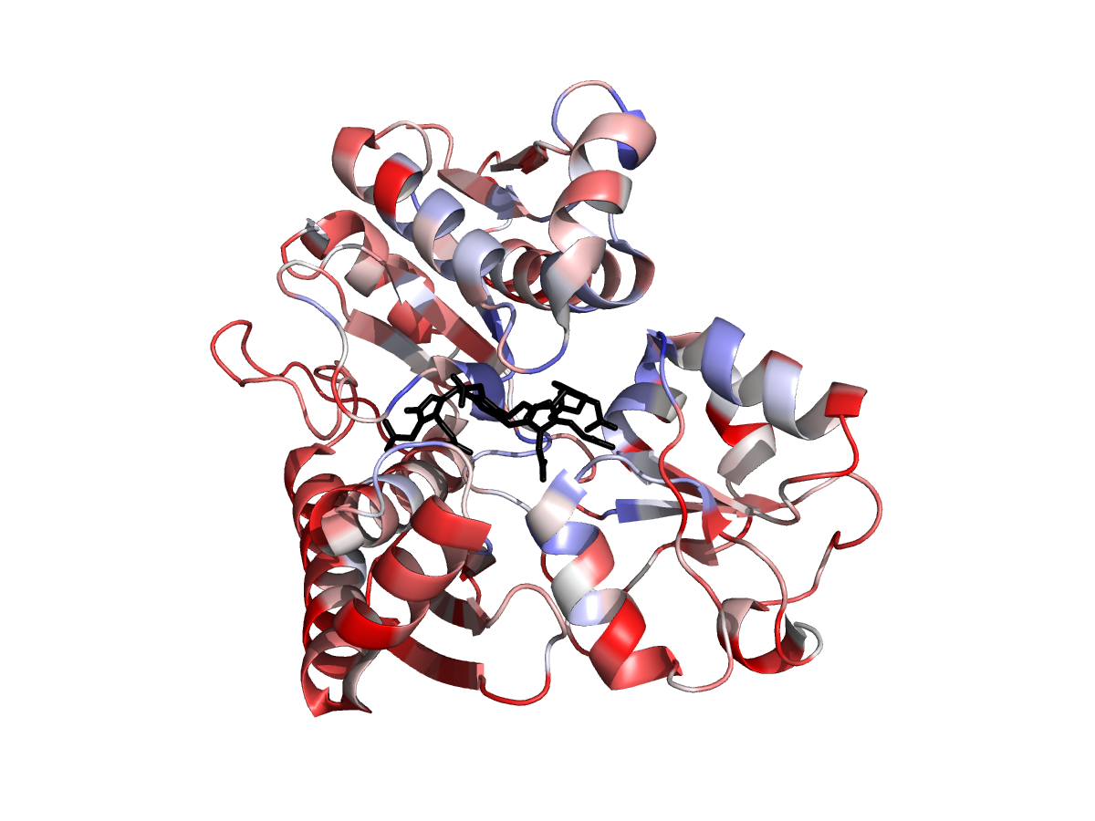
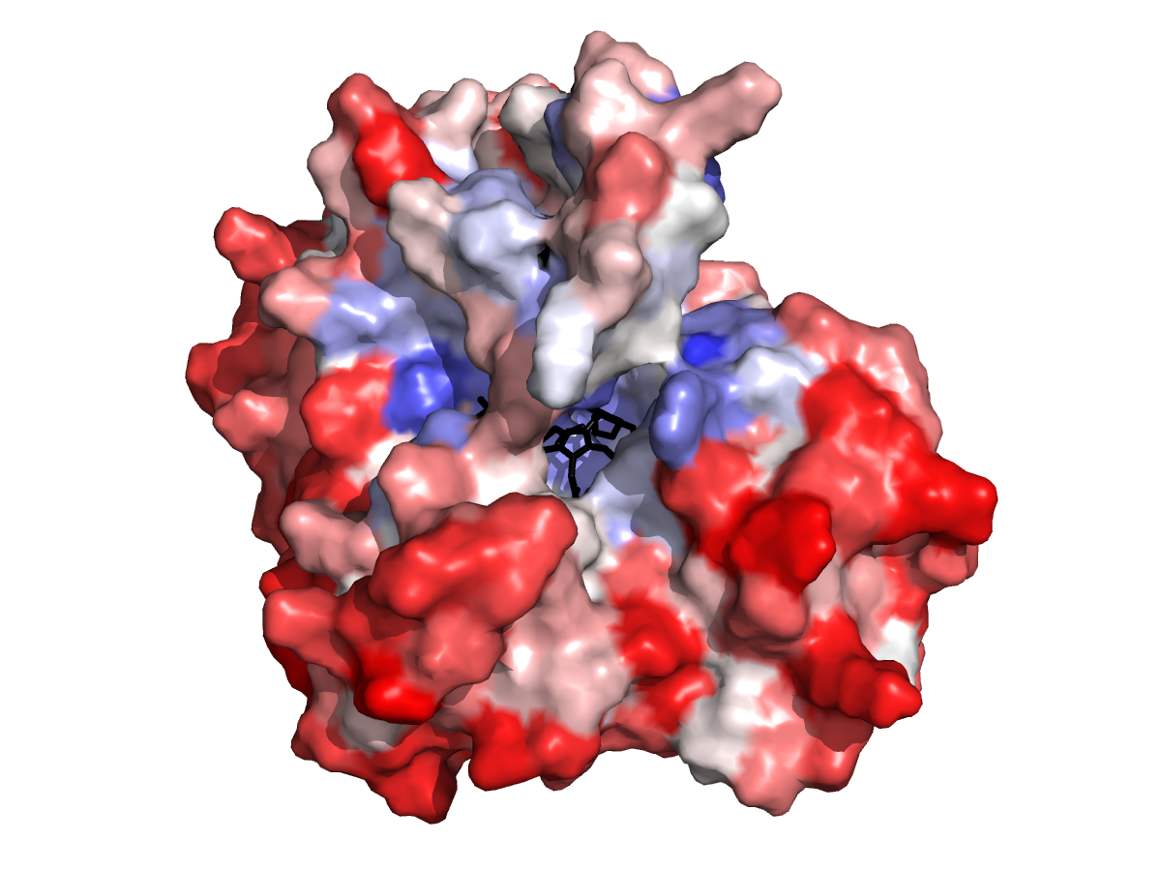
Predicted fitness scores highlights the functional sites
Mobile loop
Method
Use transformed scores
Remove team1 inverse scores (4 groups)
Average remaining scores for each mutation across groups
Pick maximum and minimum average score for each position
Map scores to B-factors
Blue-white-red colorspectrum from 0 to 1.3
Minimum
Maximum
Mobile loop
Created for CAGI 6
genomeinterpretation.org
Qian Cong

Slide 36
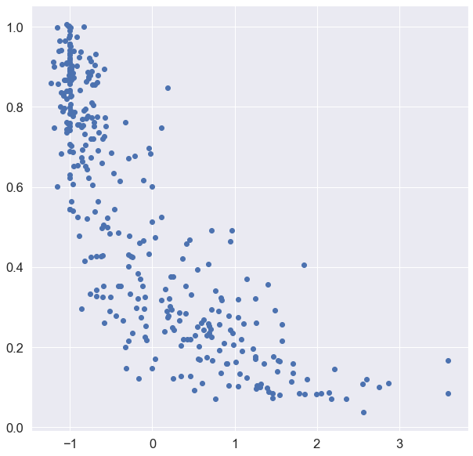
Average predicted score for each position corelate with conservation
Created for CAGI 6
genomeinterpretation.org
Qian Cong

Slide 37
Regions where predictions poorly match experimental results
RMSD between experimental score and the median predicted score from top-ranking groups
Smooth by averaging neighboring dots
Created for CAGI 6
genomeinterpretation.org
Qian Cong

Slide 38
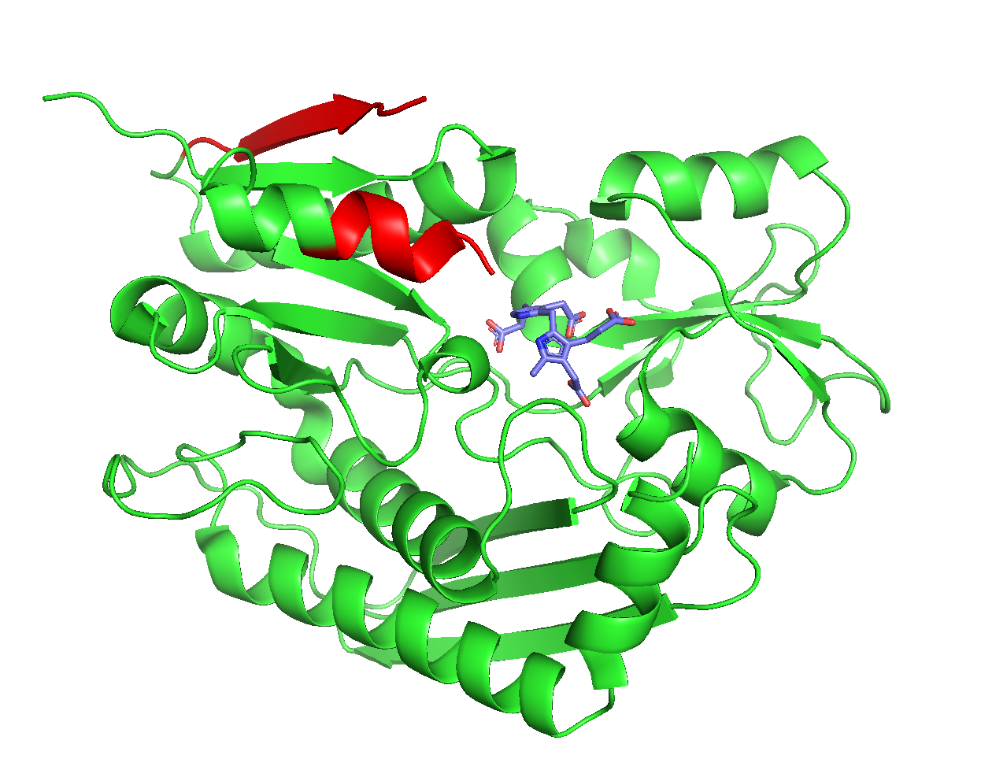
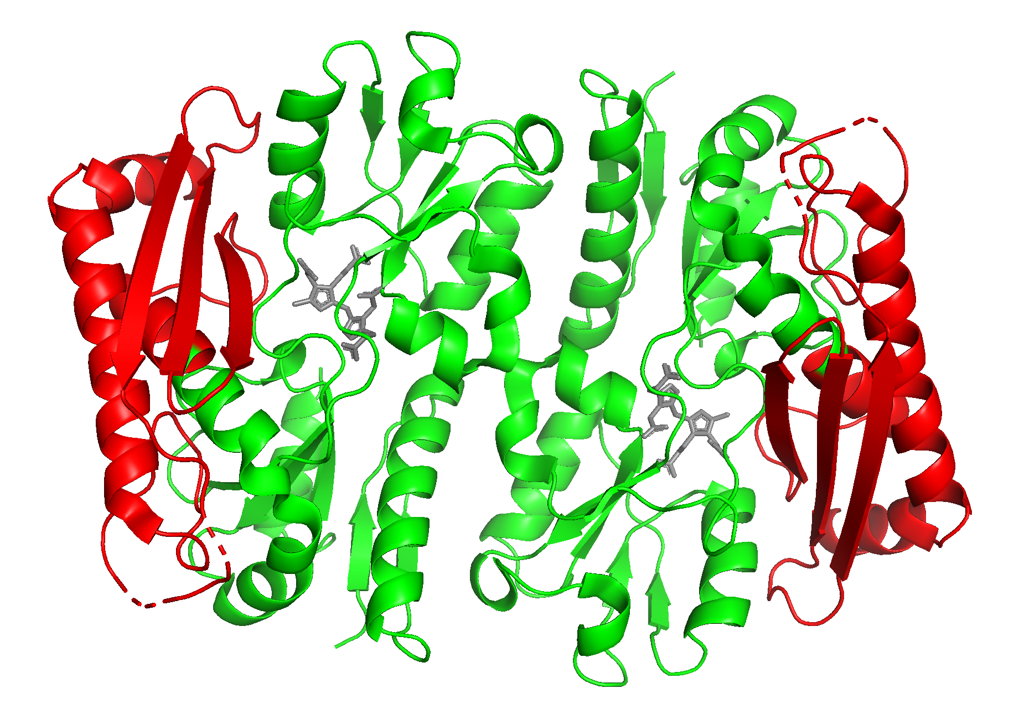
Regions where predictions poorly match experimental results
Created for CAGI 6
genomeinterpretation.org
Qian Cong

