Slide 1

CAGI slide pack guidelines
I agree to my slides being used according to the following terms:
_______Rajgopal Srinivasan_______
Authors: please include THIS slide at the beginning of your presentation to indicate that you agree with reuse of your slides in CAGI presentations, according to the terms below, and digitally sign by writing your name above.
To disseminate the CAGI results, I encourage all CAGI participants to remix these CAGI slides for inclusion in their oral and poster presentations
CAGI participants may use or publish any content of these slides only in compliance with the CAGI Data Use Agreement
CAGI participants may not cite or publish any content of these slides except with the written permission of the originating author or in the primary CAGI publications
CAGI participants must acknowledge the original authors of these slides and CAGI 6. Include the acknowledgement banner across the bottom
CAGI participants must include the CAGI credits slide in their presentations
Slides with a red slash (no remix) may not be included in a presentation unless all attendees are registered CAGI participants who signed the data use agreement
Slides with a red X over the entire slide may not be used in any circumstances
Slides with a blue slash (embargoed) may not be used unless the embargo is explicitly lifted
Slides without slash or X may be tweeted unless flagged with the “No tweet” icon.
CAGI participants using these slides must explain the “No tweet” icon, which means that the slide content should not be disseminated outside the presenting conference hall. If the presentation venue permits pervasive tweeting, you may not include these slides in your talk
Note for slide authors: we expect all CAGI participants to abide by these restrictions, and will make best effort to ensure they are followed. However, but bear in mind that we have limited means of enforcing them, and therefore the restrictions cannot be guaranteed.

Slide 2
Permission request regarding CAGI 6 recordings and hybrid presentations
I understand that my presentation as associated with CAGI 6 will be recorded and broadcasted via the internet through CAGI’s designated technology provider.
As the copyright holder to this presentation entitled Predicting patient clinical phenotypes and causal variants, I hereby agree that the copyright for the online broadcast and recording of my presentation be released to CAGI and my recording be uploaded on to the CAGI website.

Slide 3
Predicting patient clinical phenotypes and causal variants
CAGI6 – Intellectual Disability Panel Challenge
Rajgopal Srinivasan & Uma Sunderam
TCS Research
Hyderabad India

Slide 4
Approach
Variant processing across all samples
  Annotation
Variant prioritization for individual samples
  Quality Checks
  Identify variants that are unique to individual samples
  Rank identified variants by likelihood to cause phenotype
Gene Phenotype Association
  List of phenotypes possibly associated with each of the 74 panel genes
Identifying Phenotypes and Causal Variants for each patient
Created for CAGI 6
genomeinterpretation.org
Rajgopal Srinivasan

Slide 5
Variant Processing (1)
Gather
Variants for the 74 panel genes from Gnomad and Clinvar were collected
Annotate
In-house tool
Missense, Nonsense, Synonymous, Frame-shift and frame-preserving indels, Frequency in Gnomad (2.1.1), ALFA v2, Conservation scores, ...
Splice annotations (ESE, ESS, new splice site, …)
Scoring
Score each variant using above annotations
In house procedure based on pathogenic and benign variants from Clinvar with 2 stars
Scores for SNVs from dbNSFP 4.1c
Scores in range (0, 1)
Convert scores to percentile
So, a raw score of 0.5, for e.g. may have a percentile score of 50 in one gene and 60 in another gene
Created for CAGI 6
genomeinterpretation.org
Rajgopal Srinivasan

Slide 6
Variant Processing (2)
Merge
Combine variants from all 517 samples into a single file
Remove Duplicates
Annotate with frequency of occurrence of variants in the 517 samples
Annotate
In-house tool
Missense, Nonsense, Synonymous, Frame-shift and frame-preserving indels, Frequency in Gnomad (2.1.1), ALFA v2, Conservation scores, ...
Splice annotations (ESE, ESS, new splice site, …)
Scoring
Score each variant using above annotations
Remove variants that occur in more than 5% of samples
In house procedure based on pathogenic and benign variants from Clinvar with 2 stars
Scores for SNVs from dbNSFP 4.1c
Scores in range (0, 1)
Convert Score to Gene based percentile
Retain variants with percentile score >= 60
Created for CAGI 6
genomeinterpretation.org
Rajgopal Srinivasan

Slide 7
Individual Patient Variant Processing
Every variant in each sample was assigned a call quality of
  High
  Medium
  Low
The procedure used the STB, FAO, HRUN, GQ, DP and QUAL fields and was adapted from Damiati et al (doi:10.1007/s00439-016-1656-8, PMC4835520)
Only variants classified as High or Medium were considered for further analysis
  A procedure to assign biological sex to each sample based on X chromosome variants was used
  Variants that were not hemizygous in some samples classified as male, but were nevertheless marked as High or Medium were re-classified as Low
Created for CAGI 6
genomeinterpretation.org
Rajgopal Srinivasan

Slide 8
Gene to Phenotype Mapping
We had previously created a gene-phenotype-disease network based on text mining of Medline abstracts and articles (https://doi.org/10.1371/journal.pone.0231728)
We queried this network with each of the 7 phenotypes (after mapping them to one or more HPO ids) to check if the phenotypes could be linked to one of the 74 genes by at most 2 hops
Ideally, we would have weighted the association between the gene and the phenotype by the number of hops and the confidence in the association. In this case, however, we did not.
Created for CAGI 6
genomeinterpretation.org
Rajgopal Srinivasan

Slide 9
Linking Phenotypes to Causal Variants
For each sample, the variants were ranked, in order, by the number of samples with the variant (fewer is better), the quality of the variant and its score
The ranked variants were grouped by gene, and a gene score was computed as
  Average of the 2 highest scoring variants for genes that are thought to follow a recessive model
  The score of the highest scoring variant for genes that are thought to follow a dominant model
The genes were then ranked by the computed gene score, which is in the range 0 to 1
The ranked genes are then iterated over and the phenotypes associated with the gene are assigned to the sample. The probability of the phenotype is set as the gene score
  Multiple genes can be assigned to the same phenotype
  A sample can be assigned multiple phenotypes and multiple causative variants
Created for CAGI 6
genomeinterpretation.org
Rajgopal Srinivasan

Slide 10
Results
For 69 samples (16.5 %) no assignment was made
  These samples are according to our model disorder free
Percentage of samples for which phenotype assignment was possible with "probability" >= 0.5
ID | ASD | Epilepsy | Microcephaly | Macrocephaly | Hypotonia | Ataxia
70 | 64 | 64.5 | 49 | 22.5 | 53 | 20.6
Created for CAGI 6
genomeinterpretation.org
Rajgopal Srinivasan

Slide 11
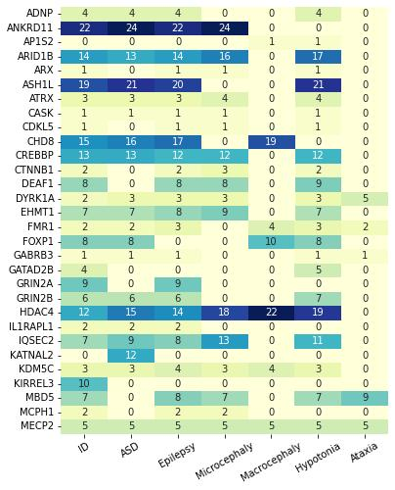
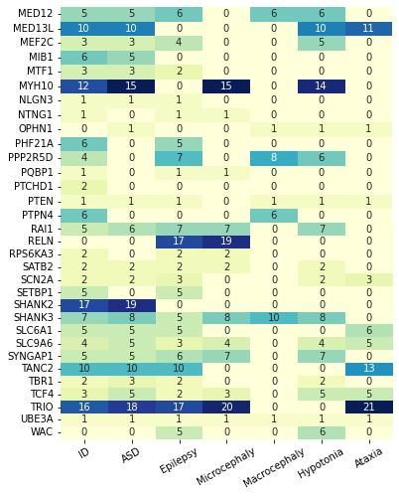
Results
No causal variants were found in 12 of the 74 genes
  ARFGEF2, CC2D1A, CNTNAP2, FOXG1, GAD1, GRIA3, GRIK2, NLGN4X, NRXN1, PHF8, RAB39B, TUSC3
Distribution of genes by phenotype
Created for CAGI 6
genomeinterpretation.org
Rajgopal Srinivasan

Slide 12
Acknowledgments
CAGI organizers for enabling this assessment
Data providers for their generosity
Evaluators for their effort in evaluating difficult to interpret predictions
Tata Consultancy Services Ltd for supporting this work
Created for CAGI 6
genomeinterpretation.org
Rajgopal Srinivasan

