Slide 1

CAGI slide pack guidelines
I agree to my slides being used according to the following terms:
_______Milind Jagota_______
Authors: please include THIS slide at the beginning of your presentation to indicate that you agree with reuse of your slides in CAGI presentations, according to the terms below, and digitally sign by writing your name above.
To disseminate the CAGI results, I encourage all CAGI participants to remix these CAGI slides for inclusion in their oral and poster presentations
CAGI participants may use or publish any content of these slides only in compliance with the CAGI Data Use Agreement
CAGI participants may not cite or publish any content of these slides except with the written permission of the originating author or in the primary CAGI publications
CAGI participants must acknowledge the original authors of these slides and CAGI 6. Include the acknowledgement banner across the bottom
CAGI participants must include the CAGI credits slide in their presentations
Slides with a red slash (no remix) may not be included in a presentation unless all attendees are registered CAGI participants who signed the data use agreement
Slides with a red X over the entire slide may not be used in any circumstances
Slides with a blue slash (embargoed) may not be used unless the embargo is explicitly lifted
Slides without slash or X may be tweeted unless flagged with the “No tweet” icon.
CAGI participants using these slides must explain the “No tweet” icon, which means that the slide content should not be disseminated outside the presenting conference hall. If the presentation venue permits pervasive tweeting, you may not include these slides in your talk
Note for slide authors: we expect all CAGI participants to abide by these restrictions, and will make best effort to ensure they are followed. However, but bear in mind that we have limited means of enforcing them, and therefore the restrictions cannot be guaranteed.

Slide 2
Permission request regarding CAGI 6 recordings and hybrid presentations
I understand that my presentation as associated with CAGI 6 will be recorded and broadcasted via the internet through CAGI’s designated technology provider.
As the copyright holder to this presentation entitled [Cross-protein transfer learning for variant effect prediction], I hereby agree that the copyright for the online broadcast and recording of my presentation be released to CAGI and my recording be uploaded on to the CAGI website.

Slide 3
Cross-protein transfer learning for variant effect prediction
CAGI6 HMBS Challenge
Milind Jagota, Antoine Koehl, Ryan Chung, Roshan Rao, Eyes Robson, Nilah Ioannidis, Yun S. Song
University of California, Berkeley

Slide 4
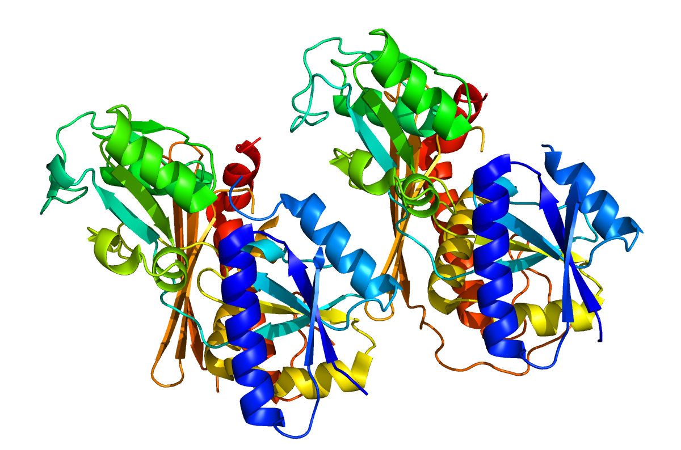
Motivation
There are many machine learning methods for unsupervised variant effect prediction. [1-4]
Can we learn to combine methods only using data from other proteins?
Can we create features with novel signal?
HMBS is third protein with data from Roth group
Created for CAGI 6
genomeinterpretation.org
Milind Jagota

Slide 5
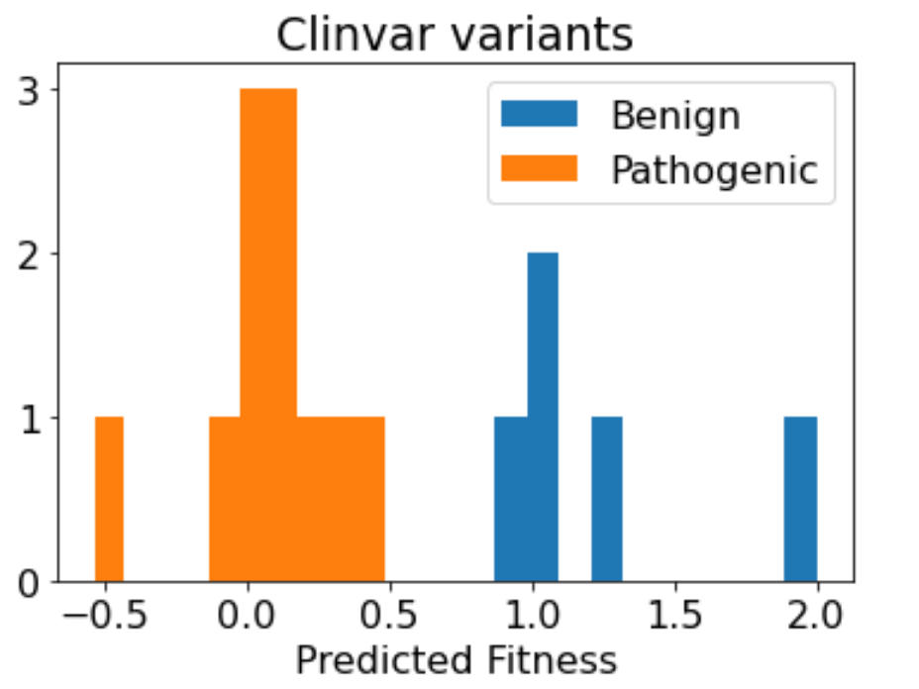
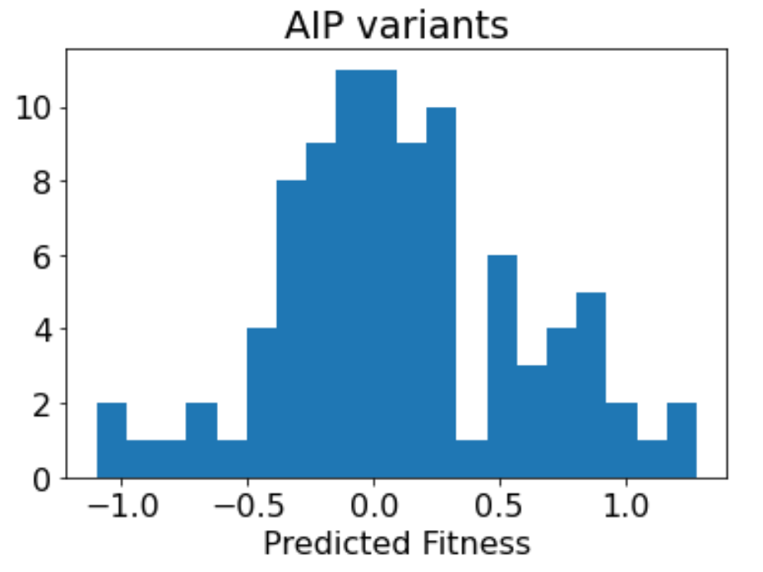
Results
Fit variant effect predictor on MTHFR, CALM1 data from Roth group [5-6]
Validate on HMBS ClinVar and AIP data
Method performs well on validation and was a winner of the challenge
Created for CAGI 6
genomeinterpretation.org
Milind Jagota

Slide 6
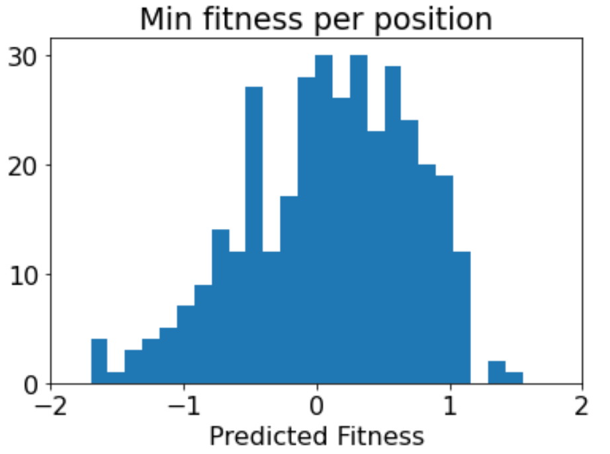
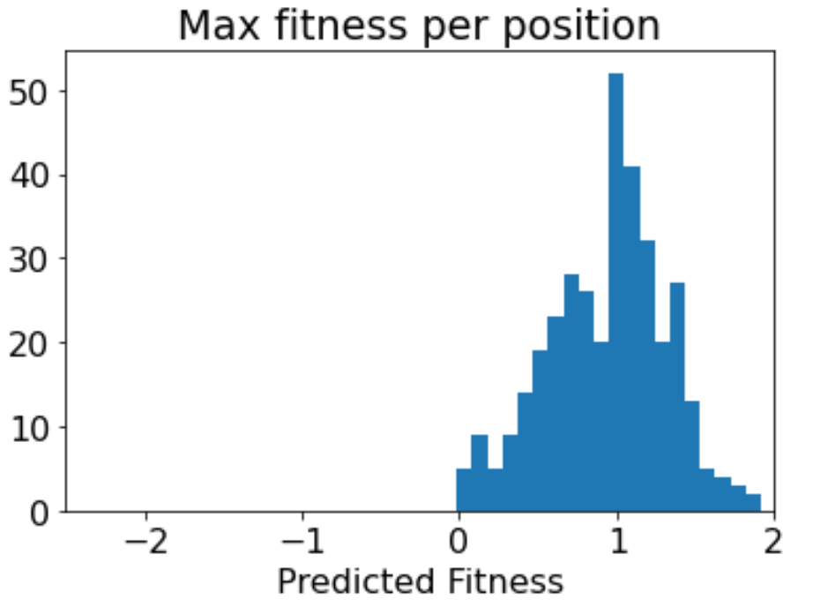
Model
Ensemble of linear regressions on missense variants only.
Nonsense: worst score at position. Synonymous: best score at position.
Confidence is variance over bootstrap draws.
Created for CAGI 6
genomeinterpretation.org
Milind Jagota

Slide 7
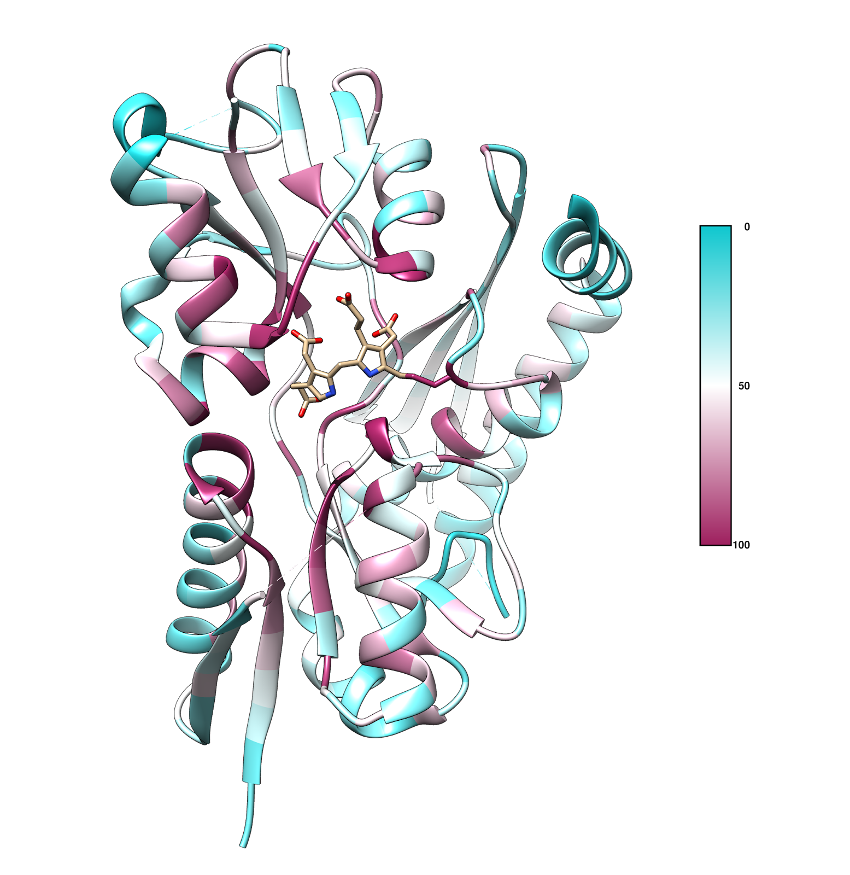
Features
REVEL, DeepSequence, ESM-1v [1-3]
Amino acid descriptor, BLOSUM index 1 [7-8]
MSA features: WT/mutant frequencies, entropy
Novel structural feature: MSA mutant probability conditioned on same structural neighbors as WT
Created for CAGI 6
genomeinterpretation.org
Milind Jagota

Slide 8
Wrap-up
Talk to Yun Song or me (Milind Jagota) for more details, and to hear about experiments we didn’t have space to report here.
References
Funding Acknowledgement: Research supported in partby an NIH grant R35-GM134922.
[1] Ioannidis, Nilah M., et al. The American Journal of Human Genetics 99.4 (2016).
[2] Riesselman, Adam J., et al. Nature methods 15.10 (2018): 816-822.
[3] Meier, Joshua, et al. Advances in Neural Information Processing Systems 34 (2021).
[4] Frazer, Jonathan, et al. Nature 599.7883 (2021): 91-95.
[5] Weile, Jochen, et al. The American Journal of Human Genetics 108.7 (2021).
[6] Weile, Jochen, et al. Molecular systems biology 13.12 (2017): 957.
[7] Mei, H. U., et al. Peptide Science: Original Research on Biomolecules 80.6 (2005).
[8] Georgiev, Alexander G. Journal of Computational Biology 16.5 (2009): 703-723.
Created for CAGI 6
genomeinterpretation.org
Milind Jagota

