Slide 1

CAGI slide pack guidelines
I agree to my slides being used according to the following terms:
______Turina P, Dal Cortivo G, Cicconardi A, Dell’Orco D, Capriotti E*_______
Authors: please include THIS slide at the beginning of your presentation to indicate that you agree with reuse of your slides in CAGI presentations, according to the terms below, and digitally sign by writing your name above.
To disseminate the CAGI results, I encourage all CAGI participants to remix these CAGI slides for inclusion in their oral and poster presentations
CAGI participants may use or publish any content of these slides only in compliance with the CAGI Data Use Agreement
CAGI participants may not cite or publish any content of these slides except with the written permission of the originating author or in the primary CAGI publications
CAGI participants must acknowledge the original authors of these slides and CAGI 6. Include the acknowledgement banner across the bottom
CAGI participants must include the CAGI credits slide in their presentations
Slides with a red slash (no remix) may not be included in a presentation unless all attendees are registered CAGI participants who signed the data use agreement
Slides with a red X over the entire slide may not be used in any circumstances
Slides with a blue slash (embargoed) may not be used unless the embargo is explicitly lifted
Slides without slash or X may be tweeted unless flagged with the “No tweet” icon.
CAGI participants using these slides must explain the “No tweet” icon, which means that the slide content should not be disseminated outside the presenting conference hall. If the presentation venue permits pervasive tweeting, you may not include these slides in your talk
Note for slide authors: we expect all CAGI participants to abide by these restrictions, and will make best effort to ensure they are followed. However, but bear in mind that we have limited means of enforcing them, and therefore the restrictions cannot be guaranteed.

Slide 2
Permission request regarding CAGI 6 recordings and hybrid presentations
I understand that my presentation as associated with CAGI 6 will be recorded and broadcasted via the internet through CAGI’s designated technology provider.
As the copyright holder to this presentation entitled Assessing the predictions of the CaM challenge, I hereby agree that the copyright for the online broadcast and recording of my presentation be released to CAGI and my recording be uploaded on to the CAGI website.

Slide 3
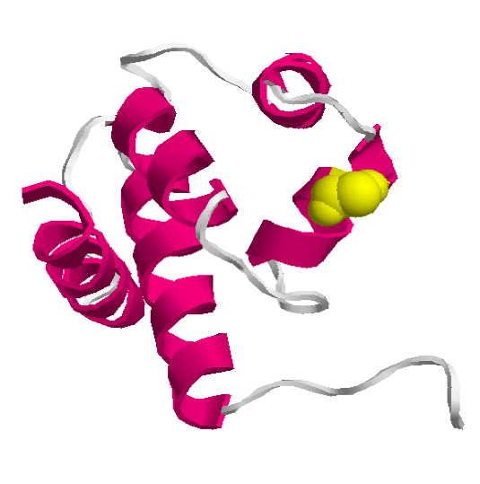
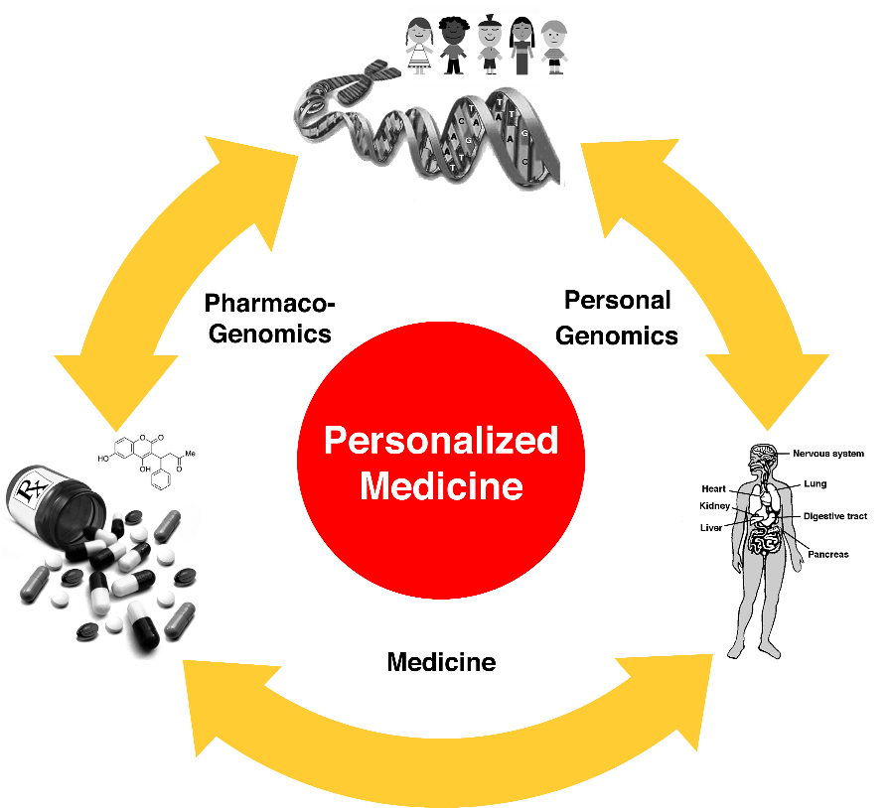
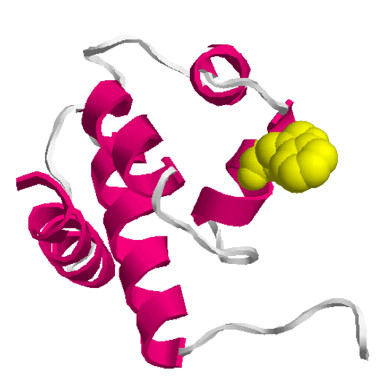

Assessing the predictions of the CaM challenge
Turina P¹, Dal Cortivo G², Cicconardi A¹, Dell’Orco D², Capriotti E¹*
¹ Department of Pharmacy and Biotechnology (FaBiT), University of Bologna. Bologna (Italy)
² Department of Neurosciences, Biomedicine and Movement Sciences University of Verona, Verona, (Italy)
Contact: emidio,capriotti@unibo.it
CAGI 6 Meeting
14-16 May, 2022 – Berkeley (CA) USA
Native
Mutant

Slide 4
CaM Challenge
Calmodulin (CaM) is a sensor protein which variants have been associated with ventricular tachycardia and sudden cardiac death.
Thermal denaturation profiles 15 variants (E141G was discarded) were collected by monitoring far-UV circular dichroism spectra following the variations of ellipticity at 222 nm at different temperatures ranging from 4 to 120°C.
For each variant and for apo and holo (Ca²⁺) forms, participants are asked to predict:
Tm
% of unfolding
stabilization/destabilization effect
Data providers:
Giuditta Dal Cortivo and Daniele Dell’Orco University of Verona, Italy.
Created for CAGI 6
genomeinterpretation.org
An Author

Slide 5
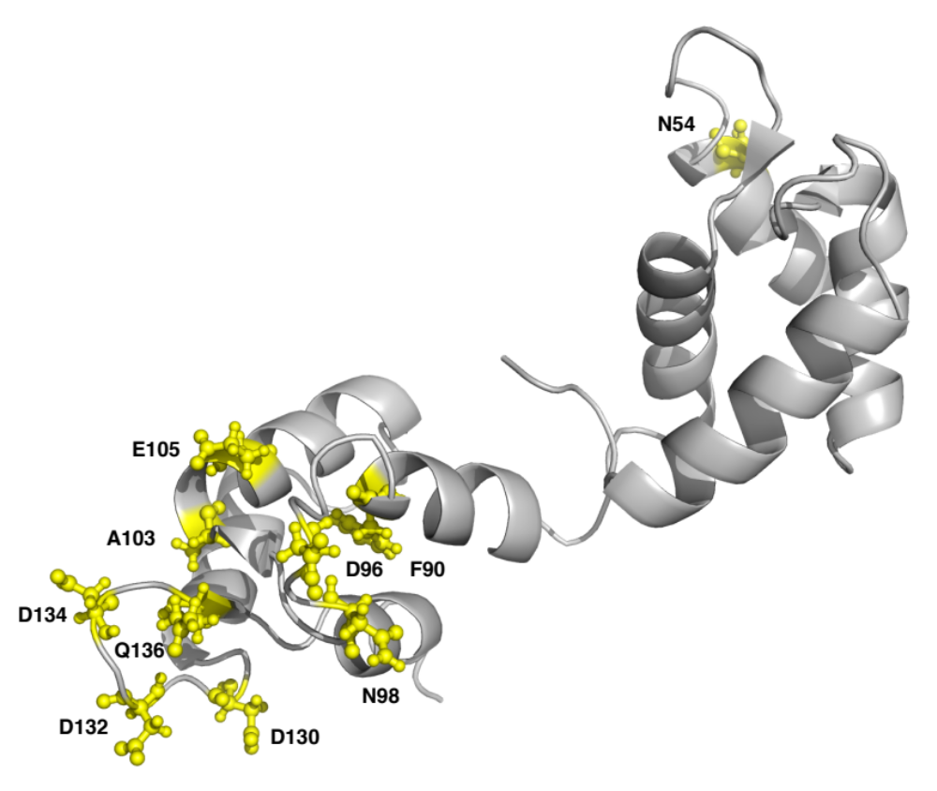
Model of the Apo Form
Protein model obtained from the mutant D129N. PDB: 1DMO (NMR)
Created for CAGI 6
genomeinterpretation.org
Capriotti E

Slide 6
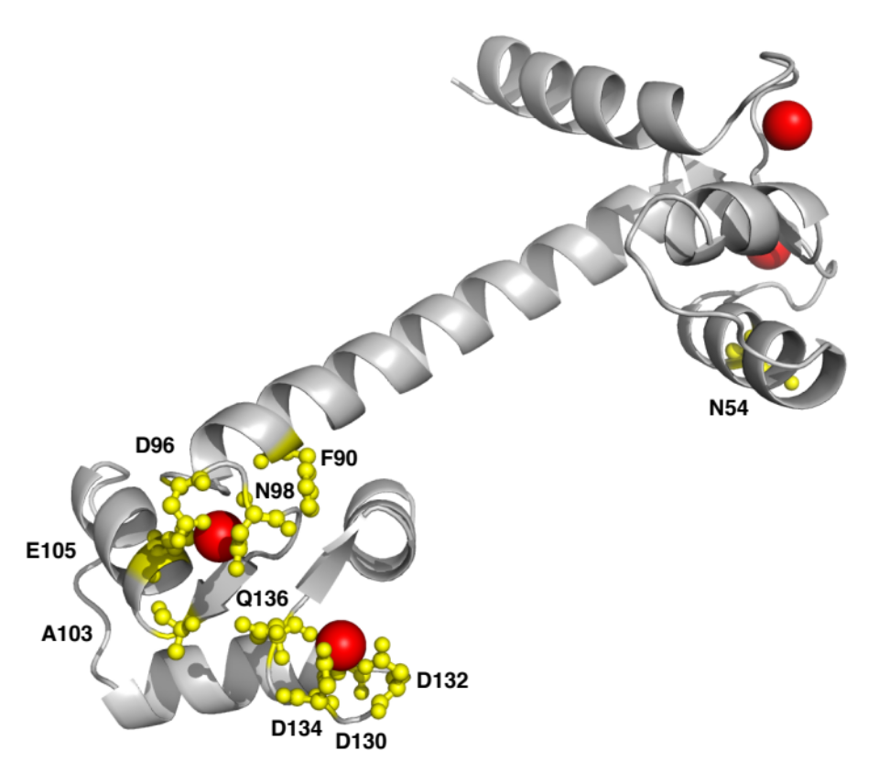
Structure of the Holo Form
Protein structure 1CLL is the holo form (Resolution: 1.70 Å)
Created for CAGI 6
genomeinterpretation.org
Capriotti E

Slide 7
Stability of Apo Mutants
Embargoed
Protein | Tm (ºC) | ∆Tm (ºC) | -Unfolding (%) | ∆Unfolding (%)
Wild-Type | 59.2 ± 0.3 | - | 71.3 ± 1.2 | -
p.N54I* | 55.5 ± 0.8 | -3.7 ± 1.1 | 71.8 ± 2.0 | -0.5 ± 3.2
p.F90L | 60.2 ± 0.9 | 1.0 ± 1.2 | 72.8 ± 0.5 | -1.5 ± 1.7
p.D96H | 59.4 ± 0.4 | 0.2 ± 0.7 | 71.2 ± 0.8 | 0.1 ± 2.0
p.D96V | 58.7 ± 0.4 | -0.5 ± 0.7 | 72.2 ± 1.2 | -0.9 ± 2.4
p.N98I | 59.7 ± 0.3 | 0.5 ± 0.6 | 72.3 ± 0.3 | -1.0 ± 1.5
p.N98S* | 60.4 ± 0.4 | 1.2 ± 0.7 | 69.1 ± 0.8 | 2.2 ± 2.0
p.A103V* | 60.8 ± 0.3 | 1.6 ± 0.6 | 72.1 ± 0.2 | -0.8 ± 1.4
p.E105A | 59.3 ± 0.5 | 0.1 ± 0.8 | 71.9 ± 0.4 | -0.6 ± 1.6
p.D130G* | 61.2 ± 0.2 | 2.0 ± 0.5 | 73.4 ± 0.3 | -2.1 ± 1.5
p.D130V | 59.9 ± 0.2 | 0.7 ± 0.5 | 71.6 ± 0.3 | -0.3 ± 1.5
p.D132E | 59.4 ± 0.4 | 0.2 ± 0.7 | 73.6 ± 0.7 | -2.3 ± 1.9
p.D132H | 59.7 ± 0.6 | 0.5 ± 0.9 | 73.2 ± 0.8 | -1.9 ± 2.0
p.D132V | 60.0 ± 0.4 | 0.8 ± 0.7 | 72.9 ± 0.3 | -1.6 ± 1.5
p.D134H | 59.4 ± 0.3 | 0.2 ± 0.6 | 73.1 ± 1.0 | -1.8 ± 2.2
p.Q136P | 59.4 ± 0.9 | 0.2 ± 1.2 | 73.4 ± 0.6 | -2.1 ± 1.8
Created for CAGI 6
genomeinterpretation.org
Capriotti E

Slide 8
Comparing stability measures for Apo
Embargoed
Created for CAGI 6
genomeinterpretation.org
Capriotti E

Slide 9
Stability of Holo Mutants
Embargoed
Protein | Tm (ºC) | ∆Tm (ºC) | - Unfolding (%) | ∆Unfolding (%)
Wild-Type* | 109.0 ± 1.2 | - | 74.8 ± 0.6 | -
p.N54I* | 109.7 ± 0.5 | 0.7 ± 1.7 | 75.0 ± 0.4 | -0.2 ± 1.0
p.F90L* | 103.4 ± 1.5 | -5.6 ± 2.7 | 75.4 ± 0.7 | -0.6 ± 1.3
p.D96H* | 103.3 ± 0.7 | -5.7 ± 1.9 | 75.6 ± 0.7 | -0.8 ± 1.3
p.D96V* | 103.3 ± 1.7 | -5.7 ± 2.9 | 75.4 ± 2.1 | -0.6 ± 2.7
p.N98I* | 103.3 ± 0.7 | -5.7 ± 1.9 | 75.7 ± 0.3 | -0.9 ± 0.9
p.N98S* | 106.0 ± 0.6 | -3.0 ± 1.8 | 76.1 ± 0.4 | -1.3 ± 1.0
p.A103V* | 107.3 ± 0.6 | -1.7 ± 1.8 | 76.7 ± 0.5 | -1.9 ± 1.1
p.E105A* | 104.6 ± 2.4 | -4.4 ± 3.6 | 74.1 ± 1.1 | 0.7 ± 1.7
p.D130G | 104.1 ± 0.2 | -4.9 ± 1.4 | 73.8 ± 0.8 | 1.0 ± 1.4
p.D130V | 103.6 ± 0.5 | -5.4 ± 1.7 | 69.9 ± 0.7 | 4.9 ± 1.3
p.D132E | 103.4 ± 2.1 | -5.6 ± 3.3 | 73.6 ± 1.2 | 1.2 ± 1.8
p.D132H | 104.1 ± 0.9 | -4.9 ± 2.1 | 72.2 ± 0.8 | 2.6 ± 1.4
p.D132V | 112.8 ± 5.0 | 3.8 ± 6.2 | 71.0 ± 5.3 | 3.8 ± 5.9
p.D134H | 103.2 ± 0.6 | -5.8 ± 1.8 | 70.8 ± 1.4 | 4.0 ± 2.0
p.Q136P | 103.6 ± 0.8 | -5.4 ± 2.0 | 67.1 ± 0.6 | 7.7 ± 1.2
Created for CAGI 6
genomeinterpretation.org
Capriotti E

Slide 10
Comparing stability measures for Holo
Embargoed
Created for CAGI 6
genomeinterpretation.org
Capriotti E

