Slide 1
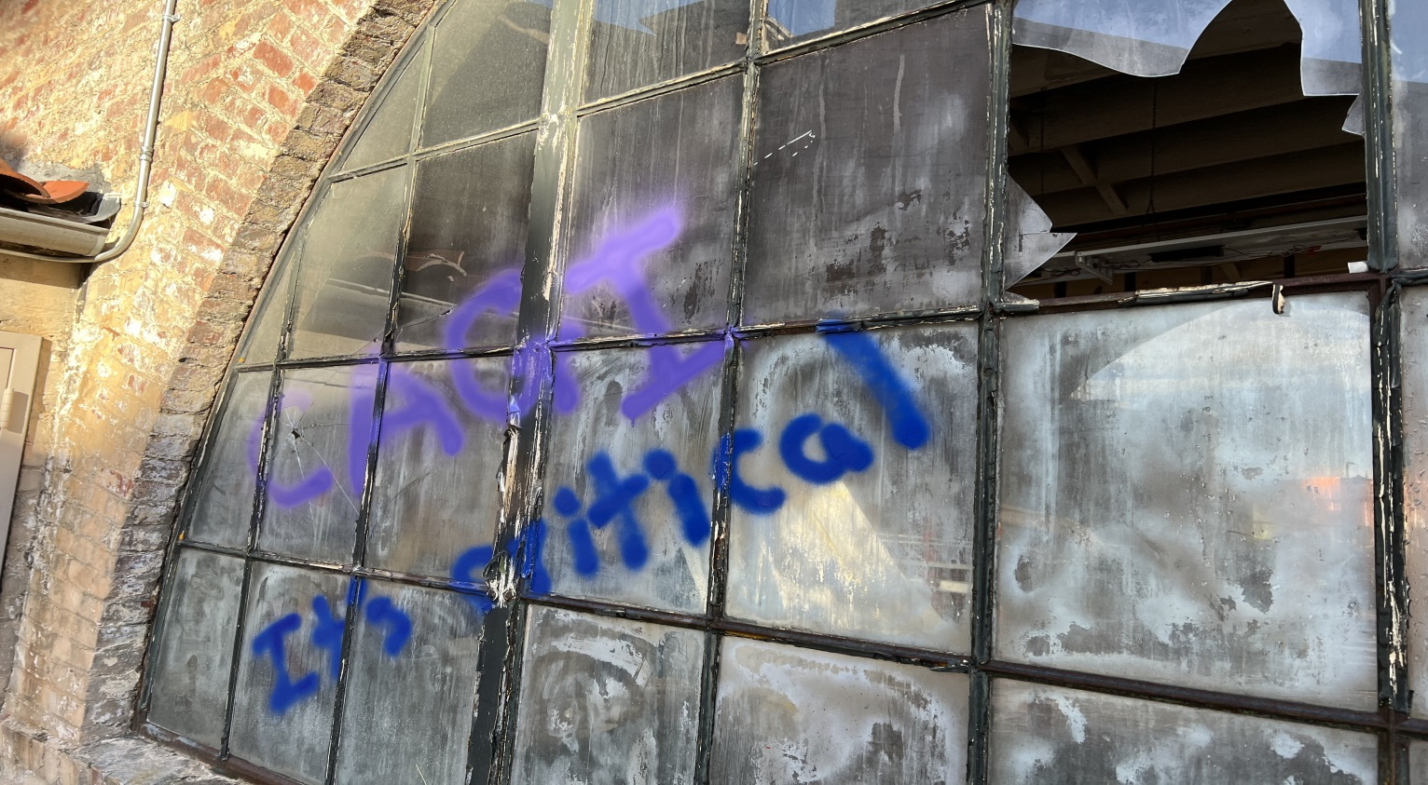
CAGI 6
#CAGI6
The CAGI Sixth Edition
International Conference
Critical Assessment of Genome Interpretation
Conference
14-16 May 2022
Brower Center
Berkeley, CA
USA
Remote Participants
We are still setting up the COVID protections We will be starting soon

Slide 2
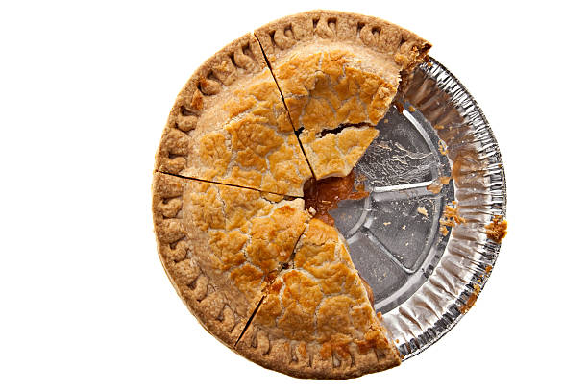
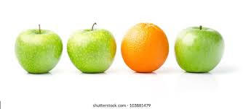
CAGI Data for Benchmarking
No remix
Created for CAGI 6
genomeinterpretation.org
Steven E. Brenner
https://www.google.com/url?sa=i&url=https%3A%2F%2Fwww.istockphoto.com%2Fphotos%2Ftwo-thirds&psig=AOvVaw1eDM7k9qkx8hjS06uMz7n0&ust=1652736018955000&source=images&cd=vfe&ved=0CAkQjRxqFwoTCIie-tC34vcCFQAAAAAdAAAAABAD
Notes:
Many groups have asked to use CAGI challenge data for benchmarking
Some journal reviewers have explicitly asked for this.
But we don’t allow it
Why?
Data Use Agreement only allows
use of data for CAGI experiment
CAGI permissions often only for
CAGI experiment especially for sensitive data

Slide 3
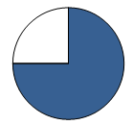



Different measures for different applications
No remix
e.g, Research –vs– Diagnosis –vs– Screening
Individuals
in CA per year
Affected
Portion
Sensitivity
Specificity
Pedigree
Analysis
Diagnostic
Exomes
Thousands
??
25-60%??
??
Trios
Expert
review
Typically, for
some indication
Wide range
of diseases
Newborn
Screening
486,354
0.03%
99.3%
99.7%
Individuals
Automated
Population-wide
Narrow set
of disorders
Created for CAGI 6
genomeinterpretation.org
Steven E. Brenner
https://www.google.com/url?sa=i&url=https%3A%2F%2Fwww.istockphoto.com%2Fphotos%2Ftwo-thirds&psig=AOvVaw1eDM7k9qkx8hjS06uMz7n0&ust=1652736018955000&source=images&cd=vfe&ved=0CAkQjRxqFwoTCIie-tC34vcCFQAAAAAdAAAAABAD
Notes:
Many groups have asked to use CAGI challenge data for benchmarking
Some journal reviewers have explicitly asked for this.
But we don’t allow it
Why?
Data Use Agreement only allows
use of data for CAGI experiment
CAGI permissions often only for
CAGI experiment especially for sensitive data

Slide 4


Slide 5
CAGI 6 feedback
Leads & ideas for CAGI 7
We need you
Created for CAGI 6
genomeinterpretation.org
Steven E. Brenner
Notes:
Many groups have asked to use CAGI challenge data for benchmarking
Some journal reviewers have explicitly asked for this.
But we don’t allow it
Why?
Data Use Agreement only allows
use of data for CAGI experiment
CAGI permissions often only for
CAGI experiment especially for sensitive data

Slide 6
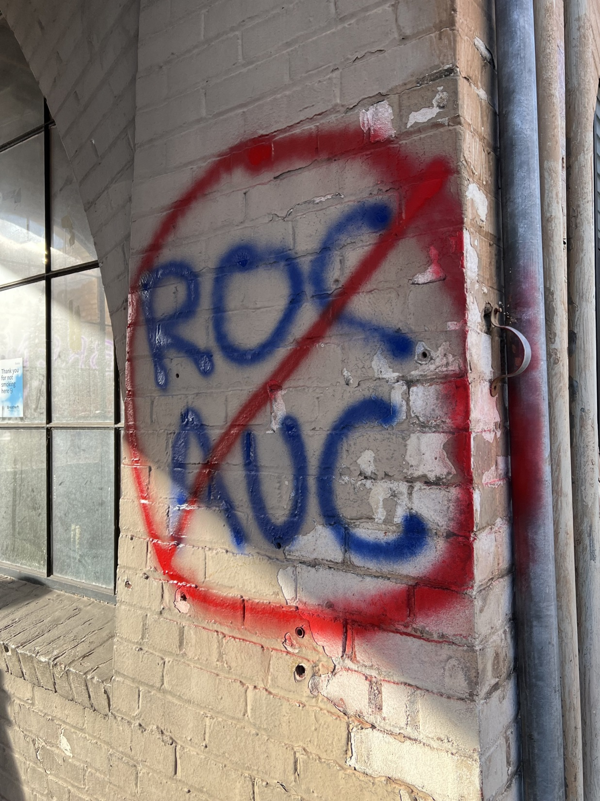

Slide 7
CAGI Data for Benchmarking
No remix
Created for CAGI 6
genomeinterpretation.org
Steven E. Brenner
https://www.google.com/url?sa=i&url=https%3A%2F%2Fwww.istockphoto.com%2Fphotos%2Ftwo-thirds&psig=AOvVaw1eDM7k9qkx8hjS06uMz7n0&ust=1652736018955000&source=images&cd=vfe&ved=0CAkQjRxqFwoTCIie-tC34vcCFQAAAAAdAAAAABAD
Notes:
Many groups have asked to use CAGI challenge data for benchmarking
Some journal reviewers have explicitly asked for this.
But we don’t allow it
Why?
Data Use Agreement only allows
use of data for CAGI experiment
CAGI permissions often only for
CAGI experiment especially for sensitive data

