Slide 1

CAGI slide pack guidelines
I agree to my slides being used according to the following terms:
_______Steven E. Brenner _______
Authors: please include THIS slide at the beginning of your presentation to indicate that you agree with reuse of your slides in CAGI presentations, according to the terms below, and digitally sign by writing your name above.
To disseminate the CAGI results, I encourage all CAGI participants to remix these CAGI slides for inclusion in their oral and poster presentations
CAGI participants may use or publish any content of these slides only in compliance with the CAGI Data Use Agreement
CAGI participants may not cite or publish any content of these slides except with the written permission of the originating author or in the primary CAGI publications
CAGI participants must acknowledge the original authors of these slides and CAGI 2013. Include the acknowledgement banner across the bottom
CAGI participants must include the CAGI credits slide in their presentations
Slides with a red slash (no remix) may not be included in a presentation unless all attendees are registered CAGI participants who signed the data use agreement
Slides with a red X over the entire slide may not be used in any circumstances
Slides with a blue slash (embargoed) may not be used unless the embargo is explicitly lifted
Slides without slash or X may be tweeted unless flagged with the “No tweet” icon.
CAGI participants using these slides must explain the “No tweet” icon, which means that the slide content should not be disseminated outside the presenting conference hall. If the presentation venue permits pervasive tweeting, you may not include these slides in your talk
Note for slide authors: we expect all CAGI participants to abide by these restrictions, and will make best effort to ensure they are followed. However, but bear in mind that we have limited means of enforcing them, and therefore the restrictions cannot be guaranteed.

Slide 2
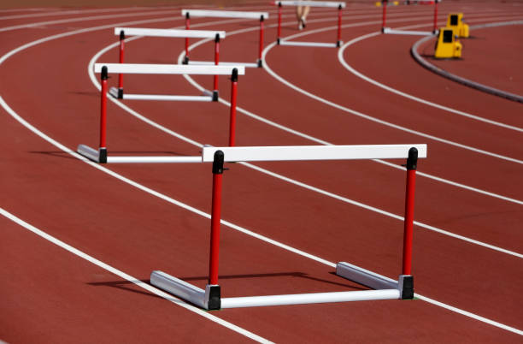
CAGI Data for Benchmarking
No remix
https://www.google.com/url?sa=i&url=https%3A%2F%2Fwww.istockphoto.com%2Fphotos%2Fhurdle&psig=AOvVaw0OJb3g2Eim4idxkDmu5C-Z&ust=1652642667475000&source=images&cd=vfe&ved=0CAkQjRxqFwoTCNiHkOzb3_cCFQAAAAAdAAAAABAJ
Created for CAGI 6
genomeinterpretation.org
Steven E. Brenner
Notes:
Many groups have asked to use CAGI challenge data for benchmarking
Some journal reviewers have explicitly asked for this.
But we don’t allow it
Why?
Data Use Agreement only allows
use of data for CAGI experiment
CAGI permissions often only for
CAGI experiment especially for sensitive data

Slide 3
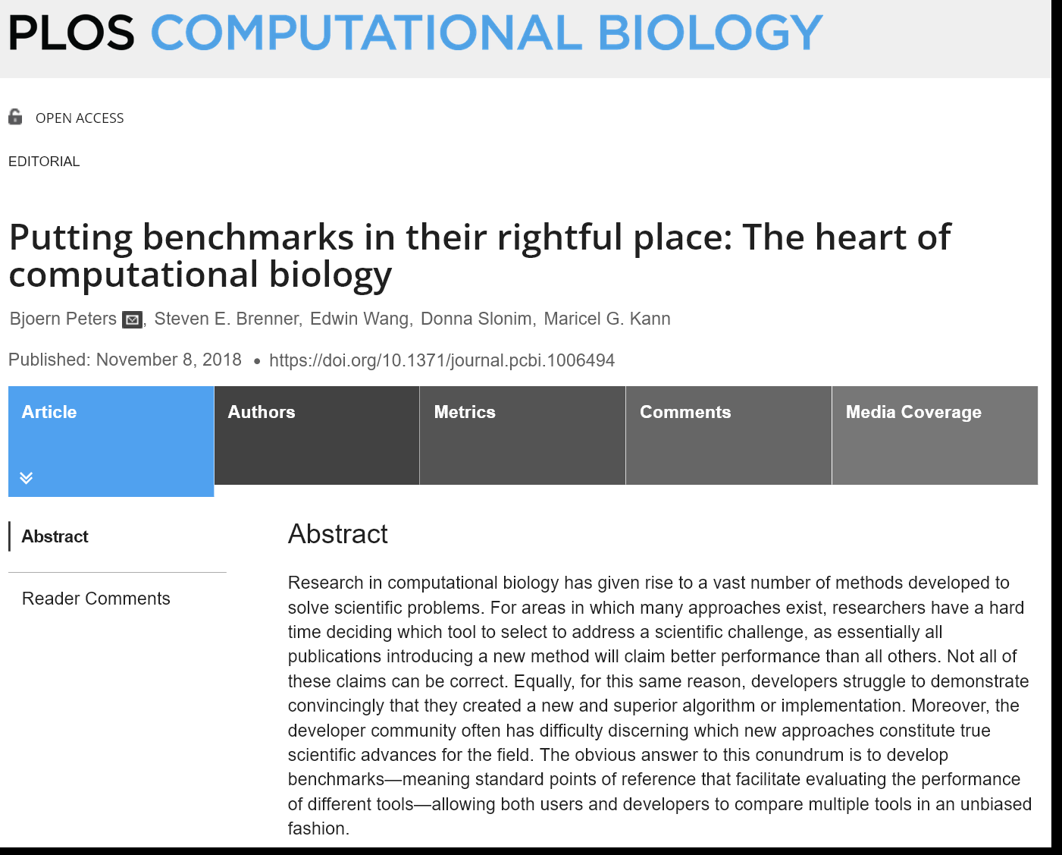
CAGI Data
Created for CAGI 6
genomeinterpretation.org
Steven E. Brenner
Notes:
Many groups have asked to use CAGI challenge data for benchmarking
Some journal reviewers have explicitly asked for this.
But we don’t allow it
Why?
Data Use Agreement only allows
use of data for CAGI experiment
CAGI permissions often only for
CAGI experiment especially for sensitive data

Slide 4

Critical Assessment Principles
No remix
https://s.abcnews.com/images/Technology/GTY_blindfolded_people_jt_140906_16x9_992.jpg
Created for CAGI 6
genomeinterpretation.org
Steven E. Brenner
Notes:
CASP pioneered blind prediction. We try to use unpublished data that nobody could have seen
Also independent assessment – assessors who are distinct from the predictors
Structure prediction had fallen into disrepute: phenomenal claims were rarely substantiated
Early CASP experiments showed that some most prominent methods failing
But also showed Rosettta’s predecessor iSites was doing amazing things -- though nobody believed the method.
It’s the need for this that we have all the rigamarole of CAGI rather than just making datasets and putting them out ther.
Why? Does that happen.
Self-assessment on open data allow manifold opportunities for self-deception
e.g., just visually and intellectually knowong high and low values. Some values over 1. general sense of distribution
Could repeatedly develop new methods and run against validation set, see what it got wrong and tweak
Or could inadvertently entirely train on these data
When I was in college I won the price for the fastest sort algorithm given numbers from a random number function

Slide 5
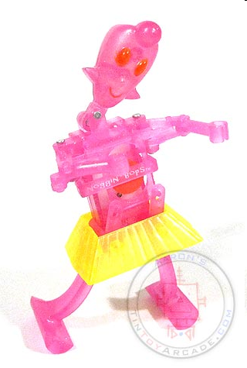

CAGI Molly
Created for CAGI 6
genomeinterpretation.org
Steven E. Brenner
Notes:
So if we let benchmarkers with open data compare against CAGI with closed data
CAGI predictors will lose
Incentivizing people to not participate in CAGI because it puts them at a disadvantage is the opposite of what we need to do.

Slide 6
¯\_(ツ)_/¯
Created for CAGI 6
genomeinterpretation.org
Steven E. Brenner

Slide 7
CAGI Data for Benchmarking
Many groups have asked to use CAGI challenge data for benchmarking
Some journal reviewers have explicitly asked for this.
But we don’t allow it
Why?
  Data Use Agreement only allows
  use of data for CAGI experiment
  CAGI permissions often only for
  CAGI experiment especially for sensitive data
Created for CAGI 6
genomeinterpretation.org
Steven E. Brenner

Slide 8
Back-history
CASP pioneered blind prediction and independent assessment on real data
Structure prediction had fallen into disrepute: phenomenal claims were rarely substantiated
Early CASP experiments showed that some most prominent methods failing
Why?
Self-assessment on open data allow manifold opportunities for self-deception
Created for CAGI 6
genomeinterpretation.org
Steven E. Brenner

Slide 10

Critical Assessment Principles

Slide 11
Title
No remix
This slide cannot be used except for viewing by registered CAGI participants
Created for CAGI 6
genomeinterpretation.org
An Author

Slide 12
Title
CAGI meeting ONLY
This slide cannot be used outside of the CAGI meeting.
We do not anticipate many slides of this nature
Created for CAGI 6
genomeinterpretation.org
An Author

Slide 13
Title
Embargoed
Until embargoed data are released, this slide cannot be used except for viewing by registered CAGI participants
Created for CAGI 6
genomeinterpretation.org
An Author

Slide 14
Title
No Tweet
This slide can be remixed and used in oral and poster presentations by any CAGI participant, consistent with limitations on slide 1
However, it is intended for participants of the conference hall and the CAGI live hybrid meeting only. Its content should not be tweeted, discussed, or otherwise shared outside of the conference hall
Do not use this slide in venues that give blanket permission for tweeting
Created for CAGI 6
genomeinterpretation.org
An Author

