Slide 1

Predicting splicing disruption from variants of unknown significance
Carolina Jaramillo Oquendo
Diana Baralle’s Lab

Slide 2
Background
  Splicing
  The splicing VUS challenge
Results
  Model performance comparison
  Performance by location/variant type
Summary/conclusions

Slide 3

What is splicing?
Excision of introns and joining of exons
DNA
Intron
Exon
Exon
Transcription
Pre-mRNA
Exon
Intron
Exon
Splicing
Mature mRNA
Exon
Exon
G-P-P-P-
AAAAAAAAA…
5’ Cap
Poly(A) tail
Notes:
Splicing is a step in mRNA processing whereby introns are removed and exons are joined together to form a mature mRNA transcript, that can be capped and polyadenylated and ultimately translated into a protein.

Slide 4
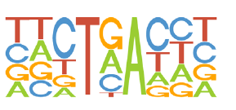
Splicing regulation
Branchpoint
5’ splice site
Donor
3’ splice site
Acceptor
ESE/ESS
ISE/ISS
Exon
A
Exon
Polypyrimidine tract (PPT)
Canonical
Canonical
ESE/ESS = exonic splicing enhancer/silencer
ISE/ISS = intronic splicing enhancer/silencer
Notes:
The regulation of splicing is complex and not well understood and recognising where to splice is quite tricky. There are various things that contribute to splice site recognition predominantly the canonical splice donor and acceptor sites, and these are supported by other components such as enhances and silencers. At the splice donor you almost always have a GT in the canonical position, but it’s also supported by these other conserved bases around there. At the acceptor site you almost always have an AG as well as a polypyrimidine tract 5-20 bases upstream comprised of mostly Cs and Ts. These patterns of conservation help identify each splice site, and this is also related to how susceptible splice sites are to mutations, since a strong match in the pattern might not affect it as much.
Mutations in any of the elements can disrupt splicing and cause disease

Slide 5
Disruption of splicing
Up to 50% of disease causing mutations affect splicing
Difficult to recognise and interpret
  Classification often binary
  Under-ascertained in clinical databases
  Functional testing time consuming and expensive – need to prioritise
  Many in silico tools exist – interpretation and reliability?
  Clinical implementation needs reliability and strong evidence base
Notes:
It’s estimated that about 50% of disease-causing mutation affect splicing, although this is a rough estimate. Ascertaining these mutations is really difficult. We know that even WES/WGS leave ~50% of patients of are disease go undiagnosed and so that leaves good scope for diagnostic rates to be improved by ascertaining splicing variants.
Because the regulation of splicing is so complex and not well understood trying to figure out which variants disrupt splicing is very hard. It has led to a binary classification of variants, so it if falls within canonical splice sites it will be classed as pathogenic or likely pathogenic, whereas if it falls outside those canonical splice sites it’s very likely to get lost in the filtering process In diagnostics. Which ultimately then leads to these variants being under-ascertained in clinical databased such as clinVar and HGMD by about 35-40%. The best way to test if a variants affects splicing is of course with functional testing, but like most functional validation it is expensive and time consuming. So testing hundreds of variants is not feasible.
There are many in silico tools for splicing prediction, but we don’t really have a gold standard and how they should used in clinical interpretation. Which is what we were hoping to improve with this challenge.
ClinVar/HGMD - 35-40% underascertainment

Slide 6
The Challenge
Predicting splicing disruption from variants of unknown significance (VUS)
VUS tested in Splicing and Disease Study or Salisbury Regional Genetics Laboratory
  Possible splicing variants
  Clinically ascertained (rare disease, cancer predisposition)
  Relevant disease genes
  No requirement for prior in silico evidence
  Gene expression in blood checked in GTEx
Notes:
Variants were taken from two sources either the splicing and disease study run in Diana’s lab at the University of Southampton, or the Salisbury Regional Genetics Laboratory which is part of the UK National Health service laboratories. We’re trying to improve ascertainment of splicing related disorders and getting splicing technologies utilised in NHS clinical care. All the variant are possible splicing variants that were clinically ascertained. Usually, patients have had some sort of sequencing either WES.WGS or targeted panels. There is a variant that can’t be classified under ACGM that might affect splicing, most are rare disease patients and some cancer predisposition patients as well. All variants are thought to be in genes relevant to the patient’s disease. Good prior evidence for this gene if the variant turns out to be splicing. Strengthens the case for the diagnosis. We don’t require prior in silico evidence for the variant to be sent, but a requirement is that the gene be expressed in blood.

Slide 7
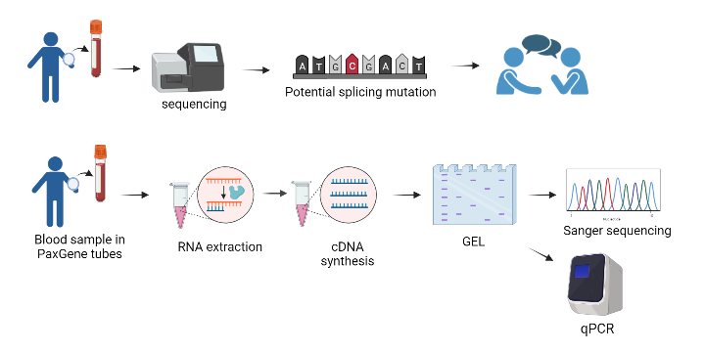
The Challenge
P
C
C
C
Notes:
WB in PaxGene, RNA extracted and cDNA synthesised + amplified.
Each variant - custom primers – amplify at two exons up and downstream of the exon of interest

Slide 8
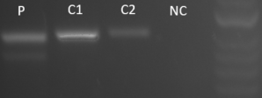
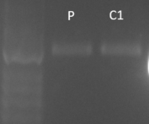
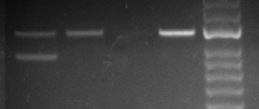
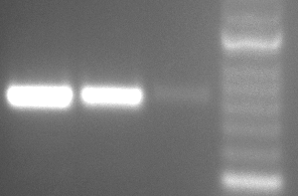
The Challenge
RT-PCR validation of splicing impact in whole blood
  Binary outcome – does it affect splicing?
  Confirmation by Sanger sequencing
Splice affecting
Not splice affecting
P
C
C
C
P
C2
NC
P = proband, C = control
Notes:
Each variant - custom primers – amplify at two exons up and downstream of the exon of interest

Slide 9
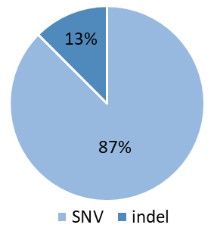
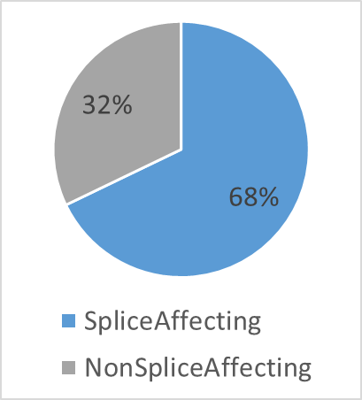
The Variants
56 variants from 43 genes
gene | Count
BRCA1 | 6
FBN1 | 4
MYBPC3 | 3
BRCA2 | 2
SCN5A | 2
APC | 2
Notes:
Put in 65: Mention variants not included – 6 not confirmed in time, 3 mislabelled in the challenge file

Slide 10
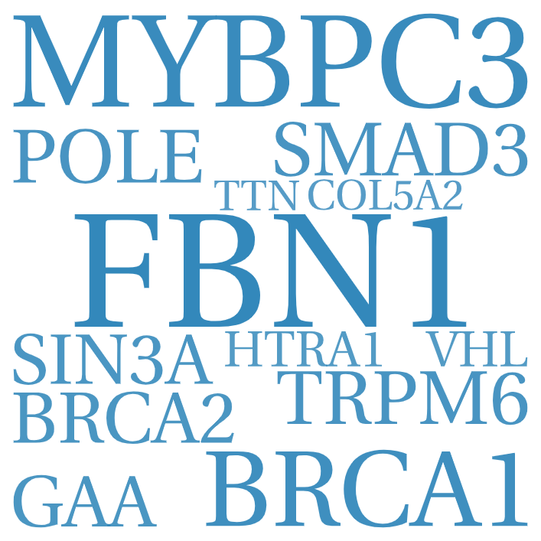
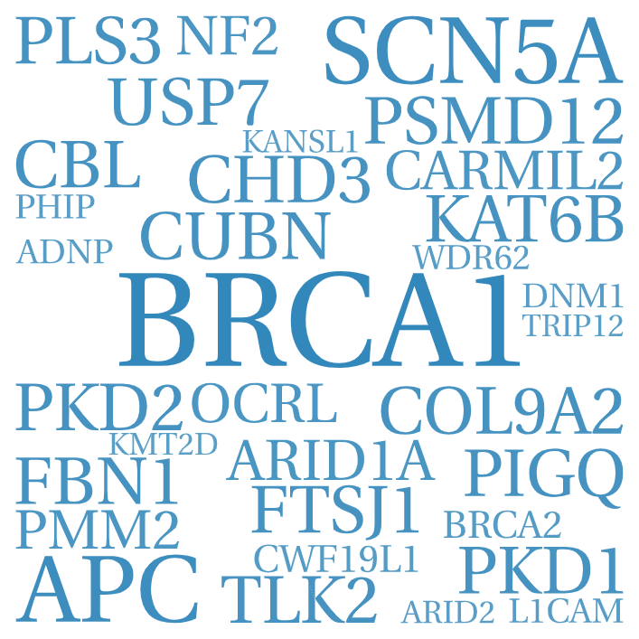
The Variants
Does not affect splicing
Affects splicing
gene | Count
BRCA1 | 2
FBN1 | 3
MYBPC3 | 3
BRCA2 | 1
SCN5A | 0
APC | 0
gene | Count
BRCA1 | 6
FBN1 | 1
MYBPC3 | 0
BRCA2 | 1
SCN5A | 2
APC | 2
Notes:
Mention variants not included – 6 not confirmed in time, 3 mislabelled in the challenge file

Slide 11

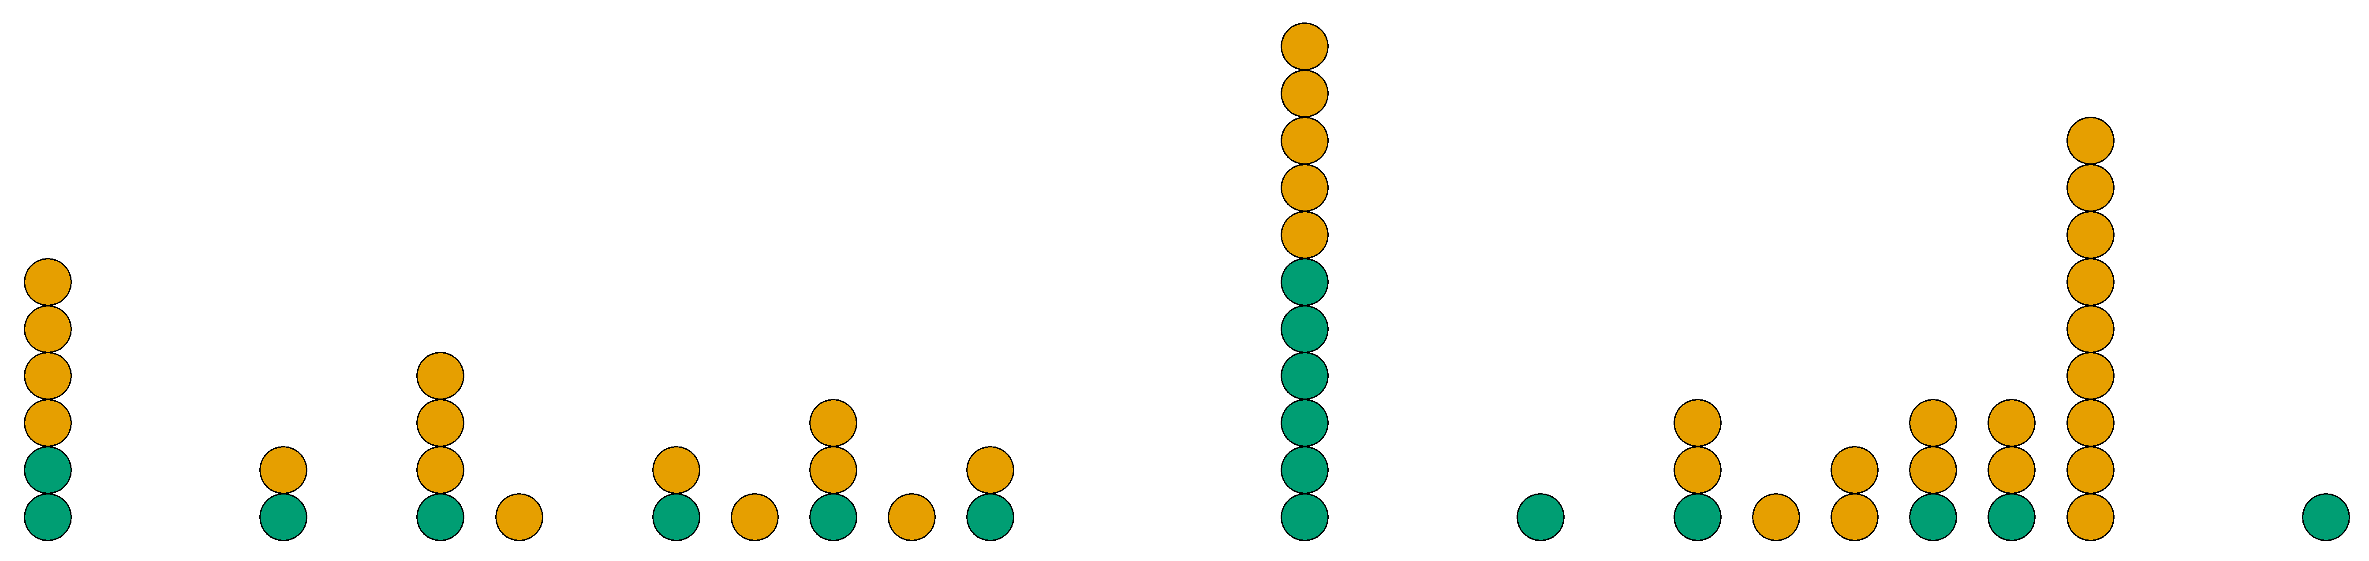
Variant location relative to splice sites
Splice affecting
Not splice affecting
Exonic
>10bp from splice site
>10bp from A
D+5
A-8
D+3
>10bp from D
A-3
D0
D+4
A-10
A-5
A-1
D+2
A-4
D-2
A-7
A-2
D+1
CSS
Exon
CSS
Polypyrimidine tract
Acceptor
Donor
Polypyrimidine tract (PPT)
Acceptor
Donor
Notes:
Where variants lie in relation to splice site. Splice affecting in mustard and non splice affecting in green. Grouped near canonical acceptor and donor site. Some that fall within the canonical splice sites itself, most time they wouldn’t be tested because it was just assumed that they are splice affecting, which we can see is not always the case.

Slide 12
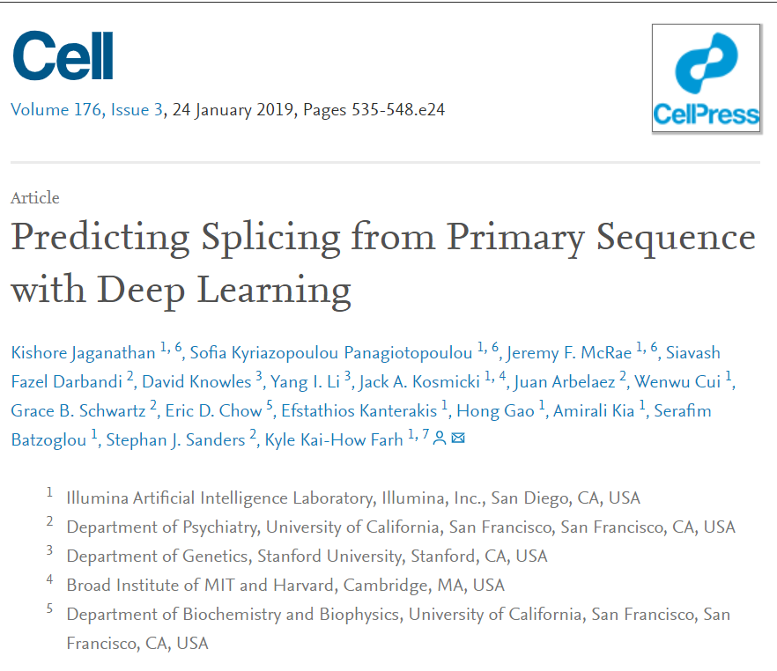
The Contenders
8 Teams submitted predictions
  3 groups submitted multiple models
    13 sets of predictions overall
    Showing results just for one per group – selected on highest AUC
Also ran SpliceAI on the variants to compare
  Scores obtained through Ensembl’s VEP
  0.2 cut-off used

Slide 13
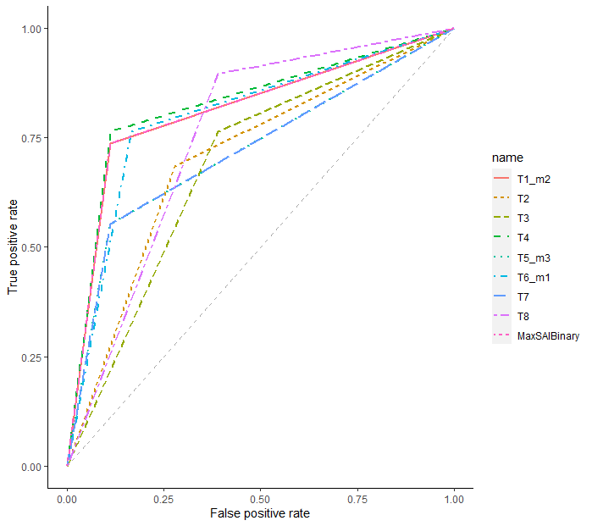
Performance comparison - ROC
Group | AUC
T4 | 0.826
T1_m2 | 0.813
SpliceAI | 0.813
T6_m1 | 0.798
T8 | 0.753
T5_m3 | 0.721
T7 | 0.721
T2 | 0.703
T3 | 0.687
SpliceAI
Notes:
This is a ROC curve showing how all the groups performed including splceAI, the aurea under the curve is here in descending order. T4 has the best AUC, the next two highest are T1 and splice AI .Spliceai line under T1 line

Slide 14
Performance comparison stats
 | T1_m2 | T2 | T3 | T4 | T5_m3 | T6_m1 | T7 | T8 | SpliceAI
AUC | 0.813 | 0.703 | 0.687 | 0.826 | 0.721 | 0.798 | 0.721 | 0.753 | 0.813
Accuracy | 0.786 | 0.696 | 0.714 | 0.804 | 0.661 | 0.786 | 0.661 | 0.804 | 0.786
Sensitivity | 0.636 | 0.667 | 0.725 | 0.644 | 0.568 | 0.659 | 0.568 | 0.756 | 0.636
Specificity | 0.889 | 0.722 | 0.611 | 0.889 | 0.889 | 0.833 | 0.889 | 0.611 | 0.889
PPV | 0.933 | 0.839 | 0.806 | 0.935 | 0.913 | 0.906 | 0.913 | 0.829 | 0.933
NPV | 0.615 | 0.520 | 0.550 | 0.640 | 0.485 | 0.625 | 0.485 | 0.733 | 0.615
HuZ_WangY
SpliceAI + allele frequency
Submitted as control
U1245/Leman
PPV = Positive predictive value, NPV = Negative predictive value, AUC = Area under curve
Notes:
This is a tabulation of a variety of difference performance metrics, and in each row the highest scoring model has been highlighted.
4+8 tie on accuracy. Several groups equal SpliceAI (encouraging that the models perform as well or outperform it).
T8 has very high sensitivity and negative predictive value – variant doesn’t affect splicing likely true
T4 has best positive predictive value – variant does affect splicing true
Sens+Spec. PPV + NPV.
Mention T1 == SAI.
Small sample size, so the same scores for T1 and SpliceA1

Slide 15
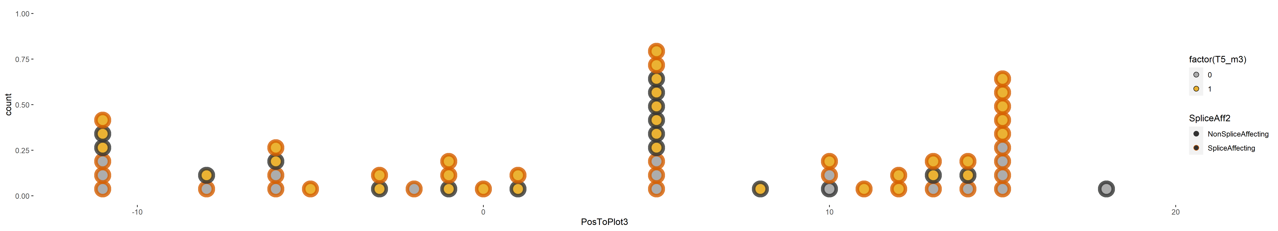
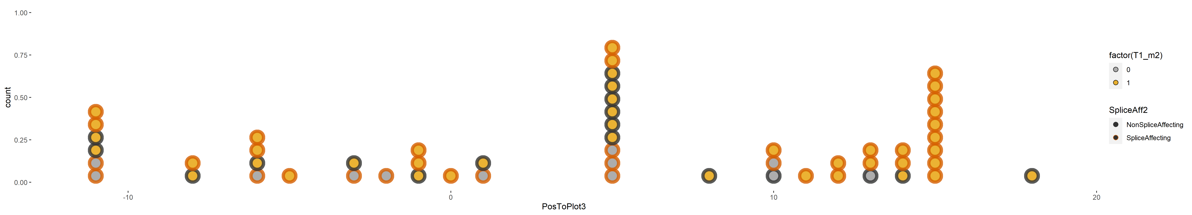
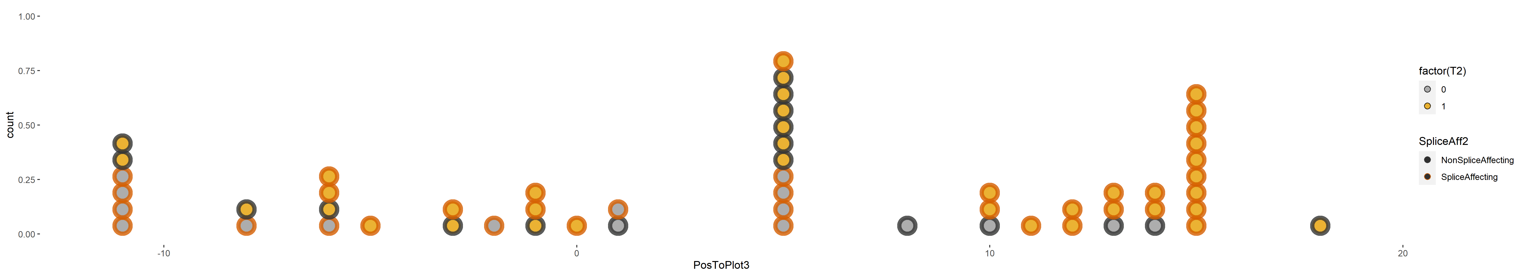
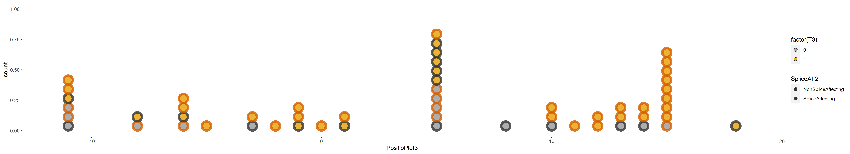
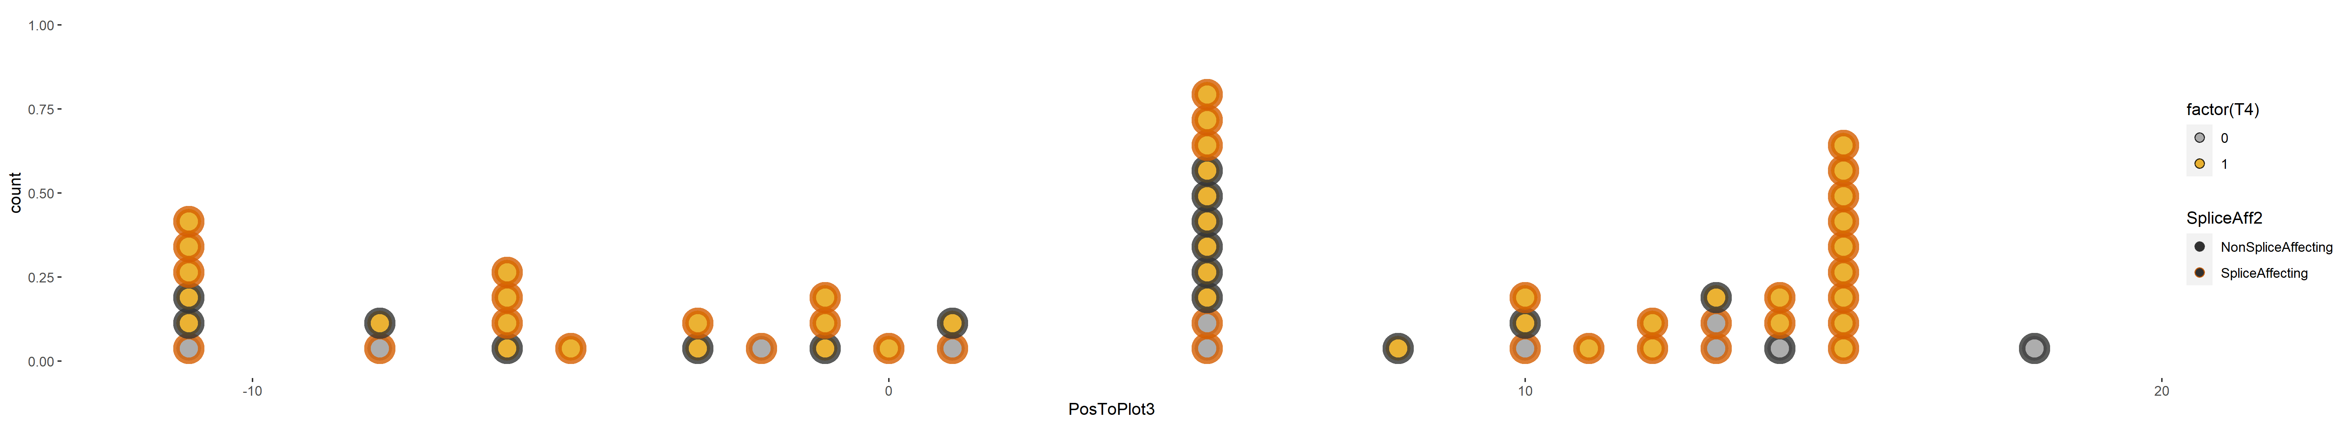
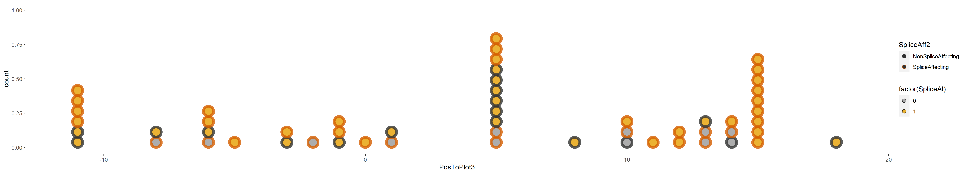
Performance by location
Incorrect prediction
Outline:
Fill:
Correct prediction
AUC
Team 1
0.813
Team 2
0.703
Team 3
0.687
Team 4
0.826
SpliceAI
0.813
>10bp
Exon
>10bp
Acceptor
>10bp
Donor
Notes:
Team prediction shown across different regions
Things to note
m1 and SpliceAI are not the same thing – despite identical stats
FPs around donor in T2,T3,
Most models perform worse further away from splice sites
Are there more false positives near splice sites, and more false negatives further away? I will come on to this

Slide 16
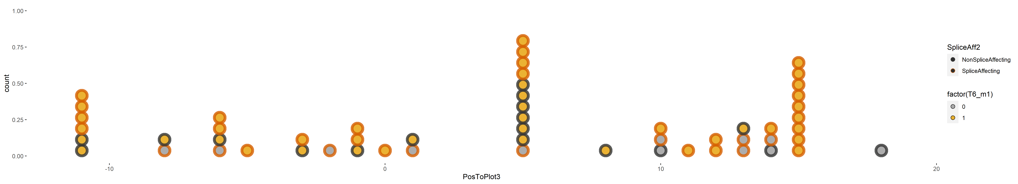
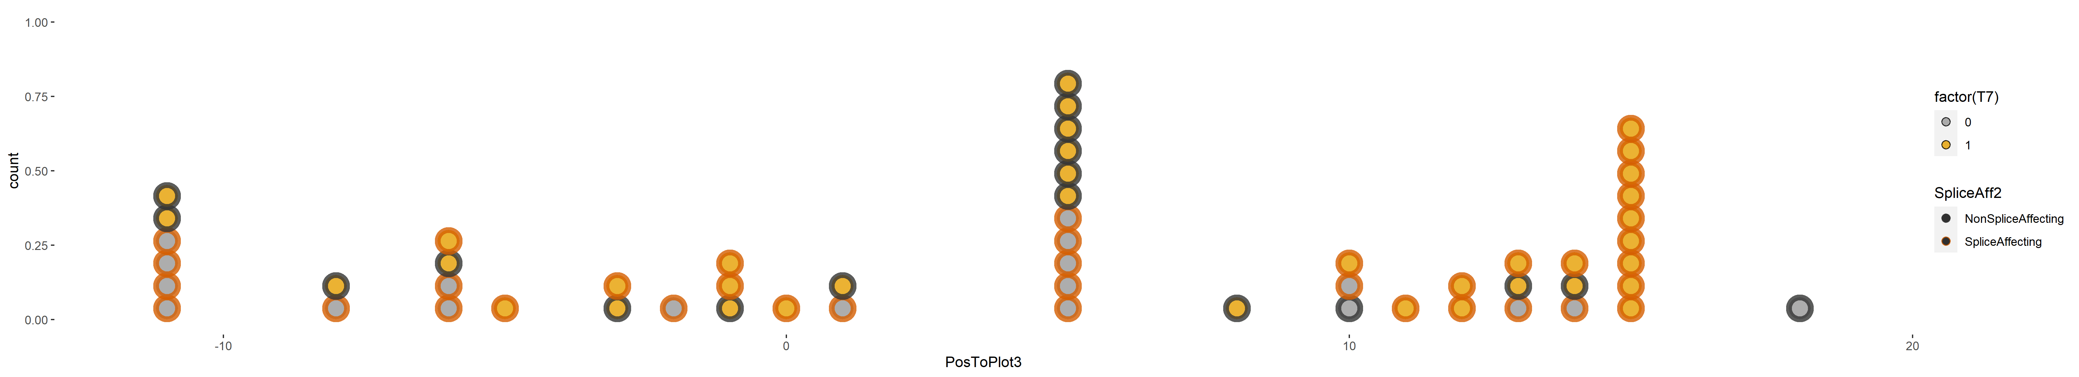

Performance by location
Incorrect prediction
Outline:
Fill:
Correct prediction
AUC
Team 5
0.721
Team 6
0.798
Team 7
0.721
Team 8
0.753
SpliceAI
0.813
>10bp
Exon
>10bp
Acceptor
>10bp
Donor
Notes:
T7 – lots of mispredictions away from CSSs

Slide 17
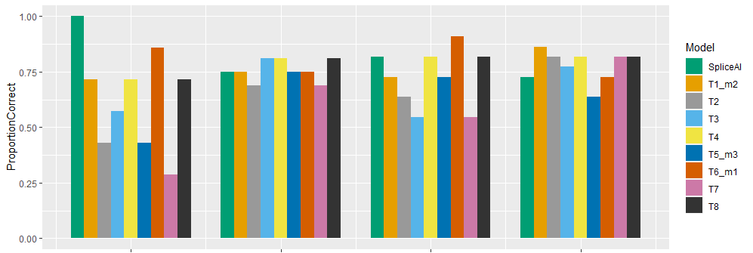
Performance by location - summary
>10bp
Exon
>10bp
Acceptor
>10bp
Donor
IntronicDistant
N=6
NearAcc
N=16
ExonicDistant
N=11
NearDon
N=22
IntronicDistant
N=1
IntronicDistant
N=7
Median proportion correct = 0.714
NearAcc
N=16
Median proportion correct = 0.750
ExonicDistant
N=11
Median proportion correct = 0.727
NearDon
N=22
Median proportion correct = 0.818
Notes:
Talk through the grouping + what the plot is showing
More consistent results nearer splice sites, generally better predictions nearer splice sites (some groups do well on intronic ones). Generally, exonic > intronic. Mention medians.

Slide 18
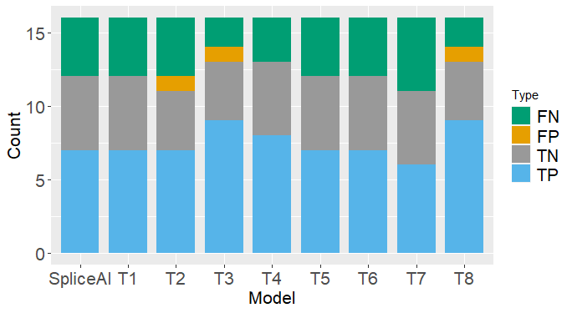
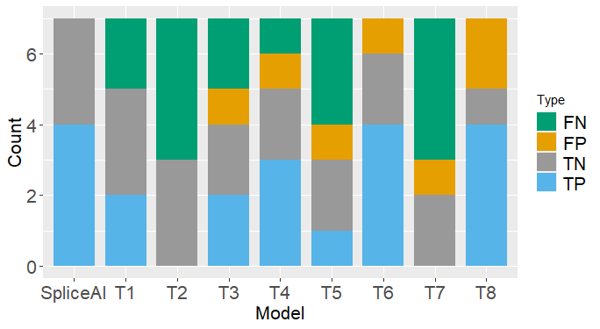
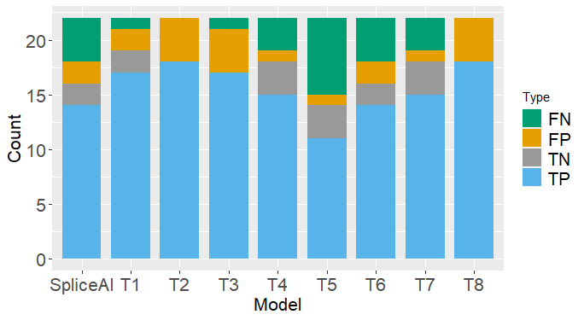
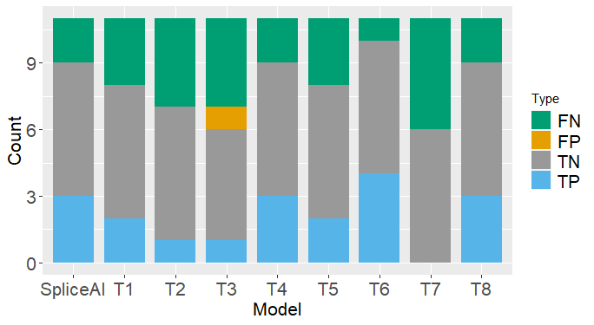
Performance by location - summary
NearAcc (n=16, 11 splice affecting)
Intronic Distant (n=7, 4 splice affecting)
NearDon (n=22, 18 splice affecting)
Exonic Distant (n=11, 5 splice affecting)
FN = False Negative, FP = False Positive, TN = True Negative, TP = True Positive
Notes:
Exonic – very few FPs across any models – almost all errors are false negatives. T7 didn’t pick up any SA. No groups detected all the SAs.
Intronic – SAI all right. T2 – just TN and FN – didn’t predict any SA in that group.
Near – more consistent between groups.
Don dominated by TP – most variants there are SA

Slide 19
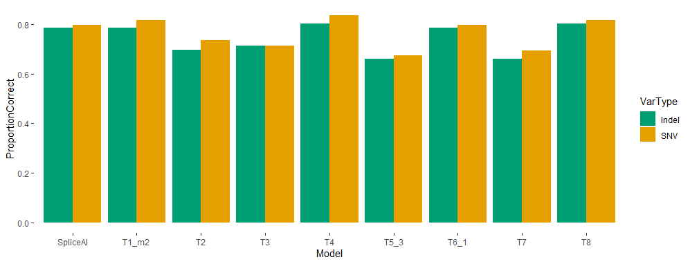
Performance on different variant types
49 SNVs, 7 indels
Notes:
All methods bar T3 show greater performance on SNVs than indels. Fairly marginal. None showing much worse performance on indels.

Slide 20
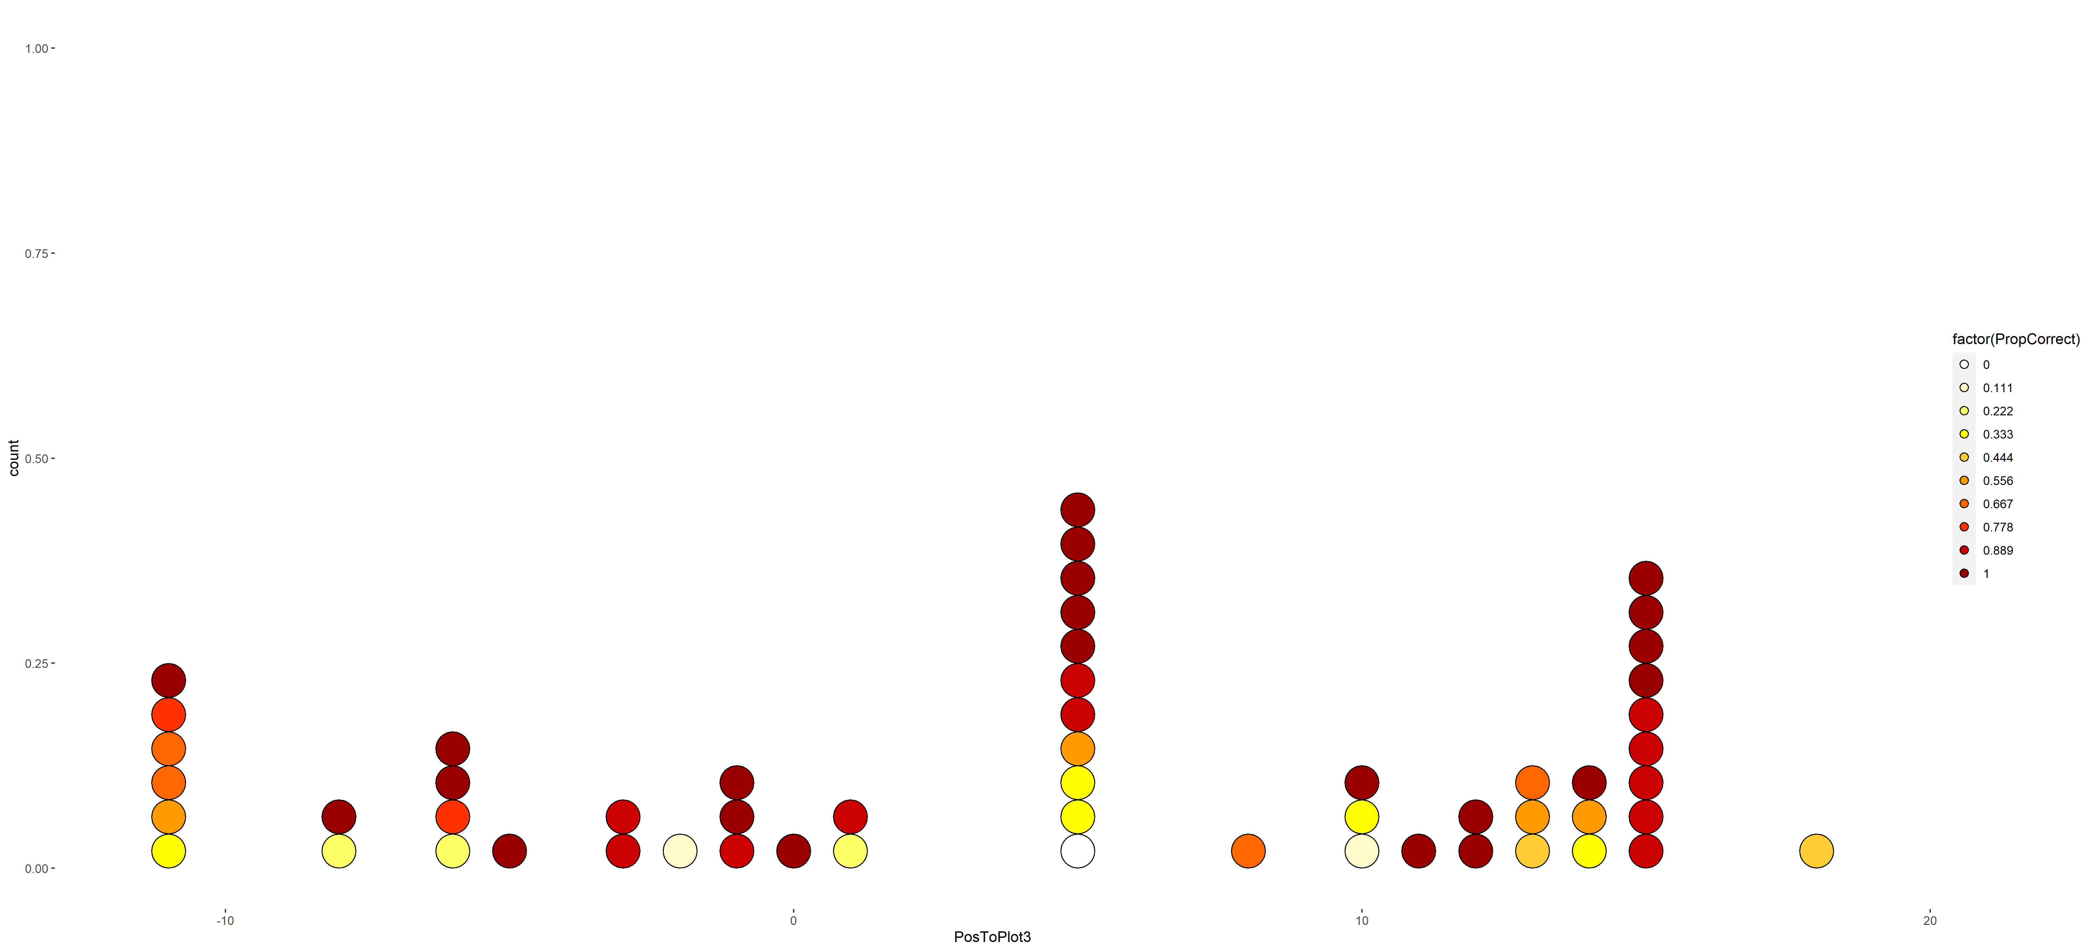
Some variants hard to predict
Proportion of tools with correct predictions
Exonic
>10bp from splice site
>10bp from A
D+5
A-8
D+3
>10bp from D
A-3
D0
D+4
A-10
A-5
A-1
D+2
A-4
D-2
A-7
A-2
D+1
CSS
Exon
CSS
Polypyrimidine tract
Acceptor
Donor
Notes:
Small number of variants are consistently poorly predicted. One variant – no correct – exonic missense variant in TRIP12.

Slide 21
Some variants hard to predict
Genes
BRCA1 (n=3)
L1CAM
DNM1
KANSL1
KMT2D
TRIP12
BRCA2
TRPM6
ARID2
PHIP
FBN1
P-value = 0.5144 | 5 or more Teams predicted correctly | 5 or more Teams predicted incorrectly
Splice affecting | 28 (74%) | 10 (26%)
Non splice affecting | 15 (83%) | 3 (16%)
P-value = 0.7361 | 5 or more Teams predicted correctly | 5 or more Teams predicted incorrectly
Deep intronic or exonic | 13 (72%) | 5 (27%)
Near acceptor or donor | 30 (79%) | 8 (21%)

Slide 22
Conclusions
Team 8 (U1245/Leman) overall winners
  Highest accuracy & good specificity and PPV
Team 1’s model 2 (HuZ_WangY)
  Second highest accuracy, best AUC & good sensitivity
Team 6’s model 1 (UMSplicing)
  Same accuracy as team 1 and second highest AUC
General patterns in performance:
  Near splice sites > Exonic distant > Intronic distant
  SNVs > Indels
  Small number of variants consistently poorly predicted

Slide 23
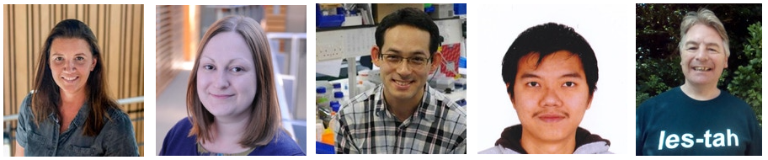
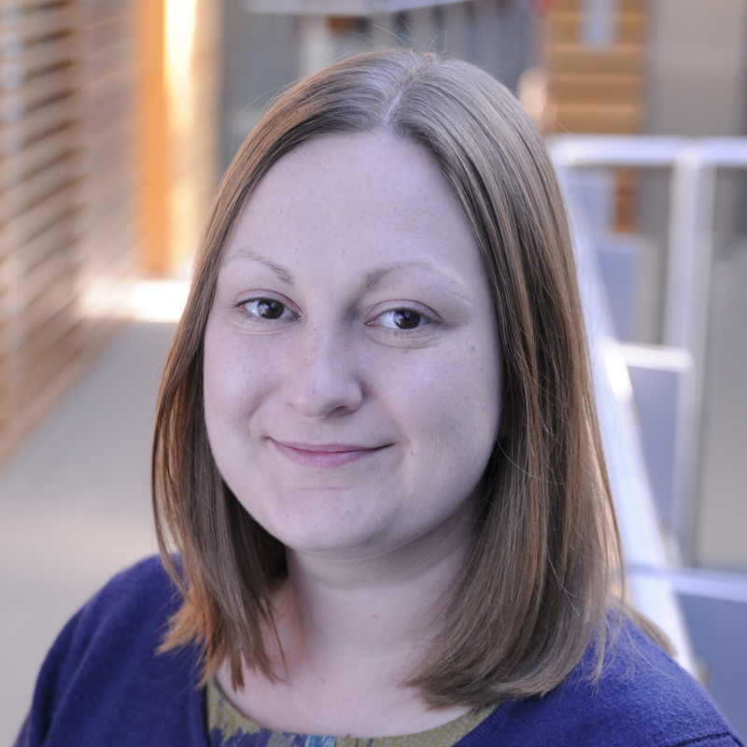
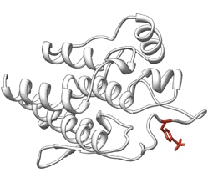

Acknowledgements
Diana Baralle
Jenny Lord
Andrew Douglas
Htoo Wai
Dave Bunyan
All patients and clinicians for taking part in this research
CAGI

