Slide 1

CAGI slide pack guidelines
I agree to my slides being used according to the following terms:
_______Brynja Matthiasardottir, Chiao-Feng Lin, Stephen M. Mount_______
Authors: please include THIS slide at the beginning of your presentation to indicate that you agree with reuse of your slides in CAGI presentations, according to the terms below, and digitally sign by writing your name above.
To disseminate the CAGI results, I encourage all CAGI participants to remix these CAGI slides for inclusion in their oral and poster presentations
CAGI participants may use or publish any content of these slides only in compliance with the CAGI Data Use Agreement
CAGI participants may not cite or publish any content of these slides except with the written permission of the originating author or in the primary CAGI publications
CAGI participants must acknowledge the original authors of these slides and CAGI 6. Include the acknowledgement banner across the bottom
CAGI participants must include the CAGI credits slide in their presentations
Slides with a red slash (no remix) may not be included in a presentation unless all attendees are registered CAGI participants who signed the data use agreement
Slides with a red X over the entire slide may not be used in any circumstances
Slides with a blue slash (embargoed) may not be used unless the embargo is explicitly lifted
Slides without slash or X may be tweeted unless flagged with the “No tweet” icon.
CAGI participants using these slides must explain the “No tweet” icon, which means that the slide content should not be disseminated outside the presenting conference hall. If the presentation venue permits pervasive tweeting, you may not include these slides in your talk
Note for slide authors: we expect all CAGI participants to abide by these restrictions, and will make best effort to ensure they are followed. However, but bear in mind that we have limited means of enforcing them, and therefore the restrictions cannot be guaranteed.

Slide 2
Permission request regarding CAGI 6 recordings and hybrid presentations
I understand that my presentation as associated with CAGI 6 will be recorded and broadcasted via the internet through CAGI’s designated technology provider.
As the copyright holder to this presentation entitled “Predicting splicing disruption from variants of unknown significance”, I hereby agree that the copyright for the online broadcast and recording of my presentation be released to CAGI and my recording be uploaded on to the CAGI website.

Slide 3
Team: UMSplicing
SplicingVUS
Predict whether experimentally validated variants of unknown significance impact normal splicing in blood mRNA
Created for CAGI 6
genomeinterpretation.org
Brynja Matthiasardottir

Slide 4
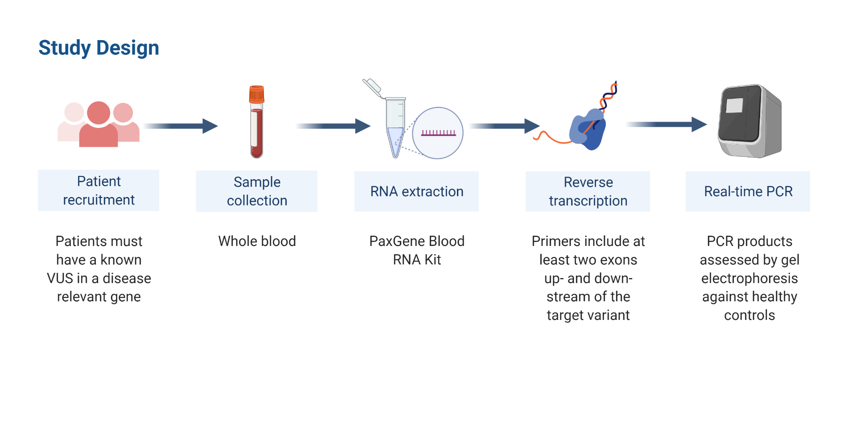
Experiment
*Experimental work conducted in Dr. Baralle’s Lab at The University of Southampton
and at Wessex Regional Genetics Lab in Salisbury
Created for CAGI 6
genomeinterpretation.org
Brynja Matthiasardottir

Slide 5
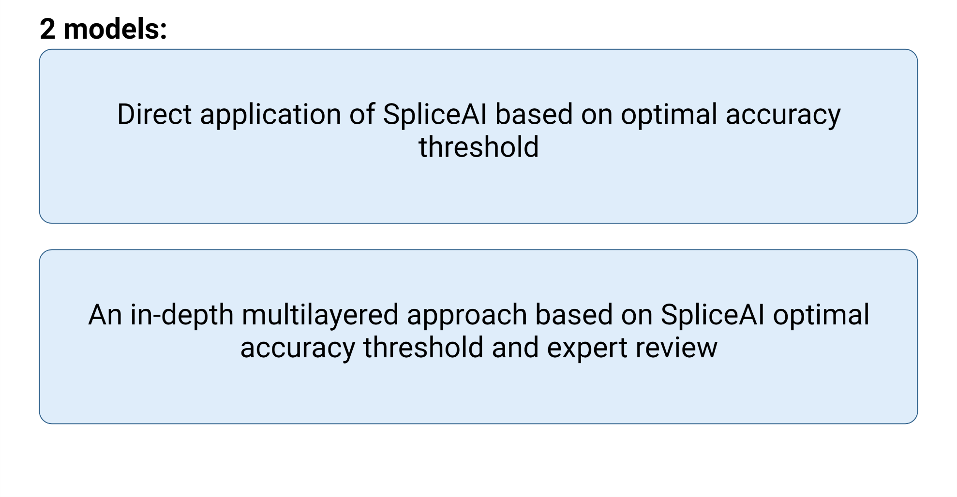
Methods
Created for CAGI 6
genomeinterpretation.org
Brynja Matthiasardottir

Slide 6
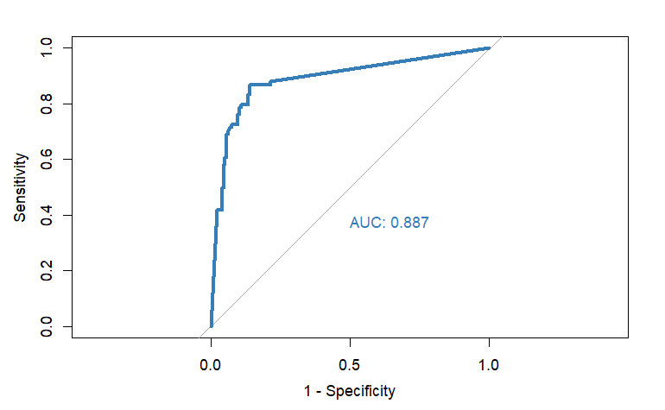
Methods
Optimal accuracy threshold, SpliceAI
Training set: 257 previously validated variants (Wai et al., 2020)
Threshold
0.21
Created for CAGI 6
genomeinterpretation.org
Brynja Matthiasardottir

Slide 7
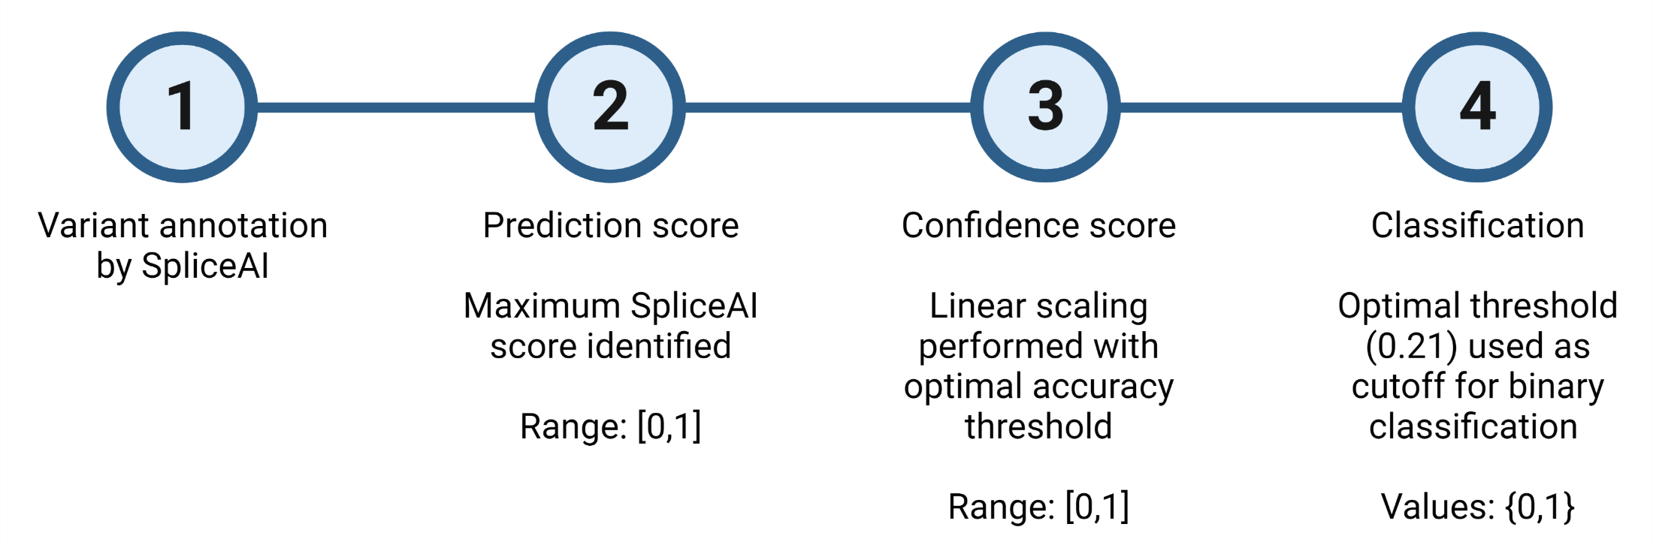

Methods
Model: Direct application of SpliceAI
Four probability scores for each variant:
Acceptor Gain
Acceptor Loss
Donor Gain
Donor Loss
$${CS=Y}_{0}+ \frac{Y_{1}−Y_{0}}{X_{1}−X_{0}}×(Z−X_{0})$$
Created for CAGI 6
genomeinterpretation.org
Brynja Matthiasardottir

Slide 8
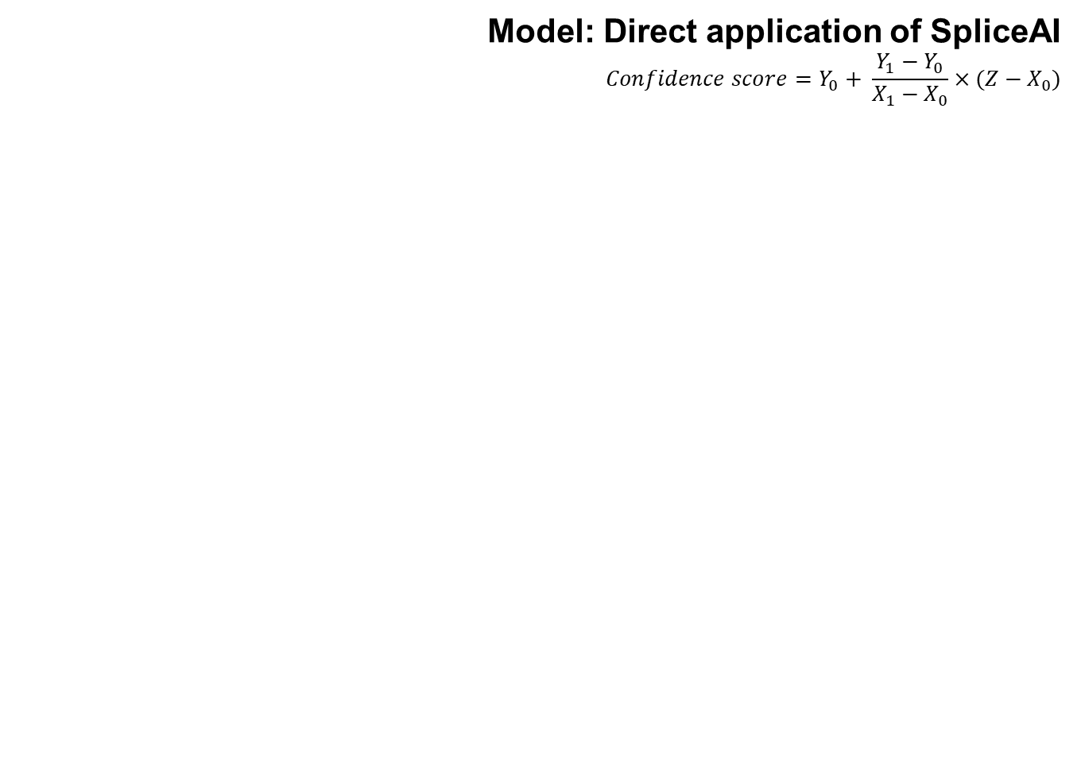
Results
Model: Direct application of SpliceAI
$$Confidence score=Y_{0}+ \frac{Y_{1}−Y_{0}}{X_{1}−X_{0}}×(Z−X_{0})$$
Created for CAGI 6
genomeinterpretation.org
Brynja Matthiasardottir

Slide 9
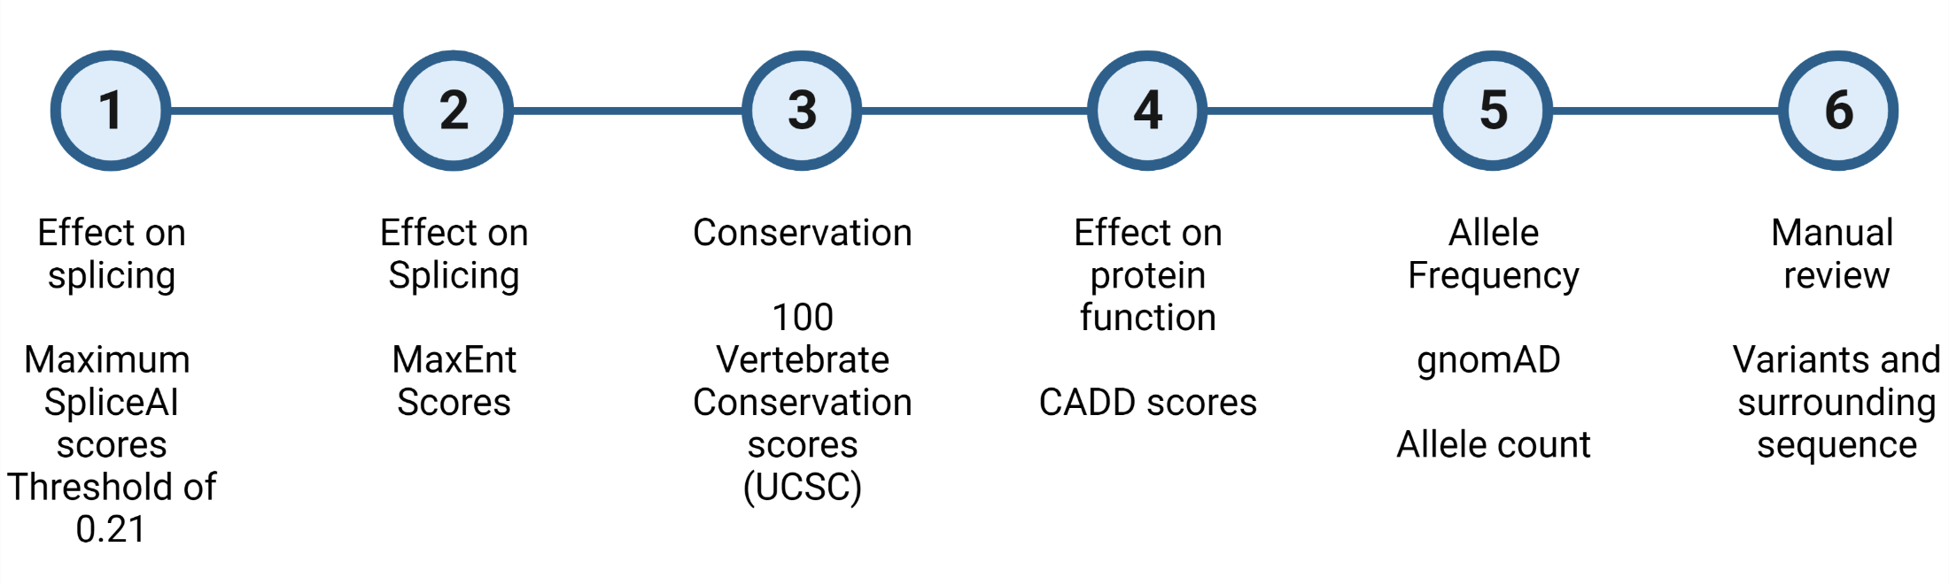
Methods
Model: Multilayered approach
Created for CAGI 6
genomeinterpretation.org
Brynja Matthiasardottir

Slide 10
Results
Model: Multilayered approach
Created for CAGI 6
genomeinterpretation.org
Brynja Matthiasardottir

Slide 11
Conclusions
A model was developed for annotation of Splicing VUS in CAGI6 that highlights the utility of a multi-layered approach and calls attention to the importance of optimizing variant detection through multiple bioinformatic approaches
Created for CAGI 6
genomeinterpretation.org
Brynja Matthiasardottir

Slide 12
Next Steps
In the future, we will attempt to formalize and automate this model to run on additional data sets
Created for CAGI 6
genomeinterpretation.org
Brynja Matthiasardottir

