Slide 1

I agree to my slides being used according to the following terms: Kyoko Yuki, Huayun Hou
•To disseminate the CAGI results, I encourage all CAGI participants to remix these CAGI slides for inclusion in their oral and poster presentations
•CAGI participants may use or publish any content of these slides only in compliance with the CAGI Data Use Agreement
•CAGI participants may not cite or publish any content of these slides except with the written permission of the originating author or in the primary CAGI publications
•CAGI participants must acknowledge the original authors of these slides and CAGI 6. Include the acknowledgement banner across the bottom
•CAGI participants must include the CAGI credits slide in their presentations
•Slides with a red slash (no remix) may not be included in a presentation unless all attendees are registered CAGI participants who signed the data use agreement
•Slides with a red X over the entire slide may not be used in any circumstances
•Slides with a blue slash (embargoed) may not be used unless the embargo is explicitly lifted
•Slides without slash or X may be tweeted unless flagged with the “No tweet” icon.
•CAGI participants using these slides must explain the “No tweet” icon, which means that the slide content should not be disseminated outside the presenting conference hall. If the presentation venue permits pervasive tweeting, you may not include these slides in your talk

Slide 2
Permission request regarding CAGI 6 recordings and hybrid presentations
I understand that my presentation as associated with CAGI 6 will be recorded and broadcasted via the internet through CAGI’s designated technology provider.
As the copyright holder to this presentation entitled "CAGI6 SickKids challenge", I hereby agree that the copyright for the online broadcast and recording of my presentation be released to CAGI and my recording be uploaded on to the CAGI website.

Slide 3




CAGI6 SickKids Challenge
Kyoko Yuki
Huayun Hou
2022.05.15

Slide 4
RNA-seq can facilitate the diagnosis for rare diseases
Diagnostic rate for rare Mendelian disorders by WES/WGS is often < 50%
Functional interpretation of non-coding variants remains challenging
Loss-of-function variants
Exon
Exon
Variants with unknown significance (VUS)
RNA-seq provides direct insights into the transcription alterations
Diagnostic rate:
Heterogeneous cohort: 8-17%
Cohort with muscle disorders: ~ 35%
A
C
Aberrant splicing
Abnormal expression levels
Allele-specific expression

Slide 5
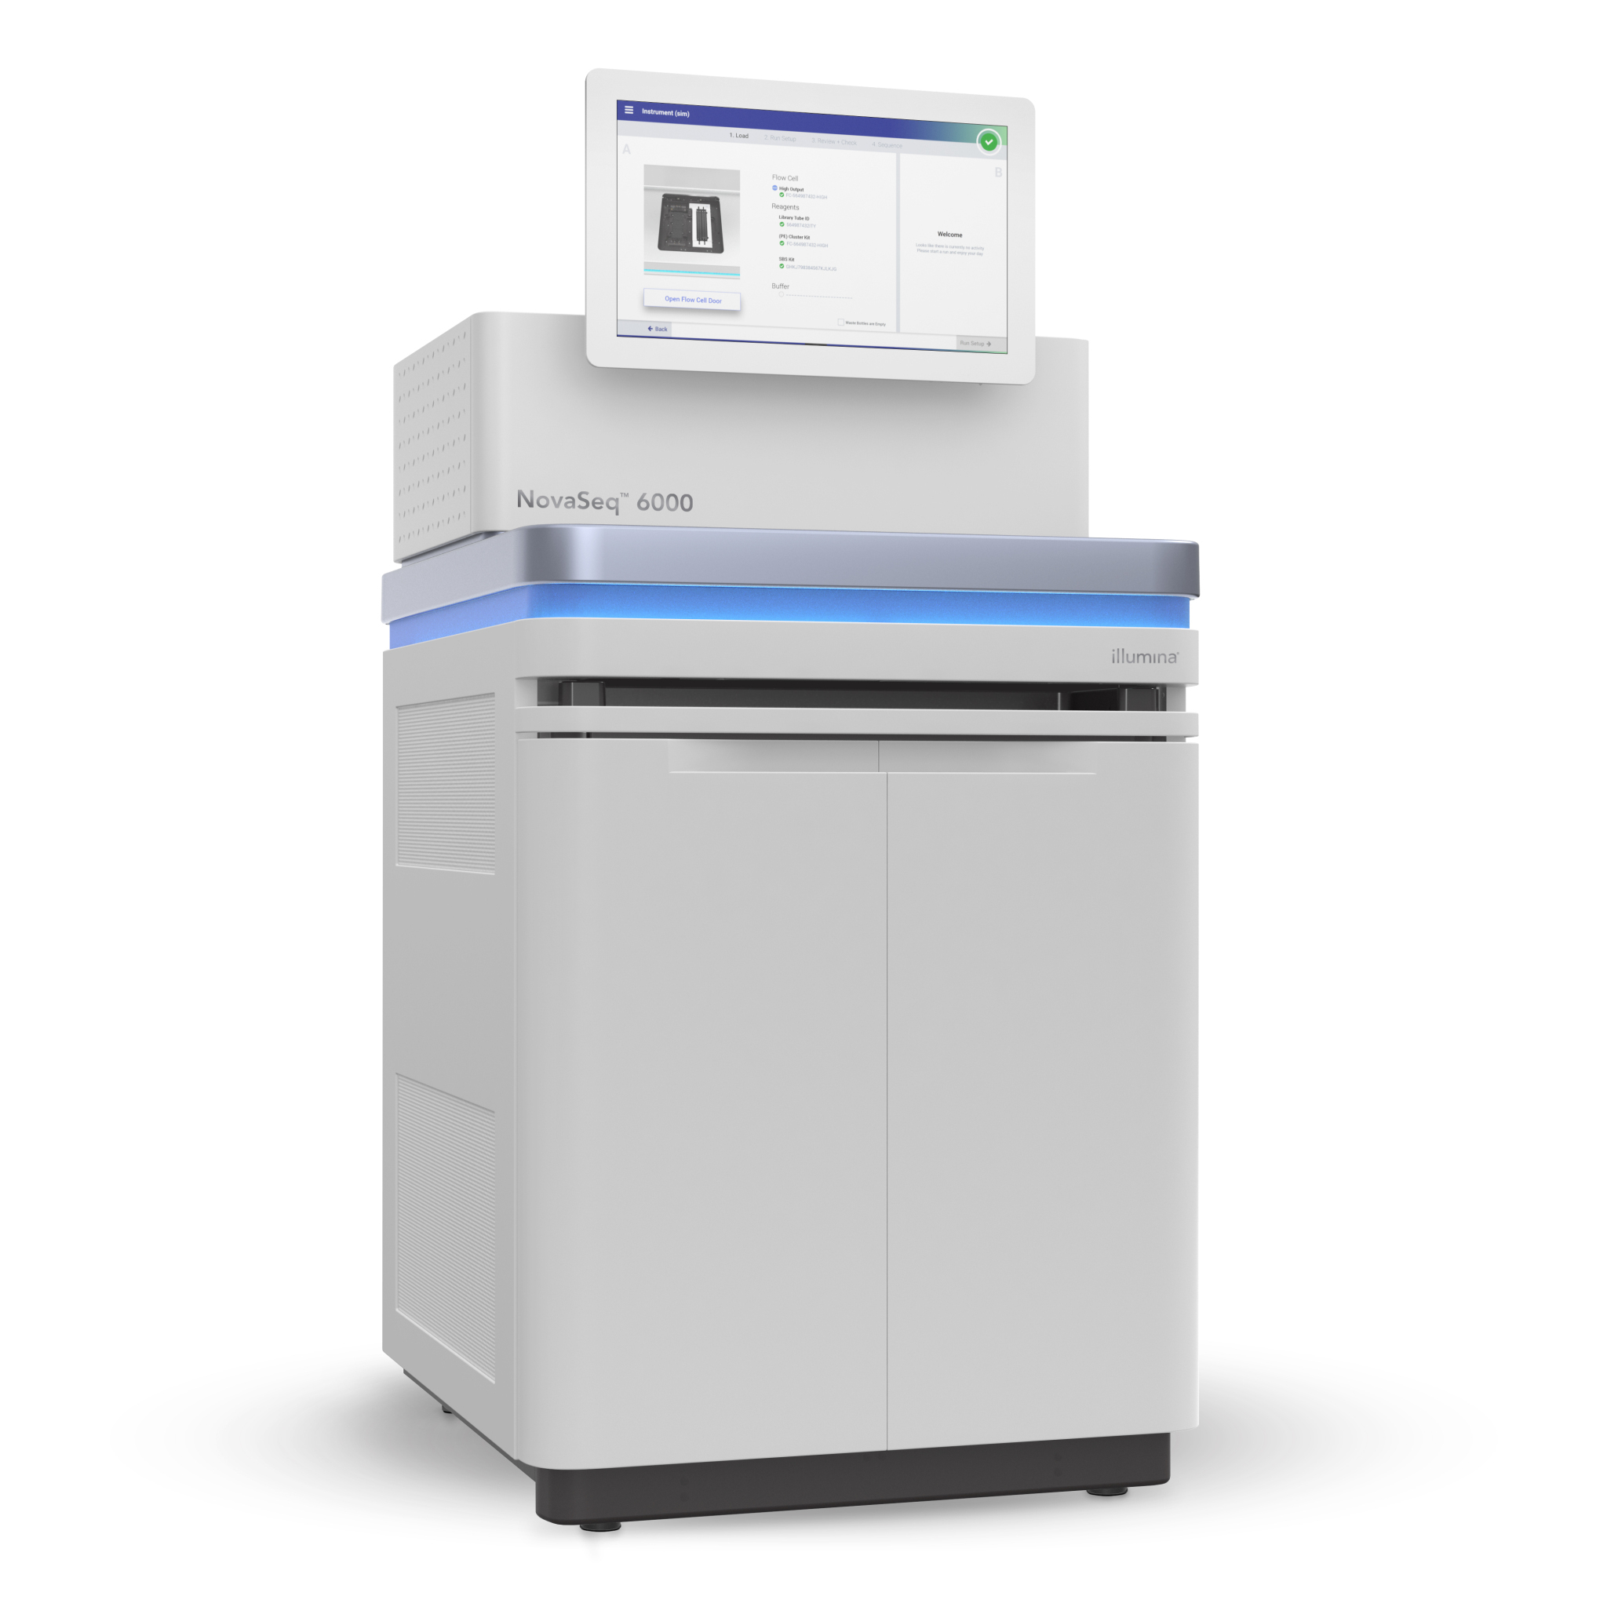
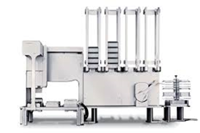


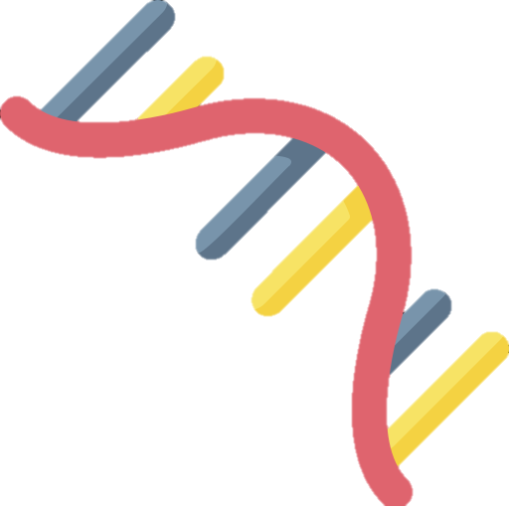


Developing a clinical-grade, automated RNAseq platform
RNA extraction
Automated library preparation
Data processing
Splicing & transcript levels
Fusion detection
Spike-in RNA variants (SIRVs, Lexogen)
NGS workstation
(Agilent)
NovaSeq 6000
(Illumina)
* No globin RNA depletion for blood samples
Notes:
While these intial studies are promising, implementing rnaseq in clinical diagnosis requires establishing robust experimental and computational protocols, strict quality controls, efficient interpretation strategy and adequate source material.

Slide 6
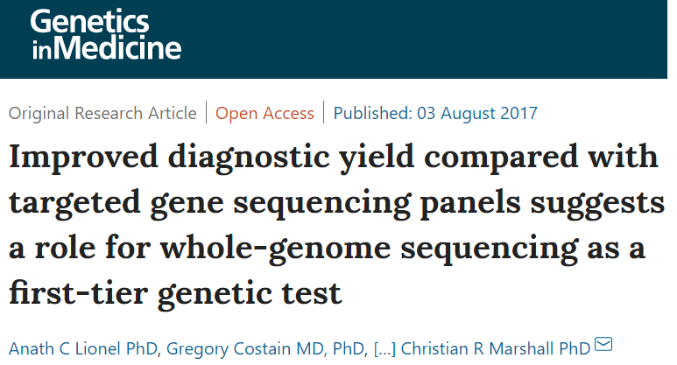
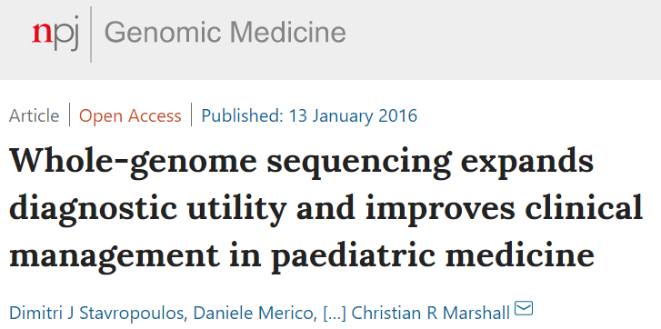
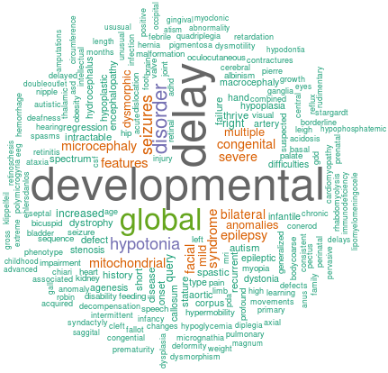
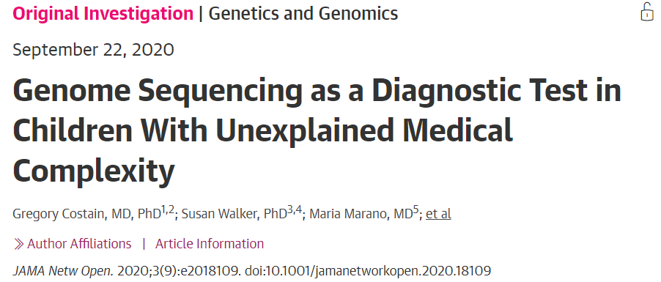
Rare disease cohort
Patients with heterogenous disorders previously tested by WGS with blood available for RNA
Causative DNA variants were identified in 30-41%
Subset had also been included in CAGI4 and CAGI5

Slide 7
CAGI challenge
79 patients
  Solved: 3 by RNA (only 2 had DNA available); 12 DNA only
Provided RNA-seq (79) + PhenoTips file (79) + WGS (78)
Using the RNAseq data, can participants identify gene(s) and molecular events that may explain a patient’s phenotype?
Rank up to 100 genes providing RNA evidence, optional DNA variant
HGNC Symbol | P | SD | Expression (yes/no) | Splicing (yes/no) | ASE (yes/no) | Other (yes/no) | RNA impact | Refseq transcript version | DNA variant (optional, up to 4) | Additional comments (optional)
DNAJC19 | 0.99 | 0.26 | Yes | Yes | No | No | Decreased expression (z-score of -3), skipping of exon 5 | NM_145261.3 | 3:180703708:ACTTAC:A | Domains impacted, in-frame, inheritance, etc

Slide 8
Bioinformatics pipeline for detecting transcriptional alterations
Pre-processing
Quality control
Quantification
Outlier detection
Gene quantification (RSEM)
Identify expression outliers based on normalized read counts (OUTRIDER)
Read alignment to hg19
QC metrics (alignment rate, transcript coverage, duplication rate, etc)
Splicing junction quantification (STAR)
Identify splicing outliers based on junction coverage
(Z scores)
Variant calling with
DNA sequencing
Quantify allelic expression (GATK)
Identify allele-specific expression (DESeq2)
Clinical interpretation
Compared to uniformly processed internal samples
Annotation with HPO, OMIM, Orphanet
Notes:
We have developed a custom pipeline to detect splicing outliers and via quantification of transcripts expression outliers. We also have the ability to identify allele specific expression of genes. We have customized the outputs to annotate the data with HPO terms as well as information from OMIM and Gtex and other data bases.

Slide 9
True positive cases used for assessment
RNA ID | DNA variant
235956 | HMGA2 c.303delC p.(Ser102Hisfs*64) (het) [NM_003483.4]
238275 | KCNB1 c.623T>C* p.(Leu208Pro) (het) [NM_004975.3]
240909 | COL12A1 c.8453G>A (pGly2818Glu) (het) [NM_004370.6]
228810 | ZNF711 c.430G>A p.(Val144Met) (hem)
235383 | DSG2 c.2434G4A p.Gly812Ser (het)
236709 | SMAD6 c.821C>G p.(Ser274Cys) (het) [NM_005585.4]
250316 | EPG5 (NM_020964) c.3472C>T (p.L1158F) (hom)
20-10336 | HDAC8 (NM_018486.2) c.134_137del (p.Ile45Lysfs*9) (hem)
20-10324 | H3F3B (NM_005324.4) c.365C>G (p.Pro122Arg) (het)
20-10329 | CASK (NM_003688.3) c.1685dup (p.Ser562Argfs*18) (het)
20-10331 | PDHA1 (NM_000284.3) c.937_940dup (p.Ser314Lysfs*3) (het)
20-10339 | FBXW7 (NM_033632.3) c.1920C>A (p.Ser640Arg) (het)
20-10356 | NKX6-2 (NM_177400.2) c.234del (p.Leu79Cysfs*109) (hom)
20-10362 | SMS (NM_004595.5) c.265-5T>A (p.?) (hem)
20-10878 | FOXG1 (NM_005249.3) c.177_186del (p.Pro60Argfs*129) (het)
Other potential cases to use:
20-10347:
KDM6A: a deletion that’s not included in the vcf file provided
221888 WGS-NGS-009:
OCA2: specific variant information is not available
221506 WGS-NGS-007:
Three candidate genes
20-10320
trisomy 21, multiple genes impacted
Another 10 cases with candidate aberrant RNA events proposed
Decreased expression
Decreased expression
Aberrant splicing;
WGS vcf was not available for the challenge
With RNA evidence

Slide 10
Evaluation strategies
RNAseq based challenge:
  Identification of known pathogenic genes with RNA impact (n = 3)
  If the participants processed and utilized RNAseq data
  Methods and Submission format
    If the participants describe RNA aberrations in a principled way
    Accessibility and reproducibility of the methods
    If the methods are statistically robust
    If the methods have taken clinical information into consideration
WGS based challenge:
  Identification of known pathogenic genes and the correct DNA variants (n = 14)
Additional: Identification of additional clinically relevant candidate genes

Slide 11
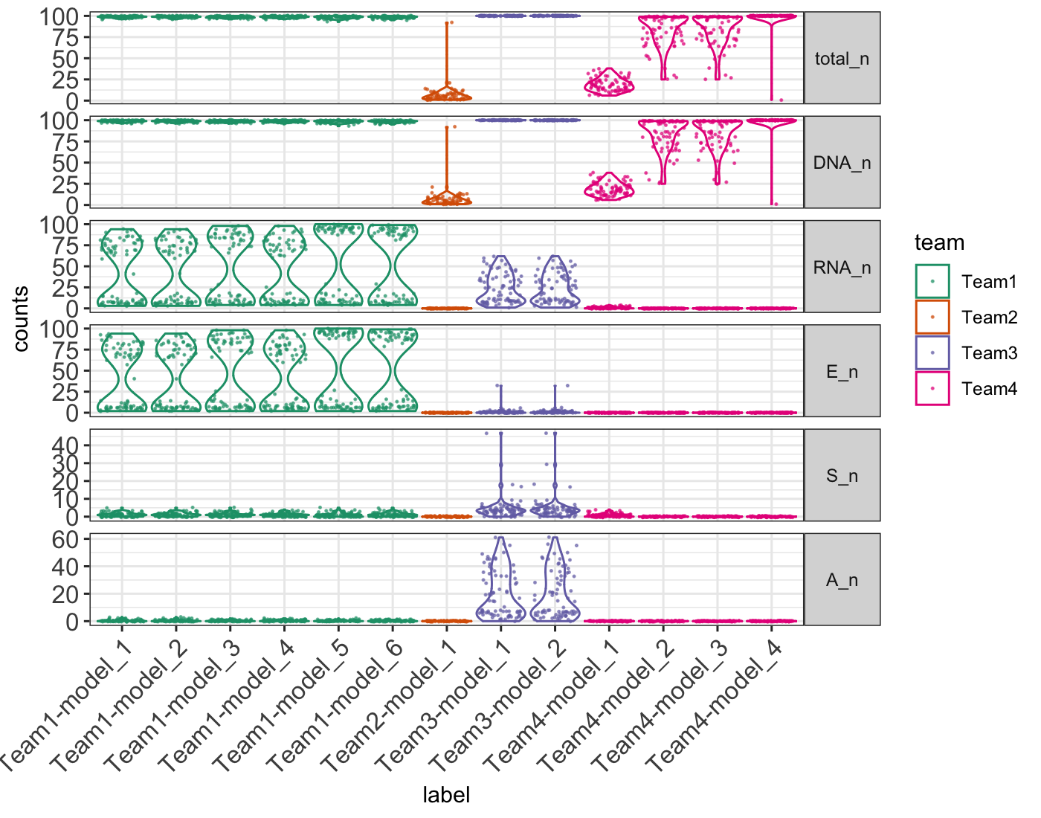
Prediction result summary
Total_n: total number of genes reported
DNA_n: total number of genes with associated DNA variants
RNA_n: total number of genes with at least one type of RNA aberration
E_n: # aberrant expression levels
S_n: # aberrant splicing events
A_n: # genes with ASE

Slide 12
Summary of methods
 | RNA expression | RNA splicing | RNA allele specific expression | DNA variants | Phenotype | Additional datasets used
Team1 | ACMG criteria PVS1 for null variants in lof genes | SpliceAI score > 0.8 | ANEVA and ANEVA-DOT, adjust p value < 0.05 | Scoring based on Seo et al., 2020, Won et al., 2021, semantic similarity and combined in various ways | Similar way to the Phenomizer algorithm | In-house patient-derived data for training
Team2 | RNA data not used | RNA data not used | RNA data not used | Filtered based on VEP annotations | EDGAR and PhenPath to retrive functional annotations based on phenotypes | NA
Team3 | OUTRIDER | FRASER | DROP MAE model | Annotations and filters based on VEP, CADD, SpliceAI, EVE, UTRannotator and scored based on model learnt with combining RNA impact and variants impact annotations | R package PCAN | GTEx blood samples; In-house positive cases for training
Team4 | RNA data not used | RNA data not used | RNA data not used | The Evolutionary Action method | Known associations based on HPO, clinVar, HumSaver, DisGeNet, VarElect

Slide 13
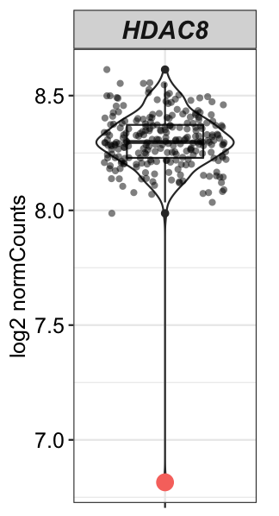
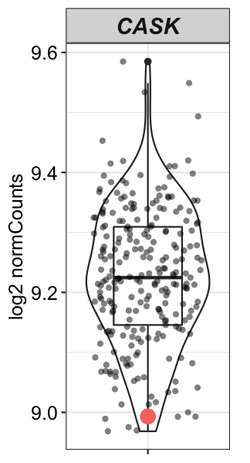
RNA positive cases: decreased expression
Sample: 20-10336
HDAC8 (NM_018486.2) c.134_137del (p.Ile45Lysfs*9) (hem)
Z-Score: -10.15
P value: 3.32e-17
Padjust: 5.82e-12
Sample: 20-10329
CASK (NM_003688.3) c.1685dup (p.Ser562Argfs*18) (het)
Z-Score: -2.04
P value: 0.067
Padjust: 1
Other
Samples
(n = 244)
Affected sample

Slide 14
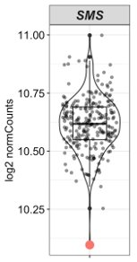
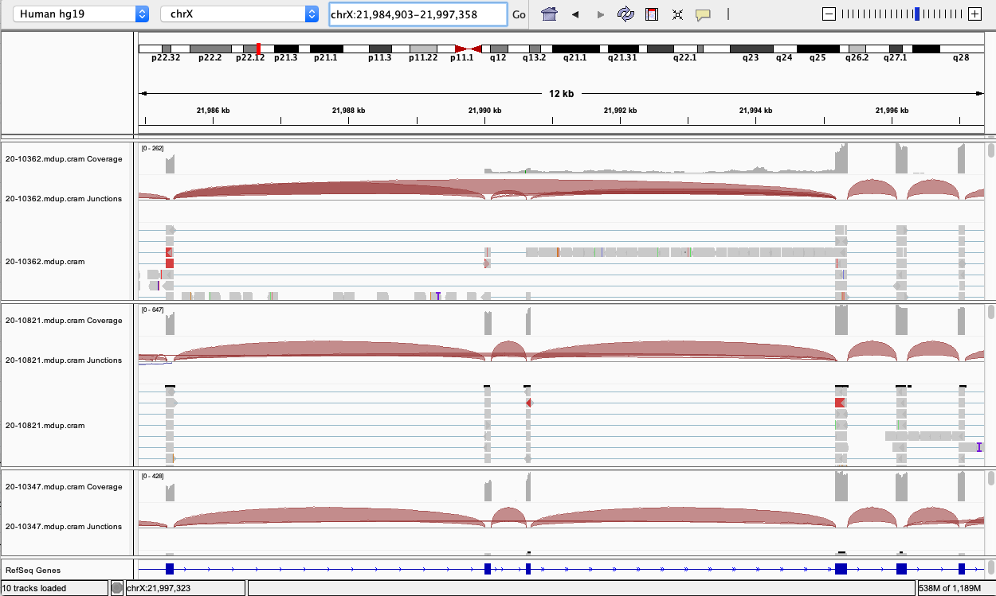
RNA positive cases: aberrant splicing
NM_004595.5:c.265-5T>A -5 Splice acceptor site
Case
Control1
Control2
SampleID: 20-10362
Z-Score: -4.44
P value: 3.18e-5
Padjust: 0.47

Slide 15
RNA positive cases: prediction results
sampleID | HGNC.Symbol | team | model | P | SD | Expression | Splicing | ASE | Other | RNA.impact | Additional.comments
20-10329 | CASK | Team1 | model_1 | 0.96 | 0.41 | yes | no | no | no | decreased expression | no
20-10329 | CASK | Team1 | model_2 | 0.96 | 0.41 | yes | no | no | no | decreased expression | no
20-10329 | CASK | Team1 | model_3 | 1 | 0.43 | yes | no | no | no | decreased expression | no
20-10329 | CASK | Team1 | model_4 | 1 | 0.43 | yes | no | no | no | decreased expression | no
20-10329 | CASK | Team1 | model_5 | 1 | 0.43 | yes | no | no | no | decreased expression | no
20-10329 | CASK | Team1 | model_6 | 1 | 0.43 | yes | no | no | no | decreased expression | no
20-10336 | HDAC8 | Team1 | model_1 | 0.93 | 0.4 | yes | no | no | no | decreased expression | no
20-10336 | HDAC8 | Team1 | model_2 | 0.93 | 0.4 | yes | no | no | no | decreased expression | no
20-10336 | HDAC8 | Team1 | model_3 | 1 | 0.43 | yes | no | no | no | decreased expression | no
20-10336 | HDAC8 | Team1 | model_4 | 1 | 0.43 | yes | no | no | no | decreased expression | no
20-10336 | HDAC8 | Team1 | model_5 | 1 | 0.43 | yes | no | no | no | decreased expression | no
20-10336 | HDAC8 | Team1 | model_6 | 1 | 0.43 | yes | no | no | no | decreased expression | no
20-10362 | SMS | Team3 | model_1 | 0.14 | 0.05 | no | yes | no | no | splicing change: exonSkipping,sameIntron,sameIntron,exonSkipping,inconclusive,sameIntron,inconclusive,inconclusive, genomic location: X:21985435-21995178,X:21990690-21995178,X:21985435-21990014,X:21985435-21995178,X:21990624-21990625,X:21990109-21990624,X:21990689-21990690,X:21990108-21990109
20-10362 | SMS | Team3 | model_2 | 1 | 0.1 | no | yes | no | no | Same as above | Patient is male with Snyder-Robinson-Syndrome and has a hemizygous variant in SMS which causes intron 3 & 4 retention. SMS is known to cause Snyder-Robinson-Syndrome.

Slide 16
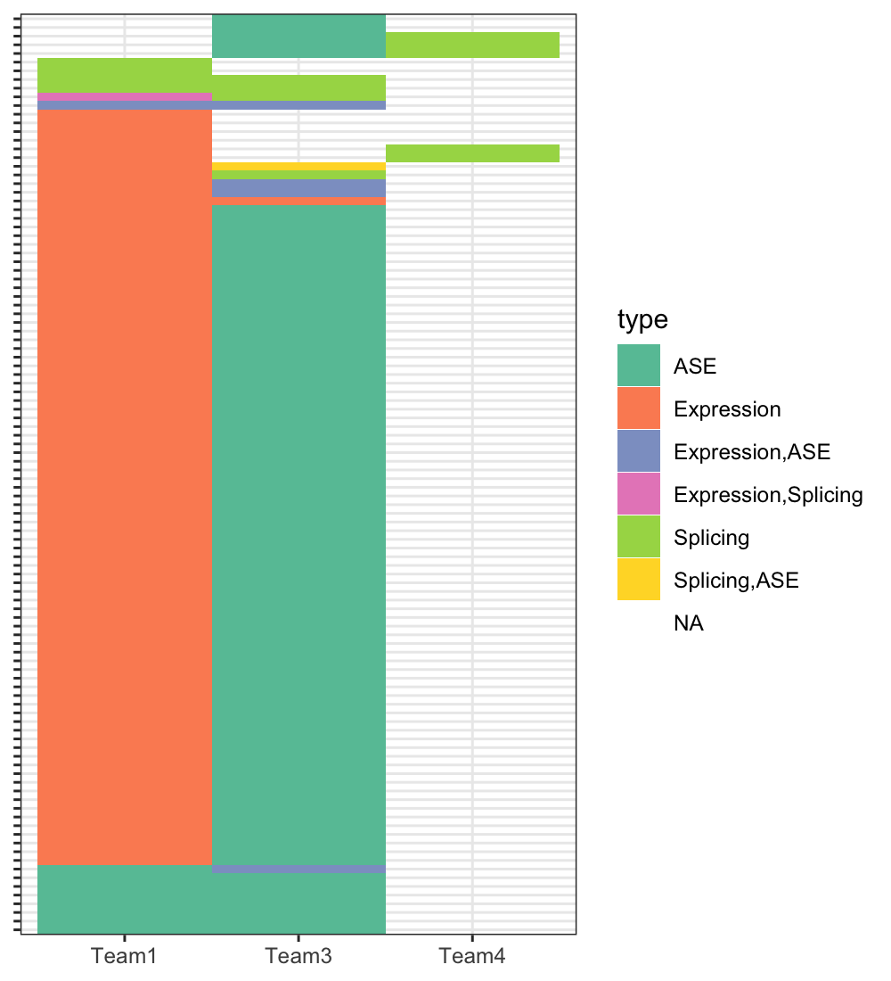
Predicted RNA impact across teams
106 gene-sample pairs predicted to have RNA changes by at least 2 teams
15 agreeing, all between Team1 and Team3
3 expression
3 splicing
1 ASE & expression
8 ASE
Sample -
Gene
Each team's prediction is summarized across models

Slide 17
Scoring based on DNA variants
Adapted from the RGP challenge
Rank score: 101 – rank
Rank points:
  1-5:100;
  6-10: 50;
  11-25: 25;
  26-50: 10;
  > 50: 5
P score: 100*probability
Add score: P score + Rank score
Multiply score: P * Rank score
Scores are calculated for each correctly identified case and are summed up for final scores

Slide 18
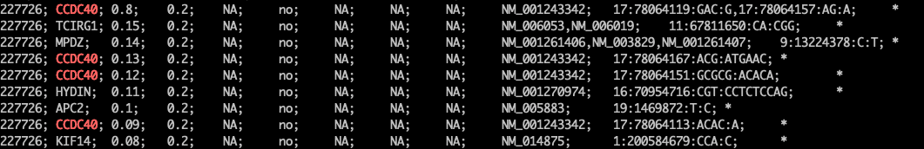
Reporting format issues
Some teams/models had duplicated entries or genes with different P/SD values:
  Team4 model1: Different variants for one gene:
Team1：Same variant with different additional values?
For duplicated entries, only taking the entry with the highest probability

Slide 19
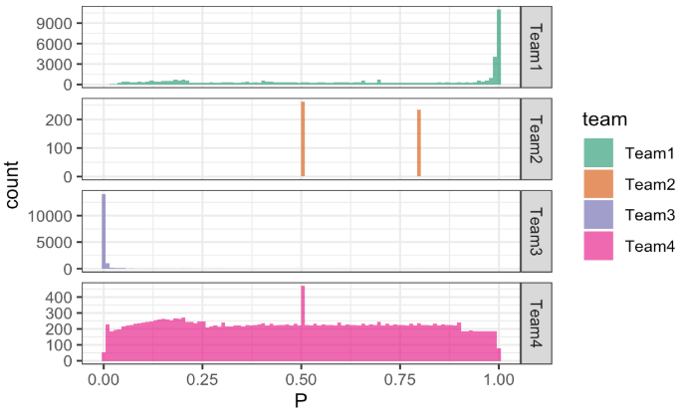
Reporting format issues
Interpretation of "Probability" -- scale?

Slide 20
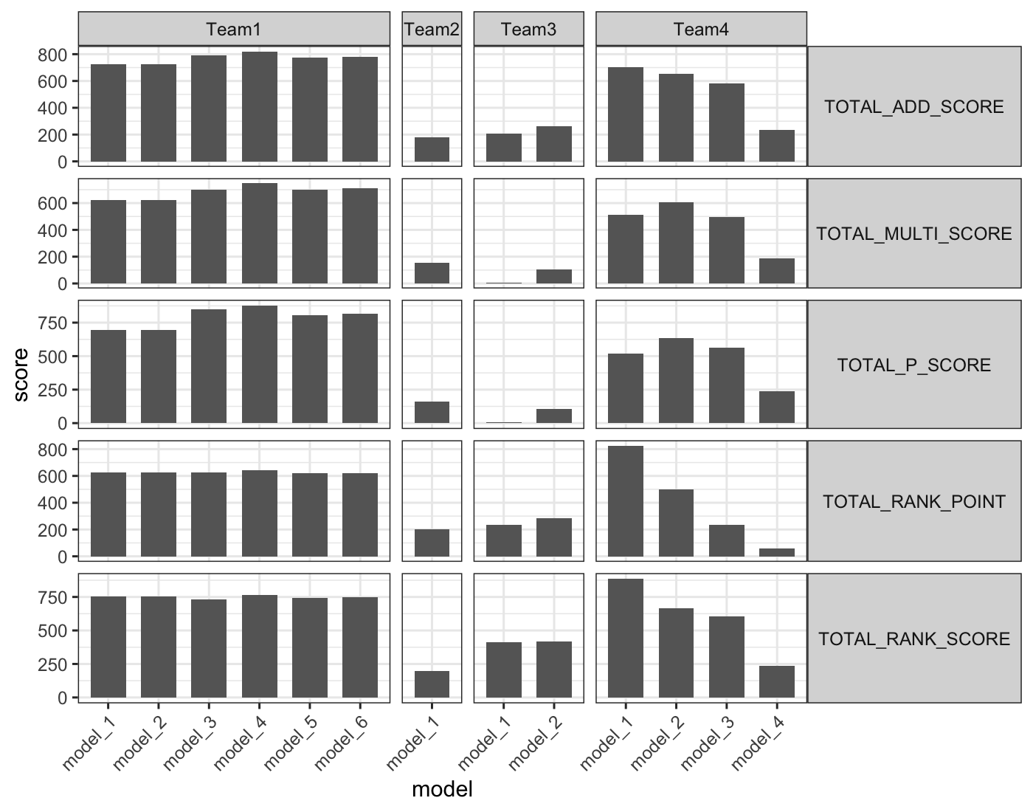
Final scores

Slide 21
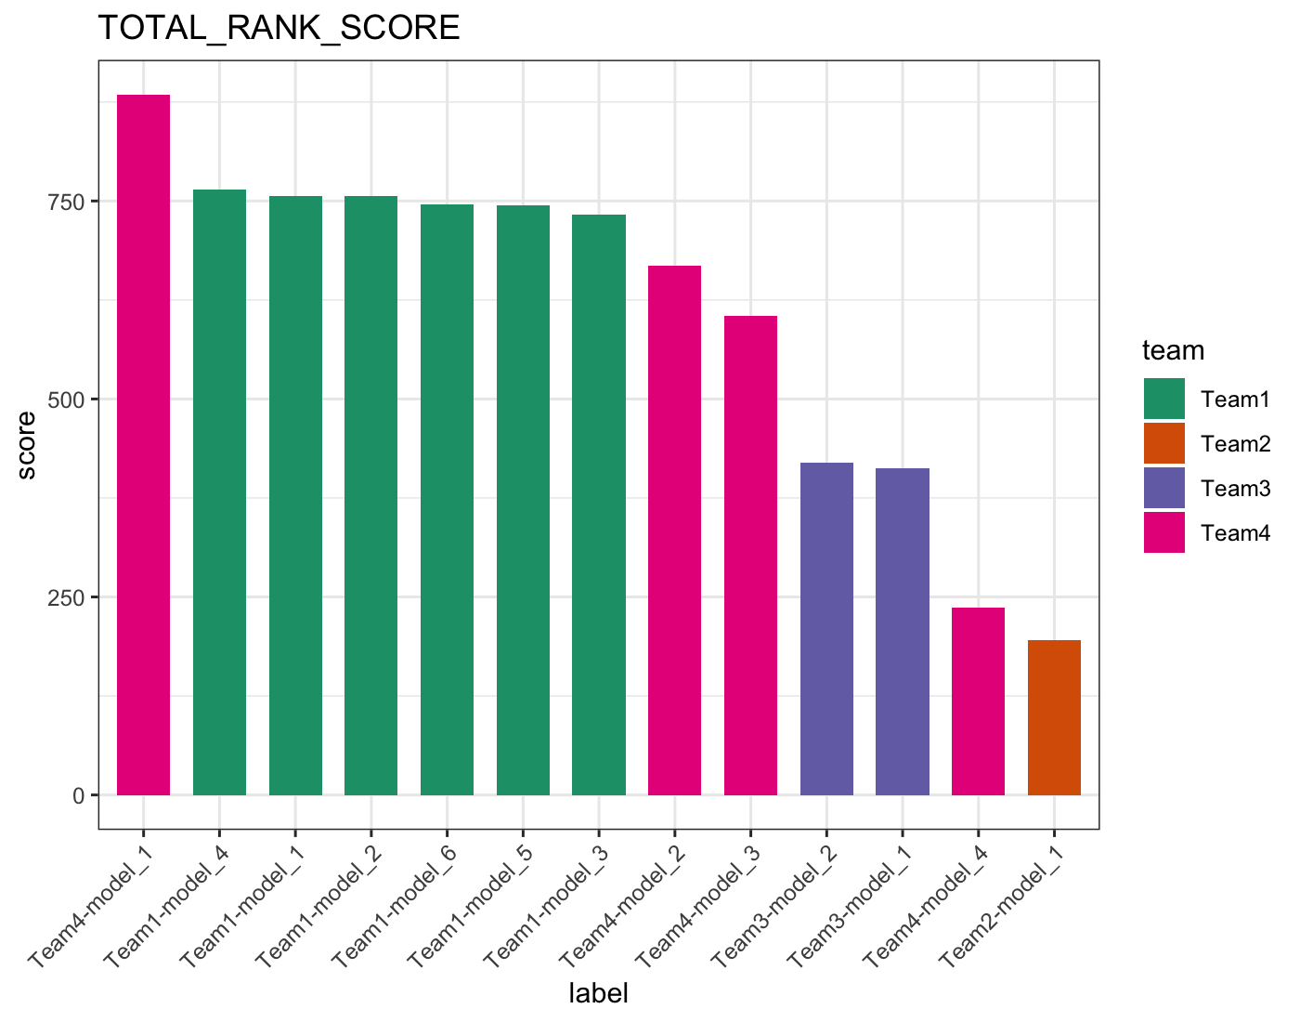
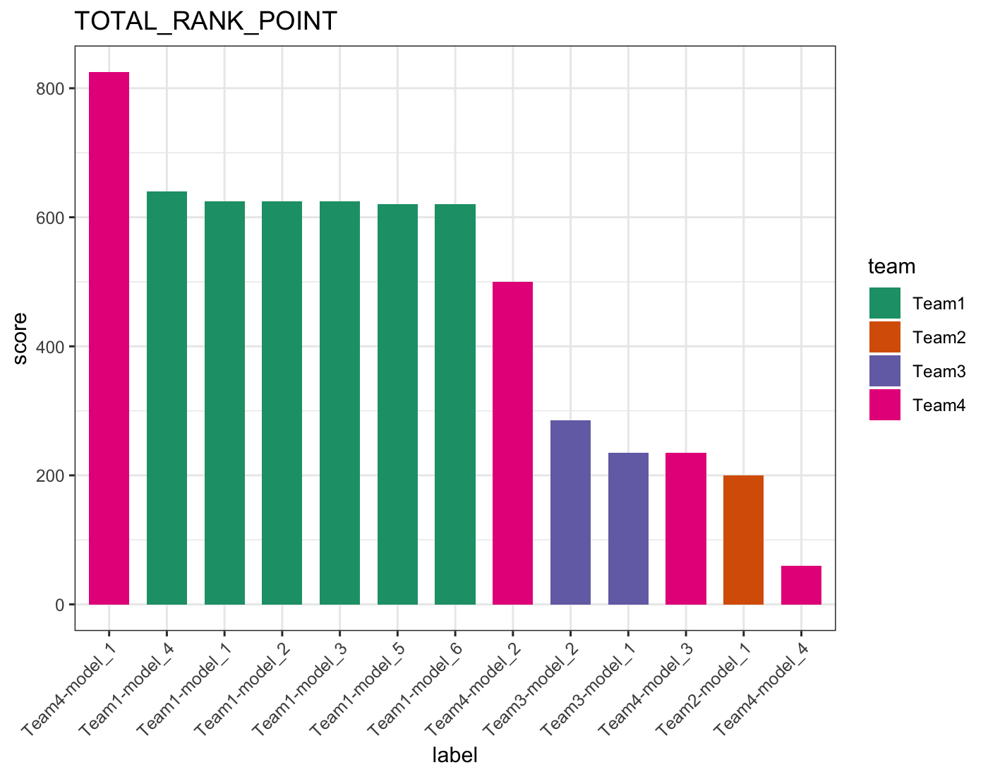

Slide 22
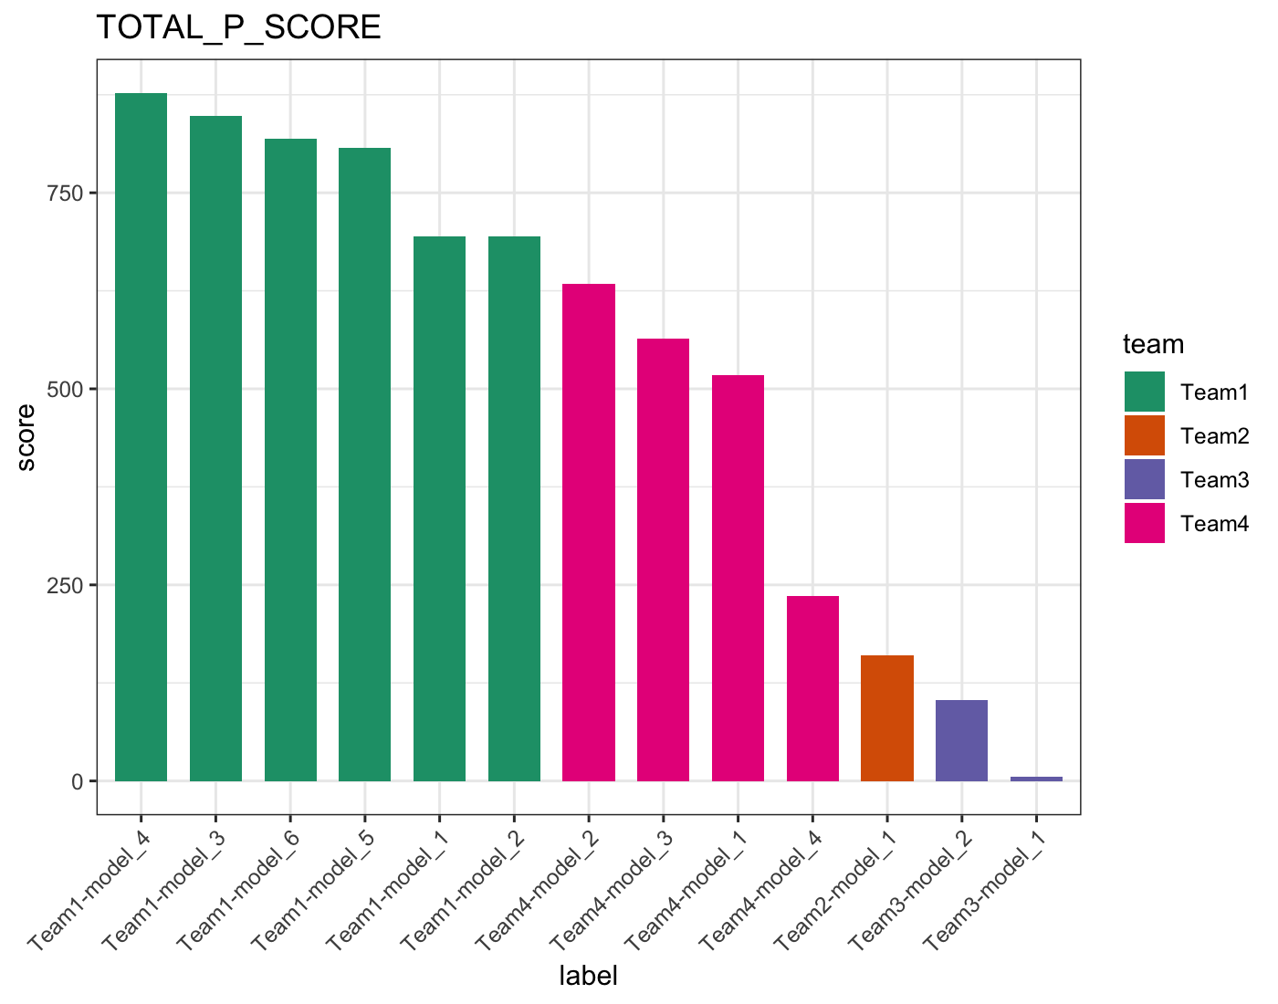

Slide 23
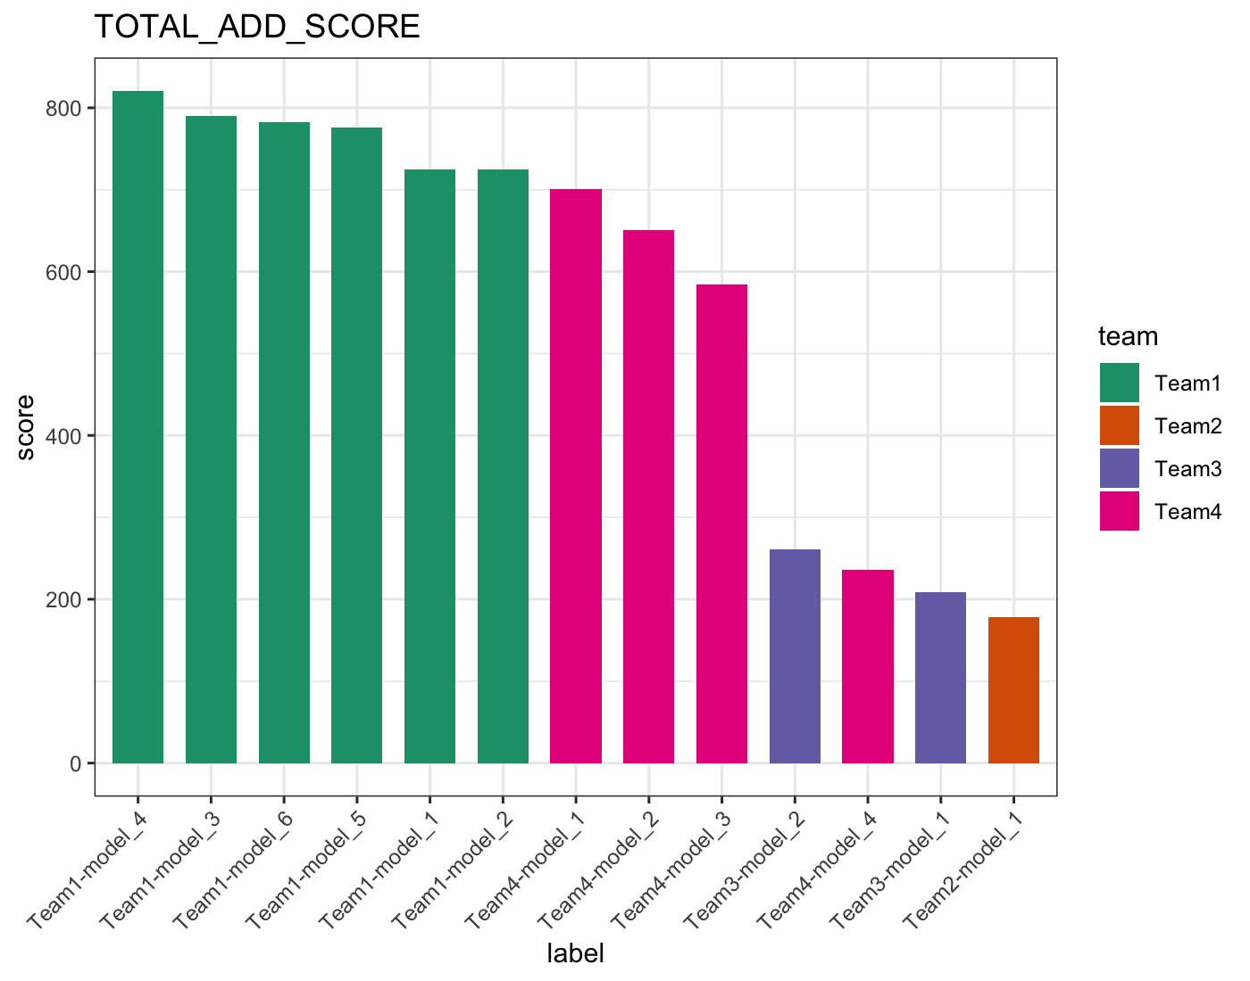
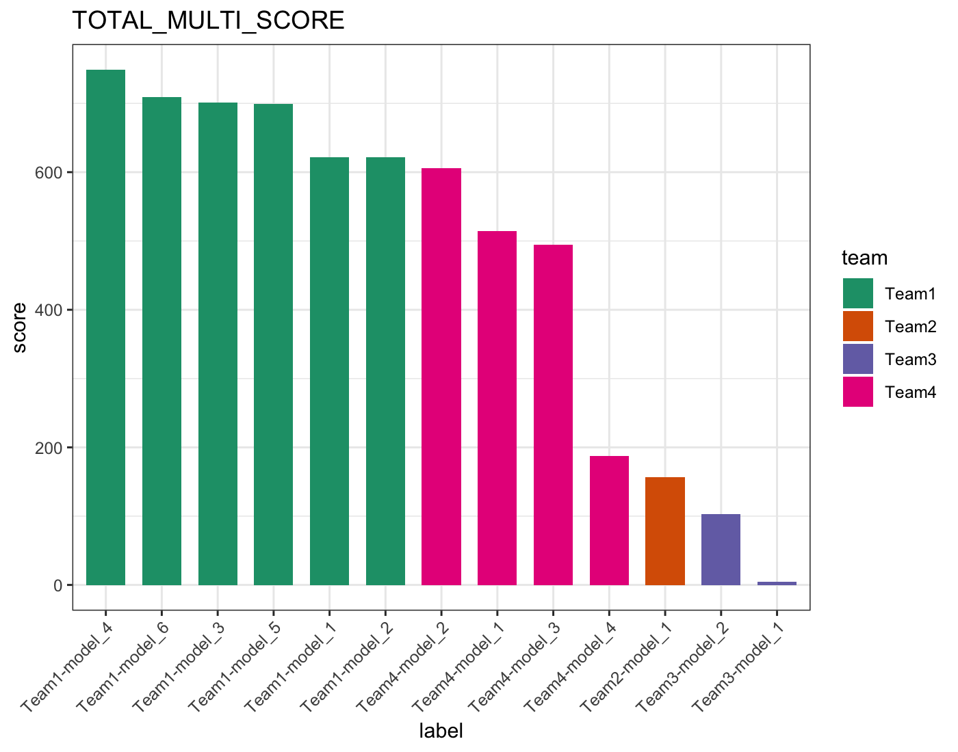

Slide 24
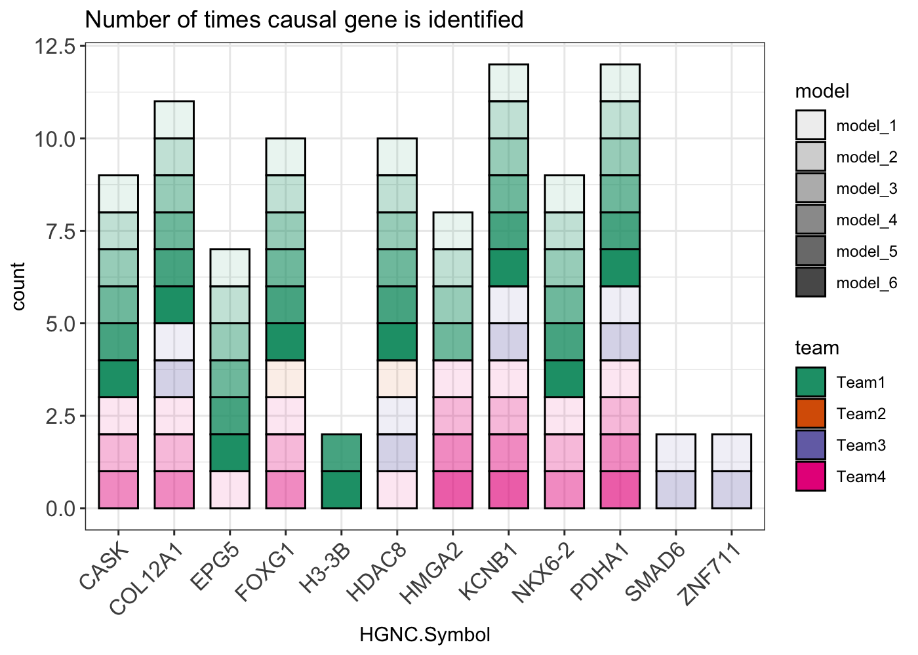
Which genes were identified by which teams?
Two cases not identified by any team

Slide 25
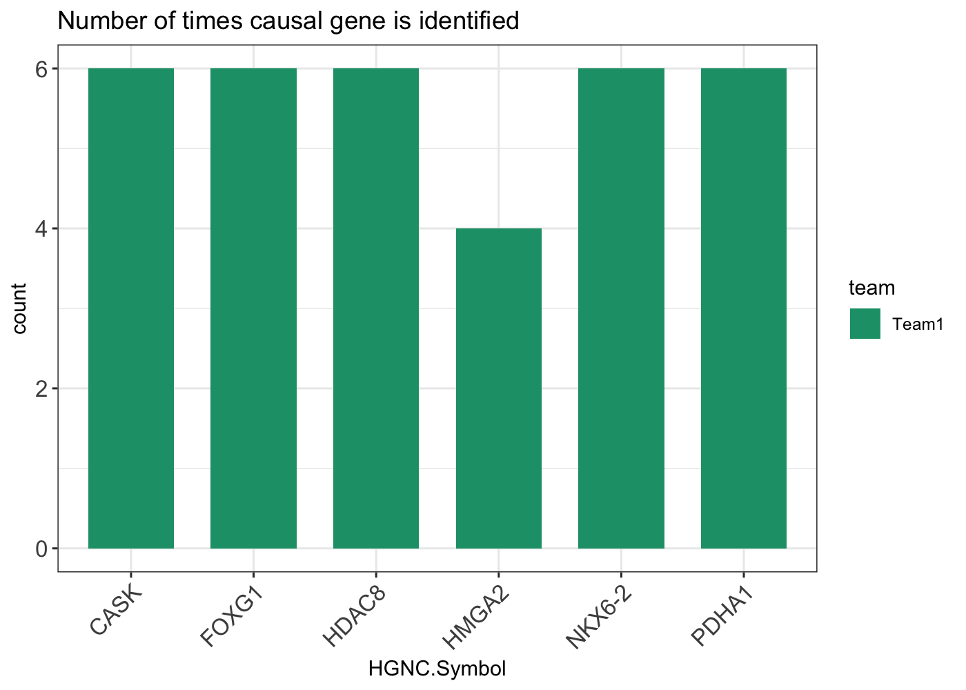
Causal genes identified with RNA evidence

Slide 26
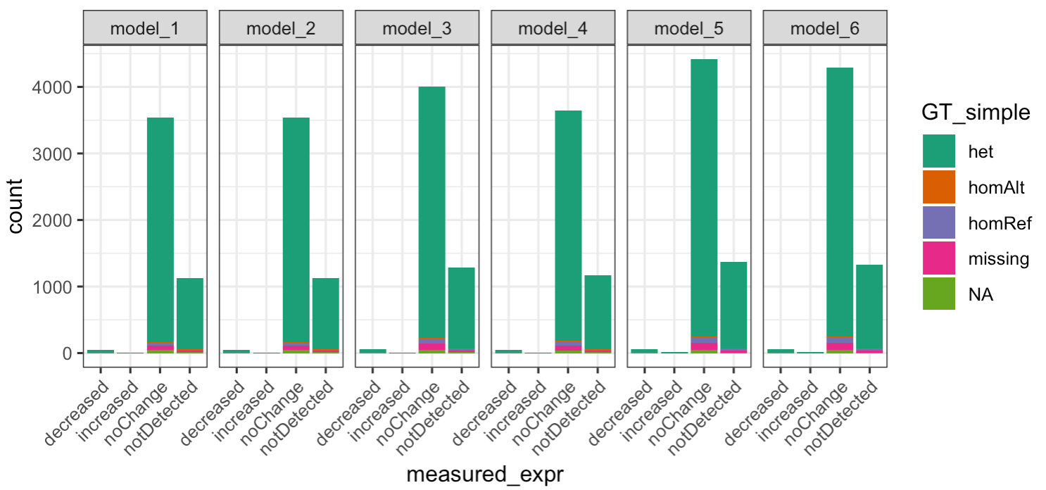
Compare predictions with RNAseq results -- expression
Team1: variants predicted to affect expression are predicted to decrease gene expression
Genotype

Slide 27
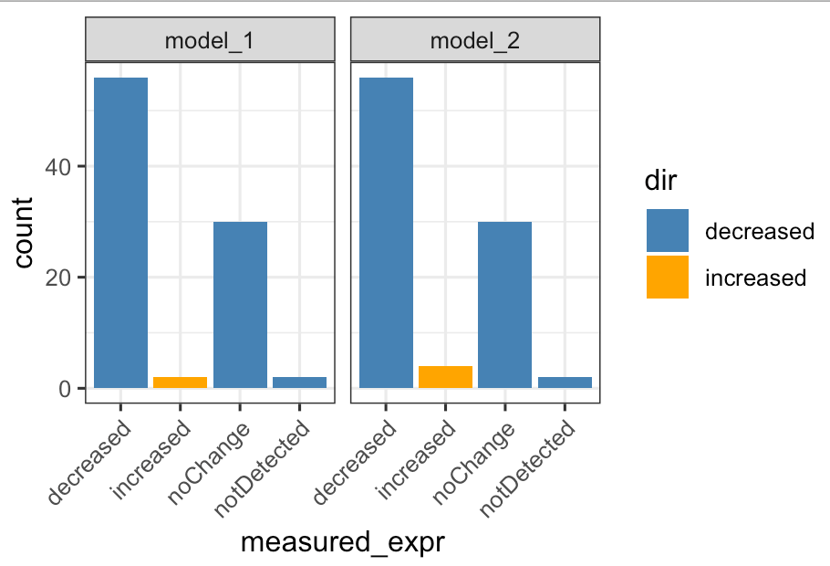
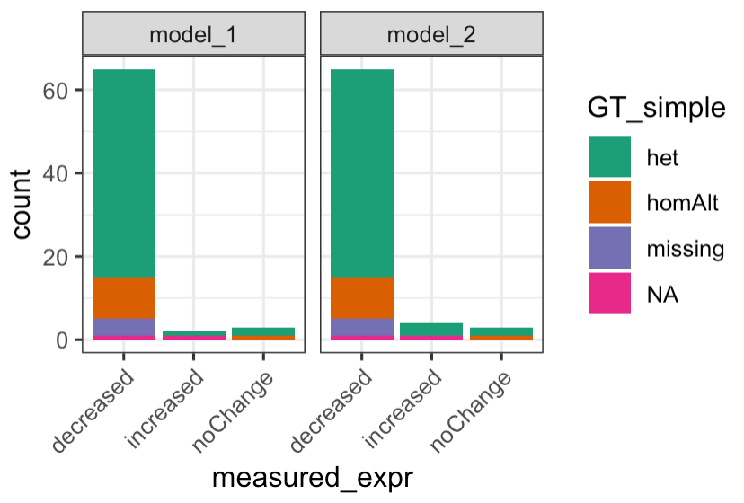
Compare predictions with RNAseq results -- expression
Team3: OUTRIDER with samples + 50 GTEx blood RNAseq data
Team3 report
"No change" and "not detected": due to 2 samples we considered low quality
2 additional genes were not determined as shown decreased expression by our analysis
2 low quality samples filtered out

Slide 28
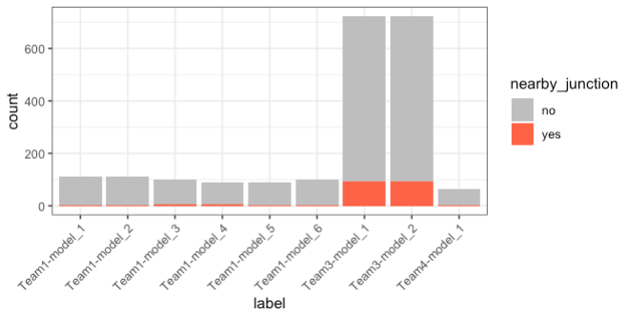
Compare predictions with RNAseq results -- splicing
For each variant that is predicted to cause splicing change, if there is aberrant splicing detected with 50bp of the variant
Num of reported variants

Slide 29
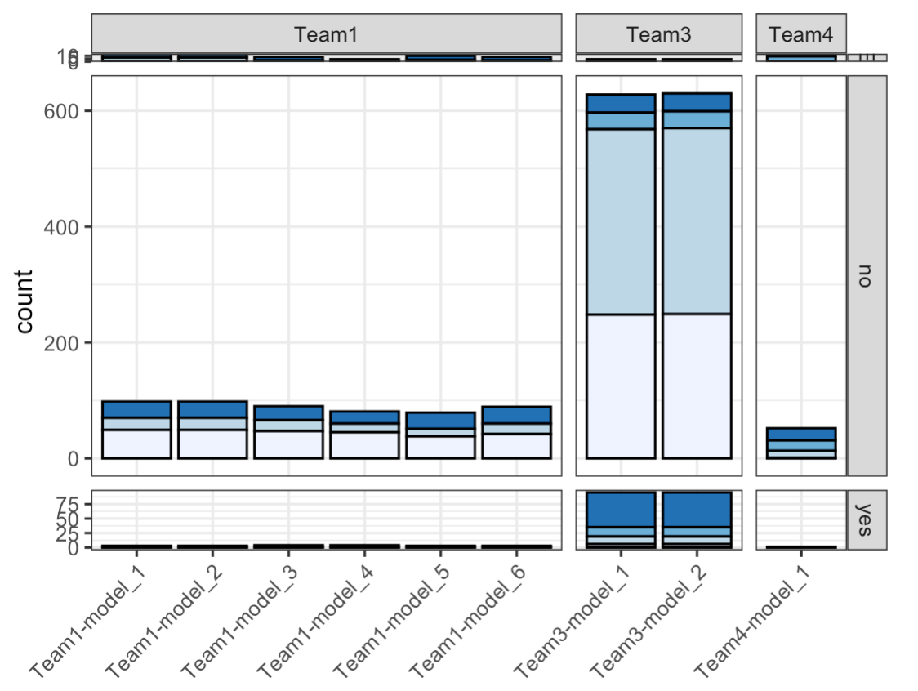
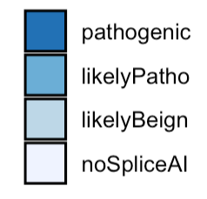
Gene not detected in blood
SpliceAI score
No reported junctions near the variant (within 50bp)
With reported junctions near the variant

Slide 30
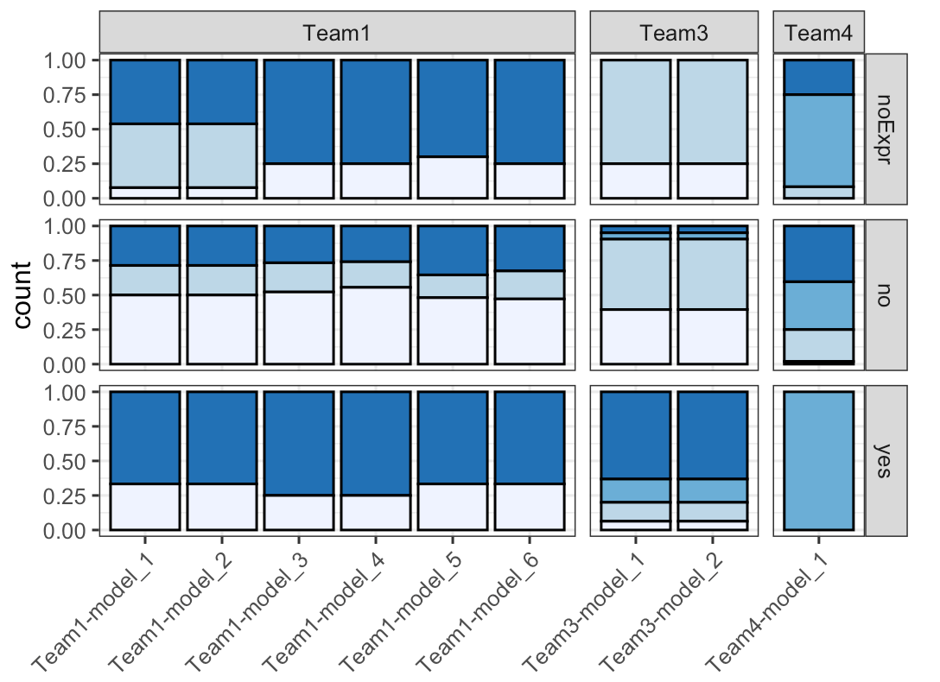
SpliceAI score

Slide 31
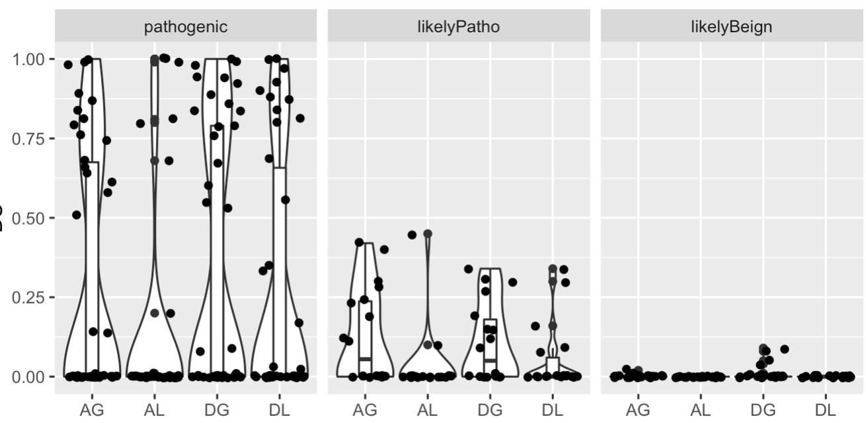
131 variants
predicted to cause splicing changes by team1-model5 or team4-model1
Do not have a reported splicing change nearby
SpliceAI predicted score
SpliceAI predicted change

Slide 32
Summary
Based on RNA positive cases, Team1 identified two expression outliers and Team3 identified one aberrant splicing. However, only Team3 used RNAseq data to identify RNA changes.
Team3 provided the most comprehensive RNA impact description
Based on DNA positive cases, Team4 ranks first when scoring by rank

Slide 33
Conclusions
RNA predictions are helpful but not always accurate
  RNAseq can be helpful to directly assess impact of splice variant
Lessons learned for future challenges:
  Have more RNA positive cases
  More teams participating in challenges AND using the RNAseq data
  Update/be stricter about submission format to be more RNA centric

Slide 34
Discussion
Should P (probability) be considered in scoring:
  likely reported as p value for team3? -- highly ranked genes have very low P
  Penalize scores by P of false positive cases? -- not fair because they were told to rank up to 100
  Scale all P so its comparable?
    Team1 & 4: P ranges from 0-1
    Team2: 0.5-0.8; Team3: 0-0.75
Considering RNA:
  Teams identified RNA cases get extra scores?
  Consider cases with RNA candidates?
Precision recall?
  Have to combine results from all true positive cases to calculate – fair?
Taking methods into account

Slide 35
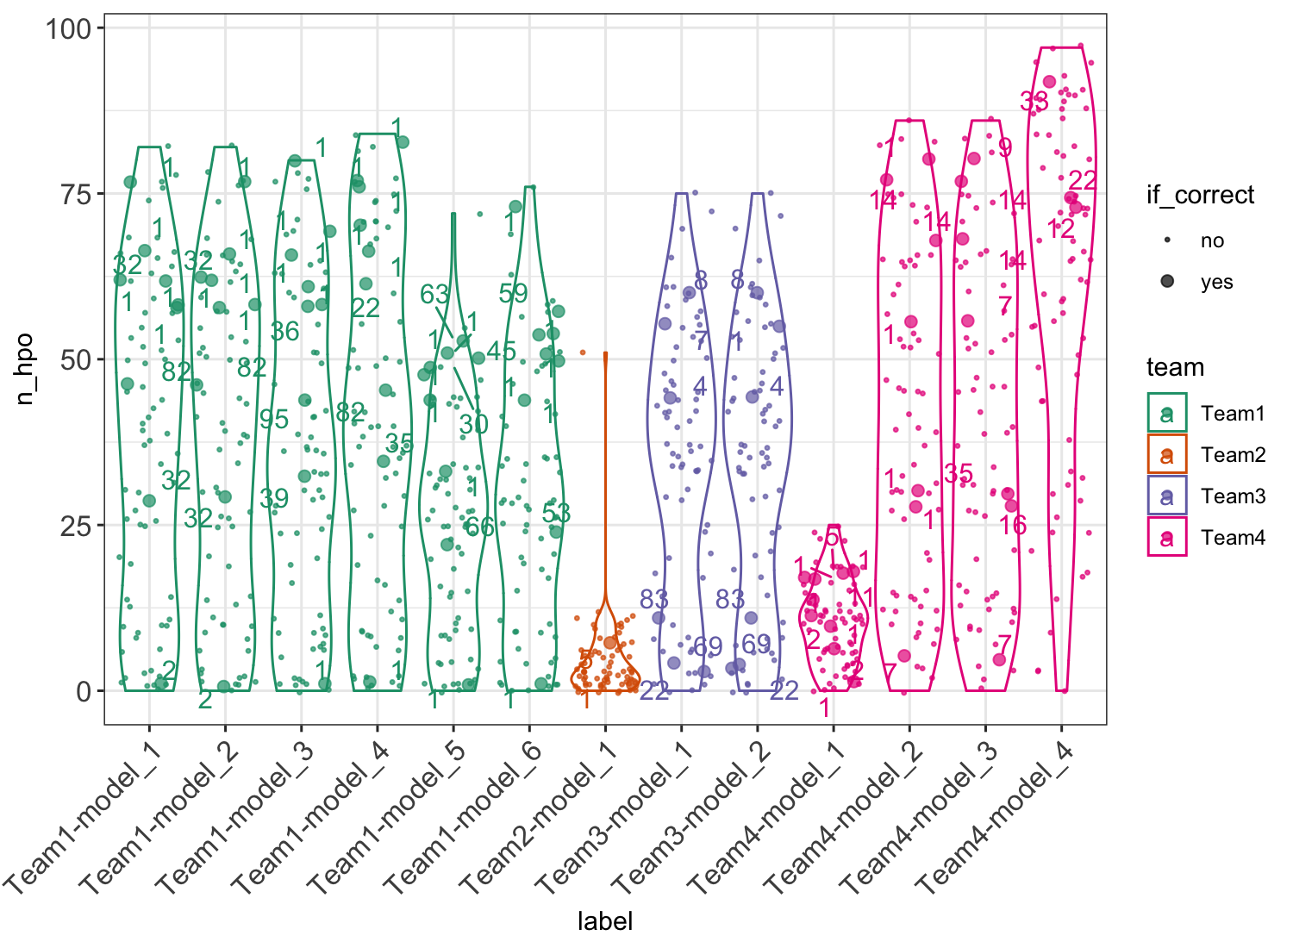
Numbers of reported genes that are associated with relevant HPO terms
Incorporation of clinical information
Each dot is one sample
Samples for which the causal gene was correctly identified are highlighted
Highlighted number showing the ranking of the causal gene by team/model

Slide 36
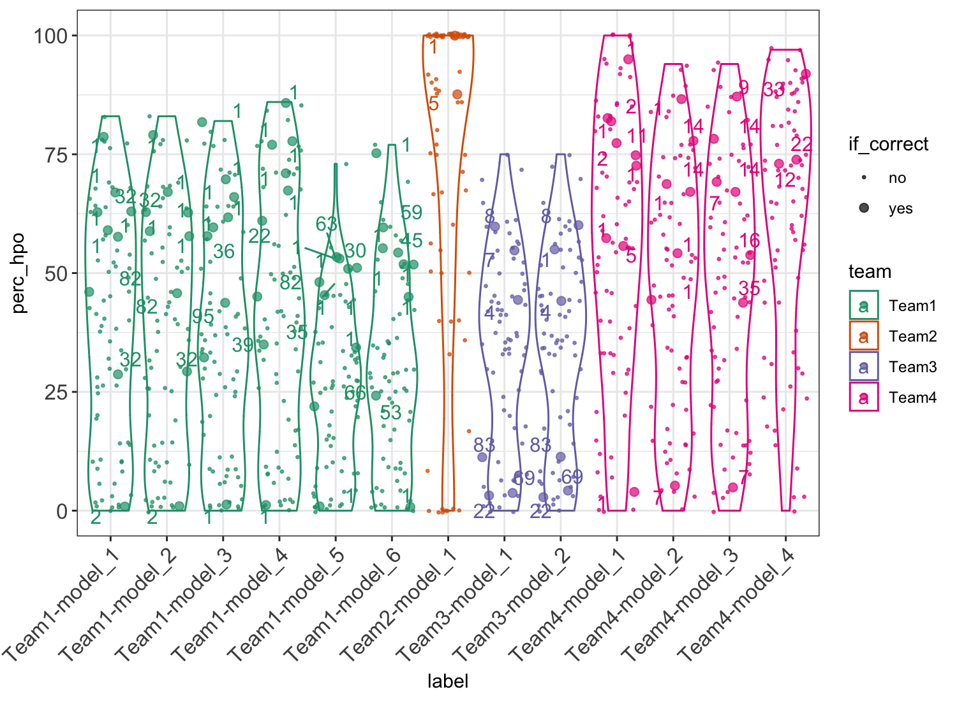
Incorporation of clinical information
Percent of reported genes that are associated with relevant HPO terms
Genes with relevant HPO terms/ total number of genes reported

Slide 37
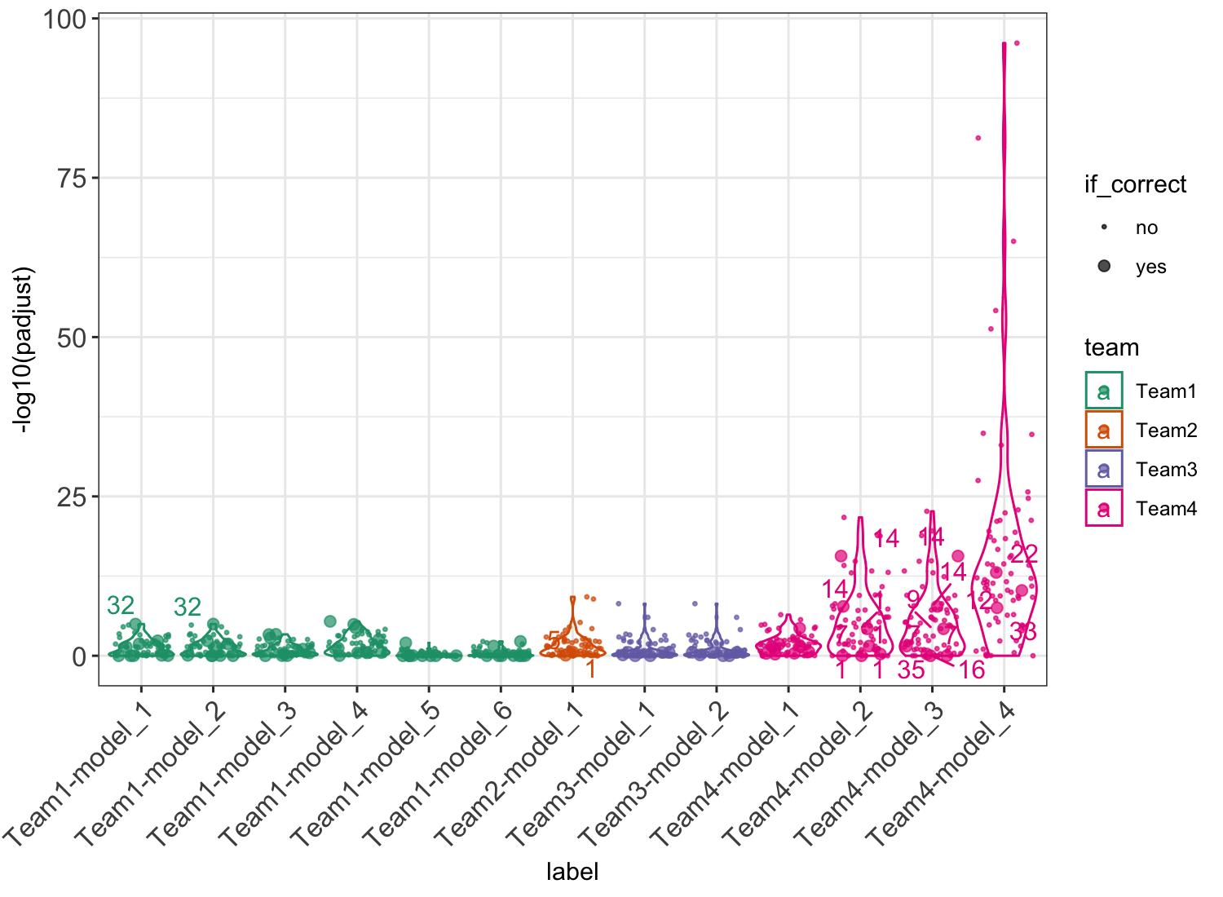
Incorporation of clinical information
Hypergenometric test for over-representation of reported genes with relevant HPO terms (all HPO genes as background)
All teams seem to have considered clinical relevance of hits to some extent

Slide 38
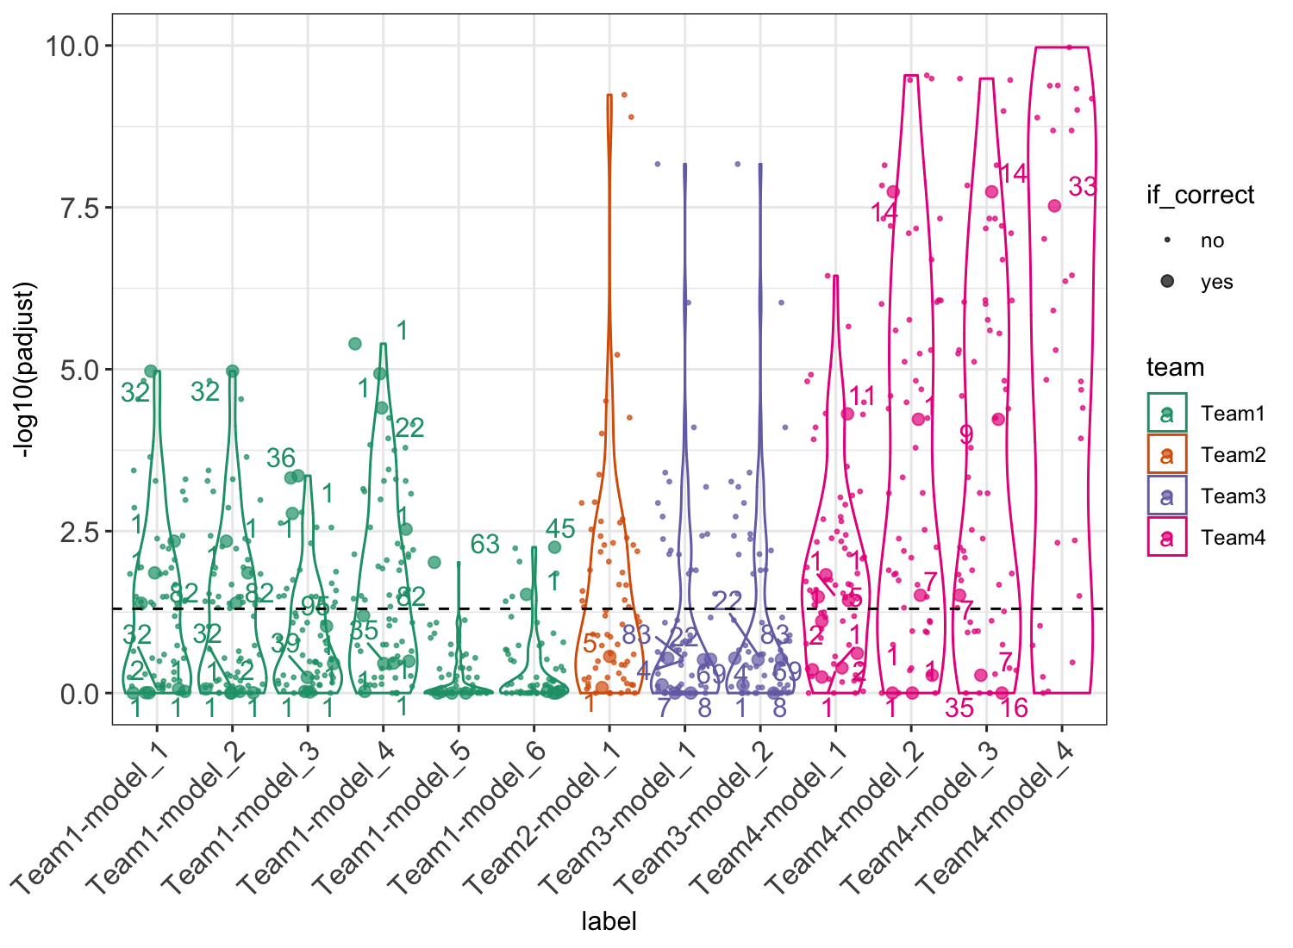
Incorporation of clinical information
Hypergenometric test for over-representation of reported genes with relevant HPO terms (all HPO genes as background)
All teams seem to have considered clinical relevance of hits to some extent

