Slide 1

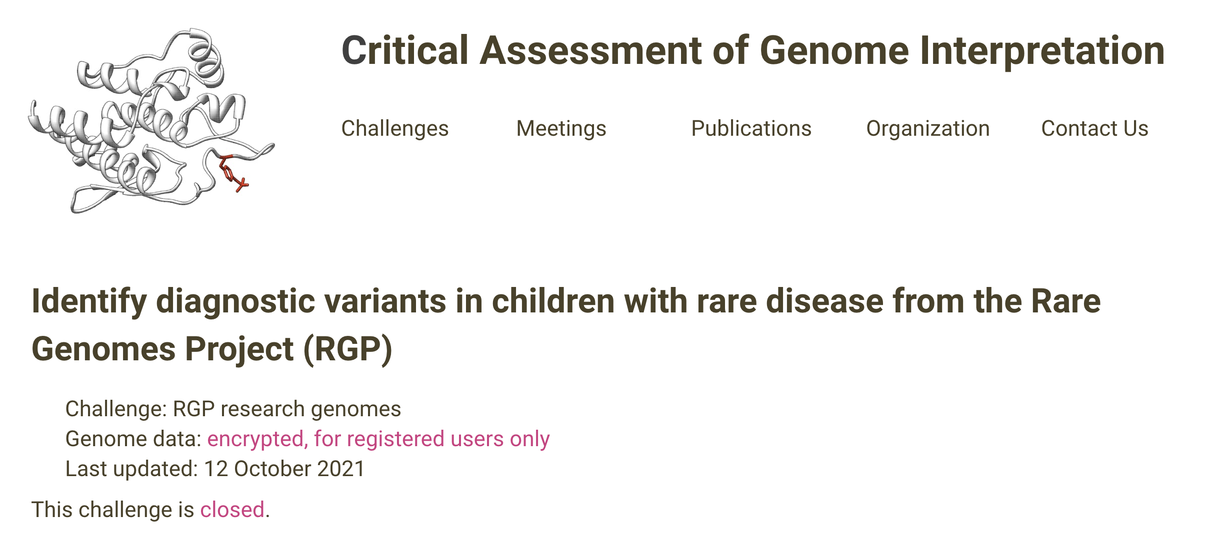



Performance of diagnostic methods in identifying disease-causing variants: assessment of the Rare Genomes Project CAGI challenge
Anne O’Donnell-Luria & Sarah Louise Stenton
Boston Children’s Hospital & Broad Institute of MIT and Harvard
05/15/2022

Slide 2

CAGI slide pack guidelines
I agree to my slides being used according to the following terms:
Anne O’Donnell-Luria, Sarah Louise Stenton
Authors: please include THIS slide at the beginning of your presentation to indicate that you agree with reuse of your slides in CAGI presentations, according to the terms below, and digitally sign by writing your name above.
To disseminate the CAGI results, I encourage all CAGI participants to remix these CAGI slides for inclusion in their oral and poster presentations
CAGI participants may use or publish any content of these slides only in compliance with the CAGI Data Use Agreement
CAGI participants may not cite or publish any content of these slides except with the written permission of the originating author or in the primary CAGI publications
CAGI participants must acknowledge the original authors of these slides and CAGI 6. Include the acknowledgement banner across the bottom
CAGI participants must include the CAGI credits slide in their presentations
Slides with a red slash (no remix) may not be included in a presentation unless all attendees are registered CAGI participants who signed the data use agreement
Slides with a red X over the entire slide may not be used in any circumstances
Slides with a blue slash (embargoed) may not be used unless the embargo is explicitly lifted
Slides without slash or X may be tweeted unless flagged with the “No tweet” icon.
CAGI participants using these slides must explain the “No tweet” icon, which means that the slide content should not be disseminated outside the presenting conference hall. If the presentation venue permits pervasive tweeting, you may not include these slides in your talk
Note for slide authors: we expect all CAGI participants to abide by these restrictions, and will make best effort to ensure they are followed. However, but bear in mind that we have limited means of enforcing them, and therefore the restrictions cannot be guaranteed.

Slide 3
Permission request regarding CAGI 6 recordings and hybrid presentations
I understand that my presentation as associated with CAGI 6 will be recorded and broadcasted via the internet through CAGI’s designated technology provider.
As the copyright holder to this presentation entitled Performance of diagnostic methods in identifying disease-causing variants: assessment of the Rare Genomes Project CAGI challenge, I hereby agree that the copyright for the online broadcast and recording of my presentation be released to CAGI and my recording be uploaded on to the CAGI website.

Slide 4
The challenges of rare disease diagnosis
One major obstacle facing rare disease patients is simply obtaining a genetic diagnosis
The average “diagnostic odyssey” lasts more than five years, and over 60% of patients still lack a genetic diagnosis
While genome sequencing provides coverage of coding and noncoding regions, major obstacle to diagnosis is analytical – how to recognize pathogenic variation within a sea of benign variation
Rare Genomes Project (RGP)
Direct-to-participant research study on the utility of genome sequencing for rare disease diagnosis and gene discovery
Led by genomics experts and clinicians at the Broad Institute of MIT and Harvard
Research subjects are consented for genome sequencing and the sharing of their sequence and phenotype information with researchers working to understand the molecular causes of rare disease
Created for CAGI 6
genomeinterpretation.org
Anne O’Donnell-Luria
Notes:
Anne to update

Slide 5
Overview of the RGP CAGI challenge
https://genomeinterpretation.org/cagi6-rgp.html
…with the idea to put variant pathogenicity prediction models and diagnostic algorithms head-to-head in a “real-life” diagnostic setting
Regulatory: Required additional IRB permission to share data with CAGI and adjust for CAGI further sharing the data, with participants agreeing to delete the data in 1 year (extended to June 2023)
Created for CAGI 6
genomeinterpretation.org
Anne O’Donnell-Luria
Notes:
Anne to update

Slide 6
Design of the RGP CAGI challenge
35 families – training data with causal variants provided
30 families – test data consisted of proband only (2), duos (3), trios (23), quads (2)
14 solved - included to evaluate the performance of each participant's predictive model
16 unsolved - included with the goal of identifying new potentially causal variants
Probands with suspected Mendelian disease
Phenotype provided as Human Phenotype Ontology (HPO) nomenclature
Range 1-9 per proband (median 5)
Diversity represents the range of phenotypes routinely seen in patients referred for genetic testing
HPO extraction from medical records
Genome sequencing performed at the Broad Institute on an Illumina sequencer at ~30x depth
Raw sequence reads reassembled against GRCh38 with variant calling by GATK
Variant calls in the form of SNVs and indels (no structural variants) provided within a joint vcf
DNA purified from blood for genetic analysis
Aim: participants asked to provide a molecular diagnosis for as many probands as possible i.e., to identify one or more causal variants per proband
Created for CAGI 6
genomeinterpretation.org
Anne O’Donnell-Luria
Notes:
Anne to update

Slide 7
Selection of solved “ground truth” cases
Consider evidence driven by the ACMG/AMP guidelines (Richards et al. 2015, Genetics in Medicine)
all variants fall in established Mendelian disease genes
all were absent from ClinVar
majority of variants were classified as P/LP (12/14) by ACMG/AMP, two were VUS (2/14)
Prioritized variants were discussed in an MDT of physicians, genetic counselors, analysts, and molecular geneticists
all in agreement to return the result to the patient following CLIA confirmation
received agreement from patient’s physician
Created for CAGI 6
genomeinterpretation.org
Anne O’Donnell-Luria
Notes:
Anne to update

Slide 8
Selection of solved “ground truth” families
De Novo/ Dominant Restrictive:
Inheritance: De Novo/ Dominant
Pathogenicity: ClinVar Pathogenic/ Likely Path (gnomAD AF <0.05) + HGMD disease causing
Annotations: PTV (nonsense, frameshift, canonical splice site) + Missense + Extended Splice Site
Frequency: gnomAD genomes AF: <=0.001 gnomAD exomes AF: <=0.001 Callset AF: 0.01
Location: None
Call Quality: Pass Variants Only GQ 40 AB 20
De Novo/ Dominant Permissive:
Inheritance: De Novo/ Dominant
Pathogenicity: Pathogenic/Likely Path. (gnomAD popmax AF <0.05) + Clinvar VUS or Conflicting + HGMD DM
Annotations: All rare coding variants, SpliceAI >0.1
Frequency: gnomAD genomes AF: <=0.001, gnomAD exomes AF: <=0.001, Callset AF: <=0.01
Location: None
Call Quality: Show all variants GQ 40 AB 10

Slide 9
Selection of solved “ground truth” families
Recessive Restrictive:
Inheritance: Recessive
Pathogenicity: Pathogenic/ Likely Path. ClinVar (gnomAD AF <0.05) + HGMD DM
Annotations: PTV, Missense, extended splice site, SpliceAI score >0.2
Frequency: gnomAD genomes AF: <=0.01 gnomAD exomes AF: <=0.01 Callset AF: <=0.03
Location: None
Call Quality: Pass Variants only GQ 40 AB 20
Recessive Permissive:
Inheritance: Recessive
Pathogenicity: Pathogenic/ Likely Path. ClinVar (gnomAD AF <0.05) + HGMD DM
Annotations: All rare coding variants, SpliceAI >0.1
Annotations (second hit): PTV, Missense, In frame indel
Frequency: gnomAD genomes AF: <=0.01 gnomAD exomes AF: <=0.01 Callset AF: <=0.03
Location: None
Call Quality: Pass Variants only GQ 40 AB 10
Depending on the phenotype a more permissive search on a specific gene list may have been run

Slide 10
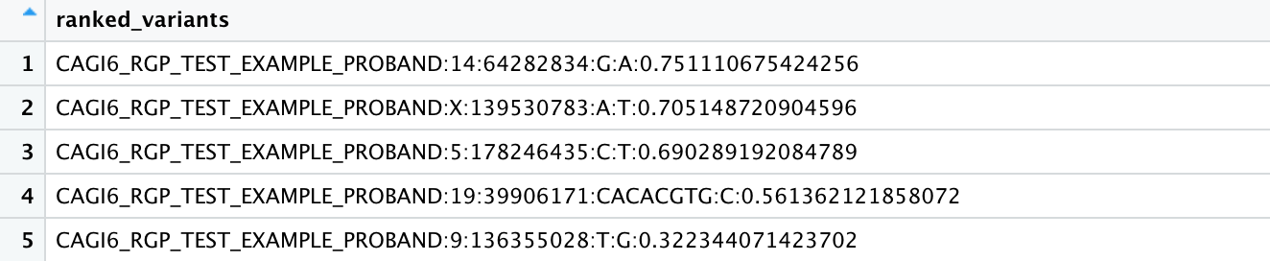
RGP CAGI challenge entry format
Participants submitted a ranked list of maximum 100 variants per proband
Proposed single or biallelic variants
proband identifier
variant
estimated probability of causal relationship (real number, 0 to 1, indicating the degree of certainty)
Variants ranked by the estimated probability of causal relationship value
(example data)
Created for CAGI 6
genomeinterpretation.org
Sarah L. Stenton

Slide 11
RGP CAGI challenge participant summary
16 teams entered the challenge across academia and industry
52 models submitted in total, one primary model per team (indicated as model 1)
Models per team | 1-6 (median 3)
Predictions per proband per model | 0-100 (median 100)
Estimated probability of causal relationship values | 0-1 (median 0.32)
Submitted variants
single versus biallelic | 90% single, 10% biallelic 5/16 teams made single variant predictions only
known disease causing versus novel gene | 53% known disease genes, 47% potential novel disease gene 2/16 teams only included known disease genes
coding and splice versus non-coding | 85% coding and splice region, 15% non-coding 2/16 teams only included coding and splice variants
Created for CAGI 6
genomeinterpretation.org
Sarah L. Stenton

Slide 12
RGP CAGI challenge objectives
Objective 1: utilize the 14 solved cases to assess each model’s ability to identify the causal variant(s)
Objective 2: explore the 16 unsolved cases in search of additional diagnoses
Created for CAGI 6
genomeinterpretation.org
Sarah L. Stenton

Slide 13
Overview of the solved cases
Family | HPO n | HPO IC | Gene | Variant(s) | Inheritance | Variant class | Sequencing type | ACMG
F28 | 4 | 27.1 | FGFR2 | chr10:g.121517378C>T | de novo | missense | trio, unaffected parents | P
F11 | 4 | 33.4 | TPM2 | chr9:g.35685677T>A | AD | missense | proband only | VUS
F04 | 5 | 32.6 | NALCN | chr13:g.101229500C>A | de novo | missense | trio, unaffected parents | LP
F07 | 5 | 42.7 | EHMT1 | chr9:g.137743969AG>A | de novo | frameshift | trio, unaffected parents | LP
F02 | 5 | 38.6 | FAM111B | chr11:g.59125977G>C | AD | missense | proband only | LP
F24 | 7 | 59.8 | KMT2D | chr12:g.49054901T>C | de novo | missense | trio, unaffected parents | LP
F21 | 3 | 21.8 | BICC1 | chr10:g.58813842T>C | de novo | missense | trio, unaffected parents | LP
F22 | 6 | 47.6 | GRIN2A | chr16:g.9764502C>T | unknown | nonsense | duo, unaffected mother | P
F23 | 6 | 43.1 | GNAI1 | chr7:g.80212805G>C | de novo | missense | trio, unaffected parents | LP
F16 | 9 | 68.9 | DLG4 | chr17:g.7190808AC>A | de novo | frameshift | trio, unaffected parents | LP
F27 | 1 | 9.4 | TUBB8 | chr10:g.47353T>C | AD | missense | quad with affected sibling | VUS
F19 | 8 | 65.4 | CLTC | chr17:g.59664785AG>A | de novo | frameshift | trio, unaffected parents | LP
F05 | 7 | 55.5 | PI4KA | chr22:g.20726493C>T; 20799245G>A | AR | nonsense; missense | duo, unaffected father | P; LP
F06 | 8 | 63.3 | KCND2 | chr7:g.120732994C>G | unknown | missense | duo, unaffected father | LP
Detection rate
Created for CAGI 6
genomeinterpretation.org
Sarah L. Stenton

Slide 14
Selection of assessment methods
Two independent methods selected to assess:
(1) How highly the models ranked the true causal variants
(2) How confidently the models made the predictions
Final performance ranking: mean rank of the two methods
Created for CAGI 6
genomeinterpretation.org
Sarah L. Stenton

Slide 15
Method 1. Point allocation based on the prioritization of causal variants
Implemented a weighted scoring system for occurrence of the correct diagnosis in the top 5, 10, 20, 50, or 100 ranked variants
14 solved cases for evaluation > maximum 1,400 points to be gained
Rank of the causative variant | Rank score
Top 5 | 100
Top 10 | 50
Top 20 | 25
Top 50 | 10
Top 100 | 5
Variant not listed | 0
Created for CAGI 6
genomeinterpretation.org
Sarah L. Stenton

Slide 16
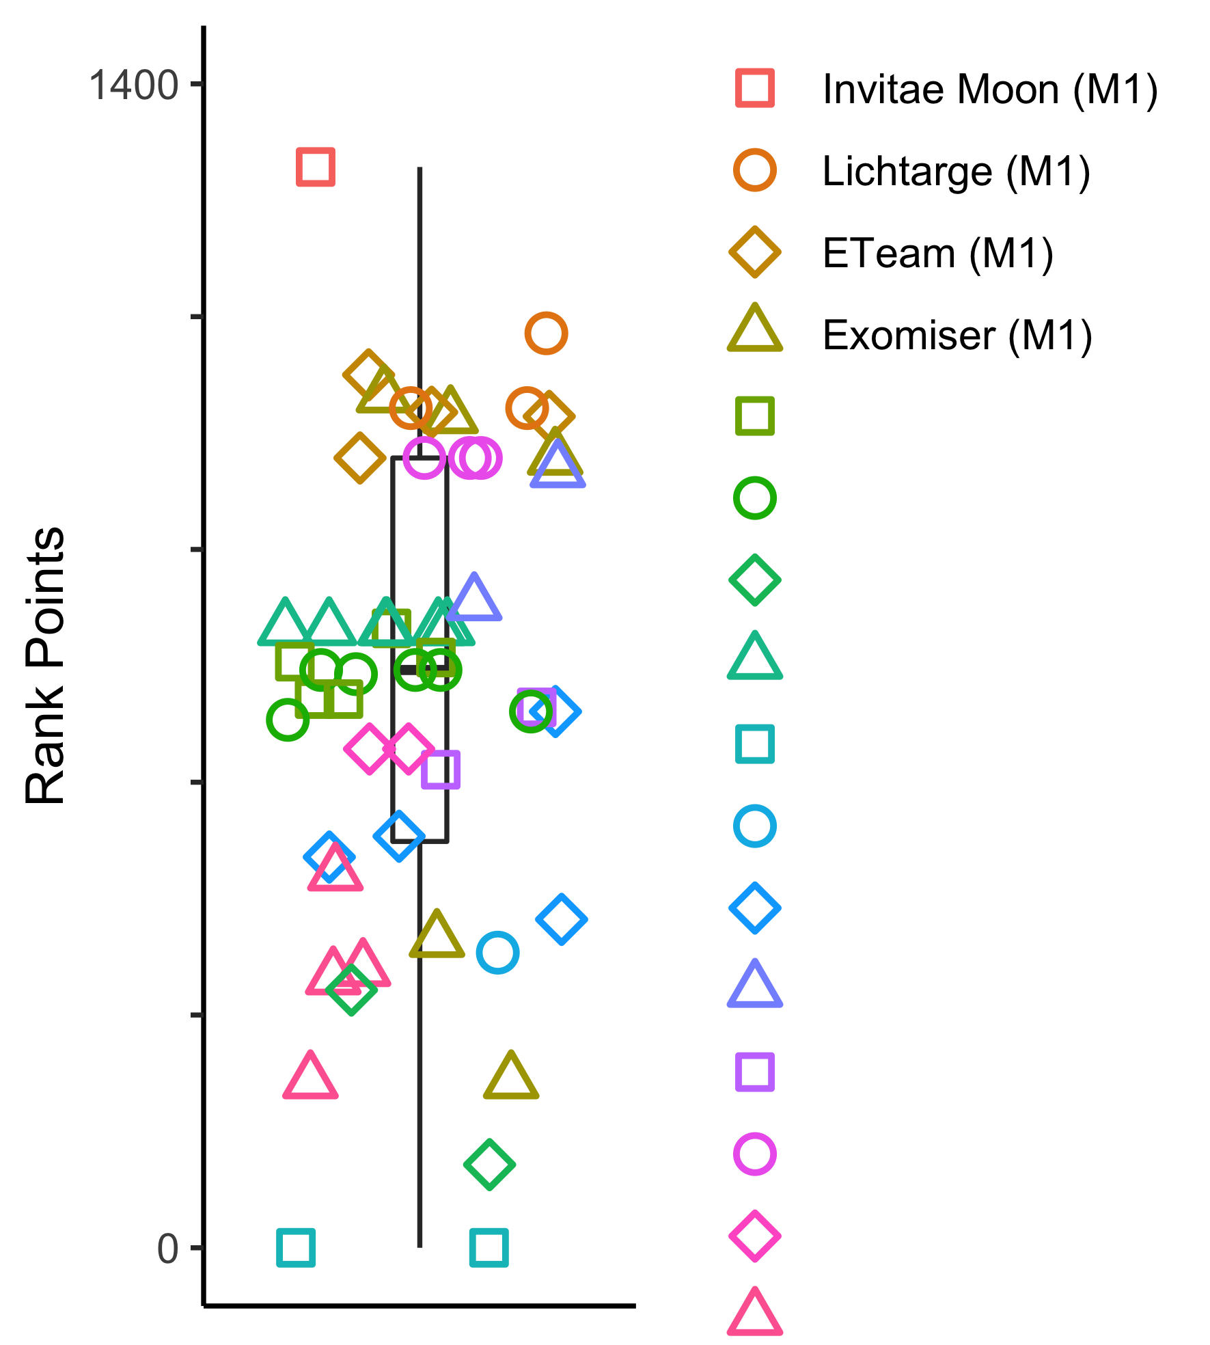
Result 1. Point allocation based on the prioritization of causal variants
Total scores ranged from 0 - 1,300 (mean 695)
Team | Model | Total rank score | Rank 1 | Rank 3 | Rank 5 | Rank 10 | Rank 20 | Rank 50 | Rank 100
Invitae Moon | 1 | 1300 | 9 | 12 | 13 | 13 | 13 | 13 | 13
Lichtarge | 1 | 1100 | 8 | 9 | 11 | 11 | 11 | 11 | 11
ETeam | 1 | 1050 | 7 | 8 | 10 | 11 | 11 | 11 | 11
Exomiser | 1 | 1025 | 6 | 9 | 9 | 11 | 12 | 12 | 12
 |  | 200 | 1 | 1 | 2 | 2 | 2 | 2 | 2
 |  | 200 | 1 | 1 | 2 | 2 | 2 | 2 | 2
 |  | 100 | 1 | 1 | 1 | 1 | 1 | 1 | 1
 |  | 0 | 0 | 0 | 0 | 0 | 0 | 0 | 0
 |  | 0 | 0 | 0 | 0 | 0 | 0 | 0 | 0
The most successful team identified the correct diagnosis for 13/14 probands in top 5
One diagnosis was missed in BICC1, possibly due to “susceptibility to” status in OMIM
Created for CAGI 6
genomeinterpretation.org
Sarah L. Stenton

Slide 17
Result 1. Point allocation based on the prioritization of causal variants
ID | HPO IC | Gene | Inheritance | Variant | Sequencing type | ACMG | 1 | 3 | 5 | 10 | 20 | 50 | 100
F28 | 27.1 | FGFR2 | de novo | missense | trio, unaffected parents | P | 35 | 45 | 45 | 45 | 46 | 46 | 46
F11 | 33.4 | TPM2 | AD | missense | proband only | VUS | 17 | 33 | 39 | 40 | 43 | 46 | 46
F04 | 32.6 | NALCN | de novo | missense | trio, unaffected parents | LP | 27 | 34 | 37 | 39 | 40 | 44 | 46
F07 | 42.7 | EHMT1 | de novo | frameshift | trio, unaffected parents | LP | 27 | 33 | 33 | 35 | 36 | 37 | 39
F02 | 38.6 | FAM111B | AD | missense | proband only | LP | 15 | 23 | 26 | 32 | 34 | 40 | 40
F24 | 59.8 | KMT2D | de novo | missense | trio, unaffected parents | LP | 9 | 18 | 19 | 28 | 30 | 34 | 34
F21 | 21.8 | BICC1 | de novo | missense | trio, unaffected parents | LP | 3 | 17 | 21 | 24 | 27 | 32 | 35
F22 | 47.6 | GRIN2A | unknown | nonsense | duo, unaffected mother | P | 6 | 9 | 19 | 23 | 32 | 33 | 33
F23 | 43.1 | GNAI1 | de novo | missense | trio, unaffected parents | LP | 14 | 19 | 19 | 19 | 21 | 29 | 31
F16 | 68.9 | DLG4 | de novo | frameshift | trio, unaffected parents | LP | 10 | 17 | 18 | 22 | 23 | 24 | 25
F27 | 9.4 | TUBB8 | AD | missense | quad with affected sibling | VUS | 9 | 12 | 15 | 17 | 19 | 20 | 20
F19 | 65.4 | CLTC | de novo | frameshift | trio, unaffected parents | LP | 8 | 11 | 13 | 15 | 16 | 17 | 17
F05 | 55.5 | PI4KA | AR | nonsense; missense | duo, unaffected father | P; LP | 6 | 7 | 9 | 12 | 12 | 15 | 18
F06 | 63.3 | KCND2 | unknown | missense | duo, unaffected father | LP | 0 | 1 | 3 | 5 | 12 | 22 | 26
Detection rate
Created for CAGI 6
genomeinterpretation.org
Sarah L. Stenton

Slide 18
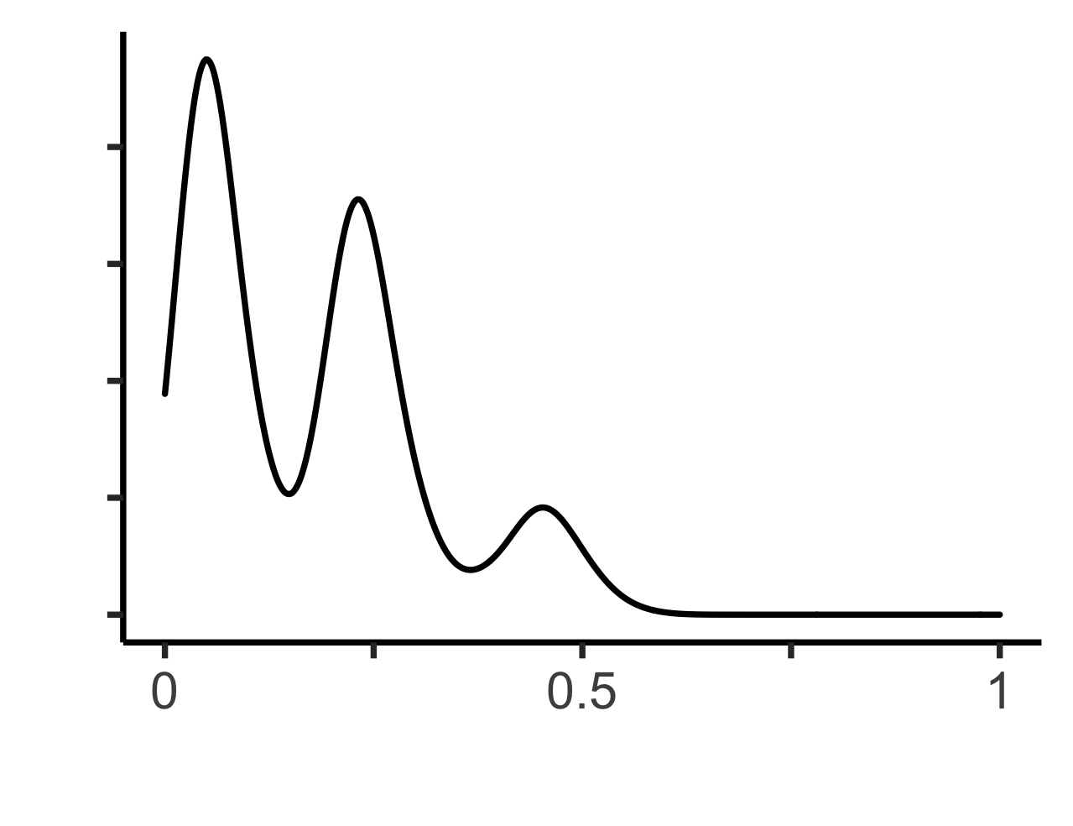
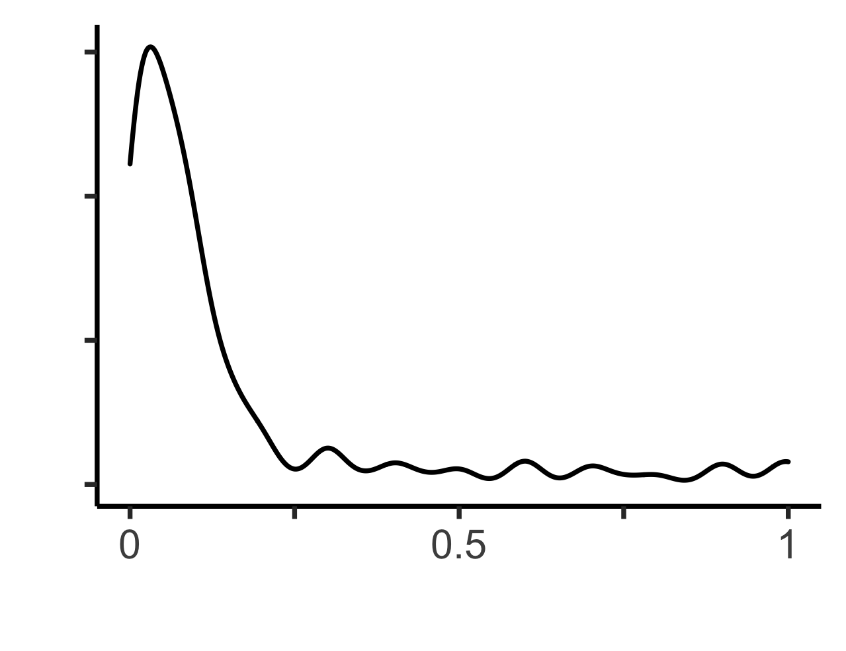
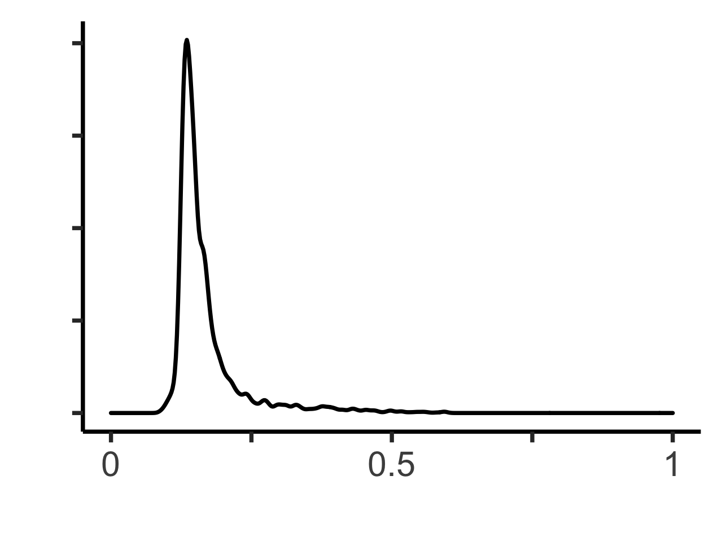
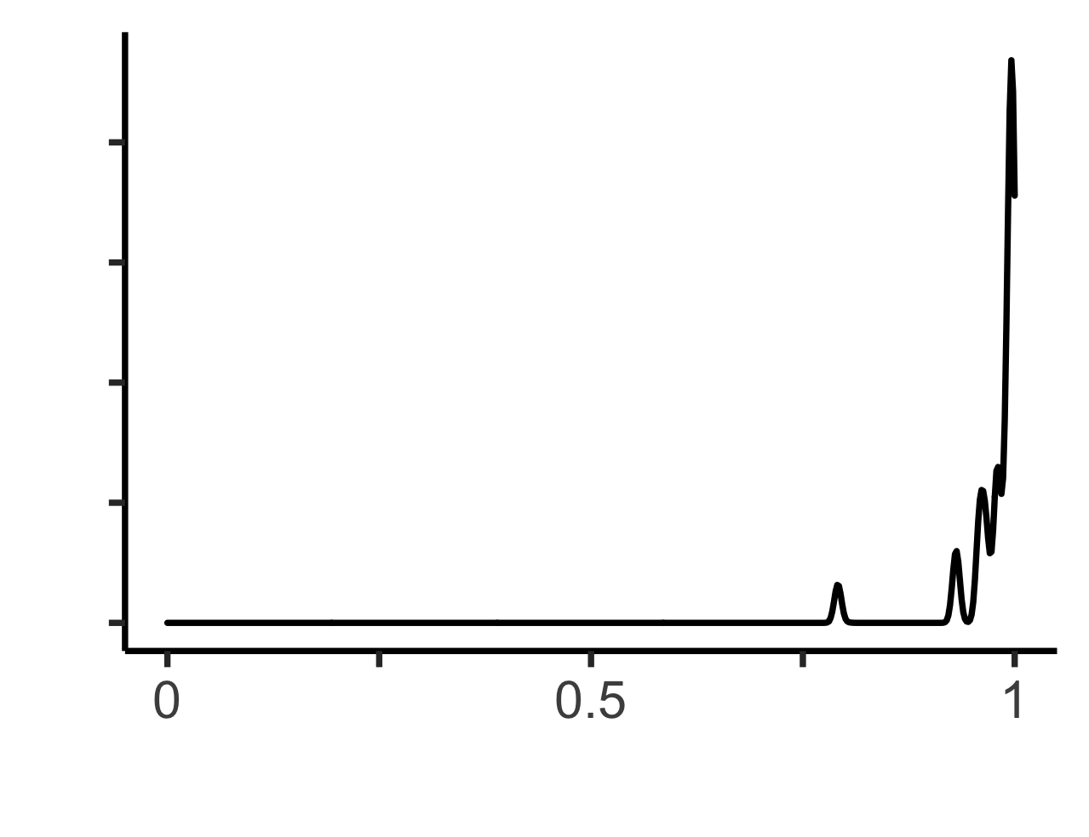
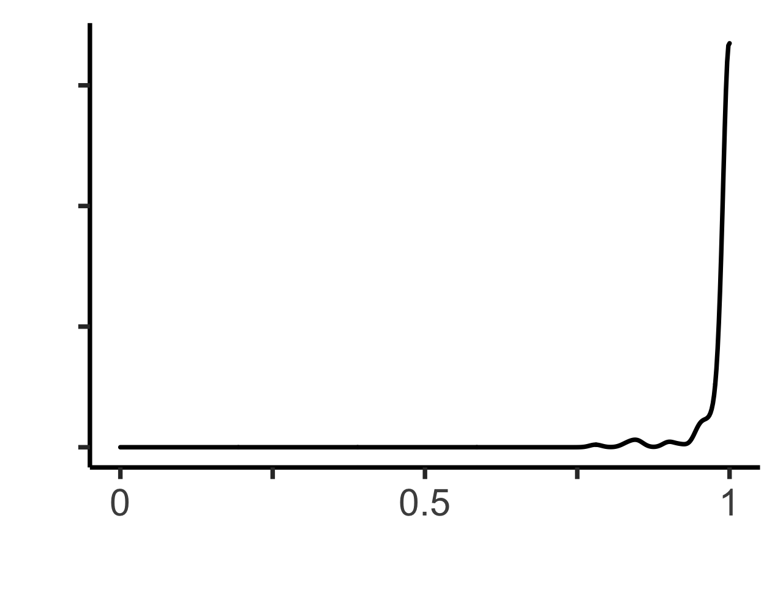
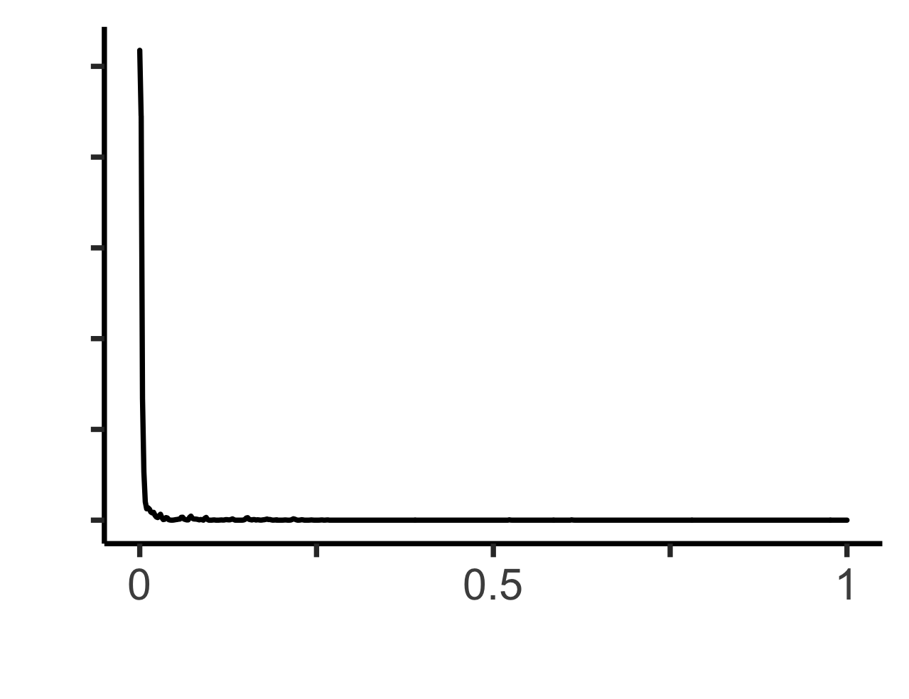
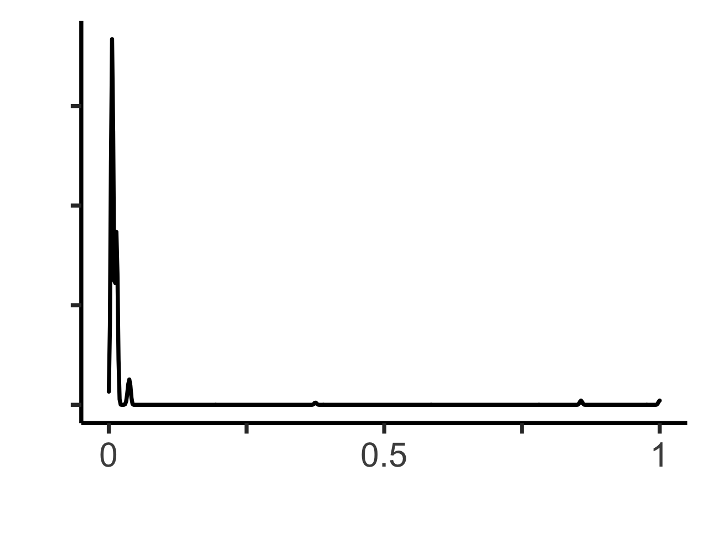
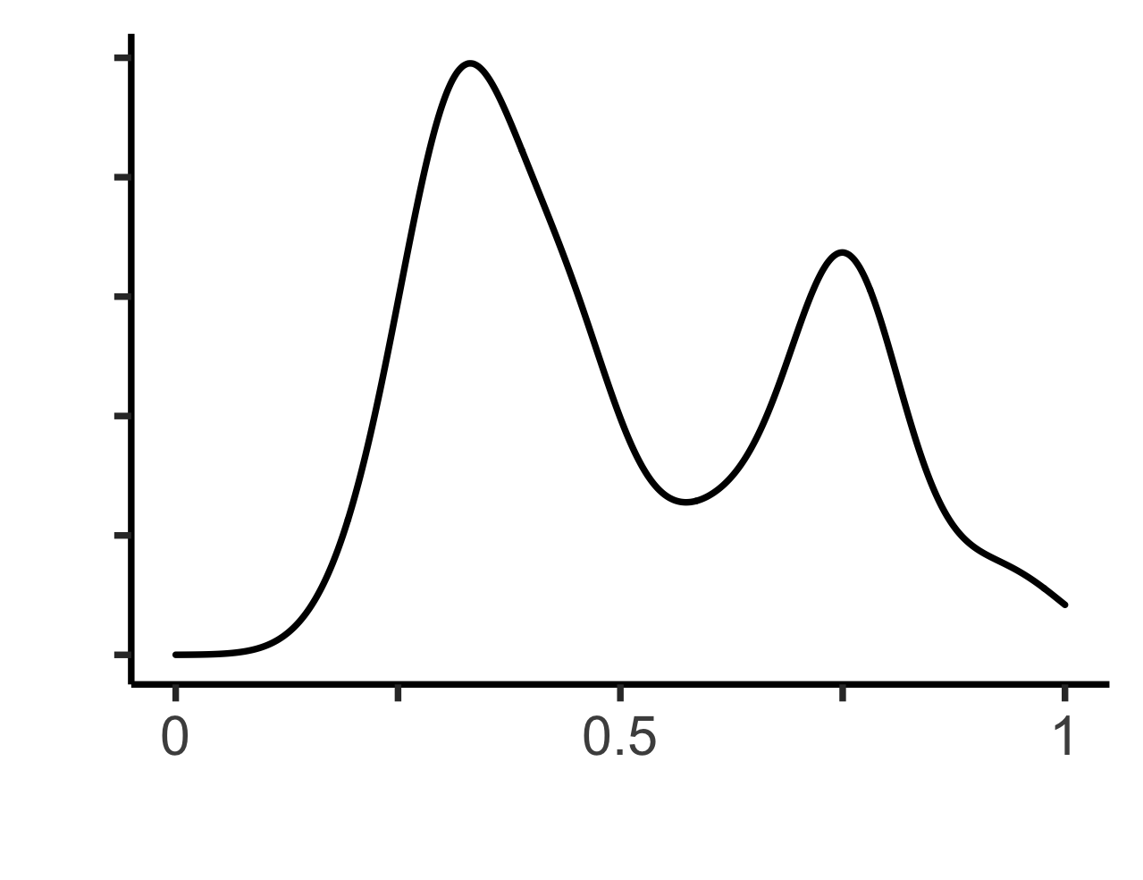
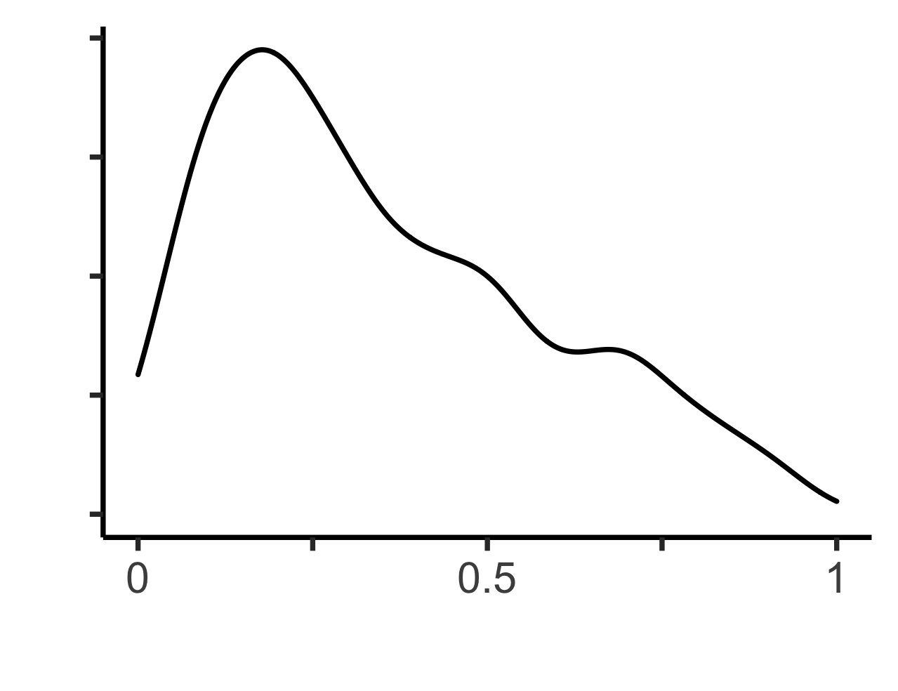
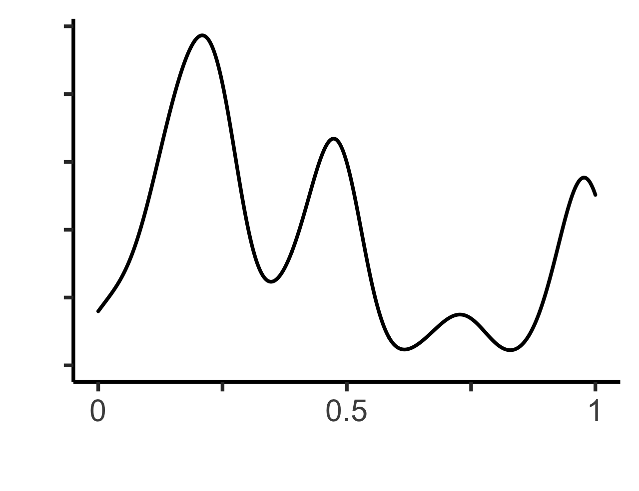
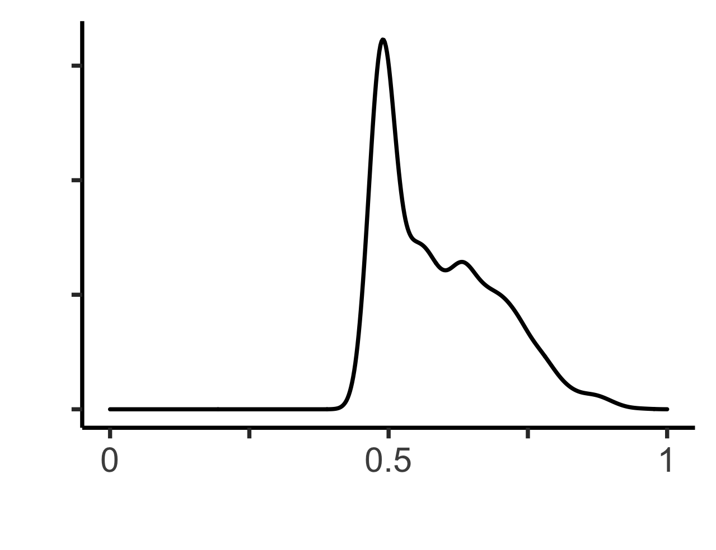
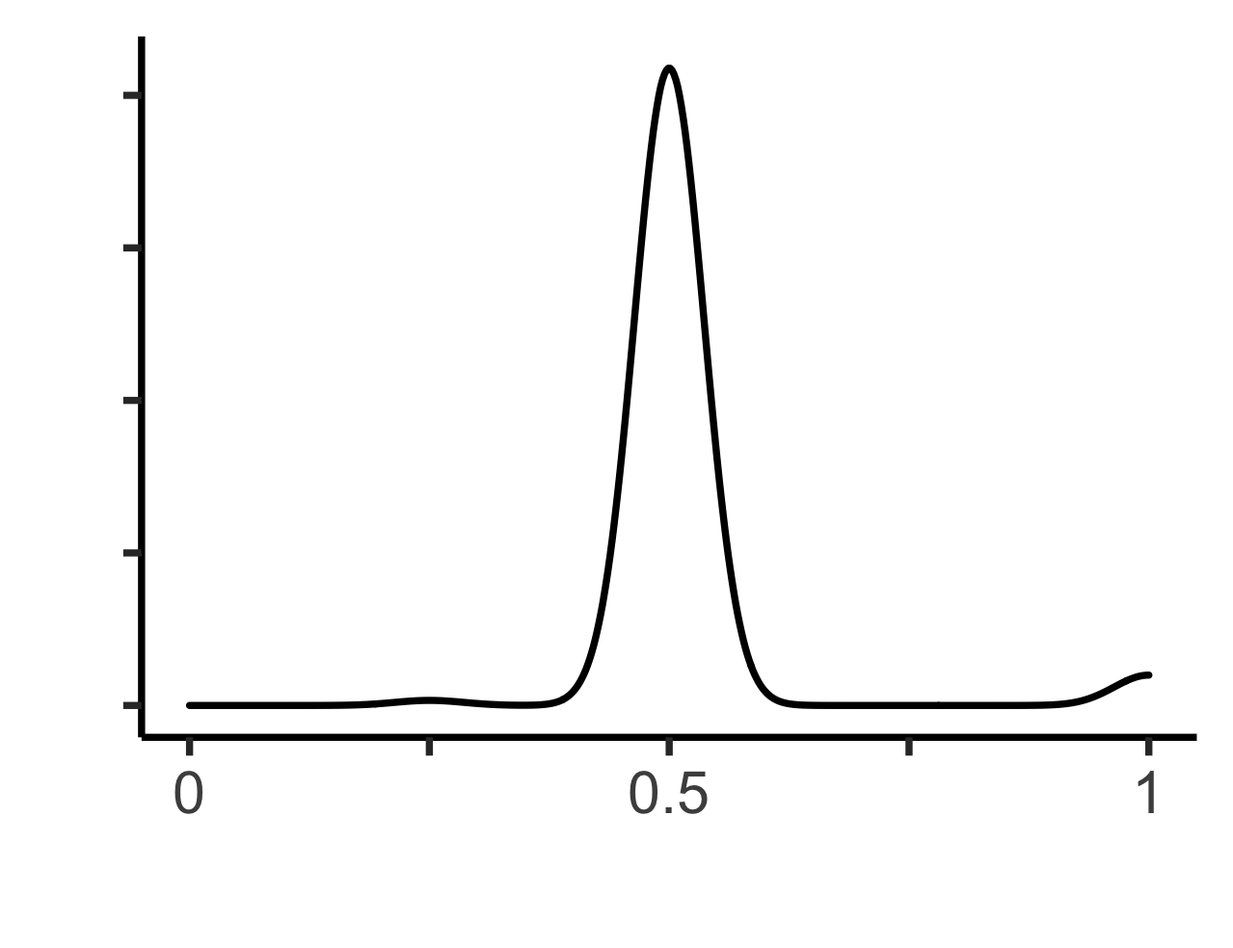
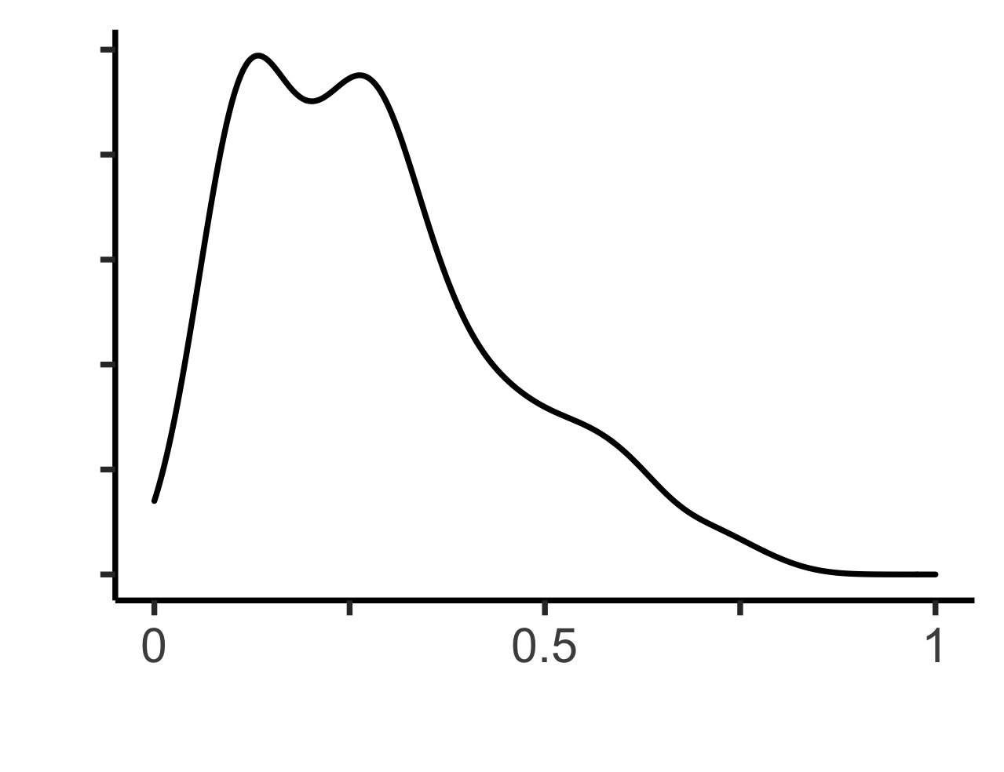
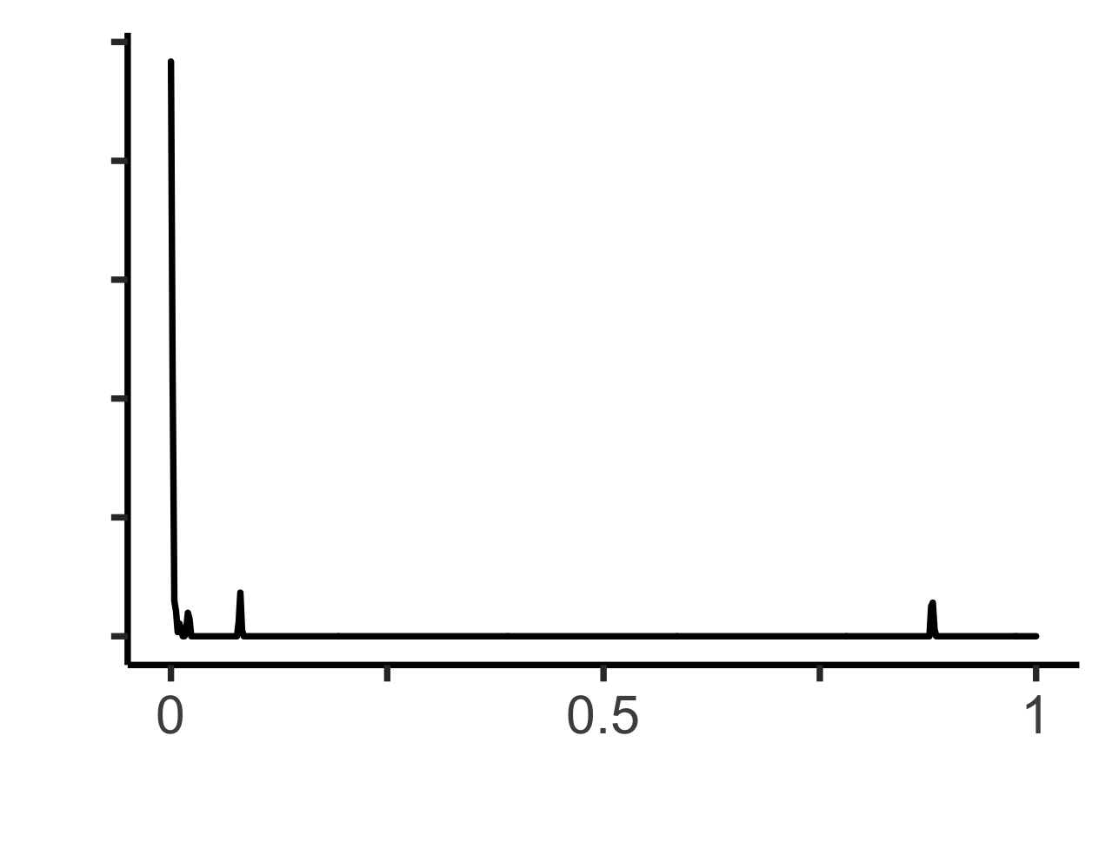
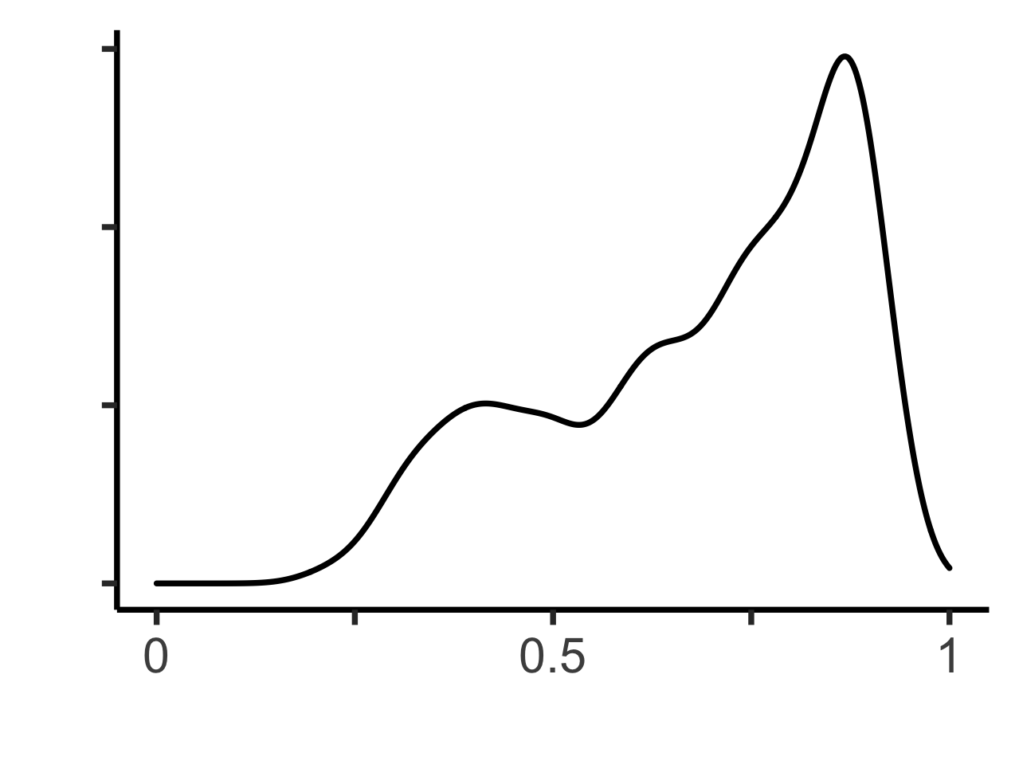
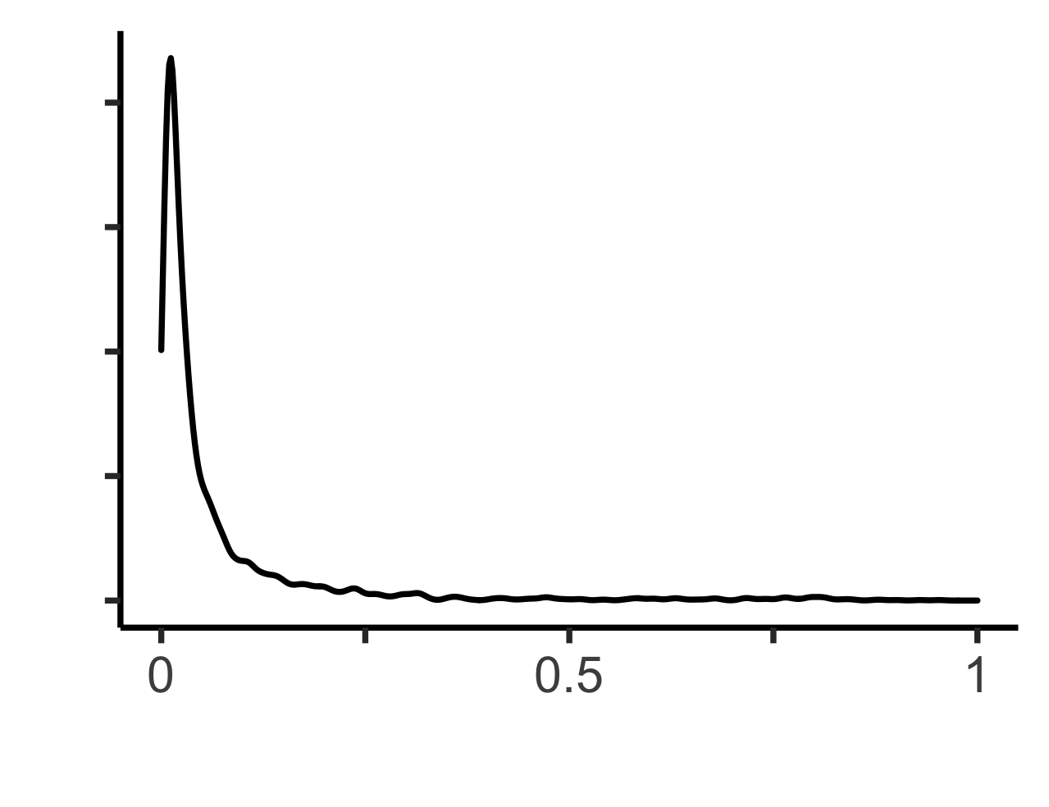
Method 2. Maximum F-measure (F-max) based on estimated probability of causal relationship values
All teams submitted an estimated probability of causal relationship value with each variant prediction
Real number, 0 to 1, indicating the degree of certainty of causal relationship in the proband
Determine how confident the teams were in their predictions based on how well they discriminated P variants
Issue:
Value distributions varied widely
Infeasible to select threshold to apply to all models to determine precision and recall of causative variants
Created for CAGI 6
genomeinterpretation.org
Sarah L. Stenton

Slide 19
Method 2. Maximum F-measure (F-max) based on estimated probability of causal relationship values
Solution: maximum F-measure or “F-max”
F-measure: harmonic mean between precision and recall
(2 * precision * recall) / (precision + recall)
F-max: determines the estimated probability of causal relationship value at which the diagnostic test has the highest performance
Returns a value from 0-1 where 0 indicates low performance and 1 indicates high performance
Rewards models with high precision and recall of causative variants
Penalizes models with low precision allocating similar probability values to many variants
Created for CAGI 6
genomeinterpretation.org
Sarah L. Stenton

Slide 20
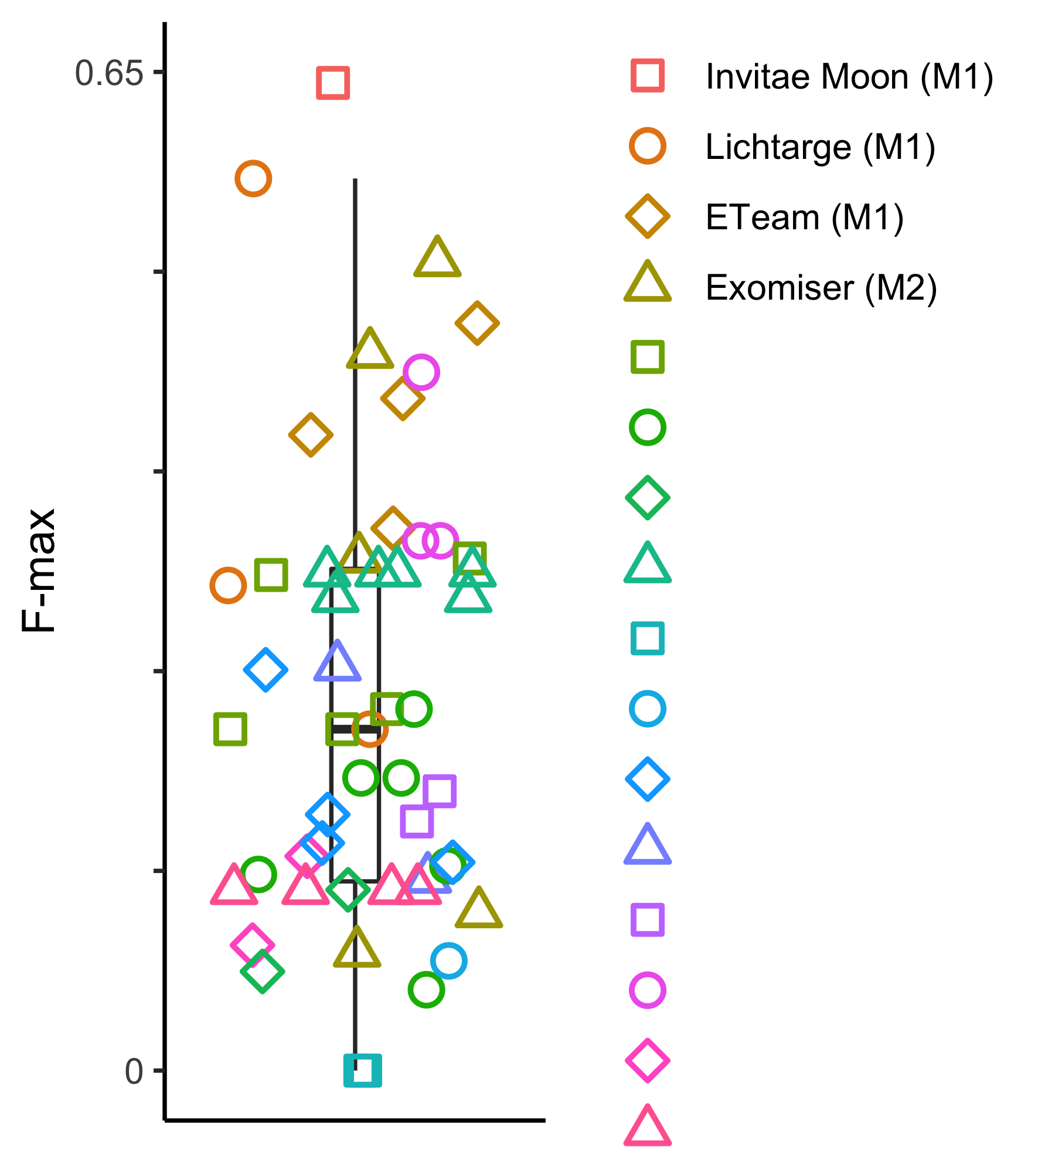
Result 2. Maximum F-measure (F-max) based on estimated probability of causal relationship values
F-max values ranged from 0 - 0.64 (mean 0.24)
Team | Model | F-max | Threshold | Precision | Recall | TP | FP | FN
Invitae Moon | 1 | 0.64 | 0.88 | 0.64 | 0.64 | 9 | 5 | 5
Lichtarge | 1 | 0.58 | 0.6 | 0.53 | 0.64 | 9 | 8 | 5
Exomiser | 2 | 0.53 | 0.6 | 0.42 | 0.71 | 10 | 14 | 4
ETeam | 1 | 0.49 | 0.16 | 0.39 | 0.64 | 9 | 14 | 5
Exomiser | 1 | 0.47 | 0.86 | 0.44 | 0.5 | 7 | 9 | 7
 |  | 0.07 | 1 | 0.07 | 0.07 | 1 | 13 | 13
 |  | 0.06 | 1 | 0.04 | 0.21 | 3 | 76 | 11
 |  | 0.05 | 0.99 | 0.03 | 0.36 | 5 | 171 | 9
 |  | 0 | 1 | 0 | 0 | 0 | 0 | 14
 |  | 0 | 1 | 0 | 0 | 0 | 0 | 14
At an optimized threshold, the top performing team identified 9/14 diagnoses with only 5 false positives and 5 false negatives
Created for CAGI 6
genomeinterpretation.org
Sarah L. Stenton

Slide 21
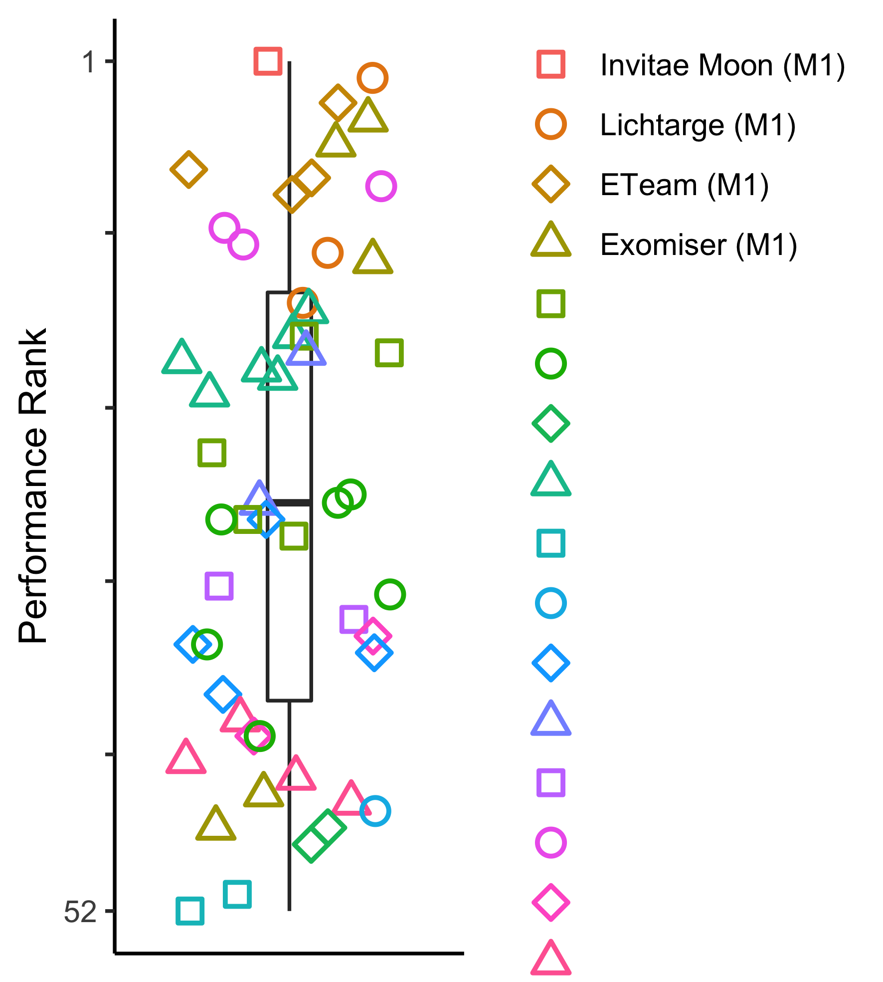
Summary of assessment results
Team | Rank in assessment 1 | Rank in assessment 2 | Rank mean
Invitae Moon (industry) | 1 | 1 | 1
Lichtarge (academia) | 2 | 2 | 2
ETeam (industry) | 3 | 4 | 3.5
Exomiser (academia) | 4 | 5 | 4.5
Created for CAGI 6
genomeinterpretation.org
Sarah L. Stenton

Slide 22
Patterns in performance - what did top performing teams have in common?
 | T9 | T12 | T11 | T5 | T14 | T4 | T1 | T10 | T2 | T8 | T13 | T15 | T16 | T7 | T3 | T6
variant QC
variant frequency
pathogenicity prediction
familial segregation, inheritance
phenotype relevance, similarity
use of proprietary data
all models
some models
not specified
Highest performing teams identified high quality rare damaging variants segregating correctly in-keeping with the phenotype
Created for CAGI 6
genomeinterpretation.org
Sarah L. Stenton

Slide 23
Patterns in performance - what did top performing teams have in common?
 | T9 | T12 | T11 | T5 | T14 | T4 | T1 | T10 | T2 | T8 | T13 | T15 | T16 | T7 | T3 | T6
variant QC
variant frequency
pathogenicity prediction
familial segregation, inheritance
phenotype relevance, similarity
use of proprietary data
all models
some models
not specified
Example: Team 5 submitted 5 models, 2 high performing, 1 moderate, 2 low performing
Features common to all: frequency filtering, pathogenicity prediction, phenotype similarity
Features that when removed reduced performance: variant QC, segregation (allowing incomplete penetrance)
Features that when added reduced performance: non-coding variants
Created for CAGI 6
genomeinterpretation.org
Sarah L. Stenton

Slide 24
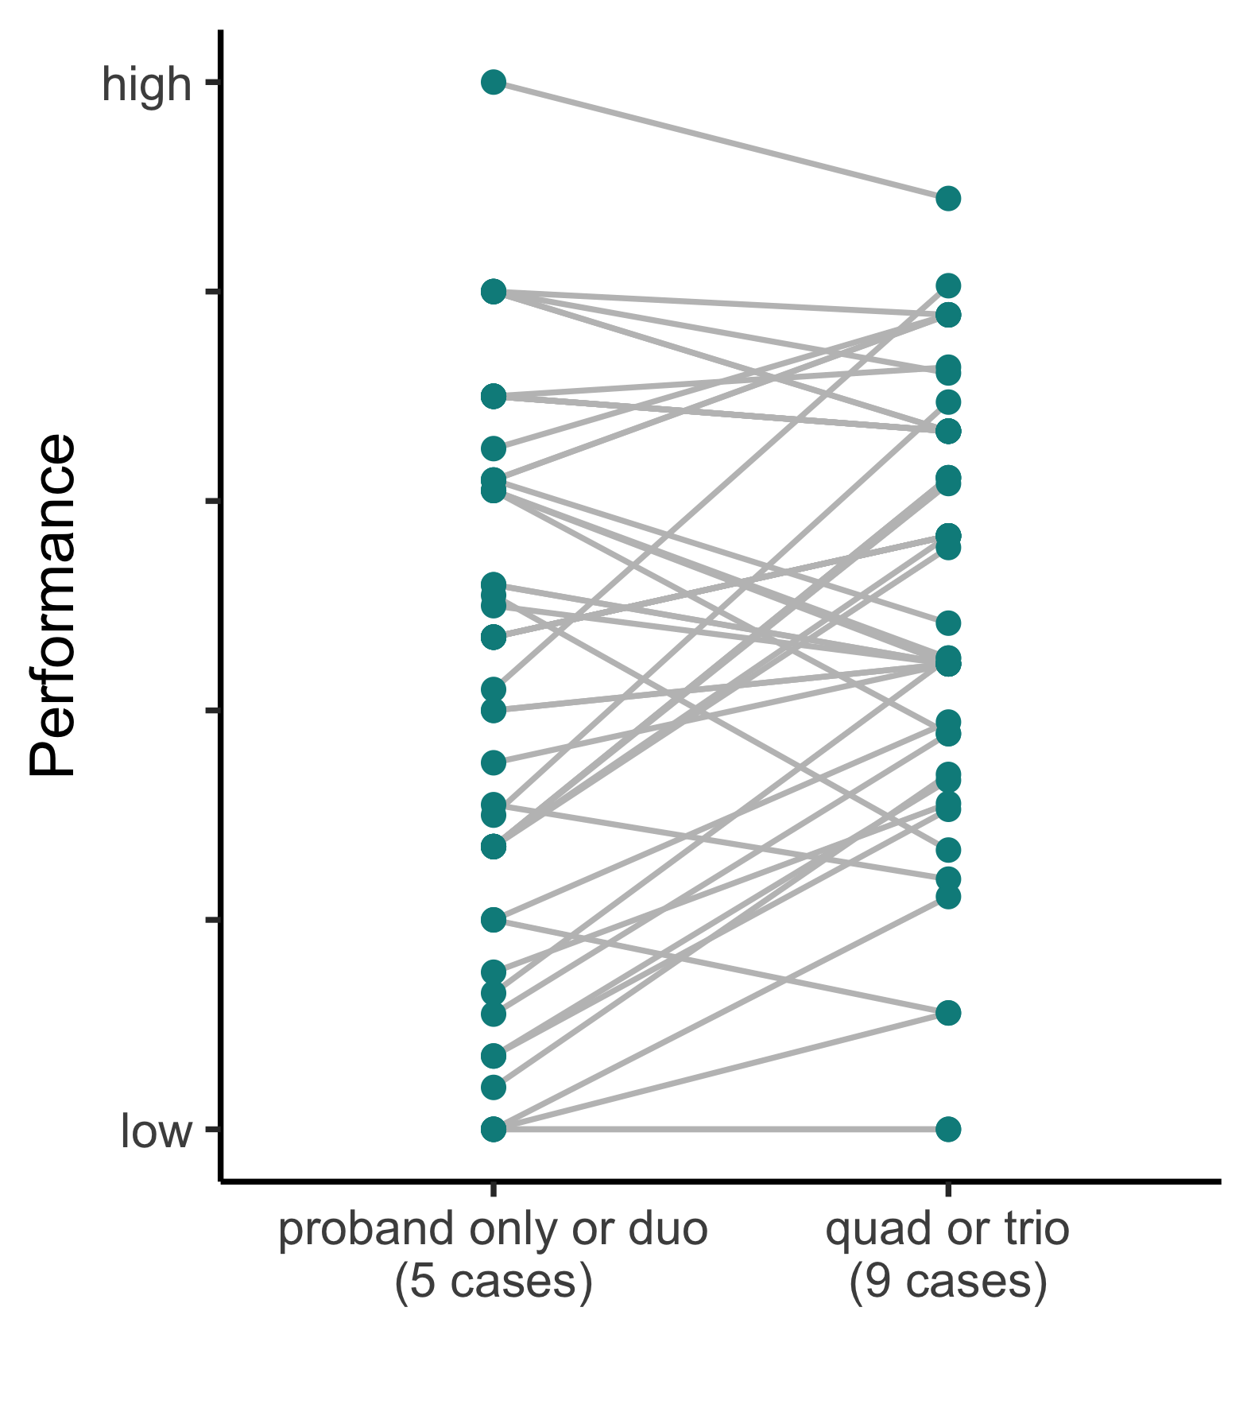
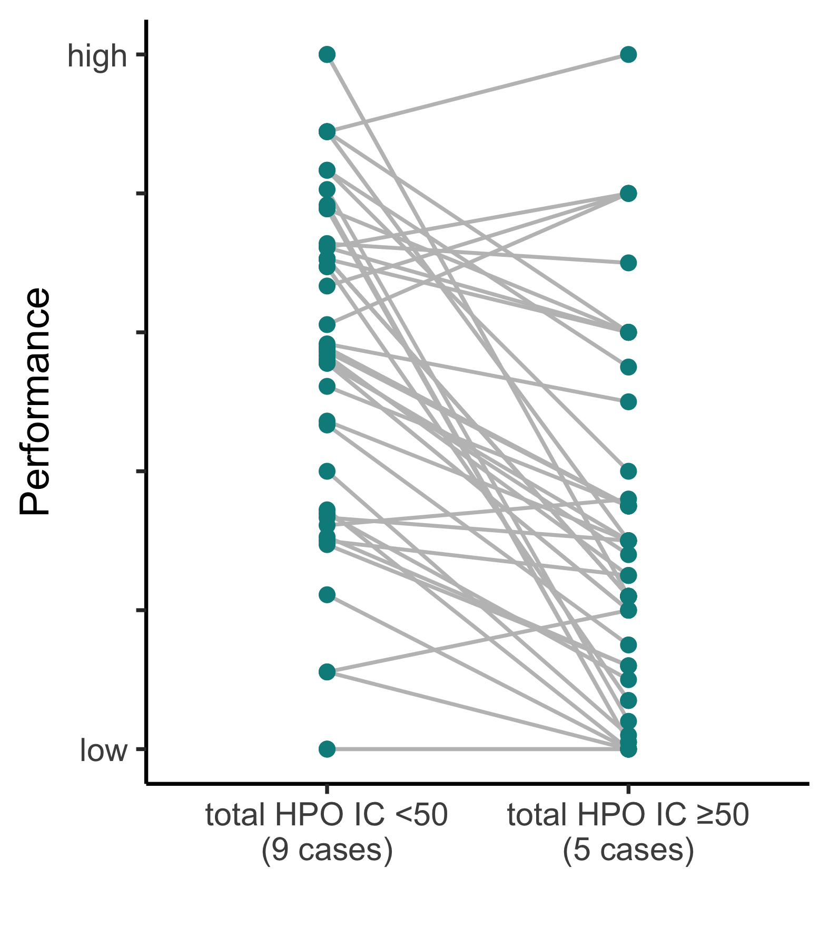
Patterns in performance - does data availability and depth influence performance?
Does the availability of family data aid in identifying diagnoses?
Does the depth of HPO data aid in identifying diagnoses?
Most models increased in performance with complete familial data availability (p 0.002)
Most models decreased in performance with higher HPO information content (p <0.001)
Created for CAGI 6
genomeinterpretation.org
Sarah L. Stenton
Notes:
Multiple explanations for the HPO finding:
Some HPO terms could be unrelated to the primary genetic condition > noise > more information is not always better!
All have equal weighting as HPO terms, this does not reflect the clinical interpretation > could be weighting the wrong phenotype
Single organ disease can often be much easier to identify
Algorithms lack clinical interpretation of related phenotypes (e.g., ataxia and nystagmus) > cerebellar dysfunction

Slide 25
Exploration of unsolved cases
16 unsolved cases included in the challenge in the hope of discovering novel diagnoses
Initially reviewed the top 25 ranked variants from the top 25 ranked teams, later extended to all submitted variants
Variants entered into seqr (web-based analysis tool for rare disease genomics, seqr.broadinstitute.org)
Results reviewed following a 1) de novo / dominant search, 2) recessive search, 3) “any affected” search
The majority of candidates were deemed non-disease causing due to issues with variant quality metrics, segregation (assuming complete penetrance) and/or phenotype relevance
Identified 12/16 probands with promising candidates
Next steps | Number of probands | Candidate diagnosis
Return following clinical confirmation | 1 | TCF4
RNA-seq for non-coding variant | 2 | ASNS, MRPL54
Submission to MME as a potential novel disease gene | 6 | FRY, KCNH8, KLHL13, MRPL54, THAP12, TPPP
Structural variant analysis for recessive single-hits | 11 | -
Created for CAGI 6
genomeinterpretation.org
Sarah L. Stenton

Slide 26
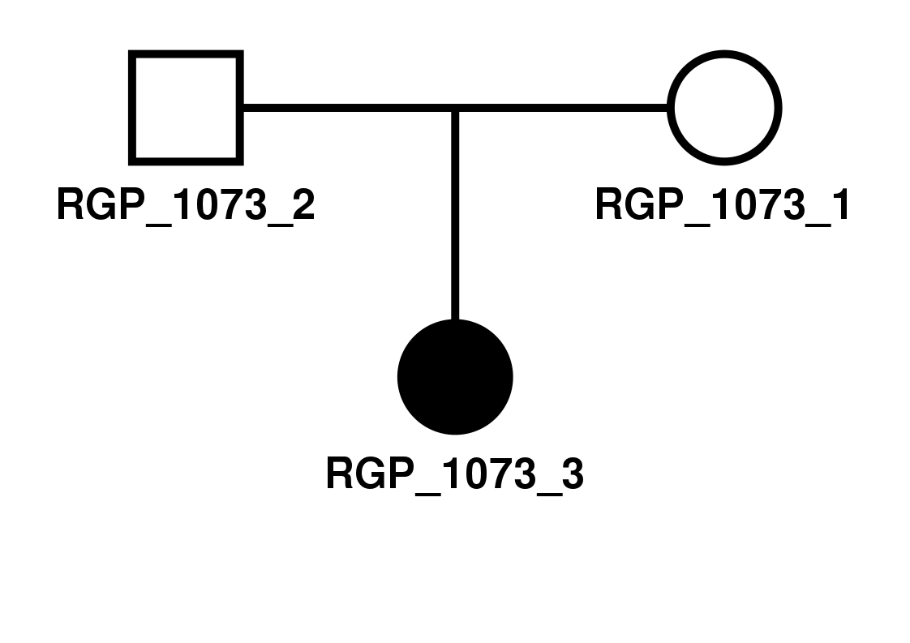

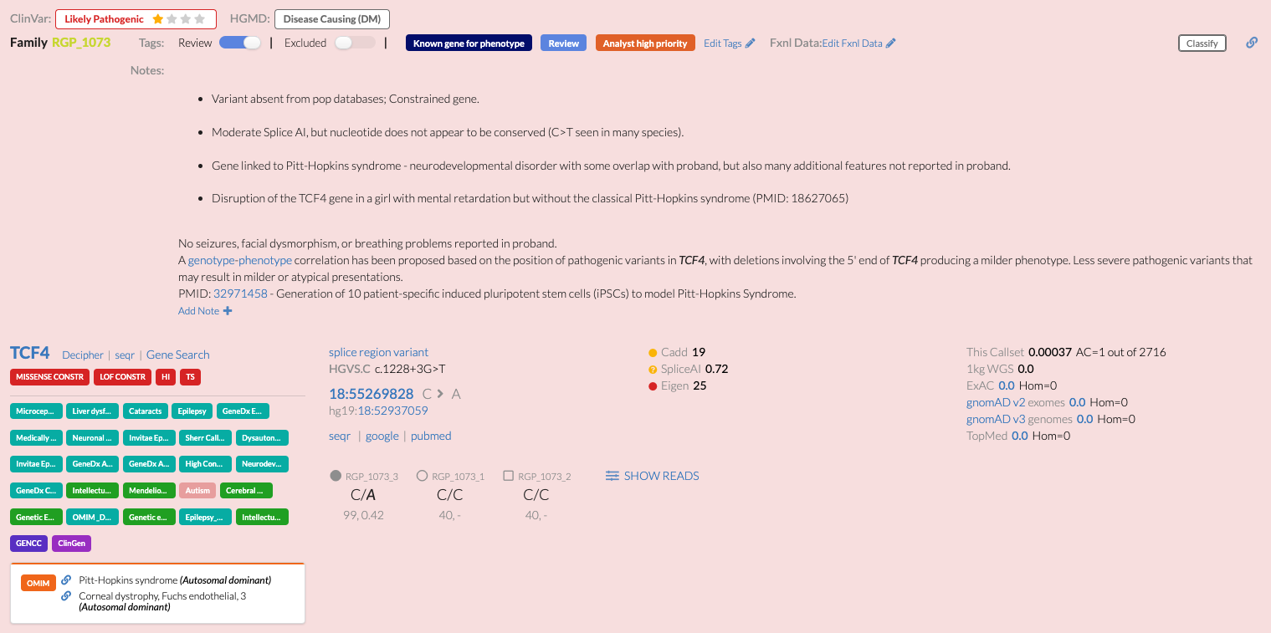
Candidate 1. de novo near-splice variant in TCF4
Undiagnosed female, onset at <1-year, neurodevelopmental phenotype
HP:0100704 (Cerebral visual impairment)
HP:0001252 (Hypotonia)
HP:0000750 (Delayed speech and language development)
HP:0001263 (Global developmental delay)
HP:0001344 (Absent speech)
Initially considered non-compelling due to only partial phenotype overlap with associated syndrome, Pitt-Hopkins syndrome (PHS)
Created for CAGI 6
genomeinterpretation.org
Sarah L. Stenton

Slide 27
Candidate 1. de novo near-splice variant in TCF4
Prioritized by three of the top performing teams at rank 1, prioritized by 8/25 models in total
Recently reported LP in ClinVar and included in a PHS study (PMID: 32971458)
Disruption of the TCF4 reported in a patient with neurodevelopmental delay without the classical PHS (PMID: 18627065)
MDT agreed TCF4 is a strong candidate and is returnable
Created for CAGI 6
genomeinterpretation.org
Sarah L. Stenton

Slide 28
Candidate 2. compound heterozygous frameshift and deep intronic indel in ASNS
Undiagnosed female, onset at <1-year, neurodevelopmental phenotype
HP:0012448 (Delayed myelination)
HP:0012469 (Infantile spasms)
HP:0000252 (Microcephaly)
HP:0001252 (Hypotonia)
HP:0000639 (Nystagmus)
HP:0000609 (Optic nerve hypoplasia)
HP:0001338 (Partial agenesis of the corpus callosum)
The compound heterozygous variants in ASNS were prioritized by one top performing team at rank 1
The frameshift variant was also prioritized amongst the top 10 by an additional top performing team
Substantial overlap with reported phenotypes
Created for CAGI 6
genomeinterpretation.org
Sarah L. Stenton

Slide 29
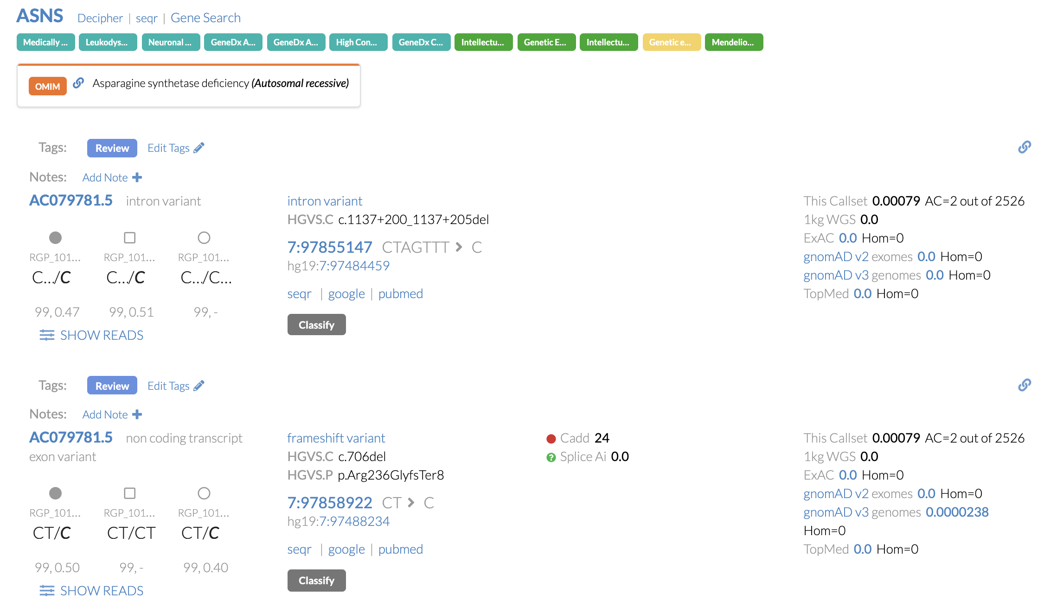
Candidate 2. compound heterozygous frameshift and deep intronic indel in ASNS
0.22
Created for CAGI 6
genomeinterpretation.org
Sarah L. Stenton

Slide 30
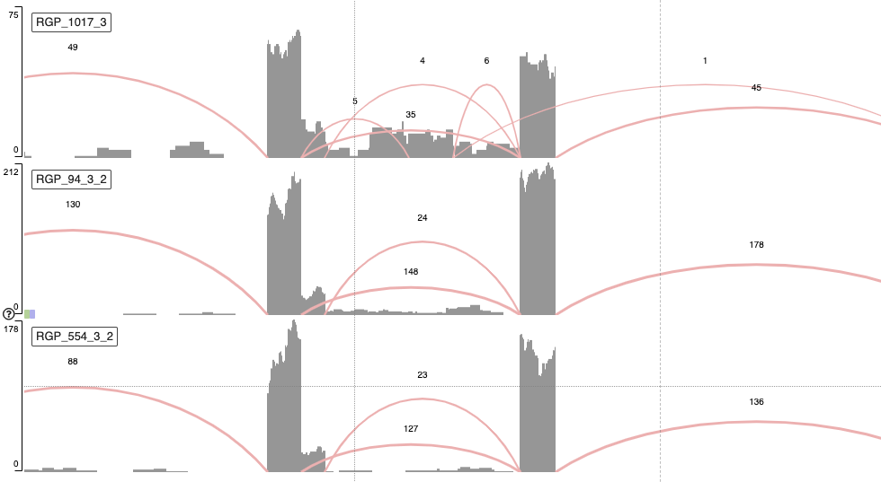
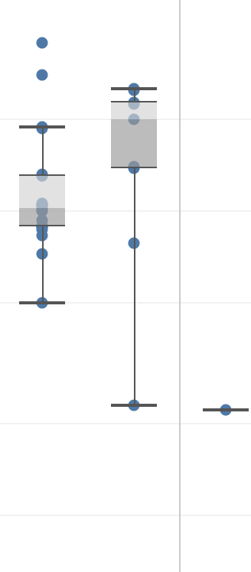
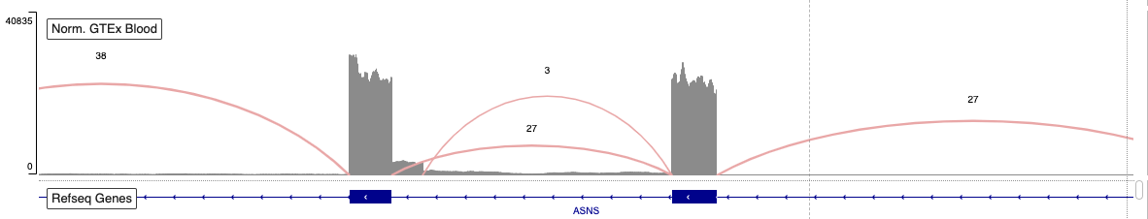
Candidate 2. compound heterozygous frameshift and deep intronic indel in ASNS
CAGI proband
50
Intronic deletion > altered splicing with intron retention
Lowest expression of ASNS in our RGP cohort
MDT agreed ASNS is a strong candidate and is returnable
20
RGP proband
10
5
Expression (TPM)
RGP proband
2
GTEx blood
1
GTEx blood
RGP probands
CAGI proband
Created for CAGI 6
genomeinterpretation.org
Sarah L. Stenton

Slide 31
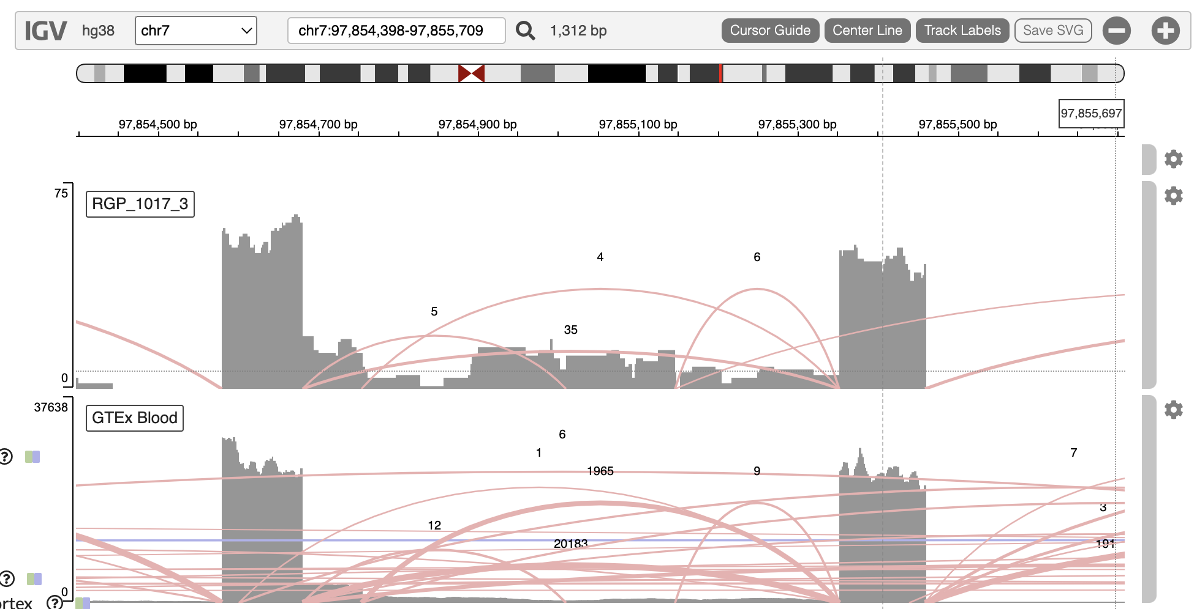
Candidate 2. compound heterozygous frameshift and deep intronic indel in ASNS
CAGI proband
Aggregate
GTEx blood

Slide 32
Novel disease gene candidates
Additionally, six candidates were entered into MME
Gene | Variants | Number Teams | Number Models | Rank | Evidence |  |  |  | Follow-up
MRPL54 | missense; splice region | 1 | 1 | 3 |  |  |  |  | RNA-seq; MME, no strong matches
FRY | missense; missense | 1 | 1 | 1 |  |  |  |  | MME, no strong matches
TPPP | splice region | 2 | 4 | 1-13 |  |  |  |  | MME, no matches
KCNH8 | missense | 5 | 8 | 1-21 |  |  |  |  | MME, awaiting update
KLHL13 | missense | 4 | 7 | 1-14 |  |  |  |  | MME, no strong matches
THAP12 | frameshift; missense | 2 | 3 | 3-7 |  |  |  |  | MME, no strong matches
segregation frequency predictions gene function
supporting
conflicting
Created for CAGI 6
genomeinterpretation.org
Sarah L. Stenton

Slide 33

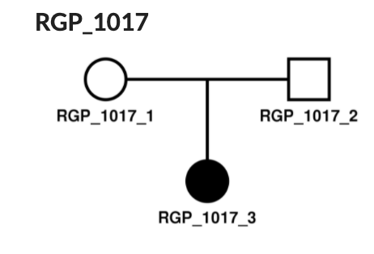

Conclusions and reflections
Conclusions
Methods of highly performing teams returned high priority variants for consideration, by:
Identification of additional potentially diagnostic variants (2/16 cases, 12.5% diagnostic uplift) promotes synergy between researchers with clinical and computational expertise
Utilizing the genetic data to prioritize high quality potentially damaging variants
Utilizing population data to prioritize rare variants
Utilizing the family data to prioritize variants segregating with the disease
Utilizing HPO data to prioritize variants explaining the patient’s phenotype
Created for CAGI 6
genomeinterpretation.org
Sarah L. Stenton

Slide 34
Conclusions and reflections
Reflections
Selection of cases to reflect all modes of inheritance (inc. incomplete penetrance) and variant types (inc. non-coding)
Increased transparency of assessment method and intended use of submitted metrics
Standardized collection of data on the methods performed (post-submission) to increase our understanding of the strengths and weaknesses
Created for CAGI 6
genomeinterpretation.org
Sarah L. Stenton

Slide 35
Acknowledgements
Heidi Rehm - RGP Principal investigator
Anne O’Donnell-Luria - RGP Medical Director
Melanie O'Leary - RGP Project Lead
CAGI Organizers
Steven E. Brenner
Predrag Radivojac
Constantina Bakolitsa
https://raregenomes.org/
RGP Team
Christina Austin-Tse
Stephanie DiTroia
Vijay Ganesh
Emily Groopman
Stacey Hall
Katie Larsson
Gabrielle Lemire
Brian Mangilog
Funders
NHGRI U01 HG008900
CZI
Illumina
Emily O’Heir
Ikeoluwa Osei-Owusu
Lynn Pais
William Phu
Jillian Serrano
Grace VanNoy
Ben Weisburd
Michael Wilson
Thank you for your attention
We’re recruiting!
(computational staff and postdocs)
odonnell@broadinstitute.org
the-tgg.org

