Slide 1

CAGI slide pack guidelines
I agree to my slides being used according to the following terms:
Vikas Pejaver (on behalf of the ClinGen-SVI WG computational tools sub-group)
Authors: please include THIS slide at the beginning of your presentation to indicate that you agree with reuse of your slides in CAGI presentations, according to the terms below, and digitally sign by writing your name above.
To disseminate the CAGI results, I encourage all CAGI participants to remix these CAGI slides for inclusion in their oral and poster presentations
CAGI participants may use or publish any content of these slides only in compliance with the CAGI Data Use Agreement
CAGI participants may not cite or publish any content of these slides except with the written permission of the originating author or in the primary CAGI publications
CAGI participants must acknowledge the original authors of these slides and CAGI 6. Include the acknowledgement banner across the bottom
CAGI participants must include the CAGI credits slide in their presentations
Slides with a red slash (no remix) may not be included in a presentation unless all attendees are registered CAGI participants who signed the data use agreement
Slides with a red X over the entire slide may not be used in any circumstances
Slides with a blue slash (embargoed) may not be used unless the embargo is explicitly lifted
Slides without slash or X may be tweeted unless flagged with the “No tweet” icon.
CAGI participants using these slides must explain the “No tweet” icon, which means that the slide content should not be disseminated outside the presenting conference hall. If the presentation venue permits pervasive tweeting, you may not include these slides in your talk
Note for slide authors: we expect all CAGI participants to abide by these restrictions, and will make best effort to ensure they are followed. However, but bear in mind that we have limited means of enforcing them, and therefore the restrictions cannot be guaranteed.

Slide 2
Permission request regarding CAGI 6 recordings and hybrid presentations
I understand that my presentation as associated with CAGI 6 will be recorded and broadcasted via the internet through CAGI’s designated technology provider.
As the copyright holder to this presentation entitled Evidence-based calibration of computational tools for the clinical classification of missense variants, I hereby agree that the copyright for the online broadcast and recording of my presentation be released to CAGI and my recording be uploaded on to the CAGI website.

Slide 3


Evidence-based calibration of computational tools for missense variant pathogenicity classification
Vikas Pejaver
(on behalf of the ClinGen-SVI WG -
computational tools sub-group)
May 15, 2022
Created for CAGI 6
genomeinterpretation.org
Vikas Pejaver

Slide 4
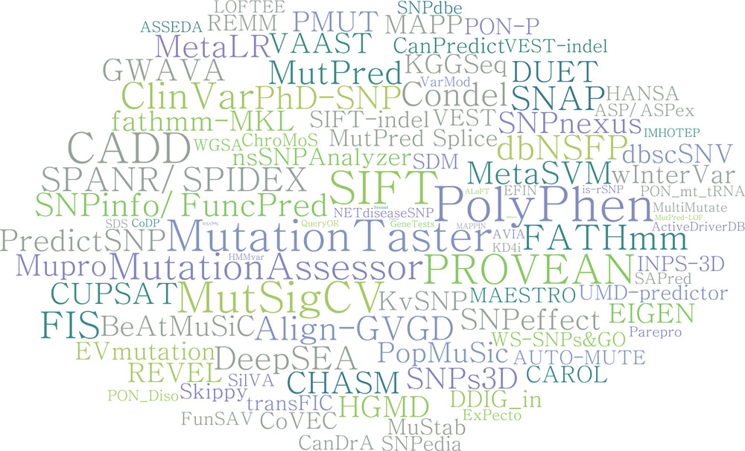
Missense variant impact prediction
Pathogenic
… AGCATACCGA …
… AGCATAGCGA …
Benign
Hu et al. (2019) VIPdb, a genetic Variant Impact Predictor Database. Human Mutat.
Created for CAGI 6
genomeinterpretation.org
Vikas Pejaver
Notes:
Of the millions of variants in an individual’s genome, we would like to know which variants lead to a particular phenotypic state (rare disease on one end of the spectrum to general differences in traits)
We can simplify this question by abstracting it to “which variant likely leads to disease?”
In the context of this talk, I’m going to talk only about protein-coding variants

Slide 5
ACMG/AMP guidelines for clinical variant classification
Data
Population
Computational and predictive
Functional
Segregation
De novo
Allelic
Other database
Other
Evidential strength
Very Strong (PVS, BVS)
Strong (PS, BS)
Moderate (PM, BM)
Supporting (PP, BP)
Indeterminate
Created for CAGI 6
genomeinterpretation.org
Vikas Pejaver

Slide 6
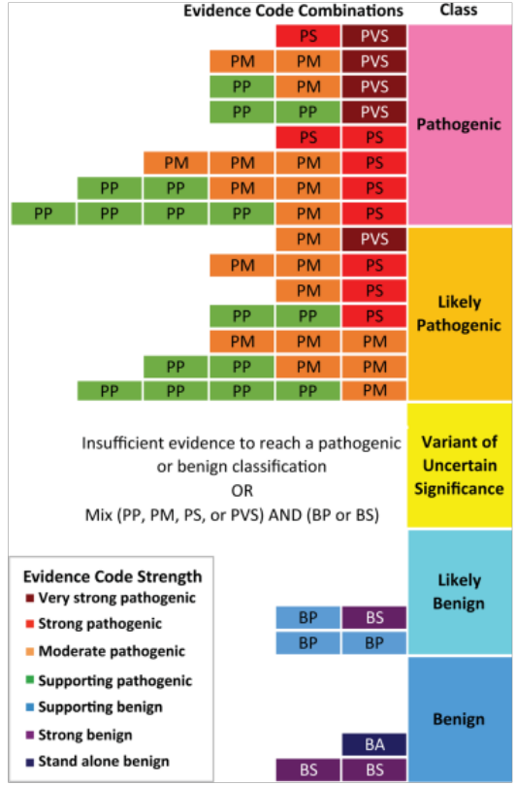
ACMG/AMP guidelines for clinical variant classification
Data
Population
Computational and predictive
Functional
Segregation
De novo
Allelic
Other database
Other
Evidential strength
Very Strong (PVS, BVS)
Strong (PS, BS)
Moderate (PM, BM)
Supporting (PP, BP)
Indeterminate
Created for CAGI 6
genomeinterpretation.org
Vikas Pejaver

Slide 7
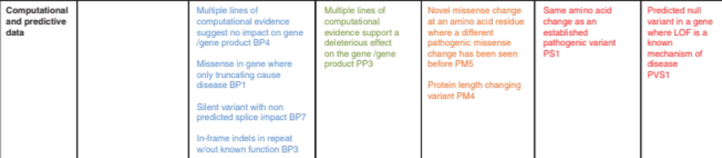
The PP3 and BP4 criteria: variant impact predictors are considered Supporting evidence
Supporting Benign
Supporting Path
Moderate Path
Strong Path
V Strong Path
Created for CAGI 6
genomeinterpretation.org
Vikas Pejaver

Slide 8
The PP3 and BP4 criteria: variant impact predictors are considered Supporting evidence
Supporting Benign
Supporting Path
Moderate Path
Strong Path
V Strong Path
Currently, the criteria do not objectively recommend which tools to be used
They assume that developer-recommended score thresholds are calibrated for clinical classification
Multiple lines of computational evidence does not account for the fact that methods may be correlated
Created for CAGI 6
genomeinterpretation.org
Vikas Pejaver

Slide 9



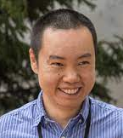









Members and affiliates of ClinGen SVI WG – Computational subgroup
Leslie Biesecker
NIH
Steven Brenner
UC Berkeley
Alicia Byrne
Broad
Bing-Jian Feng
Utah
Marc Greenblatt
Vermont
Steven Harrison
Broad
Rachel Karchin
Johns Hopkins
Sean Mooney
Washington
Anne O’Donnell-Luria
Broad
Kymberleigh Pagel
Johns Hopkins
Vikas Pejaver
Mount Sinai
Predrag Radivojac
Northeastern
Sean Tavtigian
Utah
When can a prediction be considered clinically useful?
What are the current practices on the use of computational tools?
Can we come up with a quantitative framework to revise them while being compatible with current guidelines?
Created for CAGI 6
genomeinterpretation.org
Vikas Pejaver

Slide 10
Different from typical assessments and technically challenging
Pathogenic
Evidential strength
Very Strong (PVS, BVS)
Strong (PS, BS)
Moderate (PM, BM)
Supporting (PP, BP)
Indeterminate
Binary classifiers
Pathogenic
Benign
Benign
Created for CAGI 6
genomeinterpretation.org
Vikas Pejaver

Slide 11
Different from typical assessments and technically challenging
Pathogenic
Evidential strength
Very Strong (PVS, BVS)
Strong (PS, BS)
Moderate (PM, BM)
Supporting (PP, BP)
Indeterminate
Binary classifiers
Pathogenic
Benign
Benign
What does it mean to be Supporting, Moderate, Strong, and Very Strong evidence? Can we quantify these?
Created for CAGI 6
genomeinterpretation.org
Vikas Pejaver

Slide 12
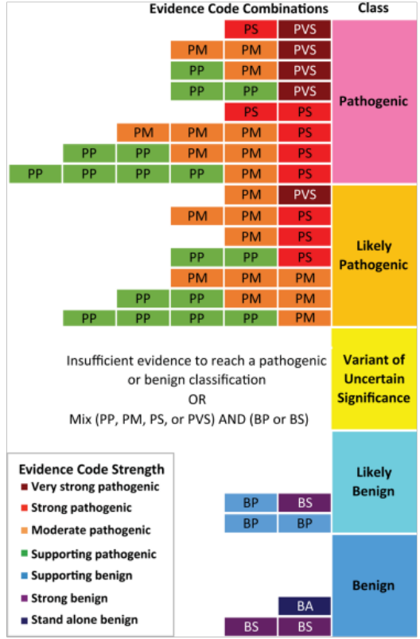
Likelihood ratios as a quantifier of evidential strength
Tavtigian et al. (2018) Modeling the ACMG/AMP variant classification guidelines as a Bayesian classification framework. Genet. Med.
Created for CAGI 6
genomeinterpretation.org
Vikas Pejaver

Slide 13
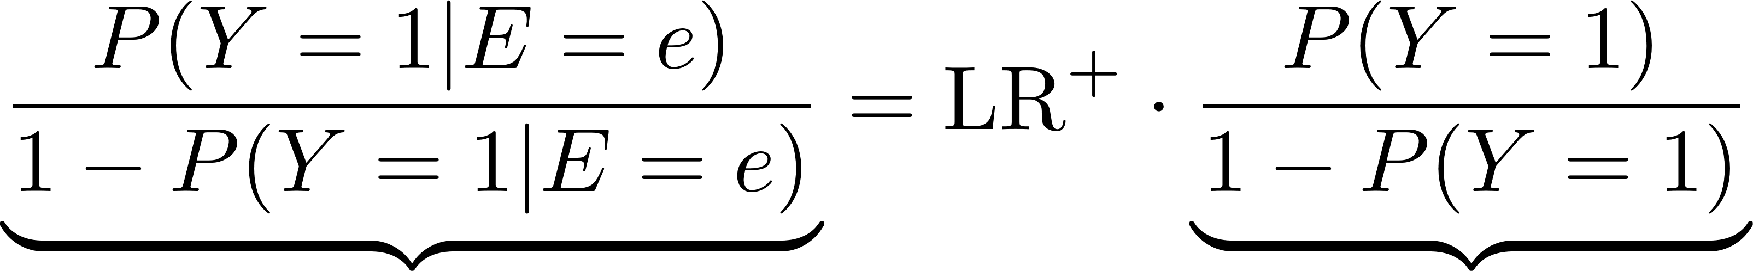


Likelihood ratios as a quantifier of evidential strength
Tavtigian et al. (2018) Modeling the ACMG/AMP variant classification guidelines as a Bayesian classification framework. Genet. Med.
Created for CAGI 6
genomeinterpretation.org
Vikas Pejaver

Slide 14
Likelihood ratios as a quantifier of evidential strength
Tavtigian et al. (2018) Modeling the ACMG/AMP variant classification guidelines as a Bayesian classification framework. Genet. Med.
Created for CAGI 6
genomeinterpretation.org
Vikas Pejaver

Slide 15
Likelihood ratios as a quantifier of evidential strength
How do we estimate this prior probability of pathogenicity?
Tavtigian et al. (2018) Modeling the ACMG/AMP variant classification guidelines as a Bayesian classification framework. Genet. Med.
Created for CAGI 6
genomeinterpretation.org
Vikas Pejaver

Slide 16
Likelihood ratio thresholds for the different strengths
Zeiberg et al. (2020) Fast nonparametric estimation of class proportions in the positive-unlabeled classification setting. Proceedings of the AAAI Conference on Artificial Intelligence.
Created for CAGI 6
genomeinterpretation.org
Vikas Pejaver

Slide 17
Likelihood ratio thresholds for the different strengths
Criterion | Evidence Strength | Positive likelihood ratio | Reciprocal of positive likelihood ratio | Posterior probability of pathogenicity (for PP3) and benignity (for BP4)
PP3 | Very Strong | 1,124:1 | 0.0009:1 | 0.9811
 | Strong | 33.53:1 | 0.0298:1 | 0.6073
 | Moderate | 5.790:1 | 0.1727:1 | 0.2108
 | Supporting | 2.406:1 | 0.4156:1 | 0.0999
BP4 | Supporting | 0.4156:1 | 2.406:1 | 0.9812
 | Moderate | 0.1727:1 | 5.790:1 | 0.9921
 | Strong | 0.0298:1 | 33.53:1 | 0.9986
 | Very Strong | 0.0009:1 | 1,124:1 | 1.0000
Zeiberg et al. (2020) Fast nonparametric estimation of class proportions in the positive-unlabeled classification setting. Proceedings of the AAAI Conference on Artificial Intelligence.
Created for CAGI 6
genomeinterpretation.org
Vikas Pejaver

Slide 18
Likelihood ratio thresholds for the different strengths
Criterion | Evidence Strength | Positive likelihood ratio | Reciprocal of positive likelihood ratio | Posterior probability of pathogenicity (for PP3) and benignity (for BP4)
PP3 | Very Strong | 1,124:1 | 0.0009:1 | 0.9811
 | Strong | 33.53:1 | 0.0298:1 | 0.6073
 | Moderate | 5.790:1 | 0.1727:1 | 0.2108
 | Supporting | 2.406:1 | 0.4156:1 | 0.0999
BP4 | Supporting | 0.4156:1 | 2.406:1 | 0.9812
 | Moderate | 0.1727:1 | 5.790:1 | 0.9921
 | Strong | 0.0298:1 | 33.53:1 | 0.9986
 | Very Strong | 0.0009:1 | 1,124:1 | 1.0000
How do we translate this framework into practice for the estimation of computational predictor score intervals?
Zeiberg et al. (2020) Fast nonparametric estimation of class proportions in the positive-unlabeled classification setting. Proceedings of the AAAI Conference on Artificial Intelligence.
Created for CAGI 6
genomeinterpretation.org
Vikas Pejaver

Slide 19
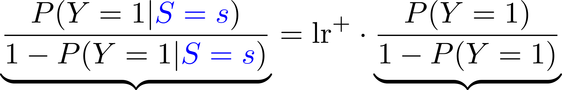
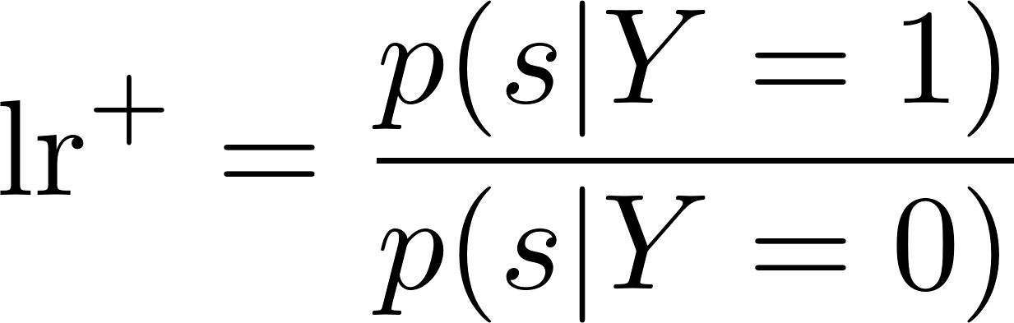
Estimating score thresholds: local posterior probability or local positive predictive value
Pejaver et al. (2022) Evidence-based calibration of computational tools for missense variant pathogenicity classification and ClinGen recommendations for clinical use of PP3/BP4 criteria. bioRxiv 2022.03.17.484479; doi: https://doi.org/10.1101/2022.03.17.484479
Created for CAGI 6
genomeinterpretation.org
Vikas Pejaver

Slide 20
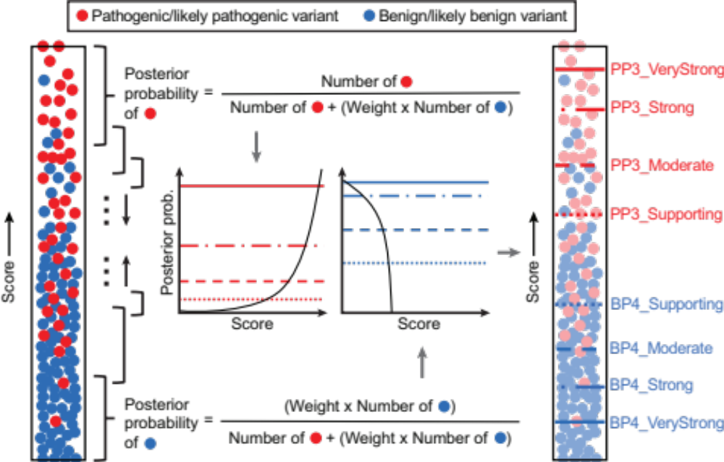
Estimating score thresholds: local posterior probability or local positive predictive value
Pejaver et al. (2022) Evidence-based calibration of computational tools for missense variant pathogenicity classification and ClinGen recommendations for clinical use of PP3/BP4 criteria. bioRxiv 2022.03.17.484479; doi: https://doi.org/10.1101/2022.03.17.484479
Created for CAGI 6
genomeinterpretation.org
Vikas Pejaver

Slide 21
Estimating score thresholds: local posterior probability or local positive predictive value
Pejaver et al. (2022) Evidence-based calibration of computational tools for missense variant pathogenicity classification and ClinGen recommendations for clinical use of PP3/BP4 criteria. bioRxiv 2022.03.17.484479; doi: https://doi.org/10.1101/2022.03.17.484479
Created for CAGI 6
genomeinterpretation.org
Vikas Pejaver

Slide 22
Estimating score thresholds: local posterior probability or local positive predictive value
Pejaver et al. (2022) Evidence-based calibration of computational tools for missense variant pathogenicity classification and ClinGen recommendations for clinical use of PP3/BP4 criteria. bioRxiv 2022.03.17.484479; doi: https://doi.org/10.1101/2022.03.17.484479
Created for CAGI 6
genomeinterpretation.org
Vikas Pejaver

Slide 23
Estimating score thresholds: local posterior probability or local positive predictive value
Pejaver et al. (2022) Evidence-based calibration of computational tools for missense variant pathogenicity classification and ClinGen recommendations for clinical use of PP3/BP4 criteria. bioRxiv 2022.03.17.484479; doi: https://doi.org/10.1101/2022.03.17.484479
Created for CAGI 6
genomeinterpretation.org
Vikas Pejaver

Slide 24
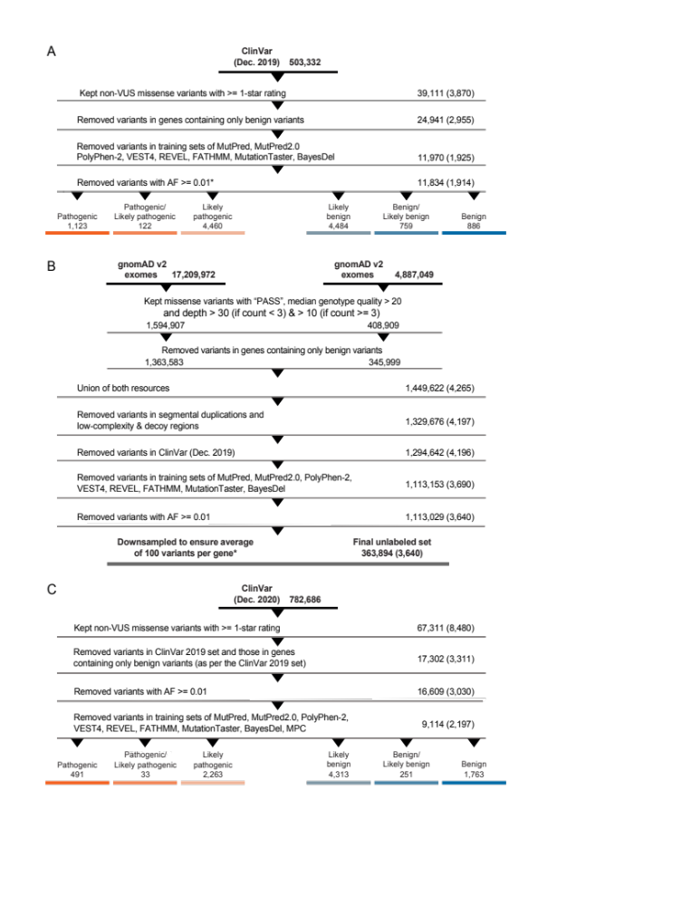
Data set for interval estimation
Pejaver et al. (2022) Evidence-based calibration of computational tools for missense variant pathogenicity classification and ClinGen recommendations for clinical use of PP3/BP4 criteria. bioRxiv 2022.03.17.484479; doi: https://doi.org/10.1101/2022.03.17.484479
Created for CAGI 6
genomeinterpretation.org
Vikas Pejaver

Slide 25
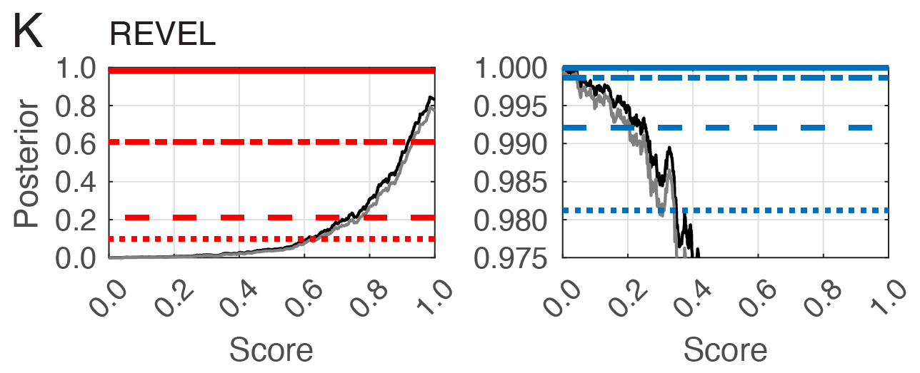
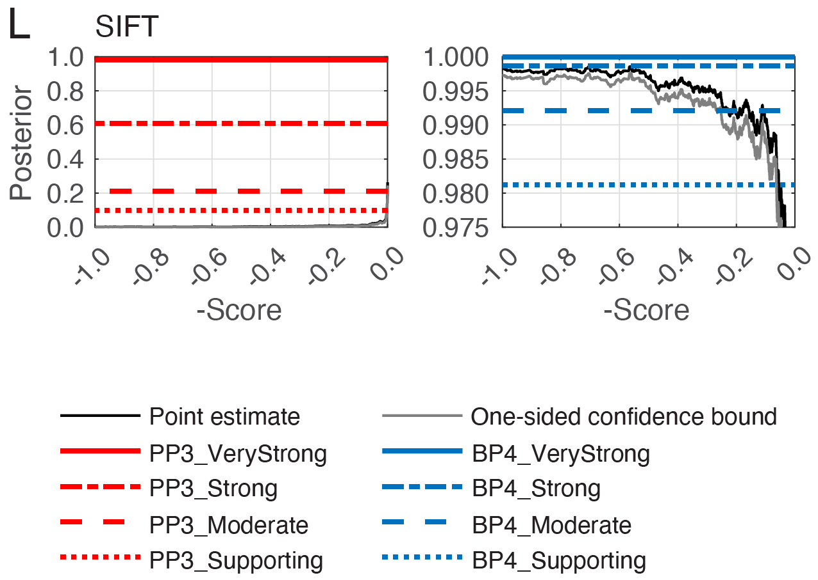
Local posterior probability curves for REVEL
Pejaver et al. (2022) Evidence-based calibration of computational tools for missense variant pathogenicity classification and ClinGen recommendations for clinical use of PP3/BP4 criteria. bioRxiv 2022.03.17.484479; doi: https://doi.org/10.1101/2022.03.17.484479
Created for CAGI 6
genomeinterpretation.org
Vikas Pejaver

Slide 26
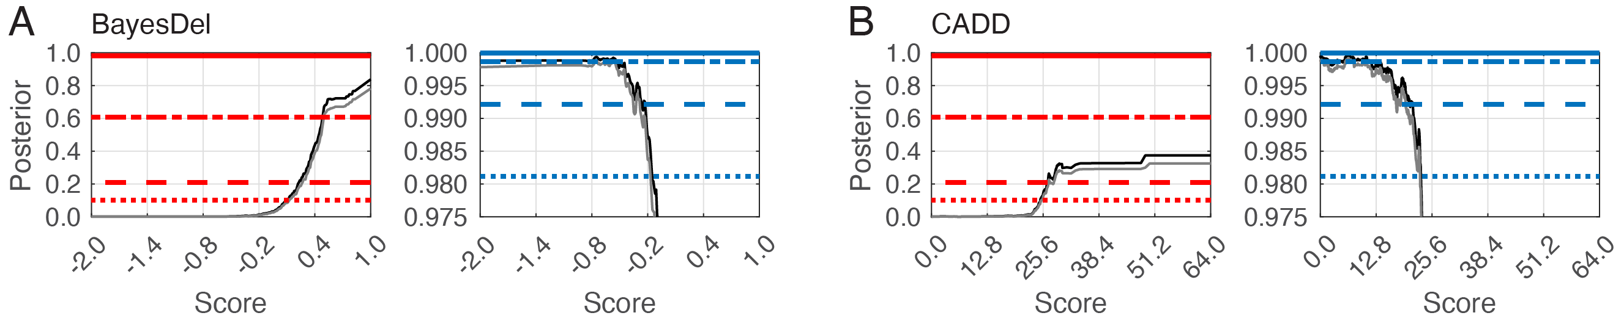
Local posterior probability curves for CADD
Pejaver et al. (2022) Evidence-based calibration of computational tools for missense variant pathogenicity classification and ClinGen recommendations for clinical use of PP3/BP4 criteria. bioRxiv 2022.03.17.484479; doi: https://doi.org/10.1101/2022.03.17.484479
Created for CAGI 6
genomeinterpretation.org
Vikas Pejaver

Slide 27
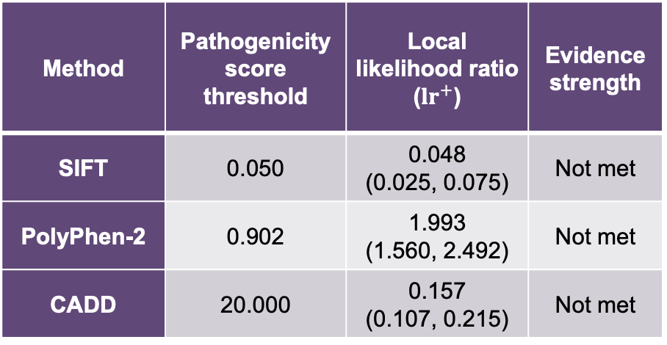
Developer-recommended thresholds do not meet Supporting level of evidence
Method | Pathogenicity score threshold | Local likelihood ratio (${lr}^{+}$) | Evidence strength
SIFT | 0.050 | 0.048 (0.025, 0.075) | Not met
PolyPhen-2 | 0.902 | 1.993 (1.560, 2.492) | Not met
CADD | 20.000 | 0.157 (0.107, 0.215) | Not met
Pejaver et al. (2022) Evidence-based calibration of computational tools for missense variant pathogenicity classification and ClinGen recommendations for clinical use of PP3/BP4 criteria. bioRxiv 2022.03.17.484479; doi: https://doi.org/10.1101/2022.03.17.484479
Created for CAGI 6
genomeinterpretation.org
Vikas Pejaver

Slide 28
At certain thresholds, some tools can provide up to Strong levels of evidence
Method | Pathogenic (PP3) |  |  |  | Benign (BP4)
 | Very Strong | Strong | Moderate | Supporting | Supporting | Moderate | Strong | Very Strong
BayesDel | - | ≥ 0.50 | [0.27, 0.50) | [0.13, 0.27) | (-0.36, -0.18] | ≤ -0.36 | - | -
CADD | - | - | ≥ 28.1 | [25.3, 28.1) | (17.3, 22.7] | (0.15, 17.3] | ≤ 0.15 | -
EA | - | - | ≥ 0.821 | [0.685, 0.821) | (0.069, 0.262] | ≤ 0.069 | - | -
FATHMM | - | - | ≤ -5.04 | (-5.04, -4.14] | [3.32, 4.69) | ≥ 4.69 | - | -
GERP++ | - | - | - | - | (-4.54, 2.70] | ≤ -4.54 | - | -
MPC | - | - | ≥ 1.828 | [1.360, 1.828) | - | - | - | -
MutPred2 | - | ≥ 0.932 | [0.829, 0.932) | [0.737, 0.829) | (0.197, 0.391] | (0.010, 0.197] | ≤ 0.010 | -
PhyloP | - | - | ≥ 9.741 | [7.367, 9.741) | (0.021, 1.879] | ≤ 0.021 | - | -
PolyPhen-2 | - | - | ≥ 0.999 | [0.978, 0.999) | (0.009, 0.113] | ≤ 0.009 | - | -
PrimateAI | - | - | ≥ 0.867 | [0.790, 0.867) | (0.362, 0.483] | ≤ 0.362 | - | -
REVEL | - | ≥ 0.932 | [0.773, 0.932) | [0.644, 0.773) | (0.183, 0.290] | (0.016, 0.183] | (0.003, 0.016] | ≤ 0.003
SIFT | - | - | ≤ 0.000 | (0.000, 0.001] | [0.080, 0.327) | ≥ 0.327 | - | -
VEST4 | - | ≥ 0.965 | [0.861, 0.965) | [0.764, 0.861) | (0.302, 0.449] | ≤ 0.302 | - | -
Pejaver et al. (2022) Evidence-based calibration of computational tools for missense variant pathogenicity classification and ClinGen recommendations for clinical use of PP3/BP4 criteria. bioRxiv 2022.03.17.484479; doi: https://doi.org/10.1101/2022.03.17.484479
Created for CAGI 6
genomeinterpretation.org
Vikas Pejaver

Slide 29
At certain thresholds, some tools can provide up to Strong levels of evidence
Method | Pathogenic (PP3) |  |  |  | Benign (BP4)
 | Very Strong | Strong | Moderate | Supporting | Supporting | Moderate | Strong | Very Strong
BayesDel | - | ≥ 0.50 | [0.27, 0.50) | [0.13, 0.27) | (-0.36, -0.18] | ≤ -0.36 | - | -
CADD | - | - | ≥ 28.1 | [25.3, 28.1) | (17.3, 22.7] | (0.15, 17.3] | ≤ 0.15 | -
EA | - | - | ≥ 0.821 | [0.685, 0.821) | (0.069, 0.262] | ≤ 0.069 | - | -
FATHMM | - | - | ≤ -5.04 | (-5.04, -4.14] | [3.32, 4.69) | ≥ 4.69 | - | -
GERP++ | - | - | - | - | (-4.54, 2.70] | ≤ -4.54 | - | -
MPC | - | - | ≥ 1.828 | [1.360, 1.828) | - | - | - | -
MutPred2 | - | ≥ 0.932 | [0.829, 0.932) | [0.737, 0.829) | (0.197, 0.391] | (0.010, 0.197] | ≤ 0.010 | -
PhyloP | - | - | ≥ 9.741 | [7.367, 9.741) | (0.021, 1.879] | ≤ 0.021 | - | -
PolyPhen-2 | - | - | ≥ 0.999 | [0.978, 0.999) | (0.009, 0.113] | ≤ 0.009 | - | -
PrimateAI | - | - | ≥ 0.867 | [0.790, 0.867) | (0.362, 0.483] | ≤ 0.362 | - | -
REVEL | - | ≥ 0.932 | [0.773, 0.932) | [0.644, 0.773) | (0.183, 0.290] | (0.016, 0.183] | (0.003, 0.016] | ≤ 0.003
SIFT | - | - | ≤ 0.000 | (0.000, 0.001] | [0.080, 0.327) | ≥ 0.327 | - | -
VEST4 | - | ≥ 0.965 | [0.861, 0.965) | [0.764, 0.861) | (0.302, 0.449] | ≤ 0.302 | - | -
Pejaver et al. (2022) Evidence-based calibration of computational tools for missense variant pathogenicity classification and ClinGen recommendations for clinical use of PP3/BP4 criteria. bioRxiv 2022.03.17.484479; doi: https://doi.org/10.1101/2022.03.17.484479
Created for CAGI 6
genomeinterpretation.org
Vikas Pejaver

Slide 30
At certain thresholds, some tools can provide up to Strong levels of evidence
Method | Pathogenic (PP3) |  |  |  | Benign (BP4)
 | Very Strong | Strong | Moderate | Supporting | Supporting | Moderate | Strong | Very Strong
BayesDel | - | ≥ 0.50 | [0.27, 0.50) | [0.13, 0.27) | (-0.36, -0.18] | ≤ -0.36 | - | -
CADD | - | - | ≥ 28.1 | [25.3, 28.1) | (17.3, 22.7] | (0.15, 17.3] | ≤ 0.15 | -
EA | - | - | ≥ 0.821 | [0.685, 0.821) | (0.069, 0.262] | ≤ 0.069 | - | -
FATHMM | - | - | ≤ -5.04 | (-5.04, -4.14] | [3.32, 4.69) | ≥ 4.69 | - | -
GERP++ | - | - | - | - | (-4.54, 2.70] | ≤ -4.54 | - | -
MPC | - | - | ≥ 1.828 | [1.360, 1.828) | - | - | - | -
MutPred2 | - | ≥ 0.932 | [0.829, 0.932) | [0.737, 0.829) | (0.197, 0.391] | (0.010, 0.197] | ≤ 0.010 | -
PhyloP | - | - | ≥ 9.741 | [7.367, 9.741) | (0.021, 1.879] | ≤ 0.021 | - | -
PolyPhen-2 | - | - | ≥ 0.999 | [0.978, 0.999) | (0.009, 0.113] | ≤ 0.009 | - | -
PrimateAI | - | - | ≥ 0.867 | [0.790, 0.867) | (0.362, 0.483] | ≤ 0.362 | - | -
REVEL | - | ≥ 0.932 | [0.773, 0.932) | [0.644, 0.773) | (0.183, 0.290] | (0.016, 0.183] | (0.003, 0.016] | ≤ 0.003
SIFT | - | - | ≤ 0.000 | (0.000, 0.001] | [0.080, 0.327) | ≥ 0.327 | - | -
VEST4 | - | ≥ 0.965 | [0.861, 0.965) | [0.764, 0.861) | (0.302, 0.449] | ≤ 0.302 | - | -
Pejaver et al. (2022) Evidence-based calibration of computational tools for missense variant pathogenicity classification and ClinGen recommendations for clinical use of PP3/BP4 criteria. bioRxiv 2022.03.17.484479; doi: https://doi.org/10.1101/2022.03.17.484479
Created for CAGI 6
genomeinterpretation.org
Vikas Pejaver

Slide 31

‘Validating’ score intervals on a new data set
Pejaver et al. (2022) Evidence-based calibration of computational tools for missense variant pathogenicity classification and ClinGen recommendations for clinical use of PP3/BP4 criteria. bioRxiv 2022.03.17.484479; doi: https://doi.org/10.1101/2022.03.17.484479
Created for CAGI 6
genomeinterpretation.org
Vikas Pejaver

Slide 32
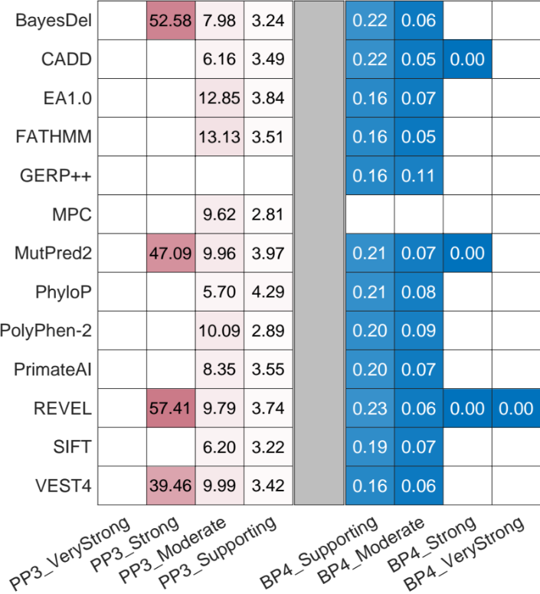
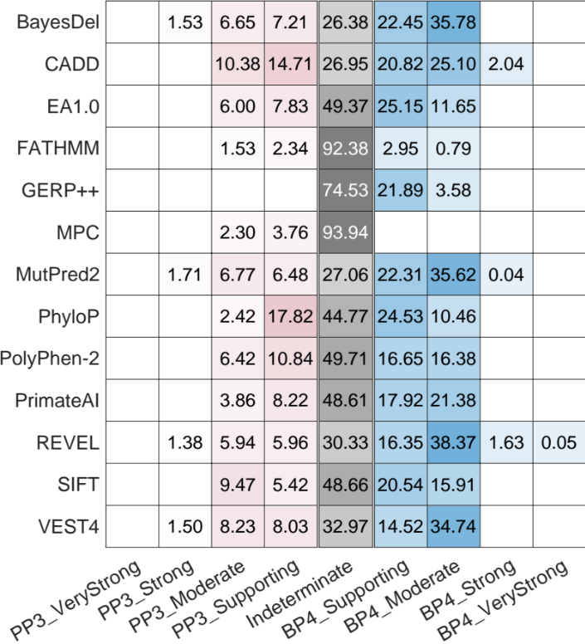
Choice of tool involves a trade-off between evidential strength and false positive classifications
Likelihood ratios on ClinVar 2020 set
Fraction of variants in gnomAD set
Pejaver et al. (2022) Evidence-based calibration of computational tools for missense variant pathogenicity classification and ClinGen recommendations for clinical use of PP3/BP4 criteria. bioRxiv 2022.03.17.484479; doi: https://doi.org/10.1101/2022.03.17.484479
Created for CAGI 6
genomeinterpretation.org
Vikas Pejaver

Slide 33
Choice of tool involves a trade-off between evidential strength and false positive classifications
Likelihood ratios on ClinVar 2020 set
Fraction of variants in gnomAD set
Pejaver et al. (2022) Evidence-based calibration of computational tools for missense variant pathogenicity classification and ClinGen recommendations for clinical use of PP3/BP4 criteria. bioRxiv 2022.03.17.484479; doi: https://doi.org/10.1101/2022.03.17.484479
Created for CAGI 6
genomeinterpretation.org
Vikas Pejaver

Slide 34
Summary and Discussion
Highlights
Default developer-recommended thresholds are not necessarily calibrated for clinical use
Computational predictors can provide more than Supporting evidence, even Strong evidence for pathogenicity/benignity
Propose updated recommendations for PP3/BP4
  Will need for more rigorous documentation of evidential lines in the future
Created for CAGI 6
genomeinterpretation.org
Vikas Pejaver

Slide 35
Summary and Discussion
Highlights
Default developer-recommended thresholds are not necessarily calibrated for clinical use
Computational predictors can provide more than Supporting evidence, even Strong evidence for pathogenicity/benignity
Propose updated recommendations for PP3/BP4
  Will need for more rigorous documentation of evidential lines in the future
Local posterior probability calculation as an approach to assess and calibrate predictions for clinical use
  Different from typical machine learning evaluation metrics and approaches
  Grounded in theory
With sufficient data, approach can be extended to gene-specific and/or disease-specific contexts
Approach can be generalized to calibrate any continuous score distribution for clinical use (e.g., functional assay scores)
Created for CAGI 6
genomeinterpretation.org
Vikas Pejaver

Slide 36
Summary and Discussion
Caveats
“Gold-standard” ClinVar annotations often incorporate prediction methods
Overlap between information used by predictors and other lines of evidence not accounted for
Estimation challenges
  Data set representativeness
  Prior probability estimation
  Limitations of ACMG/AMP rules and Bayesian framework
Developed only for use within the ACMG/AMP guidelines and may not behave as expected in other contexts
Created for CAGI 6
genomeinterpretation.org
Vikas Pejaver

Slide 37

Acknowledgments
ClinGen SVI computational subgroup members
Steven E. Brenner
Predrag Radivojac
Marc S. Greenblatt
Rachel Karchin
Anne O’Donnell-Luria
Sean V. Tavtigian
Steven M. Harrison
Leslie G. Biesecker
Jonathan S. Berg
Sharon E. Plon
Heidi L. Rehm
Alicia B. Byrne
Bing-Jian Feng
Kymberleigh A. Pagel
Sean D. Mooney
Joseph Rothstein
Weiva Sieh
Panagiotis Katsonis
Olivier Lichtarge
Our funding sources:
Created for CAGI 6
genomeinterpretation.org
Vikas Pejaver

Slide 38
Thank you
Preprint:
Pejaver et al. (2022) Evidence-based calibration of computational tools
for missense variant pathogenicity classification and ClinGen
recommendations for clinical use of PP3/BP4 criteria.
bioRxiv 2022.03.17.484479; doi: https://doi.org/10.1101/2022.03.17.484479
My lab is looking for postdocs and grad students
Email: vikas.pejaver@mssm.edu
Twitter: @vikaspejaver
Created for CAGI 6
genomeinterpretation.org
Vikas Pejaver

Slide 39
Created for CAGI 6
genomeinterpretation.org
Vikas Pejaver

Slide 40
Extra details
Created for CAGI 6
genomeinterpretation.org
Vikas Pejaver

Slide 41
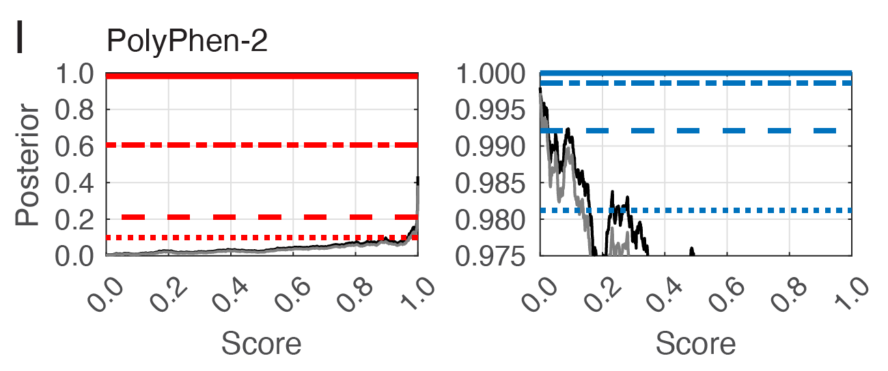
Local posterior probability curves for typical methods
Created for CAGI 6
genomeinterpretation.org
Vikas Pejaver

Slide 42
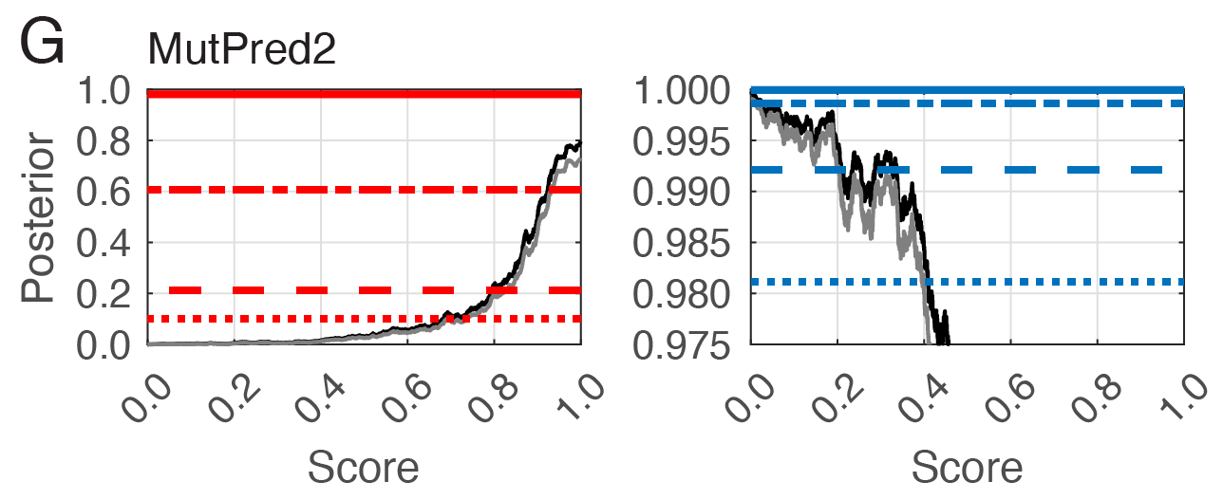
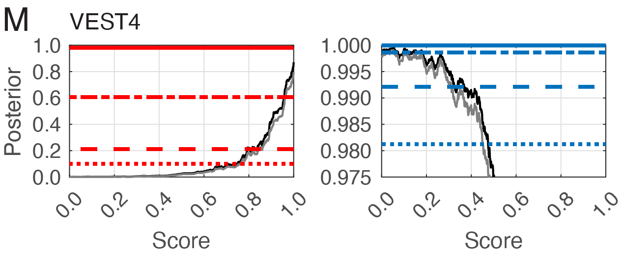
At certain thresholds, some tools can provide up to Strong levels of evidence
Created for CAGI 6
genomeinterpretation.org
Vikas Pejaver

Slide 43
Suggested updates to PP3/BP4 criteria
Guidance | 2015 ACMG/AMP recommendations | Our recommendation
Evidential strength of in silico tools | Supporting. | PP3_Strong, PP3_Moderate, PP3_Supporting, Indeterminate, BP4_Supporting, BP4_Moderate, and BP4_Strong.
Tools to be used | No specific recommendation, although a list of tools provided with the caveat that they have not been validated. | Tools that reach at least Strong evidence for pathogenicity and Moderate for benignity. It is valid to use any tool at the indicated evidential strength level as determined by our approach, so long as it is chosen before seeing its scores and preferably any other evidence.
Score thresholds for tools | No explicit recommendations but often defaults to developer-recommended thresholds. | Specific score thresholds calibrated to different evidential strengths.
Number of tools to be used | Multiple lines of evidence, suggesting multiple tools (no number provided). | Combinations of tools was not systematically assessed but results suggest the use of a single tool rather than an uncalibrated consensus of multiple tools.
Decision-making | If all agree, evidence can be counted as Supporting. Otherwise, evidence from tools cannot be used. | Evidence can be counted at the appropriate strength depending on the tool and score threshold chosen. The maximal strength of a tool must be committed to, i.e., if a tool provides at most PP3_Moderate strength and a variant satisfies the corresponding score threshold, it can only be counted as Moderate evidence.
Combining rules with other evidence codes | PP3 and BP4 can be applied for supporting evidence without consideration of other codes used. | Limit the combined evidence from PM1 and PP3 to Strong.
Pejaver et al. (2022) Evidence-based calibration of computational tools for missense variant pathogenicity classification and ClinGen recommendations for clinical use of PP3/BP4 criteria. bioRxiv 2022.03.17.484479; doi: https://doi.org/10.1101/2022.03.17.484479
Created for CAGI 6
genomeinterpretation.org
Vikas Pejaver

