Slide 1

CAGI slide pack guidelines
I agree to my slides being used according to the following terms:
________Maria Petrosino, Leonore Novak , Alessandra Pasquo, Emidio Capriotti , Roberta Chiaraluce, Valerio Consalvi_____
Authors: please include THIS slide at the beginning of your presentation to indicate that you agree with reuse of your slides in CAGI presentations, according to the terms below, and digitally sign by writing your name above.
To disseminate the CAGI results, I encourage all CAGI participants to remix these CAGI slides for inclusion in their oral and poster presentations
CAGI participants may use or publish any content of these slides only in compliance with the CAGI Data Use Agreement
CAGI participants may not cite or publish any content of these slides except with the written permission of the originating author or in the primary CAGI publications
CAGI participants must acknowledge the original authors of these slides and CAGI 6. Include the acknowledgement banner across the bottom
CAGI participants must include the CAGI credits slide in their presentations
Slides with a red slash (no remix) may not be included in a presentation unless all attendees are registered CAGI participants who signed the data use agreement
Slides with a red X over the entire slide may not be used in any circumstances
Slides with a blue slash (embargoed) may not be used unless the embargo is explicitly lifted
Slides without slash or X may be tweeted unless flagged with the “No tweet” icon.
CAGI participants using these slides must explain the “No tweet” icon, which means that the slide content should not be disseminated outside the presenting conference hall. If the presentation venue permits pervasive tweeting, you may not include these slides in your talk
Note for slide authors: we expect all CAGI participants to abide by these restrictions, and will make best effort to ensure they are followed. However, but bear in mind that we have limited means of enforcing them, and therefore the restrictions cannot be guaranteed.

Slide 2
Permission request regarding CAGI 6 recordings and hybrid presentations
I understand that my presentation as associated with CAGI 6 will be recorded and broadcasted via the internet through CAGI’s designated technology provider.
As the copyright holder to this presentation entitled [Impact of MAPK1/MAPK3 missense variants found in cancer: structural, function and stability experimental analysis], I hereby agree that the copyright for the online broadcast and recording of my presentation be released to CAGI and my recording be uploaded on to the CAGI website.

Slide 3
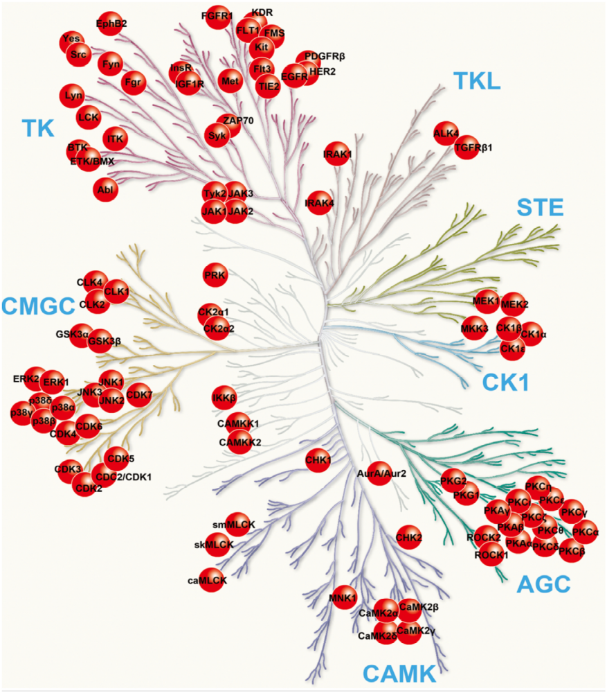
Impact of MAPK1/3 (ERK1/2) missense variants found in cancer: structural, function and stability experimental analysis
The human kinome consists of over 500 different protein kinases
(Metz et al., 2018, Cell Systems 7, 347–350 September 26, 2018ª 2018 Elsevier Inc.https://doi.org/10.1016/j.cels.2018.07.001
Kinase acronyms | Description
AGC | Containing PKA, PKG, PKC families
CAMK | Calcium/calmodulin-dependent protein kinase
CK1 | Casein kinase 1
CMGC | Containing CDK, MAPK, GSK3, CLK families
STE | Homologs of yeast Sterile 7, Sterile 11, Sterile 20 kinases
TK | Tyrosine kinase
TKL | Tyrosine kinase-like

Slide 4
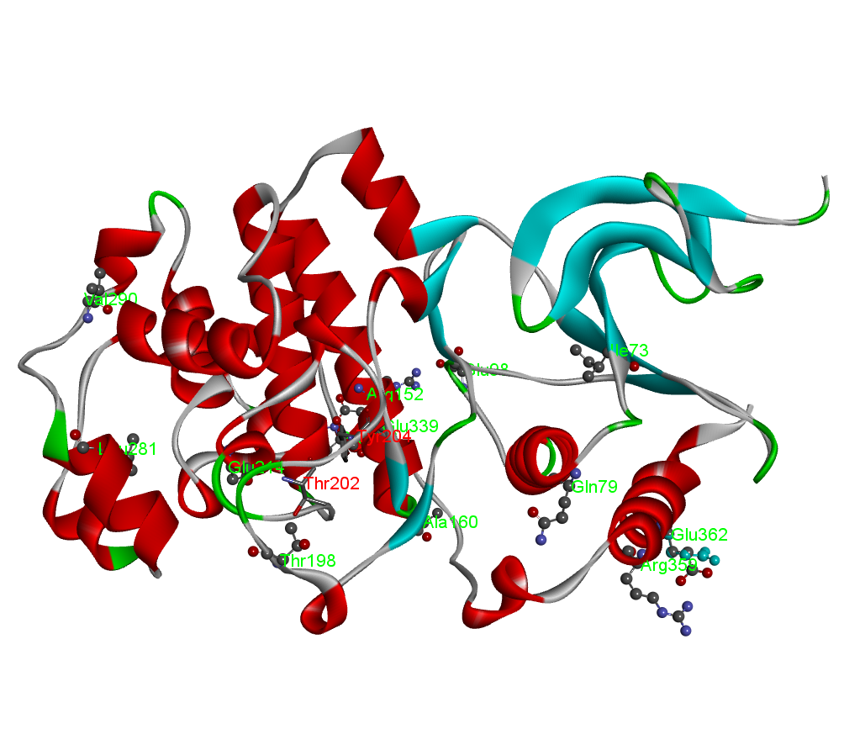
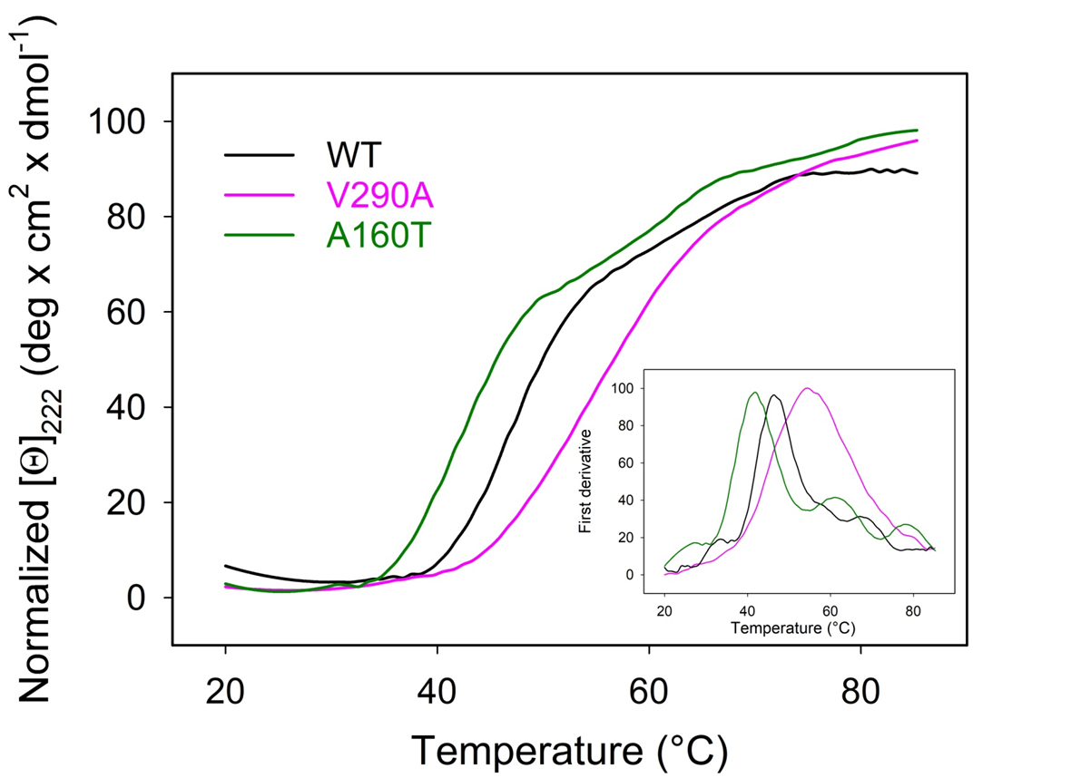
MAPK3 variants (pdb: 4QTB)
Embargoed
E339V: in the CD site of MAPK3 corresponds to E322V of MAPK1
E98K: interacting with the CD site corresponds to E81K of MAPK1
I73M, R79H, R152W, A160T, T198I, E214D, L281I, V290A, R359W, E362K: other regions of the protein

Slide 5
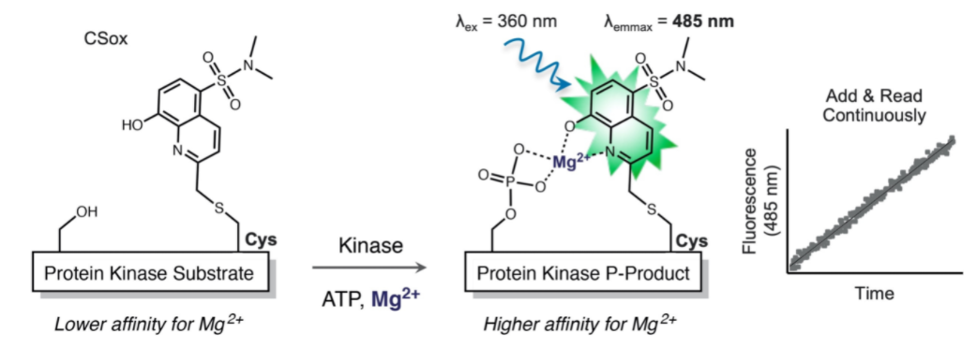
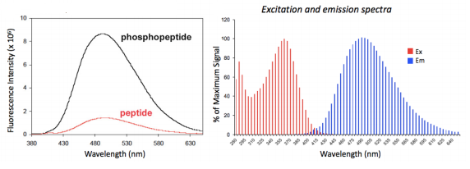
Embargoed
 | K_{m} (μM) | kcat (s⁻¹) | k_{cat}/K_{m} (s⁻¹ μM⁻¹) | act(mut)/act(wt)
Wild type | 1.81 | 2.20E+00 | 1.22E+00 | 1
L121I | 7.12 | 7.20E-02 | 1.01E-02 | 0.0083
R135K | 6.19 | 2.83E+01 | 4.58E+00 | 3.77
D162G | 1.43 | 9.30E-04 | 6.50E-04 | 0.0005
R191H | 55 | 2.00E-02 | 3.64E-04 | 0.0003
L200F | 3.23 | 2.43E-02 | 7.52E-03 | 0.006
D235V | 3.97 | 3.10E-01 | 7.81E-02 | 0.0642
P319S | 4.26 | 3.62E-01 | 8.50E-02 | 0.07
Functional studies
We used a fluorescence-based assay for rapid and sensitive detection of threonine and tyrosine kinase activities, also known as Chelation-Enhanced Fluorescence (ChEF) method.
MAPK1
 | K_{m} (μM) | kcat (s⁻¹) | k_{cat}/K_{m} (s⁻¹ μM⁻¹) | act(mut)/act(wt)
Wild type | 3.17 | 2.05 | 0.65 | 1
Q79H | 3.33 | 0.16 | 0.05 | 0.07
T198I | 3.27 | 10.74 | 3.28 | 5.08
E214D | 8.51 | 0.49 | 0.06 | 0.09
V290A | 14.19 | 1.27 | 0.09 | 0.14
MAPK3

Slide 6




Aknowledgements
Roberta Chiaraluce
Maria Petrosino
Leonore Novak
Roberta Alviti
Lucia Mastropierrono
Alessandra Pasquo
Prof. Stefan Knapp

